Slide 1
Integrating Ontology Debugging and Matching into the eXtreme Design Methodology
Zlatan Dragisic, Patrick Lambrix and Eva Blomqvist

Slide 2
Motivation
Most of the ontology engineering methodologies define a step that concerns quality assurance:
  high-level tasks that need to be executed,
  Checklists that have to be manually ticked off
The tasks usually lack specific details and require considerable user intervention – limited tool support
Ontology Design Patterns (ODPs) - way of sharing and reusing best practices in ontology engineering
Could be viewed as one way of reducing quality issues in ontologies already at the design stage

Slide 3
Motivation - continued
Number of methodologies developed based on ODPs, such as eXtreme Design(XD)
They significantly reduce the number of issues in the resulting ontologies,
However, they cannot solve the problem alone:
  ODPs can be misinterpreted,
  ODPs can be applied in an inappropriate way,
  ODPs can be integrated into the overall ontology in an inappropriate manner,
  the ontology engineer may simply make mistakes in modelling the parts not covered by an ODP
Ontology matching and debugging are active research areas and can provide solutions
Connection between different debugging tools and proposals done by some methodologies

Slide 4
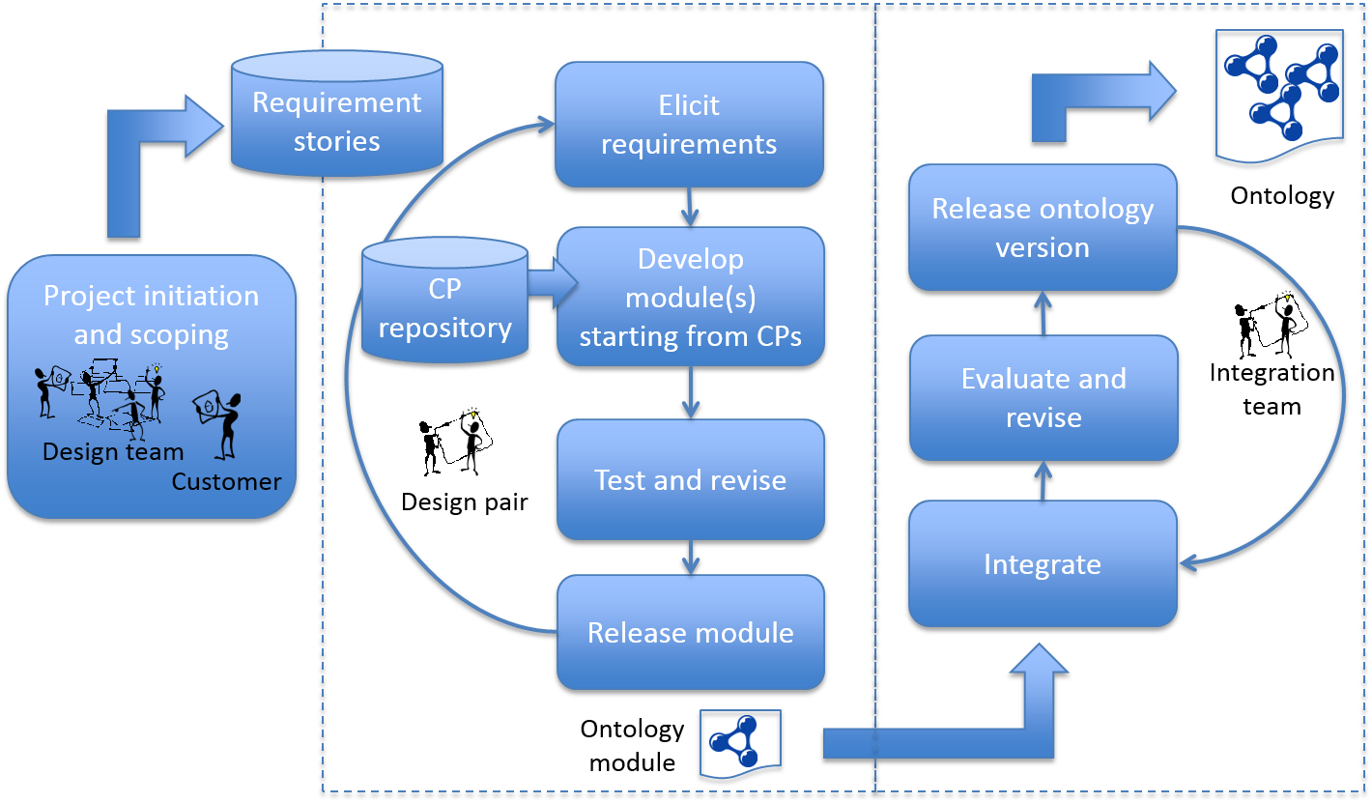
Background - XD methodology

Slide 5
Background - Defects in ontologies
Syntactic defects
  eg. wrong tags or incorrect format
Semantic defects
  eg. unsatisfiable concepts, incoherent and inconsistent ontologies
Modeling defects
  eg. wrong or missing relations

Slide 6
Ontology debugging – semantic defects
Example: DICE ontology
  Brain ⊑ CentralNervousSystem ⊓ BodyPart ⊓
  ∃systempart.NervousSystem ⊓ ∃ region.HeadAndNeck ⊓ ∀region.HeadAndNeck
  A brain is a central nervous system and a body part which has a system part that is a nervous system and that is in the head and neck region.
  CentralNervousSystem ⊑ NervousSystem
  A central nervous system is a nervous system.
  BodyPart ⊑¬NervousSystem
  Nothing can be at the same time a body part and a nervous system.
Tools: RaDON[1], Swoop[2], MUPSter[3], OOPS[4]

Slide 7

Ontology debugging – modelling defects
Incomplete results from ontology-based queries
Tools: RepOSE[5][6], OOPS[4]
return 1663 articles
return 948 articles
57% results are missed !
Notes:
7
Defects in structure is a problem in semantically-enabled applications such as ontology-based querying.
For example, when we are querying PubMed using MeSH with the term Scleral Diseases, the system will automatically enhance the query to also retrieve the documents related to Scleritis and we retrieve 1363 articles.

Slide 8
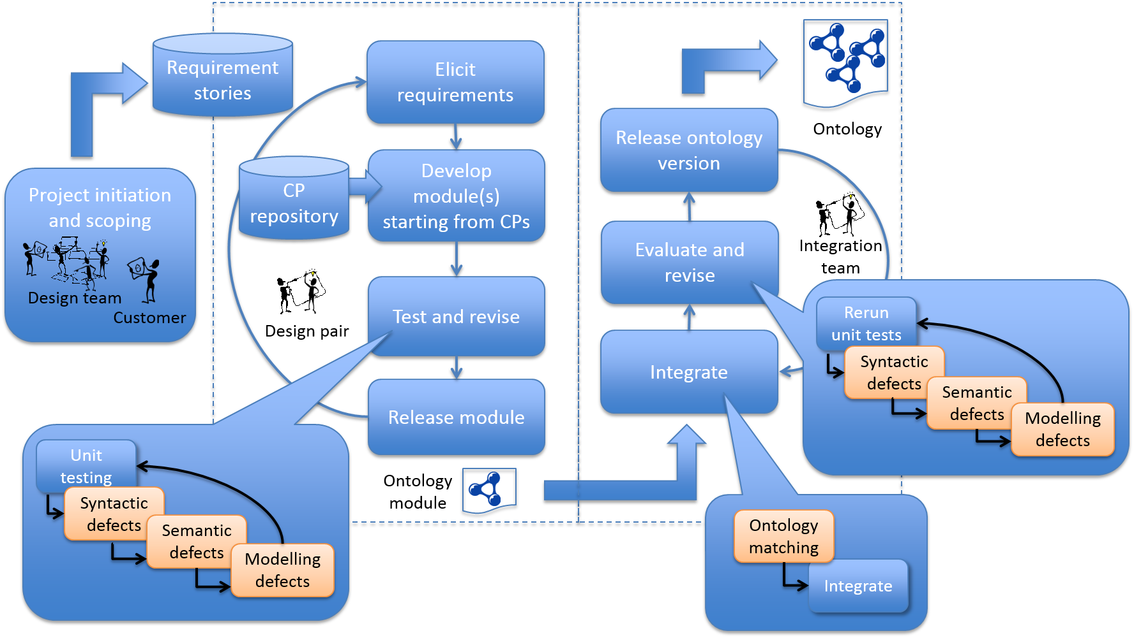
Workflow for integrating ontology matching and debugging

Slide 9
Case study
IKS project
51 modules
Resulting integrated ontology

Slide 10
Case study – Debugging individual modules
Syntactic defect
  4 defects in 3 modules
    E.g. incorrect datatype definitions
Semantic defects – using Hermit reasoner
  9 modules incoherent,
    They were repaired by removing a subsumption relation
  1 module inconsistent
    Literals outside of the range of a data property
Modelling defects –
  Run RepOSE on each module with module’s subsumption relations as input
  New is-a relations identified in 5 modules
  Total 8 new relations added

Slide 11
Modelling defects - example
mpeg7
Resource
Locator
Region
Locator
Tempral
Locator

Slide 12
Case study – Debugging the integrated ontology
Integration step
  Run ontology matching on all pairs of modules
  Validate identified correspondences and add to the integrated ontology
  26 correspondences (13 equivalence and 13 subsumption relations)
Syntactic and semantic defects
  Identified an unsatisfiable class after integration
Modelling defects
  Input all subsumption relations into RepOSE – 214
  10 new relations were added
  E.g.
EntertainmentContent
Content
Movie
ContentItem
mpeg7
Multimedia
Content

Slide 13
Impact analysis
Class level – classes affected by changes (new super/sub classes or removal of super/subclasses)
  56 affected (out of 197) with additions
  Additional 16 affected by removal of is-a relations
Instance level - instances that obtained new or changed class memberships
  28 out 88 affected by adding new relations
  Additional 29 are affected by removing relations
Query level – 1200 log files with total 10724 requests for data access
  5402 affected, i.e. they query for instances of affected classes

Slide 14
Conclusions
Analyzed how existing ontology debugging and matching approaches can be integrated in a pattern-based ontology development methodology
Tested on a real world ontology
We have shown that:
  Even when using ontology development methodologies, large number of defects still remains in ontologies
  Using different ontology debugging approaches (extended methodology) we have removed a number of defects

Slide 15
Future work
Integration of ontology debugging and matching tools into ontology development environments (e.g. as plug-ins).
Extend the scope to other ontology constructs
Evaluation of the added value of the changes

Slide 16
References
[1] Q Ji, P Haase, G Qi, P Hitzler, and S Stadtmuller. RaDON - repair and diagnosis in ontology networks. In Proc. of the 6th ESWC, pages 863-867, 2009.
[2] A Kalyanpur, B Parsia, E Sirin, and J Hendler. Debugging unsatisable classes in OWL ontologies. Journal of Web Semantics, 3(4):268-293, 2006.
[3] S Schlobach and C Ronald. Non-standard reasoning services for the debugging of description logic terminologies. In Proc. of the 18th IJCAI, pages 355-360, 2003.
[4] M Poveda-Villalon, A Gomez-Perez, and M C Suarez-Figueroa. Oops! (ontology pitfall scanner!): An on-line tool for ontology evaluation. International Journal on Semantic Web & Information Systems, 10(2):7-34, 2014
[5] P Lambrix and V Ivanova. A unied approach for debugging is-a structure and mappings in networked taxonomies. Journal of Biomedical Semantics, 4:10, 2013.
[6] P Lambrix, F Wei-Kleiner, and Z Dragisic. Completing the is-a structure in lightweight ontologies. Journal of biomedical semantics, 6(1):12, 2015.

Slide 17
Questions?

Slide 18
EntertainmentContent
Content
Movie
ContentItem
mpeg7
Multimedia
Content

