Slide 1
Semantic access to materials databases using the Materials Design Ontology
Patrick Lambrix
Linköping University, Sweden
University of Gävle, Sweden

Slide 2
Outline
Motivation
Framework for semantic and integrated access
The Materials Design Ontology
Prototype implementation
Lambrix P, Armiento R, Li H, Hartig O, Abd Nikooie Pour M, Li Y,
The Materials Design Ontology, 2022.

Slide 3
Motivation

Slide 4
Motivation
Many databases provide materials calculations data via Web APIs (e.g., REST APIs)
  Materials databases are heterogenous in nature
  APIs follow different schemas
A data-driven workflow of materials design will search these databases with desired combinations of properties

Slide 5
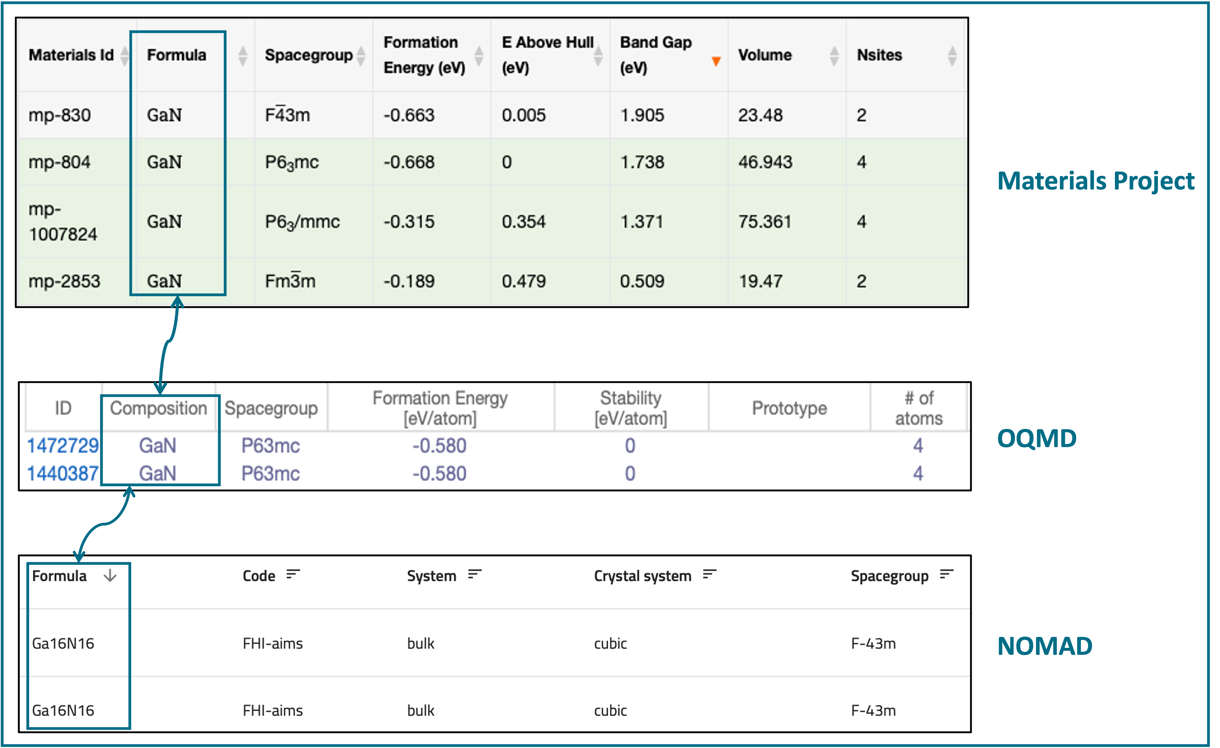
Motivation
Search for ‘GaN’ in Materials Project, OQMD, NOMAD
  Different number of fields returned
  Different terminology for the same concept
Semantic and integrated access needed
  To query multiple databases
  To deal with terminology issues

Slide 6
Motivation
Semantic and integrated access – first step
OPTIMADE (Open Databases Integration for Materials Design)
  Design a common API
  Make materials databases interoperable

Slide 7
Motivation
Semantic and integrated access
Inspired by OPTIMADE
Use of ontologies
    Ontologies as a means to make data FAIR

Slide 8
A framework for semantic and integrated access to materials databases

Slide 9
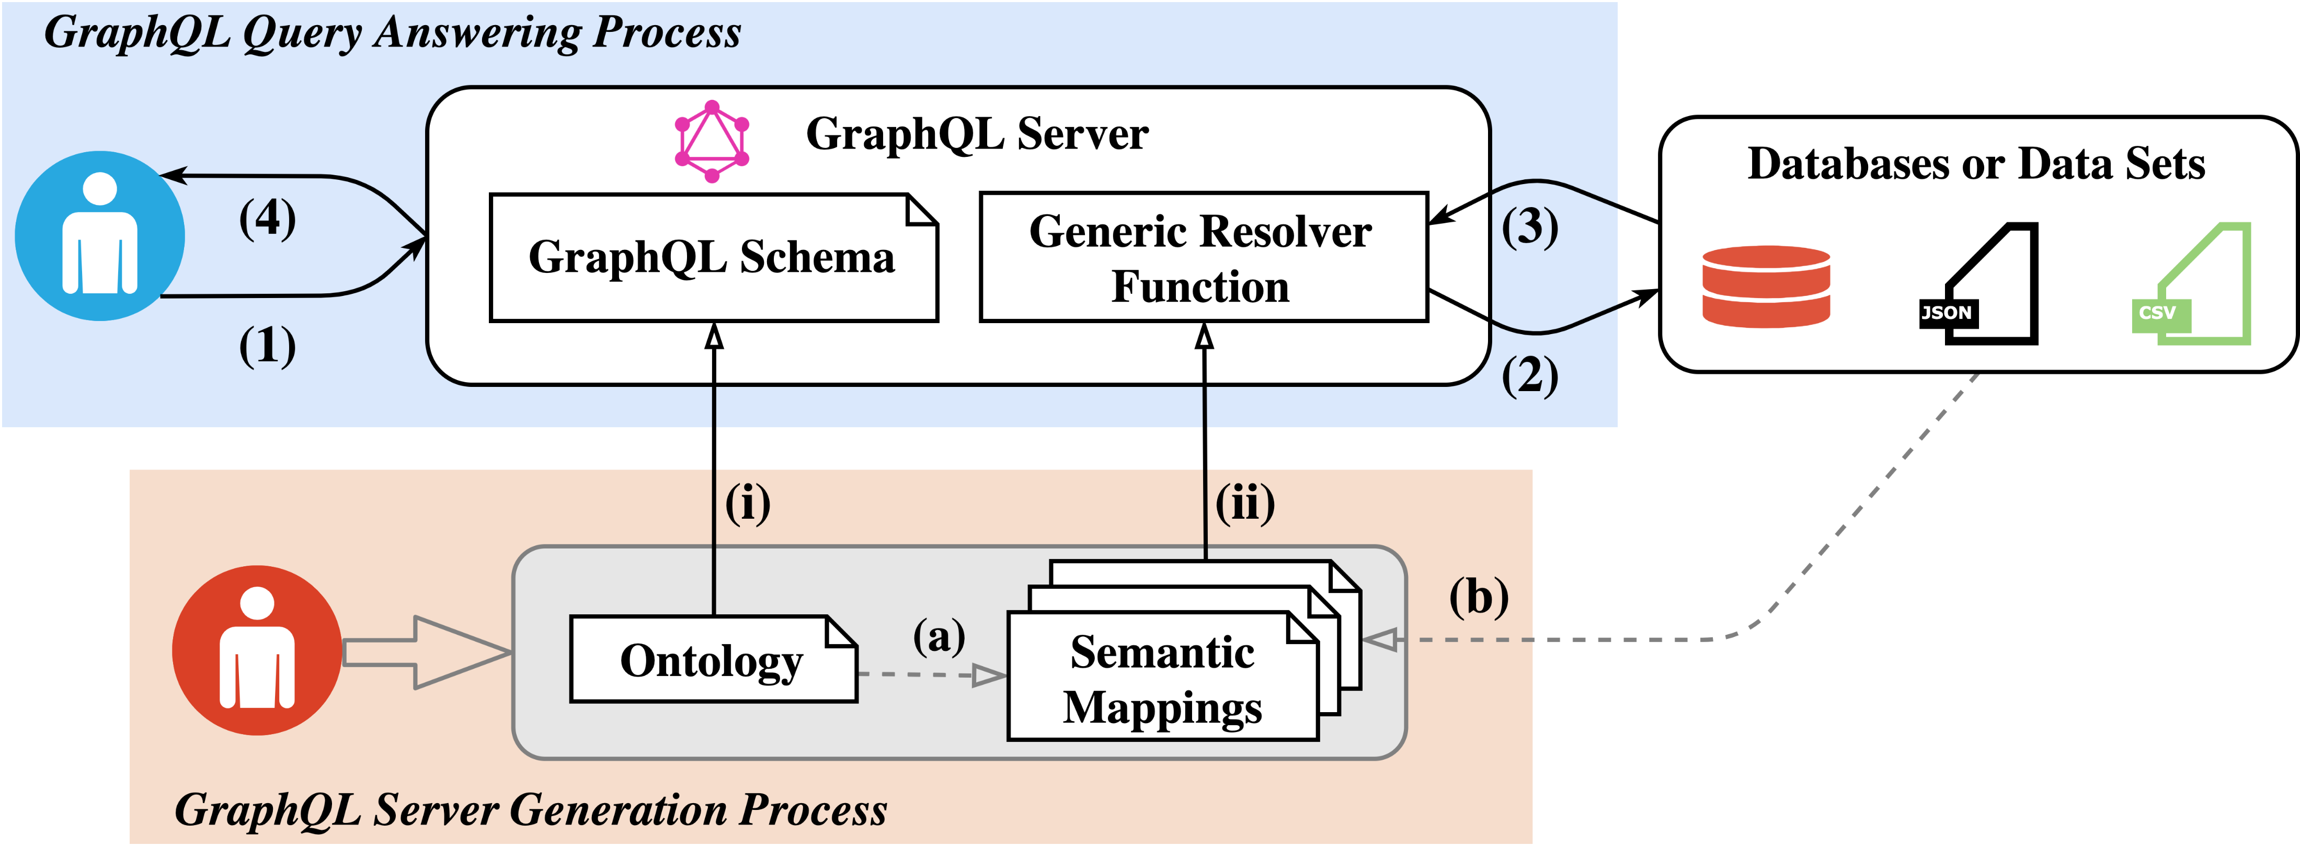
Framework
Query answering system
End Users
Developers

Slide 10
Framework
Query answering system
End Users
Developers

Slide 11
Framework
Query answering system
End Users
Developers

Slide 12
Materials Design Ontology (MDO)
Li H, Armiento R, Lambrix P, An Ontology for the Materials Design Domain,
19th International Semantic Web Conference, 212-227, 2020.

Slide 13
Note
Current focus on dealing with materials computations databases (rather than experiments)

Slide 14
Methodology
NeOn ontology engineering methodology
From Specification to Implementation
Reusing and re-engineering non-ontological resources
Reusing ontological resources
Restructuring ontological resources
Notes:
We focused on applying scenario 1 (From Specification to Implementation), scenario 2 (Reusing and re-engineering non-ontological re-
sources), scenario 3 (Reusing ontological resources) and scenario 8 (Restructuring ontological resources). We did
not re-engineer or merge ontological resources, i.e., scenarios 4-6 (but did reuse some concepts from other ontolo-
gies) and did not translate MDO into another natural language (scenario 9). Further, we did not use existing ontol-
ogy design patterns (scenario 7), as the only one we are aware of in the materials science field is about materials
transformation [44] that is not covered by MDO

Slide 15
Use cases
UC1: MDO will be used for representing knowledge in basic materials science.
UC2: MDO will be used for representing materials calculations and standardizing the publication of the materials calculation data.
UC3: MDO will be used as a standard to improve the interoperability among heterogeneous databases in the materials design domain.
UC4: MDO will be mapped to OPTIMADE’s schema to improve OPTIMADE’s search functionality.

Slide 16
Competency questions
CQ1: What are the calculated properties and their values produced by a calculation?
CQ2: What are the input and output structures of a materials calculation?
CQ3: What is the space group type of a structure?
CQ4: What is the lattice type of a structure?
CQ5: What is the chemical formula of a structure?
CQ6: For a series of calculations, what are the compositions of materials with a specific range of a calculated property (e.g., band gap)?
CQ7: For a specific material and a given range of a calculated property (e.g., band gap), what is the lattice type of the structure?

Slide 17
Additional restrictions
AR1: A property can relate to a structure.
AR2: A calculation has exactly one corresponding computational method.
AR3: A structure corresponds to one specific space group.
AR4: A calculation is performed by some software programs or codes.
AR5: A structure is a part of some materials.
AR6: A structure and a property can be published by references which could be databases or publications.
AR7: A calculation can take some structures as input.
AR8: A calculation can take some properties as input.

Slide 18
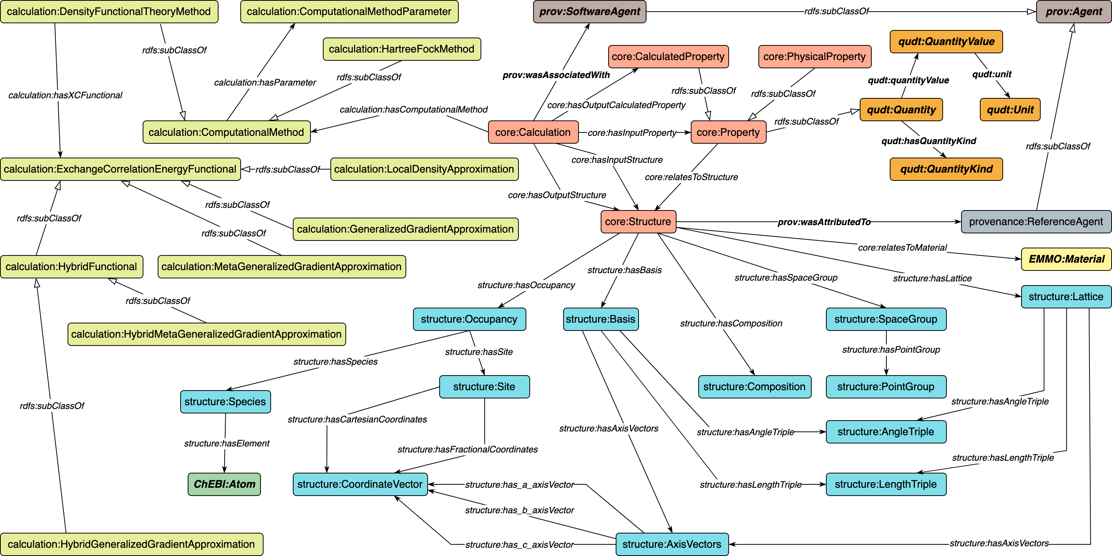
An Overview of MDO
Notes:
(Point to the figure) This figure shows the concepts and relationships of MDO.
As I mentioned before, There are four different modules in the ontology.

Slide 19
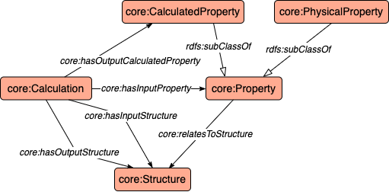
An Overview of MDO
Notes:
In the middle of the figure is the core module representing concepts such as structure and property and their relationship. For example, The concept Property has two sub concepts which are Calculated property and physical property. The other modules reuse the concepts in the core module.

Slide 20
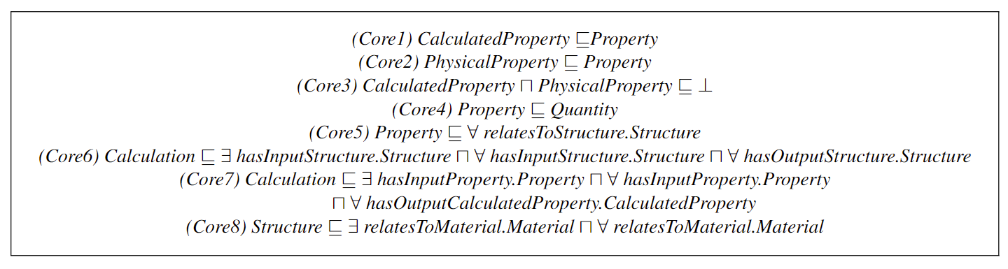
Core

Slide 21
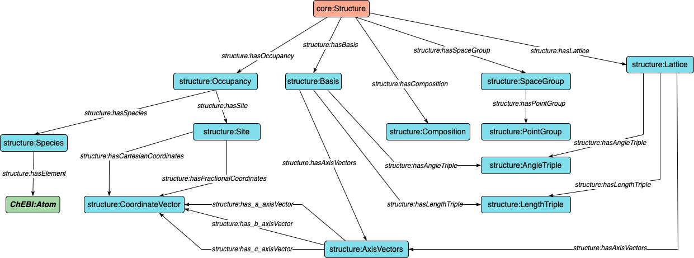
An Overview of MDO
Notes:
The Structure module is to represent domain knowledge relevant to structural information.

Slide 22
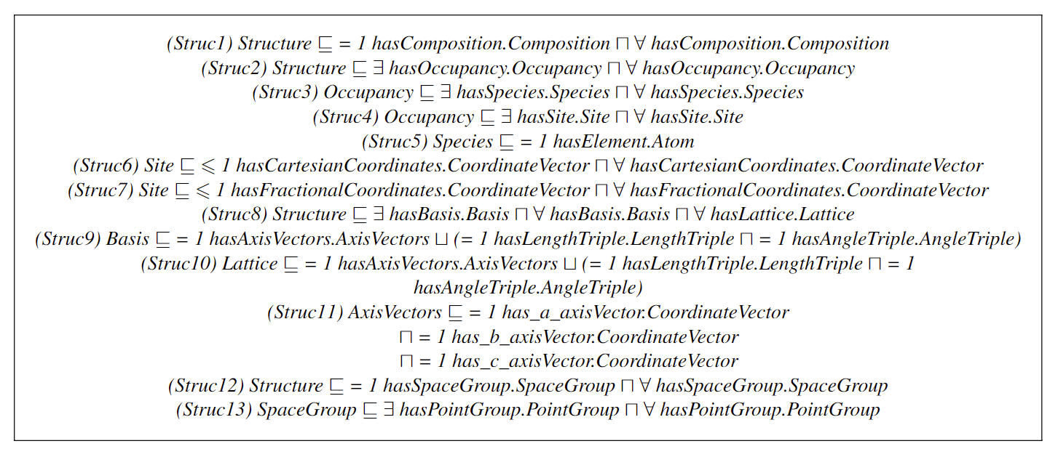
Structure

Slide 23
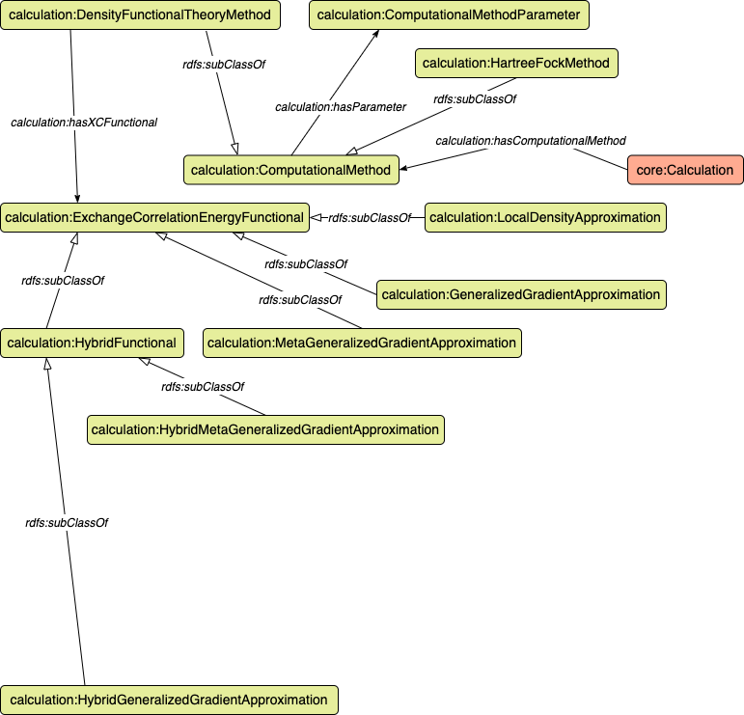
Notes:
In the calculation module, we model several computational method related concepts and some key concepts relevant to one of such method density functional theory method.

Slide 24
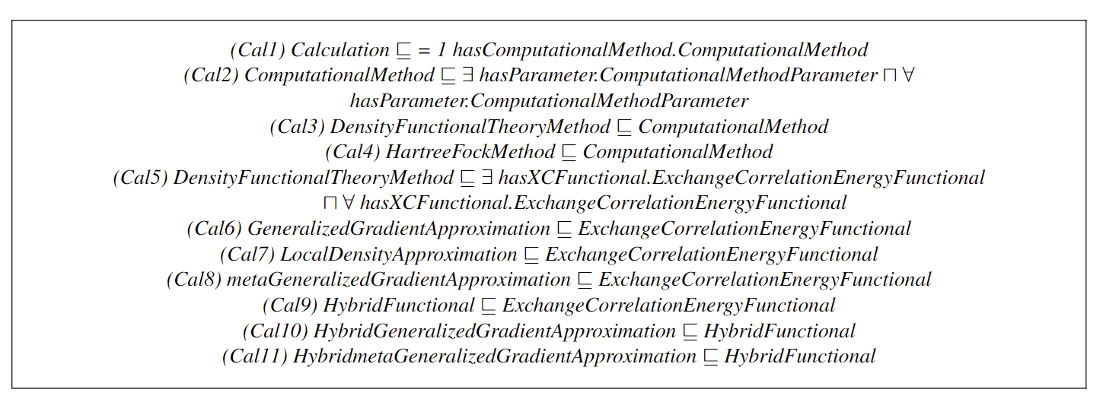
Calculation

Slide 25
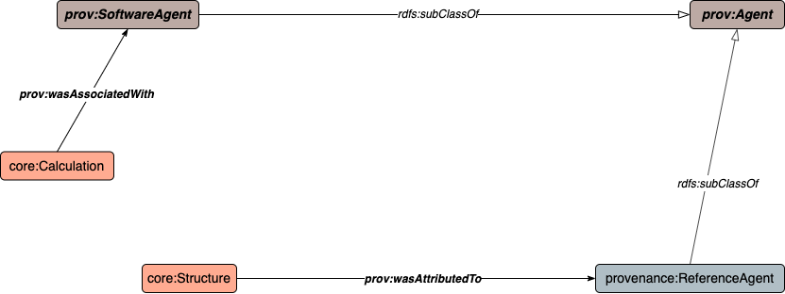
An Overview of MDO
Notes:
The provenance module is mainly about building the connection between calculation and software agent to state which software produces the calculation, and the connection between reference agent and property, structure respectively to state which reference, usually a publication publish the property and structure data. Here I show the concepts and relationships we reused from other ontologies.

Slide 26

Provenance

Slide 27
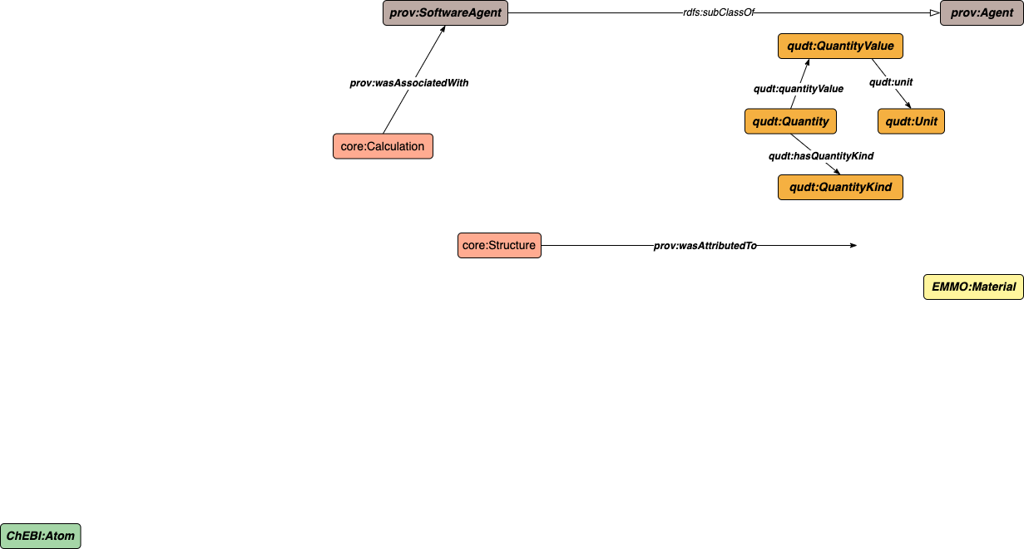
An Overview of MDO
Notes:
Here I show the concepts and relationships we reused from other ontologies.

Slide 28
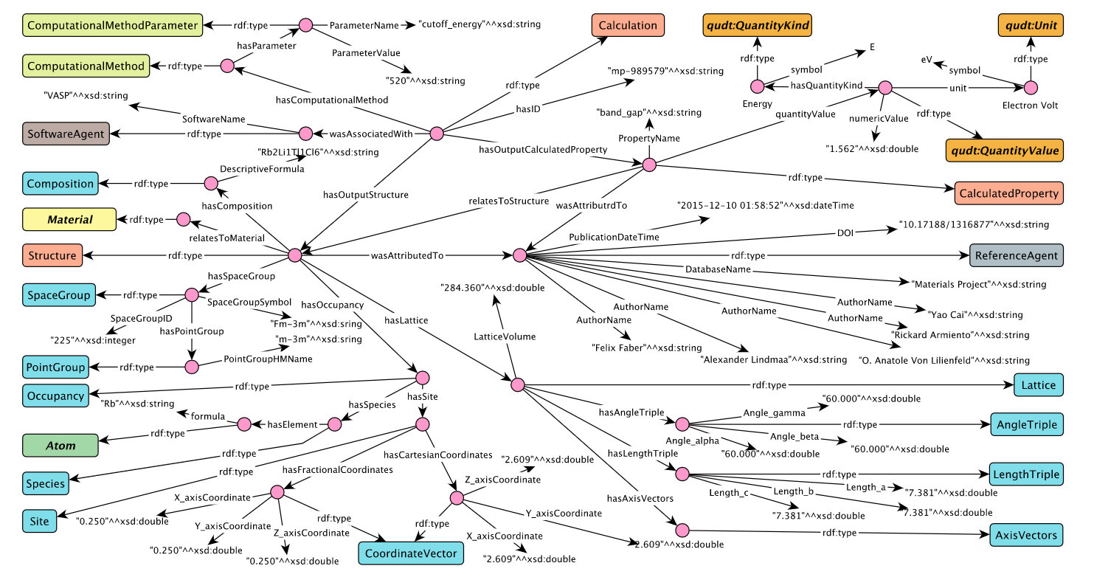
Instantiated calculation

Slide 29
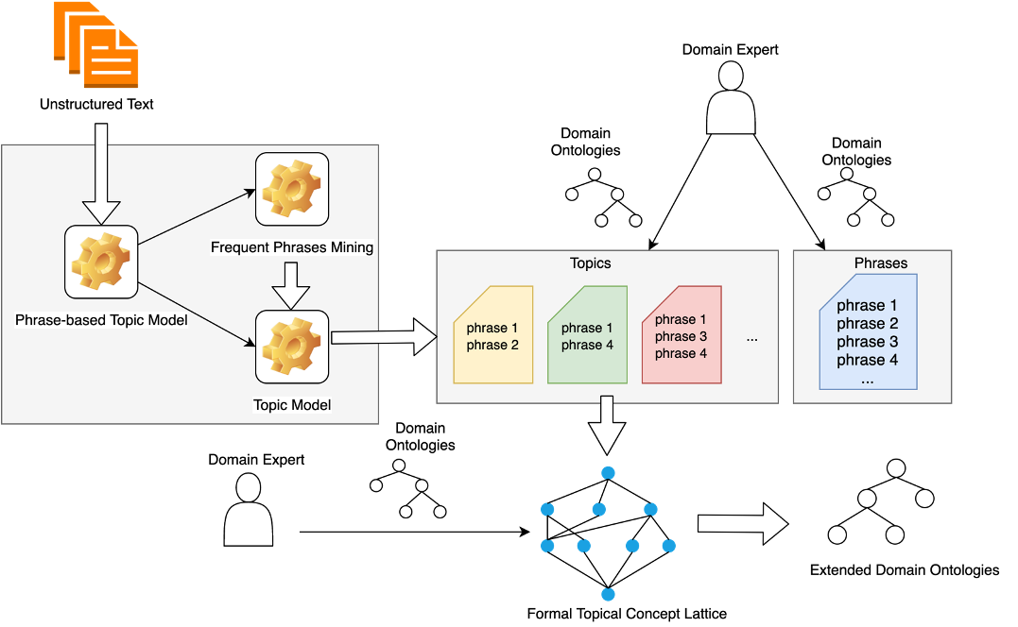
Current work – extending MDO
A framework for extending ontologies using textual information
Li H, Armiento R, Lambrix P,
A Method for Extending Ontologies with Application to the Materials Science Domain,
Data Science Journal, 18(1):Article 50, 2019.

Slide 30
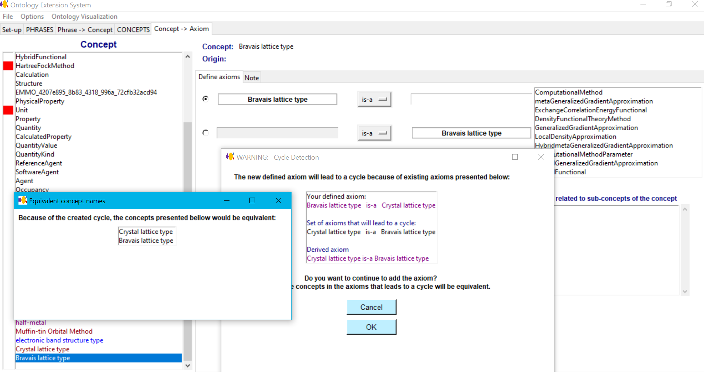
Current work – extending MDO
Poster:
Mina Abd Nikooie Pour

Slide 31
Prototype implementation of system for semantic and integrated access to materials databases

Slide 32
Prototype
End Users
Developers

Slide 33
Prototype
End Users
Developers

Slide 34
Prototype
End Users
Developers

Slide 35
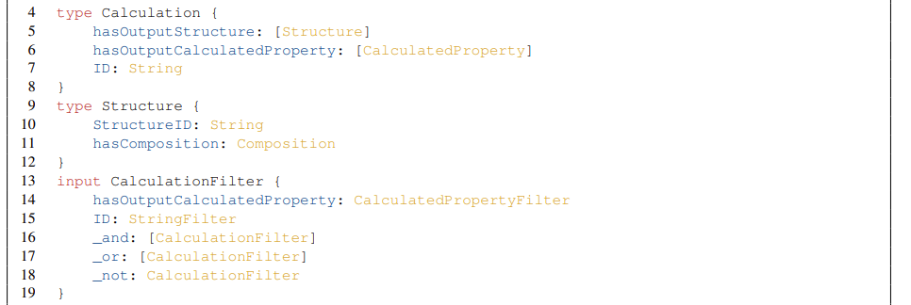
Generation of GraphQL schema for server
End Users
Developers

Slide 36
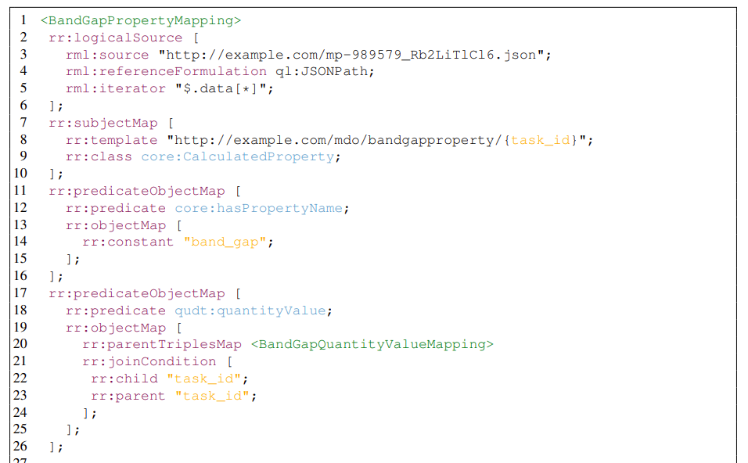
Mapping
End Users
Developers

Slide 37
Prototype evaluation
  Data from Materials Project and OQMD
  Semantic mappings based on MDO
  Compared with morph-rdb, HyperGraphQL, UltraGraphQL
  Characteristics of 12 Queries (choke points, domain interest, result size, filter expression)
  Query execution time

Slide 38
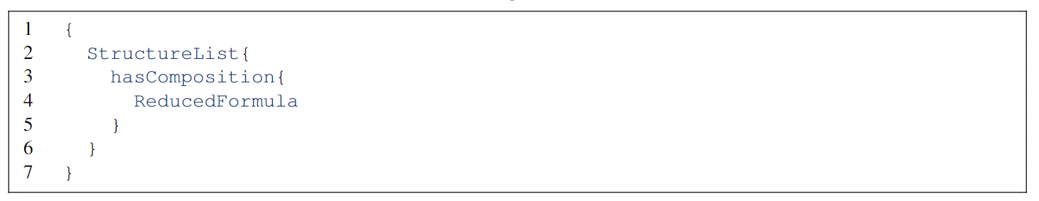
Q1
List all the structures containing the reduced chemical formula of each structure’s composition.

Slide 39
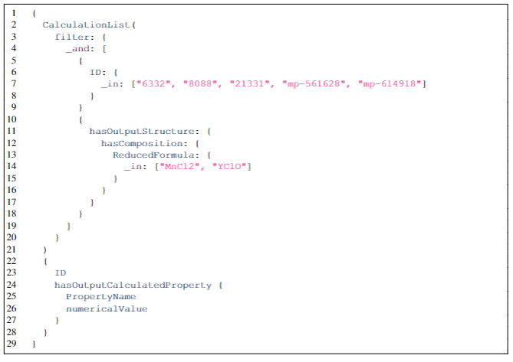
Q6
List all the calculations where the ID is in a given list of values.

Slide 40
Query execution times
Q1
Q5
Q6
Q12

Slide 41
Prototype evaluation
  The GraphQL servers generated by OBG-gen can answer all the 12 queries.
  For queries without filtering conditions
    All the systems have increases of QET as the dataset size increases
    UltraGraphQL and HyperGraphQL outperform for some smaller datasets
    OBG-gen-rdb outperforms morph-rdb for some queries in smaller dataset; for some queries, they have similar QETs
  For queries with filtering conditions (mainly on OBG-gen-rdb and morph-rdb)
    Have stable or slightly increased QETs for queries with constant result size or simple filtering expressions (i.e., Q6,Q12)
    In general, the differences of QETs between the two systems are less than those for queries without filter conditions

Slide 42
Conclusion

Slide 43
Conclusion
Framework for semantic and integrated access to materials databases
MDO - Materials Design Ontology
Prototype implementation
Current work:
  User interface for prototype implementation
  Connect more materials databases as well as the OPTIMADE API
  System for extending ontologies; extending MDO

Slide 44
Thanks to
Rickard Armiento
Huanyu Li
Olaf Hartig
Mina Abd Nikooie Pour
Ying Li
Funding
  Swedish Research Council
  Swedish e-Science Research Centre
  Swedish Agency for Economic and Regional Growth
  National Graduate School in Computer Science

