Slide 1

Phrase2Onto: A Tool to Support Ontology Extension
Mina Abd Nikooie Pourª, Huanyu Liª, Rickard Armientoª, Patrick Lambrix^{a,b}
ª Linköping University and Swedish e-Science Research Centre, Linköping, Sweden
^{b} University of Gävle, Gävle, Sweden
27th International Conference on Knowledge-Based and Intelligent Information & Engineering Systems
Athens, Greece, 06-08 September 2023

Slide 2

AGENDA
Introduction
Motivation
Phrase2Onto
Experiments
Conclusion
27th International Conference on Knowledge-Based and Intelligent Information & Engineering Systems
Athens, Greece, 06-08 September 2023

Slide 3
INTRODUCTION
What is an ontology?
  Representing a domain of interest by
    defining its concepts and the relationships that hold between them.
Ontologies may contain four components:
  Concepts
  Instances
  Relations
  Axioms
Person
SubClassOf
SubClassOf
SubClassOf
Staff
Faculty
Student
27th International Conference on Knowledge-Based and Intelligent Information & Engineering Systems
Athens, Greece, 06-08 September 2023

Slide 4
INTRODUCTION
Person
What is ontology extension?
  Make the ontology more complete.
  Not a fully automatic process.
SubClassOf
SubClassOf
SubClassOf
Staff
Faculty
Student
SubClassOf
SubClassOf
SubClassOf
Teaching Assistant
Undergraduate Student
27th International Conference on Knowledge-Based and Intelligent Information & Engineering Systems
Athens, Greece, 06-08 September 2023

Slide 5
MOTIVATION
Ontologies are used to make data FAIR.
  Findable, Accessible, Interoperable, Reusable.
There is a need for high quality ontologies.
Completeness as one of quality aspects in ontologies.
Purpose of Phrase2Onto:
  Support users in extending ontologies to make ontologies more complete.
27th International Conference on Knowledge-Based and Intelligent Information & Engineering Systems
Athens, Greece, 06-08 September 2023

Slide 6
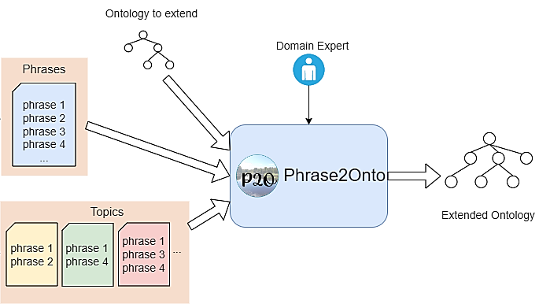
PHRASE2ONTO – INPUTS & OUTPUT
Inputs
Inputs of Phrase2Onto
  Ontology to extend
  Phrases
  Topics
Output of Phrase2Onto
  Extended ontology
Output
27th International Conference on Knowledge-Based and Intelligent Information & Engineering Systems
Athens, Greece, 06-08 September 2023

Slide 7
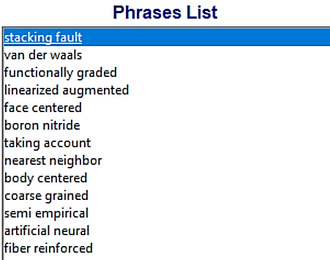
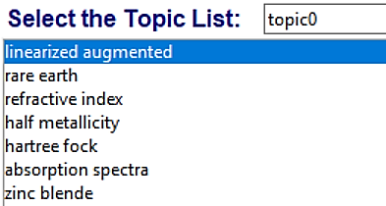
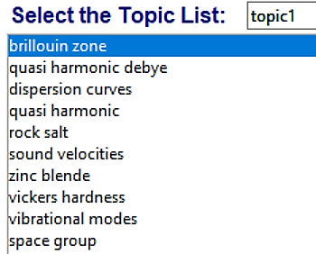
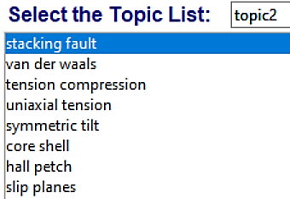
PHRASE2ONTO – PHRASES & TOPICS
Frequent contiguous phrases extracted from unstructured text.
Topic is a set of phrases that are connected to each other in some way.
Phrases example
Topics example
27th International Conference on Knowledge-Based and Intelligent Information & Engineering Systems
Athens, Greece, 06-08 September 2023

Slide 8
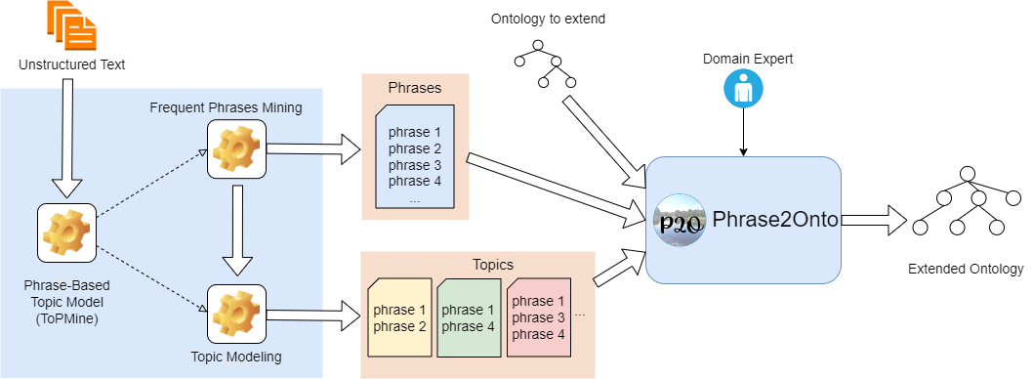
PHRASE2ONTO – PHRASES & TOPICS (CONT.)
Phrase-based Topic Model Approach for Ontology Extension [3].
  Using unstructured text related to the ontology for extension.
  Output: list of phrases and topics.
27th International Conference on Knowledge-Based and Intelligent Information & Engineering Systems
Athens, Greece, 06-08 September 2023

Slide 9
PHRASE2ONTO
Why we need Phrase2Onto for ontology extension:
  Key and simple concepts already exist in the ontology.
  Dealing with long lists of phrases and topics for investigation [3].
    Not simple to add or connect them to the ontology.
    There are phrases and topics in the lists that are not interesting for the ontology.
  Need for a process to help defining concepts from phrases and topics (or sub-topics).
  Need for a tool to facilitate working on ontology extension project.
27th International Conference on Knowledge-Based and Intelligent Information & Engineering Systems
Athens, Greece, 06-08 September 2023

Slide 10
PHRASE2ONTO – MODULAR DESIGN
Modular design including five separate tabs for ontology extension.
  Set-up
  Phrases → Concepts
  Topics → Concepts
  Concepts
  Concepts → Axioms
Using Pizza ontology as example ontology to extend.
27th International Conference on Knowledge-Based and Intelligent Information & Engineering Systems
Athens, Greece, 06-08 September 2023

Slide 11
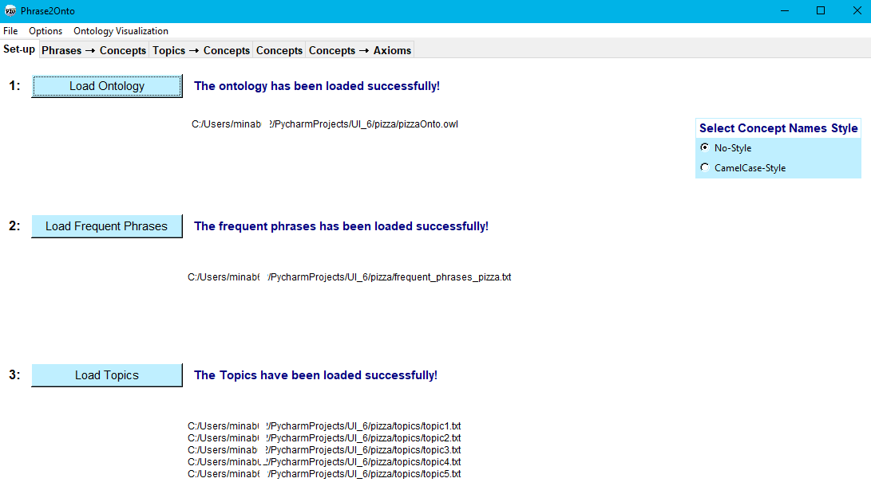
PHRASE2ONTO – SETUP
27th International Conference on Knowledge-Based and Intelligent Information & Engineering Systems
Athens, Greece, 06-08 September 2023

Slide 12
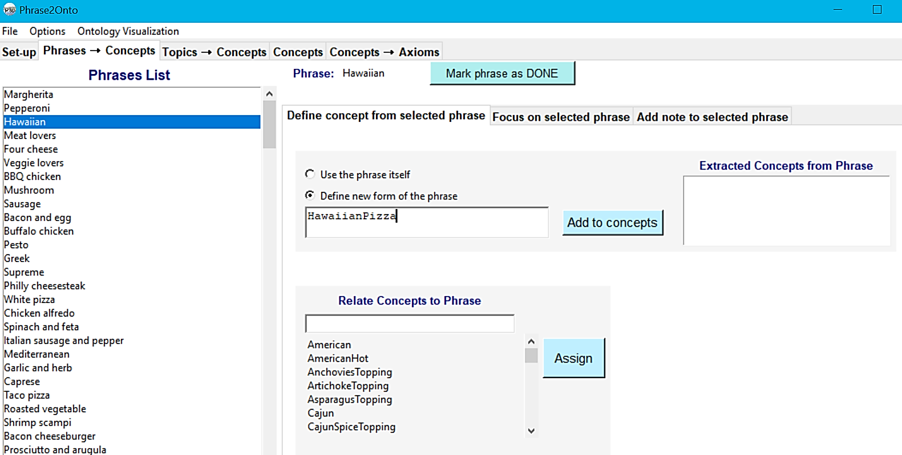
PHRASE2ONTO – PHRASES → CONCEPTS
27th International Conference on Knowledge-Based and Intelligent Information & Engineering Systems
Athens, Greece, 06-08 September 2023

Slide 13
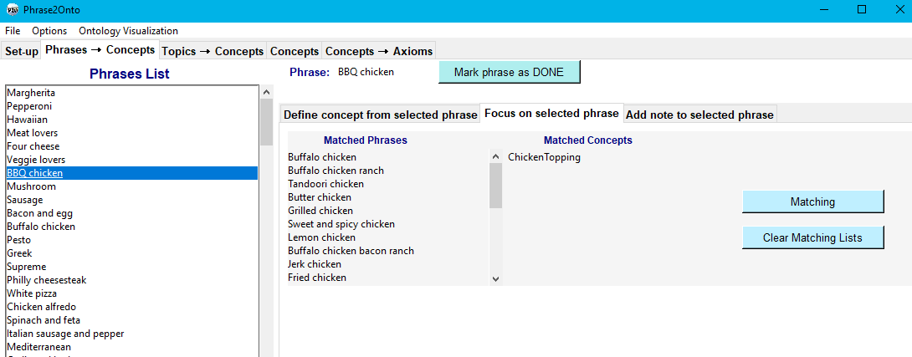
PHRASE2ONTO – PHRASES → CONCEPTS (CONT.)
27th International Conference on Knowledge-Based and Intelligent Information & Engineering Systems
Athens, Greece, 06-08 September 2023

Slide 14
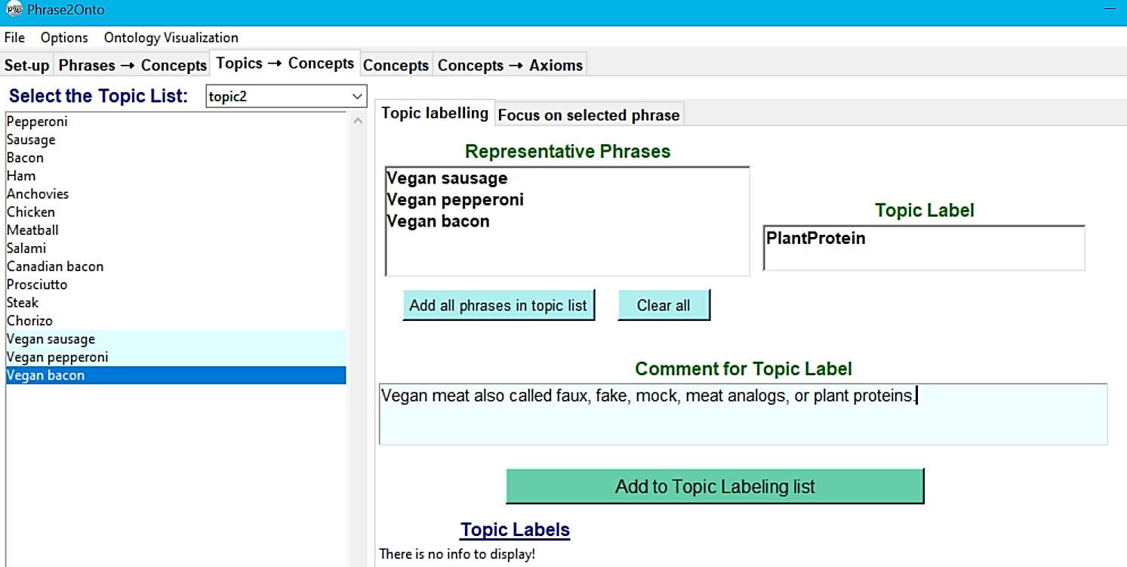
PHRASE2ONTO – TOPICS → CONCEPTS
27th International Conference on Knowledge-Based and Intelligent Information & Engineering Systems
Athens, Greece, 06-08 September 2023

Slide 15
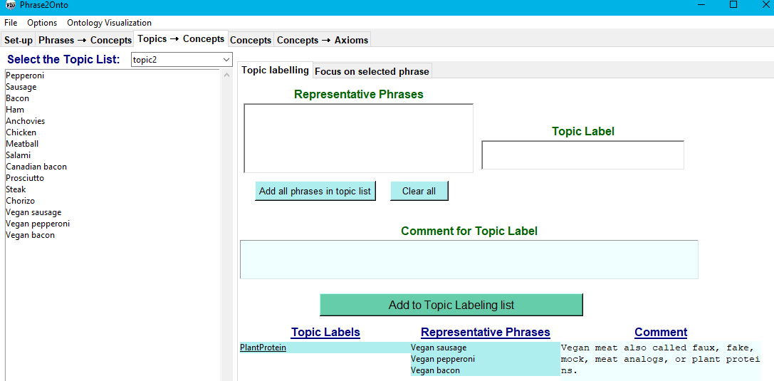
PHRASE2ONTO – TOPICS → CONCEPTS
27th International Conference on Knowledge-Based and Intelligent Information & Engineering Systems
Athens, Greece, 06-08 September 2023

Slide 16
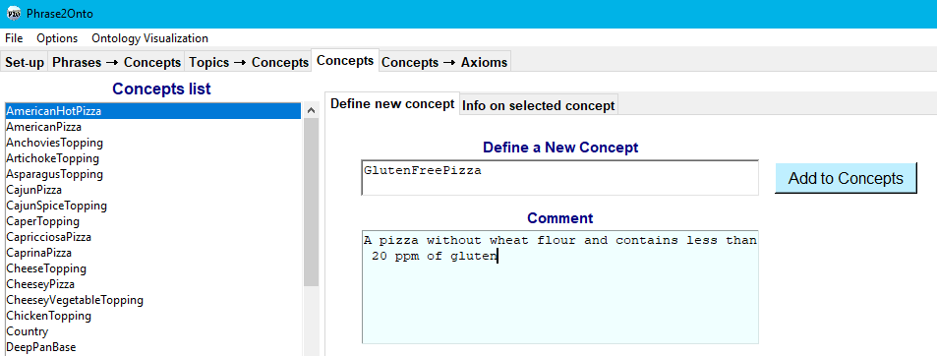
PHRASE2ONTO – CONCEPTS
27th International Conference on Knowledge-Based and Intelligent Information & Engineering Systems
Athens, Greece, 06-08 September 2023

Slide 17
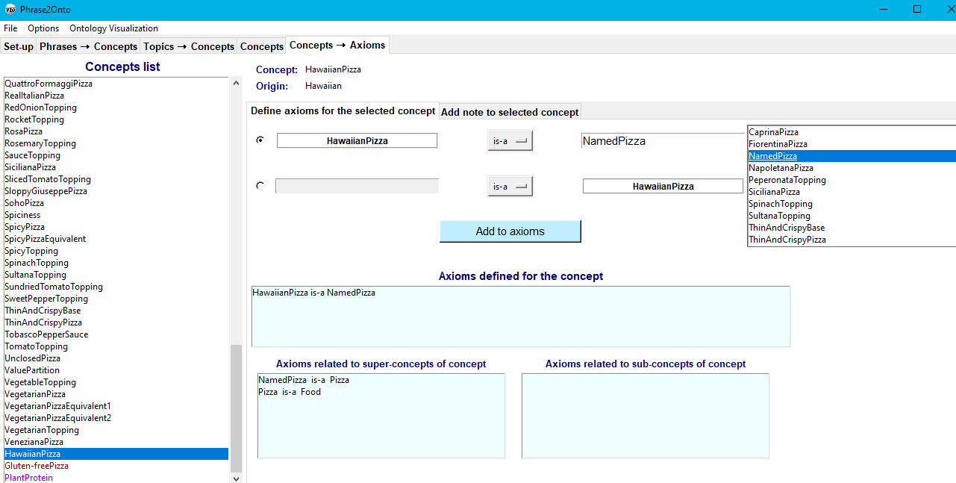
PHRASE2ONTO – CONCEPTS → AXIOMS
27th International Conference on Knowledge-Based and Intelligent Information & Engineering Systems
Athens, Greece, 06-08 September 2023

Slide 18
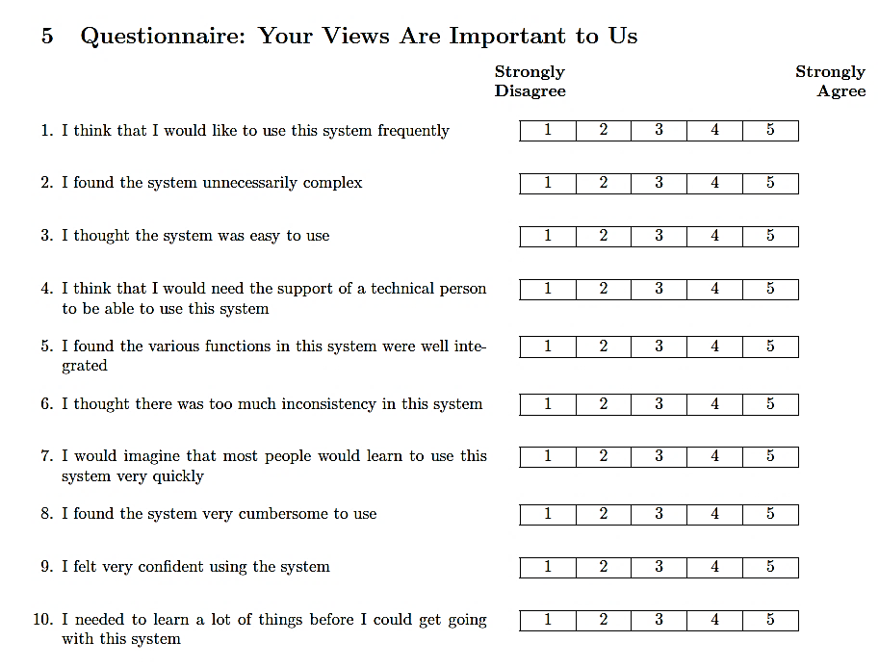
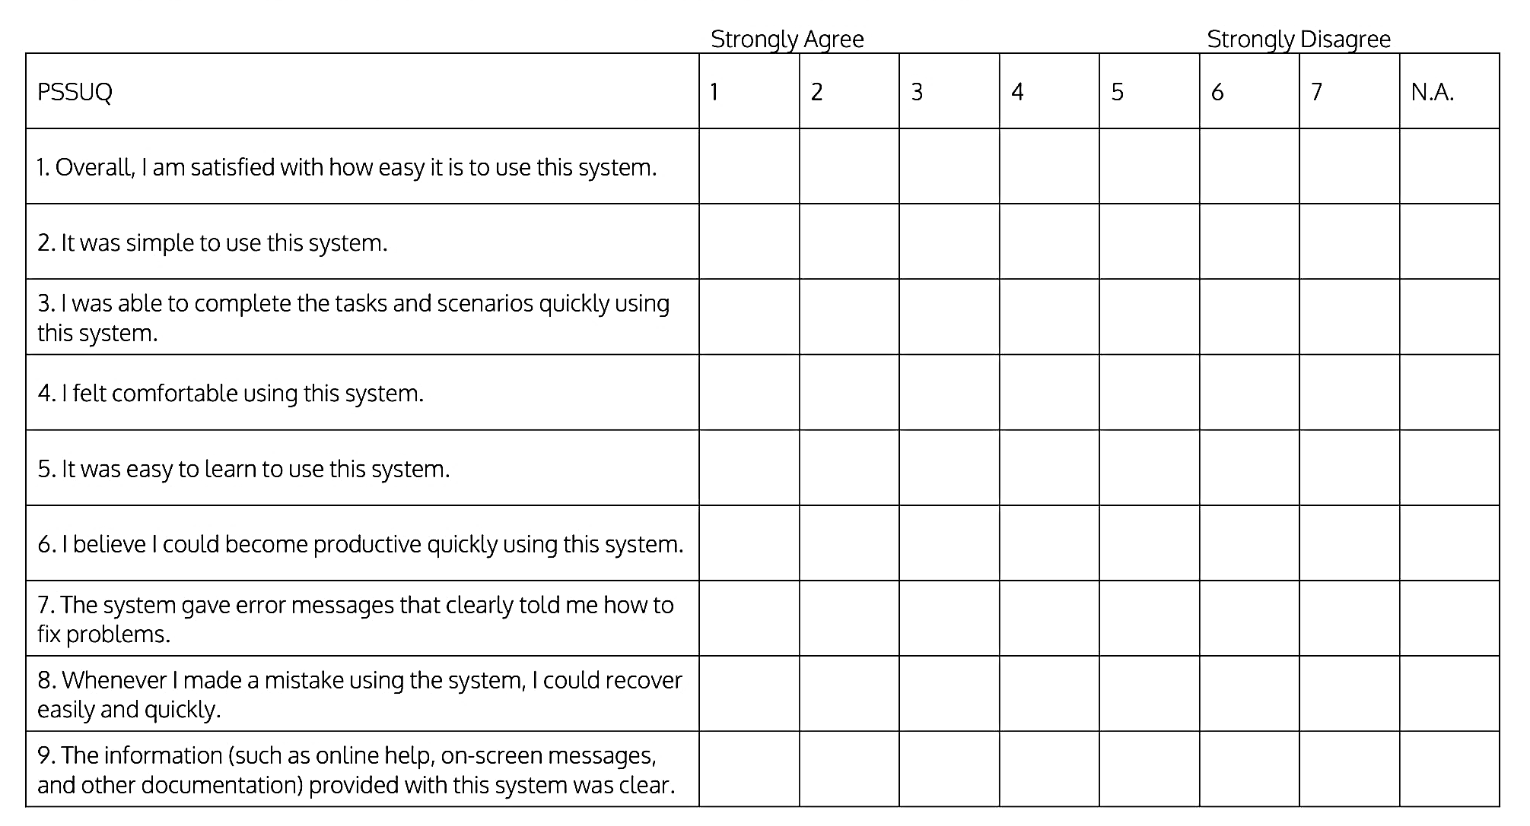
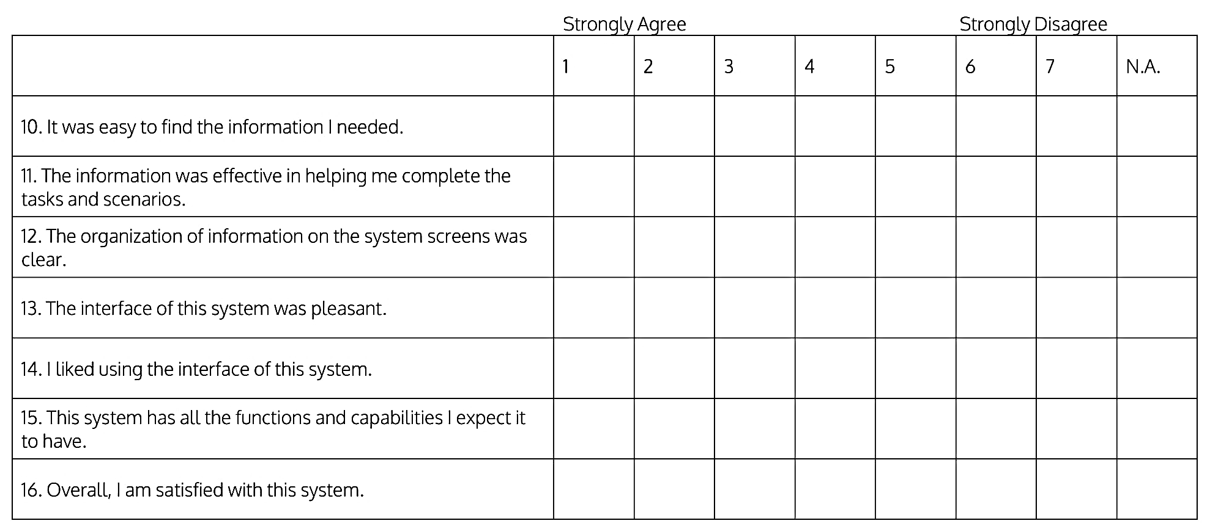
EXPERIMENT 1 – USER STUDY
Using Pizza ontology to extend.
10 PhD students and 2 Postdocs in computer science.
Phrases and topics generated by ChatGPT.
Perform 12 step-by-step tasks.
Ask participants to fill out questionaries after actual study.
  System Usability Scale (SUS) (score range: 0-100).
    Best score=100.
  PSSUQ (Post-Study System Usability Questionnaire) (score range: 1-7).
    Best score=1.
27th International Conference on Knowledge-Based and Intelligent Information & Engineering Systems
Athens, Greece, 06-08 September 2023

Slide 19
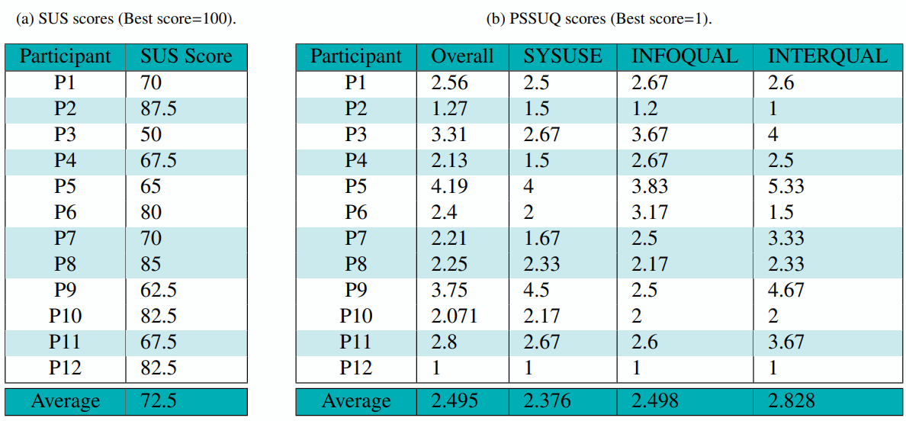
EXPERIMENT 1 – USER STUDY
The average SUS score of our user study is 72.5 (above average [2]).
The average scores of the study for PSSUQ questionnaire are (good):
  2.495, 2.376, 2.498 and 2.828 for Overall, SYSUSE, INFOQUAL and INTERQUAL.
High task completion rate.
Importance of understanding the ontology.
There are some common expectations from an interface.
27th International Conference on Knowledge-Based and Intelligent Information & Engineering Systems
Athens, Greece, 06-08 September 2023

Slide 20
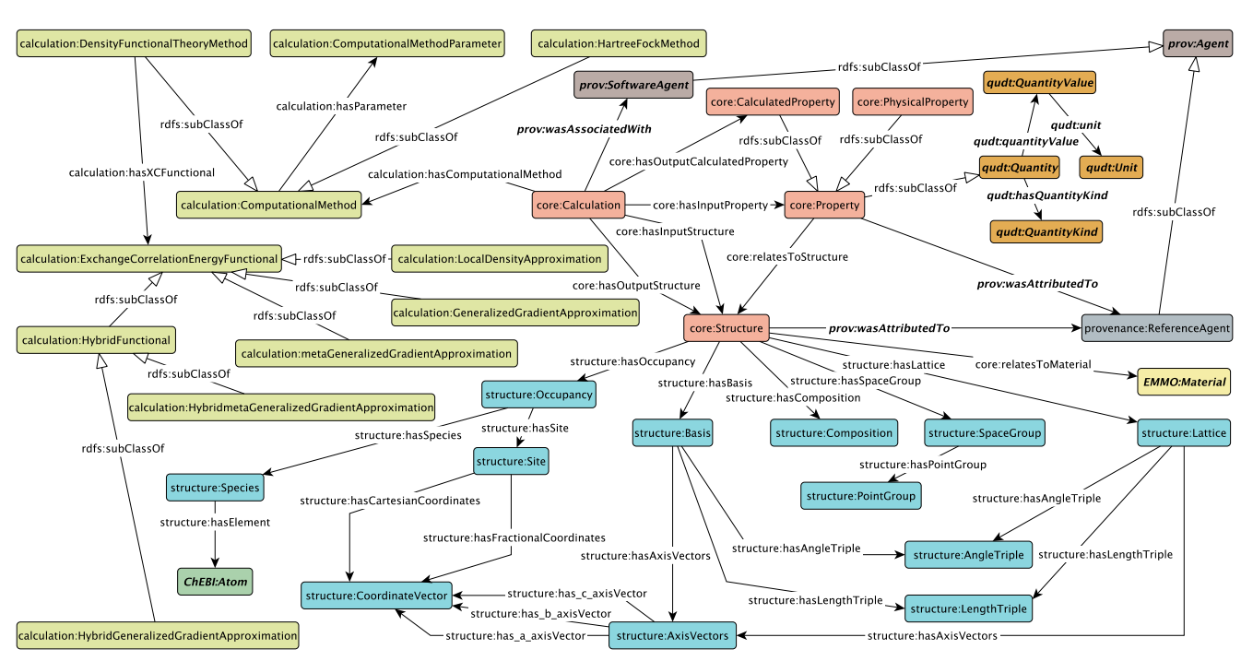
EXPERIMENT 2 – MDO EXTENSION
Extending the Materials Design Ontology (MDO) by domain expert.
Using method described in [1], to generate the frequent phrases and topics.
  131 phrases and 10 topics.
Using the Phrases→Concepts tab the domain expert defined
  29 new concepts (e.g., StackingFault and FaceCenteredCubic).
  27 new axioms (e.g., StackingFault is-a DefectType).
10 new concepts were added to the ontology using topic labels and 10 new axioms.
The domain expert found the workflow clear.
The domain expert commented on some user interface issues.
27th International Conference on Knowledge-Based and Intelligent Information & Engineering Systems
Athens, Greece, 06-08 September 2023

Slide 21
CONCLUSION AND FUTURE WORK
Phrase2Onto is a tool to support users in extending ontologies.
A user needs to make decisions regarding the appropriateness of using phrases to define new concepts.
The results of the experiments show
  Phrase2Onto contains reasonable functionality.
  Led to high task completion.
  Usefulness in real applications.
Future work
  Using Phrase2Onto in the EU Onto-DESIDE project (related to circular economy).
  Implementing new functionality based on the feedback from the user study.
27th International Conference on Knowledge-Based and Intelligent Information & Engineering Systems
Athens, Greece, 06-08 September 2023

Slide 22
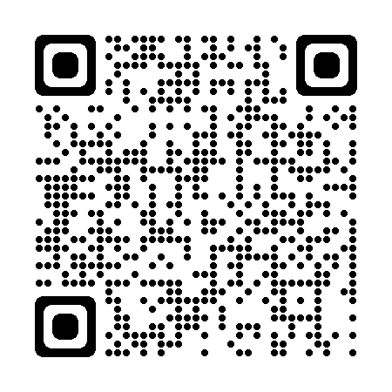
ACKNOWLEDGEMENTS
This work has been financially supported by:
  The Swedish e-Science Research Centre (SeRC).
  The Swedish National Graduate School in Computer Science (CUGS).
  The Swedish Research Council (Vetenskapsrådet, dnr 2018-04147).
We thank the participants in the user study.
Contact Info
patrick.lambrix@liu.se
mina.abd.nikooie.pour@liu.se
GitHub repository of the project
27th International Conference on Knowledge-Based and Intelligent Information & Engineering Systems
Athens, Greece, 06-08 September 2023

Slide 23
REFERENCES
[1] Pour MA, Li H, Armiento R, Lambrix P. A First Step towards a Tool for Extending Ontologies. In VOILA@ ISWC 2021 (pp. 1-12).
[2] Lewis JR, Sauro J. Item benchmarks for the system usability scale. Journal of Usability Studies. 2018 May 1;13(3).
[3] Pour MA, Li H, Armiento R, Lambrix P. A first step towards extending the materials design ontology. In Domain Ontologies for Research Data Management in Industry Commons of Materials and Manufacturing 2021 Mar 27.
[4] Li H, Armiento R, Lambrix P. An ontology for the materials design domain. In International Semantic Web Conference 2020 Nov 1 (pp. 212-227). Cham: Springer International Publishing.
27th International Conference on Knowledge-Based and Intelligent Information & Engineering Systems
Athens, Greece, 06-08 September 2023

