Slide 1
Ontology Visualization Methods
Valentina Ivanova
Massimiliano Raciti
Ontologies and Ontology Engineering Course
Department of Computer and Information Science (IDA)
Linköping University
Sweden
Notes:
Detta är en mall för att göra Poweritem presentationer.
Du skriver in din rubrik på första sidan.
För att skapa nya sidor, tryck Ctrl+M. Skriv sedan in din text.
Om du vill ha fast datum, eller ändra författarnamn, gå in under Visa, Sidhuvud och Sidfot.
Vill du använda hörnet med loggan över en utfallande bild, gå in på Bildbakgrund och kopiera. Klistra sedan in på den sida du vill ha den.

Slide 2
Overview
Ontology Engineering
Introduction
Visualization requirements
Ontology Visualization
Indented List
Node-Link and Tree
Zoomable Visualization
Space Filling
Focus+Context or Distortion
3D Information Landscapes
Ontology Alignment Visualization
Visualization requirements
Linked Trees Widgets
Graph Visualization
Treemap-based
Conclusion

Slide 3
Introduction
Semantic web and Ontology Engineering
Data storage
Data management
Data retrieval
Interoperability
Ontology: ”explicit specification of a conceptualization” (Gruber, 1993)
Mathematical formulation (Amann and Fondulaki, 1999)
set of classes
set of slots
set of inheritance relationships
set of class instances

Slide 4
Introduction Ontology Engineering
Three main areas of interest
Ontology Description
How to describe an ontology
Ontology Editing
Building
Editing
Alignment
Debugging
Ontology Visualization
Supporting editing
Navigation
Exploration
Search

Slide 5
Ontology Visualization Requirements
At design process…
Which information should be represented?
Which kind of questions should the ontology answer?
Who will use the ontology?
Requirements based on user expectation:
Understandability
Simplicity
Readability
Flexibility
Overview-Detail
Structure/relationship
Hierarchical structure
Taxonomy information
Search/filter functions
Performance

Slide 6
Visualization Techniques Elements to Visualize
Classes
Instances
Taxonomy (Isa relation)
Multiple Inheritance
Role Relations
Properties

Slide 7
Overview
Ontology Engineering
Introduction
Visualization requirements
Ontology Visualization
Indented List
Node-Link and Tree
Zoomable Visualization
Space Filling
Focus+Context or Distortion
Information Landscapes
Ontology Alignment Visualization
Visualization requirements
Linked Trees Widgets
Graph Visualization
Treemap-based
Conclusion

Slide 8
Ontology Visualization Visualization Type
Indented List
Node–Link and Tree
Zoomable Visualization
Space-filling
Focus + Context or Distortion
3D Information Landscapes
2D
3D

Slide 9
Ontology Visualization Task support
Overview
Zoom
Filter
Details-on-Demand
Relate
History

Slide 10
Indented List
Tree-like view
Nodes = Classes
Children classes indented under their parents
Role relations supported through properties
Examples: Protégé Class Browser, OntoRama, OntoEdit

Slide 11
Indented List Advantages and Disadvantages
Advantages:
Simplicity of implementation and presentation
Familiarity to the user
Clear view of class names and their hierarchy
Quick browsing
Disadvantages:
A tree, not a graph, representation
Inevident multiple inheritance
Poor space filling
Hard to see siblings when subhierarchies are expanded

Slide 12
Node-Link and Tree
Set of interconnected
nodes
Color and size coding
for classes and instances
Clear presentation of
multiple inheritance
Labeled links for the role relations
Examples:
2D – OntoViz, IsaViz, SpaceTree, OntoTrack, GoSurfer, GOBar
3D – Cone Tree, Reconfigurable Disk Tree, Tree Viewer, OntoSphere

Slide 13
Node-Link and Tree – OntoViz

Slide 14
Node-Link and Tree – fviz

Slide 15
Node-Link and Tree – OntoSphere
Selected class and its subtrees
Details on a single concept

Slide 16
Node-Link and Tree Advantages and Disadvantages
Advantages:
Intuitive presentation
Good hierarchical structure overview
Disadvantages:
Inefficient use of the screen space
Scrolling needed for big and deep structures
Display is cluttered when many nodes are visible
Improvements:
Expansion and retraction of subhierarchies
Filtering
3D

Slide 17
Zoomable Visualization
Lower hierarchy levels are nested inside their parents
Color and size coding
for classes and instances
Examples:
2D – Grokker, Jambalaya, CropCircles
3D – Information Cube, Information Pyramids, Gopher VR

Slide 18
Zoomable Visualization – Jambalaya

Slide 19
Zoomable Visualization Advantages and Disadvantages
Advantages:
Effectively locating a specific node
Disadvantages:
Ineffective hierarchical structure overview
Labels overlap when many nodes are visible
Unobvious parent node
Improvements:
Navigational cues
Hierarchical cues

Slide 20
Space-filling
The whole screen
space is used
The sizes of the nodes
are proportional to
a selected property
Lower level nodes are
placed inside their
parent nodes
Examples:
2D – TreeMaps, SequoiaView, Information Slices
3D - BeamTrees

Slide 21
Space-filling – Information Slices

Slide 22
Space-filling – BeamTrees

Slide 23
Space-filling Advantages and Disadvantages
Advantages:
Quick browsing
Easily identifiable areas with many/few classes/instances
Overview of instances related to some property
Disadvantages:
Significant cognitive effort is required to extract the actual hierarchical structure
Unfamiliar layout

Slide 24
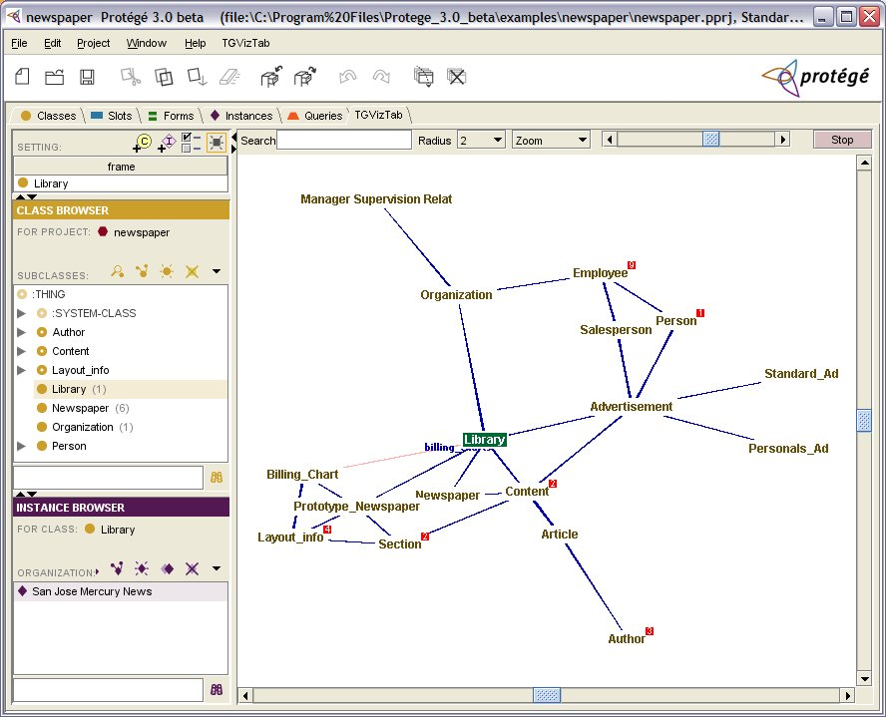
Focus + Context or Distortion
Distorting the view
of the graph in order
to combine context
and focus
The node in focus is
usually placed in the
center of the view
Other nodes are presented around, reduced in size
Examples:
2D – 2D Hyperbolic Tree, StarTree, OntoRama, MoireGraphs, TGVizTab, Bifocal Tree, OZONE
3D – 3D Hyperbolic Tree

Slide 25
Focus + Context or Distortion – OZONE

Slide 26
Focus + Context or Distortion – 3DHyperbolicTree

Slide 27
Focus + Context or Distortion Advantages and Disadvantages
Advantages:
Provides global overview
Displays many nodes at once
Easy to display details of interest
Disadvantages:
No constant position of the nodes
The distance to the center does not correspond to the node level
Indistinguishable presentation of the hierarchical structure
Display is cluttered when the role relations are visible

Slide 28
3D Information Landscapes
Common metaphor in the environments for document management
Documents are placed on a plane
Color and size-coded 3D objects represent classes and instances

Slide 29
3D Information Landscapes – Harmony Information Landscape

Slide 30
3D Information Landscapes Advantages and Disadvantages
Advantages:
An extra dimension for node properties and relation links presentation
Very intuitive
Disadvantages:
Nodes with many children are not clearly visualized
Zooming in and out is needed to see the entire subtree
Ineffective hyperlink visualization, due to cluttering
Labels overlap or occlude other objects

Slide 31
Overview
Ontology Engineering
Introduction
Visualization requirements
Ontology Visualization
Indented List
Node-Link and Tree
Zoomable Visualization
Space Filling
Focus+Context or Distortion
Information Landscapes
Ontology Alignment Visualization
Visualization requirements
Linked Trees Widgets
Graph Visualization
Treemap-based
Conclusion

Slide 32
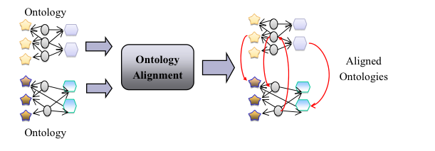
Ontology Alignment Introduction
Relating concepts from different ontologies
Ontology mapping:

Slide 33
Ontology Alignment Matching Methods
Linguistic matching
Simple symbolic methods
Language-based text analysis
Constraint based
Use other information associated to the concept
Structure-based
Use part of the structure to derive mappings
Instance-based
Use instances to extend the structure-based method
Machine learning methods
Use statistical classifiers
User feedback driven methods

Slide 34
Ontology Alignment Visualization requirements
“analyze first; show the important; zoom; filter and analyze further; details on demand”
Process Driven Requirements
Engineering of features describing the elements to be matched
Search for and selection of matching candidates
Similarity computation to determine relatedness between the candidates
Mapping discovery and storage of results
Presentation and interpretation of the mapping and related information
User feedback

Slide 35
Ontology Alignment Visualization requirements
User Driven Requirements
Presentation of mappings with confidence and evidence
Navigation and exploration of ontologies
Overview of the results
Adjustable level of detail
Filtering capabilities (terms describing concepts, mapping confidence, etc.)
Confirming and rejecting automatically generated mappings
Collaboration capabilities
Group work capabilities
Saving and loading user’s changes
User feedback driven

Slide 36
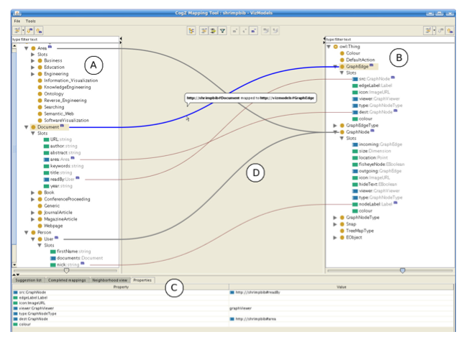
Ontology Alignment Linked trees widgets
Tree widgets side by side
Mapping shown as
Lines connecting the matched nodes
List of matching pairs
Tools
AgreementMaker
COMA++
COGZ
PROMPT
Figure: COGZ

Slide 37
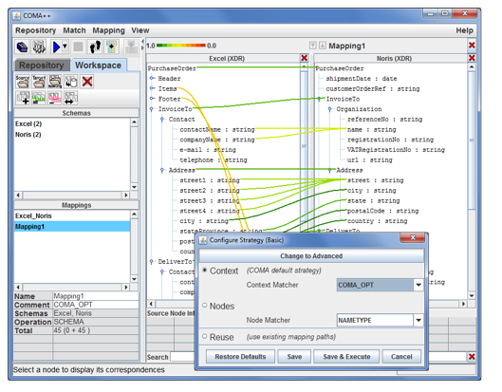
Ontology Alignment Linked trees widgets
COMA++

Slide 38
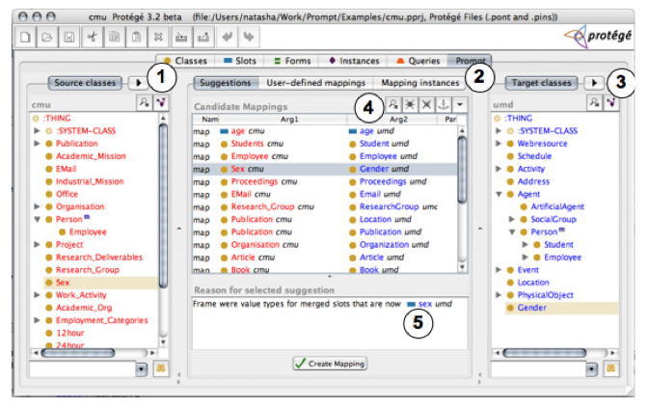
Ontology Alignment Linked trees widgets
PROMPT

Slide 39
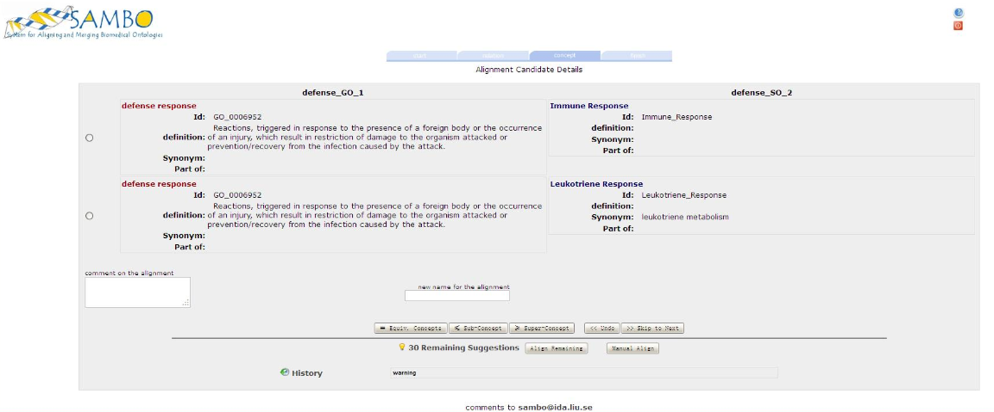
Ontology Alignment Linked trees widgets
SAMBO

Slide 40
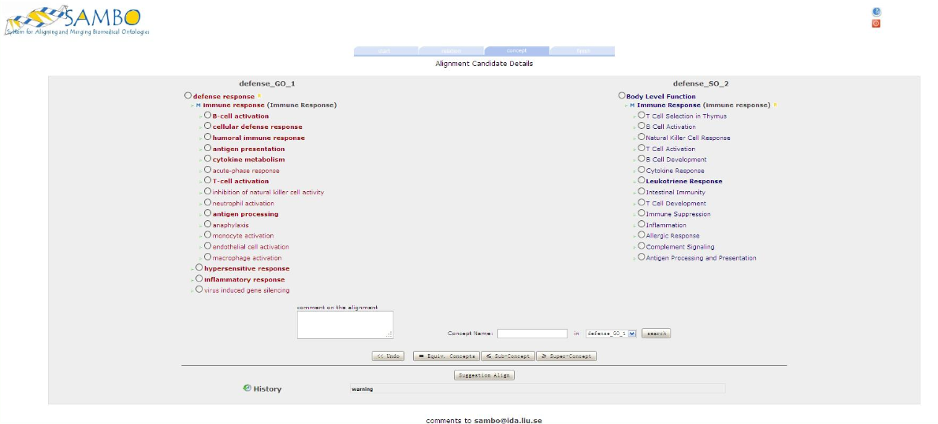
Ontology Alignment Linked trees widgets
SAMBO

Slide 41
Ontology Alignment Linked trees widgets
Requirement fulfilment analysis
Presentation of mappings with confidence and evidence
Navigation and exploration of ontologies
Overview of the results
Adjustable level of detail
Filtering capabilities (terms describing concepts, mapping confidence, etc.)

Slide 42
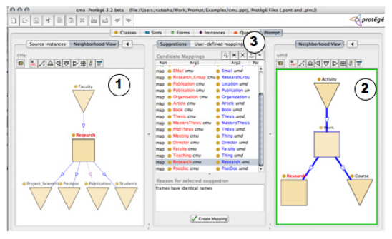
Ontology Alignment Graph Visualization
Graph widgets side by side
Mapping shown as
Additional links
Color encoding
List of matching pairs
Tools
Optima
PROMPT
AlViz
PROMPT
PROMPT

Slide 43
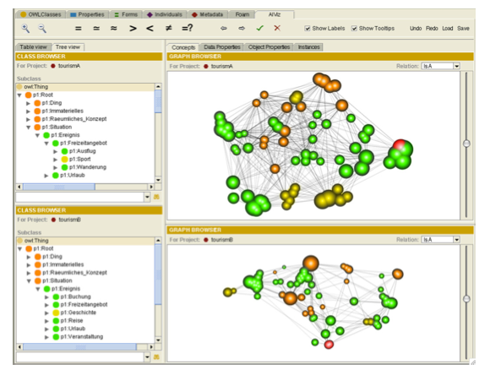
Ontology Alignment Graph Visualization
AlViz

Slide 44
Ontology Alignment Graph Visualization
Requirement fulfilment analysis
Presentation of mappings with confidence and evidence
Navigation and exploration of ontologies
Overview of the results
Adjustable level of detail
Filtering capabilities (terms describing concepts, mapping confidence, etc.)

Slide 45
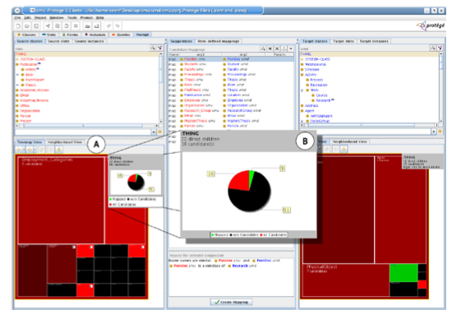
Ontology Alignment Treemap-based interfaces
Displayes hierarchical structured data as nested rectangles
A branch is represented as a rectangle
Sub-branches are nested rectangles
The size of each rectangle depends from some property of the data
COGZ

Slide 46
Ontology Alignment Treemap-based interfaces
Requirement fulfilment analysis
Presentation of mappings with confidence and evidence
Navigation and exploration of ontologies
Overview of the results
Adjustable level of detail
Filtering capabilities (terms describing concepts, mapping confidence, etc.)

Slide 47
Ontology Alignment Requirement fulfilment summary
Requirement | Linked tree | Graph | Treemap
Detailed mapping | yes | yes | yes
Ontology navigation and exploration | no | yes | no
Overview of results | no | partially | yes
Adjustable level of detail | partially | yes | yes
Filtering | partially | partially | no

Slide 48
Conclusion
Ontology visualization tools should contain multiple visualization techniques
Indented lists perform better that other visualization methods used for hierarchies
3D Landscapes need further studies
Mapping lists are always needed
Filtering methods need to be improved

Slide 49
References
Akrivi Katifori, Constantin Halatsis, George Lepouras, Costas Vassilakis, and Eugenia Giannopoulou. 2007. Ontology visualization methods—a survey. ACM Comput. Surv. 39, 4, Article 10 (November 2007)
Michael Granitzer, Vedran Sabol, Kow Weng Onn, Dickson Lukose, and Klaus Tochtermann. Ontology Alignment—A Survey with Focus on Visually Supported Semi-Automatic Techniques. Future Internet 2010, 2, 238-258
Katifori Akrivi, Torou Elena, Halatsis Constantin, Lepouras Georgios, and Vassilakis Costas. 2006. A Comparative Study of Four Ontology Visualization Techniques in Protege: Experiment Setup and Preliminary Results. In Proceedings of the conference on Information Visualization (IV '06)
Simone Kriglstein, User Requirements Analysis on Ontology Visualization. Complex, Intelligent and Software Intensive Systems, International Conference, pp. 694-699, International Conference on Complex, Intelligent and Software Intensive Systems, 2009
Monika Lanzenberger, Jennifer Sampson, and Markus Rester. Visualization in Ontology Tools. Complex, Intelligent and Software Intensive Systems, International Conference, pp. 705-711, International Conference on Complex, Intelligent and Software Intensive Systems, 2009
Patrick Lambrix and He Tan. 2006. SAMBO-A system for aligning and merging biomedical ontologies. Web Semant. 4, 3 (September 2006), 196-206.

