Slide 1
Does Scale, Size, and Locality Matter? Evaluation of Collaborative BGP Security Mechanisms
Rahul Hiran, Niklas Carlsson, Nahid Shahmehri
Linköping University, Sweden

Slide 2
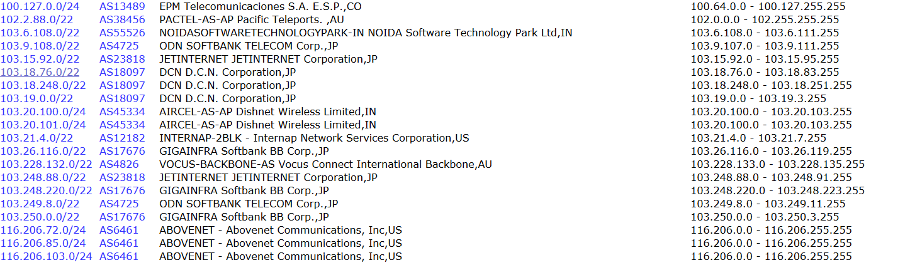
Routing attacks increasingly common
Each day there are large numbers of bogus route announcements
- e.g., cidr-report.org
Among these we have seen many serious attacks ...
Notes:
Each day there are large number of bogus route announcements on the Internet.
The list here shows the reports about such bogus announcements on a single day.

Slide 3
Routing attacks increasingly common
Each day there are large numbers of bogus route announcements
- e.g., cidr-report.org
Among these we have seen many serious attacks ...
Notes:
Routing related anomalies are quite frequent on the Internet.
Notes:Possible bogus route announcements as per cidr-report.org
6th Oct : 373 bogus route announcements
1. http://www.cidr-report.org/as6447/#Bogons
Incorrect prefix announcements are quite frequent on the Internet. Here we see a list of bogus route announcements on 4th Oct 2014.
Some of these announcements could just be misconfigurations and other deliberate attacks.

Slide 4
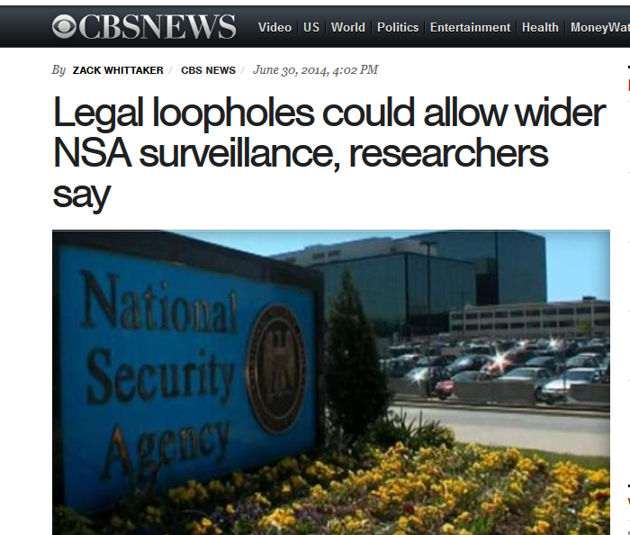
Routing attacks increasingly common
List of Bogus route announcements as listed on www.cidr-report.org.
Each day there are large numbers of bogus route announcements
- e.g., cidr-report.org
Among these we have seen many serious attacks ...
Notes:
Routing related anomalies are quite frequent on the Internet.
Notes: Possible bogus route announcements as per cidr-report.org
6th Oct : 373 bogus route announcements
1. http://www.cidr-report.org/as6447/#Bogons
Incorrect prefix announcements are quite frequent on the Internet. Here we see a list of bogus route announcements on 4th Oct 2014.
Some of these announcements could just be misconfigurations and other deliberate attacks.
These attacks can be used to perform surveillance.

Slide 5
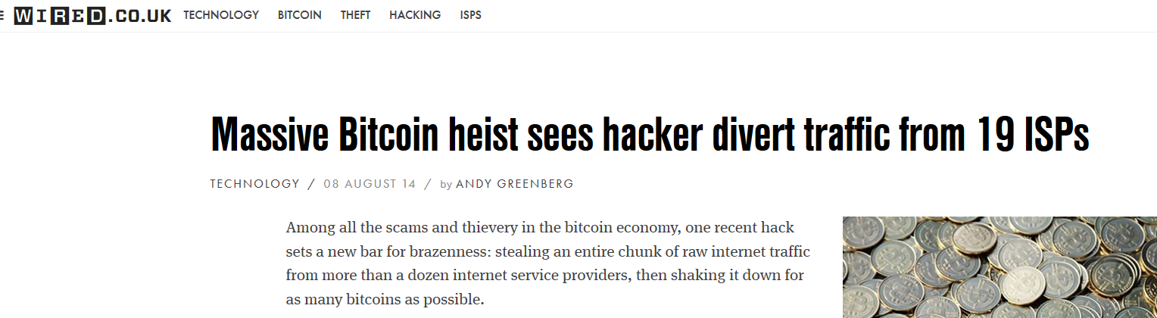
Routing attacks increasingly common
List of Bogus route announcements as listed on www.cidr-report.org.
Each day there are large numbers of bogus route announcements
- e.g., cidr-report.org
Among these we have seen many serious attacks ...
Notes:
Routing related anomalies are quite frequent on the Internet.
Notes: Possible bogus route announcements as per cidr-report.org
6th Oct : 373 bogus route announcements
1. http://www.cidr-report.org/as6447/#Bogons
Incorrect prefix announcements are quite frequent on the Internet. Here we see a list of bogus route announcements on 4th Oct 2014.
Some of these announcements could just be misconfigurations and other deliberate attacks.
These attacks can be used to perform surveillance.
Or can also be used to steal critical information such as Bitcoins.

Slide 6
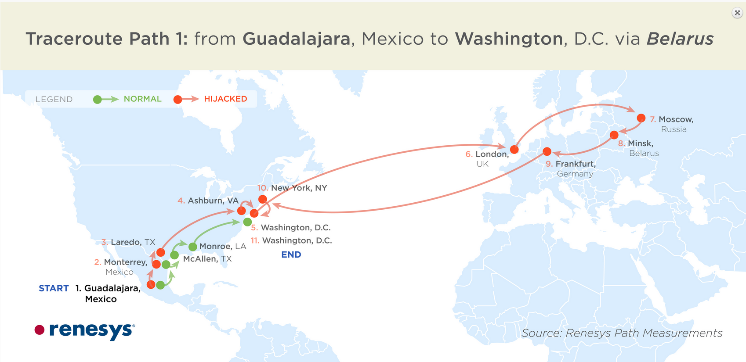
Routing attacks increasingly common
List of Bogus route announcements as listed on www.cidr-report.org.
Each day there are large numbers of bogus route announcements
- e.g., cidr-report.org
Among these we have seen many serious attacks ...
Notes:
All these attacks are related to defacto interdomain routing protocol called Border Gateway Protocol or BGP used over the Internet.
I will now explain how BGP works and then explain how BGP is vulnerable to different attacks.

Slide 7
BGP refresher
AS
Notes:
Consider a network as shown here. This is special network which consists of a set of prefixes or blocks of IP addresses under control of one or more network operators that represent single administrative domain and presents common, clearly defined routing policy to the Internet.
Each AS is allocated a unique number called as ASN. In our case the number for this AS is 22394.
Each AS is allocated a IP prefix and traffic for any IP address that falls into the range of this block of IP address should be forwarded to that AS.
Internet has hundreds of thousands of such ASes.
Consider there are several more ASes as shown in this figure.
Other networks should learn which AS is responsible for which prefix and how to reach the network. Such a reachability information is spread using BGP.

Slide 8
BGP refresher
AS 22394
AS
Notes:
Consider a network as shown here. This is special network which consists of a set of prefixes or blocks of IP addresses under control of one or more network operators that represent single administrative domain and presents common, clearly defined routing policy to the Internet.
Each AS is allocated a unique number called as ASN. In our case the number for this AS is 22394.
Each AS is allocated a IP prefix and traffic for any IP address that falls into the range of this block of IP address should be forwarded to that AS.
Internet has hundreds of thousands of such ASes.
Consider there are several more ASes as shown in this figure.
Other networks should learn which AS is responsible for which prefix and how to reach the network. Such a reachability information is spread using BGP.

Slide 9
BGP refresher
AS 22394
AS
66.174.0.0/16
Notes:
Consider a network as shown here. This is special network which consists of a set of prefixes or blocks of IP addresses under control of one or more network operators that represent single administrative domain and presents common, clearly defined routing policy to the Internet.
Each AS is allocated a unique number called as ASN. In our case the number for this AS is 22394.
Each AS is allocated a IP prefix and traffic for any IP address that falls into the range of this block of IP address should be forwarded to that AS.
Internet has hundreds of thousands of such ASes.
Consider there are several more ASes as shown in this figure.
Other networks should learn which AS is responsible for which prefix and how to reach the network. Such a reachability information is spread using BGP.

Slide 10
BGP refresher
ISP 1
Level 3
Verizon
Wireless
AS 22394
66.174.0.0/16
Notes:
So suppose there are more ASes that have connections as shown in this figure.
First this AS 22394 announces to its neighbor that it is allocated this prefix.
Neighbor appends its own AS number and forwards to the announcement to its neighbor.
So ISP1 here knows that each can reach AS 22394 following the path that is shown here.

Slide 11
BGP refresher
ISP 1
Level 3
Verizon
Wireless
22394 66.174.0.0/16
  Normal operation:
  Origin AS announces prefix
  Route announcements propagate between ASes
  Helps ASes learn about “good” paths to reach prefix
AS 22394
66.174.0.0/16
Notes:
So suppose there are more ASes that have connections as shown in this figure.
First this AS 22394 announces to its neighbor that it is allocated this prefix.
Neighbor appends its own AS number and forwards to the announcement to its neighbor.
So ISP1 here knows that each can reach AS 22394 following the path that is shown here.

Slide 12
BGP refresher
ISP 1
VZW, 22394 66.174.0.0/16
Level 3
Verizon
Wireless
22394 66.174.0.0/16
  Normal operation:
  Origin AS announces prefix
  Route announcements propagate between ASes
  Helps ASes learn about “good” paths to reach prefix
AS 22394
66.174.0.0/16
Notes:
So suppose there are more ASes that have connections as shown in this figure.
First this AS 22394 announces to its neighbor that it is allocated this prefix.
Neighbor appends its own AS number and forwards to the announcement to its neighbor.
So ISP1 here knows that each can reach AS 22394 following the path that is shown here.

Slide 13
BGP refresher
Level3, VZW, 22394 66.174.0.0/16
ISP 1
VZW, 22394 66.174.0.0/16
Level 3
Verizon
Wireless
22394 66.174.0.0/16
  Normal operation:
  Origin AS announces prefix
  Route announcements propagate between ASes
  Helps ASes learn about “good” paths to reach prefix
AS 22394
66.174.0.0/16
Notes:
So suppose there are more ASes that have connections as shown in this figure.
First this AS 22394 announces to its neighbor that it is allocated this prefix.
Neighbor appends its own AS number and forwards to the announcement to its neighbor.
So ISP1 here knows that each can reach AS 22394 following the path that is shown here.

Slide 14
BGP refresher
Level3, VZW, 22394 66.174.0.0/16
ISP 1
VZW, 22394 66.174.0.0/16
Level 3
Verizon
Wireless
22394 66.174.0.0/16
  Normal operation:
  Origin AS announces prefix
  Route announcements propagate between ASes
  Helps ASes learn about “good” paths to reach prefix
AS 22394
66.174.0.0/16
Notes:
BGP works well in normal circumstances. However, there are some inherent security issues with this protocol. It is difficult to check true ownership of prefixes. And gives rise to different types of attack.

Slide 15
BGP refresher
Level3, VZW, 22394 66.174.0.0/16
ISP 1
Level 3
Verizon
Wireless
AS 22394
66.174.0.0/16
Notes:
BGP works well in normal circumstances. However, there are some inherent security issues with this protocol. It is difficult to check true ownership of prefixes. And gives rise to different types of attack.

Slide 16
BGP refresher
Level3, VZW, 22394 66.174.0.0/16
ISP 1
Level 3
Attacker
Verizon
Wireless
AS 22394
66.174.0.0/16
Notes:
BGP works well in normal circumstances. However, there are some inherent security issues with this protocol. It is difficult to check true ownership of prefixes. And gives rise to different types of attack.

Slide 17
Prefix hijack attack
Level3, VZW, 22394 66.174.0.0/16
ISP 1
Level 3
Attacker
Verizon
Wireless
AS 22394
66.174.0.0/16
Notes:
In a prefix hijack attack, attacker announces the same prefix allocated to the victim network. So, ISP1 had two paths to reach the same prefix.
Depending on relationships of ISP1 with these two neighbor ASes it will choose the route.
Here the relationship could be cusomter/provide or peer/peer relationship. Suppose attacker network is a customer of ISP1.
In this scenario, ISP1 will choose to route to attacker network since it can earn money by using customer path.
Now assume that ISP1 has peer relationship with both the neighbors shown in this figure.
Even in this case ISP1 may choose to route to attacker network since the path offered by attacker is short.

Slide 18
Prefix hijack attack
Attacker
66.174.0.0/16
Level3, VZW, 22394 66.174.0.0/16
ISP 1
Level 3
Attacker
Verizon
Wireless
AS 22394
66.174.0.0/16
Notes:
In a prefix hijack attack, attacker announces the same prefix allocated to the victim network. So, ISP1 had two paths to reach the same prefix.
Depending on relationships of ISP1 with these two neighbor ASes it will choose the route.
Here the relationship could be cusomter/provide or peer/peer relationship. Suppose attacker network is a customer of ISP1.
In this scenario, ISP1 will choose to route to attacker network since it can earn money by using customer path.
Now assume that ISP1 has peer relationship with both the neighbors shown in this figure.
Even in this case ISP1 may choose to route to attacker network since the path offered by attacker is short.

Slide 19
Prefix hijack attack
Attacker
66.174.0.0/16
Level3, VZW, 22394 66.174.0.0/16
ISP 1
Level 3
Attacker
Verizon
Wireless
  AS relationships:
  Customer-provider
  Peer-peer
AS 22394
66.174.0.0/16
Notes:
In a prefix hijack attack, attacker announces the same prefix allocated to the victim network. So, ISP1 had two paths to reach the same prefix.
Depending on relationships of ISP1 with these two neighbor ASes it will choose the route.
Here the relationship could be cusomter/provide or peer/peer relationship. Suppose attacker network is a customer of ISP1.
In this scenario, ISP1 will choose to route to attacker network since it can earn money by using customer path.
Now assume that ISP1 has peer relationship with both the neighbors shown in this figure.
Even in this case ISP1 may choose to route to attacker network since the path offered by attacker is short.

Slide 20
Prefix hijack attack
Customer path?
?
Attacker
66.174.0.0/16
Level3, VZW, 22394 66.174.0.0/16
ISP 1
Level 3
Attacker
Verizon
Wireless
  AS relationships:
  Customer-provider
  Peer-peer
AS 22394
66.174.0.0/16

Slide 21
Prefix hijack attack
Attacker
66.174.0.0/16
Level3, VZW, 22394 66.174.0.0/16
ISP 1
Level 3
Attacker
Verizon
Wireless
AS 22394
66.174.0.0/16

Slide 22
Prefix hijack attack
Attacker path is shorter
?
Attacker
66.174.0.0/16
Level3, VZW, 22394 66.174.0.0/16
ISP 1
Level 3
Attacker
Verizon
Wireless
AS 22394
66.174.0.0/16

Slide 23
Subprefix hijack attack
Level3, VZW, 22394 66.174.0.0/16
Attacker
66.174.161.0/24
ISP 1
Level 3
Attacker
Verizon
Wireless
AS 22394
66.174.0.0/16
Notes:
More harmful form of attack in subprefix hijack attack. In this case, china telecom can announce more specific prefix that is covered by the prefix assigned to As 22394.
If there is traffic for the prefix range announced by china telecom , it will be routed to china telecom because it has longest prefix length .

Slide 24
Subprefix hijack attack
Attacker prefix is more specific
?
Level3, VZW, 22394 66.174.0.0/16
Attacker
66.174.161.0/24
ISP 1
Level 3
Attacker
Verizon
Wireless
AS 22394
66.174.0.0/16
Notes:
More harmful form of attack in subprefix hijack attack. In this case, china telecom can announce more specific prefix that is covered by the prefix assigned to As 22394.
If there is traffic for the prefix range announced by china telecom , it will be routed to china telecom because it has longest prefix length .

Slide 25
Imposture attack
Level3, VZW, 22394 66.174.0.0/16
Attacker
66.174.161.0/24
ISP 1
Level 3
Attacker
Verizon
Wireless
AS 22394
66.174.0.0/16
Notes:
And even more harmful attack would be interception attack and imposture In this case, a network is able to attract the data towards itself , store is for future analysis, and then reroute the data back to original owner. While in case of imposture attack, an attacker imposters as a victim network and communicates on behalf of the victim network.
The affected network keeps getting responses for its request and thus these attacks are difficult to detect before they cause harm.
We have seen that
- prefix length matters
- path length matters
when making these decisions. However, also relationships between Ases matters … to better understand the importance of these relationships, we will next look at …

Slide 26
Interception attack
Level3, VZW, 22394 66.174.0.0/16
Attacker
66.174.161.0/24
ISP 1
Level 3
Attacker
Verizon
Wireless
AS 22394
66.174.0.0/16
Notes:
These case clearly shows that interception attack are quite hard to detect without observing the actual datapath taken by the traffic. So these data paths can either be extracted by performing active measurements such as traceroute or by using passive measurements.
There are several ways to prevent/detect these attacks.
For example, if ISP 1 knows that only AS 22394 can originate this prefix, it can simply drop the announcement received from attacker network. So mechanisms such as RPKI (Resource Public key infrastructure) and ROVER have been proposed to prevent prefix hijack. These techniques build a trusted and formally verifiable database of prefix-to-AS pairings which can be used to check correct announcements.
Hijack detection systems have also been proposed where the information seen in route path announcements is used. For each prefix these mechanisms track the set of origin ASes as seen in the route path announcements. If any change in the origin set is detected then an alert is raised which can be further studies by concerned network operators.
Finally, the cases of interception and imposture attacks are not possible to detect by only looking at origin or route announcement information. Actual path taken by the traffic or information such as RTT is needed to detect these attacks.
Systems that gather such information and aid in detection of these attacks have also been proposed.

Slide 27
Interception attack
Level3, VZW, 22394 66.174.0.0/16
Attacker
66.174.161.0/24
ISP 1
Level 3
Attacker
Verizon
Wireless
AS 22394
66.174.0.0/16
Notes:
These case clearly shows that interception attack are quite hard to detect without observing the actual datapath taken by the traffic. So these data paths can either be extracted by performing active measurements such as traceroute or by using passive measurements.
There are several ways to prevent/detect these attacks.
For example, if ISP 1 knows that only AS 22394 can originate this prefix, it can simply drop the announcement received from attacker network. So mechanisms such as RPKI (Resource Public key infrastructure) and ROVER have been proposed to prevent prefix hijack. These techniques build a trusted and formally verifiable database of prefix-to-AS pairings which can be used to check correct announcements.
Hijack detection systems have also been proposed where the information seen in route path announcements is used. For each prefix these mechanisms track the set of origin ASes as seen in the route path announcements. If any change in the origin set is detected then an alert is raised which can be further studies by concerned network operators.
Finally, the cases of interception and imposture attacks are not possible to detect by only looking at origin or route announcement information. Actual path taken by the traffic or information such as RTT is needed to detect these attacks.
Systems that gather such information and aid in detection of these attacks have also been proposed.

Slide 28
Examples of systems to secure BGP
Information shared | Prefix hijack | Subprefix hijack | Interception | Imposture | Example solutions
Prefix origin (Hijack prevention) |  |  |  |  | Route filtering, RPKI, ROVER
Route path updates (Hijack detection) |  |  |  |  | PHAS, PrefiSec, PG/BGP
Passive measurements |  |  |  |  | CrowdSec
Active measurements |  |  |  |  | Zheng at. al., PrefiSec
Notes:
Mechanisms such as RPKI, ROVER have been proposed to prevent prefix hijack. These techniques build a trusted and formally verifiable database of prefix-to-AS pairings which can be used to check correct announcements.
Anomaly detection system based on tracking route path updates have also been proposed. For each prefix these mechanisms track the set of origin ASes as seen in the route path announcements. If any change in the origin set is detected then an alert is raised which can be further studies by concerned network operators.
These mechanisms are targeted to detect prefix and subprefix hijack attacks.
Interception attack and imposture attack are impossible to detect without observing the actual datapath taken by the traffic or without extracting information related to the traffic, such as RTT. So these data paths can either be extracted by performing active measurements such as traceroute or by using passive measurements.
Passive and active measurements based techniques have been proposed to detect the cases of interception and imposture attack.

Slide 29
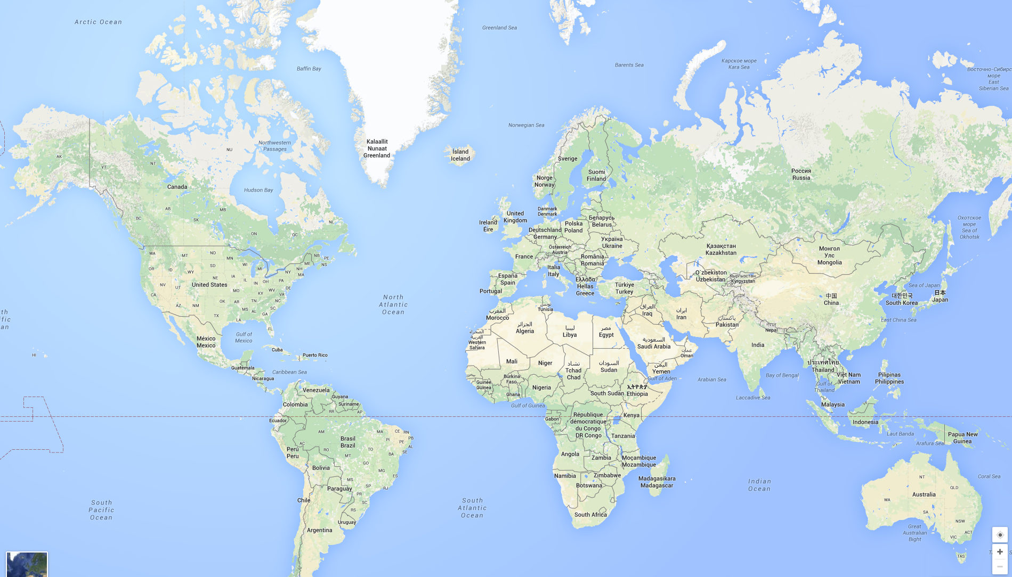
Security gain when large ASes collaborate
Notes:
It has been shown that there is good security gain when several large ASes agree to use the proposed security mechanisms. This evaluation is normally done using simulations where it is assumed that the large ASes are using the proposed security mechanism.
Now the main issue here is that these large ASes, the so called tier1 ASes are distributed all over the world. It may include ASes in US, Europe, China.

Slide 30
Security gain when large ASes collaborate
Several ASes with few large size AS gives good security
Locality aspects often not considered
Notes:
It has been shown that there is good security gain when several large ASes agree to use the proposed security mechanisms. This evaluation is normally done using simulations where it is assumed that the large ASes are using the proposed security mechanism.
Now the main issue here is that these large ASes, the so called tier1 ASes are distributed all over the world. It may include ASes in US, Europe, China.

Slide 31

AS Relationship issues
In October, 2010, Sprint severed its connection with Cogent
These two ASes had issues with peering relationship that allowed them to exchange traffic at no cost
ASes do not agree with each other
Notes:
Well there are relationship issues between ASes within same region, so good luck with the hope that large ASes belonging to different countries will agree on using single solution to secure BGP.

Slide 32
AS Relationship issues
In October, 2010, Sprint severed its connection with Cogent
These two ASes had issues with peering relationship that allowed them to exchange traffic at no cost
ASes do not agree with each other
Notes:
Well there are relationship issues between ASes within same region, so good luck with the hope that large ASes belonging to different countries will agree on using single solution to secure BGP.

Slide 33
AS Relationship issues
In October, 2010, Sprint severed its connection with Cogent
These two ASes had issues with peering relationship that allowed them to exchange traffic at no cost
ASes do not agree with each other
Global collaboration not practical
Collaboration among networks within same region plausible, for example, through legislation
Notes:
Well there are relationship issues between ASes within same region, so good luck with the hope that large ASes belonging to different countries will agree on using single solution to secure BGP.

Slide 34
Research questions
How are attack prevention/detection rates affected
  When location of participant ASes is considered?
  When size of participant ASes is considered?
  When number of ASes participating in the collaboration is considered?
In the context of last two questions, we consider the locality aspects
Notes:
However, not much is known how the proposed security mechanisms behave when deployment from regional perspective is considered.

Slide 35


Research questions
How are attack prevention/detection rates affected
  When location of participant ASes is considered?
  When size of participant ASes is considered?
  When number of ASes participating in the collaboration is considered?
In the context of last two questions, we consider the locality aspects
Vs
Notes:
However, not much is known how the proposed security mechanisms behave when deployment from regional perspective is considered.

Slide 36
Research questions
How are attack prevention/detection rates affected
  When location of participant ASes is considered?
  When size of participant ASes is considered?
  When number of ASes participating in the collaboration is considered?
In the context of last two questions, we consider the locality aspects
Vs
Vs
Notes:
However, not much is known how the proposed security mechanisms behave when deployment from regional perspective is considered.

Slide 37
Research questions
How are attack prevention/detection rates affected
  When location of participant ASes is considered?
  When size of participant ASes is considered?
  When number of ASes participating in the collaboration is considered?
In the context of last two questions, we consider the locality aspects
Vs
Vs
Vs
Notes:
However, not much is known how the proposed security mechanisms behave when deployment from regional perspective is considered.

Slide 38
Contributions
Systematic data-driven evaluation
Using real world topologies and routing information we evaluate the impact of:
  Locality
  Scale
  Size
The research questions are evaluated for three different techniques that are based on sharing
  Prefix origin
  Route path updates
  Passively collected RTT
Notes:
We perform systematic data-driven evaluation to evaluate the research questions.
Using real world topologies and routing information we evaluate the impact of locality, scale, and size of ASes on routing security mechanisms.
In particular we focus on systems that use prefix origin, route path updates, and passive measurements to detect different types of routing attacks.
I will first begin with systems that use prefix origin information to detect routing anomalies.

Slide 39
Examples of systems to secure BGP
Information shared | Prefix hijack | Subprefix hijack | Interception | Imposture | Example solutions
Prefix origin |  |  |  |  | Route filtering, RPKI, ROVER
Route path updates |  |  |  |  | PHAS, PrefiSec, PG/BGP
Passive measurements |  |  |  |  | CrowdSec
Active measurements |  |  |  |  | Zheng at. al., PrefiSec
Notes:
Refering to previously shown table, we perform our evaluation for the mechanisms that are highlighted here.
We have not performed the evaluation for active measurement based systems, since the results are expected to be on similar lines as passive measurement based systems. These two systems differ only by the fact how data is collected. The evaluation of the data once collected is expected to give same results.

Slide 40
Examples of systems to secure BGP
Information shared | Prefix hijack | Subprefix hijack | Interception | Imposture | Example solutions
Prefix origin |  |  |  |  | Route filtering, RPKI, ROVER
Route path updates |  |  |  |  | PHAS, PrefiSec, PG/BGP
Passive measurements |  |  |  |  | CrowdSec
Active measurements |  |  |  |  | Zheng at. al., PrefiSec
Notes:
Refering to previously shown table, we perform our evaluation for the mechanisms that are highlighted here.
We have not performed the evaluation for active measurement based systems, since the results are expected to be on similar lines as passive measurement based systems. These two systems differ only by the fact how data is collected. The evaluation of the data once collected is expected to give same results.

Slide 41
Contributions
Systematic data-driven evaluation
Using real world topologies and routing information we evaluate the impact of:
  Locality
  Scale
  Size
The research questions are evaluated for three different techniques that share:
  Prefix origin → hijack prevention mechanisms
  Route path updates → hijack detection mechanisms
  Passively collected RTT
Notes:
We perform systematic data-driven evaluation to evaluate the research questions.
Using real world topologies and routing information we evaluate the impact of locality, scale, and size of ASes on routing security mechanisms.
In particular we focus on systems that use prefix origin, route path updates, and passive measurements to detect different types of routing attacks.
I will first begin with systems that use prefix origin information to detect routing anomalies.

Slide 42
Hijack prevention technique evaluation
Simulation based evaluation
Simulate route propagation using standard routing policy used over the Internet
Modified and used BSIM tool
AS-level topology and AS relationship information that has 51,507 ASes and 199,540 relationships

Slide 43
Evaluation methodology
Simulate route propagation when hijack prevention mechanism is present and absent
Measure fraction of ASes that choose correct destination AS for the prefix
Calculate percentage increase in ASes that choose correct origin
Victim and attacker AS chosen randomly

Slide 44
Evaluation methodology
Simulate route propagation when hijack prevention mechanism is present and absent
Measure fraction of ASes that choose correct destination AS for the prefix
Calculate percentage increase in ASes that choose correct origin
Victim and attacker AS chosen randomly

Slide 45
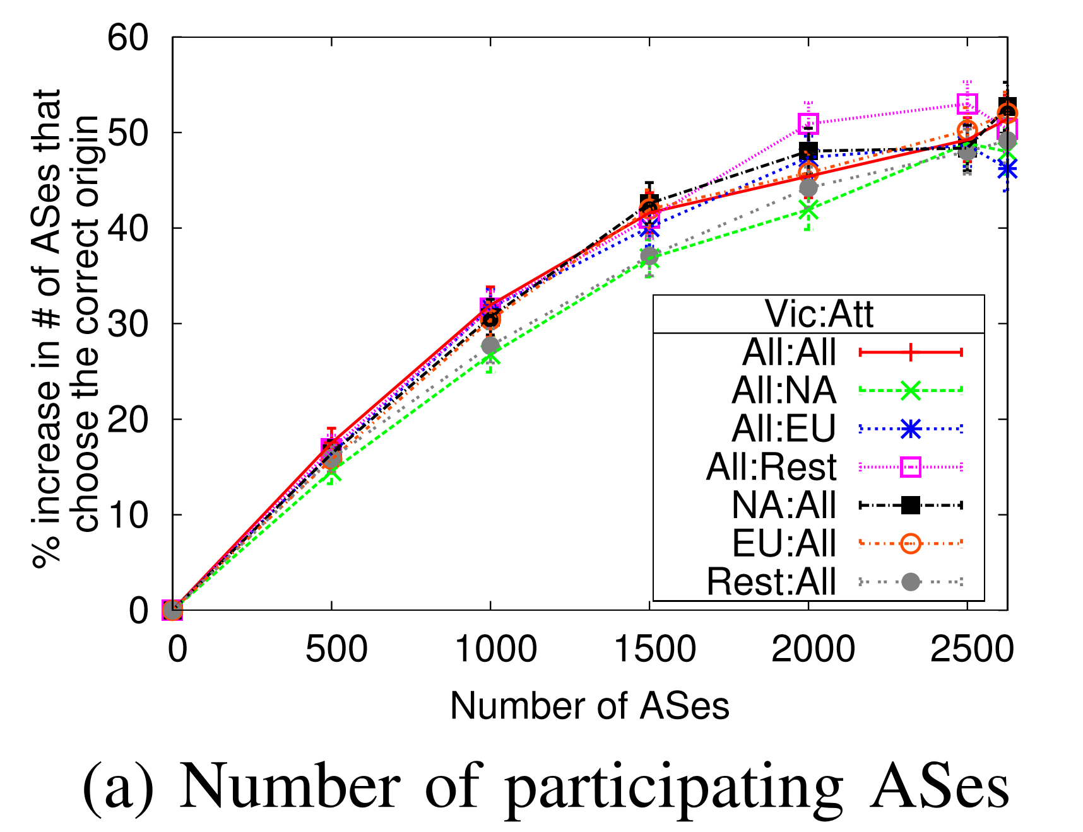
Global baseline: scale
vs
As number of ASes that collaborate increases, the protection to ASes increases
With 500 ASes an average gain of 15% across attacker-victim pairs
Gain rises to 45% when all ASes with node degree >= 20 deploy the prevention mechanism
Global
Notes:
I will present the results for the scale aspect.
Now let us carefully see what this graph is, since similar graphs are used in next few slides.
The numbers on x/axis is the number of ASes that are assumed to have deployed the hijack prevention mechanism.
Each line represents the results for different vic-att combination. For example. The blue line indicates the results for the case when victim can be global but the attacker network is located in EU.
Finally y-axis represents percentage gain in number of ASes that choose the correct origin.
For example, consider this points for case when number of ASes = 500.
We first simulate route propagation assuming that hijack prevention mechanism is not deployed and by selecting an attacker network. Next, we randomly select 500 ASes to have deployed these security mechanisms and again simulate the route propagation by selecting the same attacker network. We measure the % increase in the number of ASes that choose the correct origin and the these number if plotted on y-axis. For each point we simulate 500 times to calculate the average.

Slide 46
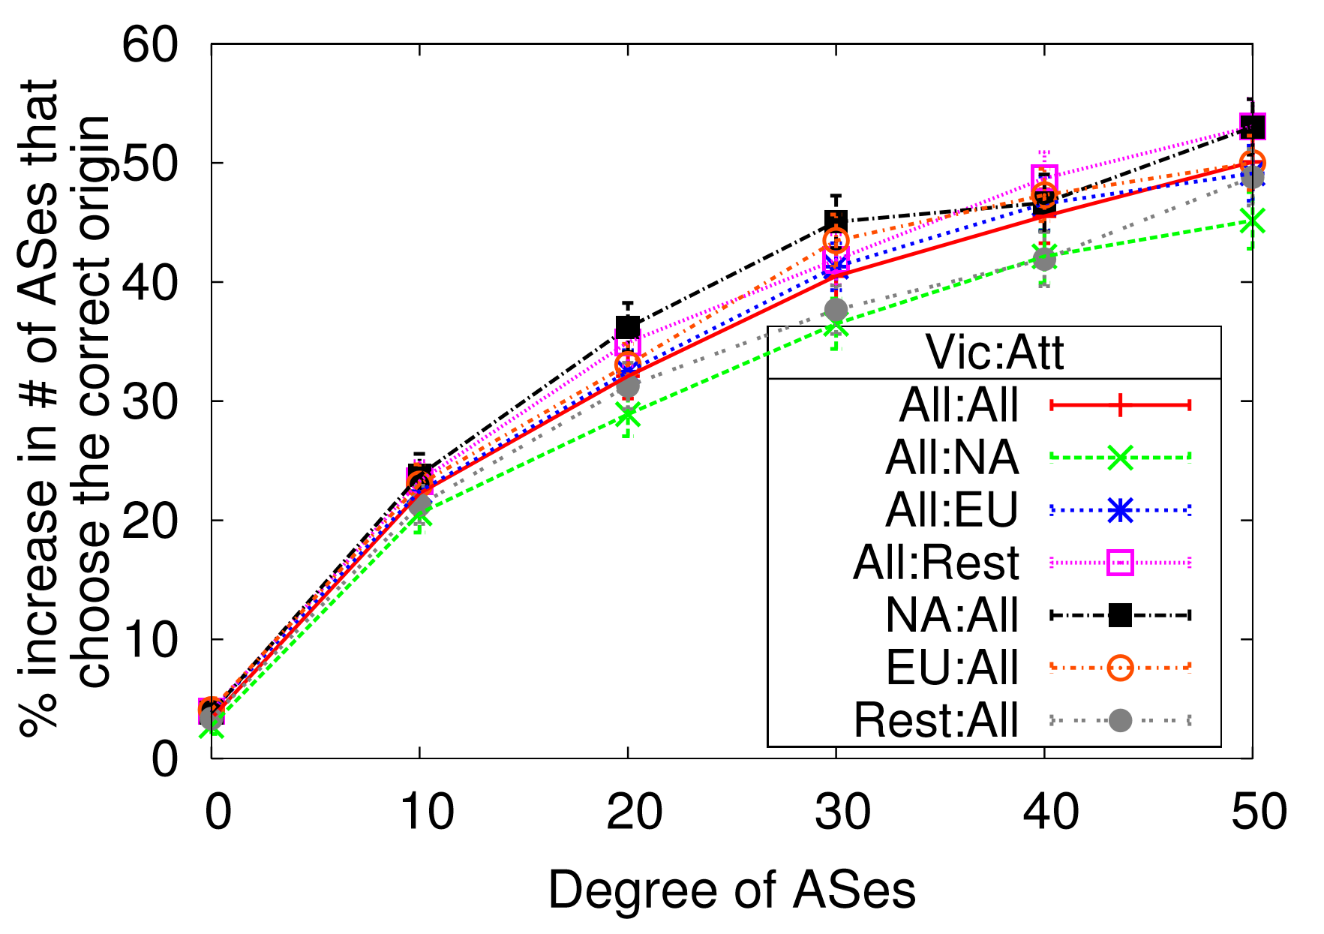
Global baseline: size
vs
Size of an AS is based on the number of neighbors of that AS and is termed as degree of AS
As size of ASes that collaborate increases, the protection to ASes increases
Global
Notes:
This is not a new observation. But we take one step further and include the locality aspects in our evaluations.

Slide 47
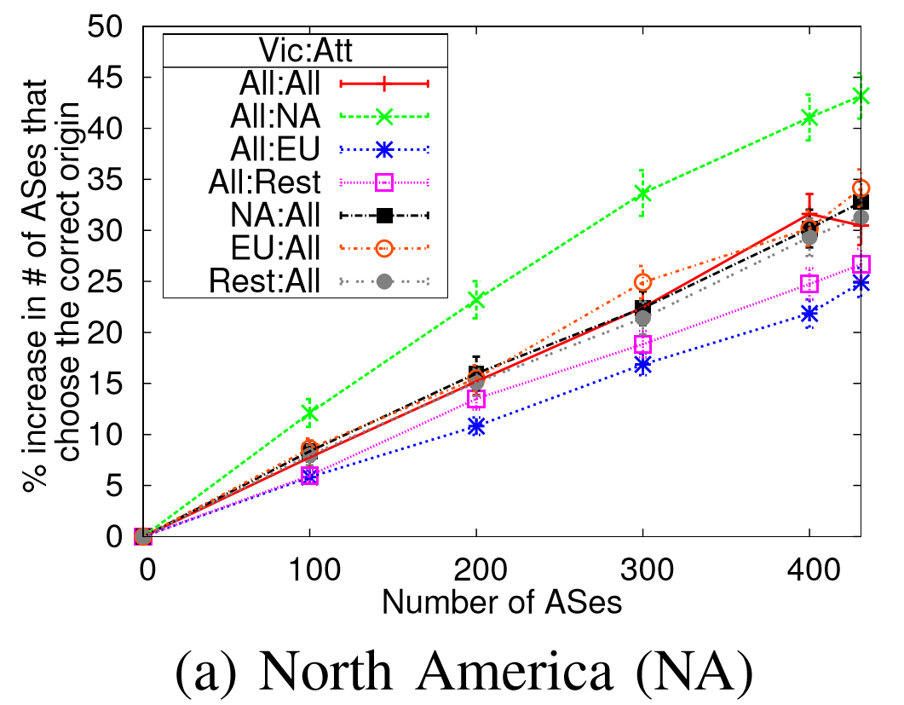
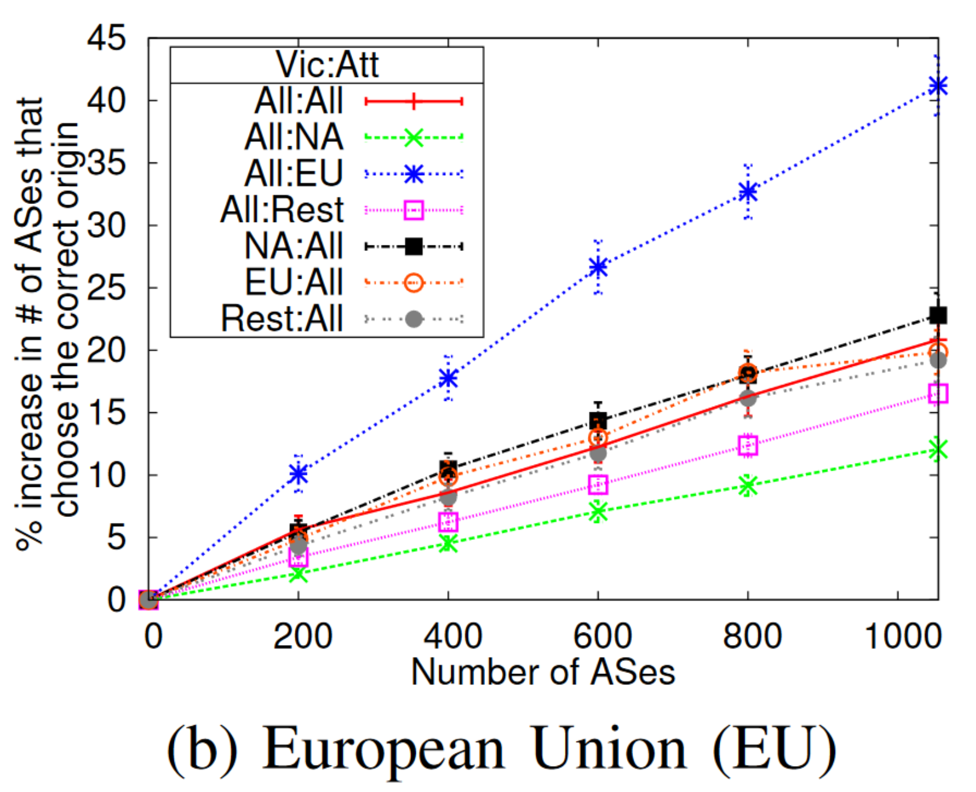
Compare global and regional deployment: scale
vs
vs
Global
North America (NA)
European Union (EU)
Regional deployment provide improvements similar to global deployment when attacker is local
Deployment to prevent attacks from own region
Mechanisms for greater good

Slide 48
Compare global and regional deployment: scale
vs
vs
Global
North America (NA)
500 randomly selected global ASes vs 431 ASes in NA region
Notes:
Also see that regional deployment may give better results compared to random deployment globally.
For example, globally if 500 randomly selected ASes deploy prevention mechanisms then the security gain hovers around 15%.
However, if all the 431 ASes with degree greater than 20 in NA region deploy the prevention mechanisms then the security gain ranges between 25 to 45 %.

Slide 49
Contributions
Systematic data-driven evaluation
Using real world topologies and routing information we evaluate the impact of:
  Locality
  Scale
  Size
The research questions are evaluated for three different techniques that share:
  Prefix origin → hijack prevention mechanisms
  Route path updates → hijack detection mechanisms
  Passively collected RTT

Slide 50
Contributions
Systematic data-driven evaluation
Using real world topologies and routing information we evaluate the impact of:
  Locality
  Scale
  Size
The research questions are evaluated for three different techniques that share:
  Prefix origin → hijack prevention mechanisms
  Route path updates → hijack detection mechanisms
  Passively collected RTT
Notes:
We have also evaluated systems that use route path updates for various aspects. Now I will present the results for such systems.

Slide 51
Hijack detection system evaluation
Extended earlier proposed system that uses route path announcements to aid in raising alerts for routing attacks
Routepath updates from RouteViews project around large scale routing anomaly
On April 8, 2010, China Telecom announced ≈50,000 prefixes allocated to other networks

Slide 52
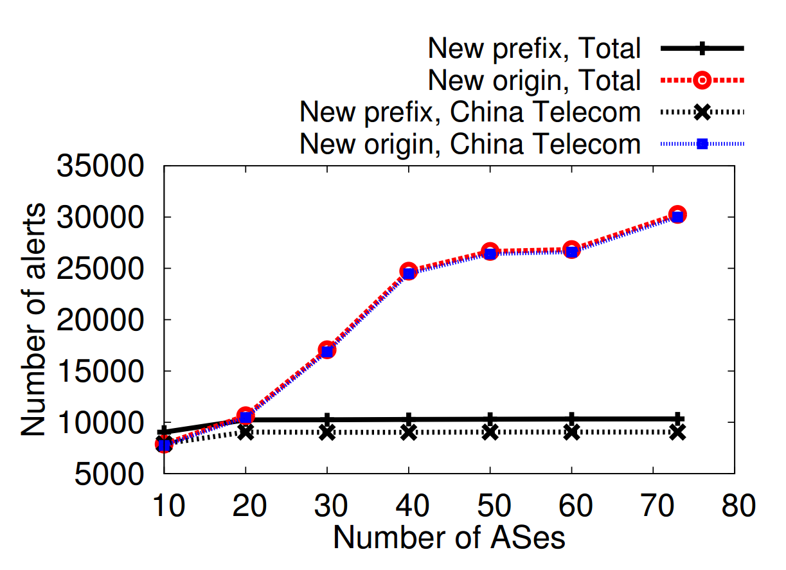
Global vs regional baseline: scale
vs
Global
Number of alerts for prefix hijack increases number of ASes
Few ASes needed to detect subprefix hijack alerts
High detection rate in rest of the world region despite fewer ASes
Confirms result with the hijack prevention mechanisms
Notes:
First I will present the results for scale aspect from global perspective.
The x-axis here shows the number of ASes that are sharing routepath updates.
The red line shows the number of alerts with new origin. These are possible prefix hijack attacks.
The solid black line shows the number of alerts with new prefixes. These are possible subprefix hijacks attaks.
The blue line and dotted black line shows the alerts that concerns the announcements made by china telecom network.
Note that even with fewer ASes collaborating in rest of the world region the number of alerts is significantly higher compared to the case when higher ASes in NA region collaborate.
This is because the vantage points in this region are perhaps closer to China Telecom network and have better visibility to the route announcements made by the china Telecom.
This confirms our results from hijack prevention mechanisms that detector closer to prospective attacker give better results.

Slide 53
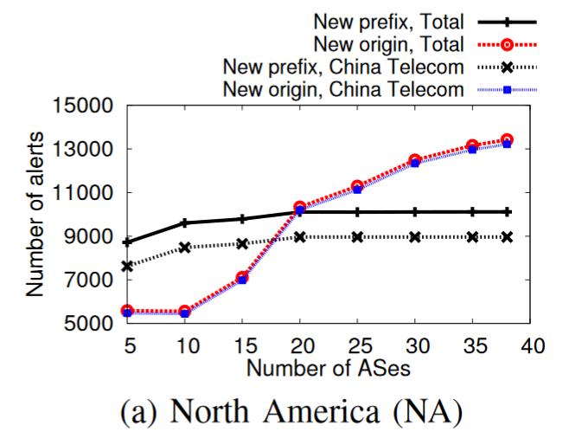
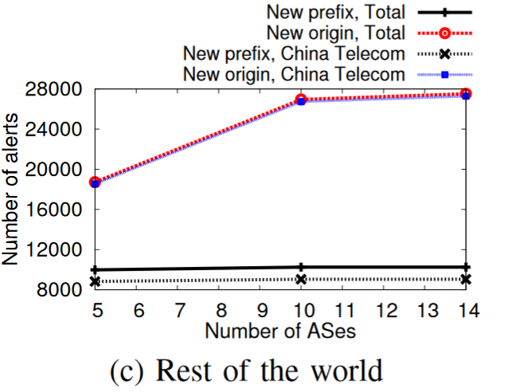
Global vs regional baseline: scale
vs
vs
Global
NA
Rest of the world
Number of alerts for prefix hijack increases number of ASes
Few ASes needed to detect subprefix hijack alerts
High detection rate in rest of the world region despite fewer ASes
Confirms result with the hijack prevention mechanisms
Notes:
First I will present the results for scale aspect from global perspective.
The x-axis here shows the number of ASes that are sharing routepath updates.
The red line shows the number of alerts with new origin. These are possible prefix hijack attacks.
The solid black line shows the number of alerts with new prefixes. These are possible subprefix hijacks attaks.
The blue line and dotted black line shows the alerts that concerns the announcements made by china telecom network.
Note that even with fewer ASes collaborating in rest of the world region the number of alerts is significantly higher compared to the case when higher ASes in NA region collaborate.
This is because the vantage points in this region are perhaps closer to China Telecom network and have better visibility to the route announcements made by the china Telecom.
This confirms our results from hijack prevention mechanisms that detector closer to prospective attacker give better results.

Slide 54
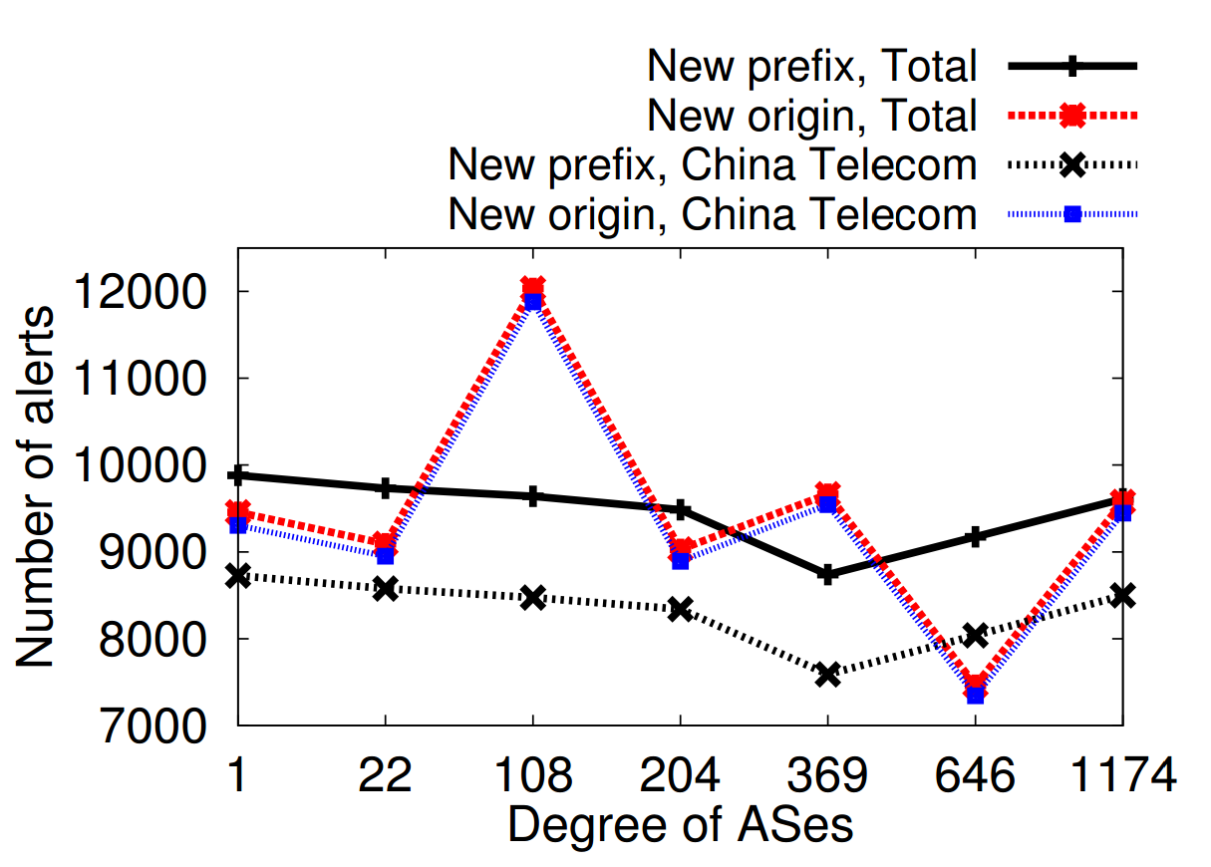
Global baseline: size
vs
Global
With increasing degree threshold the alerts rate does not increase
Regional deployment with complementing ASes from other regions
Routes learnt by mid/tier ASes may not reach their providers
Notes:
First I will present the results for scale aspect from global perspective.
The x-axis here shows the number of ASes that are sharing routepath updates.
The red line shows the number of alerts with new origin. These are possible prefix hijack attacks.
The solid black line shows the number of alerts with new prefixes. These are possible subprefix hijacks attaks.
The blue line and dotted black line shows the alerts that concerns the announcements made by china telecom network.

Slide 55
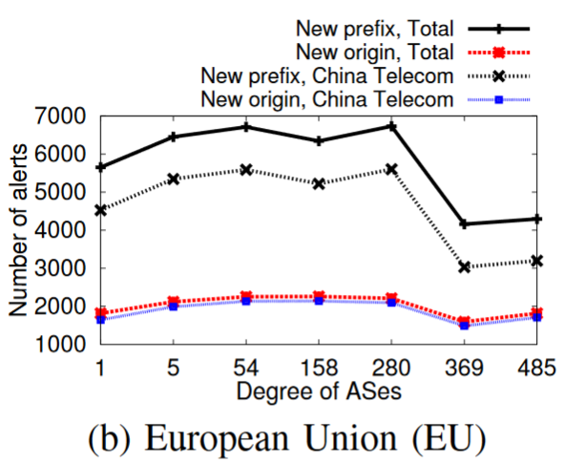
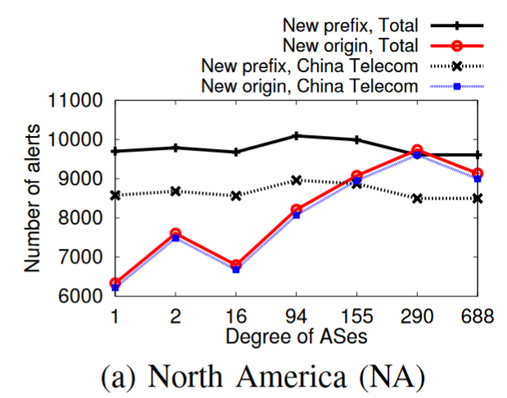
Global baseline: size
vs
vs
Global
North America (NA)
European Union (EU)
With increasing degree threshold the alerts rate does not increase
Regional deployment with complementing ASes from other regions
Routes learnt by mid/tier ASes may not reach their providers
Notes:
First I will present the results for scale aspect from global perspective.
The x-axis here shows the number of ASes that are sharing routepath updates.
The red line shows the number of alerts with new origin. These are possible prefix hijack attacks.
The solid black line shows the number of alerts with new prefixes. These are possible subprefix hijacks attaks.
The blue line and dotted black line shows the alerts that concerns the announcements made by china telecom network.

Slide 56
Contributions
Systematic data-driven evaluation
Using real world topologies and routing information we evaluate the impact of:
  Locality
  Scale
  Size
The research questions are evaluated for three different techniques that share:
  Prefix origin
  Route path updates
  Passively collected RTT
Notes:
We have also evaluated systems that use route path updates for various aspects. Now I will present the results for such systems.

Slide 57
Conclusion
Systematic evaluation of three broad classes of routing attack prevention/detection techniques
Locality, size, and scale aspects considered
For all three classes of techniques we see cases where regional deployment provides substantial benefits
Regional deployment with carefully selected participants can outperform global deployment that is not planned

Slide 58
Linköping University
expanding reality
Does Scale, Size, and Locality Matter?
Rahul Hiran
rahul.hiran@liu.se

