Slide 1
Setting up CDT Makefile project
Eclipse Version: Neon.3 Release (4.6.3)

Slide 2
OpenModelica compile with -g
Make sure the OpenModelica runtime is compiled with -g
> cd OpenModelica
> cd OMCompiler/SimulationRuntime/c
> make –f Makefile.omdev.mingw clean
> cd OpenModelica
> make –f Makefile.omdev.mingw CFLAGS=-g –j4

Slide 3
Setup workspace
Create Eclipse Workspace (if you don’t have it already)
Create a SimulationDbg directory in the workspace (any name is OK)
Add the generated Model files and C files to the new directory
adrpo33@ida-0030 MINGW64 /c/home/adrpo33/debug/SimulationDebug
$ cp EMTSim.Examples.Circuit_RLC_sans_Switch* /e/dev/workspace/SimulationDbg/
Start Eclipse, switch to the new workspace

Slide 4
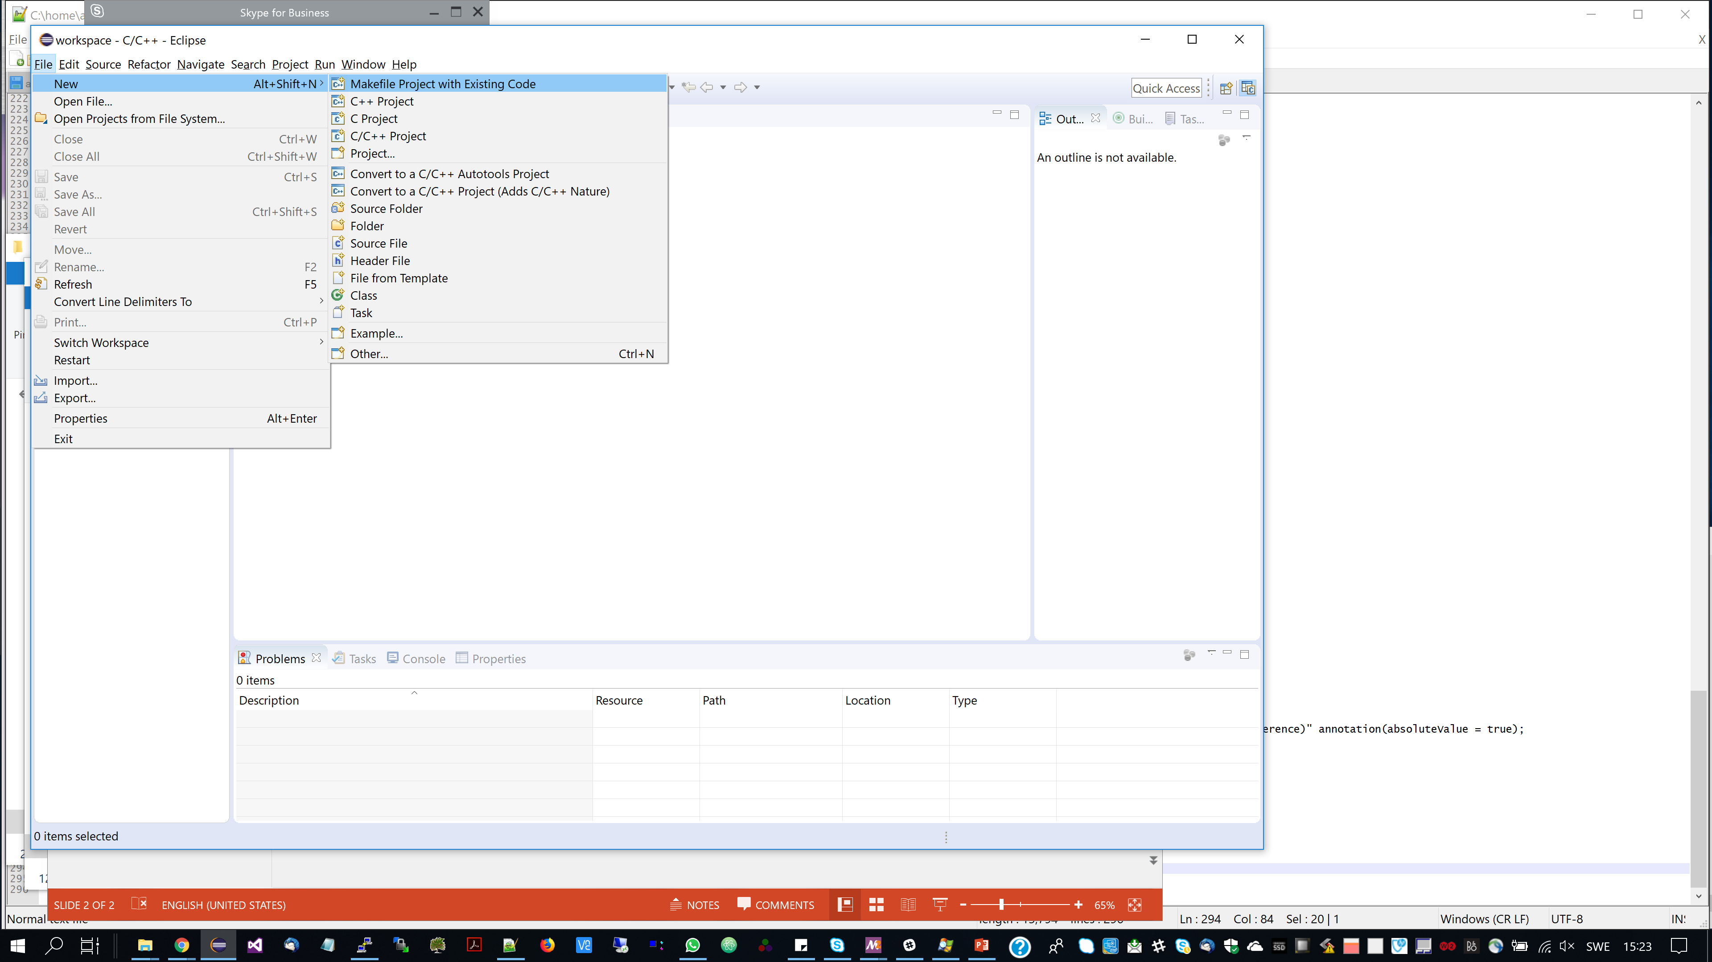

Slide 5
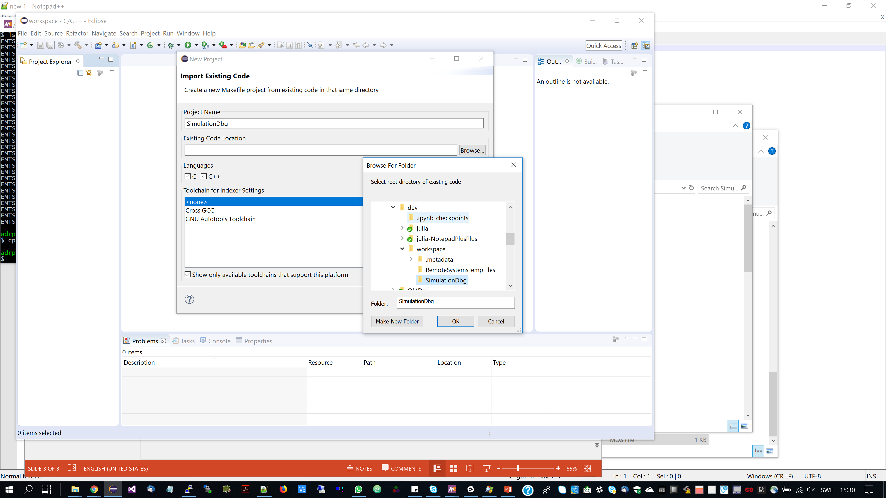

Slide 6
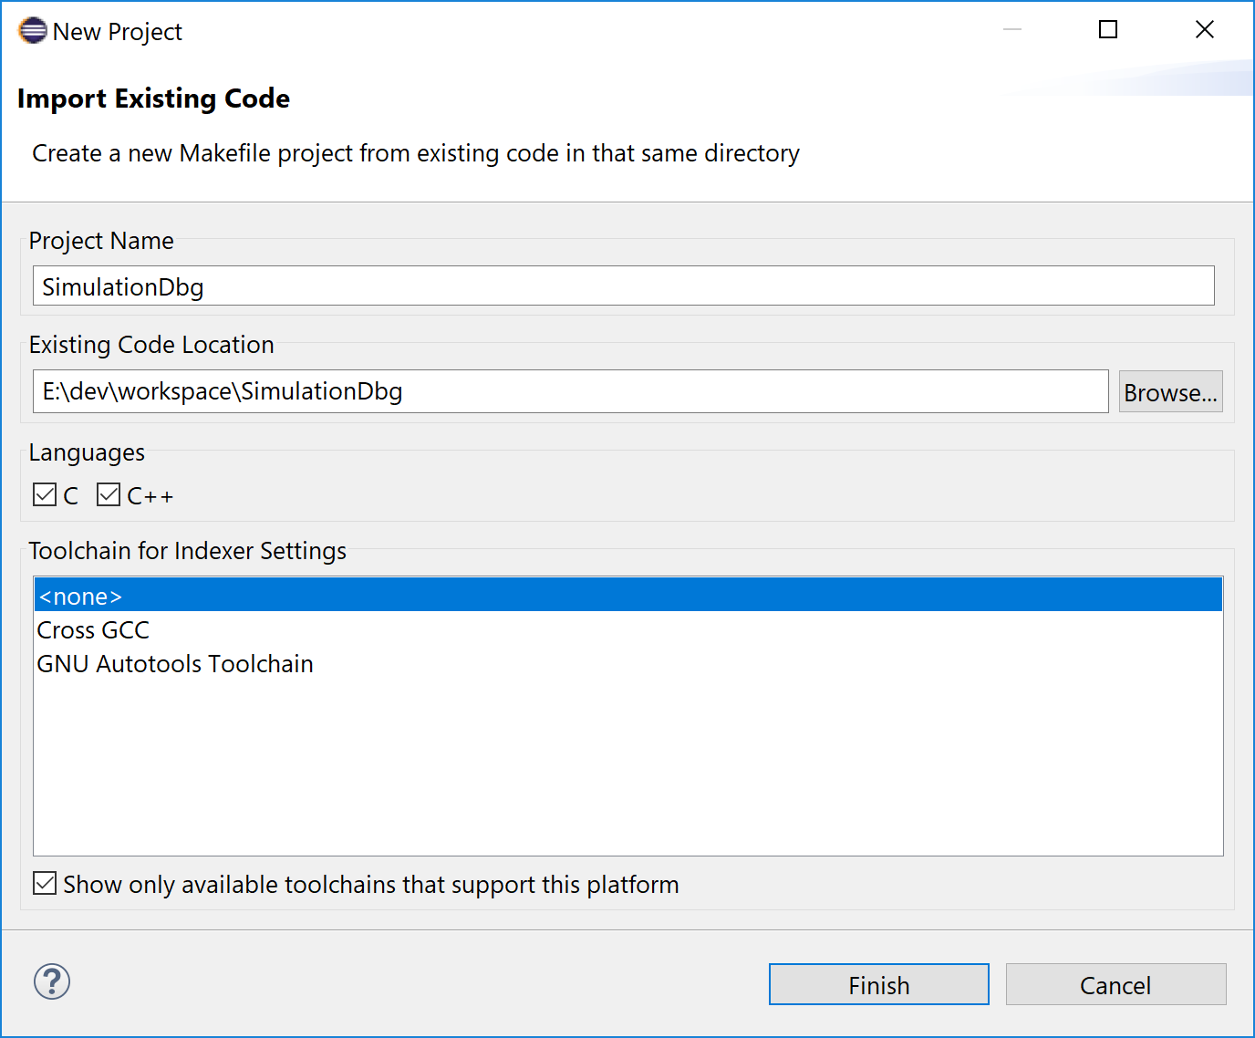

Slide 7
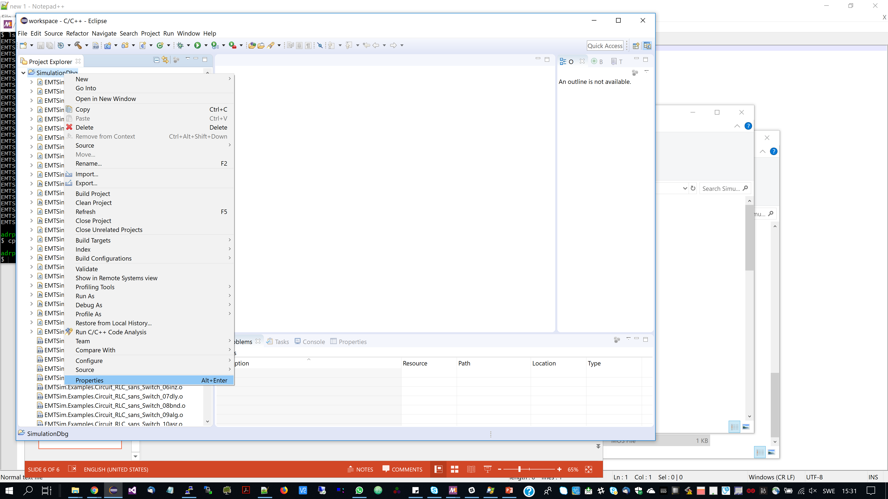

Slide 8
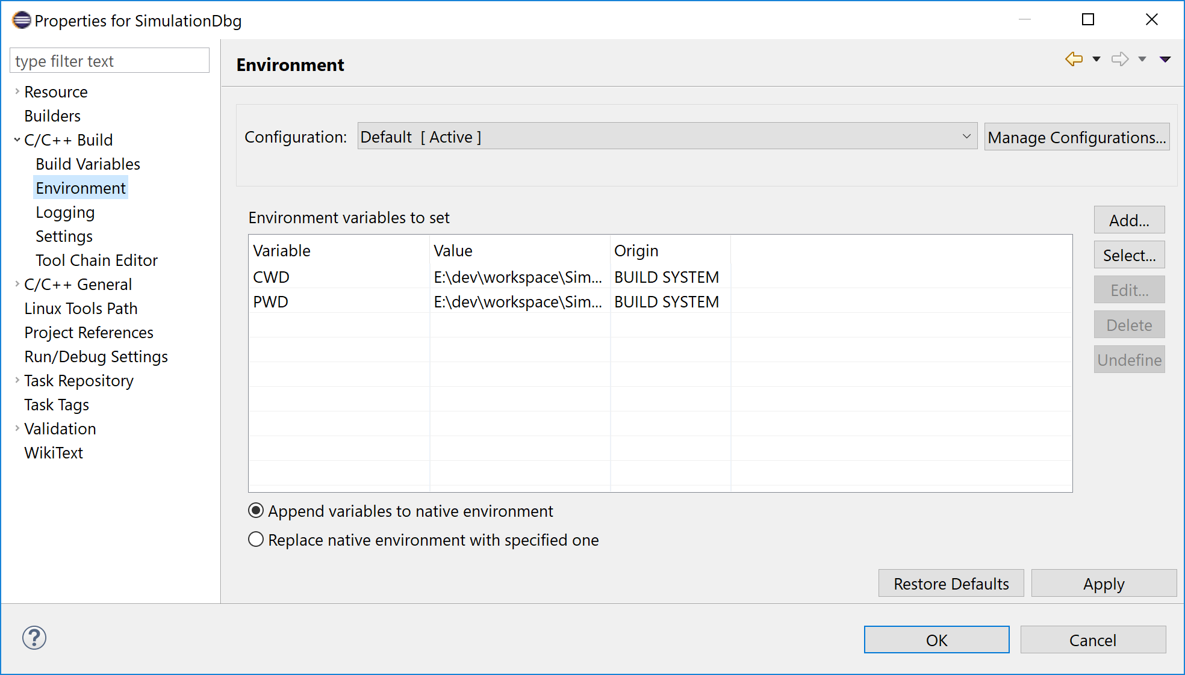

Slide 9
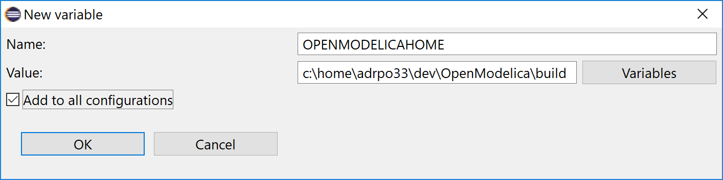
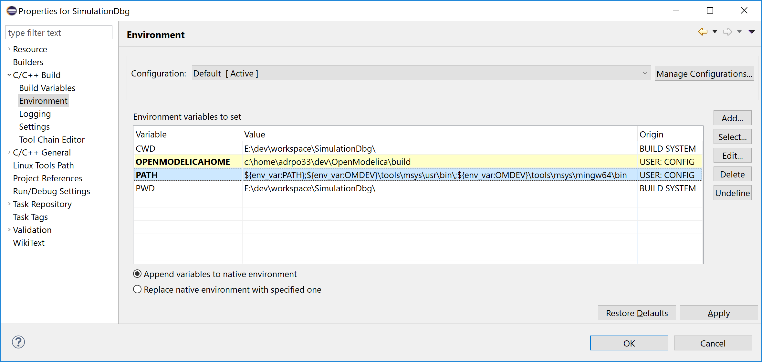
Add environment variables

Slide 10
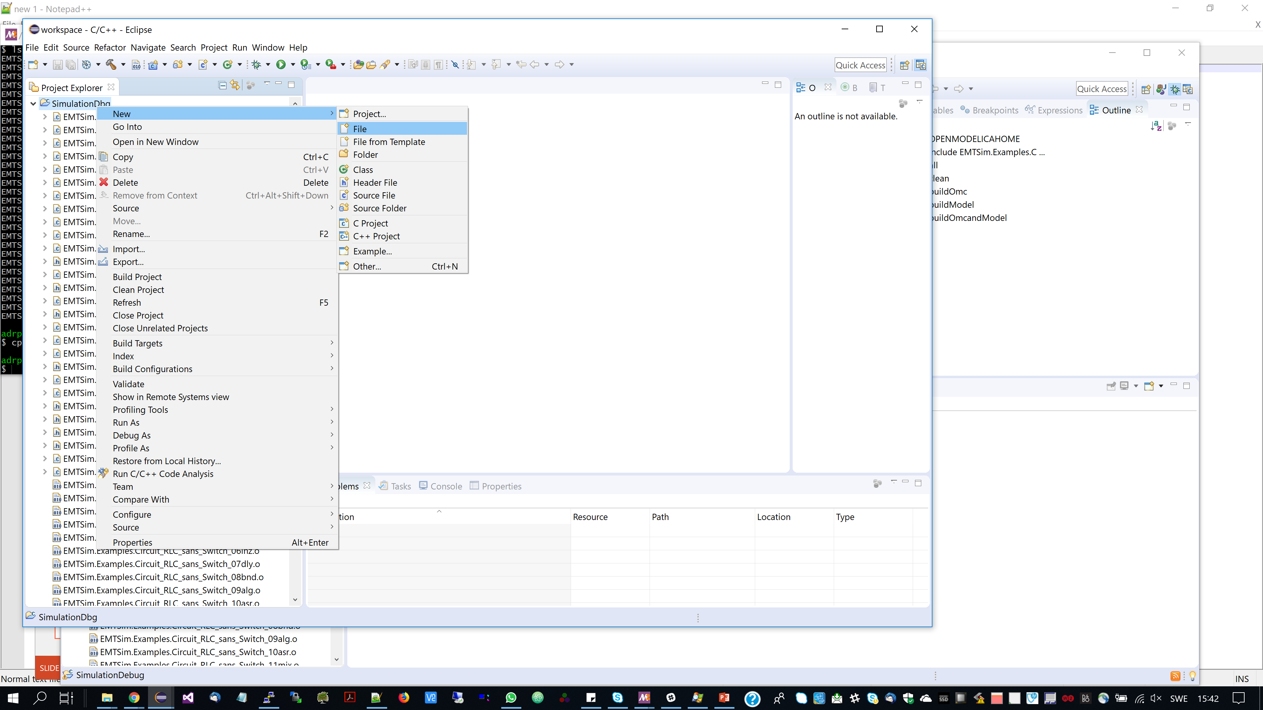

Slide 11
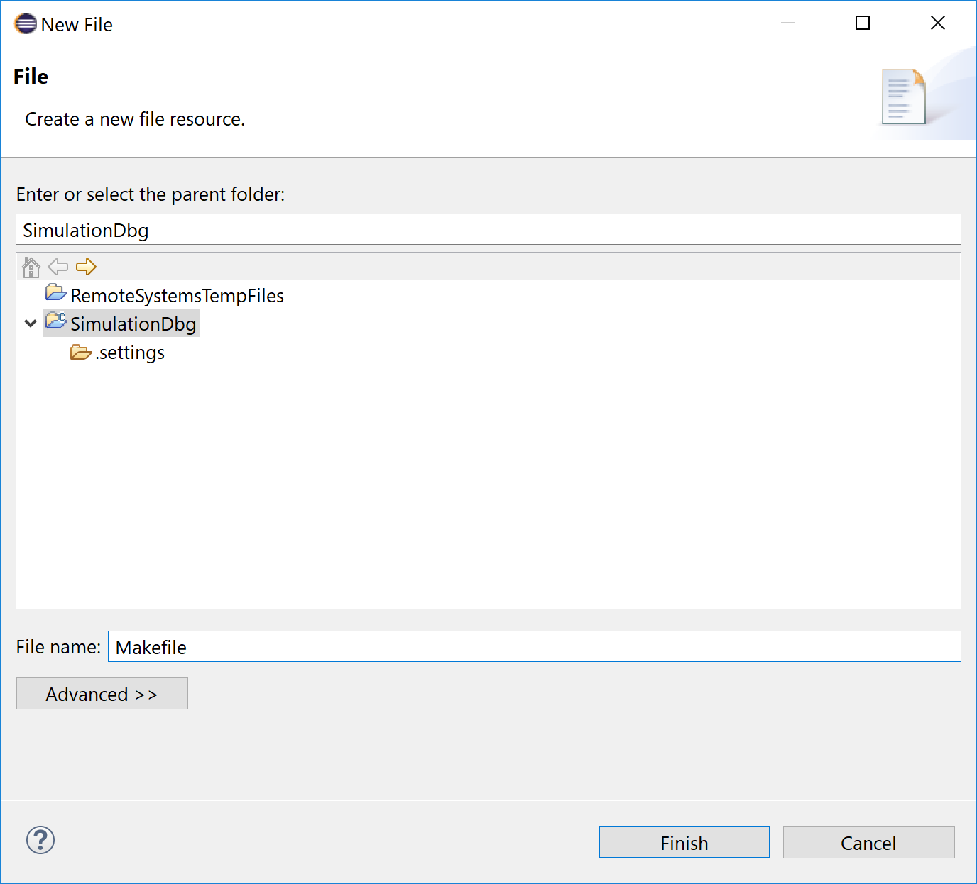

Slide 12
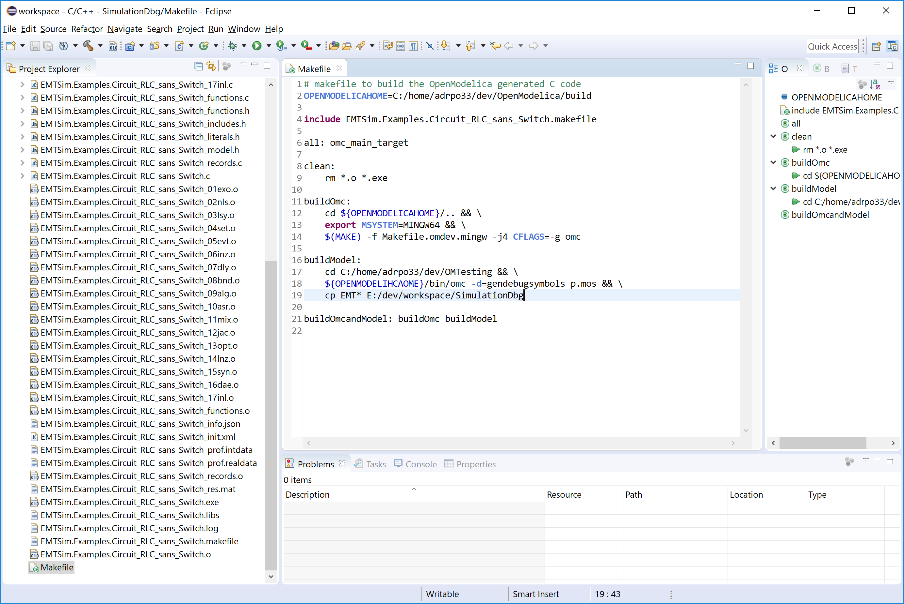
Create Makefile and write the targets

Slide 13
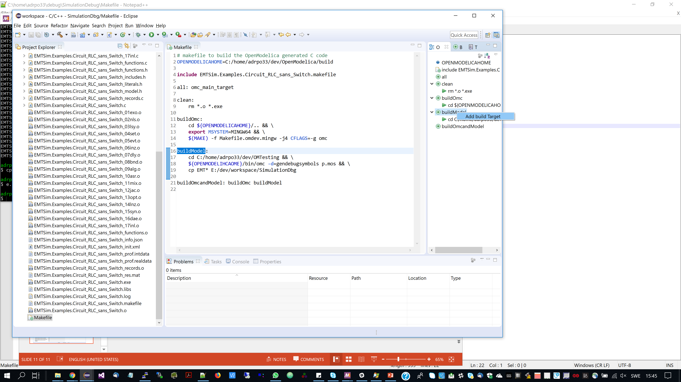
Add buid targets to the project

Slide 14
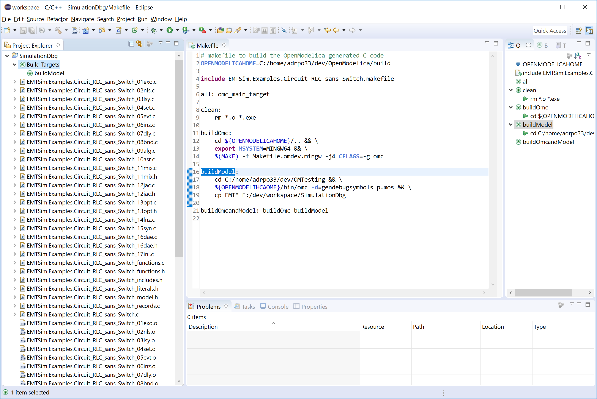

Slide 15
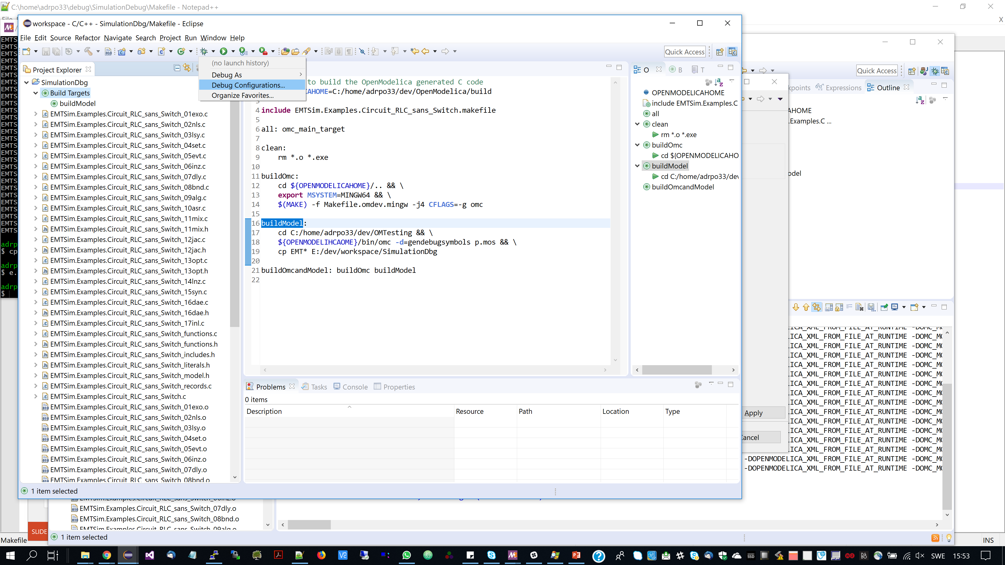
Window->Preferences->C/C++->GDB, uncheck: Use aggressive breakpoint filtering

Slide 16
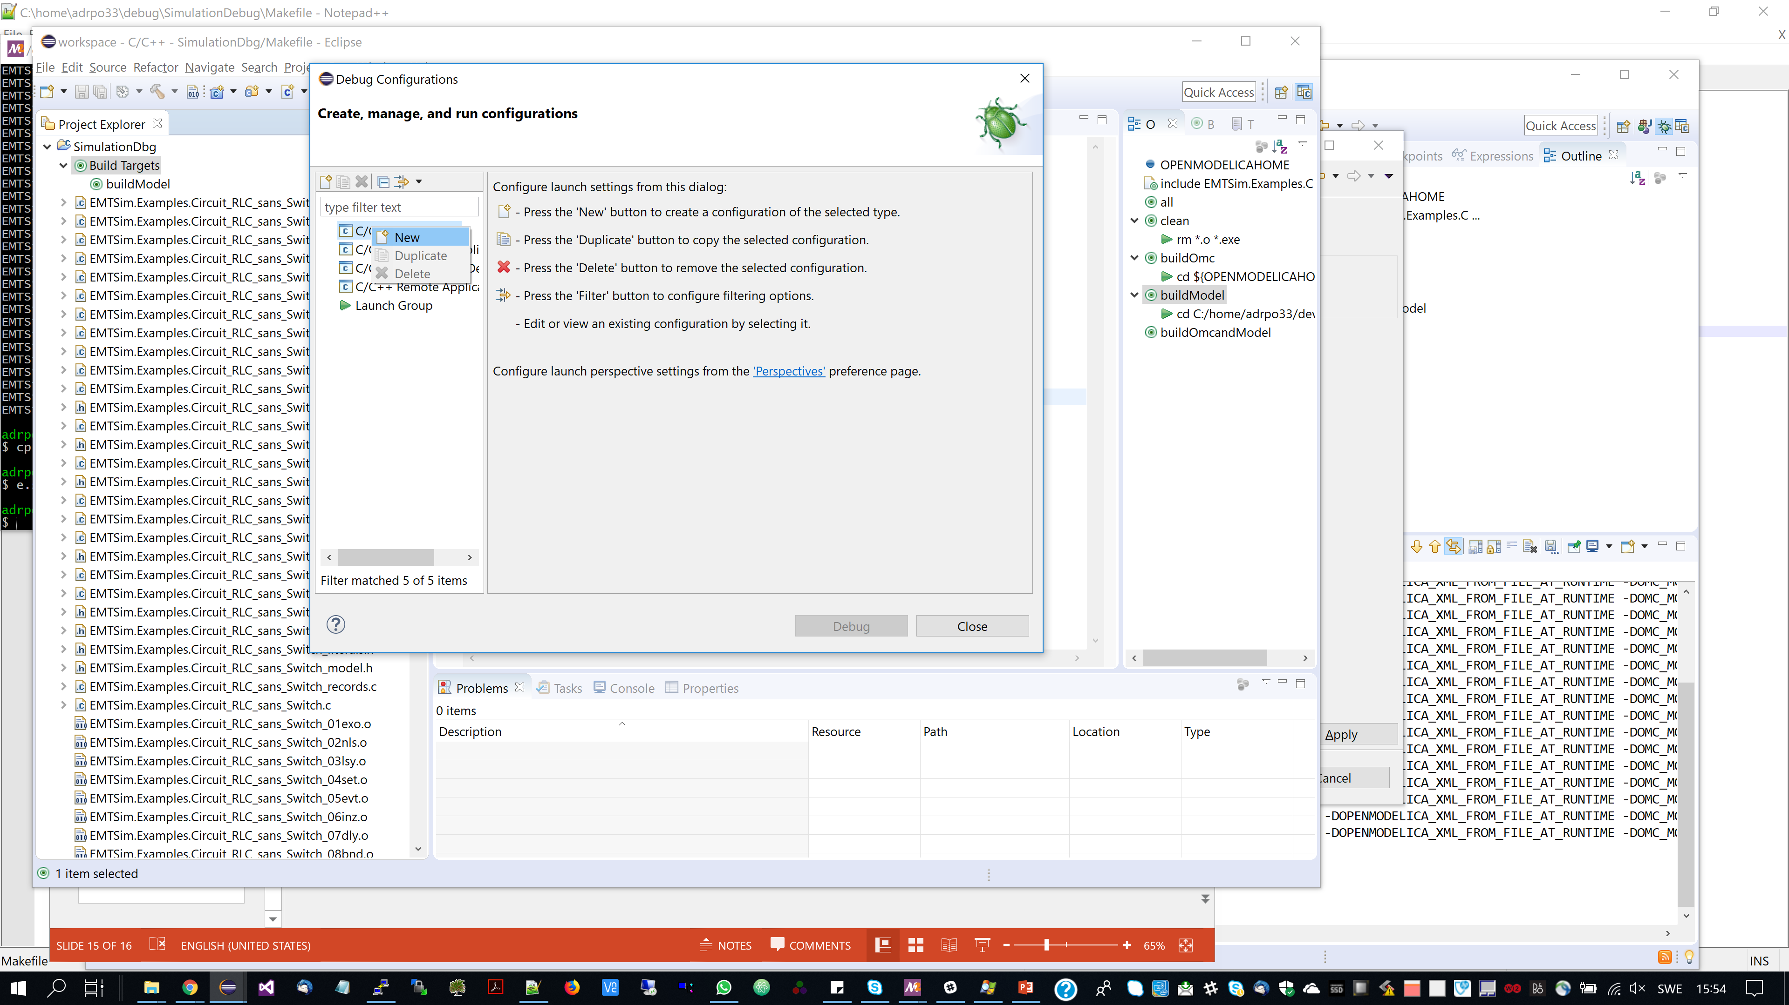

Slide 17
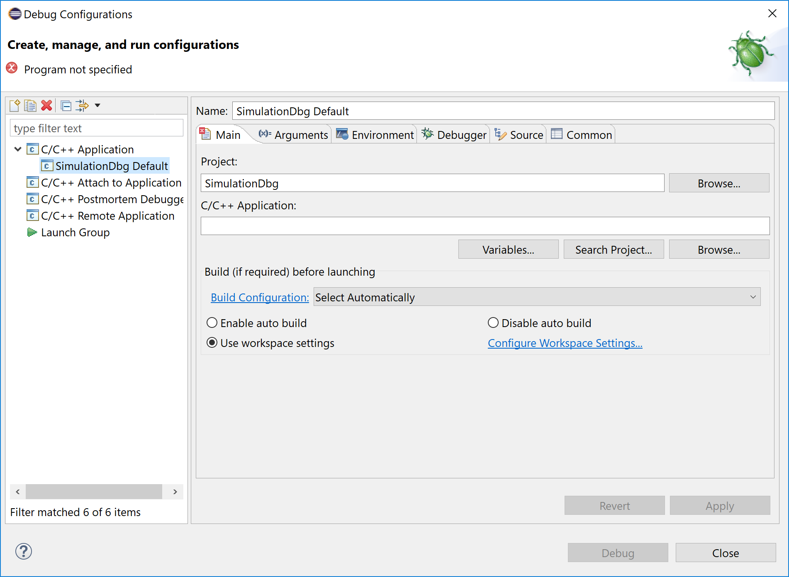

Slide 18
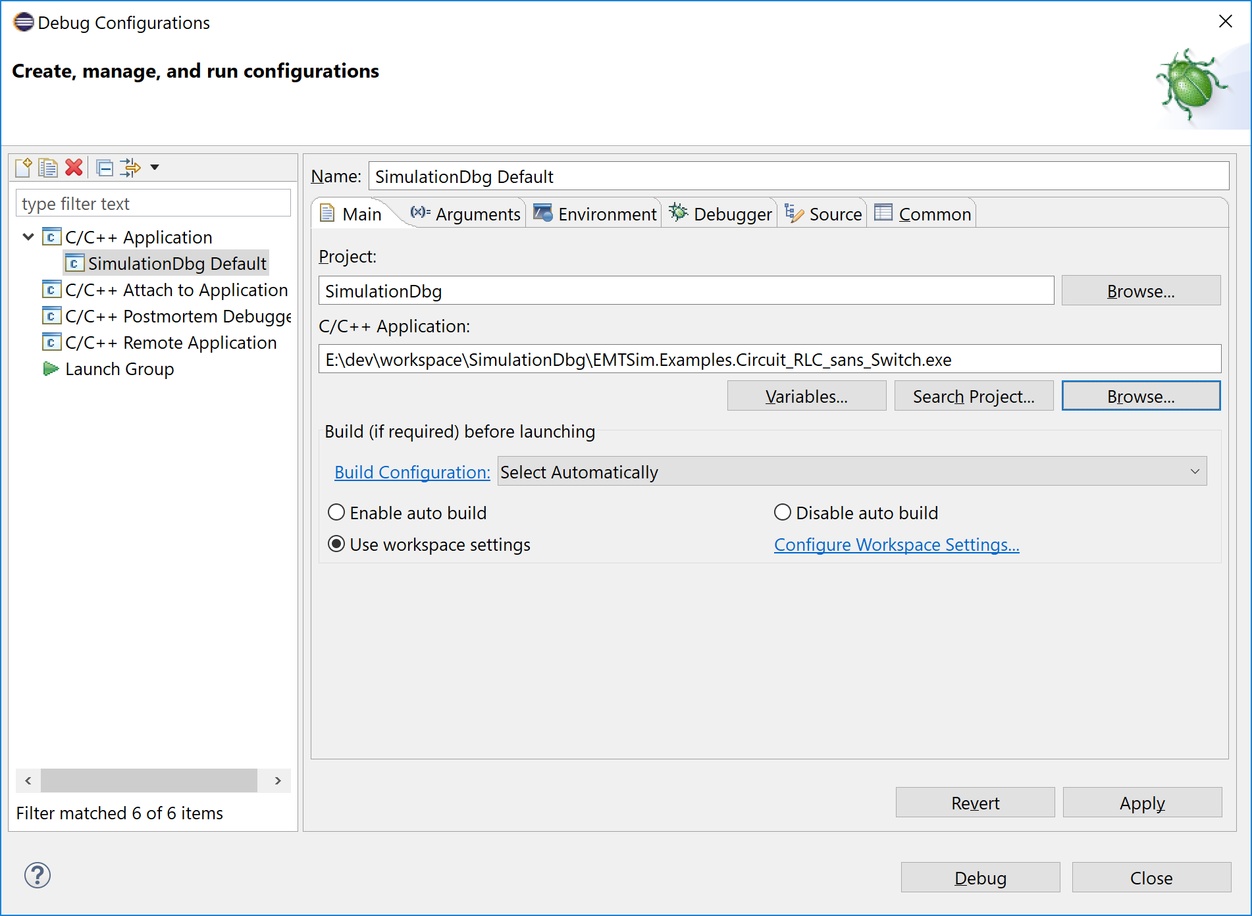

Slide 19
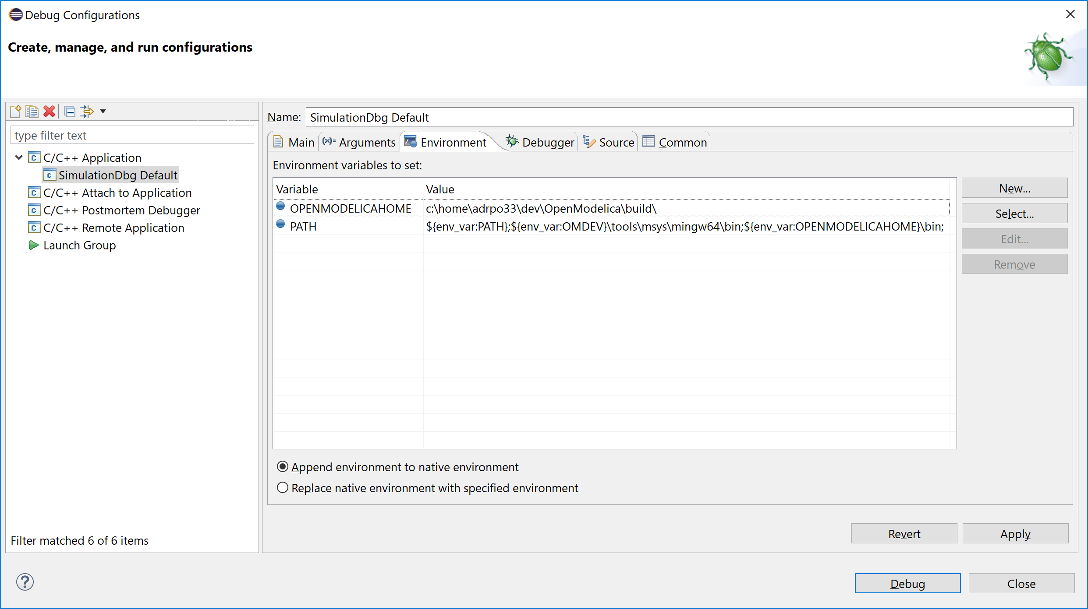

Slide 20
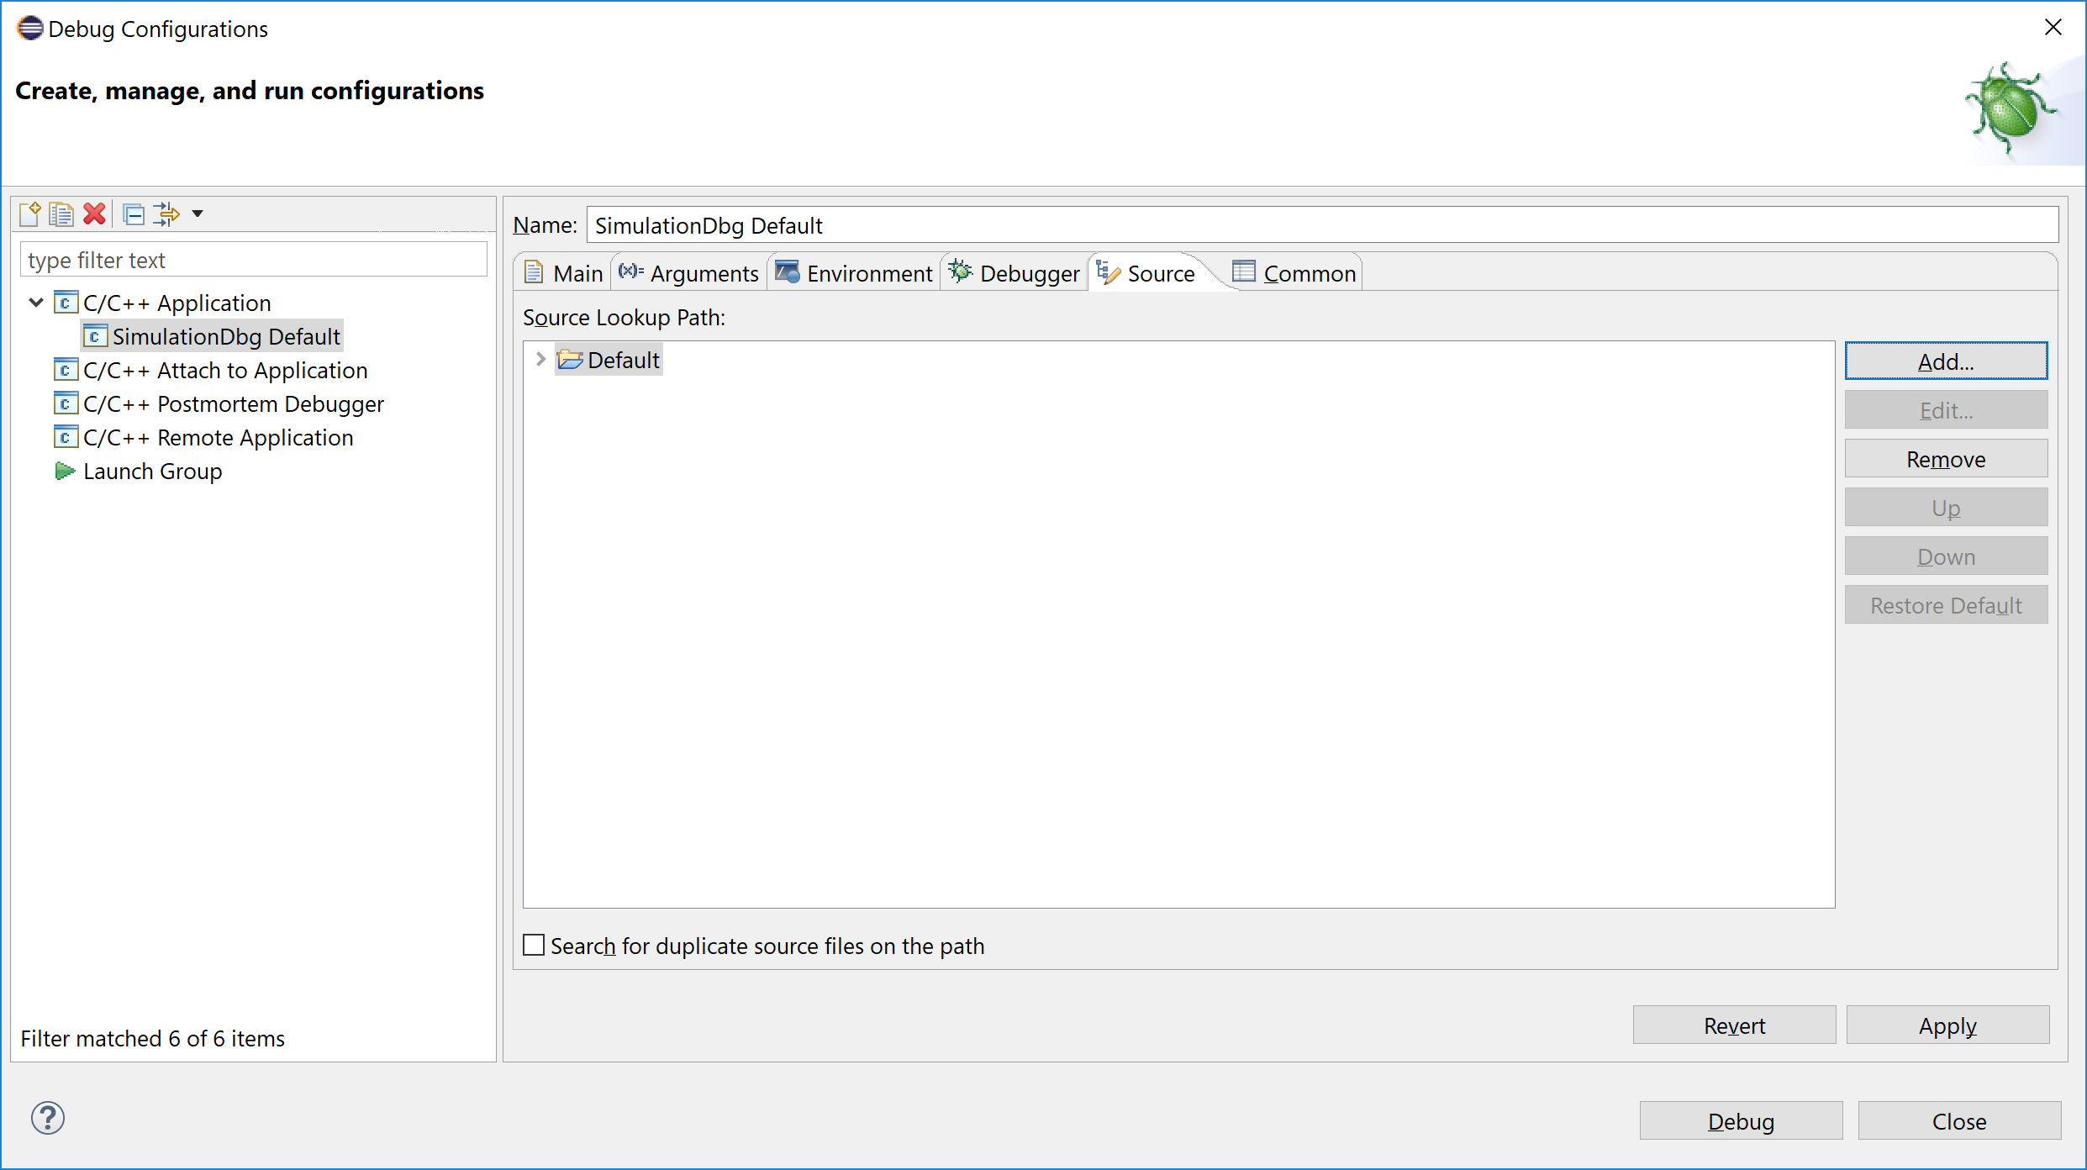
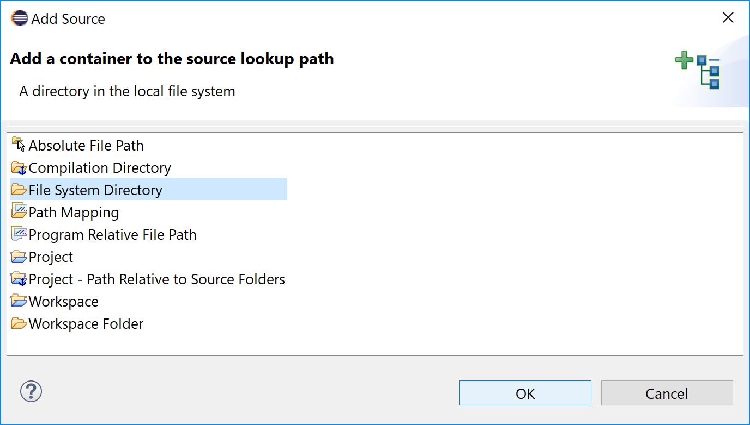

Slide 21
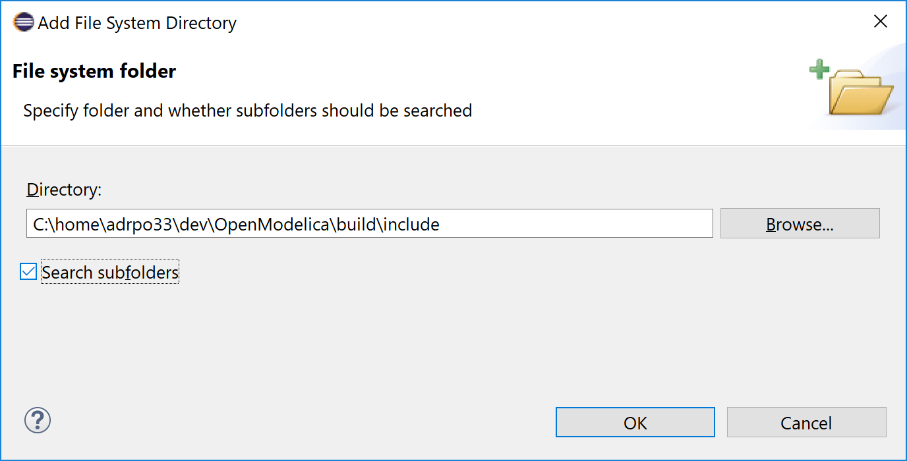

Slide 22
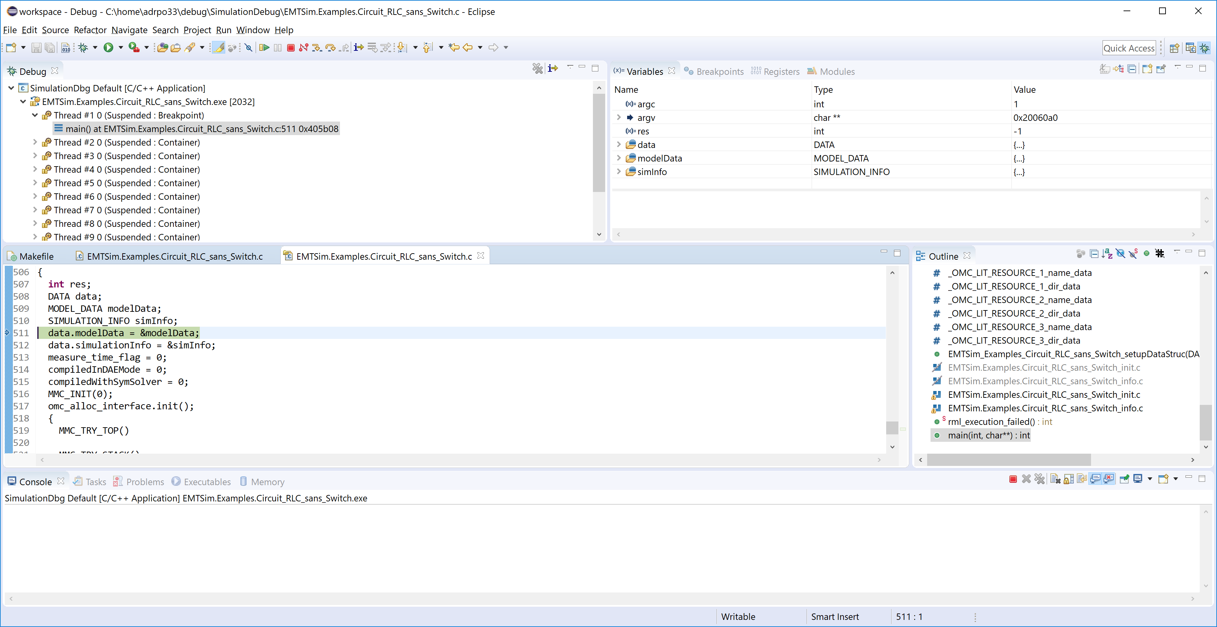

Slide 23
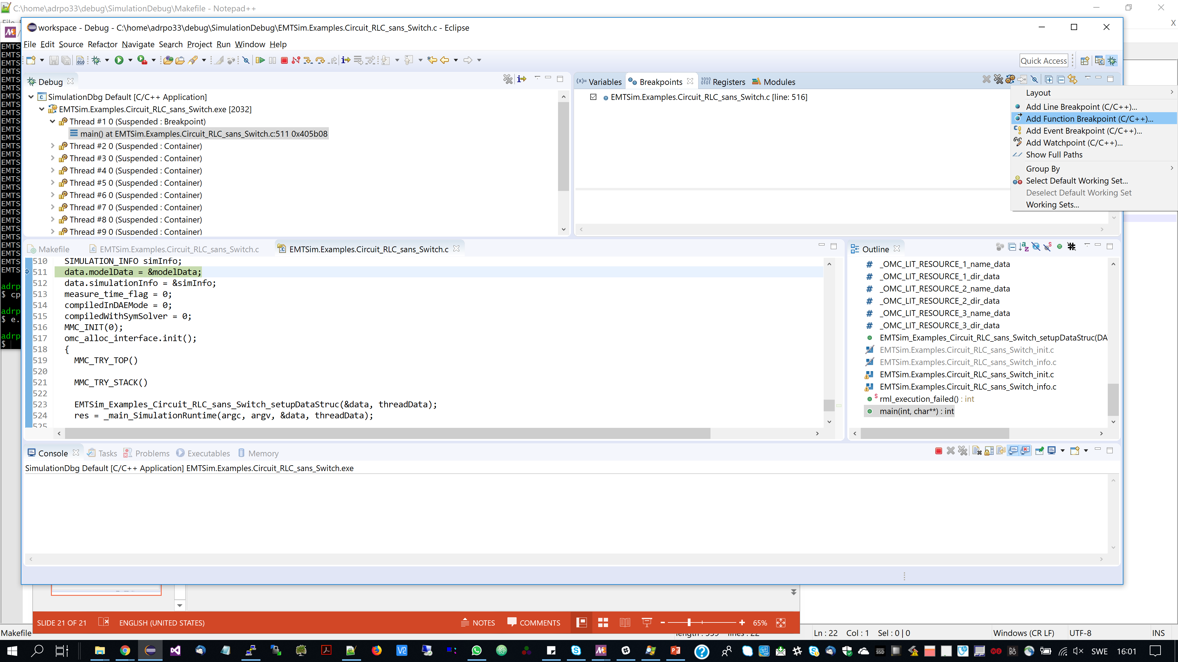
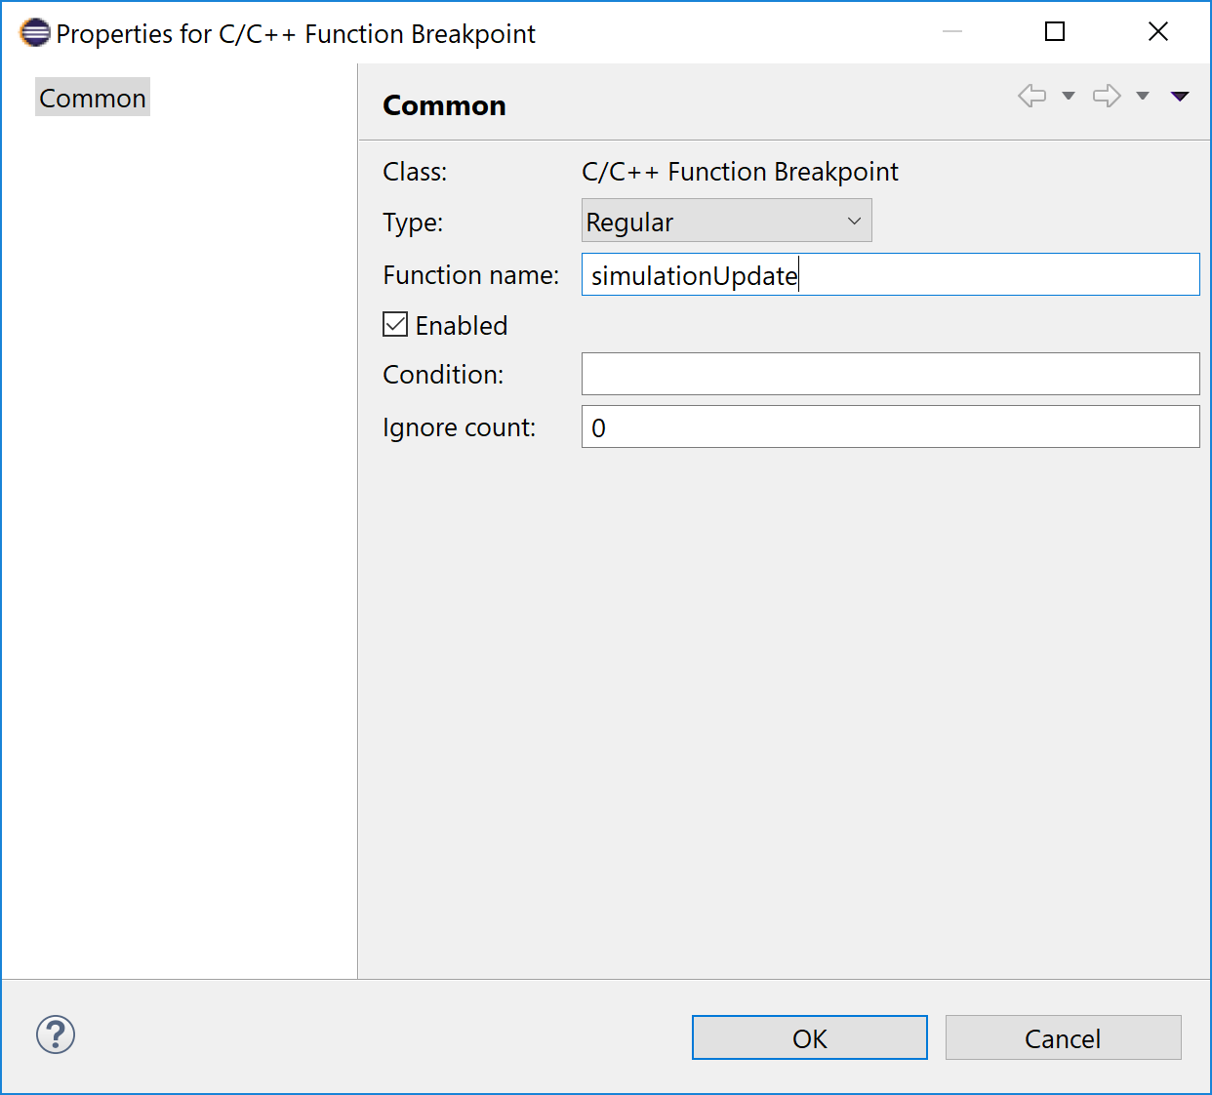

Slide 24
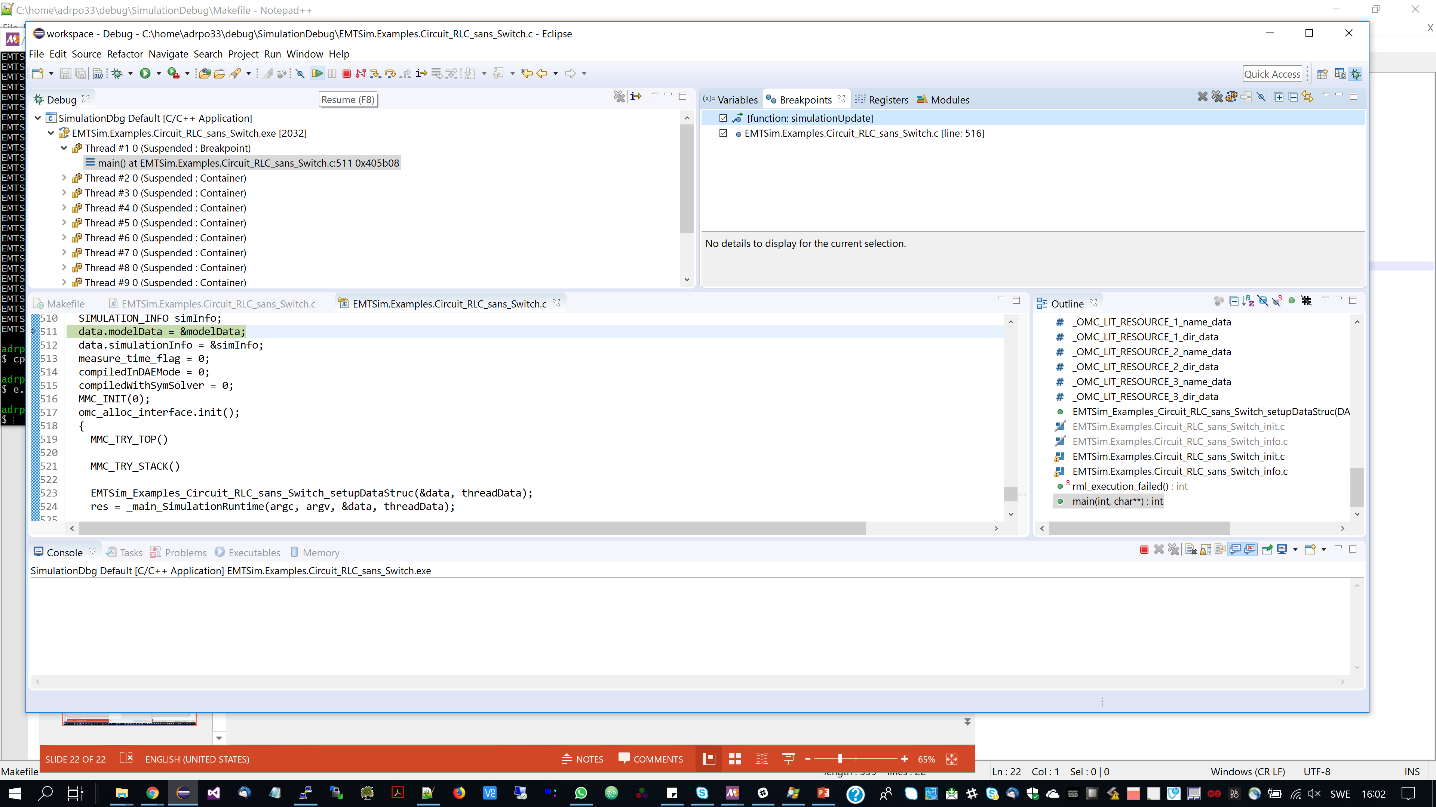

Slide 25
