Slide 1
TDTS21 Advanced Networking
BGP and Inter-domain Routing
(It’s all about the Money)
Based on slides from P. Gill, D. Choffnes, J. Rexford, and A. Feldman
Revised 2015, 2019, 2021 by N. Carlsson

Slide 2
Control plane vs. Data Plane
Control:
  Make sure that if there’s a path available, data is forwarded over it
  BGP sets up such paths at the AS-level
Data:
  For a destination, send packet to most-preferred next hop
  Routers forward data along IP paths

Slide 3
Network Layer, Control Plane
Function:
  Set up routes between networks
Key challenges:
  Implementing provider policies
  Creating stable paths
Data Plane
Application
Transport
Network
RIP
OSPF
BGP
Control Plane
Data Link
Physical

Slide 5



ASs, Revisited
AS-1
AS-3
Interior Routers
AS-2
BGP Routers

Slide 6
AS Numbers
Each AS identified by an ASN number
  16-bit values (latest protocol supports 32-bit ones)
  Some blocks (e.g., 64512 – 65535) are reserved
Currently, there are ~ 100,000 ASNs
  AT&T: 5074, 6341, 7018, …
  Sprint: 1239, 1240, 6211, 6242, …
  LIUNET: 2843 (prefix: 130.236.0.0/16)
  Google 15169, 36561 (formerly YT), + others
  Facebook 32934
  North America ASs → ftp://ftp.arin.net/info/asn.txt

Slide 7
Inter-Domain Routing
Global connectivity is at stake!
  Thus, all ASs must use the same protocol
  Contrast with intra-domain routing
What are the requirements?
  Scalability
  Flexibility in choosing routes
    Cost
    Routing around failures
Question: link state or distance vector?
  Trick question: BGP is a path vector protocol

Slide 8
BGP
Border Gateway Protocol
  De facto inter-domain protocol of the Internet
  Policy based routing protocol
  Uses a Bellman-Ford path vector protocol
Relatively simple protocol, but…
  Complex, manual configuration
  Entire world sees advertisements
    Errors can screw up traffic globally
  Policies driven by economics
    How much $$$ does it cost to route along a given path?
    Not by performance (e.g. shortest paths)

Slide 9
BGP Relationships
Provider
Peer 2 has no incentive to route 1→ 3
Peers do not pay each other
$
Customer
Provider
Customer
Peer 1
Peer 2
Peer 3
Customer pays provider
Customer

Slide 10
Tier-1 ISP Peering
Inteliquent
Centurylink
Verizon Business
AT&T
So you want to be a tier 1 network?
All you have to do is get all the other tier 1s to peer with you!
(not that easy ☺)
Level 3
Sprint
XO Communications

Slide 11
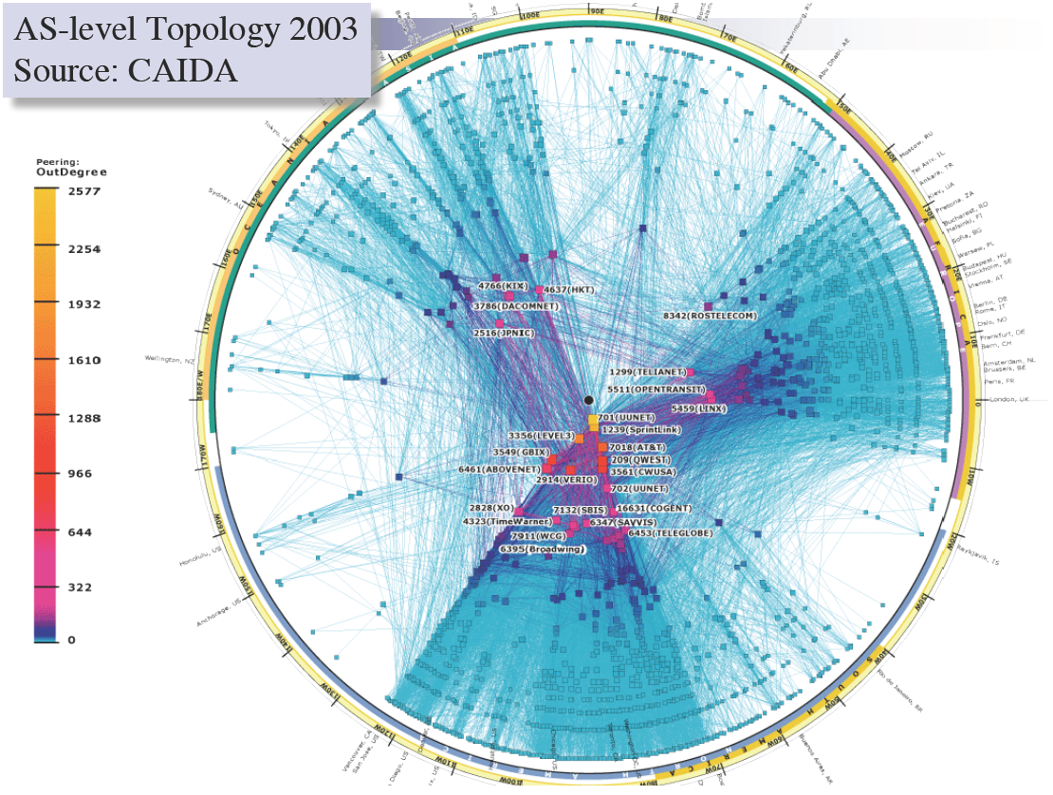

Slide 12
Peering Wars
Peer
Don’t Peer
Reduce upstream costs
Improve end-to-end performance
May be the only way to connect to parts of the Internet
You would rather have customers
Peers are often competitors
Peering agreements require periodic renegotiation
Peering struggles in the ISP world are extremely contentious agreements are usually confidential
Example: If you are a customer of my peer why should I peer with you? You should pay me too!
Incentive to keep relationships private!

Slide 13
Two Types of BGP Neighbors
Exterior routers also speak IGP
IGP
eBGP
eBGP
iBGP
iBGP

Slide 14
Full iBGP Meshes
Question: why do we need iBGP?
  OSPF does not include BGP policy info
  Prevents routing loops within the AS
iBGP updates do not trigger announcements
eBGP
iBGP

Slide 15
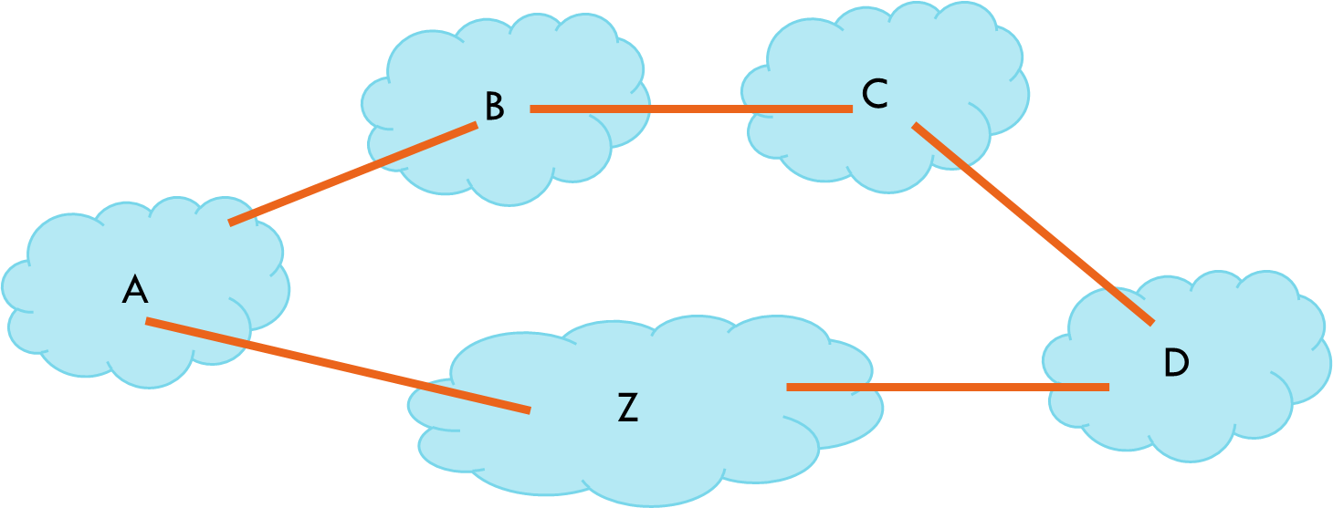

Border Gateway Protocol
ASes exchange info about who they can reach
  IP prefix: block of destination IP addresses
  AS path: sequence of ASes along the path
Policies configured by the AS’s operator
  Path selection: which of the paths to use?
  Path export: which neighbors to tell?
“12.34.158.0/24:
path (2,1)”
“12.34.158.0/24:
path (1)”
3
2
1
data traffic
data traffic
12.34.158.5

Slide 16
Path Vector Protocol
AS-path: sequence of ASs a route traverses
  Like distance vector, plus additional information
  Used for loop detection and to apply policy
  E.g., pick cheapest/shortest path
Routing done based on longest prefix match
AS 4
120.18.0.0/16
AS 3
130.18.0.0/16
AS 5
AS 2
110.18.0.0/16
120.18.0.0/16: AS 2 → AS 3 → AS 4
130.18.0.0/16: AS 2 → AS 3
110.18.0.0/16: AS 2 → AS 5
AS 1

Slide 17
BGP Operations (Simplified)
Establish session on TCP port 179
AS-1
Exchange active routes
BGP Session
AS-2
Exchange incremental updates

Slide 18
Four Types of BGP Messages
Open: Establish a peering session.
Keep Alive: Handshake at regular intervals.
Notification: Shuts down a peering session.
Update: Announce new routes or withdraw previously announced routes.
announcement = IP prefix + attributes values

Slide 19
Applying Policy to Routes
Import policy
  Q: What route advertisements do I accept?
  Filter unwanted routes from neighbor
    E.g. prefix that your customer doesn’t own
  Manipulate attributes to influence path selection
    E.g., assign local preference to favored routes
Export policy
  Q: Which routes do I forward to whom?
  Filter routes you don’t want to tell your neighbor
    E.g., don’t tell a peer a route learned from other peer
  Manipulate attributes to control what they see
    E.g., make a path look artificially longer than it is

Slide 20
BGP Policy: Influencing Decisions
Open ended programming.
Constrained only by vendor configuration language
Receive
BGP
Updates
Apply Policy =
filter routes &
tweak attributes
Based on
Attribute
Values
Apply Policy =
filter routes &
tweak attributes
Transmit
BGP
Updates
Best
Routes
Apply Import
Policies
Best Route
Selection
Best Route
Table
Apply Export
Policies
Install forwarding
Entries for best
Routes.
IP Forwarding Table

Slide 21
Routing Policies
Economics
  Enforce business relationships
  Pick routes based on revenue and cost
  Get traffic out of the network as early as possible
Traffic engineering
  Balance traffic over edge links
  Select routes with good end-to-end performance
Security and scalability
  Filter routes that seem erroneous
  Prevent the delivery of unwanted traffic
  Limit the dissemination of small address blocks

Slide 22
Route Selection Summary
Highest Local Preference
Enforce relationships
Shortest AS Path
Lowest MED
Traffic engineering
Lowest IGP Cost to BGP Egress
When all else fails,
break ties
Lowest Router ID

Slide 23
Shortest AS Path != Shortest Path
4 hops
4 ASs
9 hops
2 ASs
Source
?
?
Destination

Slide 24
Hot Potato Routing
Pick the next hop with the shortest IGP route
Source
?
?
Destination

Slide 25
Importing Routes
From Provider
ISP Routes
From Peer
From Peer
From Customer

Slide 26
Exporting Routes
$$$ generating routes
Customer and ISP routes only
To Provider
To Peer
To Peer
To Customer
Customers get all routes

Slide 27

Modeling BGP
AS relationships
  Customer/provider
  Peer
  Sibling, IXP
Gao-Rexford model
  AS prefers to use customer path, then peer, then provider
    Follow the money!
  Valley-free routing
  Hierarchical view of routing (incorrect but frequently used)
P-P
P-P
C-P
P-C
P-C
P-P

Slide 28
AS Relationships: It’s Complicated
GR Model is strictly hierarchical
  Each AS pair has exactly one relationship
  Each relationship is the same for all prefixes
In practice it’s much more complicated
  Rise of widespread peering
  Regional, per-prefix peerings
  Tier-1’s being shoved out by “hypergiants”
  IXPs dominating traffic volume
Modeling is very hard, very prone to error
  Huge potential impact for understanding Internet behavior

Slide 30
BGP: The Internet’s Routing Protocol
A simple model of AS-level business relationships.
$
$
ISP 1
(peer)
ISP 1
Level 3
(peer)
Level 3
Stub
(customer)
$
stub
Verizon
Wireless
ISP 2
(provider)
ISP 2
$
$
22394
(also VZW)
Notes:
In this work we look at issues relating to security of routing on the internet, but first lets see what we mean when we talk about routing.
In this work we focus on routing between autonomous systems on the internet. So you can think of autonomous systems as the network run by an organization. So for example, AT&T’s network might be one autonomous system and the university of toronto’s network is another autonomous system.
Say the prefix is a block of ip addresses
Define AS
This topology corresponds to:
Large ISP 1 = ATT
Large ISP 2 = NTT
Verizon wireless is really “6167 --- 22394”
We have routeviews announcements for ATT and NTT below
======================= ATT = “Large ISP 1” FIXES THINGS ==============
updates.20100408.1600.lines: | TIME: 04/08/10 12:02:49 | TYPE: BGP4MP/MESSAGE/Update | FROM: 12.0.1.63 AS7018 | TO: 128.223.51.102 AS6447 | ORIGIN: IGP | ASPATH: 7018 3356 6167 22394 22394 | NEXT_HOP: 12.0.1.63 | COMMUNITY: 7018:5000 | ANNOUNCE | 72.103.0.0/19 | 166.180.96.0/19 | 66.174.161.0/24 | 166.180.115.0/24 | 166.153.208.0/20 | 166.180.119.0/24 | 166.153.38.0/24 | 166.145.112.0/20 | 166.145.118.0/24 | 166.145.48.0/24 | 70.203.128.0/20 | 166.145.16.0/24 | 166.180.192.0/19 | 166.145.22.0/24 | 70.201.0.0/19 | 70.204.128.0/20 | 151.144.43.0/24 | 151.144.144.0/24 | 166.145.44.0/24 | 166.153.40.0/24 | 66.174.56.0/24 | 166.180.193.0/24 | 151.144.95.0/24 | 166.145.117.0/24 | 70.205.0.0/18 | 70.200.128.0/19 | 166.145.12.0/24 | 166.145.116.0/24 | 151.144.46.0/24 | 166.180.240.0/24 | 166.153.33.0/24 | 72.103.32.0/20 | 70.205.192.0/19 | 166.153.176.0/24 | 166.153.36.0/24 | 166.145.54.0/24 | 166.180.224.0/24 | 166.180.225.0/24 | 166.180.249.0/24 | 166.180.243.0/24 | 166.180.195.0/24 | 166.180.251.0/24 | 166.180.230.0/24 | 166.180.229.0/24 | 166.180.197.0/24 | 166.180.234.0/24 | 166.180.250.0/24 | 166.180.235.0/24 | 166.180.233.0/24 | 166.180.245.0/24 | 166.180.226.0/24 | 166.180.227.0/24 | 166.180.242.0/24 | 166.180.241.0/24 | 166.180.238.0/24 | 166.180.194.0/24 | 166.180.246.0/24 | 166.180.196.0/24 | 151.144.47.0/24
And
================== NTT = “Large ISP 2” fixes things
updates.20100408.1549.lines: | TIME: 04/08/10 11:58:59 | TYPE: BGP4MP/MESSAGE/Update | FROM: 195.66.224.138 AS2914 | TO: 195.66.225.222 AS6447 | ORIGIN: IGP | ASPATH: 2914 3356 6167 22394 22394 | NEXT_HOP: 195.66.224.138 | MULTI_EXIT_DISC: 5 | COMMUNITY: 2914:420 2914:2201 2914:3200 65504:3356 | ANNOUNCE | 66.174.161.0/24 | 66.174.56.0/24

Slide 31
BGP: The Internet’s Routing Protocol (2)
  A stub is an AS with no customers that never transits traffic.
  (Transit = carry traffic from one neighbor to another)
$
ISP 1
  ISP
Level 3
  ISP
stub
Loses $
X
Verizon
Wireless
ISP 2
$
22394
  85% of ASes are stubs!
  We call the rest (15%) ISPs.
Notes:
In this study we distinguish between two different types of autonomous systems. The first are stubs that do not transit traffic. So forexample the stub in the slide here would not transit traffic between its two provider Ases because it would lose money in doing so. For stubs you can think of Internet as a cost, like electricity rather than a source of income. The second type of ASes are ISPs that transit traffic for other autonomous systems. For these Ases transiting traffic is a source of revenue and profit.

Slide 32
BGP: The Internet’s Routing Protocol (3)
  BGP sets up paths from ASes to destination IP prefixes.
ISP1, Level3, VZW, 22394
66.174.161.0/24
Level3, VZW, 22394 66.174.161.0/24
$
ISP 1
VZW, 22394 66.174.161.0/24
Level 3
stub
Verizon
Wireless
ISP 2
$
ISP2, Level3, VZW, 22394 66.174.161.0/24
22394
(also VZW)
A model of BGP routing policies:
Prefer cheaper paths. Then, prefer shorter paths.
Notes:
Say the prefix is a block of ip addresses
Define AS

Slide 33
Standard model of Internet routing
Proposed by Gao & Rexford 20 years ago
Based on practices employed by a large ISP
Provide an intuitive model of path selection and export policy

Slide 34
Standard model of Internet routing
Proposed by Gao & Rexford 20 years ago
Customer
Path Selection:
1. LocalPref: Prefer customer paths
over peer paths
over provider paths
2. Prefer shorter paths
3. Arbitrary tiebreak
$
$
Peer
ISP
$
Provider

Slide 35
Standard model of Internet routing
Proposed by Gao & Rexford 20 years ago
Provider
Path Selection:
1. LocalPref: Prefer customer paths
over peer paths
over provider paths
2. Prefer shorter paths
3. Arbitrary tiebreak
Announcements
$
ISP
$
$
Export Policy:
Export customer path
  to all neighbors.
Export peer/provider path
to all customers.
Provider
Customer

Slide 36
Standard model of Internet routing
Proposed by Gao & Rexford 20 years ago
Provider
Path Selection:
1. LocalPref: Prefer customer paths
over peer paths
over provider paths
2. Prefer shorter paths
3. Arbitrary tiebreak
Announcements
$
ISP
$
$
Export Policy:
Export customer path
  to all neighbors.
Export peer/provider path
to all customers.
Provider
Customer

Slide 37
BGP-related Hijacks
AS 22394
  Normal operation
  Origin AS announces prefix
  Route announcements propagate between ASes
  Helps ASes learn about “good” paths to reach prefix
66.174.0.0/16
Notes:
Routing attacks are possible due to some inherent security issues with this protocol. It is difficult to check true ownership of prefixes. And gives rise to different types of attack.
I will give a basic introduction about BGP so that it helps in understanding the policies that we propose and evaluation of those policies.
Internet is made up of thousands of networks that connect each other. Consider a example in this figure.
Suppose Level3 wants to send the traffic to prefix 66.174.0.0./16. It should know that the prefix is assigned to AS 22394 and it should also know path along which the data can be send. This reachability information can be spread through BGP protocol.
AS 22394 sends the announcement to Verizon wireless that this prefix is assigned to me. Verizon wireless appends its AS number and sends the update to Level 3. Level 3 now knows that it can reach AS 22394 using the path through Verizon wireless.
One attack is prefix hijack attack. For example, china telecom can announce the prefix that is assigned to AS 22394. Now ISP1 has two paths and two different distinations for the same prefix. It might choose apparent shorter path to china telecom and send the traffic to it. And this is simple prefix hijack attack. Note that it is possible that ISP1 might not have chosen to route to china telecom if this path was not shorter. Such 50k prefixes were announced by the china telecom during the incident.
More harmful form of attack in subprefix hijack attack. In this case, china telecom can announce more specific prefix that is covered by the prefix assigned to As 22394.
If there is traffic for the prefix range announced by china telecom , it will be routed to china telecom because it has longest prefix length .
Even more harmful is the case where china telecom is able to reroute the traffic back to AS 22394. These cases are harder to detect. And such interception cases were also observed during the china telecom incident. So we have also analyzed such interception cases that were observed during the china telecom incident.
And even more harmful attack would be interception attack. In this case, a network is able to attract the data towards itself , store it for future analysis, and then reroute the data back to original owner.
We will use the public data available around the data when china telecom incident occurred to evaluate the system that we propose.
I also want to bring forth the point that the attack is possible not because of some vulnerability in BGP or weak security defenses of AS 22394. But it is because of the decisions made by AS ISP1 which are purely based on trust among the ASes. Thus, collaboration is an important aspect that can help detect such routing anomalies.

Slide 38
BGP-related Hijacks
Verizon
Wireless
AS X
AS 22394
  Normal operation
  Origin AS announces prefix
  Route announcements propagate between ASes
  Helps ASes learn about “good” paths to reach prefix
66.174.0.0/16
Notes:
Routing attacks are possible due to some inherent security issues with this protocol. It is difficult to check true ownership of prefixes. And gives rise to different types of attack.
I will give a basic introduction about BGP so that it helps in understanding the policies that we propose and evaluation of those policies.
Internet is made up of thousands of networks that connect each other. Consider a example in this figure.
Suppose Level3 wants to send the traffic to prefix 66.174.0.0./16. It should know that the prefix is assigned to AS 22394 and it should also know path along which the data can be send. This reachability information can be spread through BGP protocol.
AS 22394 sends the announcement to Verizon wireless that this prefix is assigned to me. Verizon wireless appends its AS number and sends the update to Level 3. Level 3 now knows that it can reach AS 22394 using the path through Verizon wireless.
One attack is prefix hijack attack. For example, china telecom can announce the prefix that is assigned to AS 22394. Now ISP1 has two paths and two different distinations for the same prefix. It might choose apparent shorter path to china telecom and send the traffic to it. And this is simple prefix hijack attack. Note that it is possible that ISP1 might not have chosen to route to china telecom if this path was not shorter. Such 50k prefixes were announced by the china telecom during the incident.
More harmful form of attack in subprefix hijack attack. In this case, china telecom can announce more specific prefix that is covered by the prefix assigned to As 22394.
If there is traffic for the prefix range announced by china telecom , it will be routed to china telecom because it has longest prefix length .
Even more harmful is the case where china telecom is able to reroute the traffic back to AS 22394. These cases are harder to detect. And such interception cases were also observed during the china telecom incident. So we have also analyzed such interception cases that were observed during the china telecom incident.
And even more harmful attack would be interception attack. In this case, a network is able to attract the data towards itself , store it for future analysis, and then reroute the data back to original owner.
We will use the public data available around the data when china telecom incident occurred to evaluate the system that we propose.
I also want to bring forth the point that the attack is possible not because of some vulnerability in BGP or weak security defenses of AS 22394. But it is because of the decisions made by AS ISP1 which are purely based on trust among the ASes. Thus, collaboration is an important aspect that can help detect such routing anomalies.

Slide 39
BGP-related Hijacks
22394 66.174.0.0/16
Verizon
Wireless
22394 66.174.0.0/16
AS X
AS 22394
  Normal operation
  Origin AS announces prefix
  Route announcements propagate between ASes
  Helps ASes learn about “good” paths to reach prefix
66.174.0.0/16
Notes:
Routing attacks are possible due to some inherent security issues with this protocol. It is difficult to check true ownership of prefixes. And gives rise to different types of attack.
I will give a basic introduction about BGP so that it helps in understanding the policies that we propose and evaluation of those policies.
Internet is made up of thousands of networks that connect each other. Consider a example in this figure.
Suppose Level3 wants to send the traffic to prefix 66.174.0.0./16. It should know that the prefix is assigned to AS 22394 and it should also know path along which the data can be send. This reachability information can be spread through BGP protocol.
AS 22394 sends the announcement to Verizon wireless that this prefix is assigned to me. Verizon wireless appends its AS number and sends the update to Level 3. Level 3 now knows that it can reach AS 22394 using the path through Verizon wireless.
One attack is prefix hijack attack. For example, china telecom can announce the prefix that is assigned to AS 22394. Now ISP1 has two paths and two different distinations for the same prefix. It might choose apparent shorter path to china telecom and send the traffic to it. And this is simple prefix hijack attack. Note that it is possible that ISP1 might not have chosen to route to china telecom if this path was not shorter. Such 50k prefixes were announced by the china telecom during the incident.
More harmful form of attack in subprefix hijack attack. In this case, china telecom can announce more specific prefix that is covered by the prefix assigned to As 22394.
If there is traffic for the prefix range announced by china telecom , it will be routed to china telecom because it has longest prefix length .
Even more harmful is the case where china telecom is able to reroute the traffic back to AS 22394. These cases are harder to detect. And such interception cases were also observed during the china telecom incident. So we have also analyzed such interception cases that were observed during the china telecom incident.
And even more harmful attack would be interception attack. In this case, a network is able to attract the data towards itself , store it for future analysis, and then reroute the data back to original owner.
We will use the public data available around the data when china telecom incident occurred to evaluate the system that we propose.
I also want to bring forth the point that the attack is possible not because of some vulnerability in BGP or weak security defenses of AS 22394. But it is because of the decisions made by AS ISP1 which are purely based on trust among the ASes. Thus, collaboration is an important aspect that can help detect such routing anomalies.

Slide 40
BGP-related Hijacks
Verizon
Wireless
22394 66.174.0.0/16
AS 22394
  Normal operation
  Origin AS announces prefix
  Route announcements propagate between ASes
  Helps ASes learn about “good” paths to reach prefix
66.174.0.0/16
Notes:
Routing attacks are possible due to some inherent security issues with this protocol. It is difficult to check true ownership of prefixes. And gives rise to different types of attack.
I will give a basic introduction about BGP so that it helps in understanding the policies that we propose and evaluation of those policies.
Internet is made up of thousands of networks that connect each other. Consider a example in this figure.
Suppose Level3 wants to send the traffic to prefix 66.174.0.0./16. It should know that the prefix is assigned to AS 22394 and it should also know path along which the data can be send. This reachability information can be spread through BGP protocol.
AS 22394 sends the announcement to Verizon wireless that this prefix is assigned to me. Verizon wireless appends its AS number and sends the update to Level 3. Level 3 now knows that it can reach AS 22394 using the path through Verizon wireless.
One attack is prefix hijack attack. For example, china telecom can announce the prefix that is assigned to AS 22394. Now ISP1 has two paths and two different distinations for the same prefix. It might choose apparent shorter path to china telecom and send the traffic to it. And this is simple prefix hijack attack. Note that it is possible that ISP1 might not have chosen to route to china telecom if this path was not shorter. Such 50k prefixes were announced by the china telecom during the incident.
More harmful form of attack in subprefix hijack attack. In this case, china telecom can announce more specific prefix that is covered by the prefix assigned to As 22394.
If there is traffic for the prefix range announced by china telecom , it will be routed to china telecom because it has longest prefix length .
Even more harmful is the case where china telecom is able to reroute the traffic back to AS 22394. These cases are harder to detect. And such interception cases were also observed during the china telecom incident. So we have also analyzed such interception cases that were observed during the china telecom incident.
And even more harmful attack would be interception attack. In this case, a network is able to attract the data towards itself , store it for future analysis, and then reroute the data back to original owner.
We will use the public data available around the data when china telecom incident occurred to evaluate the system that we propose.
I also want to bring forth the point that the attack is possible not because of some vulnerability in BGP or weak security defenses of AS 22394. But it is because of the decisions made by AS ISP1 which are purely based on trust among the ASes. Thus, collaboration is an important aspect that can help detect such routing anomalies.

Slide 41
BGP-related Hijacks
ISP 1
Level 3
Verizon
Wireless
22394 66.174.0.0/16
AS 22394
  Normal operation
  Origin AS announces prefix
  Route announcements propagate between ASes
  Helps ASes learn about “good” paths to reach prefix
66.174.0.0/16
Notes:
Routing attacks are possible due to some inherent security issues with this protocol. It is difficult to check true ownership of prefixes. And gives rise to different types of attack.
I will give a basic introduction about BGP so that it helps in understanding the policies that we propose and evaluation of those policies.
Internet is made up of thousands of networks that connect each other. Consider a example in this figure.
Suppose Level3 wants to send the traffic to prefix 66.174.0.0./16. It should know that the prefix is assigned to AS 22394 and it should also know path along which the data can be send. This reachability information can be spread through BGP protocol.
AS 22394 sends the announcement to Verizon wireless that this prefix is assigned to me. Verizon wireless appends its AS number and sends the update to Level 3. Level 3 now knows that it can reach AS 22394 using the path through Verizon wireless.
One attack is prefix hijack attack. For example, china telecom can announce the prefix that is assigned to AS 22394. Now ISP1 has two paths and two different distinations for the same prefix. It might choose apparent shorter path to china telecom and send the traffic to it. And this is simple prefix hijack attack. Note that it is possible that ISP1 might not have chosen to route to china telecom if this path was not shorter. Such 50k prefixes were announced by the china telecom during the incident.
More harmful form of attack in subprefix hijack attack. In this case, china telecom can announce more specific prefix that is covered by the prefix assigned to As 22394.
If there is traffic for the prefix range announced by china telecom , it will be routed to china telecom because it has longest prefix length .
Even more harmful is the case where china telecom is able to reroute the traffic back to AS 22394. These cases are harder to detect. And such interception cases were also observed during the china telecom incident. So we have also analyzed such interception cases that were observed during the china telecom incident.
And even more harmful attack would be interception attack. In this case, a network is able to attract the data towards itself , store it for future analysis, and then reroute the data back to original owner.
We will use the public data available around the data when china telecom incident occurred to evaluate the system that we propose.
I also want to bring forth the point that the attack is possible not because of some vulnerability in BGP or weak security defenses of AS 22394. But it is because of the decisions made by AS ISP1 which are purely based on trust among the ASes. Thus, collaboration is an important aspect that can help detect such routing anomalies.

Slide 42
BGP-related Hijacks
ISP 1
Level 3
Verizon
Wireless
22394 66.174.0.0/16
AS 22394
  Normal operation
  Origin AS announces prefix
  Route announcements propagate between ASes
  Helps ASes learn about “good” paths to reach prefix
66.174.0.0/16
Notes:
Routing attacks are possible due to some inherent security issues with this protocol. It is difficult to check true ownership of prefixes. And gives rise to different types of attack.
I will give a basic introduction about BGP so that it helps in understanding the policies that we propose and evaluation of those policies.
Internet is made up of thousands of networks that connect each other. Consider a example in this figure.
Suppose Level3 wants to send the traffic to prefix 66.174.0.0./16. It should know that the prefix is assigned to AS 22394 and it should also know path along which the data can be send. This reachability information can be spread through BGP protocol.
AS 22394 sends the announcement to Verizon wireless that this prefix is assigned to me. Verizon wireless appends its AS number and sends the update to Level 3. Level 3 now knows that it can reach AS 22394 using the path through Verizon wireless.
One attack is prefix hijack attack. For example, china telecom can announce the prefix that is assigned to AS 22394. Now ISP1 has two paths and two different distinations for the same prefix. It might choose apparent shorter path to china telecom and send the traffic to it. And this is simple prefix hijack attack. Note that it is possible that ISP1 might not have chosen to route to china telecom if this path was not shorter. Such 50k prefixes were announced by the china telecom during the incident.
More harmful form of attack in subprefix hijack attack. In this case, china telecom can announce more specific prefix that is covered by the prefix assigned to As 22394.
If there is traffic for the prefix range announced by china telecom , it will be routed to china telecom because it has longest prefix length .
Even more harmful is the case where china telecom is able to reroute the traffic back to AS 22394. These cases are harder to detect. And such interception cases were also observed during the china telecom incident. So we have also analyzed such interception cases that were observed during the china telecom incident.
And even more harmful attack would be interception attack. In this case, a network is able to attract the data towards itself , store it for future analysis, and then reroute the data back to original owner.
We will use the public data available around the data when china telecom incident occurred to evaluate the system that we propose.
I also want to bring forth the point that the attack is possible not because of some vulnerability in BGP or weak security defenses of AS 22394. But it is because of the decisions made by AS ISP1 which are purely based on trust among the ASes. Thus, collaboration is an important aspect that can help detect such routing anomalies.

Slide 43
BGP-related Hijacks
ISP 1
VZW, 22394 66.174.0.0/16
Level 3
Verizon
Wireless
22394 66.174.0.0/16
AS 22394
  Normal operation
  Origin AS announces prefix
  Route announcements propagate between ASes
  Helps ASes learn about “good” paths to reach prefix
66.174.0.0/16
Notes:
Routing attacks are possible due to some inherent security issues with this protocol. It is difficult to check true ownership of prefixes. And gives rise to different types of attack.
I will give a basic introduction about BGP so that it helps in understanding the policies that we propose and evaluation of those policies.
Internet is made up of thousands of networks that connect each other. Consider a example in this figure.
Suppose Level3 wants to send the traffic to prefix 66.174.0.0./16. It should know that the prefix is assigned to AS 22394 and it should also know path along which the data can be send. This reachability information can be spread through BGP protocol.
AS 22394 sends the announcement to Verizon wireless that this prefix is assigned to me. Verizon wireless appends its AS number and sends the update to Level 3. Level 3 now knows that it can reach AS 22394 using the path through Verizon wireless.
One attack is prefix hijack attack. For example, china telecom can announce the prefix that is assigned to AS 22394. Now ISP1 has two paths and two different distinations for the same prefix. It might choose apparent shorter path to china telecom and send the traffic to it. And this is simple prefix hijack attack. Note that it is possible that ISP1 might not have chosen to route to china telecom if this path was not shorter. Such 50k prefixes were announced by the china telecom during the incident.
More harmful form of attack in subprefix hijack attack. In this case, china telecom can announce more specific prefix that is covered by the prefix assigned to As 22394.
If there is traffic for the prefix range announced by china telecom , it will be routed to china telecom because it has longest prefix length .
Even more harmful is the case where china telecom is able to reroute the traffic back to AS 22394. These cases are harder to detect. And such interception cases were also observed during the china telecom incident. So we have also analyzed such interception cases that were observed during the china telecom incident.
And even more harmful attack would be interception attack. In this case, a network is able to attract the data towards itself , store it for future analysis, and then reroute the data back to original owner.
We will use the public data available around the data when china telecom incident occurred to evaluate the system that we propose.
I also want to bring forth the point that the attack is possible not because of some vulnerability in BGP or weak security defenses of AS 22394. But it is because of the decisions made by AS ISP1 which are purely based on trust among the ASes. Thus, collaboration is an important aspect that can help detect such routing anomalies.

Slide 44
BGP-related Hijacks
Level3, VZW, 22394 66.174.0.0/16
ISP 1
VZW, 22394 66.174.0.0/16
Level 3
Verizon
Wireless
22394 66.174.0.0/16
AS 22394
  Normal operation
  Origin AS announces prefix
  Route announcements propagate between ASes
  Helps ASes learn about “good” paths to reach prefix
66.174.0.0/16
Notes:
Routing attacks are possible due to some inherent security issues with this protocol. It is difficult to check true ownership of prefixes. And gives rise to different types of attack.
I will give a basic introduction about BGP so that it helps in understanding the policies that we propose and evaluation of those policies.
Internet is made up of thousands of networks that connect each other. Consider a example in this figure.
Suppose Level3 wants to send the traffic to prefix 66.174.0.0./16. It should know that the prefix is assigned to AS 22394 and it should also know path along which the data can be send. This reachability information can be spread through BGP protocol.
AS 22394 sends the announcement to Verizon wireless that this prefix is assigned to me. Verizon wireless appends its AS number and sends the update to Level 3. Level 3 now knows that it can reach AS 22394 using the path through Verizon wireless.
One attack is prefix hijack attack. For example, china telecom can announce the prefix that is assigned to AS 22394. Now ISP1 has two paths and two different distinations for the same prefix. It might choose apparent shorter path to china telecom and send the traffic to it. And this is simple prefix hijack attack. Note that it is possible that ISP1 might not have chosen to route to china telecom if this path was not shorter. Such 50k prefixes were announced by the china telecom during the incident.
More harmful form of attack in subprefix hijack attack. In this case, china telecom can announce more specific prefix that is covered by the prefix assigned to As 22394.
If there is traffic for the prefix range announced by china telecom , it will be routed to china telecom because it has longest prefix length .
Even more harmful is the case where china telecom is able to reroute the traffic back to AS 22394. These cases are harder to detect. And such interception cases were also observed during the china telecom incident. So we have also analyzed such interception cases that were observed during the china telecom incident.
And even more harmful attack would be interception attack. In this case, a network is able to attract the data towards itself , store it for future analysis, and then reroute the data back to original owner.
We will use the public data available around the data when china telecom incident occurred to evaluate the system that we propose.
I also want to bring forth the point that the attack is possible not because of some vulnerability in BGP or weak security defenses of AS 22394. But it is because of the decisions made by AS ISP1 which are purely based on trust among the ASes. Thus, collaboration is an important aspect that can help detect such routing anomalies.

Slide 45
BGP-related Hijacks
Level3, VZW, 22394 66.174.0.0/16
ISP 1
VZW, 22394 66.174.0.0/16
Level 3
Verizon
Wireless
22394 66.174.0.0/16
AS 22394
  Normal operation
  Origin AS announces prefix
  Route announcements propagate between ASes
  Helps ASes learn about “good” paths to reach prefix
66.174.0.0/16
Notes:
Routing attacks are possible due to some inherent security issues with this protocol. It is difficult to check true ownership of prefixes. And gives rise to different types of attack.
I will give a basic introduction about BGP so that it helps in understanding the policies that we propose and evaluation of those policies.
Internet is made up of thousands of networks that connect each other. Consider a example in this figure.
Suppose Level3 wants to send the traffic to prefix 66.174.0.0./16. It should know that the prefix is assigned to AS 22394 and it should also know path along which the data can be send. This reachability information can be spread through BGP protocol.
AS 22394 sends the announcement to Verizon wireless that this prefix is assigned to me. Verizon wireless appends its AS number and sends the update to Level 3. Level 3 now knows that it can reach AS 22394 using the path through Verizon wireless.
One attack is prefix hijack attack. For example, china telecom can announce the prefix that is assigned to AS 22394. Now ISP1 has two paths and two different distinations for the same prefix. It might choose apparent shorter path to china telecom and send the traffic to it. And this is simple prefix hijack attack. Note that it is possible that ISP1 might not have chosen to route to china telecom if this path was not shorter. Such 50k prefixes were announced by the china telecom during the incident.
More harmful form of attack in subprefix hijack attack. In this case, china telecom can announce more specific prefix that is covered by the prefix assigned to As 22394.
If there is traffic for the prefix range announced by china telecom , it will be routed to china telecom because it has longest prefix length .
Even more harmful is the case where china telecom is able to reroute the traffic back to AS 22394. These cases are harder to detect. And such interception cases were also observed during the china telecom incident. So we have also analyzed such interception cases that were observed during the china telecom incident.
And even more harmful attack would be interception attack. In this case, a network is able to attract the data towards itself , store it for future analysis, and then reroute the data back to original owner.
We will use the public data available around the data when china telecom incident occurred to evaluate the system that we propose.
I also want to bring forth the point that the attack is possible not because of some vulnerability in BGP or weak security defenses of AS 22394. But it is because of the decisions made by AS ISP1 which are purely based on trust among the ASes. Thus, collaboration is an important aspect that can help detect such routing anomalies.

Slide 46
BGP-related Hijacks
Level3, VZW, 22394 66.174.0.0/16
ISP 1
VZW, 22394 66.174.0.0/16
Level 3
Verizon
Wireless
22394 66.174.0.0/16
AS 22394
  Normal operation
  Origin AS announces prefix
  Route announcements propagate between ASes
  Helps ASes learn about “good” paths to reach prefix
66.174.0.0/16
Notes:
Routing attacks are possible due to some inherent security issues with this protocol. It is difficult to check true ownership of prefixes. And gives rise to different types of attack.
I will give a basic introduction about BGP so that it helps in understanding the policies that we propose and evaluation of those policies.
Internet is made up of thousands of networks that connect each other. Consider a example in this figure.
Suppose Level3 wants to send the traffic to prefix 66.174.0.0./16. It should know that the prefix is assigned to AS 22394 and it should also know path along which the data can be send. This reachability information can be spread through BGP protocol.
AS 22394 sends the announcement to Verizon wireless that this prefix is assigned to me. Verizon wireless appends its AS number and sends the update to Level 3. Level 3 now knows that it can reach AS 22394 using the path through Verizon wireless.
One attack is prefix hijack attack. For example, china telecom can announce the prefix that is assigned to AS 22394. Now ISP1 has two paths and two different distinations for the same prefix. It might choose apparent shorter path to china telecom and send the traffic to it. And this is simple prefix hijack attack. Note that it is possible that ISP1 might not have chosen to route to china telecom if this path was not shorter. Such 50k prefixes were announced by the china telecom during the incident.
More harmful form of attack in subprefix hijack attack. In this case, china telecom can announce more specific prefix that is covered by the prefix assigned to As 22394.
If there is traffic for the prefix range announced by china telecom , it will be routed to china telecom because it has longest prefix length .
Even more harmful is the case where china telecom is able to reroute the traffic back to AS 22394. These cases are harder to detect. And such interception cases were also observed during the china telecom incident. So we have also analyzed such interception cases that were observed during the china telecom incident.
And even more harmful attack would be interception attack. In this case, a network is able to attract the data towards itself , store it for future analysis, and then reroute the data back to original owner.
We will use the public data available around the data when china telecom incident occurred to evaluate the system that we propose.
I also want to bring forth the point that the attack is possible not because of some vulnerability in BGP or weak security defenses of AS 22394. But it is because of the decisions made by AS ISP1 which are purely based on trust among the ASes. Thus, collaboration is an important aspect that can help detect such routing anomalies.

Slide 47
BGP-related Hijacks
Level3, VZW, 22394 66.174.0.0/16
ISP 1
VZW, 22394 66.174.0.0/16
Level 3
Verizon
Wireless
22394 66.174.0.0/16
AS 22394
  Normal operation
  Origin AS announces prefix
  Route announcements propagate between ASes
  Helps ASes learn about “good” paths to reach prefix
66.174.0.0/16
Notes:
Routing attacks are possible due to some inherent security issues with this protocol. It is difficult to check true ownership of prefixes. And gives rise to different types of attack.
I will give a basic introduction about BGP so that it helps in understanding the policies that we propose and evaluation of those policies.
Internet is made up of thousands of networks that connect each other. Consider a example in this figure.
Suppose Level3 wants to send the traffic to prefix 66.174.0.0./16. It should know that the prefix is assigned to AS 22394 and it should also know path along which the data can be send. This reachability information can be spread through BGP protocol.
AS 22394 sends the announcement to Verizon wireless that this prefix is assigned to me. Verizon wireless appends its AS number and sends the update to Level 3. Level 3 now knows that it can reach AS 22394 using the path through Verizon wireless.
One attack is prefix hijack attack. For example, china telecom can announce the prefix that is assigned to AS 22394. Now ISP1 has two paths and two different distinations for the same prefix. It might choose apparent shorter path to china telecom and send the traffic to it. And this is simple prefix hijack attack. Note that it is possible that ISP1 might not have chosen to route to china telecom if this path was not shorter. Such 50k prefixes were announced by the china telecom during the incident.
More harmful form of attack in subprefix hijack attack. In this case, china telecom can announce more specific prefix that is covered by the prefix assigned to As 22394.
If there is traffic for the prefix range announced by china telecom , it will be routed to china telecom because it has longest prefix length .
Even more harmful is the case where china telecom is able to reroute the traffic back to AS 22394. These cases are harder to detect. And such interception cases were also observed during the china telecom incident. So we have also analyzed such interception cases that were observed during the china telecom incident.
And even more harmful attack would be interception attack. In this case, a network is able to attract the data towards itself , store it for future analysis, and then reroute the data back to original owner.
We will use the public data available around the data when china telecom incident occurred to evaluate the system that we propose.
I also want to bring forth the point that the attack is possible not because of some vulnerability in BGP or weak security defenses of AS 22394. But it is because of the decisions made by AS ISP1 which are purely based on trust among the ASes. Thus, collaboration is an important aspect that can help detect such routing anomalies.

Slide 48
BGP-related Hijacks
Level3, VZW, 22394 66.174.0.0/16
ISP 1
VZW, 22394 66.174.0.0/16
Level 3
Verizon
Wireless
22394 66.174.0.0/16
AS 22394
  Normal operation
  Origin AS announces prefix
  Route announcements propagate between ASes
  Helps ASes learn about “good” paths to reach prefix
66.174.0.0/16
Notes:
Routing attacks are possible due to some inherent security issues with this protocol. It is difficult to check true ownership of prefixes. And gives rise to different types of attack.
I will give a basic introduction about BGP so that it helps in understanding the policies that we propose and evaluation of those policies.
Internet is made up of thousands of networks that connect each other. Consider a example in this figure.
Suppose Level3 wants to send the traffic to prefix 66.174.0.0./16. It should know that the prefix is assigned to AS 22394 and it should also know path along which the data can be send. This reachability information can be spread through BGP protocol.
AS 22394 sends the announcement to Verizon wireless that this prefix is assigned to me. Verizon wireless appends its AS number and sends the update to Level 3. Level 3 now knows that it can reach AS 22394 using the path through Verizon wireless.
One attack is prefix hijack attack. For example, china telecom can announce the prefix that is assigned to AS 22394. Now ISP1 has two paths and two different distinations for the same prefix. It might choose apparent shorter path to china telecom and send the traffic to it. And this is simple prefix hijack attack. Note that it is possible that ISP1 might not have chosen to route to china telecom if this path was not shorter. Such 50k prefixes were announced by the china telecom during the incident.
More harmful form of attack in subprefix hijack attack. In this case, china telecom can announce more specific prefix that is covered by the prefix assigned to As 22394.
If there is traffic for the prefix range announced by china telecom , it will be routed to china telecom because it has longest prefix length .
Even more harmful is the case where china telecom is able to reroute the traffic back to AS 22394. These cases are harder to detect. And such interception cases were also observed during the china telecom incident. So we have also analyzed such interception cases that were observed during the china telecom incident.
And even more harmful attack would be interception attack. In this case, a network is able to attract the data towards itself , store it for future analysis, and then reroute the data back to original owner.
We will use the public data available around the data when china telecom incident occurred to evaluate the system that we propose.
I also want to bring forth the point that the attack is possible not because of some vulnerability in BGP or weak security defenses of AS 22394. But it is because of the decisions made by AS ISP1 which are purely based on trust among the ASes. Thus, collaboration is an important aspect that can help detect such routing anomalies.

Slide 49
BGP-related Hijacks
Level3, VZW, 22394 66.174.0.0/16
ISP 1
VZW, 22394 66.174.0.0/16
Level 3
Verizon
Wireless
22394 66.174.0.0/16
AS 22394
  Normal operation
  Origin AS announces prefix
  Route announcements propagate between ASes
  Helps ASes learn about “good” paths to reach prefix
66.174.0.0/16
Notes:
Routing attacks are possible due to some inherent security issues with this protocol. It is difficult to check true ownership of prefixes. And gives rise to different types of attack.
I will give a basic introduction about BGP so that it helps in understanding the policies that we propose and evaluation of those policies.
Internet is made up of thousands of networks that connect each other. Consider a example in this figure.
Suppose Level3 wants to send the traffic to prefix 66.174.0.0./16. It should know that the prefix is assigned to AS 22394 and it should also know path along which the data can be send. This reachability information can be spread through BGP protocol.
AS 22394 sends the announcement to Verizon wireless that this prefix is assigned to me. Verizon wireless appends its AS number and sends the update to Level 3. Level 3 now knows that it can reach AS 22394 using the path through Verizon wireless.
One attack is prefix hijack attack. For example, china telecom can announce the prefix that is assigned to AS 22394. Now ISP1 has two paths and two different distinations for the same prefix. It might choose apparent shorter path to china telecom and send the traffic to it. And this is simple prefix hijack attack. Note that it is possible that ISP1 might not have chosen to route to china telecom if this path was not shorter. Such 50k prefixes were announced by the china telecom during the incident.
More harmful form of attack in subprefix hijack attack. In this case, china telecom can announce more specific prefix that is covered by the prefix assigned to As 22394.
If there is traffic for the prefix range announced by china telecom , it will be routed to china telecom because it has longest prefix length .
Even more harmful is the case where china telecom is able to reroute the traffic back to AS 22394. These cases are harder to detect. And such interception cases were also observed during the china telecom incident. So we have also analyzed such interception cases that were observed during the china telecom incident.
And even more harmful attack would be interception attack. In this case, a network is able to attract the data towards itself , store it for future analysis, and then reroute the data back to original owner.
We will use the public data available around the data when china telecom incident occurred to evaluate the system that we propose.
I also want to bring forth the point that the attack is possible not because of some vulnerability in BGP or weak security defenses of AS 22394. But it is because of the decisions made by AS ISP1 which are purely based on trust among the ASes. Thus, collaboration is an important aspect that can help detect such routing anomalies.

Slide 50
BGP-related Hijacks
Level3, VZW, 22394 66.174.0.0/16
ISP 1
VZW, 22394 66.174.0.0/16
Level 3
Verizon
Wireless
22394 66.174.0.0/16
AS 22394
66.174.0.0/16
Notes:
Routing attacks are possible due to some inherent security issues with this protocol. It is difficult to check true ownership of prefixes. And gives rise to different types of attack.
I will give a basic introduction about BGP so that it helps in understanding the policies that we propose and evaluation of those policies.
Internet is made up of thousands of networks that connect each other. Consider a example in this figure.
Suppose Level3 wants to send the traffic to prefix 66.174.0.0./16. It should know that the prefix is assigned to AS 22394 and it should also know path along which the data can be send. This reachability information can be spread through BGP protocol.
AS 22394 sends the announcement to Verizon wireless that this prefix is assigned to me. Verizon wireless appends its AS number and sends the update to Level 3. Level 3 now knows that it can reach AS 22394 using the path through Verizon wireless.
One attack is prefix hijack attack. For example, china telecom can announce the prefix that is assigned to AS 22394. Now ISP1 has two paths and two different distinations for the same prefix. It might choose apparent shorter path to china telecom and send the traffic to it. And this is simple prefix hijack attack. Note that it is possible that ISP1 might not have chosen to route to china telecom if this path was not shorter. Such 50k prefixes were announced by the china telecom during the incident.
More harmful form of attack in subprefix hijack attack. In this case, china telecom can announce more specific prefix that is covered by the prefix assigned to As 22394.
If there is traffic for the prefix range announced by china telecom , it will be routed to china telecom because it has longest prefix length .
Even more harmful is the case where china telecom is able to reroute the traffic back to AS 22394. These cases are harder to detect. And such interception cases were also observed during the china telecom incident. So we have also analyzed such interception cases that were observed during the china telecom incident.
And even more harmful attack would be interception attack. In this case, a network is able to attract the data towards itself , store it for future analysis, and then reroute the data back to original owner.
We will use the public data available around the data when china telecom incident occurred to evaluate the system that we propose.
I also want to bring forth the point that the attack is possible not because of some vulnerability in BGP or weak security defenses of AS 22394. But it is because of the decisions made by AS ISP1 which are purely based on trust among the ASes. Thus, collaboration is an important aspect that can help detect such routing anomalies.

Slide 51
BGP-related Hijacks
ChinaTel 66.174.0.0/16
Level3, VZW, 22394 66.174.0.0/16
ISP 1
VZW, 22394 66.174.0.0/16
Level 3
China
Telecom
Verizon
Wireless
22394 66.174.0.0/16
AS 22394
  Prefix and subprefix attacks
  Difficult to check true ownership of prefixes
66.174.0.0/16
Notes:
Routing attacks are possible due to some inherent security issues with this protocol. It is difficult to check true ownership of prefixes. And gives rise to different types of attack.
I will give a basic introduction about BGP so that it helps in understanding the policies that we propose and evaluation of those policies.
Internet is made up of thousands of networks that connect each other. Consider a example in this figure.
Suppose Level3 wants to send the traffic to prefix 66.174.0.0./16. It should know that the prefix is assigned to AS 22394 and it should also know path along which the data can be send. This reachability information can be spread through BGP protocol.
AS 22394 sends the announcement to Verizon wireless that this prefix is assigned to me. Verizon wireless appends its AS number and sends the update to Level 3. Level 3 now knows that it can reach AS 22394 using the path through Verizon wireless.
One attack is prefix hijack attack. For example, china telecom can announce the prefix that is assigned to AS 22394. Now ISP1 has two paths and two different distinations for the same prefix. It might choose apparent shorter path to china telecom and send the traffic to it. And this is simple prefix hijack attack. Note that it is possible that ISP1 might not have chosen to route to china telecom if this path was not shorter. Such 50k prefixes were announced by the china telecom during the incident.
More harmful form of attack in subprefix hijack attack. In this case, china telecom can announce more specific prefix that is covered by the prefix assigned to As 22394.
If there is traffic for the prefix range announced by china telecom , it will be routed to china telecom because it has longest prefix length .
Even more harmful is the case where china telecom is able to reroute the traffic back to AS 22394. These cases are harder to detect. And such interception cases were also observed during the china telecom incident. So we have also analyzed such interception cases that were observed during the china telecom incident.
And even more harmful attack would be interception attack. In this case, a network is able to attract the data towards itself , store it for future analysis, and then reroute the data back to original owner.
We will use the public data available around the data when china telecom incident occurred to evaluate the system that we propose.
I also want to bring forth the point that the attack is possible not because of some vulnerability in BGP or weak security defenses of AS 22394. But it is because of the decisions made by AS ISP1 which are purely based on trust among the ASes. Thus, collaboration is an important aspect that can help detect such routing anomalies.

Slide 52
BGP-related Hijacks
??
ChinaTel 66.174.0.0/16
Level3, VZW, 22394 66.174.0.0/16
ISP 1
VZW, 22394 66.174.0.0/16
Level 3
China
Telecom
Verizon
Wireless
22394 66.174.0.0/16
AS 22394
  Prefix and subprefix attacks
  Difficult to check true ownership of prefixes
66.174.0.0/16
Notes:
Routing attacks are possible due to some inherent security issues with this protocol. It is difficult to check true ownership of prefixes. And gives rise to different types of attack.
I will give a basic introduction about BGP so that it helps in understanding the policies that we propose and evaluation of those policies.
Internet is made up of thousands of networks that connect each other. Consider a example in this figure.
Suppose Level3 wants to send the traffic to prefix 66.174.0.0./16. It should know that the prefix is assigned to AS 22394 and it should also know path along which the data can be send. This reachability information can be spread through BGP protocol.
AS 22394 sends the announcement to Verizon wireless that this prefix is assigned to me. Verizon wireless appends its AS number and sends the update to Level 3. Level 3 now knows that it can reach AS 22394 using the path through Verizon wireless.
One attack is prefix hijack attack. For example, china telecom can announce the prefix that is assigned to AS 22394. Now ISP1 has two paths and two different distinations for the same prefix. It might choose apparent shorter path to china telecom and send the traffic to it. And this is simple prefix hijack attack. Note that it is possible that ISP1 might not have chosen to route to china telecom if this path was not shorter. Such 50k prefixes were announced by the china telecom during the incident.
More harmful form of attack in subprefix hijack attack. In this case, china telecom can announce more specific prefix that is covered by the prefix assigned to As 22394.
If there is traffic for the prefix range announced by china telecom , it will be routed to china telecom because it has longest prefix length .
Even more harmful is the case where china telecom is able to reroute the traffic back to AS 22394. These cases are harder to detect. And such interception cases were also observed during the china telecom incident. So we have also analyzed such interception cases that were observed during the china telecom incident.
And even more harmful attack would be interception attack. In this case, a network is able to attract the data towards itself , store it for future analysis, and then reroute the data back to original owner.
We will use the public data available around the data when china telecom incident occurred to evaluate the system that we propose.
I also want to bring forth the point that the attack is possible not because of some vulnerability in BGP or weak security defenses of AS 22394. But it is because of the decisions made by AS ISP1 which are purely based on trust among the ASes. Thus, collaboration is an important aspect that can help detect such routing anomalies.

Slide 53
BGP-related Hijacks
??
ChinaTel 66.174.0.0/16
Level3, VZW, 22394 66.174.0.0/16
ISP 1
VZW, 22394 66.174.0.0/16
Level 3
China
Telecom
Verizon
Wireless
22394 66.174.0.0/16
AS 22394
  Prefix and subprefix attacks
  Difficult to check true ownership of prefixes
  When business agreements (money flow) of same type, typically pick “shorter” path
66.174.0.0/16
Notes:
Routing attacks are possible due to some inherent security issues with this protocol. It is difficult to check true ownership of prefixes. And gives rise to different types of attack.
I will give a basic introduction about BGP so that it helps in understanding the policies that we propose and evaluation of those policies.
Internet is made up of thousands of networks that connect each other. Consider a example in this figure.
Suppose Level3 wants to send the traffic to prefix 66.174.0.0./16. It should know that the prefix is assigned to AS 22394 and it should also know path along which the data can be send. This reachability information can be spread through BGP protocol.
AS 22394 sends the announcement to Verizon wireless that this prefix is assigned to me. Verizon wireless appends its AS number and sends the update to Level 3. Level 3 now knows that it can reach AS 22394 using the path through Verizon wireless.
One attack is prefix hijack attack. For example, china telecom can announce the prefix that is assigned to AS 22394. Now ISP1 has two paths and two different distinations for the same prefix. It might choose apparent shorter path to china telecom and send the traffic to it. And this is simple prefix hijack attack. Note that it is possible that ISP1 might not have chosen to route to china telecom if this path was not shorter. Such 50k prefixes were announced by the china telecom during the incident.
More harmful form of attack in subprefix hijack attack. In this case, china telecom can announce more specific prefix that is covered by the prefix assigned to As 22394.
If there is traffic for the prefix range announced by china telecom , it will be routed to china telecom because it has longest prefix length .
Even more harmful is the case where china telecom is able to reroute the traffic back to AS 22394. These cases are harder to detect. And such interception cases were also observed during the china telecom incident. So we have also analyzed such interception cases that were observed during the china telecom incident.
And even more harmful attack would be interception attack. In this case, a network is able to attract the data towards itself , store it for future analysis, and then reroute the data back to original owner.
We will use the public data available around the data when china telecom incident occurred to evaluate the system that we propose.
I also want to bring forth the point that the attack is possible not because of some vulnerability in BGP or weak security defenses of AS 22394. But it is because of the decisions made by AS ISP1 which are purely based on trust among the ASes. Thus, collaboration is an important aspect that can help detect such routing anomalies.

Slide 54
BGP-related Hijacks
??
ChinaTel 66.174.0.0/24
Level3, VZW, 22394 66.174.0.0/16
ISP 1
VZW, 22394 66.174.0.0/16
Level 3
China
Telecom
Verizon
Wireless
22394 66.174.0.0/16
AS 22394
  Prefix and subprefix attacks
  Difficult to check true ownership of prefixes
  When business agreements (money flow) of same type, typically pick “shorter” path
  Or more specific prefix (subprefix attack)
66.174.0.0/16
Notes:
Routing attacks are possible due to some inherent security issues with this protocol. It is difficult to check true ownership of prefixes. And gives rise to different types of attack.
I will give a basic introduction about BGP so that it helps in understanding the policies that we propose and evaluation of those policies.
Internet is made up of thousands of networks that connect each other. Consider a example in this figure.
Suppose Level3 wants to send the traffic to prefix 66.174.0.0./16. It should know that the prefix is assigned to AS 22394 and it should also know path along which the data can be send. This reachability information can be spread through BGP protocol.
AS 22394 sends the announcement to Verizon wireless that this prefix is assigned to me. Verizon wireless appends its AS number and sends the update to Level 3. Level 3 now knows that it can reach AS 22394 using the path through Verizon wireless.
One attack is prefix hijack attack. For example, china telecom can announce the prefix that is assigned to AS 22394. Now ISP1 has two paths and two different distinations for the same prefix. It might choose apparent shorter path to china telecom and send the traffic to it. And this is simple prefix hijack attack. Note that it is possible that ISP1 might not have chosen to route to china telecom if this path was not shorter. Such 50k prefixes were announced by the china telecom during the incident.
More harmful form of attack in subprefix hijack attack. In this case, china telecom can announce more specific prefix that is covered by the prefix assigned to As 22394.
If there is traffic for the prefix range announced by china telecom , it will be routed to china telecom because it has longest prefix length .
Even more harmful is the case where china telecom is able to reroute the traffic back to AS 22394. These cases are harder to detect. And such interception cases were also observed during the china telecom incident. So we have also analyzed such interception cases that were observed during the china telecom incident.
And even more harmful attack would be interception attack. In this case, a network is able to attract the data towards itself , store it for future analysis, and then reroute the data back to original owner.
We will use the public data available around the data when china telecom incident occurred to evaluate the system that we propose.
I also want to bring forth the point that the attack is possible not because of some vulnerability in BGP or weak security defenses of AS 22394. But it is because of the decisions made by AS ISP1 which are purely based on trust among the ASes. Thus, collaboration is an important aspect that can help detect such routing anomalies.

Slide 55
BGP-related Hijacks
??
ChinaTel 66.174.0.0/24
Level3, VZW, 22394 66.174.0.0/16
ISP 1
VZW, 22394 66.174.0.0/16
Level 3
China
Telecom
Verizon
Wireless
22394 66.174.0.0/16
AS 22394
  Prefix and subprefix attacks
  Difficult to check true ownership of prefixes
  When business agreements (money flow) of same type, typically pick “shorter” path
  Or more specific prefix (subprefix attack)
66.174.0.0/16
Notes:
Routing attacks are possible due to some inherent security issues with this protocol. It is difficult to check true ownership of prefixes. And gives rise to different types of attack.
I will give a basic introduction about BGP so that it helps in understanding the policies that we propose and evaluation of those policies.
Internet is made up of thousands of networks that connect each other. Consider a example in this figure.
Suppose Level3 wants to send the traffic to prefix 66.174.0.0./16. It should know that the prefix is assigned to AS 22394 and it should also know path along which the data can be send. This reachability information can be spread through BGP protocol.
AS 22394 sends the announcement to Verizon wireless that this prefix is assigned to me. Verizon wireless appends its AS number and sends the update to Level 3. Level 3 now knows that it can reach AS 22394 using the path through Verizon wireless.
One attack is prefix hijack attack. For example, china telecom can announce the prefix that is assigned to AS 22394. Now ISP1 has two paths and two different distinations for the same prefix. It might choose apparent shorter path to china telecom and send the traffic to it. And this is simple prefix hijack attack. Note that it is possible that ISP1 might not have chosen to route to china telecom if this path was not shorter. Such 50k prefixes were announced by the china telecom during the incident.
More harmful form of attack in subprefix hijack attack. In this case, china telecom can announce more specific prefix that is covered by the prefix assigned to As 22394.
If there is traffic for the prefix range announced by china telecom , it will be routed to china telecom because it has longest prefix length .
Even more harmful is the case where china telecom is able to reroute the traffic back to AS 22394. These cases are harder to detect. And such interception cases were also observed during the china telecom incident. So we have also analyzed such interception cases that were observed during the china telecom incident.
And even more harmful attack would be interception attack. In this case, a network is able to attract the data towards itself , store it for future analysis, and then reroute the data back to original owner.
We will use the public data available around the data when china telecom incident occurred to evaluate the system that we propose.
I also want to bring forth the point that the attack is possible not because of some vulnerability in BGP or weak security defenses of AS 22394. But it is because of the decisions made by AS ISP1 which are purely based on trust among the ASes. Thus, collaboration is an important aspect that can help detect such routing anomalies.

Slide 56
BGP-related Hijacks
??
ChinaTel 66.174.0.0/16
Level3, VZW, 22394 66.174.0.0/16
ISP 1
VZW, 22394 66.174.0.0/16
Level 3
China
Telecom
Verizon
Wireless
22394 66.174.0.0/16
AS 22394
  Prefix and subprefix attacks
  Difficult to check true ownership of prefixes
  When business agreements (money flow) of same type, typically pick “shorter” path
  Or more specific prefix (subprefix attack)
  Apr. 2010: ChinaTel announces 50K prefixes
66.174.0.0/16
Notes:
Routing attacks are possible due to some inherent security issues with this protocol. It is difficult to check true ownership of prefixes. And gives rise to different types of attack.
I will give a basic introduction about BGP so that it helps in understanding the policies that we propose and evaluation of those policies.
Internet is made up of thousands of networks that connect each other. Consider a example in this figure.
Suppose Level3 wants to send the traffic to prefix 66.174.0.0./16. It should know that the prefix is assigned to AS 22394 and it should also know path along which the data can be send. This reachability information can be spread through BGP protocol.
AS 22394 sends the announcement to Verizon wireless that this prefix is assigned to me. Verizon wireless appends its AS number and sends the update to Level 3. Level 3 now knows that it can reach AS 22394 using the path through Verizon wireless.
One attack is prefix hijack attack. For example, china telecom can announce the prefix that is assigned to AS 22394. Now ISP1 has two paths and two different distinations for the same prefix. It might choose apparent shorter path to china telecom and send the traffic to it. And this is simple prefix hijack attack. Note that it is possible that ISP1 might not have chosen to route to china telecom if this path was not shorter. Such 50k prefixes were announced by the china telecom during the incident.
More harmful form of attack in subprefix hijack attack. In this case, china telecom can announce more specific prefix that is covered by the prefix assigned to As 22394.
If there is traffic for the prefix range announced by china telecom , it will be routed to china telecom because it has longest prefix length .
Even more harmful is the case where china telecom is able to reroute the traffic back to AS 22394. These cases are harder to detect. And such interception cases were also observed during the china telecom incident. So we have also analyzed such interception cases that were observed during the china telecom incident.
And even more harmful attack would be interception attack. In this case, a network is able to attract the data towards itself , store it for future analysis, and then reroute the data back to original owner.
We will use the public data available around the data when china telecom incident occurred to evaluate the system that we propose.
I also want to bring forth the point that the attack is possible not because of some vulnerability in BGP or weak security defenses of AS 22394. But it is because of the decisions made by AS ISP1 which are purely based on trust among the ASes. Thus, collaboration is an important aspect that can help detect such routing anomalies.

Slide 57
BGP-related Hijacks
??
ChinaTel 66.174.0.0/16
Level3, VZW, 22394 66.174.0.0/16
ISP 1
VZW, 22394 66.174.0.0/16
Level 3
China
Telecom
Verizon
Wireless
22394 66.174.0.0/16
AS 22394
66.174.0.0/16
Notes:
Routing attacks are possible due to some inherent security issues with this protocol. It is difficult to check true ownership of prefixes. And gives rise to different types of attack.
I will give a basic introduction about BGP so that it helps in understanding the policies that we propose and evaluation of those policies.
Internet is made up of thousands of networks that connect each other. Consider a example in this figure.
Suppose Level3 wants to send the traffic to prefix 66.174.0.0./16. It should know that the prefix is assigned to AS 22394 and it should also know path along which the data can be send. This reachability information can be spread through BGP protocol.
AS 22394 sends the announcement to Verizon wireless that this prefix is assigned to me. Verizon wireless appends its AS number and sends the update to Level 3. Level 3 now knows that it can reach AS 22394 using the path through Verizon wireless.
One attack is prefix hijack attack. For example, china telecom can announce the prefix that is assigned to AS 22394. Now ISP1 has two paths and two different distinations for the same prefix. It might choose apparent shorter path to china telecom and send the traffic to it. And this is simple prefix hijack attack. Note that it is possible that ISP1 might not have chosen to route to china telecom if this path was not shorter. Such 50k prefixes were announced by the china telecom during the incident.
More harmful form of attack in subprefix hijack attack. In this case, china telecom can announce more specific prefix that is covered by the prefix assigned to As 22394.
If there is traffic for the prefix range announced by china telecom , it will be routed to china telecom because it has longest prefix length .
Even more harmful is the case where china telecom is able to reroute the traffic back to AS 22394. These cases are harder to detect. And such interception cases were also observed during the china telecom incident. So we have also analyzed such interception cases that were observed during the china telecom incident.
And even more harmful attack would be interception attack. In this case, a network is able to attract the data towards itself , store it for future analysis, and then reroute the data back to original owner.
We will use the public data available around the data when china telecom incident occurred to evaluate the system that we propose.
I also want to bring forth the point that the attack is possible not because of some vulnerability in BGP or weak security defenses of AS 22394. But it is because of the decisions made by AS ISP1 which are purely based on trust among the ASes. Thus, collaboration is an important aspect that can help detect such routing anomalies.

Slide 58
BGP-related Hijacks
??
ChinaTel 66.174.0.0/16
Level3, VZW, 22394 66.174.0.0/16
ISP 1
VZW, 22394 66.174.0.0/16
Level 3
China
Telecom
Verizon
Wireless
22394 66.174.0.0/16
AS 22394
  Interception attacks
  Traffic relayed
66.174.0.0/16
Notes:
Routing attacks are possible due to some inherent security issues with this protocol. It is difficult to check true ownership of prefixes. And gives rise to different types of attack.
I will give a basic introduction about BGP so that it helps in understanding the policies that we propose and evaluation of those policies.
Internet is made up of thousands of networks that connect each other. Consider a example in this figure.
Suppose Level3 wants to send the traffic to prefix 66.174.0.0./16. It should know that the prefix is assigned to AS 22394 and it should also know path along which the data can be send. This reachability information can be spread through BGP protocol.
AS 22394 sends the announcement to Verizon wireless that this prefix is assigned to me. Verizon wireless appends its AS number and sends the update to Level 3. Level 3 now knows that it can reach AS 22394 using the path through Verizon wireless.
One attack is prefix hijack attack. For example, china telecom can announce the prefix that is assigned to AS 22394. Now ISP1 has two paths and two different distinations for the same prefix. It might choose apparent shorter path to china telecom and send the traffic to it. And this is simple prefix hijack attack. Note that it is possible that ISP1 might not have chosen to route to china telecom if this path was not shorter. Such 50k prefixes were announced by the china telecom during the incident.
More harmful form of attack in subprefix hijack attack. In this case, china telecom can announce more specific prefix that is covered by the prefix assigned to As 22394.
If there is traffic for the prefix range announced by china telecom , it will be routed to china telecom because it has longest prefix length .
Even more harmful is the case where china telecom is able to reroute the traffic back to AS 22394. These cases are harder to detect. And such interception cases were also observed during the china telecom incident. So we have also analyzed such interception cases that were observed during the china telecom incident.
And even more harmful attack would be interception attack. In this case, a network is able to attract the data towards itself , store it for future analysis, and then reroute the data back to original owner.
We will use the public data available around the data when china telecom incident occurred to evaluate the system that we propose.
I also want to bring forth the point that the attack is possible not because of some vulnerability in BGP or weak security defenses of AS 22394. But it is because of the decisions made by AS ISP1 which are purely based on trust among the ASes. Thus, collaboration is an important aspect that can help detect such routing anomalies.

Slide 59
BGP-related Hijacks
??
ChinaTel 66.174.0.0/16
Level3, VZW, 22394 66.174.0.0/16
ISP 1
VZW, 22394 66.174.0.0/16
Level 3
China
Telecom
Verizon
Wireless
22394 66.174.0.0/16
AS 22394
  Interception attacks
  Traffic relayed
66.174.0.0/16
Notes:
Routing attacks are possible due to some inherent security issues with this protocol. It is difficult to check true ownership of prefixes. And gives rise to different types of attack.
I will give a basic introduction about BGP so that it helps in understanding the policies that we propose and evaluation of those policies.
Internet is made up of thousands of networks that connect each other. Consider a example in this figure.
Suppose Level3 wants to send the traffic to prefix 66.174.0.0./16. It should know that the prefix is assigned to AS 22394 and it should also know path along which the data can be send. This reachability information can be spread through BGP protocol.
AS 22394 sends the announcement to Verizon wireless that this prefix is assigned to me. Verizon wireless appends its AS number and sends the update to Level 3. Level 3 now knows that it can reach AS 22394 using the path through Verizon wireless.
One attack is prefix hijack attack. For example, china telecom can announce the prefix that is assigned to AS 22394. Now ISP1 has two paths and two different distinations for the same prefix. It might choose apparent shorter path to china telecom and send the traffic to it. And this is simple prefix hijack attack. Note that it is possible that ISP1 might not have chosen to route to china telecom if this path was not shorter. Such 50k prefixes were announced by the china telecom during the incident.
More harmful form of attack in subprefix hijack attack. In this case, china telecom can announce more specific prefix that is covered by the prefix assigned to As 22394.
If there is traffic for the prefix range announced by china telecom , it will be routed to china telecom because it has longest prefix length .
Even more harmful is the case where china telecom is able to reroute the traffic back to AS 22394. These cases are harder to detect. And such interception cases were also observed during the china telecom incident. So we have also analyzed such interception cases that were observed during the china telecom incident.
And even more harmful attack would be interception attack. In this case, a network is able to attract the data towards itself , store it for future analysis, and then reroute the data back to original owner.
We will use the public data available around the data when china telecom incident occurred to evaluate the system that we propose.
I also want to bring forth the point that the attack is possible not because of some vulnerability in BGP or weak security defenses of AS 22394. But it is because of the decisions made by AS ISP1 which are purely based on trust among the ASes. Thus, collaboration is an important aspect that can help detect such routing anomalies.

Slide 60
BGP-related Hijacks
??
ChinaTel 66.174.0.0/16
Level3, VZW, 22394 66.174.0.0/16
ISP 1
VZW, 22394 66.174.0.0/16
Level 3
China
Telecom
Verizon
Wireless
22394 66.174.0.0/16
AS 22394
  Interception attacks
  Traffic relayed
66.174.0.0/16
Notes:
Routing attacks are possible due to some inherent security issues with this protocol. It is difficult to check true ownership of prefixes. And gives rise to different types of attack.
I will give a basic introduction about BGP so that it helps in understanding the policies that we propose and evaluation of those policies.
Internet is made up of thousands of networks that connect each other. Consider a example in this figure.
Suppose Level3 wants to send the traffic to prefix 66.174.0.0./16. It should know that the prefix is assigned to AS 22394 and it should also know path along which the data can be send. This reachability information can be spread through BGP protocol.
AS 22394 sends the announcement to Verizon wireless that this prefix is assigned to me. Verizon wireless appends its AS number and sends the update to Level 3. Level 3 now knows that it can reach AS 22394 using the path through Verizon wireless.
One attack is prefix hijack attack. For example, china telecom can announce the prefix that is assigned to AS 22394. Now ISP1 has two paths and two different distinations for the same prefix. It might choose apparent shorter path to china telecom and send the traffic to it. And this is simple prefix hijack attack. Note that it is possible that ISP1 might not have chosen to route to china telecom if this path was not shorter. Such 50k prefixes were announced by the china telecom during the incident.
More harmful form of attack in subprefix hijack attack. In this case, china telecom can announce more specific prefix that is covered by the prefix assigned to As 22394.
If there is traffic for the prefix range announced by china telecom , it will be routed to china telecom because it has longest prefix length .
Even more harmful is the case where china telecom is able to reroute the traffic back to AS 22394. These cases are harder to detect. And such interception cases were also observed during the china telecom incident. So we have also analyzed such interception cases that were observed during the china telecom incident.
And even more harmful attack would be interception attack. In this case, a network is able to attract the data towards itself , store it for future analysis, and then reroute the data back to original owner.
We will use the public data available around the data when china telecom incident occurred to evaluate the system that we propose.
I also want to bring forth the point that the attack is possible not because of some vulnerability in BGP or weak security defenses of AS 22394. But it is because of the decisions made by AS ISP1 which are purely based on trust among the ASes. Thus, collaboration is an important aspect that can help detect such routing anomalies.

Slide 61
BGP-related Hijacks
??
ChinaTel 66.174.0.0/16
Level3, VZW, 22394 66.174.0.0/16
ISP 1
??
VZW, 22394 66.174.0.0/16
Level 3
China
Telecom
Verizon
Wireless
22394 66.174.0.0/16
AS 22394
  Interception attacks
  Traffic relayed
  Decisions of ASes matters
    E.g., selection of ChinaTel path
  Collaboration important
66.174.0.0/16
Notes:
Routing attacks are possible due to some inherent security issues with this protocol. It is difficult to check true ownership of prefixes. And gives rise to different types of attack.
I will give a basic introduction about BGP so that it helps in understanding the policies that we propose and evaluation of those policies.
Internet is made up of thousands of networks that connect each other. Consider a example in this figure.
Suppose Level3 wants to send the traffic to prefix 66.174.0.0./16. It should know that the prefix is assigned to AS 22394 and it should also know path along which the data can be send. This reachability information can be spread through BGP protocol.
AS 22394 sends the announcement to Verizon wireless that this prefix is assigned to me. Verizon wireless appends its AS number and sends the update to Level 3. Level 3 now knows that it can reach AS 22394 using the path through Verizon wireless.
One attack is prefix hijack attack. For example, china telecom can announce the prefix that is assigned to AS 22394. Now ISP1 has two paths and two different distinations for the same prefix. It might choose apparent shorter path to china telecom and send the traffic to it. And this is simple prefix hijack attack. Note that it is possible that ISP1 might not have chosen to route to china telecom if this path was not shorter. Such 50k prefixes were announced by the china telecom during the incident.
More harmful form of attack in subprefix hijack attack. In this case, china telecom can announce more specific prefix that is covered by the prefix assigned to As 22394.
If there is traffic for the prefix range announced by china telecom , it will be routed to china telecom because it has longest prefix length .
Even more harmful is the case where china telecom is able to reroute the traffic back to AS 22394. These cases are harder to detect. And such interception cases were also observed during the china telecom incident. So we have also analyzed such interception cases that were observed during the china telecom incident.
And even more harmful attack would be interception attack. In this case, a network is able to attract the data towards itself , store it for future analysis, and then reroute the data back to original owner.
We will use the public data available around the data when china telecom incident occurred to evaluate the system that we propose.
I also want to bring forth the point that the attack is possible not because of some vulnerability in BGP or weak security defenses of AS 22394. But it is because of the decisions made by AS ISP1 which are purely based on trust among the ASes. Thus, collaboration is an important aspect that can help detect such routing anomalies.

Slide 62
BGP-related Hijacks
Yes!
ChinaTel 66.174.0.0/16
Level3, VZW, 22394 66.174.0.0/16
ISP 1
No!
VZW, 22394 66.174.0.0/16
Level 3
China
Telecom
Verizon
Wireless
22394 66.174.0.0/16
AS 22394
  Interception attacks
  Traffic relayed
  Decisions of ASes matters
    E.g., selection of ChinaTel path
  Collaboration important
66.174.0.0/16
Notes:
Routing attacks are possible due to some inherent security issues with this protocol. It is difficult to check true ownership of prefixes. And gives rise to different types of attack.
I will give a basic introduction about BGP so that it helps in understanding the policies that we propose and evaluation of those policies.
Internet is made up of thousands of networks that connect each other. Consider a example in this figure.
Suppose Level3 wants to send the traffic to prefix 66.174.0.0./16. It should know that the prefix is assigned to AS 22394 and it should also know path along which the data can be send. This reachability information can be spread through BGP protocol.
AS 22394 sends the announcement to Verizon wireless that this prefix is assigned to me. Verizon wireless appends its AS number and sends the update to Level 3. Level 3 now knows that it can reach AS 22394 using the path through Verizon wireless.
One attack is prefix hijack attack. For example, china telecom can announce the prefix that is assigned to AS 22394. Now ISP1 has two paths and two different distinations for the same prefix. It might choose apparent shorter path to china telecom and send the traffic to it. And this is simple prefix hijack attack. Note that it is possible that ISP1 might not have chosen to route to china telecom if this path was not shorter. Such 50k prefixes were announced by the china telecom during the incident.
More harmful form of attack in subprefix hijack attack. In this case, china telecom can announce more specific prefix that is covered by the prefix assigned to As 22394.
If there is traffic for the prefix range announced by china telecom , it will be routed to china telecom because it has longest prefix length .
Even more harmful is the case where china telecom is able to reroute the traffic back to AS 22394. These cases are harder to detect. And such interception cases were also observed during the china telecom incident. So we have also analyzed such interception cases that were observed during the china telecom incident.
And even more harmful attack would be interception attack. In this case, a network is able to attract the data towards itself , store it for future analysis, and then reroute the data back to original owner.
We will use the public data available around the data when china telecom incident occurred to evaluate the system that we propose.
I also want to bring forth the point that the attack is possible not because of some vulnerability in BGP or weak security defenses of AS 22394. But it is because of the decisions made by AS ISP1 which are purely based on trust among the ASes. Thus, collaboration is an important aspect that can help detect such routing anomalies.

Slide 63
BGP-related Hijacks
Yes!
ChinaTel 66.174.0.0/16
Level3, VZW, 22394 66.174.0.0/16
ISP 1
No!
VZW, 22394 66.174.0.0/16
Level 3
China
Telecom
Verizon
Wireless
22394 66.174.0.0/16
AS 22394
  Interception attacks
  Traffic relayed
  Decisions of ASes matters
    E.g., selection of ChinaTel path
  Collaboration important
66.174.0.0/16
Notes:
Routing attacks are possible due to some inherent security issues with this protocol. It is difficult to check true ownership of prefixes. And gives rise to different types of attack.
I will give a basic introduction about BGP so that it helps in understanding the policies that we propose and evaluation of those policies.
Internet is made up of thousands of networks that connect each other. Consider a example in this figure.
Suppose Level3 wants to send the traffic to prefix 66.174.0.0./16. It should know that the prefix is assigned to AS 22394 and it should also know path along which the data can be send. This reachability information can be spread through BGP protocol.
AS 22394 sends the announcement to Verizon wireless that this prefix is assigned to me. Verizon wireless appends its AS number and sends the update to Level 3. Level 3 now knows that it can reach AS 22394 using the path through Verizon wireless.
One attack is prefix hijack attack. For example, china telecom can announce the prefix that is assigned to AS 22394. Now ISP1 has two paths and two different distinations for the same prefix. It might choose apparent shorter path to china telecom and send the traffic to it. And this is simple prefix hijack attack. Note that it is possible that ISP1 might not have chosen to route to china telecom if this path was not shorter. Such 50k prefixes were announced by the china telecom during the incident.
More harmful form of attack in subprefix hijack attack. In this case, china telecom can announce more specific prefix that is covered by the prefix assigned to As 22394.
If there is traffic for the prefix range announced by china telecom , it will be routed to china telecom because it has longest prefix length .
Even more harmful is the case where china telecom is able to reroute the traffic back to AS 22394. These cases are harder to detect. And such interception cases were also observed during the china telecom incident. So we have also analyzed such interception cases that were observed during the china telecom incident.
And even more harmful attack would be interception attack. In this case, a network is able to attract the data towards itself , store it for future analysis, and then reroute the data back to original owner.
We will use the public data available around the data when china telecom incident occurred to evaluate the system that we propose.
I also want to bring forth the point that the attack is possible not because of some vulnerability in BGP or weak security defenses of AS 22394. But it is because of the decisions made by AS ISP1 which are purely based on trust among the ASes. Thus, collaboration is an important aspect that can help detect such routing anomalies.

Slide 64
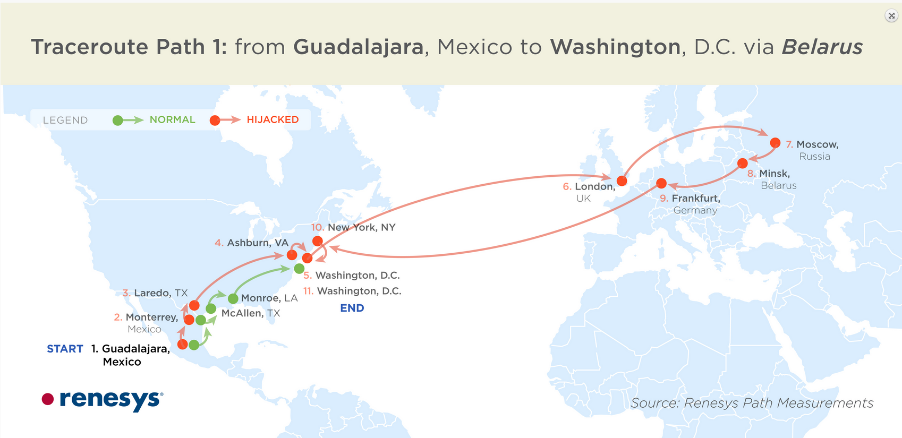
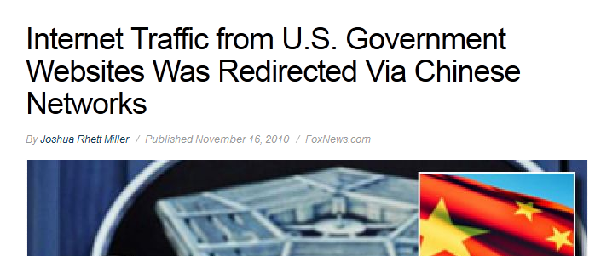
Example attacks
“Characterizing Large-scale Routing Anomalies: A Case Study of the China Telecom Incident”, Hiran et al., Proc. PAM 2013

Slide 66
Conventional Wisdom (i.e., lies)
Internet is a global scale end-to-end network
  Packets transit (mostly) unmodified
  Value of network is global addressability /reachability
Broad distribution of traffic sources / sinks
An Internet “core” exists
  Dominated by a dozen global transit providers (tier 1)
  Interconnecting content, consumer and regional providers

Slide 67



Does this still hold?
Emergence of ‘hyper giant’ services
How much traffic do these services contribute?
Hard to answer!
  Reading on Web page: Labovitz 2010 tries to look at this.

Slide 68
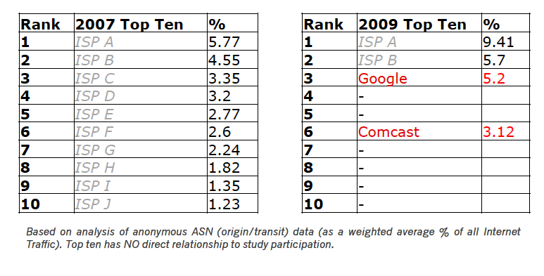
Change in Carrier Traffic Demands
In 2007 top ten match “Tier 1” ISPs
In 2009 global transit carry significant volumes
  But Google and Comcast join the list
  Significant fraction of ISP A traffic is Google transit

Slide 69
Market intuition
Commoditization of IP and hosting/CDN
  Drop in price of transit
  Drop in price of video/CDN
  Economics of scale → Cloud computing
Consolidation
  Big get bigger (economics of scale)
  Acquisitions (e.g., Google + YT)
New economic models
  Paid peering, paid content
Disintermediation
  Direct connections between content + consumer
  Cost + performance considerations

Slide 70
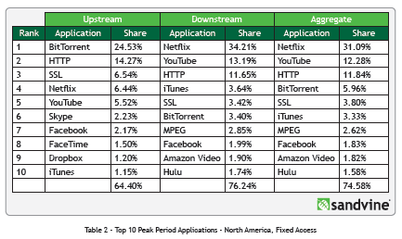
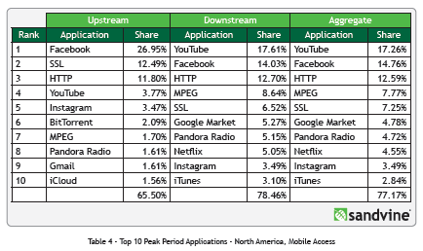
New applications + ways to access them
Fixed vs. Mobile Usage

Slide 71

The shift from hierarchy to flat
$
Verizon
AT&T
Tier 1 ISPs
(settlement free peering)
Money follows the arrows.
$$$
Sprint
$
$
Tier 2 ISPs
Regional Access
Provider
Regional Access
Provider
$
Tier 3 ISPs
$
Local Access
Provider
Local Access
Provider
$
$
Autonomous systems (ASes) connect to each other based on business relationships.
Businesses/consumers

Slide 72
The shift from hierarchy to flat
Verizon
AT&T
Tier 1 ISPs
(settlement free peering)
Sprint
Tier 2 ISPs
Regional Access
Provider
Regional Access
Provider
Content provider no longer needs to pay for transit!
More “eyeballs” less $$
Local Access Provider doesn’t have to pay for consumer access to content!
Tier 3 ISPs
Local Access
Provider
$
Local Access
Provider
$
IXP
$
Businesses/consumers

Slide 73
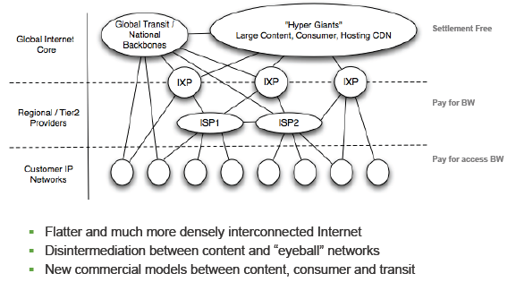
A new Internet model

Slide 74
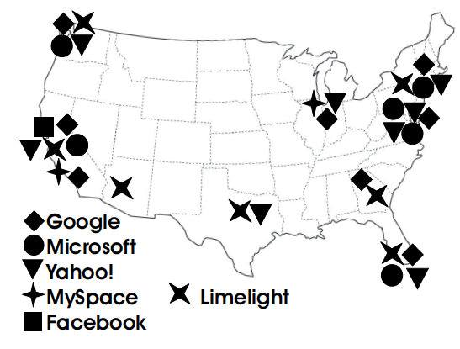
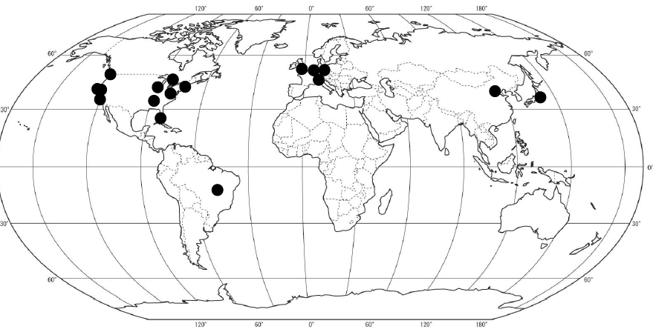
An initial map of connectivity
The Flattening Internet Topology: Natural Evolution, Unsightly
Barnacles or Contrived Collapse?, Proc. PAM 2008
Google

Slide 76
How do ASes connect?
Point of Presence (PoP)
  Usually a room or a building (windowless)
  One router from one AS is physically connected to the other
  Often in big cities
  Establishing a new connection at PoPs can be expensive
Internet eXchange Points
  Facilities dedicated to providing presence and connectivity for large numbers of ASes
  Many fewer IXPs than PoPs
  Economies of scale

Slide 77
IXPs Definition
Industry definition (according to Euro-IX)
  A physical network infrastructure operated by a single entity with the purpose to facilitate the exchange of Internet traffic between Autonomous Systems
  The number of Autonomous Systems connected should be at least three and there must be a clear and open policy for others to join.
  https://www.euro-ix.net/what-is-an-ixp

Slide 78


Internet eXchange Points

Slide 79
Inside an IXP

Slide 80
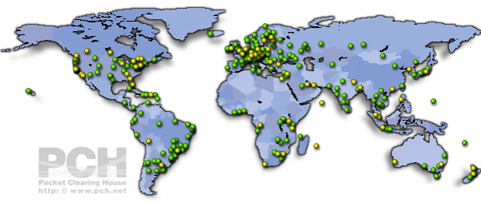
IXPs worldwide
https://prefix.pch.net/applications/ixpdir/

Slide 81
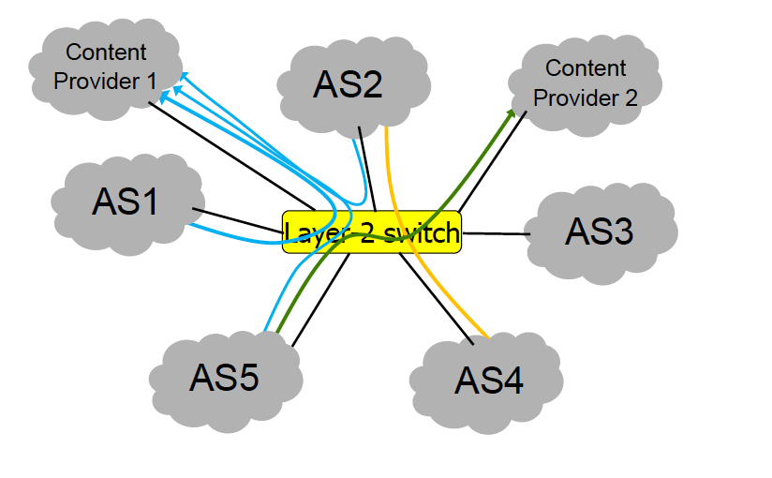
Structure
IXPs offer connectivity to ASes enable peering

Slide 82
IXPs -- Peering
Peering – Why? E.g., Giganews:
  “Establishing open peering arrangements at neutral Internet Exchange Points is a highly desirable practice because the Internet Exchange members are able to significantly improve latency, bandwidth, fault-tolerance, and the routing of traffic between themselves at no additional costs.”
IXPs – Four types of peering policies
  Open Peering – inclination to peer with anyone, anywhere
    Most common!
  Selective Peering – Inclination to peer, with some conditions
  Restrictive Peering – Inclination not to peer with any more entities
  No Peering – No, prefer to sell transit
  http://drpeering.net/white-papers/Peering-Policies/Peering-Policy.html

Slide 83
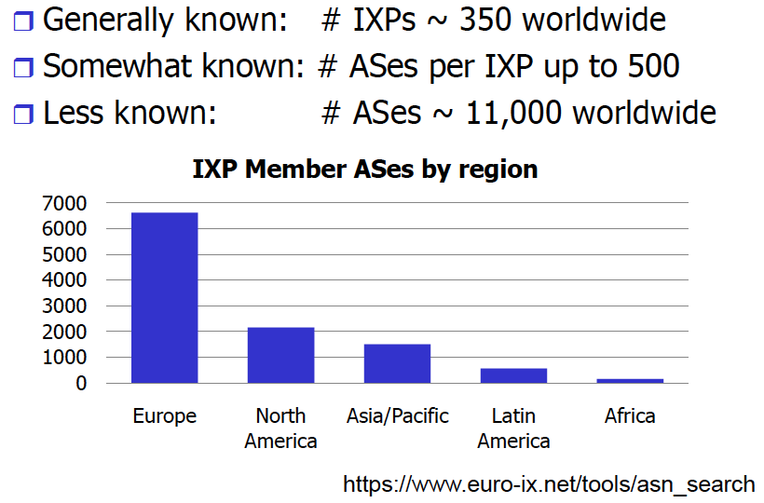
IXPs – Publicly available information

Slide 84
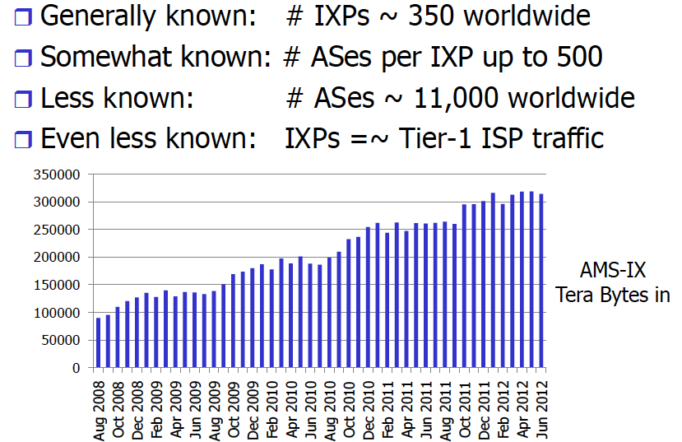
IXPs- Publicly available information
Unknown: # of peerings at IXPs

Slide 85
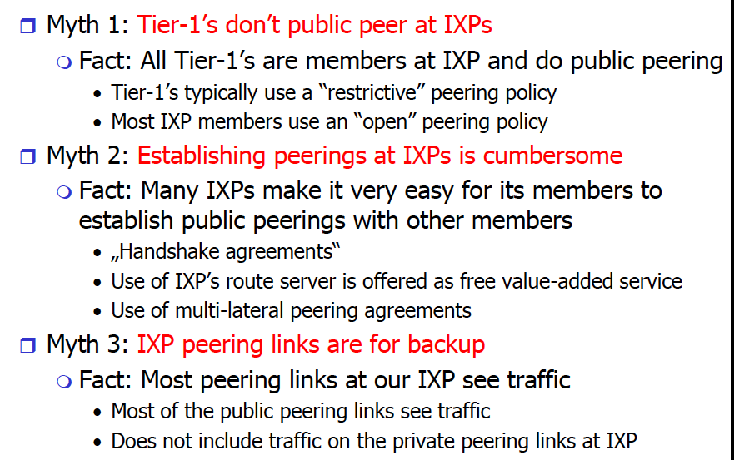
Interesting observations

Slide 86
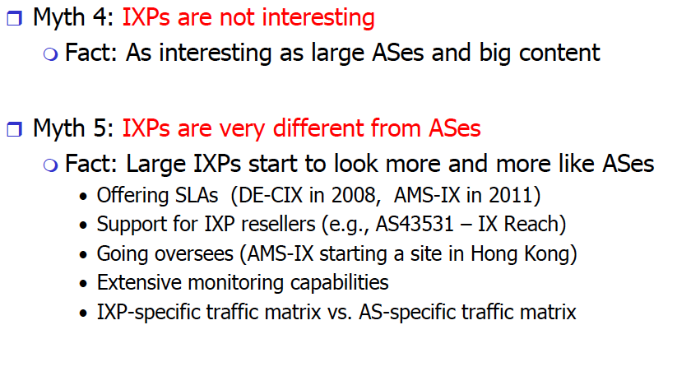
Interesting observations (2)

Slide 87
Revised model 2012+

Slide 89
Inter-Domain Routing Summary
BGP4 is the only inter-domain routing protocol currently in use world-wide
Issues?
  Lack of security
  Ease of misconfiguration
  Poorly understood interaction between local policies
  Poor convergence
  Lack of appropriate information hiding
  Non-determinism
  Poor overload behavior

Slide 90
Why are these still issues?
Backward compatibility
Buy-in / incentives for operators
Stubbornness
Very similar issues to IPv6 deployment

Slide 92
More slides …

Slide 93
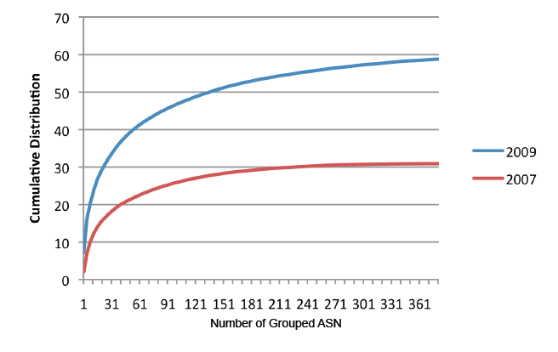
Consolidation of Content
In 2009, 150 ASes contribute 50% of traffic!
In 2007 1,000s of ASes contribute 50% of traffic

Slide 94
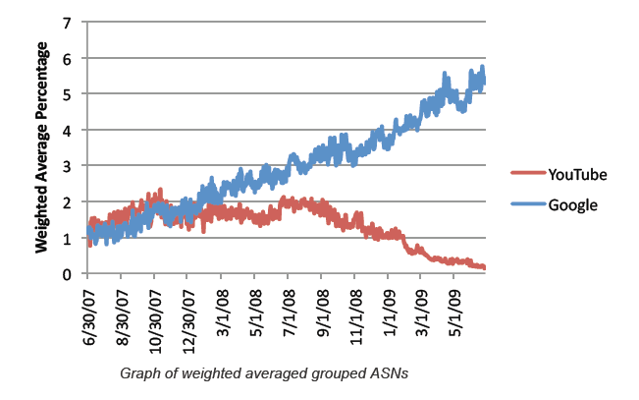
Case Study: Google
Over time Google begins delivering YT’s traffic
As of 2009 Google is 6% of traffic

Slide 95
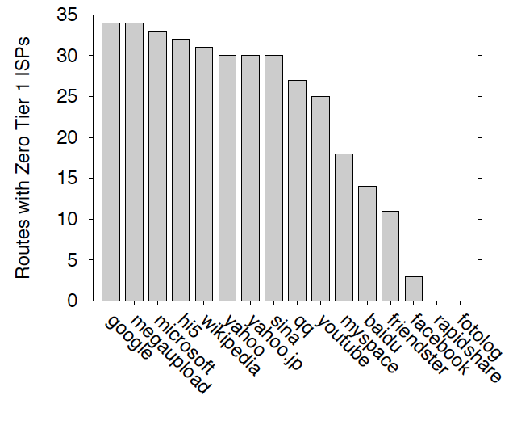
Flattening: Paths with no Tier 1s
The Flattening Internet Topology: Natural Evolution, Unsightly
Barnacles or Contrived Collapse?, Proc. PAM 2008
60% of paths with no tier 1 ISP
(30 out of 50)

Slide 96
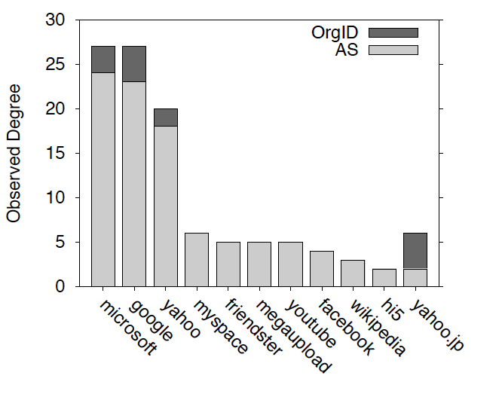
Relative degree of top content providers
The Flattening Internet Topology: Natural Evolution, Unsightly
Barnacles or Contrived Collapse?, Proc. PAM 2008
We saw many more neighboring ASes for the top content providers
(not just a few providers)
These numbers are actually way lower than the true degree of these ASes

Slide 98
What Problem is BGP Solving?
Underlying Problem | Distributed Solution
Shortest Paths | RIP, OSPF, IS-IS, etc.
??? | BGP
Knowing ??? can:
  Aid in the analysis of BGP policy
  Aid in the design of BGP extensions
  Help explain BGP routing anomalies
  Give us a deeper understanding of the protocol

Slide 99
The Stable Paths Problem
An instance of the SPP:
  Graph of nodes and edges
  Node 0, called the origin
  A set of permitted paths from each node to the origin
  Each set of paths is ranked
2 1 0
2 0
5
5 2 1 0
2
2
4 2 0
4 3 0
4
0
1
3
3 0
1 3 0
1 0

Slide 100
A Solution to the SPP
A solution is an assignment of permitted paths to each node such that:
  Node u’s path is either null or uwP, where path uw is assigned to node w and edge u → w exists
  Each node is assigned the highest ranked path that is consistent with their neighbors
2 1 0
2 0
5
5 2 1 0
2
Solutions need not use the shortest paths, or form a spanning tree
2
4 2 0
4 3 0
4
0
1
3
3 0
1 3 0
1 0

Slide 101
Simple SPP Example
1 0
1 3 0
2 0
2 1 0
1
2
2
Each node gets its preferred route
Totally stable topology
0
3
4
3 0
4 3 0
4 2 0
4 2 0
4 3 0

Slide 102
Good Gadget
1 3 0
1 0
2 1 0
2 0
1
2
2
Not every node gets preferred route
Topology is still stable
Only one stable configuration
  No matter which node chooses first!
0
3
4
3 0
4 3 0
4 2 0

Slide 103
SPP May Have Multiple Solutions
1 2 0
1 0
1 2 0
1 0
1 2 0
1 0
1
1
1
0
0
0
2
2
2
2 1 0
2 0
2 1 0
2 0
2 1 0
2 0

Slide 104
Bad Gadget
1 3 0
1 0
2 1 0
2 0
That was only one round of oscillation!
This keeps going, infinitely
Problem stems from:
  Local (not global) decisions
  Ability of one node to improve its path selection
1
2
2
0
3
4
3 4 2 0
3 0
4 2 0
4 3 0

Slide 105
SPP Explains BGP Divergence
BGP is not guaranteed to converge to stable routing
  Policy inconsistencies may lead to “livelock”
  Protocol oscillation
Solvable
Can Diverge
Good Gadgets
Bad Gadgets
Must
Converge
Must
Diverge
Naughty Gadgets

Slide 106
Beware of Backup Policies
1 3 0
1 0
2 1 0
2 0
1
2
2
BGP is not robust
It may not recover from link failure
0
3
4
3 4 2 0
3 0
4 0
4 2 0
4 3 0

Slide 107
BGP is Precarious
If node 1 uses path 1 → 0, this is solvable
4 3 1 0
4 5 3 1 2 0
4 3 1 2 0
1 2 0
1 0
4
1
3 1 0
3 1 2 0
3
No longer stable
0
5
6
2
5 3 1 0
5 6 3 1 2 0
5 3 1 2 0
6 3 1 0
6 4 3 1 2 0
6 3 1 2 0
2 1 0
2 0

Slide 108
Can BGP Be Fixed?
Unfortunately, SPP is NP-complete
Possible Solutions
Static Approach
Dynamic Approach
Extend BGP to
detect and suppress
policy-based oscillations?
Automated Analysis
of Routing Policies
(This is very hard)
Inter-AS
coordination
These approaches are complementary

Slide 109
B
C
A
D
Z

