Slide 1
TDTS21: Advanced Networking
Lecture 7: Internet topology
Based on slides from P. Gill and D. Choffnes
Revised 2015 by N. Carlsson

Slide 2
Measuring the Internet’s topology
What do we mean by topology?
  Internet as graph
  Edges? Nodes?
  Node = Autonomous System (AS); edge = connection.
Edges labeled with business relationship
Customer → Provider
Peer -- Peer
AT&T
Sprint
SBU

Slide 3
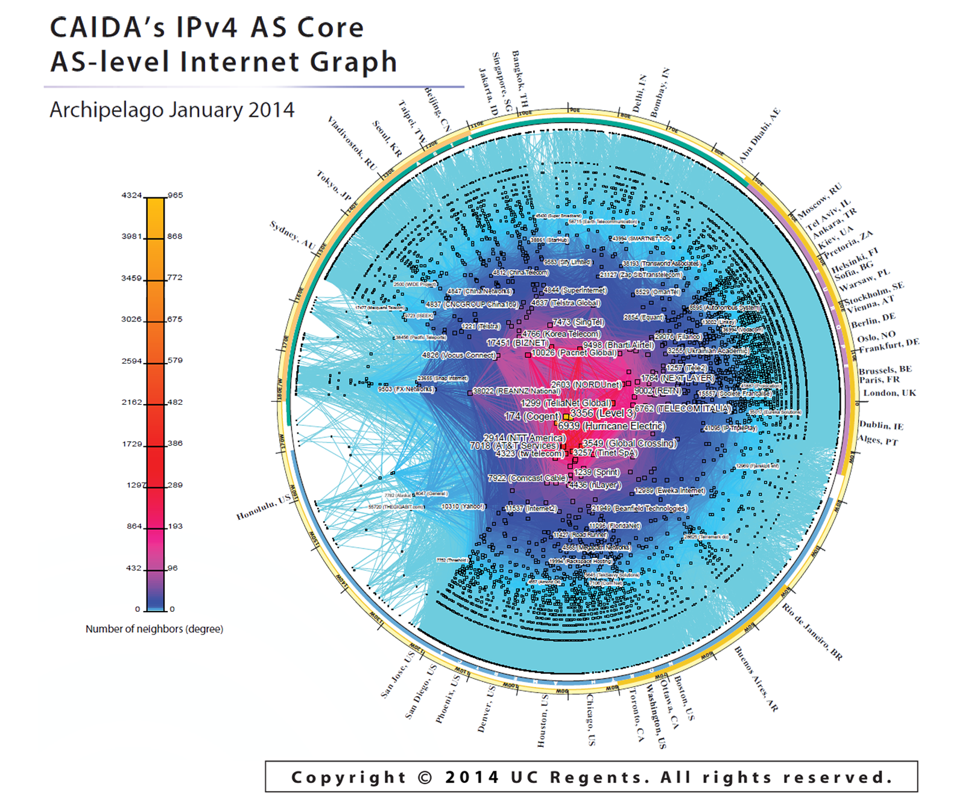
The outputs ….
15412 12041 p2c
15412 12486 p2c
15412 12880 p2c
15412 13810 p2c
15412 15802 p2c
15412 17408 p2c
15412 17554 p2c
15412 17709 p2c
15412 18101 p2c
15412 19806 p2c
19809 p2c
…

Slide 4
So how do we measure this graph?
Passive approach: BGP route monitors
  Coverage of the topology
  Amount of visibility provided by each neighbor
Active approach: Traceroute
  From where?
  Traceroute gives series of IP addresses not ASes
Active approach: TransitPortal
  Much more control over what we see
  …scalability/coverage?

Slide 5


Passive approach: BGP Route Monitors
Receive BGP announcements from participating ASes at multiple vantage points
Regional ISP
www.routeviews.org
“originally motivated by interest on the part of operators in determining how the global routing system viewed their prefixes and/or AS space”
www.routeviews.org

Slide 6
Going from BGP Updates to a Topology
Example update:
TIME: 03/22/11 12:10:45
FROM: 12.0.1.63 AS7018
TO: 128.223.51.102 AS6447
ASPATH: 7018 4134 9318 32934 32934 32934
69.171.224.0/20
AT&T (AS7018) it telling
Routeviews (AS 6447) about this route.
This /20 prefix can be reached via the above path

Slide 7
Going from BGP Updates to a Topology
Key idea
  The business relationships determine the routing policies
  The routing policies determine the paths that are chosen
  So, look at the chosen paths and infer the policies
Example: AS path “7018 4134 9318” implies
  AS 4134 allows AS 7018 to reach AS 9318
  China Telecom allows AT&T to reach Hanaro Telecom
  Each “triple” tells something about transit service

Slide 8

Why are peering links hard to see?
The challenge:
  BGP announcements do not reflect complete connectivity information
  They are an agreement to transit traffic for the AS they are advertised to…
Regional ISP won’t see the peering edge!
Neither will Routeviews
Local ISP will only tell his customers about the peering link.
Regional ISP
(ASes only transit traffic if it generates revenue!)
Local ISP, Small business
Local ISP, Google
Local ISP
  Combination of no valley routing policy and a lack of monitors in stub ASes mean missing up to 90% of peering links of content providers! (Oliveria et al. 2008)
$
Small
business

Slide 9
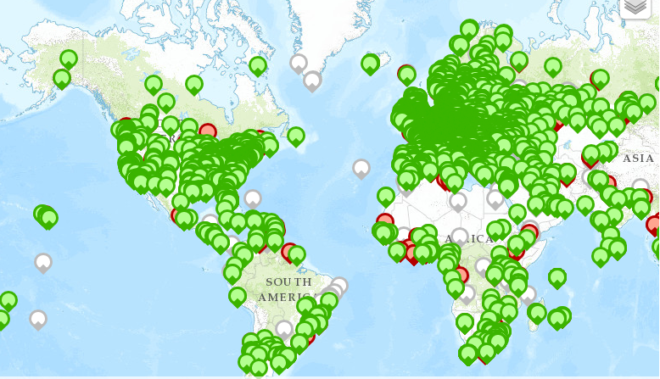
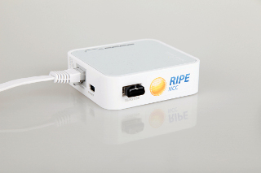
Active approach: Traceroute
Issue: Need control over end hosts to run traceroute
  How to get VPs?
http://www.traceroute.org/
  Collection of O(100) servers that will run traceroute
  Hosted by ISPs/other network operators (e.g. universities)
RIPE Atlas
  Distribute specialized hardware to volunteers
  O(1000s) of probes
Dasu
  Bittorrent plug in that does measurements
  O(200) ASes with Dasu clients

Slide 11
Traceroute vs Announced Path
ChinaTel 66.174.0.0/16
Level3, VZW, 22394 66.174.0.0/16
ISP 1
Level 3
VZW, 22394 66.174.0.0/16
China
Telecom
Verizon
Wireless
22394 66.174.0.0/16
AS 22394
66.174.0.0/16
Notes:
Continuing with our example, we see that ISP 1 expects the traffic intended for prefix to reach the destination traversing through single AS.
However, if interception attack is successful the path of ASes through which traffic passes does not match the announced AS-PATH from china telecom.

Slide 12
Traceroute vs Announced Path
ChinaTel 66.174.0.0/16
Level3, VZW, 22394 66.174.0.0/16
ISP 1
Level 3
VZW, 22394 66.174.0.0/16
  Interception typically results in differences between
  Announced AS-PATH
  Data path (traffic)
  Policy checks if legit reason(s)
China
Telecom
Verizon
Wireless
22394 66.174.0.0/16
AS 22394
66.174.0.0/16
Notes:
Continuing with our example, we see that ISP 1 expects the traffic intended for prefix to reach the destination traversing through single AS.
However, if interception attack is successful the path of ASes through which traffic passes does not match the announced AS-PATH from china telecom.

Slide 13
Traceroute vs Announced Path
3549
4637
  Sometimes differences
  Announced AS-PATH
  Data path (traffic)
  Many legit reason(s)
18881
Telstra
28198
Notes:
We envision that members will maintain a history of the announced AS-PATHs, and evaluate any newly observed path-prefix pairs for inconsistencies.
Node keeps track of path-prefix pairs. If new pair is observed, then it
(1) performs a traceroute to an IP address
within the prefix.
(2). It then uses registry to map IP addresses in traceroute to AS numbers. As can be seen here.
(3). A traceroute AS path is created from the sequence of AS numbers obtained in previous step.
(4). If the traceroute AS path matches the newly announced AS-PATH, then there is no anomaly.
If the paths do not match, then node uses information maintained by the AS registry regarding legit
path discrepancy reasons. Finally, if no legit reason is found,
(5) the node raises an alert and informs the appropriate AS
and prefix holder nodes.
There are multiple legit reasons for why traceroute PATH may not match AS-PATH in the BGP announcement.
One such reason is presented here. (go to next slide).

Slide 14
Traceroute vs Announced Path
3549
4637
  Sometimes differences
  Announced AS-PATH
  Data path (traffic)
  Many legit reason(s)
18881
Telstra
28198
AS-PATH: 177.52.48.0/21|1221 4637 3549 18881 28198
Notes:
We envision that members will maintain a history of the announced AS-PATHs, and evaluate any newly observed path-prefix pairs for inconsistencies.
Node keeps track of path-prefix pairs. If new pair is observed, then it
(1) performs a traceroute to an IP address
within the prefix.
(2). It then uses registry to map IP addresses in traceroute to AS numbers. As can be seen here.
(3). A traceroute AS path is created from the sequence of AS numbers obtained in previous step.
(4). If the traceroute AS path matches the newly announced AS-PATH, then there is no anomaly.
If the paths do not match, then node uses information maintained by the AS registry regarding legit
path discrepancy reasons. Finally, if no legit reason is found,
(5) the node raises an alert and informs the appropriate AS
and prefix holder nodes.
There are multiple legit reasons for why traceroute PATH may not match AS-PATH in the BGP announcement.
One such reason is presented here. (go to next slide).

Slide 15
Traceroute vs Announced Path
3549
4637
  Sometimes differences
  Announced AS-PATH
  Data path (traffic)
  Many legit reason(s)
18881
Telstra
28198
AS-PATH: 177.52.48.0/21|1221 4637 3549 18881 28198
Notes:
We envision that members will maintain a history of the announced AS-PATHs, and evaluate any newly observed path-prefix pairs for inconsistencies.
Node keeps track of path-prefix pairs. If new pair is observed, then it
(1) performs a traceroute to an IP address
within the prefix.
(2). It then uses registry to map IP addresses in traceroute to AS numbers. As can be seen here.
(3). A traceroute AS path is created from the sequence of AS numbers obtained in previous step.
(4). If the traceroute AS path matches the newly announced AS-PATH, then there is no anomaly.
If the paths do not match, then node uses information maintained by the AS registry regarding legit
path discrepancy reasons. Finally, if no legit reason is found,
(5) the node raises an alert and informs the appropriate AS
and prefix holder nodes.
There are multiple legit reasons for why traceroute PATH may not match AS-PATH in the BGP announcement.
One such reason is presented here. (go to next slide).

Slide 16
Traceroute vs Announced Path
3549
4637
  Sometimes differences
  Announced AS-PATH
  Data path (traffic)
  Many legit reason(s)
18881
Telstra
28198
AS-PATH: 177.52.48.0/21|1221 4637 3549 18881 28198
Traceroute:
... (initial hops)
9. telstraglobal.net (134.159.63.202) 164.905 ms
10 impsat.net.br (189.125.6.194) 337.434 ms
11 spo.gvt.net.br (187.115.214.217) 332.926 ms
12 spo.gvt.net.br (189.59.248.109) 373.021 ms
13 host.gvt.net.br (189.59.249.245) 343.685 ms
14 isimples.com.br (177.52.48.1) 341.172 ms
Notes:
We envision that members will maintain a history of the announced AS-PATHs, and evaluate any newly observed path-prefix pairs for inconsistencies.
Node keeps track of path-prefix pairs. If new pair is observed, then it
(1) performs a traceroute to an IP address
within the prefix.
(2). It then uses registry to map IP addresses in traceroute to AS numbers. As can be seen here.
(3). A traceroute AS path is created from the sequence of AS numbers obtained in previous step.
(4). If the traceroute AS path matches the newly announced AS-PATH, then there is no anomaly.
If the paths do not match, then node uses information maintained by the AS registry regarding legit
path discrepancy reasons. Finally, if no legit reason is found,
(5) the node raises an alert and informs the appropriate AS
and prefix holder nodes.
There are multiple legit reasons for why traceroute PATH may not match AS-PATH in the BGP announcement.
One such reason is presented here. (go to next slide).

Slide 17
Traceroute vs Announced Path
3549
4637
  Sometimes differences
  Announced AS-PATH
  Data path (traffic)
  Many legit reason(s)
18881
Telstra
28198
AS-PATH: 177.52.48.0/21|1221 4637 3549 18881 28198
AS HOPS in traceroute: 1221 1221 1221 1221 4637 4637 4637 4637 4637 3549 3549 3549 18881 18881 18881 18881 28198
Notes:
We envision that members will maintain a history of the announced AS-PATHs, and evaluate any newly observed path-prefix pairs for inconsistencies.
Node keeps track of path-prefix pairs. If new pair is observed, then it
(1) performs a traceroute to an IP address
within the prefix.
(2). It then uses registry to map IP addresses in traceroute to AS numbers. As can be seen here.
(3). A traceroute AS path is created from the sequence of AS numbers obtained in previous step.
(4). If the traceroute AS path matches the newly announced AS-PATH, then there is no anomaly.
If the paths do not match, then node uses information maintained by the AS registry regarding legit
path discrepancy reasons. Finally, if no legit reason is found,
(5) the node raises an alert and informs the appropriate AS
and prefix holder nodes.
There are multiple legit reasons for why traceroute PATH may not match AS-PATH in the BGP announcement.
One such reason is presented here. (go to next slide).

Slide 18
Traceroute vs Announced Path
3549
4637
  Sometimes differences
  Announced AS-PATH
  Data path (traffic)
  Many legit reason(s)
18881
Telstra
28198
AS-PATH: 177.52.48.0/21|1221 4637 3549 18881 28198
AS HOPS in traceroute: 1221 1221 1221 1221 4637 4637 4637 4637 4637 3549 3549 3549 18881 18881 18881 18881 28198
Traceroute-PATH: 1221 4637 3549 18881 28198
Notes:
We envision that members will maintain a history of the announced AS-PATHs, and evaluate any newly observed path-prefix pairs for inconsistencies.
Node keeps track of path-prefix pairs. If new pair is observed, then it
(1) performs a traceroute to an IP address
within the prefix.
(2). It then uses registry to map IP addresses in traceroute to AS numbers. As can be seen here.
(3). A traceroute AS path is created from the sequence of AS numbers obtained in previous step.
(4). If the traceroute AS path matches the newly announced AS-PATH, then there is no anomaly.
If the paths do not match, then node uses information maintained by the AS registry regarding legit
path discrepancy reasons. Finally, if no legit reason is found,
(5) the node raises an alert and informs the appropriate AS
and prefix holder nodes.
There are multiple legit reasons for why traceroute PATH may not match AS-PATH in the BGP announcement.
One such reason is presented here. (go to next slide).

Slide 19
Traceroute vs Announced Path
3549
4637
  Sometimes differences
  Announced AS-PATH
  Data path (traffic)
  Many legit reason(s)
18881
Telstra
28198
AS-PATH: 177.52.48.0/21|1221 4637 3549 18881 28198
AS HOPS in traceroute: 1221 1221 1221 1221 4637 4637 4637 4637 4637 3549 3549 3549 18881 18881 18881 18881 28198
Traceroute-PATH: 1221 4637 3549 18881 28198
Notes:
We envision that members will maintain a history of the announced AS-PATHs, and evaluate any newly observed path-prefix pairs for inconsistencies.
Node keeps track of path-prefix pairs. If new pair is observed, then it
(1) performs a traceroute to an IP address
within the prefix.
(2). It then uses registry to map IP addresses in traceroute to AS numbers. As can be seen here.
(3). A traceroute AS path is created from the sequence of AS numbers obtained in previous step.
(4). If the traceroute AS path matches the newly announced AS-PATH, then there is no anomaly.
If the paths do not match, then node uses information maintained by the AS registry regarding legit
path discrepancy reasons. Finally, if no legit reason is found,
(5) the node raises an alert and informs the appropriate AS
and prefix holder nodes.
There are multiple legit reasons for why traceroute PATH may not match AS-PATH in the BGP announcement.
One such reason is presented here. (go to next slide).

Slide 21
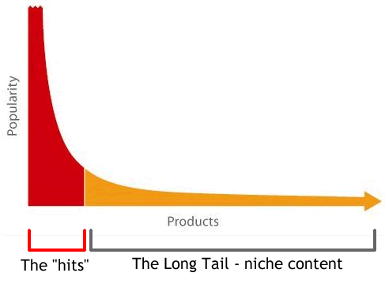
Zipf popularity...
... and long tails
Degree (v)
Rank (r)

Slide 22
Zipf popularity...
... and long tails
Degree (v)
log v
Rank (r)
log r

Slide 23
Zipf popularity...
... and long tails
Degree (v)
log v
Rank (r)
log r

Slide 24
Zipf popularity...
... and long tails
Degree (v)
log v
Rank (r)
log r

Slide 25
Zipf popularity...
... and long tails
Degree (v)
log v
Rank (r)
log r
y(x) = x₀ -- α x

Slide 26
Zipf popularity...
... and long tails
Degree (v)
log v
Rank (r)
log r
y(x) = x₀ -- α x

Slide 27
Zipf popularity...
... and long tails
Degree (v)
log v
Rank (r)
log r

Slide 28
Power law, Pareto, and Zipf
Power-law, Pareto, Zipf (in some sense the same)
  Power-law: f(x) ∼ x^{-η} (probability of value x)
  Pareto: F(x) = P[X > x] = ∫ f(x) dx ∝ x^{-κ} (cumulative prob.)
  Zipf: v_{r}∝ r^{-α} (discrete representation; frequency v_{r} of rank r)
  Parameters related as: κ = η -1 = 1/α
    E.g., paper and references therein: “A Tale of the Tails: Power-laws in Internet Measurements”, IEEE Network, Mahanti et al., 2013

Slide 29
Heavy-tail distributions …
“A probability distribution is said to have a heavy tail if the tail is not exponentially bounded”
… and then there are many many other “heavy tail” distributions, variations and generalizations, including distributions such as log-normal, various generalized Zipf/Pareto distributions, etc.

