Slide 1
TDTS21 Advanced Networking
Lecture 3: Transport, including TCP and congestion control …
Based on slides from D. Choffnes, P. Gill, and S. Katti
Revised Spring 2015 by N. Carlsson

Slide 2


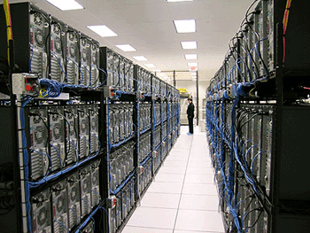
Holding the Internet Together
Distributed cooperation for resource allocation
  BGP: what end-to-end paths to take (for ~50K ASes)
  TCP: what rate to send over each path (for ~3B hosts)
AS 2
AS 1
AS 3
AS 4

Slide 3
What Problem Does a Protocol Solve?
BGP path selection
  Select a path that each AS on the path is willing to use
  Adapt path selection in the presence of failures
TCP congestion control
  Prevent congestion collapse of the Internet
  Allocate bandwidth fairly and efficiently

Slide 4
What Problem Does a Protocol Solve?
BGP path selection
  Select a path that each AS on the path is willing to use
  Adapt path selection in the presence of failures
TCP congestion control
  Prevent congestion collapse of the Internet
  Allocate bandwidth fairly and efficiently
Today, we will focus on TCP (and UDP) …

Slide 5
Transport Layer
Function:
  Demultiplexing of data streams
Optional functions:
  Creating long lived connections
  Reliable, in-order packet delivery
  Error detection
  Flow and congestion control
Key challenges:
  Detecting and responding to congestion
  Balancing fairness against high utilization
Application
Transport
Network
Data Link
Physical

Slide 6
Outline
UDP
TCP
Congestion Control
Evolution of TCP
Problems with TCP

Slide 7




The Case for Multiplexing
Datagram network
  No circuits
  No connections
Clients run many applications at the same time
  Who to deliver packets to?
IP header “protocol” field
  8 bits = 256 concurrent streams
Insert Transport Layer to handle demultiplexing
Transport
Network
Data Link
Physical
Packet

Slide 8


Demultiplexing Traffic
Server applications communicate with multiple clients
Host 1
Host 2
Host 3
Unique port for each application
Application
Applications share the same network
Transport
P1
P2
P3
P4
P5
P6
P7
Network
Endpoints identified by <src_ip, src_port, dest_ip, dest_port>

Slide 9
Layering, Revisited
Layers communicate peer-to-peer
Host 1
Router
Host 2
Application
Application
Transport
Transport
Network
Network
Network
Data Link
Data Link
Data Link
Physical
Physical
Physical
Lowest level end-to-end protocol
  Transport header only read by source and destination
  Routers view transport header as payload

Slide 10
User Datagram Protocol (UDP)
0
16
31
Source Port
Destination Port
Payload Length
Checksum
Simple, connectionless datagram
Port numbers enable demultiplexing
  16 bits = 65535 possible ports
  Port 0 is invalid
Checksum for error detection
  Detects (some) corrupt packets
  Does not detect dropped, duplicated, or reordered packets

Slide 11
Uses for UDP
Invented after TCP
  Why?
Not all applications can tolerate TCP
Custom protocols can be built on top of UDP
  Reliability? Strict ordering?
  Flow control? Congestion control?
Examples
  RTMP, real-time media streaming (e.g. voice, video)
  Facebook datacenter protocol

Slide 12
Outline
UDP
TCP
Congestion Control
Evolution of TCP
Problems with TCP

Slide 13
Transmission Control Protocol
Reliable, in-order, bi-directional byte streams
  Port numbers for demultiplexing
  Virtual circuits (connections)
  Flow control
  Congestion control, approximate fairness
0
4
16
31
Source Port
Destination Port
Sequence Number
Acknowledgement Number
HLen
Flags
Advertised Window
Checksum
Urgent Pointer
Options

Slide 14
Connection Setup
Why do we need connection setup?
  To establish state on both hosts
  Most important state: sequence numbers
    Count the number of bytes that have been sent
    Initial value chosen at random
    Why?
Important TCP flags (1 bit each)
  SYN – synchronization, used for connection setup
  ACK – acknowledge received data
  FIN – finish, used to tear down connection

Slide 15
Three Way Handshake
Client
Server
SYN <SeqC, 0>
SYN/ACK <SeqS, SeqC+1>
ACK <SeqC+1, SeqS+1>
Each side:
  Notifies the other of starting sequence number
  ACKs the other side’s starting sequence number
Notes:
Seq + 1 → next expected data byte
211

Slide 16
Connection Setup Issues
Connection confusion
  How to disambiguate connections from the same host?
  Random sequence numbers
Source spoofing
  Kevin Mitnick
  Need good random number generators!
Connection state management
  Each SYN allocates state on the server
  SYN flood = denial of service attack
  Solution: SYN cookies
Notes:
Spoofing + sequence prediction to hijack connections
SYN cookie: special sequence number sent in SYNACK so that when ACK comes back SYN cookie value can be reconstructed

Slide 17
Connection Tear Down
Either side can initiate tear down
Other side may continue sending data
  Half open connection
  shutdown()
Acknowledge the last FIN
  Sequence number + 1
Client
Server
FIN <SeqA, *>
ACK <*, SeqA+1>
Data
ACK
FIN <SeqB, *>
ACK <*, SeqB+1>

Slide 18
Sequence Number Space
TCP uses a byte stream abstraction
  Each byte in each stream is numbered
  32-bit value, wraps around
  Initial, random values selected during setup
Byte stream broken down into segments (packets)
  Size limited by the Maximum Segment Size (MSS)
  Set to limit fragmentation
Each segment has a sequence number
13450
14950
16050
17550
Segment 8
Segment 9
Segment 10

Slide 19
Bidirectional Communication
Seq.
Ack.
Client
Server
Seq.
Ack.
1
23
Data (1460 bytes)
23
1
23
1461
Data/ACK (730 bytes)
1461
753
Data/ACK (1460 bytes)
Data and ACK in the same packet
753
2921
Each side of the connection can send and receive
  Different sequence numbers for each direction

Slide 20
Flow Control
Problem: how many packets should a sender transmit?
  Too many packets may overwhelm the receiver
  Size of the receivers buffers may change over time
Solution: sliding window
  Receiver tells the sender how big their buffer is
  Called the advertised window
  For window size n, sender may transmit n bytes without receiving an ACK
  After each ACK, the window slides forward

Slide 21
Flow Control: Sender Side
Packet Sent
Packet Received
Src. Port
Dest. Port
Src. Port
Dest. Port
Sequence Number
Sequence Number
Acknowledgement Number
Acknowledgement Number
HL
Flags
Window
HL
Flags
Window
Checksum
Urgent Pointer
Checksum
Urgent Pointer
Must be buffered until ACKed
ACKed
Sent
To Be Sent
Outside Window
Window
Notes:
Each side acts and sender and receiver
Every message contains sequence number, even if payload length is zero
Every message contains acknowledgements, even if no data was received
Every message advertises the window size

Slide 22
Sliding Window Example
1
2
3
4
5
6
TCP is ACK Clocked
Short RTT → quick ACK → window slides quickly
Long RTT → slow ACK → window slides slowly
7
5
6
7
Time
Time

Slide 23
Observations
Throughput is ~ w/RTT
Sender has to buffer all unacknowledges packets, because they may require retransmission
Receiver may be able to accept out-of-order packets, but only up to buffer limits

Slide 24
Outline
UDP
TCP
Congestion Control
Evolution of TCP
Problems with TCP

Slide 25
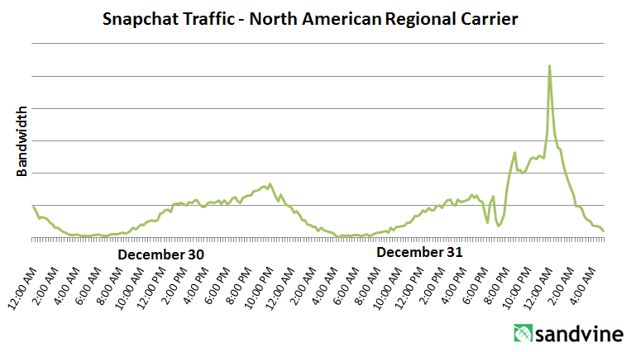
What is Congestion?
Load on the network is higher than capacity
  Capacity is not uniform across networks
    Modem vs. Cellular vs. Cable vs. Fiber Optics
  There are multiple flows competing for bandwidth
    Residential cable modem vs. corporate datacenter
  Load is not uniform over time
    10pm, Sunday night = Bittorrent Game of Thrones

Slide 26
Why is Congestion Bad?
Results in packet loss
  Routers have finite buffers
  Internet traffic is bursty, no buffer can prevent all drops
  When routers get overloaded, packets will be dropped
Practical consequences
  Router queues build up, delay increases
  Wasted bandwidth from retransmissions
  Low network “goodput”

Slide 27
Congestion Avoidance and Control
Van Jacobson ‘88

Slide 28
Main contributions
???

Slide 29
Main contributions
Seven new algorithms:
  RTT Variance estimation
  Exponential retransmit timer backoff
  Slow-start
  More aggressive receiver ack policy
  Dynamic window sizing on congestion
  Karn’s algorithm
  Fast retransmit
Paper explores the first 5.

Slide 30
The Danger of Increasing Load
Congestion Collapse
Knee – point after which
  Throughput increases very slow
  Delay increases fast
In an M/M/1 queue
  Delay = 1/(1 – utilization)
Cliff – point after which
  Throughput → 0
  Delay → ∞
Knee
Cliff
Goodput
Ideal point
Load
Delay
Load

Slide 31
Cong. Control vs. Cong. Avoidance
Congestion Avoidance:
Stay left of the knee
Congestion Control:
Stay left of the cliff
Knee
Cliff
Congestion Collapse
Goodput
Load

Slide 32
Advertised Window, Revisited
Does TCP’s advertised window solve congestion?
NO
The advertised window only protects the receiver
A sufficiently fast receiver can max the window
  What if the network is slower than the receiver?
  What if there are other concurrent flows?
Key points
  Window size determines send rate
  Window must be adjusted to prevent congestion collapse

Slide 33
Goals of Congestion Control
Adjusting to the bottleneck bandwidth
Adjusting to variations in bandwidth
Sharing bandwidth between flows
Maximizing throughput

Slide 34
General Approaches
Do nothing, send packets indiscriminately
  Many packets will drop, totally unpredictable performance
  May lead to congestion collapse
Reservations
  Pre-arrange bandwidth allocations for flows
  Requires negotiation before sending packets
  Must be supported by the network
Dynamic adjustment
  Use probes to estimate level of congestion
  Speed up when congestion is low
  Slow down when congestion increases
  Messy dynamics, requires distributed coordination

Slide 35
TCP Congestion Control
Each TCP connection has a window
  Controls the number of unACKed packets
Sending rate is ~ window/RTT
Idea: vary the window size to control the send rate
Introduce a congestion window at the sender
  Congestion control is sender-side problem

Slide 36
Congestion Window (cwnd)
Limits how much data is in transit
Denominated in bytes
wnd = min(cwnd, adv_wnd);
effective_wnd = wnd –
(last_byte_sent – last_byte_acked);
last_byte_acked
last_byte_sent
effective_wnd
wnd

Slide 37
Two Basic Components
Detect congestion
  Packet dropping is most reliably signal
    Delay-based methods are hard and risky
  How do you detect packet drops? ACKs
    Timeout after not receiving an ACK
    Several duplicate ACKs in a row (ignore for now)
Rate adjustment algorithm
  Modify cwnd
  Probe for bandwidth
  Responding to congestion

Slide 38
Error Detection
Checksum detects (some) packet corruption
  Computed over IP header, TCP header, and data
Sequence numbers catch sequence problems
  Duplicates are ignored
  Out-of-order packets are reordered or dropped
  Missing sequence numbers indicate lost packets
Lost segments detected by sender
  Use timeout to detect missing ACKs
  Need to estimate RTT to calibrate the timeout
  Sender must keep copies of all data until ACK

Slide 39
Retransmission Time Outs (RTO)
Problem: time-out is linked to round trip time
Timeout is too short
Initial Send
Initial Send
RTO
RTO
ACK
Retry
Retry
What about if timeout is too long?
ACK

Slide 40
Round Trip Time Estimation
Data
Sample
ACK
Original TCP round-trip estimator
  RTT estimated as a moving average
  new_rtt = α (old_rtt) + (1 – α)(new_sample)
  Recommended α: 0.8-0.9 (0.875 for most TCPs)
RTO = function of new_rtt and new_dev_rtt

Slide 41
RTT Sample Ambiguity
Initial Send
Initial Send
RTO
RTO
ACK
Retry
Sample?
Retry
Sample
ACK
Karn’s algorithm: ignore samples for retransmitted segments

Slide 42
Rate Adjustment
Recall: TCP is ACK clocked
  Congestion = delay = long wait between ACKs
  No congestion = low delay = ACKs arrive quickly
Basic algorithm
  Upon receipt of ACK: increase cwnd
    Data was delivered, perhaps we can send faster
    cwnd growth is proportional to RTT
  On loss: decrease cwnd
    Data is being lost, there must be congestion
Question: increase/decrease functions to use?

Slide 43
Utilization and Fairness
Max throughput for flow 2
More than full utilization (congestion)
Equal throughput
(fairness)
Less than full utilization
Ideal point
Max efficiency
Perfect fairness
Flow 2 Throughput
Zero throughput for flow 1
Zero throughput for flow 2
Max throughput for flow 1
Flow 1 Throughput

Slide 44
Multiplicative Increase, Additive Decrease
Not stable!
Veers away from fairness
Flow 2 Throughput
Flow 1 Throughput

Slide 45
Additive Increase, Additive Decrease
Stable
But does not converge to fairness
Flow 2 Throughput
Flow 1 Throughput

Slide 46
Multiplicative Increase, Multiplicative Decrease
Stable
But does not converge to fairness
Flow 2 Throughput
Flow 1 Throughput

Slide 47
Additive Increase, Multiplicative Decrease
Converges to stable and fair cycle
Symmetric around y=x
Flow 2 Throughput
Flow 1 Throughput

Slide 48
Implementing Congestion Control
Maintains three variables:
  cwnd: congestion window
  adv_wnd: receiver advertised window
  ssthresh: threshold size (used to update cwnd)
For sending, use: wnd = min(cwnd, adv_wnd)
Two phases of congestion control
  Slow start (cwnd < ssthresh)
    Probe for bottleneck bandwidth
  Congestion avoidance (cwnd >= ssthresh)
    AIMD
Notes:
Got to here.

Slide 49
Slow Start
Knee
Cliff
Goal: reach knee quickly
Upon starting (or restarting) a connection
  cwnd =1
  ssthresh = adv_wnd
  Each time a segment is ACKed, cwnd++
Continues until…
  ssthresh is reached
  Or a packet is lost
Slow Start is not actually slow
  cwnd increases exponentially
Goodput
Load

Slide 50
Slow Start Example
cwnd = 1
cwnd grows rapidly
Slows down when…
  cwnd >= ssthresh
  Or a packet drops
1
cwnd = 2
2
3
cwnd = 4
4
5
6
7
cwnd = 8

Slide 51
Congestion Avoidance
AIMD mode
ssthresh is lower-bound guess about location of the knee
If cwnd >= ssthresh then
each time a segment is ACKed
increment cwnd by 1/cwnd (cwnd += 1/cwnd).
So cwnd is increased by one only if all segments have been acknowledged

Slide 52
Congestion Avoidance Example
cwnd = 1
cwnd = 2
cwnd >= ssthresh
cwnd = 4
ssthresh = 8
cwnd (in segments)
Slow Start
cwnd = 8
cwnd = 9
Round Trip Times

Slide 53
TCP Pseudocode
Initially:
cwnd = 1;
ssthresh = adv_wnd;
New ack received:
if (cwnd < ssthresh)
/* Slow Start*/
cwnd = cwnd + 1;
else
/* Congestion Avoidance */
cwnd = cwnd + 1/cwnd;
Timeout:
/* Multiplicative decrease */
ssthresh = cwnd/2;
cwnd = 1;

Slide 54
The Big Picture
ssthresh
Timeout
Congestion
Avoidance
cwnd
Slow Start
Time

Slide 55
Outline
UDP
TCP
Congestion Control
Evolution of TCP
Problems with TCP

Slide 56
The Evolution of TCP
Thus far, we have discussed TCP Tahoe
  Original version of TCP
However, TCP was invented in 1974!
  Today, there are many variants of TCP
Early, popular variant: TCP Reno
  Tahoe features, plus…
  Fast retransmit
  Fast recovery

Slide 57
TCP Reno: Fast Retransmit
Problem: in Tahoe, if segment is lost, there is a long wait until the RTO
Reno: retransmit after 3 duplicate ACKs
cwnd = 1
1
2
cwnd = 2
2
3
3
4
cwnd = 4
4
5
6
7
4
3 Duplicate ACKs
4
4

Slide 58
TCP Reno: Fast Recovery
After a fast-retransmit set cwnd to ssthresh/2
  i.e. don’t reset cwnd to 1
  Avoid unnecessary return to slow start
  Prevents expensive timeouts
But when RTO expires still do cwnd = 1
  Return to slow start, same as Tahoe
  Indicates packets aren’t being delivered at all
  i.e. congestion must be really bad

Slide 59
Fast Retransmit and Fast Recovery
ssthresh
Timeout
Congestion Avoidance
Fast Retransmit/Recovery
Timeout
cwnd
Slow Start
Time
At steady state, cwnd oscillates around the optimal window size
TCP always forces packet drops

Slide 60
Many TCP Variants…
Tahoe: the original
  Slow start with AIMD
  Dynamic RTO based on RTT estimate
Reno: fast retransmit and fast recovery
NewReno: improved fast retransmit
  Reduce number of retransmissions
  Window inflation
Vegas: delay-based congestion avoidance
And many, many, many more…

Slide 61
TCP in the Real World
What are the most popular variants today?
  Key problem: TCP performs poorly on high bandwidth-delay product networks (like the modern Internet)
  Compound TCP (Windows)
    Based on Reno
    Uses two congestion windows: delay based and loss based
    Thus, it uses a compound congestion controller
  TCP CUBIC (Linux)
    Enhancement of BIC (Binary Increase Congestion Control)
    Window size controlled by cubic function
    Parameterized by the time T since the last dropped packet

Slide 62
High Bandwidth-Delay Product
Key Problem: TCP performs poorly when
  The capacity of the network (bandwidth) is large
  The delay (RTT) of the network is large
  Or, when bandwidth * delay is large
    b * d = maximum amount of in-flight data in the network
    a.k.a. the bandwidth-delay product
Why does TCP perform poorly?
  Slow start and additive increase are slow to converge
  TCP is ACK clocked
    i.e. TCP can only react as quickly as ACKs are received
    Large RTT → ACKs are delayed → TCP is slow to react

Slide 63
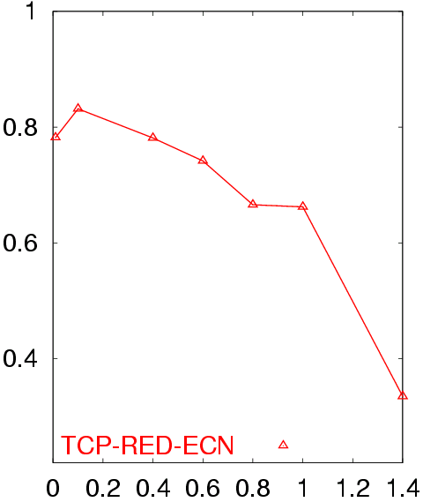
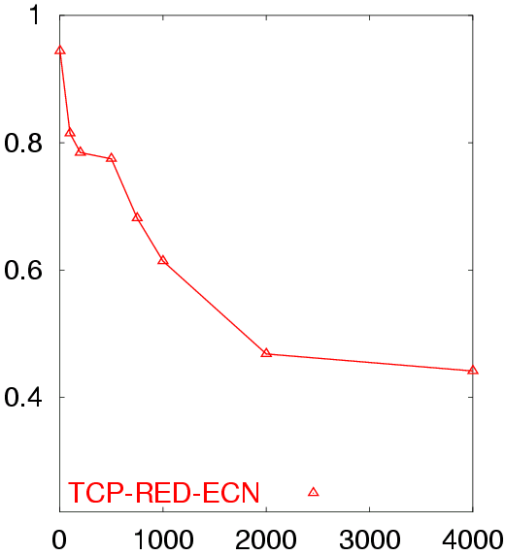
Poor Performance of TCP Reno CC
50 flows in both directions
Buffer = BW x Delay
RTT = 80 ms
50 flows in both directions
Buffer = BW x Delay
BW = 155 Mb/s
Avg. TCP Utilization
Avg. TCP Utilization
Bottleneck Bandwidth (Mb/s)
Round Trip Delay (sec)

Slide 64
Goals
Fast window growth
  Slow start and additive increase are too slow when bandwidth is large
  Want to converge more quickly
Maintain fairness with other TCP variants
  Window growth cannot be too aggressive
Improve RTT fairness
  TCP Tahoe/Reno flows are not fair when RTTs vary widely
Simple implementation

Slide 65
Compound TCP Implementation
Default TCP implementation in Windows
Key idea: split cwnd into two separate windows
  Traditional, loss-based window
  New, delay-based window
wnd = min(cwnd + dwnd, adv_wnd)
  cwnd is controlled by AIMD
  dwnd is the delay window
Rules for adjusting dwnd:
  If RTT is increasing, decrease dwnd (dwnd >= 0)
  If RTT is decreasing, increase dwnd
  Increase/decrease are proportional to the rate of change

Slide 66
Compound TCP Example
Faster cwnd growth
High
RTT
Low
RTT
Slower cwnd growth
Timeout
Timeout
cwnd
Slow Start
Time
Aggressiveness corresponds to changes in RTT
Advantages: fast ramp up, more fair to flows with different RTTs
Disadvantage: must estimate RTT, which is very challenging

Slide 67
TCP CUBIC Implementation
Default TCP implementation in Linux
Replace AIMD with cubic function
  B → a constant fraction for multiplicative increase
  T → time since last packet drop
  W_max ➔ cwnd when last packet dropped

Slide 68
TCP CUBIC Example
Slowly accelerate to probe for bandwidth
CUBIC Function
Timeout
cwnd_{max}
cwnd
Stable
Region
Slow Start
Fast ramp up
Time
Less wasted bandwidth due to fast ramp up
Stable region and slow acceleration help maintain fairness
  Fast ramp up is more aggressive than additive increase
  To be fair to Tahoe/Reno, CUBIC needs to be less aggressive

Slide 69
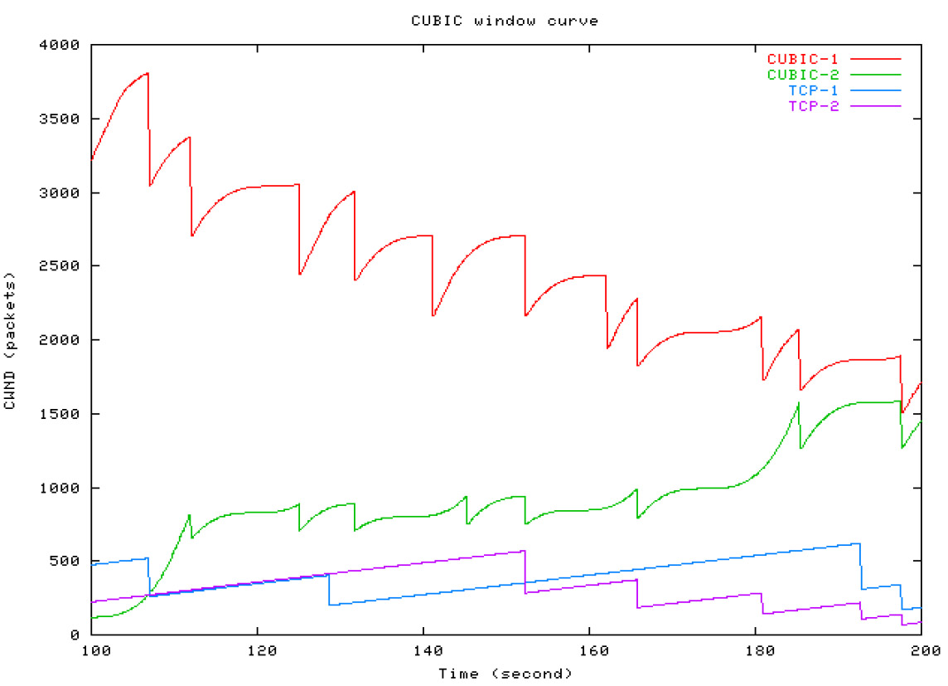
Simulations of CUBIC Flows
CUBIC
CUBIC
Reno
Reno

Slide 70
Deploying TCP Variants
TCP assumes all flows employ TCP-like congestion control
  TCP-friendly or TCP-compatible
  Violated by UDP :(
If new congestion control algorithms are developed, they must be TCP-friendly
Be wary of unforeseen interactions
  Variants work well with others like themselves
  Different variants competing for resources may trigger unfair, pathological behavior

Slide 72
Issues with TCP
The vast majority of Internet traffic is TCP
However, many issues with the protocol
  Lack of fairness
  Synchronization of flows
  Poor performance with small flows
  Really poor performance on wireless networks
  Susceptibility to denial of service

Slide 73

Fairness
Problem: TCP throughput depends on RTT
100 ms
1 Mbps
1 Mbps
1 Mbps
1 Mbps
1 Mbps
1000 ms
ACK clocking makes TCP inherently unfair
Possible solution: maintain a separate delay window
  Implemented by Microsoft’s Compound TCP

Slide 74
Synchronization of Flows
Oscillating, but high overall utilization
Ideal bandwidth sharing
cwnd
cwnd
In reality, flows synchronize
One flow causes all flows to drop packets
Periodic lulls of low utilization
cwnd

Slide 75
Small Flows
Problem: TCP is biased against short flows
  1 RTT wasted for connection setup (SYN, SYN/ACK)
  cwnd always starts at 1
Vast majority of Internet traffic is short flows
  Mostly HTTP transfers, <100KB
  Most TCP flows never leave slow start!
Proposed solutions (driven by Google):
  Increase initial cwnd to 10
  TCP Fast Open: use cryptographic hashes to identify receivers, eliminate the need for three-way handshake

Slide 76
Wireless Networks
Problem: Tahoe and Reno assume loss = congestion
  True on the WAN, bit errors are very rare
  False on wireless, interference is very common
TCP throughput ~ 1/sqrt(drop rate)
  Even a few interference drops can kill performance
Possible solutions:
  Break layering, push data link info up to TCP
  Use delay-based congestion detection (TCP Vegas)
  Explicit congestion notification (ECN)

Slide 77
Denial of Service
Problem: TCP connections require state
  Initial SYN allocates resources on the server
  State must persist for several minutes (RTO)
SYN flood: send enough SYNs to a server to allocate all memory/meltdown the kernel
Solution: SYN cookies
  Idea: don’t store initial state on the server
  Securely insert state into the SYN/ACK packet
  Client will reflect the state back to the server

Slide 78
SYN Cookies
0
5
8
31
Sequence Number
Timestamp
MSS
Crypto Hash of Client IP & Port
Did the client really send me a SYN recently?
  Timestamp: freshness check
  Cryptographic hash: prevents spoofed packets
Maximum segment size (MSS)
  Usually stated by the client during initial SYN
  Server should store this value…
  Reflect the clients value back through them

Slide 79
SYN Cookies in Practice
Advantages
  Effective at mitigating SYN floods
  Compatible with all TCP versions
  Only need to modify the server
  No need for client support
Disadvantages
  MSS limited to 3 bits, may be smaller than clients actual MSS
  Server forgets all other TCP options included with the client’s SYN
    SACK support, window scaling, etc.

Slide 81
More slides …

Slide 82
What Should the Receiver ACK?
ACK every packet
Use cumulative ACK, where an ACK for sequence n implies ACKS for all k < n
Use negative ACKs (NACKs), indicating which packet did not arrive
Use selective ACKs (SACKs), indicating those that did arrive, even if not in order
  SACK is an actual TCP extension
Notes:
Why is Cum. Ack a bad idea -> packets 0-10,000 ;; 0-999 are lost but 1000-10000 received. Cumack val = 0. Server will hold 9K bytes in buffer even though received successfully and may even retransmit them.

Slide 83
Sequence Numbers, Revisited
32 bits, unsigned
  Why so big?
For the sliding window you need…
  |Sequence # Space| > 2 * |Sending Window Size|
  2³² > 2 * 2¹⁶
Guard against stray packets
  IP packets have a maximum segment lifetime (MSL) of 120 seconds
    i.e. a packet can linger in the network for 2 minutes
  Sequence number would wrap around at 286Mbps
    What about GigE? PAWS algorithm + TCP options
Notes:
Paws = protection against wrapping sequence

Slide 84
Silly Window Syndrome
Problem: what if the window size is very small?
  Multiple, small packets, headers dominate data
Equivalent problem: sender transmits packets one byte at a time
for (int x = 0; x < strlen(data); ++x)
write(socket, data + x, 1);
Header
Data
Header
Data
Header
Data
Header
Data

Slide 85
Nagle’s Algorithm
If the window >= MSS and available data >= MSS:
  Send the data
Elif there is unACKed data:
  Enqueue data in a buffer until an ACK is received
Else: send the data
Problem: Nagle’s Algorithm delays transmissions
  What if you need to send a packet immediately?
  int flag = 1;
  setsockopt(sock, IPPROTO_TCP, TCP_NODELAY, (char *) &flag, sizeof(int));
Send a full packet
Send a non-full packet if nothing else is happening

Slide 86
Challenge of RTO in data centers
TCP Incast problem – E.g. Hadoop, Map Reduce, HDFS, GFS
Many senders sending simultaneously to receiver
Wait RTO
Challenges:
Need to break synchronization
RTO estimation designed for wide area
Data centers have much smaller RTT
Wait RTO
Wait RTO
Buffer at switch fills and packets are lost!
No ACKs will come back ☹

Slide 87
TCP Perspectives
Cerf/Kahn
  Provide flow control
  Congestion handled by retransmission
Jacobson / Karels
  Need to avoid congestion
  RTT estimates critical
  Queuing theory can help
Winstein/Balakrishnan
  TCP is maximizing an objective function
    Fairness/efficiency
    Throughput/delay
  Let a learning program pick the best fit for your environment

Slide 88
Outline
UDP
TCP
Congestion Control
Evolution of TCP
Common TCP options
Problems with TCP

Slide 89
Common TCP Options
0
4
16
31
Source Port
Destination Port
Sequence Number
Acknowledgement Number
HLen
Flags
Advertised Window
Checksum
Urgent Pointer
Options
Window scaling
SACK: selective acknowledgement
Maximum segment size (MSS)
Timestamp

Slide 90
Window Scaling
Problem: the advertised window is only 16-bits
  Effectively caps the window at 65536B, 64KB
  Example: 1.5Mbps link, 513ms RTT
(1.5Mbps * 0.513s) = 94KB
64KB / 94KB = 68% of maximum possible speed
Solution: introduce a window scaling value
  wnd = adv_wnd << wnd_scale;
  Maximum shift is 14 bits, 1GB maximum window

Slide 91
SACK: Selective Acknowledgment
Problem: duplicate ACKs only tell us about 1 missing packet
  Multiple rounds of dup ACKs needed to fill all holes
Solution: selective ACK
  Include received, out-of-order sequence numbers in TCP header
  Explicitly tells the sender about holes in the sequence
4
5
6
7
4
8
9
4
10
11
4
4
4

Slide 92
Other Common Options
Maximum segment size (MSS)
  Essentially, what is the hosts MTU
  Saves on path discovery overhead
Timestamp
  When was the packet sent (approximately)?
  Used to prevent sequence number wraparound
  PAWS algorithm

