Slide 1
TDTS21: Advanced Networking
Lecture 8: Online Social Networks
Based on slides from P. Gill
Revised 2015 by N. Carlsson

Slide 2
What are (online) social networks?
Social networks are graphs of people
Graph edges connect friends
`Friend’ has different implications
How hard is it to be Facebook `friends’?
Online social networking
Social network hosted by a Web site
Friendship represents shared interest or trust
Online friends may have never met

Slide 3
What are online social networks used for?
Popular for sharing content
Photos (Flickr), videos (YouTube), blogs (LiveJournal), profiles (Facebook, Orkut)
Fixed broadband (Sandvine Q1 2014)
YouTube 5.5% upload, 13.2% down
Facebook 2.2% upload, 2.0% down
Popular with users on the go
Mobile (Sandvine Q1 2014)
YouTube 3.8% up, 17.6% down
Facebook 27.0% up, 14.0% down

Slide 4
Why are social networks interesting?
Popular way to connect
Estimated 1.32B users online each day
Average American spends 40 minutes/day on the site
Changing the flow of information
Formerly few ``writers’’ many ``readers’’ online
Now anyone can write!
What does this mean for Internet traffic?
Important in regions with strict media controls
E.g., Iran, Egypt using social media platforms to get word out in times of unrest
Useful in times of disaster
Notes:
Stats:
http://www.dailymail.co.uk/sciencetech/article-2703440/Theres-no-escape-Facebook-set-record-stock-high-results-beats-expectations-1-32-BILLION-users-30-mobile.html

Slide 5
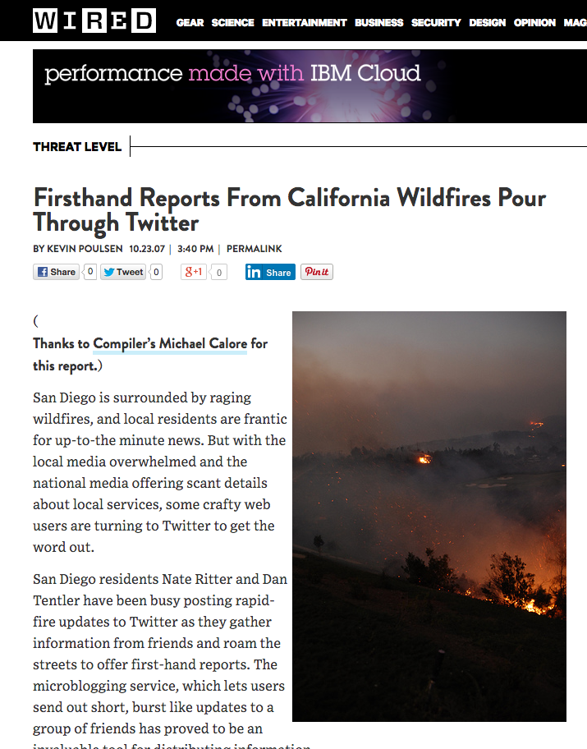
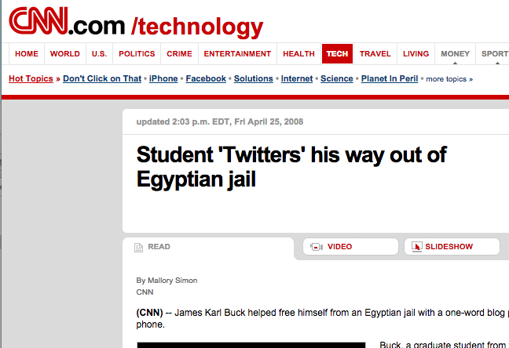
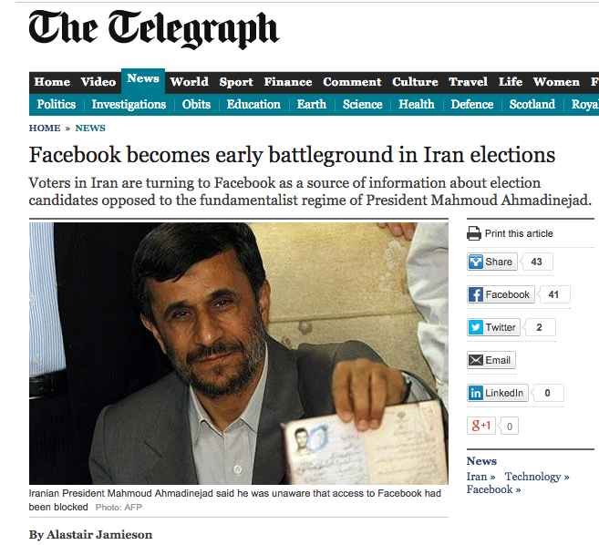
Notable incidents …

Slide 6
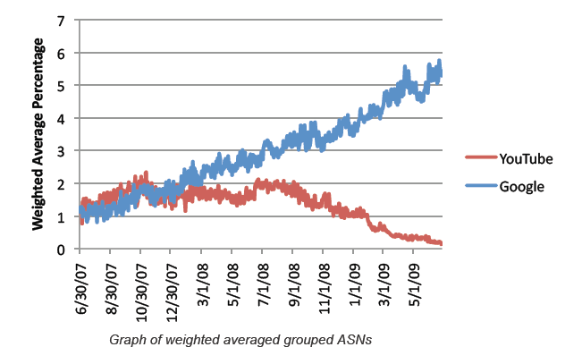
Not just a social phenomenon…
Facebook now contains photo and video
→ Content delivery challenges!
YouTube is a large fraction of Google’s traffic!
Understanding properties of these networks is important to understand how we build systems to support them!

Slide 8
A few words about “Rich get richer” and “Preferential attachment”

Slide 9
A few chirps about Twitter
… by Krishnamurthy, Gill, and Arlitt

Slide 10
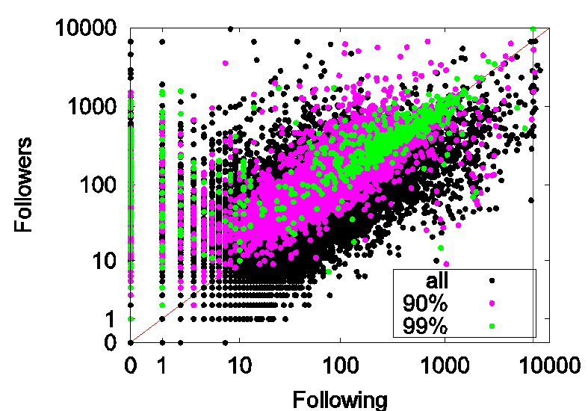
Aside: User relationships on Twitter
Acquaintances
Similar number of followers and following
Along the diagonal
Green portion is top 1-percentile of tweeters
14

Slide 11
Aside: User relationships on Twitter
Broadcasters
News outlets, radio stations
No reason to follow anyone
Post playlists, headlines
13

Slide 12
Aside: User relationships on Twitter
Miscreants?
Some people follow many users (programmatically)
Hoping some will follow them back
Spam, widgets, celebrities (at top)
15

Slide 13
Aside: User relationships on Twitter
Twitter noticed the miscreants…
… enacted the 10% rule (you can follow 10% more people than follow you)

Slide 14
Evolution of an Online Social Aggregation Network: An Empirical Study
by Garg et al.

Slide 15
[Garg et al. IMC ‘09]
An online social service aggregator
A glimpse into service popularity and usage (although some bias)
Link formation:
Can preferential attachment explain link formations? Any impact of node age?
What influence does factors such as proximity and group affiliation have in link formations?
Notes:
This paper studies how the social network graph of an online social aggregator evolves. The aggregator considered is FF.
The work here focuses on two aspects:
applicability of PA for modeling evolution of this network, and the impact of age?
2) Influence of factors such as proximity and group affiliation (explained later in the talk) on network graph evolution.

Slide 16
[Garg et al. IMC ‘09]
C
D
B
B follows C
B is follower of C
C is friend of B
A
Notes:
Social aggregators collate information of activity of a user on various services and enables easy dissemination of this information.
In our example, B follows C; B is the follower of C and C is the friend of B. Because of aggregation B sees all activity of C on Twitter and YouTube.
FF allows some aggregation from 50 odd services.
Note that the relationships are unidirectional; B follows C but C does not follow B.

Slide 17
Preferential Attachment (PA)
Does PA explain the observed data ?
p_{i} proportional to k_{i}^{α}
For source node selection (Out-degree, α = 0.8)
For destination node selection (In-degree, α = 0.9)
A
B
C
Notes:
For FF, we looked at the applicability of Preferential Attachment: that is new links preferentially go to nodes with many links.
We looked at two variants:
Source node selection: the probability p that new links originate from a node with out-degree k is proportional to k^(alpha).
So if alpha = 1, then in our example above, the node with 3 out-going links is 3 times more likely to generate a new out-going link than the node with 1 out-going link.
Similarly, we looked at the selection of destination nodes based on the number of in-bound edges to a node.
For source selection alpha was about 0.8 and for destination selection it is about 0.9. So PA seems to apply.

Slide 18
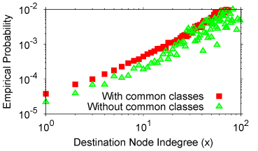
Group Affiliation & Link Formation
We considered subscription to common services as an indicator of common interest.
Source nodes younger than 50 days
Notes:
Next, we look at the influence of group affiliation on edge formations.
The figure shows the empirical probability of edge formation between nodes as a function of the node in-degree for two cases: nodes share a common service, do not share a common service. Note that the y-axis is on a log scale.
It appears that group affiliation may be a factor when the destination node doesn’t have a high in-degree.

Slide 20
OSNs: Wrap up
Many different types of OSNs
Photos, video, profile-based
Some extremely popular source of much Internet traffic
Facebook, YouTube
New ones emerging
Instagram, snapchat
Old ones fading
MySpace, Friendster
Studying their properties can inform how we build networks and systems to support them!

