Slide 1
TDTS21 Advanced Networking
Lecture 5: Multipath TCP …
Based on slides from J. Rexford
Revised Spring 2015 by N. Carlsson

Slide 2
Multipath
Mobile user
WiFi and cellular at the same time
High-end servers
Multiple Ethernet cards
Data centers
Rich topologies with many paths
Benefits of multipath
Higher throughput
Failover from one path to another
Seamless mobility

Slide 3
Bringing Multipath to the End Host
Multiple addresses
One or more addresses at an end host
E.g., one per interface card
Multiple paths
Sequence of links between sender and receiver
E.g., four-tuple of source and dest address and port
Multiple subflows
Flow of TCP segments over an individual path
All associated with a single TCP connection

Slide 4
Keeping the Same Socket API
Backwards compatibility with existing apps
Present the same socket API and expectations
Establish the TCP connection in the same way
Create a socket to a single remote IP address/port
… and then add more subflows to the connection
Work in all scenarios where regular TCP works
If a subflow fails, the connection should continue
… as long as some other subflow has connectivity

Slide 5
MPTCP in the Network Stack
From http://queue.acm.org/detail.cfm?id=2591369

Slide 6
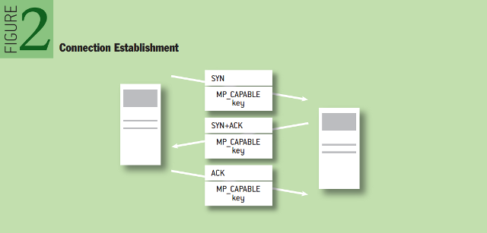
Negotiating MTTCP Capability
How do end-points know they both speak MPTCP?
During the 3-way SYN/SYN-ACK/ACK handshake

Slide 8
Use of Multipath TCP in iOS 7
Multipath TCP in iOS 7
Primary TCP connection over WiFi
Backup TCP connection over cellular data
Failover
If WiFi becomes unavailable…
… iOS 7 will use the cellular data connection
For destinations controlled by Apple
E.g., Siri

Slide 9
Multipath Congestion Control
Slides from Damon Wischik

Slide 10
Goal #1: Fair at Shared Bottlenecks
To be fair, Multipath TCP should take as much capacity as TCP at a bottleneck link, no matter how many paths it is using.
A multipath TCP flow with two subflows
Regular TCP
Notes:
This is the very first thing that comes to mind with multipath TCP, and it’s something that many other people have solved in different ways.
This is just a warm-up... Design Goal 3 is a much “richer” generalization of this goal, which accommodates different topologies, different RTTs. So there’s no point giving an evaluation here.

Slide 11
Use Efficient Paths
Each flow has a choice of a 1-hop and a 2-hop path.
How should split its traffic?
12Mb/s
12Mb/s
12Mb/s
Notes:
I’m thinking of the paths as given. MPTCP has the choice of how to split its traffic over those given paths.

Slide 12
Use Efficient Paths
12Mb/s
If each flow split its traffic 1:1 ...
8Mb/s
8Mb/s
12Mb/s
8Mb/s
12Mb/s

Slide 13
Use Efficient Paths
If each flow split its traffic 2:1 ...
12Mb/s
9Mb/s
9Mb/s
12Mb/s
9Mb/s
12Mb/s

Slide 14
Use Efficient Paths
12Mb/s
12Mb/s
Better: Each connection on a one-hop path
Each connection should send all traffic on the least-congested paths
12Mb/s
12Mb/s
12Mb/s
12Mb/s

Slide 15
Use Efficient Paths
Better: Each connection on a one-hop path
Each connection should send all traffic on the least-congested paths
But keep some traffic on the alternate paths as a probe
12Mb/s
12Mb/s
12Mb/s
12Mb/s
12Mb/s
12Mb/s

