Slide 1
TDTS21: Advanced Networking
Lecture 7: IP and Intra Domain Routing
Based on slides from P. Gill and D. Choffnes
Revised 2015 by N. Carlsson

Slide 2
Internet Routing
Internet organized as a two level hierarchy
First level – autonomous systems (AS’s)
AS – region of network under a single administrative domain
Examples: Comcast, AT&T, Verizon, Sprint, etc.
AS’s use intra-domain routing protocols internally
Distance Vector, e.g., Routing Information Protocol (RIP)
Link State, e.g., Open Shortest Path First (OSPF)
Connections between AS’s use inter-domain routing protocols
Border Gateway Routing (BGP)
De facto standard today, BGP-4

Slide 3
AS Example
AS-1
AS-3
Interior Routers
AS-2
BGP Routers

Slide 4
Why Do We Need ASs?
Routing algorithms are not efficient enough to execute on the entire Internet topology
Different organizations may use different routing policies
Allows organizations to hide their internal network structure
Allows organizations to choose how to route across each other (BGP)
Easier to compute routes
Greater flexibility
More autonomy/independence

Slide 6
How to find a good path?

Slide 7
Routing on a Graph
Goal: determine a “good” path through the network from source to destination
What is a good path?
Usually means the shortest path
Load balanced
Lowest $$$ cost
Network modeled as a graph
Routers → nodes
Link → edges
Edge cost: delay, congestion level, etc.
5
3
B
C
5
2
A
2
1
F
3
1
D
E
2
1

Slide 8
Routing Problems
Assume
A network with N nodes
Each node only knows
Its immediate neighbors
The cost to reach each neighbor
How does each node learn the shortest path to every other node?
5
3
B
C
5
2
A
2
1
F
3
1
D
E
2
1

Slide 10
Intra-domain Routing Protocols
Distance vector
Routing Information Protocol (RIP), based on Bellman-Ford
Routers periodically exchange reachability information with neighbors
Link state
Open Shortest Path First (OSPF), based on Dijkstra
Each network periodically floods immediate reachability information to all other routers
Per router local computation to determine full routes

Slide 11
Distance Vector Routing
What is a distance vector?
Current best known cost to reach a destination
Idea: exchange vectors among neighbors to learn about lowest cost paths
No entry for C
Initially, only has info for immediate neighbors
Other destinations cost = ∞
Eventually, vector is filled
Destination | Cost
A | 7
B | 1
D | 2
E | 5
F | 1
DV Table
at Node C
Routing Information Protocol (RIP)

Slide 12
Distance Vector Routing Algorithm
Wait for change in local link cost or message from neighbor
Recompute distance table
If least cost path to any destination has changed, notify neighbors

Slide 13
Link State Routing
Each node knows its connectivity and cost to direct neighbors
Each node tells every other node this information
Each node learns complete network topology
Use Dijkstra to compute shortest paths
Notes:
Why can we get away with this

Slide 14
Link State vs. Distance Vector
 | Link State | Distance Vector
Message Complexity | O(n²*e) | O(d*n*k)
Time Complexity | O(n*log n) | O(n)
Convergence Time | O(1) | O(k)
Robustness | Nodes may advertise incorrect link costs Each node computes their own table | Nodes may advertise incorrect path cost Errors propagate due to sharing of DV tables
Which is best?
In practice, it depends.
In general, link state is more popular.
n = number of nodes in the graph
d = degree of a given node
k = number of rounds

Slide 15
Additional organization in Large ASes
OSPF
IS-IS
Organized around overlapping areas
Area 0 is the core network
Organized as a 2-level hierarchy
Level 2 is the backbone
Area 1
Area 2
Level 1
Level 1-2
Level 2
Area 0
Area 4
Area 3

Slide 17
Possible Addressing Schemes
Flat
e.g. each host is identified by a 48-bit MAC address
Router needs an entry for every host in the world
Too big
Too hard to maintain (hosts come and go all the time)
Too slow (more later)
Hierarchy
Addresses broken down into segments
Each segment has a different level of specificity
Notes:
If time, show correlation between lookup speed and maximum line rate

Slide 18
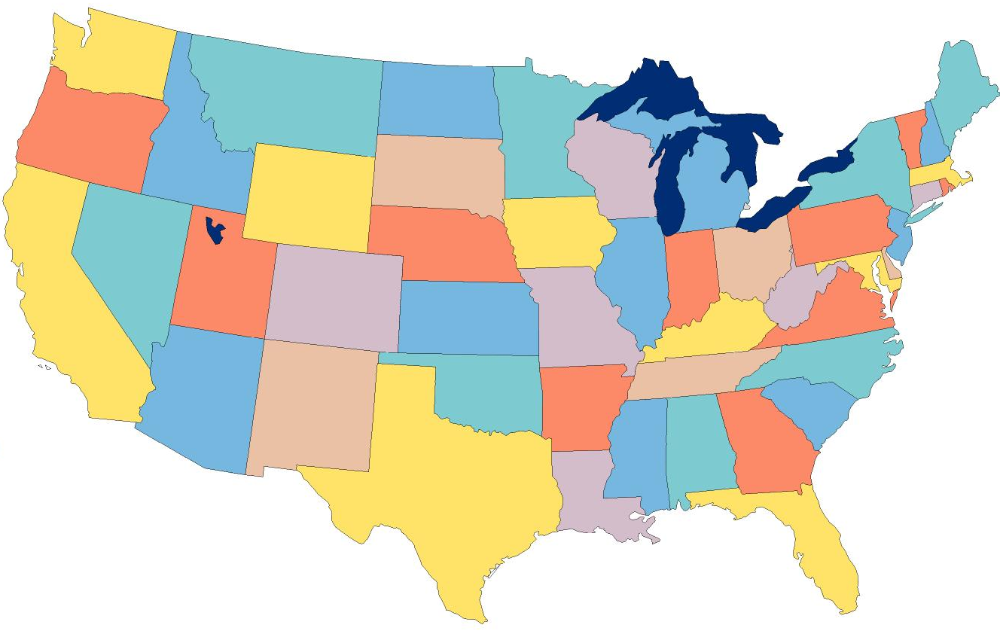
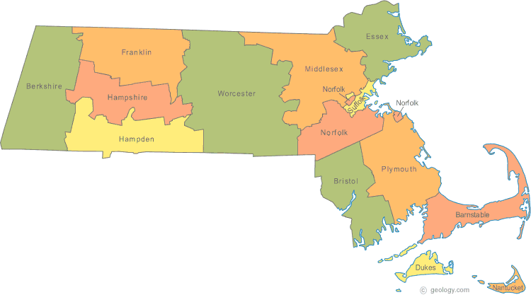
Example: Telephone Numbers
1-617-373-1234
3278
Very General
West Village H
Room 256
West Village G
Room 1234
Updates are Local
Very Specific

Slide 19
IP Addressing and Forwarding
Routing Table Requirements
For every possible IP, give the next hop
But for 32-bit addresses, 2³² possibilities!
Too slow: 48GE ports and 4x10GE needs 176Gbps bandwidth DRAM: ~1-6 Gbps; TCAM is fast, but 400x cost of DRAM
Hierarchical address scheme
Separate the address into a network and a host
0
31
Pfx
Network
Host
Known by all routers
Known by edge (LAN) routers

Slide 20
Aggregation with CIDR
Classless inter-domain routing (CIDR)
Allow variable sized network parts (prefixes)
One organization given contiguous IP ranges
Example: Microsoft, 207.46.192.* – 207.46.255.*
Specified as CIDR address 207.46.192.0/18
0
8
16
24
31
Decimal
207
46
192
0
Hex
CF
2E
C0
00
Binary
11001111
00101110
11xxxxxx
xxxxxxxx
18 Bits Frozen By Netmask
14 Arbitrary Bits

Slide 21
Example CIDR Routing Table
Address | Netmask | Third Byte | Byte Range
207.46.0.0 | 19 | 000xxxxx | 0 – 31
207.46.32.0 | 19 | 001xxxxx | 32 – 63
207.46.64.0 | 19 | 010xxxxx | 64 – 95
207.46.128.0 | 18 | 10xxxxxx | 128 – 191
207.46.192.0 | 18 | 11xxxxxx | 192 – 255
Hole in the Routing Table: No coverage for 96 – 127
207.46.96.0/19

Slide 22
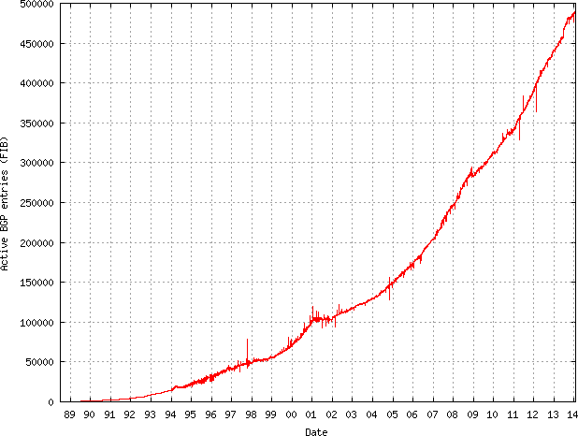
Size of CIDR Routing Tables
From www.cidr-report.org
CIDR has kept IP routing table sizes in check
Currently ~500,000 entries for a complete IP routing table
Only required by backbone routers

Slide 23
We had a special day this summer!
512K day – August 12, 2014
Default threshold size for IPv4 route data in older Cisco routers → 512K routes
Some routers failed over to slower memory
RAM vs. CAM (content addressable memory)
Some routes dropped
Cisco issues update in May anticipating this issue
Reallocated some IPv6 space for IPv4 routes
http://cacm.acm.org/news/178293-internet-routing-failures-bring-architecture-changes-back-to-the-table/fulltext

Slide 24
How Do You Get IPs?
IP address ranges controlled by IANA
Internet Assigned Number Authority
Roots go back to 1972, ARPANET, UCLA
Today, part of ICANN
IANA grants IPs to regional authorities (RIRs)
E.g., RIPE (Europe, Middle East), ARIN (North America), APNIC (Asia/Pacific), AfriNIC (Africa), and LACNIC (Latin America) may grant you a range of IPs
You may then advertise routes to your new IP range
There are now secondary markets, auctions, …

Slide 25
The IPv4 Address Space Crisis
Problem: the IPv4 address space is too small
2³² = 4,294,967,296 possible addresses
Less than one IP per person
Parts of the world have already run out of addresses
IANA assigned the last /8 block of addresses in 2011
Region | Regional Internet Registry (RIR) | Exhaustion Date
Asia/Pacific | APNIC | April 19, 2011
Europe/Middle East | RIPE | September 14, 2012
North America | ARIN | 13 Jan 2015 (Projected)
South America | LACNIC | 13 Jan 2015 (Projected)
Africa | AFRINIC | 17 Jan 2022(Projected)

Slide 26
IPv6
IPv6, first introduced in 1998(!)
128-bit addresses
4.8 * 10²⁸ addresses per person
Address format
8 groups of 16-bit values, separated by ‘:’
Leading zeroes in each group may be omitted
Groups of zeroes can be omitted using ‘::’
2001:0db8:0000:0000:0000:ff00:0042:8329
2001:0db8:0:0:0:ff00:42:8329
2001:0db8::ff00:42:8329

Slide 27
IPv4 Header
IP Datagrams are like a letter
Totally self-contained
Include all necessary addressing information
No advanced setup of connections or circuits
0
4
8
12
16
19
24
31
Version
HLen
DSCP/ECN
Datagram Length
Identifier
Flags
Offset
TTL
Protocol
Checksum
Source IP Address
Destination IP Address
Options (if any, usually not)
Data

Slide 28
IPv4 Header
IP Datagrams are like a letter
Totally self-contained
Include all necessary addressing information
No advanced setup of connections or circuits
0
4
8
12
16
19
24
31
Version
HLen
DSCP/ECN
Datagram Length
Identifier
Flags
Offset
TTL
Protocol
Checksum
Source IP Address
Destination IP Address
Options (if any, usually not)
Data

Slide 29
IPv6 Header
Double the size of IPv4 (320 bits vs. 160 bits)
0
4
8
12
16
19
24
31
Version
DSCP/ECN
Flow Label
Datagram Length
Next Header
Hop Limit
Version = 6
Same as IPv4
Groups packets into flows, used for QoS
Source IP Address
Same as IPv4
Same as Protocol in IPv4
Same as TTL in IPv4
Destination IP Address

Slide 30
Deployment Challenges
HTTP, FTP, SMTP, RTP, IMAP, …
TCP, UDP, ICMP
IPv4
Ethernet, 802.11x, DOCSIS, …
Fiber, Coax, Twisted Pair, Radio, …
Switching to IPv6 is a whole-Internet upgrade
All routers, all hosts
ICMPv6, DHCPv6, DNSv6
2013: 0.94% of Google traffic was IPv6, 2.5% today

Slide 31
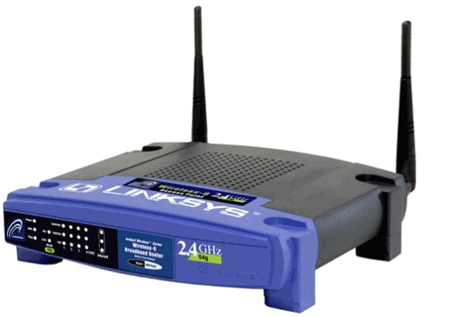
Transitioning to IPv6
How do we ease the transition from IPv4 to IPv6?
Today, most client devices are IPv6 ready
Windows/OSX/iOS/Android all support IPv6
Your wireless access point probably supports IPv6
The end-to-end network is harder to upgrade
… but a IPv4 core cannot route IPv6 traffic
IPv6 Ready
IPv4 Only :(
IPv6 Ready
IPv6 Packets
Home
Network
Core
Internet
Business
Network

Slide 32
Transition Technologies
How do you route IPv6 packets over an IPv4 Internet?
Transition Technologies
Use tunnels to encapsulate and route IPv6 packets over the IPv4 Internet
Several different implementations
6to4
IPv6 Rapid Deployment (6rd)
Teredo
… etc.

Slide 33
Tunneling
A
B
E
F
Logical view:
tunnel
IPv6
IPv6
IPv6
IPv6
A
B
C
D
E
F
Physical view:
IPv6
IPv6
IPv4
IPv4
IPv6
IPv6
Flow: X
Src: A
Dest: F
data
Src:B
Dest: E
Src:B
Dest: E
Flow: X
Src: A
Dest: F
data
Flow: X
Src: A
Dest: F
data
Flow: X
Src: A
Dest: F
data
A-to-B:
IPv6
B-to-C:
IPv6 inside
IPv4
B-to-C:
IPv6 inside
IPv4
E-to-F:
IPv6

Slide 36
More slides …

Slide 38
Differences from IPv4 Header
Several header fields are missing in IPv6
Header length – rolled into Next Header field
Checksum – was useless, so why keep it
Identifier, Flags, Offset
IPv6 routers do not support fragmentation
Hosts are expected to use path MTU discovery
Reflects changing Internet priorities
Today’s networks are more homogeneous
Instead, routing cost and complexity dominate

Slide 39
Performance Improvements
No checksums to verify
No need for routers to handle fragmentation
Simplified routing table design
Address space is huge
No need for CIDR (but need for aggregation)
Standard subnet size is 2⁶⁴ addresses
Simplified auto-configuration

Slide 40
Additional IPv6 Features
Source Routing
Host specifies the route to wants packet to take
Mobile IP
Hosts can take their IP with them to other networks
Use source routing to direct packets
Privacy Extensions
Randomly generate host identifiers
Make it difficult to associate one IP to a host
Jumbograms
Support for 4Gb datagrams

Slide 41
Consequences of IPv6
Beware unintended consequences of IPv6
Example: IP blacklists
Currently, blacklists track IPs of spammers/bots
Few IPv4 addresses mean list sizes are reasonable
Hard for spammers/bots to acquire new IPs
Blacklists will not work with IPv6
Address space is enormous
Acquiring new IP addresses is trivial

Slide 43
6to4 Basics
Problem: you’ve been assigned an IPv4 address, but you want an IPv6 address
Your ISP can’t or won’t give you an IPv6 address
You can’t just arbitrarily choose an IPv6 address
Solution: construct a 6to4 address
6to4 addresses always start with 2002::
Embed the 32-bit IPv4 inside the 128-bit IPv6 address
IPv4:
207.
46.
192.
0
IPv6:
20 02:
CF 2E:
C0 00:
0000

Slide 44
Routing from 6to4 to 6to4
How does a host using 6to4 send a packet to another host using 6to4?
Dest: 16.79.8.0
Dest: 2002:104F:0800::
IPv4
Internet
IPv4 – 207.46.192.0
IPv6 – 2002:CF2E:C000::
IPv4 – 16.79.8.0
IPv6 – 2002:104F:0800::

Slide 45
Routing from 6to4 to Native IPv6
Special, anycasted IPv4 address for
6to4 Relay Routers
Dest: 192. 88.99.1
Dest: 1893:92:13:99::
IPv4
Internet
IPv4 – 192.88.99.1
IPv6 – 2002:: /16
IPv4 – 207.46.192.0
IPv6 – 2002:CF2E:C000::
IPv6
Internet
Many ISPs provide 6to4 relay routers
IPv6 – 1893:92:13:99::

Slide 46
Routing from Native IPv6 to 6to4
IPv4
Internet
Dest: 207.46.192.0
IPv4 – 192.88.99.1
IPv6 – 2002:: /16
IPv4 – 207.46.192.0
IPv6 – 2002:CF2E:C000::
IPv6
Internet
Dest: 2002:CF2E:C000::
Use normal IPv6 routing to reach a 6to4 relay router
IPv6 – 1893:92:13:99::

Slide 47
Problems with 6to4
Uniformity
Not all ISPs have deployed 6to4 relays
Quality of service
Third-party 6to4 relays are available
…but, they may be overloaded or unreliable
Reachability
6to4 doesn’t work if you are behind a NAT
Possible solutions
IPv6 Rapid Deployment (6rd)
Each ISP sets up relays for its customers
Does not leverage the 2002:: address space
Teredo
Tunnels IPv6 packets through UDP/IPv4 tunnels
Can tunnel through NATs, but requires special relays

Slide 48
Network Layer, Control Plane
Function:
Set up routes within a single network
Key challenges:
Distributing and updating routes
Convergence time
Avoiding loops
Data Plane
Application
Transport
Network
RIP
OSPF
BGP
Control Plane
Data Link
Physical

Slide 49
Internet Routing
Internet organized as a two level hierarchy
First level – autonomous systems (AS’s)
AS – region of network under a single administrative domain
Examples: Comcast, AT&T, Verizon, Sprint, etc.
AS’s use intra-domain routing protocols internally
Distance Vector, e.g., Routing Information Protocol (RIP)
Link State, e.g., Open Shortest Path First (OSPF)
Connections between AS’s use inter-domain routing protocols
Border Gateway Routing (BGP)
De facto standard today, BGP-4

Slide 50
AS Example
AS-1
AS-3
Interior Routers
AS-2
BGP Routers

Slide 51
Why Do We Need ASs?
Routing algorithms are not efficient enough to execute on the entire Internet topology
Different organizations may use different routing policies
Allows organizations to hide their internal network structure
Allows organizations to choose how to route across each other (BGP)
Easier to compute routes
Greater flexibility
More autonomy/independence

Slide 52
Routing on a Graph
Goal: determine a “good” path through the network from source to destination
What is a good path?
Usually means the shortest path
Load balanced
Lowest $$$ cost
Network modeled as a graph
Routers → nodes
Link → edges
Edge cost: delay, congestion level, etc.
5
3
B
C
5
2
A
2
1
F
3
1
D
E
2
1

Slide 53
Routing Problems
Assume
A network with N nodes
Each node only knows
Its immediate neighbors
The cost to reach each neighbor
How does each node learn the shortest path to every other node?
5
3
B
C
5
2
A
2
1
F
3
1
D
E
2
1

Slide 54
Intra-domain Routing Protocols
Distance vector
Routing Information Protocol (RIP), based on Bellman-Ford
Routers periodically exchange reachability information with neighbors
Link state
Open Shortest Path First (OSPF), based on Dijkstra
Each network periodically floods immediate reachability information to all other routers
Per router local computation to determine full routes

Slide 55
Outline
Distance Vector Routing
RIP
Link State Routing
OSPF
IS-IS

Slide 56
Distance Vector Routing
What is a distance vector?
Current best known cost to reach a destination
Idea: exchange vectors among neighbors to learn about lowest cost paths
No entry for C
Initially, only has info for immediate neighbors
Other destinations cost = ∞
Eventually, vector is filled
Destination | Cost
A | 7
B | 1
D | 2
E | 5
F | 1
DV Table
at Node C
Routing Information Protocol (RIP)

Slide 57
Distance Vector Routing Algorithm
Wait for change in local link cost or message from neighbor
Recompute distance table
If least cost path to any destination has changed, notify neighbors

Slide 58
Distance Vector Initialization
Node A
Node B
3
B
D
Dest. | Cost | Next
B | 2 | B
C | 7 | C
D | ∞
Dest. | Cost | Next
A | 2 | A
C | 1 | C
D | 3 | D
2
1
1
A
7
C
Initialization:
for all neighbors V do
if V adjacent to A
D(A, V) = c(A,V);
else
D(A, V) = ∞;
…
Node D
Node C
Dest. | Cost | Next
A | 7 | A
B | 1 | B
D | 1 | D
Dest. | Cost | Next
A | ∞
B | 3 | B
C | 1 | C

Slide 59
Distance Vector: 1st Iteration
Node A
Node B
3
B
D
Dest. | Cost | Next
B | 2 | B
C | 7 | C
D | ∞
Dest. | Cost | Next
A | 2 | A
C | 1 | C
D | 3 | D
2
1
1
3
B
A
7
C
5
8
C
B
2
C
…
loop:
…
else if (update D(V, Y) received from V)
for all destinations Y do
if (destination Y through V)
D(A,Y) = D(A,V) + D(V, Y);
else
D(A, Y) =
min(D(A, Y),
D(A, V) + D(V, Y));
if (there is a new min. for dest. Y)
send D(A, Y) to all neighbors
forever
D(A,C) = min(D(A,C), D(A,B)+D(B,C))
= min(7, 2 + 1) = 3
Node C
Node D
D(A,D) = min(D(A,D), D(A,B)+D(B,D))
= min(8, 2 + 3) = 5
D(A,D) = min(D(A,D), D(A,C)+D(C,D))
= min(∞, 7 + 1) = 8
Dest. | Cost | Next
A | 7 | A
B | 1 | B
D | 1 | D
Dest. | Cost | Next
A | ∞
B | 3 | B
C | 1 | C
3
B
4
B

Slide 60
Distance Vector: End of 3rd Iteration
Node A
Node B
3
B
D
Dest. | Cost | Next
B | 2 | B
C | 3 | B
D | 4 | B
Dest. | Cost | Next
A | 2 | A
C | 1 | C
D | 2 | C
2
1
1
A
7
C
…
loop:
…
else if (update D(V, Y) received from V)
for all destinations Y do
if (destination Y through V)
D(A,Y) = D(A,V) + D(V, Y);
else
D(A, Y) =
min(D(A, Y),
D(A, V) + D(V, Y));
if (there is a new min. for dest. Y)
send D(A, Y) to all neighbors
forever
Nothing changes, algorithm terminates
Until something changes…
Node C
Node D
Dest. | Cost | Next
A | 3 | B
B | 1 | B
D | 1 | D
Dest. | Cost | Next
A | 4 | C
B | 2 | C
C | 1 | C

Slide 61
loop:
wait (link cost update or update message)
if (c(A,V) changes by d)
for all destinations Y through V do
D(A,Y) = D(A,Y) + d
else if (update D(V, Y) received from V)
for all destinations Y do
if (destination Y through V)
D(A,Y) = D(A,V) + D(V, Y);
else
D(A, Y) = min(D(A, Y), D(A, V) + D(V, Y));
if (there is a new minimum for destination Y)
send D(A, Y) to all neighbors
forever
B
4
1
1
A
50
C
Link Cost Changes,
Algorithm Starts
Algorithm Terminates
Good news travels fast
D | C | N
A | 4 | A
C | 1 | B
D | C | N
A | 1 | A
C | 1 | B
D | C | N
A | 1 | A
C | 1 | B
D | C | N
A | 1 | A
C | 1 | B
Node B
D | C | N
A | 5 | B
B | 1 | B
D | C | N
A | 5 | B
B | 1 | B
D | C | N
A | 2 | B
B | 1 | B
D | C | N
A | 2 | B
B | 1 | B
Node C
Time
Notes:
Change circles to rectangles, don’t block the text

Slide 62
Count to Infinity Problem
Node B knows D(C, A) = 5
However, B does not know the path is C → B → A
Thus, D(B,A) = 6 !
B
4
60
1
A
C
Bad news travels slowly
50
D | C | N
A | 4 | A
C | 1 | B
D | C | N
A | 6 | C
C | 1 | B
D | C | N
A | 6 | C
C | 1 | B
D | C | N
A | 8 | C
C | 1 | B
Node B
D | C | N
A | 5 | B
B | 1 | B
D | C | N
A | 5 | B
B | 1 | B
D | C | N
A | 7 | B
B | 1 | B
D | C | N
A | 7 | B
B | 1 | B
Node C
Time

Slide 63
Poisoned Reverse
If C routes through B to get to A
C tells B that D(C, A) = ∞
Thus, B won’t route to A via C
B
4
60
1
Does this completely solve this count to infinity problem?
NO
Multipath loops can still trigger the issue
A
50
C
D | C | N
A | 4 | A
C | 1 | B
D | C | N
A | 60 | A
C | 1 | B
D | C | N
A | 60 | A
C | 1 | B
D | C | N
A | 51 | C
C | 1 | B
Node B
D | C | N
A | 5 | B
B | 1 | B
D | C | N
A | 5 | B
B | 1 | B
D | C | N
A | 50 | A
B | 1 | B
D | C | N
A | 50 | A
B | 1 | B
Node C
Time

Slide 64
Outline
Distance Vector Routing
RIP
Link State Routing
OSPF
IS-IS

Slide 65
Link State Routing
Each node knows its connectivity and cost to direct neighbors
Each node tells every other node this information
Each node learns complete network topology
Use Dijkstra to compute shortest paths
Notes:
Why can we get away with this

Slide 66
Flooding Details
Each node periodically generates Link State Packet
ID of node generating the LSP
List of direct neighbors and costs
Sequence number (64-bit, assumed to never wrap)
Time to live
Flood is reliable (ack + retransmission)
Sequence number “versions” each LSP
Receivers flood LSPs to their own neighbors
Except whoever originated the LSP
LSPs also generated when link states change

Slide 67
Dijkstra’s Algorithm
Step | Start S | →B | →C | →D | →E | →F
0 | A | 2, A | 5, A | 1, A | ∞ | ∞
1 | AD |  | 4, D |  | 2, D | ∞
2 | ADE |  | 3, E |  |  | 4, E
3 | ADEB
4 | ADEBC
5 | ADEBCF
5
…
Loop
find w not in S s.t. D(w) is a minimum;
add w to S;
update D(v) for all v adjacent
to w and not in S:
D(v) = min( D(v), D(w) + c(w,v) );
until all nodes in S;
3
Initialization:
S = {A};
for all nodes v
if v adjacent to A
then D(v) = c(A,v);
else D(v) = ∞;
…
B
C
5
2
A
2
1
F
3
1
2
D
E
1

Slide 68
OSPF vs. IS-IS
Two different implementations of link-state routing
OSPF
IS-IS
Favored by companies, datacenters
More optional features
Built on top of IPv4
LSAs are sent via IPv4
OSPFv3 needed for IPv6
Favored by ISPs
Less “chatty”
Less network overhead
Supports more devices
Not tied to IP
Works with IPv4 or IPv6

Slide 69
Different Organizational Structure
OSPF
IS-IS
Organized around overlapping areas
Area 0 is the core network
Organized as a 2-level hierarchy
Level 2 is the backbone
Area 1
Area 2
Level 1
Level 1-2
Level 2
Area 0
Area 4
Area 3

Slide 70
Link State vs. Distance Vector
 | Link State | Distance Vector
Message Complexity | O(n²*e) | O(d*n*k)
Time Complexity | O(n*log n) | O(n)
Convergence Time | O(1) | O(k)
Robustness | Nodes may advertise incorrect link costs Each node computes their own table | Nodes may advertise incorrect path cost Errors propagate due to sharing of DV tables
Which is best?
In practice, it depends.
In general, link state is more popular.
n = number of nodes in the graph
d = degree of a given node
k = number of rounds

