Slide 1

High-level summary …
TDTS21 Advanced Networking
Niklas Carlsson, Associate Professor
http://www.ida.liu.se/~nikca/

Slide 3
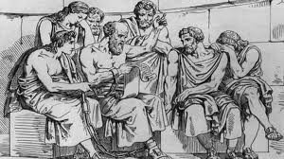
Kick starting science ...

Slide 4
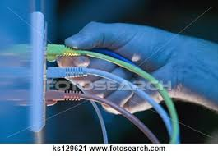
… well, cable into wall …

Slide 5

What happens there?

Slide 7

Hosts, the Internet architecture, and the E2E arguments …

Slide 8
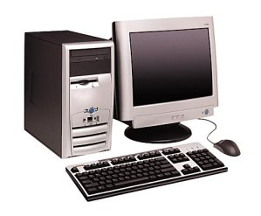
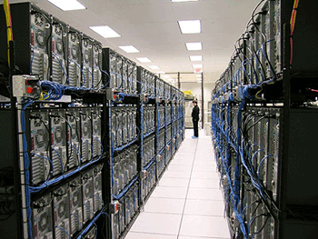
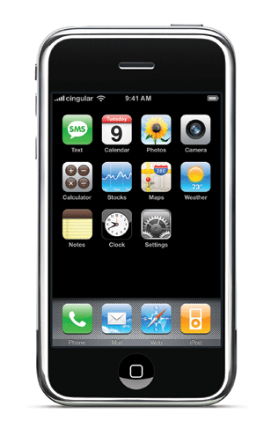

End hosts …
The Host

Slide 9

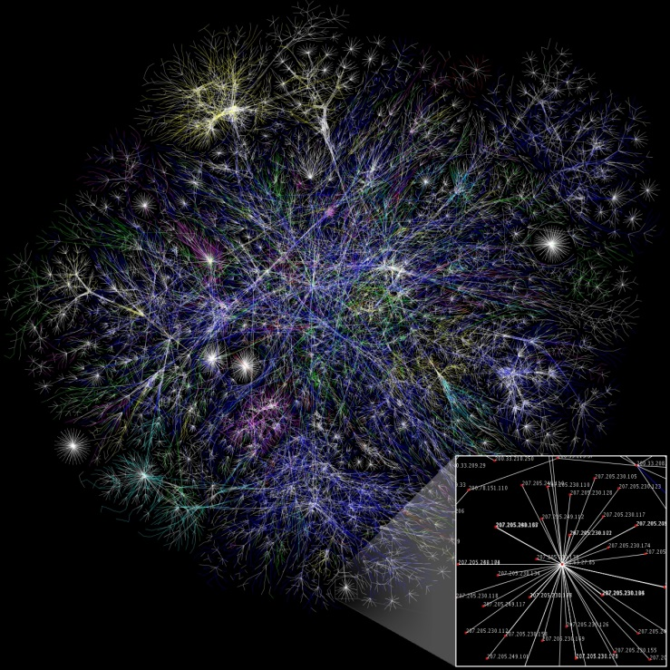
How to find who to talk to?

Slide 10

Learning a Host’s Address
me
you
adapter
adapter
Who am I?
  Hard-wired: MAC address
  Static configuration: IP interface configuration
  Dynamically learned: IP address configured by DHCP
Who are you?
  Hard-wired: IP address in a URL, or in the code
  Dynamically looked up: ARP or DNS

Slide 12
Goals of the Internet Architecture (Clark ‘88)
Connect existing networks
Robust in face of failures (not nuclear war…)
Support multiple types of services
Accommodate a variety of networks
Allow distributed management
Easy host attachment
Cost effective
Allow resource accountability
Notes:
Different types of services: e.g., even those that don’t want TCP (network debugging)
Cost effective: efficiently use the expensive communication resource. -> 40 B header “long”
Accountability becomes more important as non-military folks start to use the network

Slide 13
Real Goals
Something that works…..
Connect existing networks
Survivability (not nuclear war…)
Support multiple types of services
Accommodate a variety of networks
Allow distributed management
Easy host attachment
Cost effective
Allow resource accountability

Slide 14
Host-Network Division of Labor
Network
  Best-effort packet delivery
  Between two (or more) end-point addresses
Hosts
  Everything else
host
host
network

Slide 15
Network Stack in Practice
Host 1
Switch
Host 2
Application
Application
Presentation
Presentation
Video Client
Video Server
Session
Session
FTP Client
FTP Server
UDP
UDP
Transport
Transport
TCP
TCP
Network
Network
Network
IP
IP
IP
Data Link
Data Link
Data Link
Ethernet
Ethernet
802.11n
Ethernet
802.11n
802.11n
Physical
Physical
Physical

Slide 16
Encapsulation, Revisited
HTTP Header
Web Page
Web Server
TCP Header
HTTP Header
Web Page
TCP
TCP Segment
IP Header
TCP Header
HTTP Header
Web Page
IP
IP Datagram
Ethernet Header
IP Header
TCP Header
HTTP Header
Web Page
Ethernet Trailer
Ethernet
Ethernet Frame

Slide 17
The Hourglass
HTTP, FTP, RTP, IMAP, Jabber, …
TCP, UDP, ICMP
IPv4
Ethernet, 802.11x, DOCSIS, …
Fiber, Coax, Twisted Pair, Radio, …

Slide 18
Orthogonal Planes
Control plane: How Internet paths are established
Application
Presentation
Session
Transport
IP
BGP
RIP
OSPF
Control Plane
Data Link
Physical

Slide 19
Orthogonal Planes
Data plane: How data is forwarded over Internet paths
Host 1
Routers and Switch(es)
Host 2
Application
Application
Transport
Transport
Network
Network
Network
Data Link
Data Link
Data Link

Slide 20
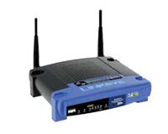


Reality Check
The layered abstraction is very nice
Does it hold in reality?
No.
Firewalls
Analyze application layer headers
Transparent Proxies
Simulate application endpoints within the network
NATs
Break end-to-end network reachability

Slide 22

Holding the Internet Together
Distributed cooperation for resource allocation
  BGP: what end-to-end paths to take (for ~50K ASes)
  TCP: what rate to send over each path (for ~3B hosts)
AS 2
AS 1
AS 3
AS 4

Slide 23

How do we find a path?

Slide 24
Routing on a Graph
Goal: determine a “good” path through the network from source to destination
What is a good path?
  Usually means the shortest path
  Load balanced
  Lowest $$$ cost
Network modeled as a graph
  Routers → nodes
  Link → edges
    Edge cost: delay, congestion level, etc.
5
3
B
C
5
2
A
2
1
F
3
1
D
E
2
1

Slide 25
Intra-domain Routing Protocols
Distance vector
  Routing Information Protocol (RIP), based on Bellman-Ford
  Routers periodically exchange reachability info with neighbors
Link state
  Open Shortest Path First (OSPF), based on Dijkstra
  Each network periodically floods neighbor information to all routers
  Routers locally compute routes
 | Link State | Distance Vector
Message Complexity | O(n²*e) | O(d*n*k)
Time Complexity | O(n*log n) | O(n)
Convergence Time | O(1) | O(k)
Robustness | Nodes may advertise incorrect link costs Each node computes their own table | Nodes may advertise incorrect path cost Errors propagate due to sharing of DV tables

Slide 26
Hierarchical addressing: route aggregation
ISP has an address block; it can further divide this block into sub blocks
and assign them to subscriber organizations.
Organization 0
200.23.16.0/23
Organization 1
200.23.18.0/23
“Send me anything
with addresses
beginning
200.23.16.0/20”
Organization 2
200.23.20.0/23
.
Fly-By-Night-ISP
.
.
.
.
Internet
Organization 7
.
200.23.30.0/23
ISPs-R-Us
“Send me anything
with addresses
beginning
199.31.0.0/16”

Slide 27
Example CIDR Routing Table
Address | Netmask | Third Byte | Byte Range
207.46.0.0 | 19 | 000xxxxx | 0 – 31
207.46.32.0 | 19 | 001xxxxx | 32 – 63
207.46.64.0 | 19 | 010xxxxx | 64 – 95
207.46.128.0 | 18 | 10xxxxxx | 128 – 191
207.46.192.0 | 18 | 11xxxxxx | 192 – 255
Hole in the Routing Table: No coverage for 96 – 127
207.46.96.0/19

Slide 28



Network of networks: BGP and ASes
AS-1
AS-3
Interior Routers
AS-2
BGP Routers

Slide 29
BGP Relationships
Provider
Peer 2 has no incentive to route 1→ 3
Peers do not pay each other
$
Customer
Provider
Customer
Peer 1
Peer 2
Peer 3
Customer pays provider
Customer

Slide 30
Importing Routes
From Provider
ISP Routes
From Peer
From Peer
From Customer

Slide 31
Exporting Routes
$$$ generating routes
Customer and ISP routes only
To Provider
To Peer
To Peer
To Customer
Customers get all routes

Slide 32

Modeling BGP
AS relationships
  Customer/provider
  Peer
  Sibling, IXP
Gao-Rexford model
  AS prefers to use customer path, then peer, then provider
    Follow the money!
  Valley-free routing
  Hierarchical view of routing (incorrect but frequently used)
P-P
P-P
C-P
P-C
P-C
P-P

Slide 33
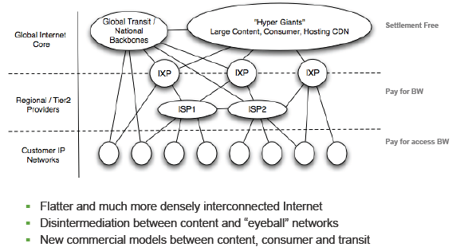
A new Internet model

Slide 35

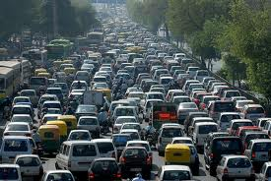
How do we avoid sending too much for the receiver and network to handle?

Slide 36
Sliding Window Example
1
2
3
4
5
6
TCP is ACK Clocked
Short RTT → quick ACK → window slides quickly
Long RTT → slow ACK → window slides slowly
7
5
6
7
Time
Time

Slide 37
Congestion Window (cwnd)
Limits how much data is in transit
Denominated in bytes
wnd = min(cwnd, adv_wnd);
effective_wnd = wnd –
(last_byte_sent – last_byte_acked);
last_byte_acked
last_byte_sent
effective_wnd
wnd

Slide 38
Congestion Avoidance Example
cwnd = 1
cwnd = 2
cwnd >= ssthresh
cwnd = 4
ssthresh = 8
cwnd (in segments)
Slow Start
cwnd = 8
cwnd = 9
Round Trip Times

Slide 39
Fast Retransmit and Fast Recovery
ssthresh
Timeout
Congestion Avoidance
Fast Retransmit/Recovery
Timeout
cwnd
Slow Start
Time
At steady state, cwnd oscillates around the optimal window size
TCP always forces packet drops

Slide 40
Compound TCP Example
Faster cwnd growth
High
RTT
Low
RTT
Slower cwnd growth
Timeout
Timeout
cwnd
Slow Start
Time
Aggressiveness corresponds to changes in RTT
Advantages: fast ramp up, more fair to flows with different RTTs
Disadvantage: must estimate RTT, which is very challenging

Slide 41
TCP CUBIC Example
Slowly accelerate to probe for bandwidth
CUBIC Function
Timeout
cwnd_{max}
cwnd
Stable
Region
Slow Start
Fast ramp up
Time
Less wasted bandwidth due to fast ramp up
Stable region and slow acceleration help maintain fairness
  Fast ramp up is more aggressive than additive increase
  To be fair to Tahoe/Reno, CUBIC needs to be less aggressive

Slide 42
Issues with TCP
The vast majority of Internet traffic is TCP
However, many issues with the protocol
  Lack of fairness
  Synchronization of flows
  Poor performance with small flows
  Really poor performance on wireless networks
  Susceptibility to denial of service

Slide 44
Multipath TCP
Each flow has a choice of a 1-hop and a 2-hop path.
How should split its traffic?
12Mb/s
12Mb/s
12Mb/s
Notes:
I’m thinking of the paths as given. MPTCP has the choice of how to split its traffic over those given paths.

Slide 45
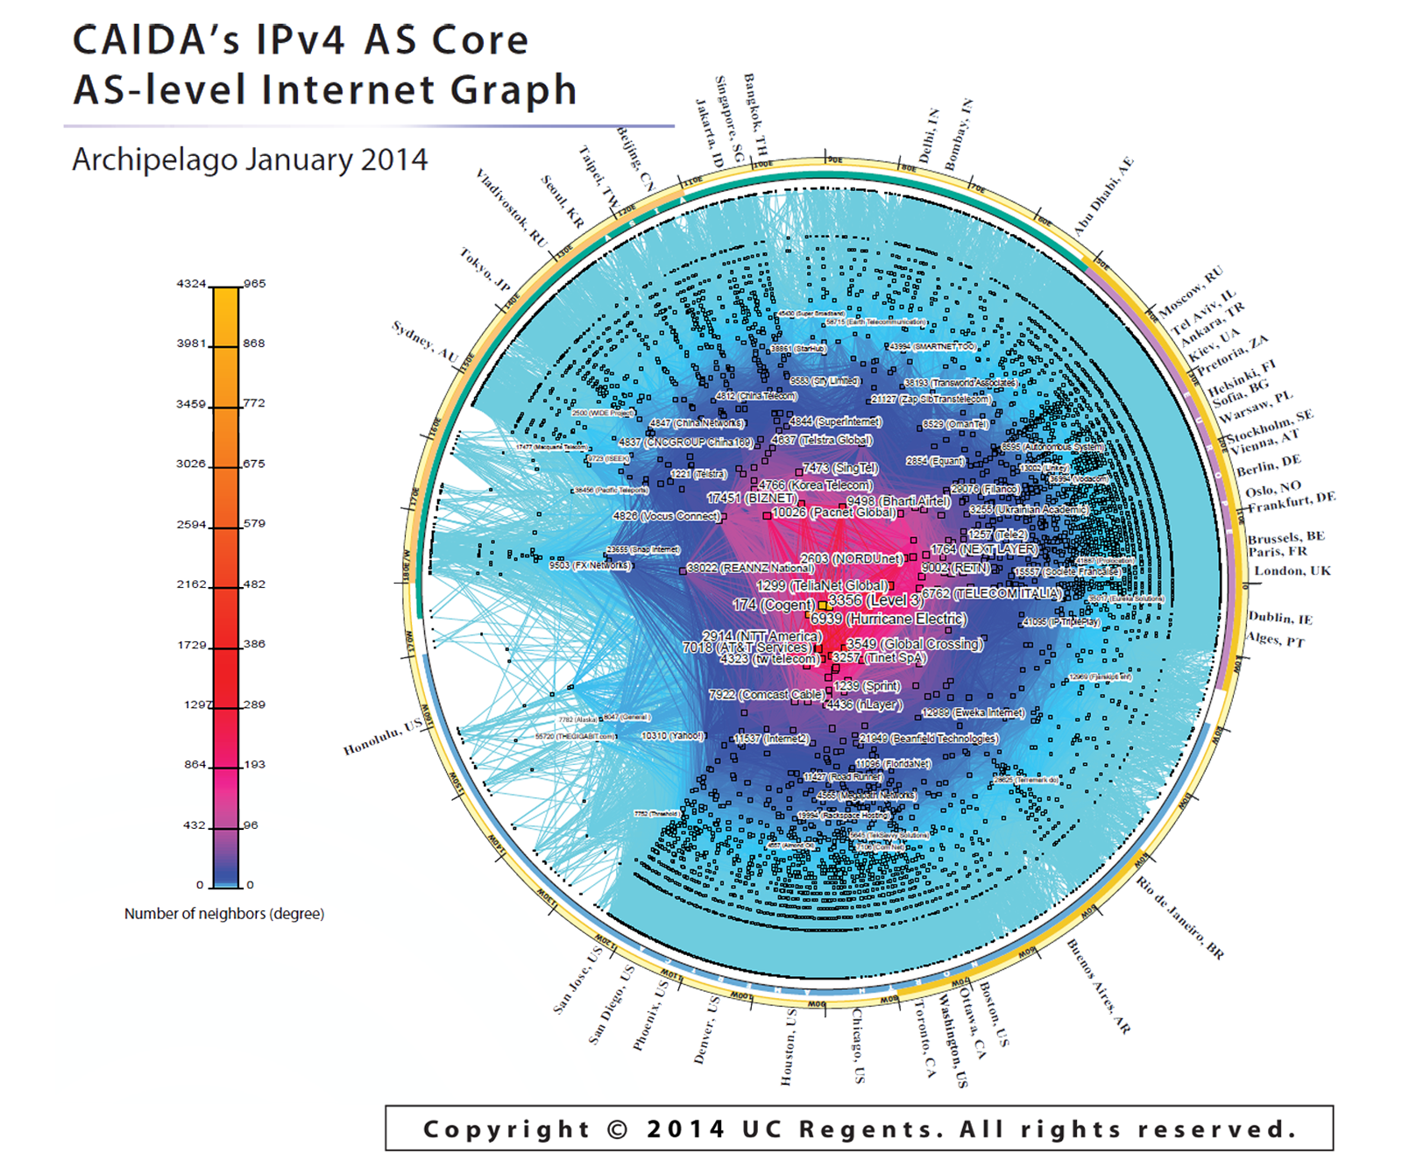
The Internet topology
15412 12041 p2c
15412 12486 p2c
15412 12880 p2c
15412 13810 p2c
15412 15802 p2c
15412 17408 p2c
15412 17554 p2c
15412 17709 p2c
15412 18101 p2c
15412 19806 p2c
19809 p2c
…

Slide 46

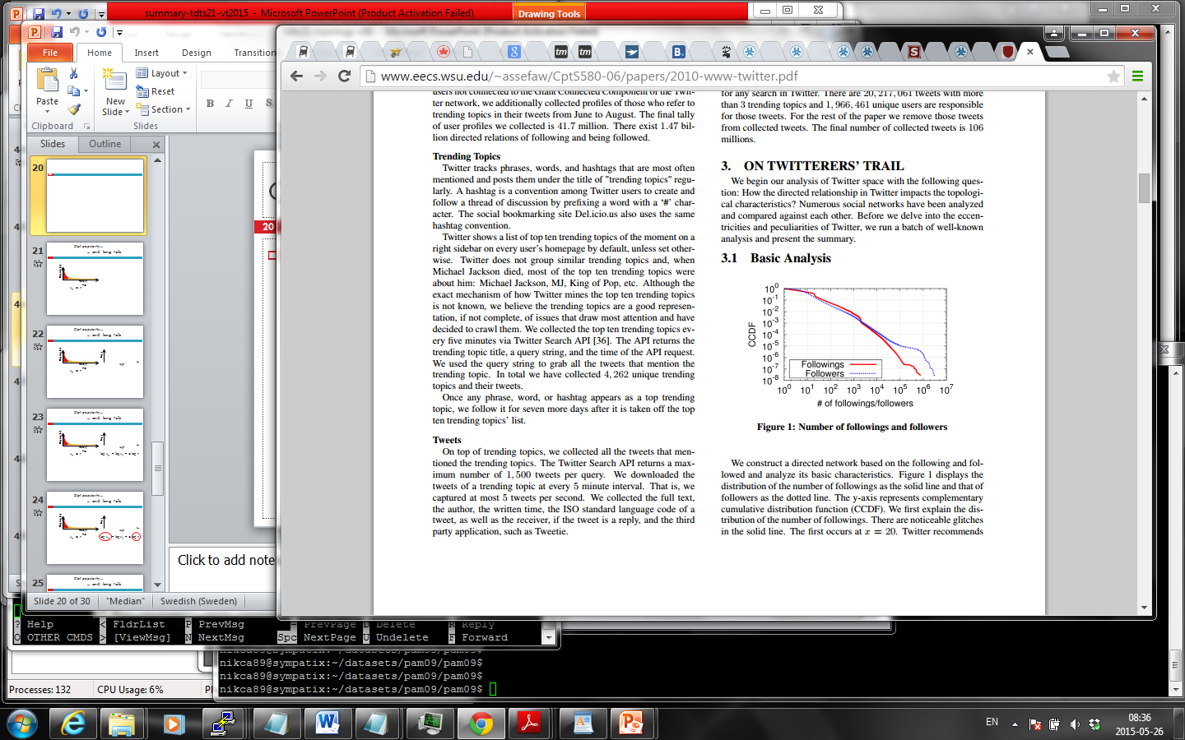





Social networks
Social networks are graphs of people

Slide 47


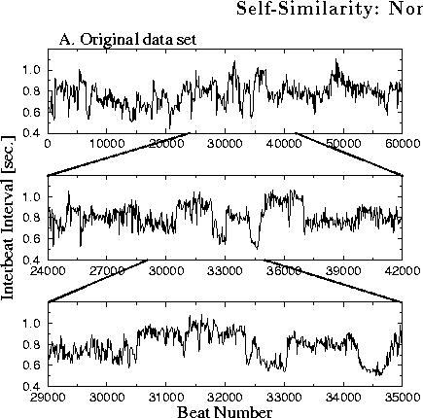
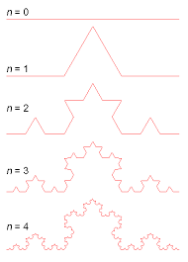
Poisson vs self similar

Slide 48
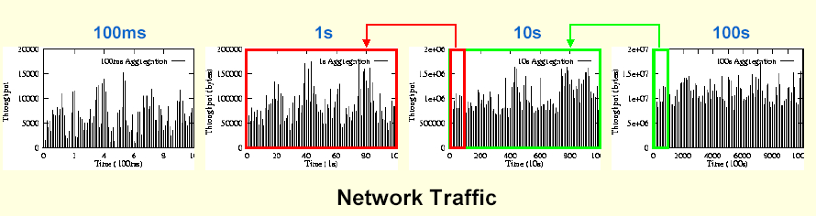
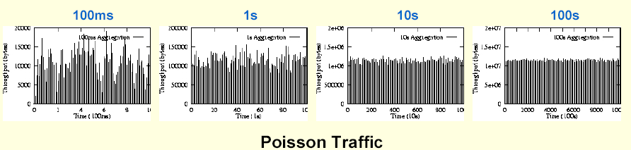
Poisson vs self similar
Others have shown that traffic is non-stationary, and may well approximated as Poisson on shorter time scales

Slide 49
Other topics covered in class
Web and web server loads
Wireless performance
HAS streaming and content popularity
Future, Content/information centric networking, and Middleboxes
SDN and Network virtualization

Slide 50

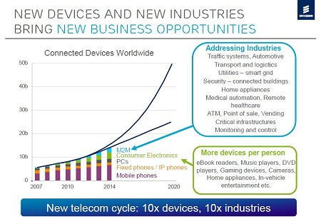
… the last topics/papers looking towards the future …
The 2020 vision
Everything that can be connected will be connected
  50B devices (perhaps more like 500B ...)
IoT and smart cities
  Machine-to-machine
High-definition 3D streaming to heterogeneous clients

Slide 52
The exam
Friday June 5, 2015
Closed book
Some “example” questions online
  For this course and offering of the course, somewhat different approach …
Bonus points from project and participation will be assigned during the exam (not before)
  See website for details

Slide 53
… more exam …
Read all instructions carefully
Please explain how you derived your answers. Your final answers should be clearly stated (and should typically include a figure or table).
Write answers legibly; no marks will be given for answers that cannot be read easily.
Where a discourse or discussion is called for, be concise and precise.
No assistance: closed book, closed notes, and no electronics ...

Slide 54
… yet more exam …
If necessary, state any assumptions you made in answering a question. However, remember to read the instructions for each question carefully and answer the questions as precisely as possible. Solving the wrong question may result in deductions! It is better to solve the right question incorrectly, than the wrong question correctly.
Please use English. (If needed, feel free to bring a dictionary from an official publisher. Hardcopy, not electronic!! Also, your dictionary is not allowed to contain any notes; only the printed text by the publisher.)

