Slide 1
TDTS11 Computer Networks and Internet Protocols
Gurjot Singh Gaba
January 2024
First part adapted from slides by
J.F. Kurose and K.W. Ross, © 1996–2020

Slide 2
Contact information
Gurjot Singh Gaba
gurjot.singh@liu.se (begin with ”TDTS11” in the email subject)

Slide 3
Overview of lessons / labs
TDTS11 Protocol Layers & Wireshark
3
Two lessons to introduce the different labs
First lesson introduces protocol layers & Wireshark (assignment 1–3)
Second lesson introduces scripts (assignment 4)
Nine* lab sessions with a total of 4 assignments
Please note that lab 4 is time-consuming, so follow the recommended deadlines

Slide 4
Protocol Layers
An introduction to Internet and protocol layers

Slide 5
Protocols
TDTS11 Protocol Layers & Wireshark
5
Hi
TCP connection request
Hi
TCP connection response
Got the time?
Get https://www.ida.liu.se/~TDTS11/
2:00
<file>
time

Slide 6
What’s the Internet: “nuts and bolts” view
TDTS11 Protocol Layers & Wireshark
6
mobile network
Billions of connected devices:
hosts = end systems
running network apps at Internet’s “edge”
national or global ISP
Packet switches: forward packets (chunks of data)
routers, switches
local or
Internet
regional ISP
Communication links
fiber, copper, radio, satellite
transmission rate: bandwidth
home network
content provider network
datacenter network
Networks
collection of devices, routers links: managed by an organization
enterprise
network

Slide 7
What’s the Internet: “nuts and bolts” view
TDTS11 Protocol Layers & Wireshark
7
mobile network _{4G}
Internet: “network of networks”
national or global ISP
Interconnected ISPs
IP
Streaming video
Protocols are everywhere
control sending, receiving of messages
e.g., HTTP (Web), streaming video, Skype, TCP, IP, WiFi, 4G, Ethernet
Skype
local or regional ISP
home network
HTTP
Ethernet
content provider network
Internet standards
RFC: Request for comments
IETF: Internet Engineering Task Force
datacenter network
TCP
enterprise
network
WiFi

Slide 8
Internet protocol stack
TDTS11 Protocol Layers & Wireshark
8
application: supporting network applications
FTP, SMTP, HTTP, DNS, DHCP
transport: process-process data transfer
TCP, UDP, ICMP, IGMP, NAT
network: routing of datagrams from source to destination
IP, routing protocols
link: data transfer between neighboring network elements
Ethernet, 802.11 (WiFi), PPP, HDLC, X.25
physical: bits “on the wire” Bluetooth, PON, DSL, IEEE.802.11, IEEE.802.3
application
transport
network
link
physical

Slide 9
Encapsulation
TDTS11 Protocol Layers & Wireshark
9
HTTP [data]
GET /somedir/page.html HTTP/1.1 Host: www.someschool.edu
…
For better understanding, let us watch this video

Slide 10
Encapsulation
TDTS11 Protocol Layers & Wireshark
10
Bits
Ethernet [frame] Destination address Source address …
IP [packet] Destination address Source address …
TCP [segment] Destination port Source port … | HTTP [data] GET /somedir/page.html HTTP/1.1 Host: www.someschool.edu …
application
transport
network
link
physical

Slide 11
Wireshark
An introduction to the network protocol analyzer Wireshark

Slide 12
What is Wireshark?
TDTS11 Protocol Layers & Wireshark
12
”Wireshark is the world’s foremost and widely-used network protocol analyzer.” (according to themselves)
Multi-platform packet analyzer, used for capturing, viewing and analyzing network packages
Free and open-source, available at https://www.wireshark.org

Slide 13
Limitations of Wireshark on school computers
TDTS11 Protocol Layers & Wireshark
13
Because administrator privileges is needed to capture network traffic, you won’t be able to capture traffic on university computers (same goes for ThinLinc)
For all assignments, except the 4th, trace files are provided. Those can be opened and analyzed without limitations on university computers.
However, it’s highly recommended to download Wireshark and do as much of network capturing as possible yourselves to gain a better understanding.

Slide 14
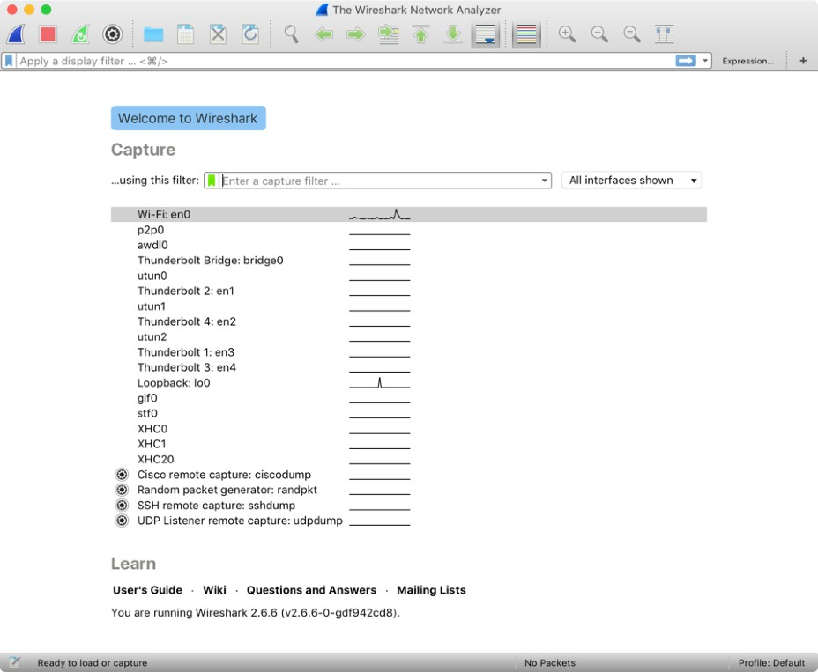
Start screen of Wireshark
TDTS11 Protocol Layers & Wireshark
14
Latest version of Wireshark (4.0.2)
Should be reasonably up to date on university computers, but it often preferred to work on own computer.
Let’s you select interface for capturing (normally Wi-Fi or Ethernet), or allows you to open trace files

Slide 15
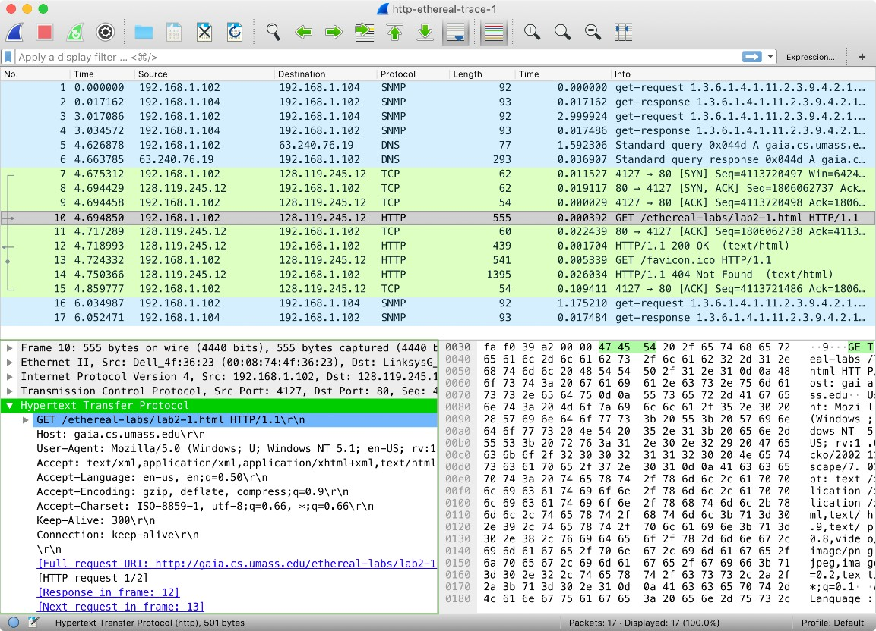
Wireshark’s GUI
TDTS11 Protocol Layers & Wireshark
15
Shortcuts
Display filter
Listing of captured packets
Details of selected packet header
Packet content in hexadecimal and ASCII

Slide 16
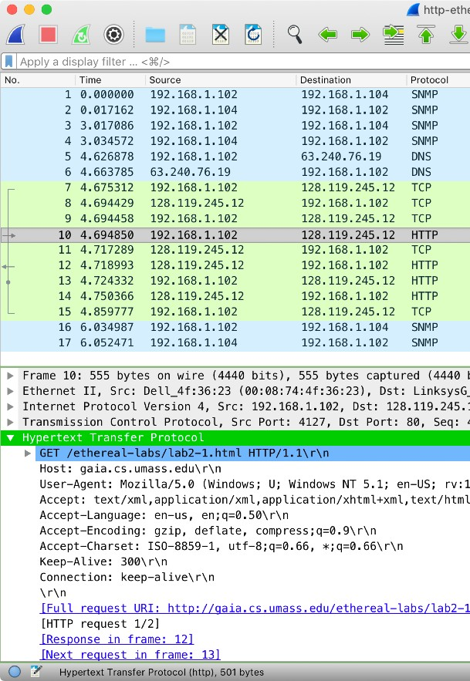
Visible headers
TDTS11 Protocol Layers & Wireshark
16
Depending on the packet/protocol type, you will see different protocol data in the expanded view
Starts with “lowest” level (physical) and is followed by link, network, transport and application layer
“Highest” level is displayed as protocol in the packet view, but all is visible in the detailed view

Slide 17
Tips & tricks
TDTS11 Protocol Layers & Wireshark
17
Data contained in [square brackets] are calculated/presented by Wireshark and are not part of the actual data, and will not always be accepted as answers
You can right click fields in the packet listing and apply as a filter (i.e. a given destination IP address will apply “ip.dst == ” followed by that IP address as filter
Ctrl/Cmd + M will mark (select) packets

Slide 18
Traceroute
A brief introduction to assignment 3

Slide 19
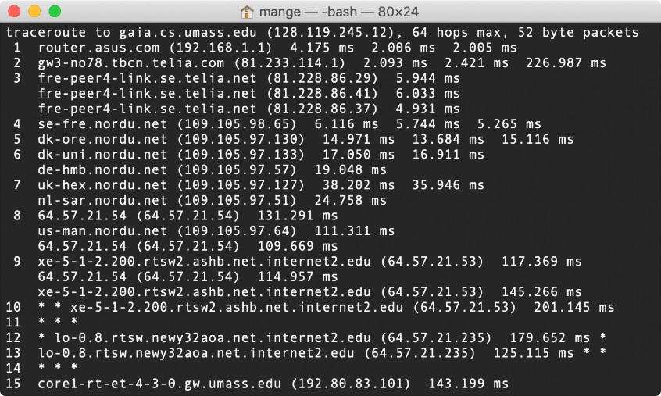
Traceroute
TDTS11 Protocol Layers & Wireshark
19
Traceroute is a program used for sending datagrams of different sizes to a destination to calculate RTT and hop distance
Mac/Unix/Linux only. For Windows alternatives, see assignment 3 text
Uses ICMP (Internet Control Message Protocol) on the IP layer. Make sure you understand it before starting assignment 3

Slide 20
Assignments

Slide 21
Assignments
TDTS11 Protocol Layers & Wireshark
21
Assignment 1: “Wireshark lab: Getting started + HTTP”
1+ time slot, plus own work (deadline January 28)
Assignment 2: “Wireshark lab: TCP”
1+ time slots, plus own work (deadline February 4)
Assignment 3: “Wireshark lab: IP”
1+ time slot, plus own work (deadline February 12)
Assignment 4: “Web analysis”
4+ to 5+ time slots, plus own work (deadline March 8-9)
Introductory teaching session February 15

Slide 22
Questions?
gurjot.singh@liu.se (subject “TDTS11 […]”)
or general questions in Teams!
www.liu.se

