Slide 1
Make sure you are registered in Group A or B in webreg
Otherwise, you are in the wrong room
Go to ➔ S11(E,F) or S14(C,D)

Slide 2

TDTS10:
Computer Architecture
Lesson
2021

Slide 3
Outline
Lab organization and goals
SimpleScalar architecture and tools
Exercises

Slide 4
Organization
Assistants
  Group A, B: Rouhollah Mahfouzi
  Group C, D: Mina Niknafs
  Group E, F: Ali Sahraee
  Extra Assistant: Yungang Pan
Web page
  http://www.ida.liu.se/~TDTS10
  Check the lab page!

Slide 5
Organization
Sign up in Webreg, TODAY
Deadline for the assignments:
Rules: Read them!
Lab 1 | Nov. 18
Lab 2 | Dec. 3
Lab 3 | Dec. 14

Slide 6
Lab Schedule
Please only attend your own lab sessions (6 sessions)
Please check the lab location from these tables (available on webpage).

Slide 7
Examination
For each lab:
Demonstrate
  Must be done during lab sessions
  Both members must be present during demo
Report, Submitted via Teams

Slide 8
Labs
Three labs:
  Cache Memories (2 lab sessions)
  Instruction Pipelining (2 lab sessions)
  Superscalar Processors (2 lab sessions)
Respond to last year comments:
  Slightly more challenging Lab 2
  Extra lab assistants

Slide 9
Goals
Obtain knowledge about computer organization and architecture
Insights in various trade-offs involved in the design of a processor
Become familiar with a set of tools necessary for evaluation of computer architectures

Slide 10


Remote
Thinlinc client: thinlinc.edu.liu.se
SSH client: ssh.edu.liu.se

Slide 11
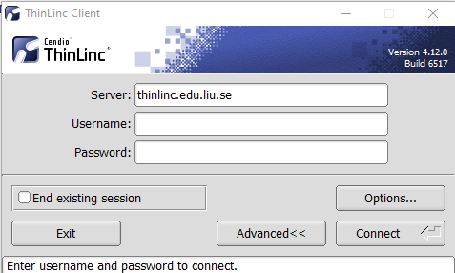
ThinLinc

Slide 12
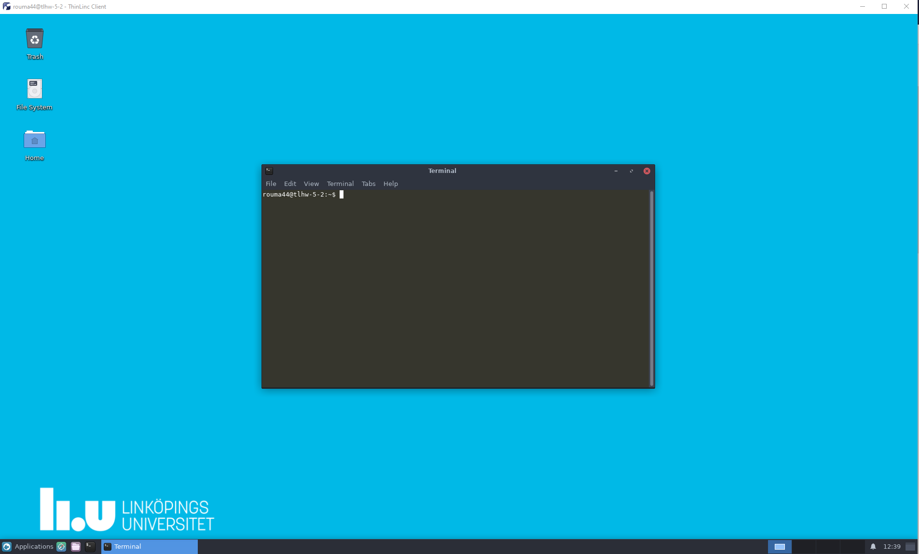
ThinLinc
Press F8 for options

Slide 13

Backup subgroups on Teams
Private Team for each subgroup
  Can be used between lab partners
  Upload your lab reports

Slide 14
Environment
Linux
Simulations are started from a command line (i.e., terminal)
  To open a new terminal you can press ctrl+alt+t
Get yourself familiarized with the terminal
  Ask Google first
  Ask your assistant
Make sure you learn the basic commands (i.e., cd, ls, cp, …)

Slide 15
Tool Setup
Don’t forget the instructions in lab0
Instructions should be clear and easy to follow, but if you face difficulties
  Don’t get frustrated :)
  Read again carefully (without skipping over the lines)
  Consult your assistant

Slide 16
Outline
Lab organization and goals
SimpleScalar architecture and tools
Exercises

Slide 17
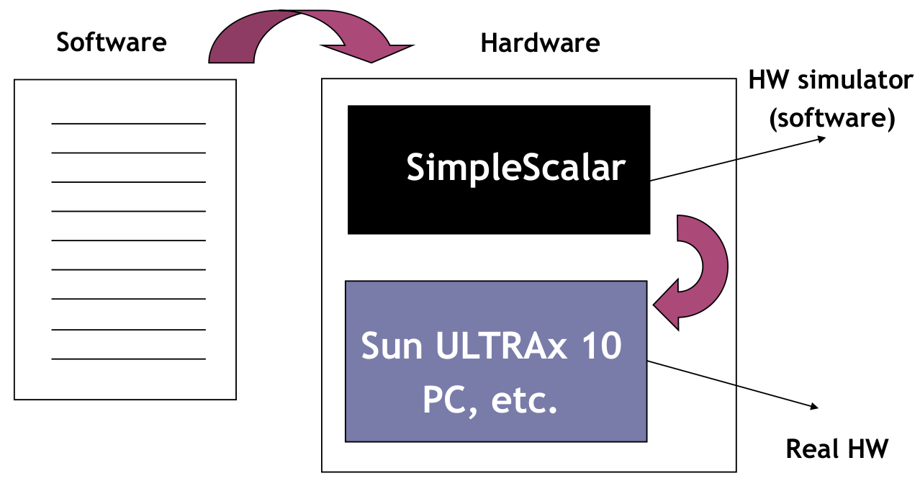
Architecture Simulation

Slide 18
SimpleScalar: Literature
“The SimpleScalar Tool Set, Version 2.0”, by Doug Burger and Todd M. Austin
  Very important preparation for the labs
  This is your main reference for the tool!
“User’s and Hacker’s guide”, slides by Austin

Slide 19
SimpleScalar Architecture
Virtual architecture derived from MIPS
  Control (j, jr,..., beq, bne,...)
  Load/Store (lb, lbu, ...)
  Integer Arithmetic (add, addu, ...)
  Floating Point Arithmetic (add.s, add.d, ...)
  Miscellaneous (nop, syscall, break)

Slide 20
SimpleScalar Architecture (cont’d)
Several simulators
  Sim-fast: Fast, only functional simulation (no timing)
  Sim-safe: Sim-fast + memory checks
  Sim-cache: Sim-safe + cache simulation and various timing properties (simulation time, measured time, ...)
  Sim-cheetah: Simulation of multiple cache configurations
  Sim-outorder: Superscalar simulator
Won’t use these two!

Slide 21
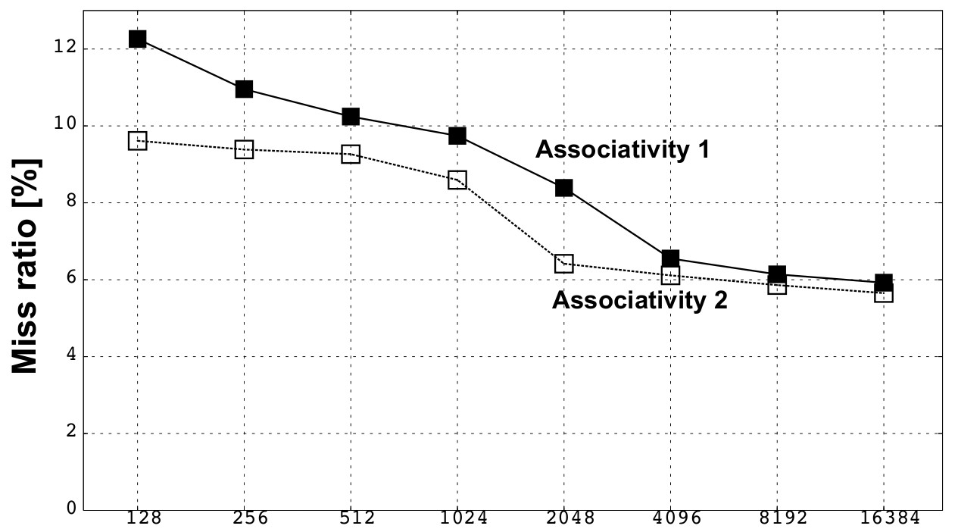
An Example
Lab1, assignment 3
  Dump the default configuration of sim-cheetah
  Modify the configuration and simulate
  Plot the results (e.g. OpenOffice, Gnuplot, Matlab, Excel)

Slide 22
Outline
Lab organization and goals
SimpleScalar architecture and tools
Let’s solve some exercises on the first lab!
  Lesson exercises

