Slide 1
TDTS10: Computer Architecture
Lesson
2017

Slide 2
Outline
Lab organization and goals
SimpleScalar architecture and tools
Exercises

Slide 3
Organization
Assistants
Group A, B: Arian Maghazeh
Group C, D: Rouhollah Mahfouzi
Web page
http://www.ida.liu.se/~TDTS10
Check the lab page!

Slide 4
Organization
Sign up in Webreg
Deadline for the assignments:
Rules: Read them!
Lab 1 | Nov. 23rd
Lab 2 | Dec. 8th
Lab 3 | Dec. 19th

Slide 5
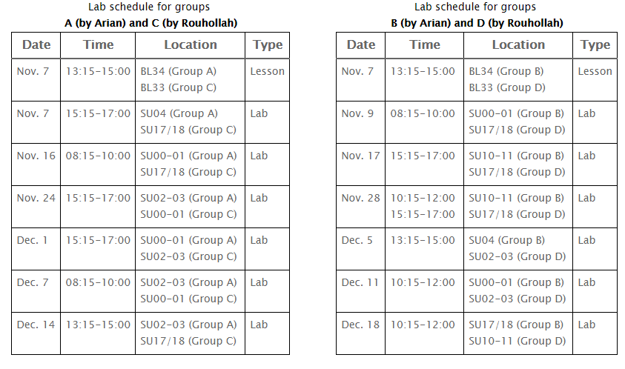
Lab Schedule
Please only attend your own lab sessions (6 sessions)

Slide 6
Examination
For each lab:
Demonstrate
Must be done during lab sessions
Both members must be present during demo
Report (by email) to your lab assistant
Hand in an empty lab cover signed by both members
Hand in the cover at a lab session, or put it in the box outside your assistant’s office

Slide 7
Labs
Three labs:
Cache Memories (2 lab sessions)
Instruction Pipelining (2 lab sessions)
Superscalar Processors (2 lab sessions)

Slide 8
Goals
Obtain knowledge about computer organization and architecture
Insights in various trade-offs involved in the design of a processor
Become familiar with a set of tools necessary for evaluation of computer architectures

Slide 9
Environment
Linux
Simulations are started from a command line (i.e., terminal)
To open a new terminal you can press ctrl+alt+t
Get yourself familiarized with the terminal
Ask Google first
Ask your assistant
Make sure you learn the basic commands (i.e., cd, ls, cp, …)

Slide 10
Tool Setup
Don’t forget the instructions in lab0
Instructions should be clear and easy to follow, but if you face difficulties
Don’t get frustrated :)
Read again carefully (without skipping over the lines)
Consult your assistant

Slide 11
Outline
Lab organization and goals
SimpleScalar architecture and tools
Exercises

Slide 12
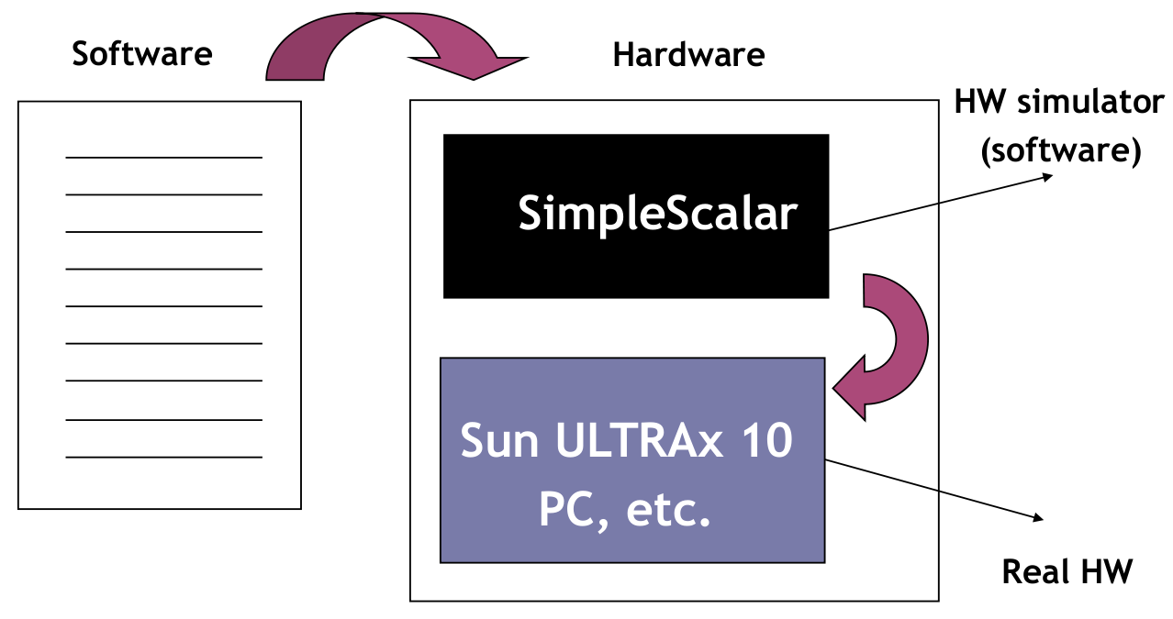
Architecture Simulation

Slide 13
SimpleScalar: Literature
“The SimpleScalar Tool Set, Version 2.0”, by Doug Burger and Todd M. Austin
Very important preparation for the labs
This is your main reference for the tool!
“User’s and Hacker’s guide”, slides by Austin

Slide 14
SimpleScalar Architecture
Virtual architecture derived from MIPS
Control (j, jr,..., beq, bne,...)
Load/Store (lb, lbu, ...)
Integer Arithmetic (add, addu, ...)
Floating Point Arithmetic (add.s, add.d, ...)
Miscellaneous (nop, syscall, break)

Slide 15
SimpleScalar Architecture (cont’d)
Several simulators
Sim-fast: Fast, only functional simulation (no timing)
Sim-safe: Sim-fast + memory checks
Sim-cache: Sim-safe + cache simulation and various timing properties (simulation time, measured time, ...)
Sim-cheetah: Simulation of multiple cache configurations
Sim-outorder: Superscalar simulator
Won’t use these two!

Slide 16
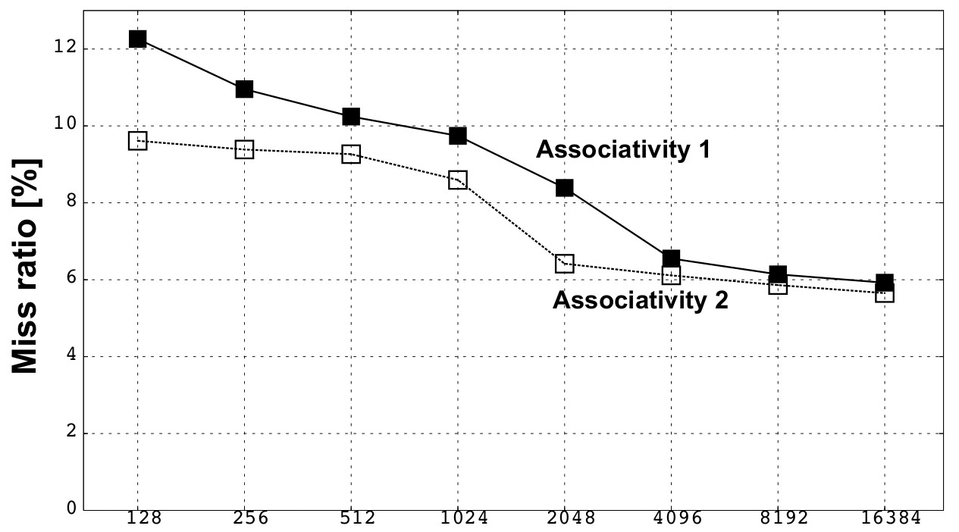
An Example
Lab1, assignment 3
Dump the default configuration of sim-cheetah
Modify the configuration and simulate
Plot the results (e.g. OpenOffice, Gnuplot, Matlab, Excel)

Slide 17
Outline
Lab organization and goals
SimpleScalar architecture and tools
Let’s solve some exercises on the first lab!
Lesson exercises

