Slide 1
TDTS08: Advanced Computer Architecture
Lesson

Slide 2
Outline
Lab organization and goals
SimpleScalar architecture and tools
Lab 5: article review
Exercises

Slide 3
Organization
Assistant: Yungang Pan
Web page
http://www.ida.liu.se/~TDTS08
Check the lab page!

Slide 4
Organization
Sign up in Webreg latest Sept. 9 (This Friday!).
Deadline for the assignments:
Rules: Read them!
Lab 1, Lab 2 | Sept. 28
Lab 3, Lab 4 | Oct. 19
Lab 5 | Oct. 28

Slide 5
Examination
Written report for each lab:
Hand in the report, in PDF or DOC format
Submit the report via email

Slide 6
Labs
Five labs:
Cache Memories (2 lab sessions)
Instruction Pipelining (2 lab sessions)
Superscalar Processors (2 lab sessions)
VLIW processors (2 lab sessions)
Article review on multiprocessor systems (no lab session)

Slide 7
Remote
Thinlinc client: thinlinc.edu.liu.se
SSH client: ssh.edu.liu.se

Slide 8
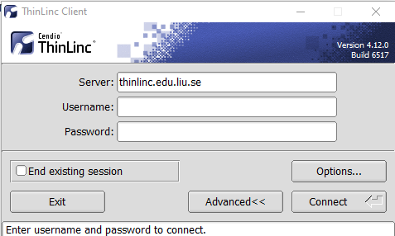
ThinLinc

Slide 9
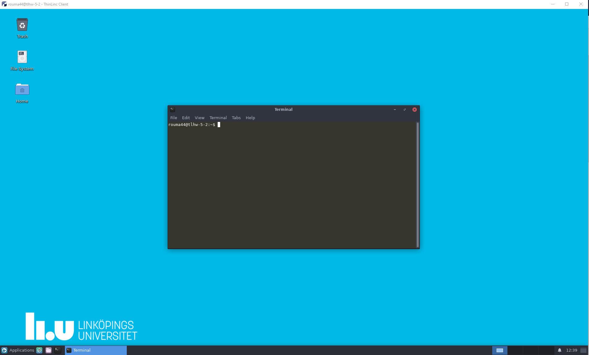
ThinLinc
Press F8 for options

Slide 10
Environment
Linux
Simulations are started from a command line (i.e., terminal)
To open a new terminal you can press ctrl+alt+t
Get yourself familiarized with the terminal
Ask Google first
Ask your assistant
Make sure you learn the basic commands (i.e., cd, ls, cp, …)

Slide 11
Tool Setup
Don’t forget the instructions in lab0
Instructions should be clear and easy to follow, but if you face difficulties
Don’t get frustrated :)
Read again carefully (without skipping over the lines)
Consult your assistant

Slide 12
Outline
Lab organization and goals
SimpleScalar architecture and tools
Lab 5: article review
Exercises

Slide 13
Architecture Simulation

Slide 14
SimpleScalar: Literature
“The SimpleScalar Tool Set, Version 2.0”, by Doug Burger and Todd M. Austin
Very important preparation for the labs
This is your main reference for the tool!
“User’s and Hacker’s guide”, slides by Austin

Slide 15
SimpleScalar Architecture
Virtual architecture derived from MIPS
Control (j, jr,..., beq, bne,...)
Load/Store (lb, lbu, ...)
Integer Arithmetic (add, addu, ...)
Floating Point Arithmetic (add.s, add.d, ...)
Miscellaneous (nop, syscall, break)

Slide 16
SimpleScalar Architecture (cont’d)
Several simulators
Sim-fast: Fast, only functional simulation (no timing)
Sim-safe: Sim-fast + memory checks
Sim-cache: Sim-safe + cache simulation and various timing properties (simulation time, measured time, ...)
Sim-cheetah: Simulation of multiple cache configurations
Sim-outorder: Superscalar simulator
Won’t use these two!

Slide 17
An Example
Lab1, assignment 3
Dump the default configuration of sim-cheetah
Modify the configuration and simulate
Plot the results (e.g. OpenOffice, Gnuplot, Matlab, Excel)

Slide 18
Outline
Lab organization and goals
SimpleScalar architecture and tools
Lab 5: article review
Exercises

Slide 19
Lab 5: Article Review
Select an article on a multi-core, multiprocessor, multi-computer system, or a graphics processor
List of papers is available on the course page
You may select other articles if your lab assistant agrees
Review the selected article
Write a review report on the article
Self-learning based; No lab session allocated
Read and understand the paper
If the course literature does not help you, investigate the referenced papers

Slide 20
Lab 5: Article Review (cont’d)
Analyze the paper
Classify the architecture (e.g. MIMD, SIMD, NUMA)
Possible questions to ask
Why has the actual method/approach been selected?
What are the advantages and disadvantages?
What is the application area?
What has been demonstrated?
...

Slide 21
Lab 5: Article Review (cont’d)
Write a report
~1000 words
Submit, in PDF format, to your lab assistant's urkund account

Slide 22
Outline
Lab organization and goals
SimpleScalar architecture and tools
Lab 5: article review
Exercises

Slide 23
Exercises
Problem 1. Review questions
Problem 2 and 3. Mandatory for lab 1
Problem 4 and 5. Additional exercises (if you feel up to the challenge)

Slide 25
Cache placement policies (Direct-Mapped)

Slide 26
Cache placement policies (Fully-Associative)

Slide 27
Cache placement policies (Set-Associative)

Slide 28
Question 2
Principle of Locality
Program instructions access a small proportion of their address space at any time

Slide 29
Question 2
Principle of Locality
Program instructions access a small proportion of their address space at any time
Temporal locality
Items accessed recently are likely to be accessed again soon

Slide 30
Question 2
Principle of Locality
Program instructions access a small proportion of their address space at any time
Temporal locality
Items accessed recently are likely to be accessed again soon
Spatial locality
Items near those accessed recently are likely to be accessed soon

Slide 31
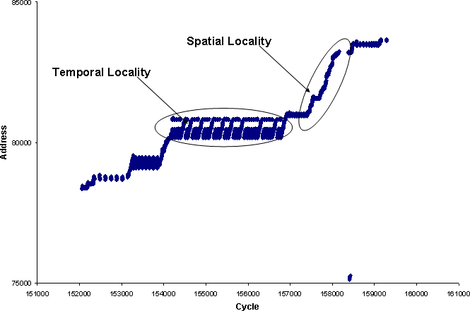
Question 2
Principle of Locality
Program instructions access a small proportion of their address space at any time
Temporal locality
Items accessed recently are likely to be accessed again soon
Spatial locality
Items near those accessed recently are likely to be accessed soon

Slide 33
8

Slide 34
3
3
2

Slide 35
3
3
2

Slide 36
1 0 1 0 0 0 x x
3
3
2

Slide 37
8 lines x 4 bytes = 32 bytes
3
3
2

Slide 38
3
3
2

Slide 39
Because we have a large main memory but a limited and finite set of cache lines. More than one address go in a particular cache line. We need tag to identify which block is in the cache line.
3
3
2

Slide 40
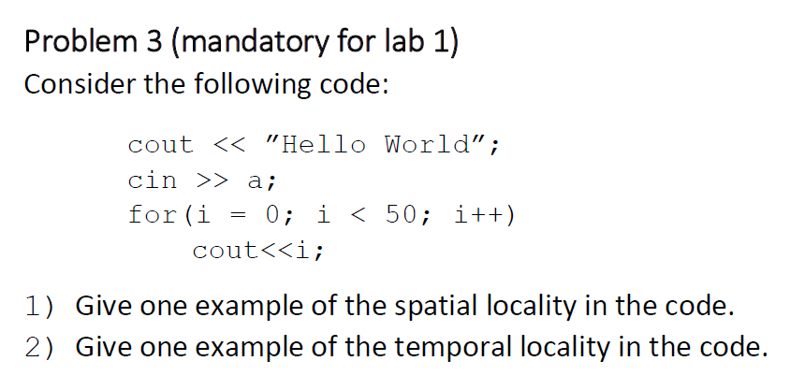

Slide 42
4
5
100
1
95

Slide 43
$$4∗\left(70∗{10}^{−9}\right)$$
4
5
100
1
$$1∗\left({10∗10}^{−3}+50∗{10}^{−9}\right)$$
95
$$95∗(15∗{10}^{−9})$$

Slide 44
$$4∗\left(70∗{10}^{−9}\right)$$
4
5
$$\frac{1∗\left({10∗10}^{−3}+50∗{10}^{−9}\right)+4∗\left(70∗{10}^{−9}\right)+95∗(15∗{10}^{−9})}{100}$$
100
1
$$1∗\left({10∗10}^{−3}+50∗{10}^{−9}\right)$$
95

Slide 46
4 x 1024 = 4 x 64 x #sets ➔ #sets = 16
set | tag | data
0
1
2
3
tag | data
tag | data
tag | data
64 word
… | …
… | …
… | …
… | …
15
Cache structure

Slide 47
set | tag | data
0
1 |  | [64-127]
2
3
tag | data
 | [1024-1087]
tag | data
 | [2048-2111]
tag | data
 | [3072-4159]
[0-63]
… | …
… | …
… | …
… | …
15
 | [960-1023]
 | [1984-2047]
 | [3008-3071]
 | [4032-4095]
Cache structure

Slide 48
set | tag | data
0
1 |  | [4160-4223]
2 |  | [4223-4287]
3 |  | [4287-4351]
tag | data
 | [1024-1087]
tag | data
 | [2048-2111]
tag | data
 | [3072-4159]
[4096-4159]
… | …
… | …
… | …
… | …
15
 | [960-1023]
 | [1984-2047]
 | [3008-3071]
 | [4032-4095]
Cache structure
1st round: 4 x 16 + 4 misses
2nd-9th round: 4 x 4 + 4 misses
Total misses: 4 x 16 + 4 + (4 x 4 + 4) x 9 = 248
With cache: 248 x 10s + (4351 x 10 – 248) x 1s = 45742
Without cache: 4351 x 10 x 10s = 435100
Speed-up:
435100/45742 ~= 9.5

