Slide 1

TDTS08:
Advanced Computer Architecture
Lesson

Slide 2
Outline
Lab organization and goals
SimpleScalar architecture and tools
Lab 5: article review
Exercises

Slide 3
Organization
Assistant: Rouhollah Mahfouzi
Web page
  http://www.ida.liu.se/~TDTS08
  Check the lab page!

Slide 4
Organization
Sign up in Webreg latest Sep. 10.
Deadline for the assignments:
Rules: Read them!
Lab 1, Lab 2 | Sep. 25
Lab 3, Lab 4 | Oct. 16
Lab 5 | Oct. 27

Slide 5
Examination
Written report for each lab:
Hand in the report, in PDF or DOC format, via email

Slide 6
Labs
Five labs:
  Cache Memories (2 lab sessions)
  Instruction Pipelining (2 lab sessions)
  Superscalar Processors (2 lab sessions)
  VLIW processors (2 lab sessions)
  Article review on multiprocessor systems (no lab session)

Slide 7


Remote
Thinlinc client: thinlinc.edu.liu.se
SSH client: ssh.edu.liu.se

Slide 8
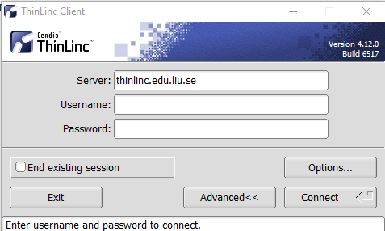
ThinLinc

Slide 9
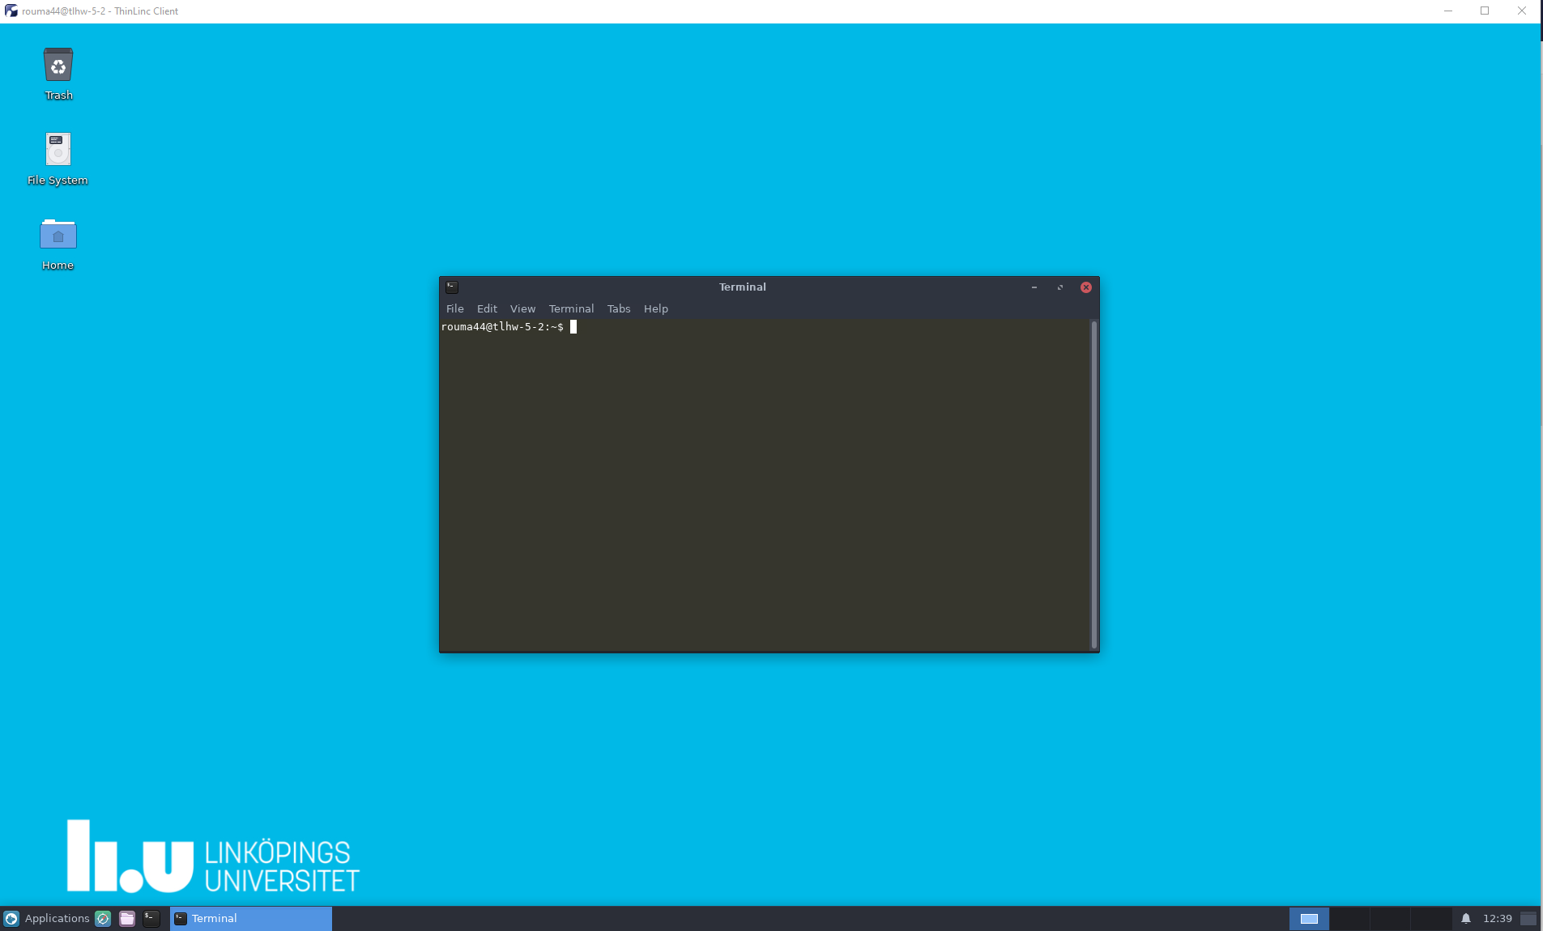
ThinLinc
Press F8 for options

Slide 10

How to ask questions during lab sessions?
Zoom meeting room
Waiting list
Possibility for the teammate to join

Slide 11
Environment
Linux
Simulations are started from a command line (i.e., terminal)
  To open a new terminal you can press ctrl+alt+t
Get yourself familiarized with the terminal
  Ask Google first
  Ask your assistant
Make sure you learn the basic commands (i.e., cd, ls, cp, …)

Slide 12
Tool Setup
Don’t forget the instructions in lab0
Instructions should be clear and easy to follow, but if you face difficulties
  Don’t get frustrated :)
  Read again carefully (without skipping over the lines)
  Consult your assistant

Slide 13
Outline
Lab organization and goals
SimpleScalar architecture and tools
Lab 5: article review
Exercises

Slide 14
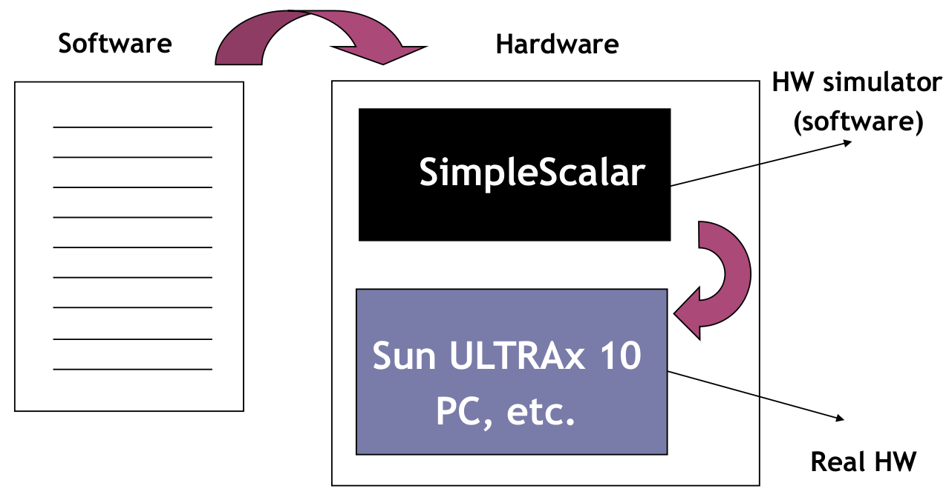
Architecture Simulation

Slide 15
SimpleScalar: Literature
“The SimpleScalar Tool Set, Version 2.0”, by Doug Burger and Todd M. Austin
  Very important preparation for the labs
  This is your main reference for the tool!
“User’s and Hacker’s guide”, slides by Austin

Slide 16
SimpleScalar Architecture
Virtual architecture derived from MIPS
  Control (j, jr,..., beq, bne,...)
  Load/Store (lb, lbu, ...)
  Integer Arithmetic (add, addu, ...)
  Floating Point Arithmetic (add.s, add.d, ...)
  Miscellaneous (nop, syscall, break)

Slide 17
SimpleScalar Architecture (cont’d)
Several simulators
  Sim-fast: Fast, only functional simulation (no timing)
  Sim-safe: Sim-fast + memory checks
  Sim-cache: Sim-safe + cache simulation and various timing properties (simulation time, measured time, ...)
  Sim-cheetah: Simulation of multiple cache configurations
  Sim-outorder: Superscalar simulator
Won’t use these two!

Slide 18
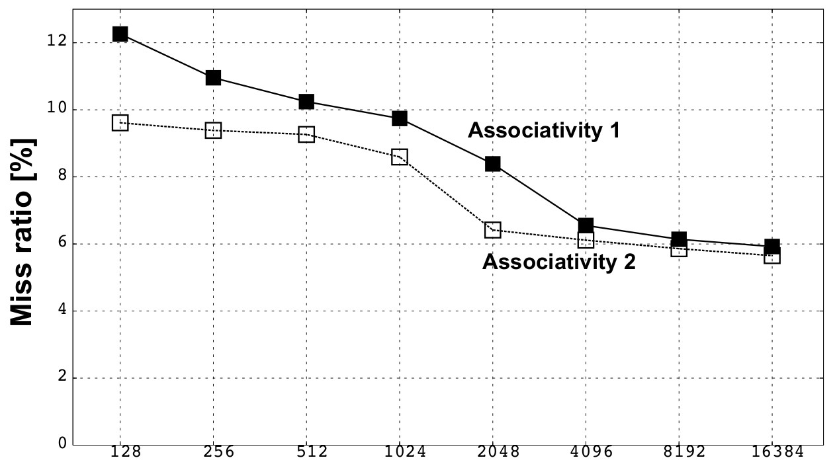
An Example
Lab1, assignment 3
  Dump the default configuration of sim-cheetah
  Modify the configuration and simulate
  Plot the results (e.g. OpenOffice, Gnuplot, Matlab, Excel)

Slide 19
Outline
Lab organization and goals
SimpleScalar architecture and tools
Lab 5: article review
Exercises

Slide 20
Lab 5: Article Review
Select an article on a multi-core, multiprocessor, multi-computer system, or a graphics processor
  List of papers is available on the course page
  You may select other articles if your lab assistant agrees
Review the selected article
Write a review report on the article
Self-learning based, no lab session allocated
Read and understand the paper
  If the course literature does not help you, investigate the referenced papers

Slide 21
Lab 5: Article Review (cont’d)
Analyze the paper
Classify the architecture (e.g. MIMD, SIMD, NUMA)
Possible questions to ask
  Why has the actual method/approach been selected?
  What are the advantages and disadvantages?
  What is the application area?
  What has been demonstrated?
  ...

Slide 22
Lab 5: Article Review (cont’d)
Write a report
  ~1000 words
  Submit, in PDF format, to your lab assistant's urkund account

Slide 23
Outline
Lab organization and goals
SimpleScalar architecture and tools
Lab 5: article review
Exercises

Slide 24
Exercises
Problem 1. Review questions
Problem 2 and 3. Mandatory for lab 1
Problem 4 and 5. Additional exercises (if you feel up to the challenge)

Slide 25
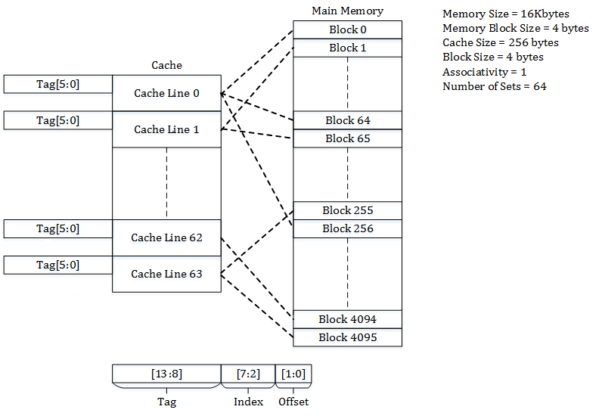
Cache placement policies (Direct-Mapped)

Slide 26
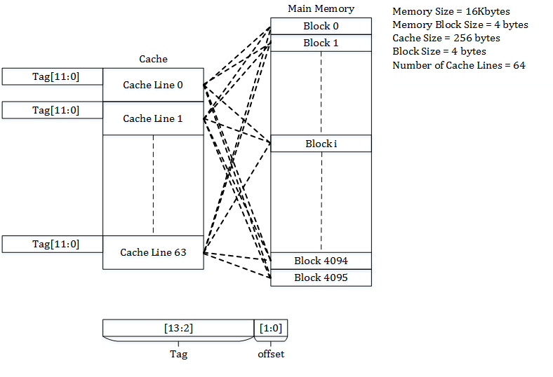
Cache placement policies (Fully-Associative)

Slide 27
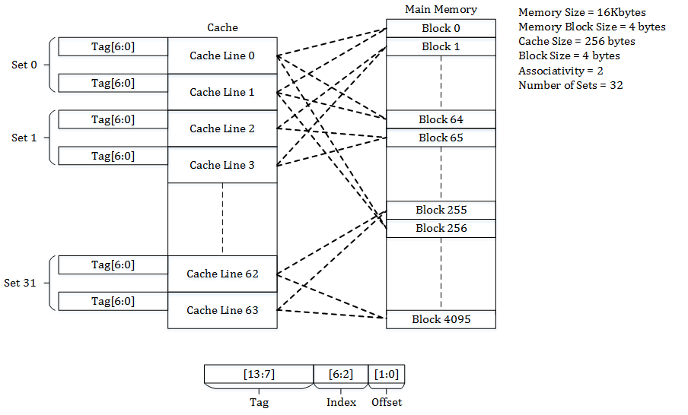
Cache placement policies (Set-Associative)

Slide 28
Question 2
Principle of Locality
Program instructions access a small proportion of their address space at any time

Slide 29
Question 2
Principle of Locality
Program instructions access a small proportion of their address space at any time
Temporal locality
  Items accessed recently are likely to be accessed again soon

Slide 30
Question 2
Principle of Locality
Program instructions access a small proportion of their address space at any time
Temporal locality
  Items accessed recently are likely to be accessed again soon
Spatial locality
  Items near those accessed recently are likely to be accessed soon

Slide 31
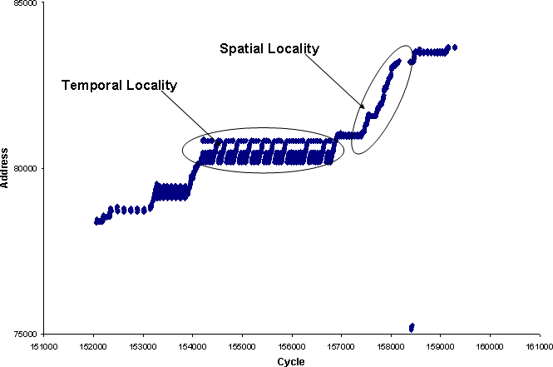
Question 2
Principle of Locality
Program instructions access a small proportion of their address space at any time
Temporal locality
  Items accessed recently are likely to be accessed again soon
Spatial locality
  Items near those accessed recently are likely to be accessed soon

