Slide 1
Privacy Engineering
TDDE62 – Information Security:
Privacy, System and Network Security
Gurjot Singh
Division of Cybersecurity at the
Department of Computer and Information Science (IDA)
Slides inspired by and adapted from material by Jenny Reuben

Slide 2
Thinking Systematically About Privacy Violations
Learning objective
Learn a structured way to identify where and how privacy violations occur
Use this structure to analyze and address privacy risks in a real-world use case
Key idea
Privacy violations can occur at different stages of the data lifecycle:
  Data collection
  Data processing
  Data dissemination
  Interaction with the data subject
This framework helps you locate the problem before trying to solve it.
Notes:
Privacy problems in organizations rarely arise from a single technical failure or legal oversight. Instead, they emerge from how personal data moves through a system over time. A systematic way of thinking about privacy therefore begins by understanding the data lifecycle: how data is collected from individuals, processed within organizations, shared with others, and ultimately how it affects the people it describes. This perspective helps move beyond vague claims that a system is “not privacy-friendly” and toward precise identification of where and how harm occurs.
A common mistake in privacy management is to jump directly to solutions, such as encryption, access controls, or consent forms, without first diagnosing the underlying problem. While these measures can be important, they are often ineffective if applied at the wrong stage of the data lifecycle. For example, encrypting data does not address the problem of collecting unnecessary information, and a consent checkbox does not justify using data for purposes that individuals do not reasonably expect. A structured analytical framework ensures that privacy risks are first located before they are addressed.
The framework introduced in this course divides privacy risks into four key stages: data collection, data processing, data dissemination, and interaction with the data subject. Privacy violations can occur at any of these stages, independently of one another. Excessive or opaque data collection can already constitute a privacy violation, even if the data is never leaked. Similarly, harmful processing practices, such as profiling or re-identification, can cause privacy harm without any external data sharing. Dissemination introduces additional risks through breaches or third-party access, while direct interactions with individuals can result in manipulation, unfair treatment, or loss of autonomy.
This lifecycle-based framework is especially useful because it clarifies responsibility and accountability. At each stage, different actors may be involved, different decisions are made, and different types of harm can arise. By asking where in the lifecycle a problem occurs, who controls that stage, and what impact it has on individuals, privacy analysis becomes concrete and actionable. Throughout this course, this approach will be applied repeatedly to real-world systems, including mobile applications, cloud services, health data platforms, and business analytics systems.
Key takeaway: Privacy problems are easier to solve, and solutions are more effective, when the specific stage of the data lifecycle where the violation occurs is identified first.

Slide 3
Privacy Solutions: Why Do We Need Them?
Context
The boundary between our physical lives and digital lives is increasingly blurred.
Everyday actions generate large volumes of personal data.
The problem
Modern technologies enable large-scale data:
  Collection
  Processing
  Analysis (big data, AI)
The consequence
Increased surveillance
Profiling and tracking by organizations
Limited transparency and accountability in how data is used
Notes:
In contemporary society, the distinction between physical life and digital life has largely disappeared. Many everyday activities that were once ephemeral now generate persistent digital records. Carrying a smartphone produces continuous location data, paying with a card creates detailed transaction histories, and working online leaves traces of behavior, performance, and communication. These digital traces are not exceptional events but a routine by-product of daily life, often created without deliberate action or explicit awareness by individuals.
At the same time, modern technologies have dramatically reduced the cost and effort required to collect, store, and process personal data. Advances in computing power, cloud infrastructure, and high-speed networks allow organizations to gather data at massive scale and in near real time. Importantly, the nature of data generation has also changed. Instead of occasional, user-provided records, organizations increasingly rely on continuous and passive data streams. This shift enables more detailed observation of individuals over time and across contexts, significantly increasing the potential for privacy risks.
The combination of large-scale data collection and advanced data analysis tools, such as big data analytics and artificial intelligence, allows organizations to infer sensitive information that individuals may never have intended to disclose. Seemingly harmless data points can be combined to reveal health conditions, personal habits, political preferences, or economic vulnerabilities. These inferences often occur without direct interaction with the individual and may be used to influence decisions about credit, employment, insurance, or access to services.
A critical consequence of these developments is a growing power imbalance between individuals and organizations. Organizations typically have far greater knowledge, technical capability, and control over how data is used, while individuals have limited visibility and influence. In many cases, people do not know what data is being collected about them, why it is collected, how long it is retained, or with whom it is shared. This lack of transparency and accountability is not necessarily the result of malicious intent but arises from the structural design of modern digital systems.
Understanding this context is essential for appreciating why privacy solutions are necessary. Privacy challenges are not merely legal compliance issues or technical security problems; they are systemic consequences of how modern technologies operate. Without recognizing these underlying dynamics, privacy controls may appear arbitrary or bureaucratic. A clear understanding of the problem space provides the foundation for evaluating, designing, and justifying meaningful privacy solutions.
Key takeaway: Privacy problems arise because modern technologies enable large-scale data collection and analysis with limited transparency, control, and accountability.

Slide 4
Why Privacy Enhancing Technologies (PETs)?
The ideal goal
Users should not have to blindly trust organizations with their personal data.
The reality
Some level of trust in system operators, service providers, or platforms is unavoidable.
What technology can do
Reduce the amount of trust required
Limit who must be trusted
Enable verification, accountability, and transparency
Privacy Enhancing Technologies (PETs)
Technologies that minimize the trust perimeter
Or provide mechanisms to check and challenge misuse of trust
Two categories of PETs
Hard Privacy
Soft Privacy
Notes:
In an ideal world, individuals would not need to place trust in organizations to protect their personal data. Privacy would be guaranteed by the design of the system itself, independent of the intentions or behavior of service providers, platform operators, or governments. In such a setting, misuse of personal data would be technically impossible rather than merely prohibited by policy. This ideal highlights an important principle: trust is a risk factor in privacy, not a neutral requirement.
In reality, however, complete trustlessness is rarely achievable. Modern digital services depend on complex ecosystems involving cloud providers, data processors, analytics platforms, and third-party services. Users inevitably rely on these actors to some extent when they share personal data. The practical question therefore is not whether trust can be eliminated entirely, but how much trust is necessary and which entities must be trusted. Each additional trusted party expands the potential for privacy violations, whether through misuse, error, or security failure.
Privacy Enhancing Technologies address this problem by reshaping how trust is distributed within a system. Rather than assuming that all parties will behave correctly, PETs aim to reduce the amount of trust required, limit the number of actors that must be trusted, and constrain what those actors are able to see or do with personal data. In many cases, PETs also enable verification, accountability, or transparency, allowing users, auditors, or regulators to check whether data is handled as intended. Importantly, PETs do not eliminate trust in all situations; instead, they minimize and manage it in a systematic way.
A useful way to understand the role of PETs is through the concept of a trust perimeter. The trust perimeter defines who can access personal data and under what conditions. In traditional systems, this perimeter is often large, with many internal and external actors having access to raw or richly detailed data. PET-based systems seek to shrink this perimeter by restricting access, limiting data exposure, or replacing direct access with cryptographic or privacy-preserving mechanisms. In some cases, the perimeter does not disappear, but it becomes auditable, making misuse of trust easier to detect and challenge.
At a high level, PETs are commonly divided into two broad categories. Hard privacy technologies aim to minimize or eliminate the need to trust third parties by providing strong technical guarantees, such as preventing access to raw data altogether. Soft privacy approaches accept that trust remains but support it through controls, transparency, monitoring, and accountability mechanisms. This distinction will be explored in more detail in subsequent sections of the course. At this stage, the key idea is that PETs exist to systematically reduce privacy risks by rethinking how trust is embedded in digital systems.
Key takeaway: Privacy Enhancing Technologies exist to reduce how much trust is required, who must be trusted, and what trusted parties can do with personal data.

Slide 5
Privacy Enhancing Technologies (PETs)
Two categories based on trust assumptions
Hard Privacy
Minimize or avoid disclosure of personal data
Reduce or eliminate the need to trust service providers
Privacy guaranteed by technical design
Soft Privacy
Personal data is disclosed and processed
Users must place trust in service providers
Technologies focus on accountability, transparency, and control
Notes:
Privacy Enhancing Technologies can be broadly classified based on the assumptions they make about trust in digital systems. This distinction is important because not all systems face the same constraints, and not all privacy risks can be addressed in the same way. Rather than competing approaches, hard privacy and soft privacy represent two complementary strategies for managing privacy in complex socio-technical environments.
Hard privacy technologies aim to minimize or completely avoid the disclosure of personal data. The underlying idea is straightforward: if a service provider never has access to raw personal data, it cannot misuse it, leak it, or repurpose it. In hard privacy systems, privacy is guaranteed by technical design rather than organizational promises or policy enforcement. Cryptographic methods and decentralized processing approaches are commonly used to ensure that data remains hidden even while useful functions are performed. In this model, trust in the service provider is reduced or eliminated, because the system is constructed so that misuse is technically infeasible.
Soft privacy technologies start from a different, more pragmatic assumption. In many real-world systems, personal data must be disclosed in order to communicate, access services, or participate in digital platforms. Once data is shared, users inevitably lose some degree of direct control. Soft privacy approaches accept this reality and focus on how trust is governed, constrained, and monitored. Instead of preventing access to data entirely, these technologies emphasize accountability, transparency, and user control. Mechanisms such as access controls, audit trails, consent management tools, and transparency dashboards aim to ensure that data is used in accordance with agreed purposes and that misuse can be detected and challenged.
The key contrast between these two categories lies in how they treat trust. Hard privacy seeks to avoid trust by minimizing data exposure and relying on technical guarantees. Soft privacy seeks to manage trust by making data practices visible, enforceable, and accountable. Neither approach is inherently superior; each is appropriate under different technical, economic, and organizational conditions. Understanding this distinction is essential for evaluating privacy solutions and for making informed design choices in real-world systems.
Key takeaway: Hard privacy reduces the need to trust service providers, while soft privacy provides accountability and control when trust cannot be avoided.

Slide 6
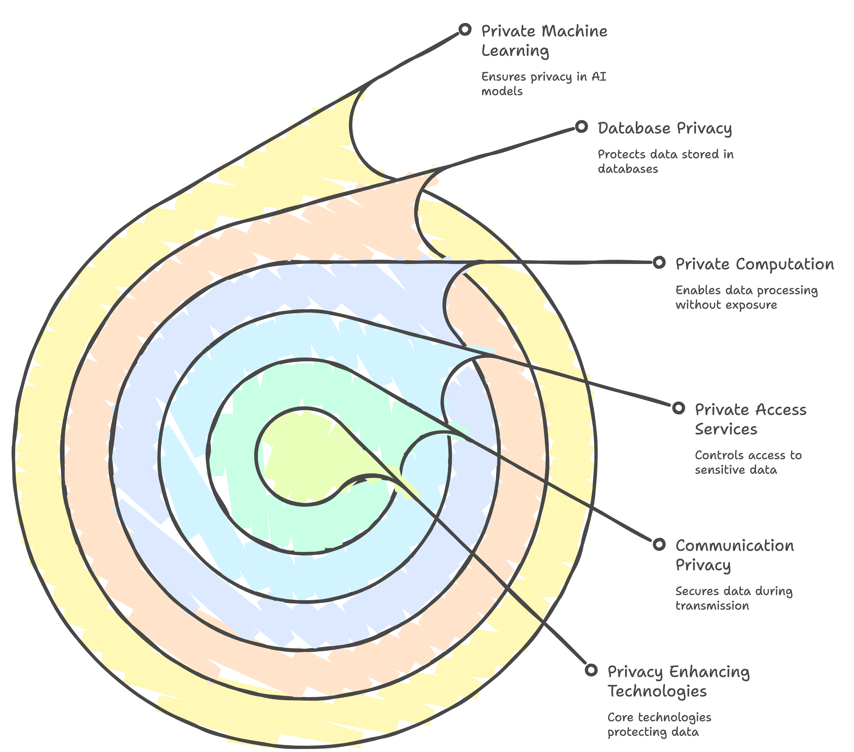
Privacy Enhancing Technologies: Main Areas
Notes:
Privacy Enhancing Technologies encompass a broad set of approaches that protect personal data at different stages of its use. The diagram on this slide should not be read as a strict classification, but rather as a conceptual map that illustrates how privacy protection can be layered across a system. Each area addresses a different question: how data is communicated, who can access it, how it is processed, how it is stored, and how insights are derived from it. Together, these areas form a comprehensive toolkit for managing privacy risks in modern digital systems. At the outer layers, communication privacy focuses on protecting data while it is being transmitted between systems. This includes preventing unauthorized parties from observing or intercepting data as it moves across networks. While often taken for granted, failures at this layer can expose sensitive information even if other privacy controls are in place. Closely related are private access services, which govern who is allowed to access data and under what conditions. These mechanisms ensure that only authorized actors can view or use sensitive information, thereby reducing unnecessary exposure within organizations.
Moving inward, private computation and database privacy address how data is handled once it is stored or processed. Private computation aims to enable useful data processing without revealing raw personal data, reducing the need for trust in the processing entity. Database privacy, by contrast, focuses on protecting stored data from inference attacks, unauthorized queries, or misuse over time. These areas are particularly important in environments where large datasets are retained and reused for multiple purposes, such as analytics or decision support. At the core of the diagram lies private machine learning, which addresses privacy risks arising from data-driven models and artificial intelligence systems. Machine learning can extract powerful insights from data, but it can also unintentionally expose sensitive information or amplify privacy harms through inference and profiling. Privacy-preserving approaches in this area aim to ensure that individuals’ data is protected both during model training and when models are deployed. Across all layers, the unifying goal of PETs is to reduce unnecessary data exposure, limit trust assumptions, and ensure that privacy is preserved by design rather than relying solely on organizational promises.
Key takeaway: Privacy Enhancing Technologies operate across multiple layers of a system, collectively protecting personal data during communication, access, storage, processing, and analysis.

Slide 7
Privacy in Communication Services
User expectations
Communications should not be:
  Eavesdropped
  Modified during transmission
How this is achieved
Secure communication channels
Authentication between communicating parties
Common technologies
Client–server communication: TLS, SSH
User-to-user communication: end-to-end encryption (e.g., Signal)
Important limitation
These technologies protect message content
They do not fully protect metadata (identity, timing, communication patterns)
Notes:
When individuals use communication services, such as web applications, messaging platforms, or cloud systems, they have clear and intuitive expectations. At a minimum, users expect that their communications are not eavesdropped on by unauthorized parties and that messages are not altered while in transit. These expectations form the baseline of trust in modern digital communication and are closely tied to notions of confidentiality and integrity. To meet these expectations, communication systems rely on secure communication channels and authentication mechanisms. Secure channels protect the content of messages as they travel across networks, while authentication ensures that users are communicating with the intended party rather than an impostor. In client–server settings, such as web browsing or remote access to cloud services, protocols like TLS and SSH establish these guarantees using cryptographic techniques, often without requiring parties to share secrets in advance. From a user perspective, this security is largely invisible but essential. In user-to-user communication, such as messaging applications, voice calls, or email, similar goals apply under different conditions. End-to-end encryption is commonly used to ensure that only the communicating users can read the messages, even if the service provider operates the infrastructure through which messages pass. This approach strengthens privacy by limiting who can access message content, and it is often cited as a best practice for secure personal communication.
However, it is important to recognize that strong cryptography does not eliminate trust entirely. Even in encrypted systems, users must still trust elements such as certificate authorities, key management mechanisms, and service providers to behave correctly and securely. More importantly from a privacy perspective, these technologies primarily protect what is said, not how communication occurs. Information about who is communicating, when communication happens, how frequently it occurs, and from where it originates is typically still visible to network observers and service operators. This information, known as metadata, can be highly revealing. Patterns of communication may allow sensitive inferences even when message content is fully encrypted. For example, frequent interaction with a medical service, repeated late-night communications, or location-based access patterns can disclose personal circumstances or vulnerabilities. As a result, secure communication is necessary but not sufficient for full privacy. Understanding this limitation motivates the need for more advanced Privacy Enhancing Technologies that aim to protect not only message content but also communication metadata.
Key takeaway: Encryption effectively protects the content of communication, but privacy also depends on limiting what can be inferred from communication metadata.

Slide 8
Privacy in Communication Services: Anonymous Communication
Why metadata matters
Communication patterns can reveal sensitive information:
  Health status
  Political activity
  Journalistic sources
  Personal relationships
Anonymous communication
Technologies that protect against disclosure of communication metadata
Aim to hide the relationship between sender and receiver
Core idea
Messages are routed through intermediate nodes
Makes communication untraceable to passive (and some active) adversaries
Common protection model
Third-party anonymity is the most widely used approach
Notes:
While message encryption protects what is being said, communication metadata can still reveal highly sensitive information about individuals. Communication patterns such as who communicates with whom, how frequently communication occurs, and at what times can be more revealing than message content itself. From these patterns, observers may infer health conditions, political engagement, journalistic activity, or personal relationships. Importantly, such inferences can be made without ever accessing or decrypting message content, which makes metadata a critical privacy concern in modern communication systems.
Anonymous communication technologies are designed to address this problem by protecting against the disclosure of communication metadata. Their primary goal is not to hide the content of messages, but to obscure the relationship between sender and receiver. This includes protecting identities, communication frequency, timing correlations, and routing information. By limiting what can be learned from traffic patterns, anonymous communication reduces the risk of inference-based privacy harms that arise even in strongly encrypted systems.
The core mechanism behind anonymous communication is indirect routing. Instead of sending messages directly from sender to receiver, messages are forwarded through a sequence of intermediate nodes. Each node only has limited, local knowledge: it knows where a message came from and where it should be forwarded next, but not the full communication path. As a result, a passive network observer, and in some cases even a partially active adversary, cannot easily reconstruct the sender–receiver relationship. This design makes large-scale traffic analysis significantly more difficult.
A widely used protection model in anonymous communication systems is third-party anonymity. In this model, trust is not placed in a single intermediary but distributed across multiple independent nodes. No single party has enough information to deanonymize a communication on its own. This distributed trust assumption is a key design principle in many real-world anonymous communication systems and reflects the broader PET goal of reducing reliance on any one trusted entity.
Anonymous communication technologies are therefore essential for protecting privacy in situations where metadata exposure can lead to serious harm. They support freedom of expression, enable safe journalism and activism, and provide protection for individuals operating in high-risk environments. Understanding their role clarifies why privacy in communication extends beyond encryption and requires dedicated mechanisms to resist traffic analysis and inference attacks.
Key takeaway: Anonymous communication enhances privacy by hiding communication relationships and patterns, not just encrypting message content.

Slide 9
Anonymity
Basic idea
Anonymity is the opposite of identifiability
Key requirement
Anonymity exists only when a subject is indistinguishable within a group
Formal definition
“Anonymity of a subject means that an adversary cannot sufficiently identify the subject within a set of subjects, called the anonymity set.”
Types of anonymity sets
Actors: possible senders or initiators of an action
Actees: possible receivers or targets of an action
Notes:
Anonymity is a core concept in privacy and anonymous communication and is best understood as the opposite of identifiability. A subject is identifiable if an adversary can uniquely determine that the subject is responsible for an action. Anonymity, by contrast, exists when such unique identification is not possible. Importantly, anonymity does not imply secrecy or invisibility; information may still be observable, but it cannot be reliably attributed to a specific individual.
A crucial requirement for anonymity is indistinguishability within a group. Anonymity can only exist when a subject blends into a set of plausible candidates, known as the anonymity set. From the adversary’s perspective, anonymity means uncertainty about which individual within this set is the true subject. The larger and more uniform the anonymity set, the stronger the anonymity guarantee. This also implies that anonymity is not a binary property but exists in degrees, depending on how effectively an adversary can narrow down the set.
Anonymity can be analyzed from different roles depending on the subject’s position in an interaction. Actor anonymity refers to hiding who initiated an action, such as sending a message or posting content, while actee anonymity refers to hiding who received or was targeted by an action. In both cases, anonymity depends on the size and quality of the anonymity set and on the capabilities of the adversary. This adversary-centric view provides a precise and practical way to reason about anonymity in real systems.
Key takeaway: Anonymity exists only when a subject is indistinguishable within a sufficiently large anonymity set, relative to a specific adversary.

Slide 10
Assumptions (Adversary Model)
Adversary capabilities
The adversary uses all available information to infer items of interest (IOIs)
IOIs include:
  Who sent a message
  Who received a message
Adversary knowledge
The adversary does not forget
Knowledge only increases over time
Content protection assumption
Message content does not reveal sender or receiver identity
Content confidentiality is assumed (e.g., encryption is in place)
Notes:
Any claim about anonymity or privacy is only meaningful when evaluated against a clearly defined adversary model. An adversary model specifies what an adversary is trying to learn and what capabilities they are assumed to have. In the context of anonymous communication, the adversary is assumed to focus on specific items of interest (IOIs), most notably who sent a message and who received it. Importantly, the adversary is not assumed to act with certainty but to make probabilistic inferences based on available evidence.
We assume a strong and conservative adversary who uses all available information to infer these items of interest. This includes network-level observations such as timing, message sizes, routing information, and historical communication patterns. Anonymity attacks often rely on combining many small pieces of information over time rather than exploiting a single weakness. To capture this realistically, the adversary is also assumed not to forget: once information is learned, it is retained and can be combined with future observations. This allows us to reason about worst-case privacy degradation and long-term anonymity loss.
At the same time, the analysis explicitly assumes that message content does not reveal sender or receiver identity. Content confidentiality is taken as given, for example through correct encryption, so that the focus remains on metadata-based inference rather than cryptographic failures. This scoping choice is deliberate: it isolates anonymity and unlinkability properties from content security. By fixing these assumptions, anonymity guarantees become precise, comparable, and analytically meaningful rather than vague or overstated.
Key takeaway: Anonymity guarantees are meaningful only when evaluated against a clearly defined and conservative adversary model.

Slide 11
Types of Anonymity Guarantees in Communication Services
Third-Party Anonymity
A network observer cannot infer who is communicating with whom
Protects the sender–receiver relationship from third parties
Sender Anonymity
The receiver gets the message
The sender’s identity remains hidden
Receiver Anonymity
Others can send messages to a receiver
The receiver’s identity remains hidden
Notes:
Anonymity in communication systems is not a single, uniform property; it depends on who is hidden from whom. Different systems provide different anonymity guarantees, and these guarantees address distinct privacy risks. Asking “anonymous with respect to whom?” is therefore essential for understanding what a system actually protects and for avoiding misleading or overstated anonymity claims.
Third-party anonymity focuses on protecting the sender–receiver relationship from external observers in the network. In this setting, the sender and receiver may know each other, but a network adversary should not be able to infer who is communicating with whom. The goal is to hide the communication link itself from third parties, such as network operators or passive eavesdroppers. This type of anonymity is particularly relevant when protecting communication against surveillance rather than against the communication partner.
Sender anonymity and receiver anonymity address different directions of information flow between the communicating parties. Sender anonymity ensures that the receiver obtains the message without learning who sent it, which is useful in scenarios such as anonymous reporting or whistleblowing. Receiver anonymity, by contrast, hides the identity of the receiver, allowing others to send messages without knowing who is being contacted, as in anonymous or hidden services. A system may provide one, two, or all three of these guarantees, depending on its design goals and trade-offs.
Key takeaway: Anonymity guarantees differ based on who is hidden from whom, and different systems protect different communication relationships.

Slide 12
Pseudonymity in Communication Systems
What is a pseudonym?
A pseudonym is an identifier other than a real name
Pseudonymity
A subject is pseudonymous when a pseudonym is used instead of a real identity
Commonly used for communication with users or services
Key properties
Pseudonyms are often persistent over time
A pseudonym may:
  Represent one individual
  Represent a group (group pseudonym)
  Be transferable between users
Notes:
Pseudonymity is closely related to anonymity but represents a distinct privacy concept. A pseudonym is an identifier other than a real-world name, such as a username, account number, or cryptographic public key. A subject is pseudonymous when this alternative identifier is used instead of their real identity during communication or interaction. Unlike anonymity, pseudonymity does not remove identifiers altogether; it replaces them.
The key distinction between pseudonymity and anonymity lies in recognizability. In anonymous systems, the system cannot reliably distinguish one individual from others within an anonymity set. In pseudonymous systems, the system can recognize and link actions performed under the same pseudonym, even if it does not know the subject’s real-world identity. This allows interaction, personalization, and accountability without direct identification, which explains why pseudonymity is widely used in practical systems.
Pseudonyms are often persistent over time, enabling actions to be linked, reputation to be built, and behavior to be tracked under the pseudonym. This persistence is a design choice rather than a necessity. Some systems use group pseudonyms shared by multiple users, creating limited anonymity within the group, while others allow pseudonyms to be transferred between users to reduce long-term linkability. As a result, pseudonymity is best understood as a flexible compromise between full identification and full anonymity.
Key takeaway: Pseudonymity replaces real identities with alternative identifiers, enabling interaction and accountability without direct real-world identification.

Slide 13
Unlinkability
What we want
Prevent others from linking related actions or identities
Basic idea
Unlinkability is the opposite of linkability
Defined with respect to items of interest (IOIs)
Formal definition
“Unlinkability of two or more items of interest means that an adversary cannot sufficiently determine whether these items are related.”
Example: An adversary cannot link messages to their respective senders
Notes:
Unlinkability addresses the question of whether an adversary can determine that two or more observed items are related. The goal is to prevent others from linking actions, messages, or identities that belong together. In this sense, unlinkability is the opposite of linkability: if actions are linkable, an adversary can correlate them; if they are unlinkable, such correlation cannot be made with sufficient confidence. Unlinkability is always defined with respect to specific items of interest (IOIs), such as messages, senders, receivers, or sessions.
Formally, unlinkability exists when an adversary cannot sufficiently determine whether two or more IOIs are related. This definition is intentionally adversary-centric and probabilistic. The adversary may observe multiple events, but cannot reliably “connect the dots” between them. Unlinkability does not hide the existence of actions; rather, it breaks the ability to infer relationships between those actions. As with anonymity, unlinkability is not absolute but depends on the adversary’s capabilities and available information.
Unlinkability is closely related to, but distinct from, anonymity and pseudonymity. Anonymity hides who a subject is, pseudonymity replaces real identities with persistent identifiers, and unlinkability hides whether multiple actions are connected to the same subject. A system may provide one, two, or all three of these properties. Unlinkability is especially important for protecting users against profiling and long-term tracking, since even anonymous or pseudonymous actions can reveal sensitive behavior if they can be linked over time.
Key takeaway: Unlinkability prevents an adversary from correlating actions or identities, even when individual actions are observable.

Slide 14
Anonymity in Terms of Unlinkability
Sender anonymity
A sender is anonymous if they cannot be distinguished from other possible senders of a message (example, Tor Browser)
Anonymous message
A message is anonymous if it could plausibly have been sent by any sender in the sender anonymity set
Key insight
Anonymity can be defined as unlinkability between:
  A subject, and
  An attribute (e.g., sending a message)
Notes:
Sender anonymity means that a sender cannot be distinguished from other possible senders of a message. An adversary may observe a message, but cannot determine which member of the sender anonymity set actually sent it. As long as multiple senders remain plausible, the sender is considered anonymous. This captures the intuition behind systems such as anonymous communication networks, where individual senders are hidden within a crowd.
The same idea can be expressed from the message’s perspective. A message is anonymous if it could plausibly have been sent by any sender in the anonymity set. The adversary sees the message but cannot reliably link it to a specific sender. These two perspectives—sender-focused and message-focused—are equivalent and describe the same privacy guarantee: the inability to associate a particular message with a particular individual.
The key insight is that anonymity can be formally defined as unlinkability between a subject and an attribute. In the case of sender anonymity, the subject is the sender and the attribute is the act of sending a message. If an adversary cannot link the sender to that action, anonymity holds. This definition generalizes beyond messaging: anonymity can be understood as unlinkability between a subject and any attribute, such as receiving a message, accessing a service, or performing an action.
Key takeaway: Anonymity can be formally understood as unlinkability between a subject and an attribute.

Slide 15
Pseudonymity in Terms of Unlinkability
Key idea
Pseudonymity allows controlled linkability
Different contexts require different degrees of unlinkability
Types of pseudonyms
Person pseudonym
Stable substitute for a person’s real identity
Strongly linkable over time
Example: national ID number, phone number
Role pseudonym
Identifies a role rather than an individual
Linkable within a specific context
Example: “customer”, “administrator”
Transaction pseudonym
Used only once per transaction
Unlinkable across transactions
Example: random transaction IDs in online banking
Notes:
Pseudonymity can be understood as a mechanism for controlled linkability. Unlike anonymity, which aims to prevent linking altogether, pseudonymity deliberately allows some actions to be linked while keeping the real identity hidden. Different systems require different degrees of unlinkability depending on their goals, such as accountability, usability, or privacy. As a result, pseudonyms are best viewed along a spectrum ranging from strongly linkable to largely unlinkable.
A person pseudonym is a stable substitute for an individual’s real identity and is strongly linkable over time. All actions performed under this pseudonym can be correlated, making it functionally similar to a real-world identifier, such as a national identity number or a phone number. Role pseudonyms reduce linkability by identifying a role rather than a specific individual. Actions are linkable within a given context or role, such as “customer” or “administrator,” but may not be linkable across different roles or contexts.
At the opposite end of the spectrum are transaction pseudonyms, which provide strong unlinkability. These pseudonyms are used only once per transaction and are not reused, preventing actions from being linked over time. Random transaction identifiers in online banking are a typical example. Together, these pseudonym types illustrate how unlinkability can be used as a design parameter, allowing systems to balance privacy, accountability, and functionality.
Key takeaway: Pseudonymity is a design choice that controls how actions are linked over time by varying degrees of unlinkability.

Slide 16
Undetectability
How it differs
Anonymity and unlinkability protect relationships
Undetectability protects the existence of items of interest (IOIs)
Definition
“Undetectability of an IOI means that an adversary cannot determine whether the IOI exists.”
Example
Messages are indistinguishable from random noise
Important limitation
Undetectability applies only when the adversary is not involved in the IOI
Notes:
Undetectability goes beyond anonymity and unlinkability by protecting the existence of an item of interest, not just the relationships around it. While anonymity hides who is involved and unlinkability hides whether actions are related, undetectability aims to ensure that an adversary cannot even determine whether a message, action, or communication occurred at all. In other words, real activity should be indistinguishable from no activity from the adversary’s perspective.
Formally, undetectability means that an adversary cannot sufficiently distinguish whether an item of interest exists. A common intuition is that observable signals carry no reliable information: traffic generated by real messages looks the same as background noise or dummy traffic. This is a strictly stronger property than encryption or anonymity, because it hides not only identities and links, but the presence of communication itself.
A critical limitation is that undetectability only applies when the adversary is not involved in the item of interest. If the adversary is the sender or receiver, they trivially know the action exists. As a result, undetectability is primarily relevant against external observers, such as network monitors or censors, and is most applicable in high-risk settings like covert communication and censorship resistance, where merely revealing that communication exists can already be harmful.

Slide 17
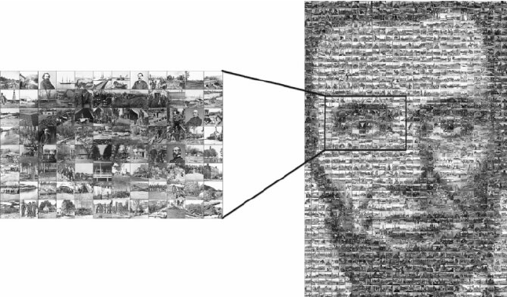
Steganography as an example
Notes:
Steganography is a classic example of a technique that aims to achieve undetectability rather than anonymity or unlinkability. The core idea is not to protect who is communicating, or how messages are related, but to hide the very existence of a message. To an adversary, a steganographic communication should look like ordinary, innocuous data, such as an image, an audio file, or network traffic with no apparent special meaning.
In steganography, the message is embedded into a cover object in such a way that the modified object remains statistically and perceptually similar to a normal one. If done correctly, an observer cannot reliably distinguish between an object that carries a hidden message and one that does not. This aligns directly with the definition of undetectability: from the adversary’s perspective, real communication and no communication are indistinguishable.
However, steganography also illustrates the practical difficulty of achieving undetectability. If the adversary suspects steganographic use or has strong statistical models, detection may become possible. Moreover, steganography only provides undetectability with respect to external observers; once the adversary is involved as sender or receiver, the existence of communication is no longer hidden. This makes steganography a powerful but fragile technique, best understood as an illustrative example of undetectability rather than a universal solution.
Key takeaway: Steganography aims for undetectability by hiding the existence of communication, making real messages appear indistinguishable from ordinary, non-sensitive data to an external observer.

Slide 18
Unobservability
What it combines
Undetectability of the item of interest (IOI)
Anonymity of the involved subjects
Definition
Unobservability means:
  The IOI is undetectable to observers not involved in it
  The involved subjects remain anonymous, even to each other
Scope
Applies to adversaries:
  Not involved in the IOI
  And involved in the IOI (with limited knowledge)
Notes:
Unobservability represents the strongest privacy notion discussed in this lecture, as it combines undetectability and anonymity into a single guarantee. While anonymity hides who is involved in an action and undetectability hides whether an action exists, unobservability aims to achieve both simultaneously. The goal is that communication should not be observable as such, and even if it is, the identities of the involved parties should not be revealed.
More precisely, unobservability has two components depending on the adversary’s position. For adversaries not involved in the item of interest (IOI), unobservability requires undetectability: the adversary cannot determine whether a communication or action exists at all. For adversaries involved in the IOI, unobservability requires anonymity: although they may know that communication occurred, they should not be able to identify the other participating subjects beyond what is strictly necessary. This distinction highlights that unobservability protects against both external observers and partially informed participants.
Because it addresses both existence and identity, unobservability is particularly relevant in high-risk scenarios such as covert communication, censorship resistance, or oppressive surveillance environments. However, it is also extremely difficult to achieve in practice, as even subtle traffic patterns or protocol artifacts can leak information. As a result, unobservability is best viewed as an ideal privacy goal that helps structure analysis and system design, rather than a property that most real-world systems fully achieve.
Key takeaway: Unobservability combines undetectability and anonymity to hide both the existence of communication and the identities of participants, providing the strongest—but hardest to achieve—privacy guarantee.

Slide 19
Relationships Between Privacy Properties
Key principle
For the same adversary, unobservability reveals less information than other properties
Implications
Unobservability ⇒ Anonymity
Sender unobservability ⇒ Sender anonymity
Receiver unobservability ⇒ Receiver anonymity
Further implication
Unobservability ⇒ Undetectability
Notes:
This slide explains how the privacy properties introduced earlier are related to one another when evaluated against the same adversary model. The central principle is that some privacy guarantees are strictly stronger than others in terms of how much information they reveal. In particular, unobservability is the strongest property discussed, because it minimizes what an adversary can learn about both the existence of communication and the parties involved.
The implications on the slide follow directly from this intuition. If a system provides unobservability, then an adversary cannot even determine whether a communication exists. As a result, the adversary also cannot identify who is involved in that communication, which means that anonymity is automatically satisfied. The same reasoning applies to more specific cases: sender unobservability implies sender anonymity, and receiver unobservability implies receiver anonymity. In each case, hiding the existence of an action necessarily hides the identity of the actor.
Unobservability also implies undetectability, because hiding the existence of communication is a core requirement of undetectability for external observers. However, the reverse implications do not hold. A system may provide anonymity without hiding the existence of communication, and it may provide undetectability without guaranteeing anonymity in all adversary positions. Understanding this directionality is essential for correctly interpreting privacy claims and for comparing different communication systems in a rigorous way.
Key takeaway: Unobservability is the strongest privacy property; it implies anonymity and undetectability for the same adversary, but neither anonymity nor undetectability implies unobservability.

Slide 20
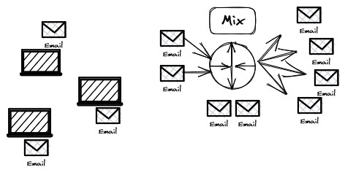

Mix Networks (Mixnets)
Origin
Introduced by David Chaum
“Untraceable Electronic Mail, Return Addresses, and Digital Pseudonyms”
What is a mixnet?
An anonymous communication system for exchanging messages (e.g., email)
Privacy guarantees
Sender anonymity
Receiver anonymity
Third-party anonymity
Core idea
Messages are routed through multiple mix nodes
Each mix:
  Reorders messages
  Delays messages
  Removes correlation between input and output
Notes:
Mix networks (mixnets) are one of the earliest concrete systems designed to provide anonymity in communication. Introduced by David Chaum, they were developed to address traffic analysis attacks, recognizing that encrypting message content alone does not prevent adversaries from learning who is communicating with whom.
In a mixnet, messages are routed through one or more intermediate servers called mixes. Each mix collects messages from multiple senders, delays them, reorders them, and forwards them onward. This process removes the observable correlation between incoming and outgoing messages, preventing an adversary from linking a sender to a receiver based on timing or ordering information.
By routing messages through multiple mixes, this unlinkability is strengthened further, as each mix independently obscures communication patterns. As a result, mixnets can provide sender anonymity, receiver anonymity, and third-party anonymity against network observers, although they typically do not hide the existence of communication itself.
Key Takeaway
Mix networks achieve anonymity by breaking the link between incoming and outgoing messages through reordering and delay, making traffic analysis ineffective even when message content is encrypted.

Slide 21
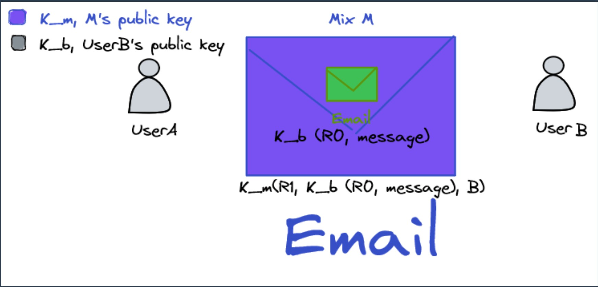
How does a mixnet technically break the link between sender and receiver?
Notes:
A mixnet breaks the link between sender and receiver by using layered (nested) encryption so that no single party can see both who sent a message and where it ultimately goes. The sender first encrypts the message for the final receiver using the receiver’s public key. This ensures that only the receiver can read the message content, and that intermediate nodes cannot inspect or modify it.
The sender then wraps this encrypted message inside another encryption layer addressed to a mix node. This outer layer contains routing information for the mix, such as the next destination, but it does not reveal the original sender. When the mix receives the message, it removes only its own encryption layer, learning where to forward the message next but not who originally sent it or what the message contains.
Crucially, the mix processes many messages together rather than immediately forwarding them. By batching messages, reordering them, and introducing delays, the mix destroys timing and ordering correlations between incoming and outgoing traffic. As a result, neither the mix itself nor an external network observer can reliably match a specific incoming message to a specific outgoing one, thereby breaking the sender–receiver link.
Key Takeaway
Mixnets technically break the sender–receiver link through layered encryption combined with batching, reordering, and delay, which removes timing and ordering correlations from observable network traffic.

Slide 22
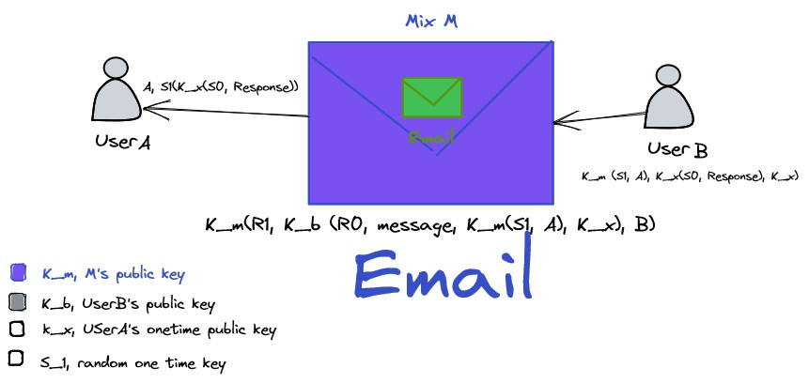
How a receiver can reply to a sender in a mixnet without learning the sender’s identity
Notes:
A mixnet enables anonymous replies by allowing the original sender to embed a cryptographic return path in the initial message. When User A sends a message to User B, they include a special return address constructed using one-time cryptographic material, such as a fresh public key and a random secret. This return path does not reveal User A’s identity, but it encodes enough information for a reply to be routed back through the mix network.
When User B wants to respond, they do not need to know who User A is or where User A is located. Instead, User B encrypts the response using the information contained in the return path and sends it back into the mixnet. The reply is treated like any other message in the network: it is mixed with other traffic, reordered, delayed, and forwarded without revealing sender–receiver relationships.
As the response traverses the mix network, no intermediate node can link the reply to the original message or identify either participant. Only User A, who possesses the corresponding one-time secret, can decrypt the response upon receipt. This mechanism allows two-way communication while preserving sender anonymity, receiver anonymity, and third-party anonymity.
Key Takeaway
Mixnets enable anonymous two-way communication by using cryptographic return paths that allow replies without revealing the sender’s identity.

Slide 23
Mixnet Limitations
High latency
Messages are delayed and queued at each mix
Shuffling increases delivery time
Limited anonymity set
Threshold-based mixing requires waiting for enough messages
Small batches reduce anonymity
Vulnerability to active attacks
Adversaries may inject specially crafted messages
Unique traffic patterns can be traced through the network
Notes:
Mixnets achieve anonymity by intentionally delaying and reordering messages at each mix node. These delays accumulate as messages traverse multiple mixes, leading to high end-to-end latency. As a result, mixnets are unsuitable for real-time applications such as web browsing, interactive chat, or voice communication, and are instead limited to delay-tolerant use cases.
The strength of anonymity in a mixnet depends on the size of the anonymity set formed at each mix. Threshold-based mixing requires waiting until enough messages arrive before forwarding them. When traffic volume is low or batch sizes are small, the anonymity set shrinks, making it easier for an adversary to correlate incoming and outgoing messages probabilistically.
Mixnets are also vulnerable to active attacks. An adversary may inject specially crafted or uniquely identifiable messages and observe how they propagate through the network. Such tagging or watermarking attacks can undermine unlinkability, even if the cryptographic mechanisms themselves remain secure.
Key takeaway: Mixnets provide strong anonymity guarantees, but these come at the cost of high latency, dependence on large anonymity sets, and exposure to active traffic analysis attacks.

Slide 24
Privacy in Access Services
Access and identity
Users access services to retrieve data or perform privileged actions
Access is usually tied to a digital identity
Identity management
Systems rely on identity management frameworks
Example: Federated Identity Management (FIM)
Federated identity model
Three parties:
  User
  Service Provider (SP)
  Identity Provider (IdP)
Common example
Single Sign-On (SSO) services
(e.g., Google, Apple, Microsoft)
Privacy feature
Users can choose to share only selected attributes with services
Notes:
Access to online services is almost always tied to a digital identity. When a user logs in, their actions become associated with an identity that enables authorization, auditing, and personalization. This linkage is essential for security and functionality, but it also introduces privacy risks by making user behavior observable and traceable.
To manage identities at scale, many systems rely on federated identity management. In this model, an identity provider authenticates the user on behalf of multiple service providers. Services trust the identity provider instead of maintaining their own authentication credentials, improving usability through mechanisms such as Single Sign-On.
From a privacy perspective, federated identity management introduces a powerful central observer. Even when services receive only selected user attributes, the identity provider can potentially observe which services are accessed and when. Attribute minimization reduces data disclosure to services, but it does not fully prevent linkability across services.
Key takeaway:
Federated identity management improves usability and security, but centralizes identity information and creates significant privacy risks through cross-service linkability.

Slide 25
Privacy Limitations in Access Services
Limited protection
Identity management systems mainly protect against third-party services
Trust assumption
Users must trust the Identity Provider (IdP) not to misuse data
Key privacy risk
The IdP can observe:
  Every authentication session
  Which services a user accesses
Collusion risk
If the IdP and Service Provider collude:
  User activities can be fully exposed
Notes:
Limited protection
Federated identity systems mainly protect users against third-party services by reducing direct exposure of credentials and personal data. Service providers rely on authentication assertions rather than handling passwords themselves. However, this protection is asymmetric and does not extend to the identity provider that mediates access.
Trust assumption
These systems rely on a strong trust assumption in the identity provider. Users must trust the identity provider not to misuse authentication data, not to profile access behavior, and not to share information beyond the intended purpose. This trust is fundamental and cannot be technically enforced in most deployments.
Observability and collusion
In practice, the identity provider can observe every authentication event and which services a user accesses over time. This enables detailed profiling even when only minimal attributes are shared. If the identity provider and a service provider collude, user activities and access patterns can be fully correlated, resulting in a complete loss of access privacy.
Key takeaway
Federated identity systems improve usability and security, but privacy ultimately depends on trusting the identity provider.

Slide 26
Attribute-Based Credentials (ABCs)
Core idea
Users prove attributes, not identities
Attributes
Examples: age, date of birth, nationality, diploma, grades
How it works
A trusted issuer issues credentials containing attributes
Credentials are bound to the user’s cryptographic key
Privacy properties
No full credential disclosure
Selective disclosure of chosen attributes
Optional disclosure of computed properties (e.g., “age ≥ 18”)
Notes:
Core idea
Attribute-Based Credentials shift access control from identity-based authentication to property-based proof. Instead of revealing who they are, users prove specific statements about themselves, such as being over a certain age or holding a particular qualification. This directly reduces unnecessary identity exposure and weakens the link between users and services.
How credentials work
A trusted issuer creates a credential that contains certified attributes and binds it cryptographically to the user. After issuance, the issuer is no longer involved in each access attempt. When interacting with a service, the user proves possession of valid attributes using cryptographic protocols, without revealing the full credential or their identity.
Privacy properties
Attribute-Based Credentials support selective disclosure, meaning users reveal only the attributes required for a specific interaction. They also allow disclosure of computed properties, such as proving “age ≥ 18” without revealing the exact date of birth. This prevents both service providers and issuers from easily tracking or profiling user behavior across services.
Key takeaway
Attribute-Based Credentials enable privacy-preserving access control by allowing users to prove attributes and properties without revealing their identity or unnecessary personal data.

Slide 27
Anonymous Authentication Protocol – Example
Goal
Authenticate a user to access a service
Without revealing unnecessary personal information
Key idea
The user proves eligibility, not identity
The credential issuer does not track service usage
Example
Alice wants to rent a video
She must prove she is over 18
She does not reveal:
  Date of birth
  Name
  Address
  Other attributes
Notes:
Goal and key idea
Anonymous authentication aims to authenticate a user for accessing a service without revealing unnecessary personal information. Instead of identifying the user, the system focuses on proving eligibility for access. This means the service learns only whether the required condition is satisfied, not who the user is.
How the protocol works
A trusted issuer first verifies the user’s real identity offline and issues a credential containing certified attributes, such as date of birth. Later, when the user wants to access a service, the service requests proof of a specific condition, for example that the user is over 18. Using the credential, the user generates a cryptographic proof that satisfies this condition without revealing the underlying attributes or identity.
Privacy guarantees
The service provider learns only the result of the eligibility check and cannot derive the user’s name, date of birth, or other attributes. The credential issuer is not involved in the service access and therefore cannot observe which services the user accesses or when. This prevents profiling, reduces linkability across services, and minimizes trust in centralized identity providers.
Key takeaway
Anonymous authentication enables access control based on eligibility rather than identity, allowing users to access services while preserving privacy and minimizing personal data disclosure.

Slide 28
2. Request for services
3. Request for data
4. Selective credential disclosure
Alice
Verifier
SWEDISH DRIVING LICENSE NAME
ADDRESS
SEX PERSONNUMMER
AGE > 18
SWEDISH DRIVING LICENSE NAME
ADDRESS
SEX PERSONNUMMER
1. Issues credentials
Issuer

Slide 29
Anonymous Credentials
What we expect
Strong unlinkability across all uses of a credential
Unlinkability guarantees
Credential use cannot be linked to its issuance
Credential use cannot be linked to previous uses
Multiple uses at the same service cannot be linked
Deployed systems
Two main anonymous credential systems
They provide slightly different privacy guarantees
Notes:
Unlinkability as the Core Property
Anonymous credentials are a special class of attribute-based credentials designed to provide strong unlinkability. The defining requirement is that every use of a credential appears fresh and independent, even when the same credential is reused multiple times. This means that observing one authentication event should not help an adversary recognize the same user in another event.
Unlinkability applies not only between different services, but also across time and context. A verifier should not be able to determine whether two authentication attempts come from the same user, even if they occur at the same service. This distinguishes anonymous credentials from pseudonymous systems, where repeated interactions can still be linked.
This property is critical for privacy because many real-world privacy harms arise from correlation rather than direct identification. Even without knowing a user’s name, the ability to link actions over time enables profiling, inference, and surveillance. Anonymous credentials aim to eliminate this risk by design.
Unlinkability from Issuance and Across Uses
A key guarantee of anonymous credentials is that credential usage cannot be linked to credential issuance. Once a credential has been issued, the issuer should have no visibility into when, where, or how it is used. This removes the issuer from the trust base during authentication and prevents centralized tracking of user activity.
In addition, multiple uses of the same credential must be unlinkable from each other. Even if a user repeatedly proves the same attribute, each proof should appear as a completely independent event. This prevents long-term tracking and stops verifiers from building behavioral profiles based on credential reuse.
Crucially, unlinkability must also hold at the same service provider. Without this property, a service could still recognize returning users and accumulate detailed usage histories. Anonymous credentials therefore provide a stronger privacy guarantee than basic anonymity by preventing correlation even in repeated interactions.
Practical Meaning and Deployed Systems
These unlinkability guarantees define what “anonymous” truly means in anonymous credential systems. If credential use can be linked across sessions or to issuance, the system effectively degrades into a pseudonymous authentication mechanism. Strong anonymity requires that such links are cryptographically infeasible.
Several anonymous credential systems have been deployed that aim to meet these requirements, although they differ in efficiency, trust assumptions, and exact privacy guarantees. The design of these systems carefully balances performance with cryptographic strength to achieve unlinkability in realistic settings.
Understanding these guarantees is essential before examining concrete systems. Without a clear definition of unlinkability, it is easy to overestimate the privacy provided by authentication technologies. This slide establishes the benchmark against which real-world systems must be evaluated.
Key Takeaway
Anonymous credentials provide strong unlinkability by ensuring that credential issuance, usage, and repeated usage cannot be linked, even by the same service.

Slide 30
Single-Credential Authentication Systems
Core idea
Each credential is used only once
Fresh credentials are issued for every authentication
Unlinkability
Multiple disclosures cannot be linked
Issuance and use are unlinkable
How it works
Uses blind signature protocols
Issuer signs attributes without seeing them
Trade-off
Efficient and simple
Requires the prover to be online to obtain new credentials
Example system:
U-Prove (Microsoft)
Notes:
Single-use credentials
Single-credential authentication systems achieve anonymity by ensuring that each credential is used only once. After a credential is presented to a service, it is discarded and never reused. As a result, every authentication attempt relies on a fresh credential, which makes linking multiple sessions inherently impossible.
Because credentials are never reused, unlinkability follows directly from the system design. Even if the same attributes are disclosed repeatedly, each disclosure appears independent. This means that neither the service provider nor the issuer can determine whether two authentications originate from the same user.
The cryptographic mechanism enabling this is the use of blind signatures. Blind signatures allow the issuer to sign a user’s attributes without learning their actual values. As a consequence, the issuer cannot later recognize or trace a credential when it is presented to a service, breaking the link between issuance and use.
Key takeaway
Single-credential systems provide strong unlinkability by design, but require users to obtain a fresh credential for every authentication.

Slide 31
Multiple-Credential Authentication Systems
Core idea
Credentials can be used multiple times
Strong unlinkability is still preserved
How unlinkability is achieved
Credential is hidden from:
  The verifier
  The issuer
Achieved using zero-knowledge proofs (ZKPs)
Key mechanism
Zero-knowledge proof:
  Proves possession of a valid credential
  Reveals only selected attributes
Example system: Idemix (IBM)
Trade-off
Strong privacy guarantees
Higher complexity and lower efficiency
Notes:
Multiple-Credential Authentication Systems – Concept
Multiple-credential authentication systems allow a user to authenticate multiple times using the same credential while still preserving strong privacy guarantees. Unlike single-use credential systems, credentials are not discarded after one authentication. The central challenge is therefore to enable reuse without allowing different authentication sessions to be linked together by a service provider or issuer. These systems aim to provide both usability and strong anonymity.
The core mechanism enabling this property is the use of zero-knowledge proofs. Instead of revealing the credential itself, the user proves possession of a valid credential issued by a trusted authority and proves that certain attributes satisfy the service’s requirements. Because the proof reveals no identifying information and no stable identifier, each authentication appears fresh and independent, even when the same credential is reused many times.
Unlinkability is preserved because the credential remains hidden from both the verifier and the issuer during authentication. The verifier learns only the required attributes, and the issuer does not observe when or where the credential is used. As a result, issuance cannot be linked to usage, and multiple authentication events cannot be correlated with one another. This provides strong protection against profiling and long-term tracking across services.
Key Takeaway
Multiple-credential authentication systems use zero-knowledge proofs to allow credentials to be reused while preventing linkage between issuance, authentication events, and repeated uses.

Slide 32
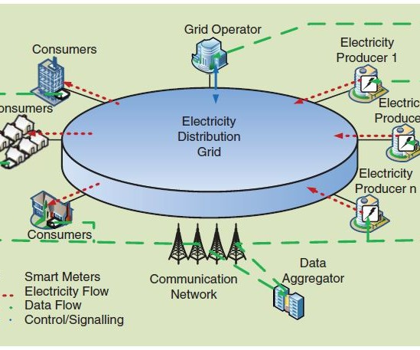
Private Computations
Example: Smart Grids
System components
Power generation systems
Transmission and distribution network
Smart meters (IoT devices)
Privacy challenge
Fine-grained consumption data reveals:
  Daily routines
  Occupancy patterns
  Lifestyle information
Goal
Compute billing and grid statistics
Without revealing individual consumption data
Notes:
Problem context
Smart grids rely on smart meters that continuously report fine-grained electricity consumption data. These measurements are required for billing, load balancing, and grid optimization, but they also reveal highly sensitive information about households. From detailed consumption traces, it is possible to infer daily routines, occupancy patterns, and lifestyle habits. This makes smart grids a representative example of systems where functionality directly conflicts with user privacy.
Why encryption is insufficient
Encrypting smart meter data protects it during transmission and storage, but it does not solve the core problem. At some point, the utility provider must decrypt the data in order to compute bills and aggregate statistics. Once decrypted, individual consumption patterns are fully exposed. This means that traditional security mechanisms protect data access, but fail to protect data usage during computation.
Privacy-preserving computation goal
The goal of private computation is to enable correct and useful computations while minimizing what is revealed about individual inputs. In the smart grid setting, the utility provider should be able to compute total consumption, billing amounts, or grid statistics without learning detailed household-level consumption patterns. This shifts the focus from hiding identities to limiting information leakage during computation itself.
Key takeaway
Private computation allows systems to compute meaningful results while protecting sensitive individual data that would otherwise be exposed during processing.

Slide 33
Private Computations: System Architectures
Centralized setup
Smart meters send fine-grained measurements to a central aggregator
Aggregator performs:
  Consumption calculation
  Load balancing
  Billing
Users access stored data to view their consumption
Decentralized setup
Smart meters participate in computation
Partial aggregation is performed locally at meters
Only aggregated values are sent to energy suppliers
Grid management and load balancing are performed collaboratively
Notes:
Centralized and decentralized architectures represent two fundamentally different design choices for private computation. In a centralized setup, smart meters send fine-grained consumption data to a central aggregator that performs billing, load balancing, and consumption analysis. While this design is operationally simple and efficient, it concentrates sensitive data in one place. From a privacy perspective, this means a single entity has visibility into detailed household behavior, creating strong assumptions about trust, data protection, and insider misuse.
In contrast, a decentralized setup distributes computation across smart meters themselves. Instead of sending raw measurements, meters perform partial or local computations, such as aggregating usage over time or contributing to collaborative load-balancing decisions. Only aggregated results are shared with energy suppliers or grid operators. This architectural choice significantly limits the exposure of fine-grained data and reduces the risk that any single party can reconstruct individual consumption patterns.
However, decentralization introduces its own trade-offs. It increases system complexity, requires more capable devices, and often relies on coordination protocols or cryptographic techniques such as secure aggregation or multi-party computation. This highlights a core lesson in privacy engineering: strong privacy guarantees are often achieved not only through cryptography, but through deliberate architectural choices that shape who sees what data, and when.
Key Takeaway
In private computation, architectural decisions—centralized versus decentralized—play a decisive role in determining privacy risks, trust assumptions, and system complexity.

Slide 34
Private Computation: Trust and Privacy Questions
Privacy risks
Fine-grained measurements are privacy-invasive
Consumption data can reveal:
  Presence or absence of residents
  Daily routines
Trust questions
Who can see raw consumption data?
Who must be trusted not to misuse it?
Utility provider needs
Accurate consumption analysis
Grid management and billing
Privacy-enhancing solution
Secure multi-party computation (SMPC)
Homomorphic encryption (HE)
Notes:
Fine-grained consumption data collected by smart meters is highly privacy-invasive. Although these measurements are necessary for modern grid operation, they can reveal sensitive information about households, such as presence or absence of residents, daily routines, and appliance usage. This means that consumption data is not merely technical data but a rich behavioral signal, making its protection a critical privacy concern.
In traditional centralized architectures, utility providers have direct access to raw consumption data. As a result, users must place significant trust in the provider to handle this data responsibly, not misuse it, and adequately protect it from breaches or unauthorized access. This trust assumption is often unrealistic at scale, especially when large datasets are retained over long periods and reused for secondary purposes.
Private computation addresses this trust problem by changing who can see what during data processing. Instead of revealing raw measurements, cryptographic techniques enable correct computation of billing, load balancing, and grid statistics while minimizing disclosure of individual inputs. Techniques such as secure multi-party computation and homomorphic encryption allow utilities to obtain accurate results without learning sensitive household-level data, thereby reducing the need for blind trust.
Key takeaway
Private computation reduces privacy risks by minimizing who must be trusted with raw data, while still enabling accurate and necessary system-wide computations.

Slide 35
Private Computation Technologies
Homomorphic Encryption (HE)
Enables computation directly on encrypted data
Data remains encrypted during processing
Suitable for centralized computation
Secure Multi-Party Computation (SMPC)
Enables joint computation across multiple parties
Each party keeps its input private
No single party learns all inputs
Notes:
Homomorphic Encryption (HE)
Homomorphic encryption enables computation directly on encrypted data. The computing entity performs operations without ever decrypting the inputs, ensuring that raw data remains hidden throughout processing.
This approach is well suited for centralized architectures where a single party performs computations such as billing or statistics. The privacy guarantee is strong, but the main limitation is high computational overhead.
Secure Multi-Party Computation (SMPC)
Secure multi-party computation allows multiple parties to jointly compute a function while keeping their individual inputs private. No single party ever learns all input values, and only the final result is revealed.
SMPC naturally supports decentralized architectures and reduces reliance on a trusted central entity. The trade-off is increased communication, coordination, and protocol complexity.
Key Takeaway
Private computation can be achieved either by computing on encrypted data in centralized systems or by distributing computation across multiple parties so that no one learns the raw inputs.

Slide 36
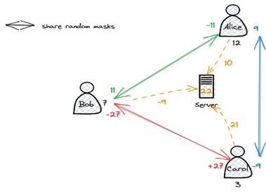
Private Computations: Secure Aggregation Example
Goal
Compute total electricity consumption
Without revealing individual measurements
Protocol idea
Users share pairwise random masks
Each user masks their data before sending it
Masks cancel out when summed
Privacy guarantee
Server learns only the total
Individual values remain private
Notes:
Goal
Secure aggregation aims to compute a global result, such as total electricity consumption, without revealing any individual user’s measurement. Each participant contributes data, but no single party—including the server—learns individual values. Only the final aggregate is revealed.
Protocol Idea
Each user masks their local measurement using random values shared pairwise with other users. For every shared mask, one user adds the value while the other subtracts it. As a result, all masks cancel out when summed, while individual inputs remain hidden from the server.
Privacy Guarantee
The server only observes masked values and can compute the correct total by aggregation. Individual contributions cannot be recovered from the received data, assuming honest participation and no collusion. Privacy is achieved by construction, not by trusting the server with raw data.
Key takeaway
Secure aggregation enables accurate global computation while keeping individual inputs private by design.

Slide 37
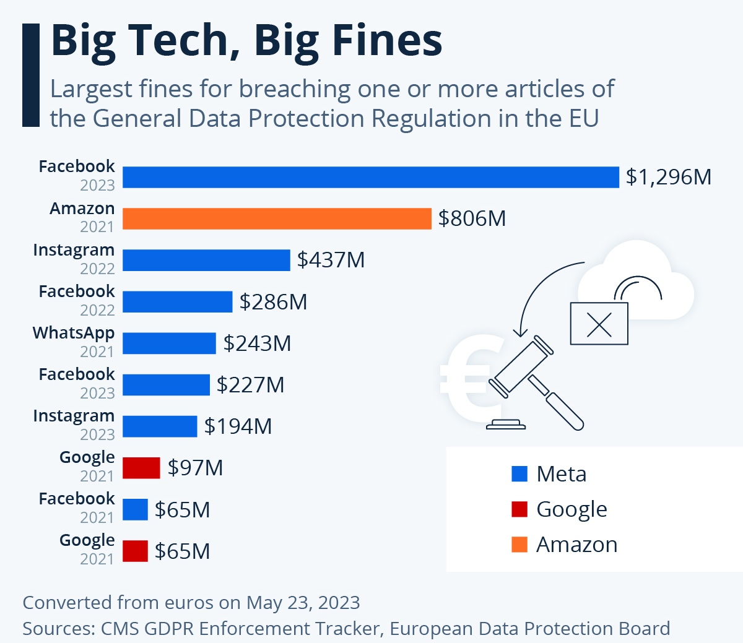

Slide 38
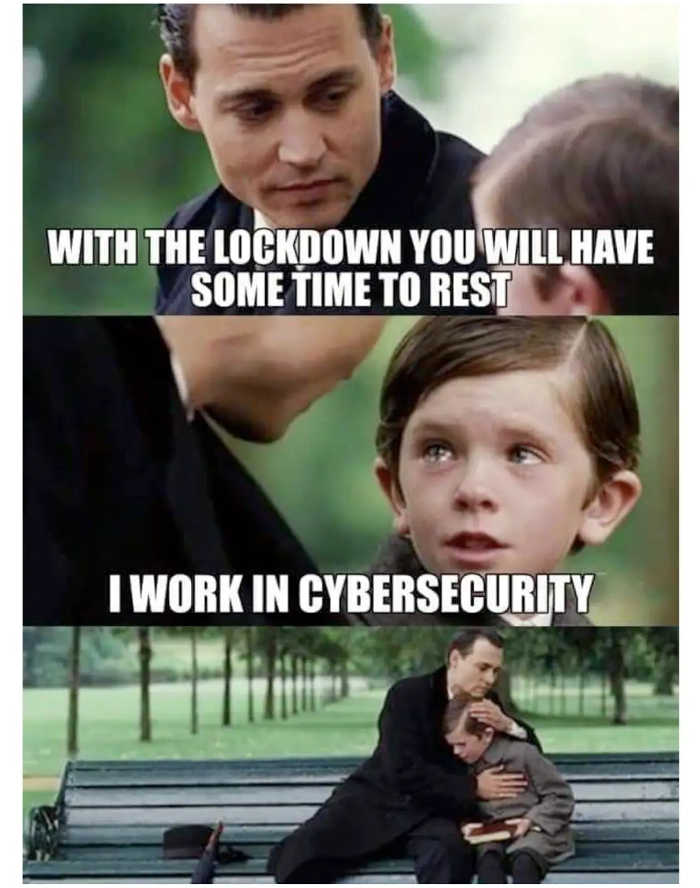
Cybersecurity is like a seatbelt. Most of the time you don't need it, but when you do, you'll be glad it's there.
Richard Bartlett

Slide 39
References for Further reading
[Pfitzmann17]
A. Pfitzmann and M. Hansen, “A Terminology for Talking about Privacy by Data Minimization: Anonymity, Unlinkability, Undetectability, Unobservability, Pseudonymity, and Identity Management,” TU Dresden & ULD Kiel, Tech. Rep. v0.34, 2010. Available: https://dud.inf.tu-dresden.de/literatur/Anon_Terminology_v0.34.pdf
[Chaum81]
D. L. Chaum, “Untraceable Electronic Mail, Return Addresses, and Digital Pseudonyms,” Communications of the ACM, vol. 24, no. 2, pp. 84–90, Feb. 1981.
doi: 10.1145/358549.358563
[Camenisch02]
J. Camenisch and E. Van Herreweghen, “Design and Implementation of the Idemix Anonymous Credential System,” in Proceedings of the 9th ACM Conference on Computer and Communications Security (CCS), New York, NY, USA, Nov. 2002, pp. 21–30. doi: 10.1145/586110.586114
[Danezis10]
G. Danezis and S. Gürses, “A Critical Review of 10 Years of Privacy Technology,” in Proceedings of the Surveillance Cultures: A Global Surveillance Society Conference, 2010.
[Shen11]
Y. Shen and S. Pearson, Privacy Enhancing Technologies: A Review, Hewlett-Packard Development Company, 2011. Available: https://bit.ly/3cfpAKz; Alternative reading site: https://www.priv.gc.ca/en/opc-actions-and-decisions/research/explore-privacy-research/2017/pet_201711/
[Solove06]
D. J. Solove, “A Taxonomy of Privacy,” University of Pennsylvania Law Review, vol. 154, no. 3, pp. 477–560, 2006.
[Nissenbaum09]
H. Nissenbaum, Privacy in Context: Technology, Policy, and the Integrity of Social Life. Stanford, CA, USA: Stanford University Press, 2009.

Slide 40
Privacy enhancing technologies
Database Privacy and Private ML training Approaches

Slide 41
Whose Privacy
Privacy concerns differ depending on who needs protection in a data-driven system.
Respondent Privacy
Protecting information about individuals whose data records are stored in a database.
Owner Privacy
Protecting information of organizations or entities that jointly contribute data to compute a query or result.
End-User Privacy
Protecting users’ queries and interactions with services such as search engines or online databases.
Notes:
Respondent Privacy
Protects individuals whose personal records are stored in a database. The main risk is that sensitive attributes can be inferred or re-identified, even when direct identifiers are removed. This type of privacy focuses on limiting what can be learned about any single individual from released data or query results.
Owner Privacy
Protects organizations or entities that contribute data to a joint computation. Each data owner wants to ensure that its raw data is not revealed to other participants or to the computing party. The goal is to enable collaboration without exposing proprietary or sensitive datasets.
End-User Privacy
Protects users who interact with data-driven services through queries or requests. Even when no personal data is stored, queries themselves may reveal interests, intentions, or sensitive information. This type of privacy focuses on hiding access patterns and query content from service providers.
Key Takeaway
Privacy requirements depend on whose information is at risk, and different system designs and technologies are needed to protect respondents, data owners, and end users.

Slide 42
Statistical Databases
Statistical databases allow users to retrieve aggregate information about a population without accessing individual records.
They support applications such as:
  Public health and disease monitoring
  Market research
  Medical and social science research
However, these databases contain confidential information about individuals who contributed their data.
A key question arises:
Making such data publicly available can:
  Enable scientific discovery
  Improve policy-making
  Advance societal knowledge
  Can data users (researchers, analysts, consumers) be trusted not to misuse this information?
Notes:
Aggregate Access
Statistical databases are designed to provide aggregate information about a population rather than access to individual records. Users interact with the database through queries that return summaries such as counts, averages, or distributions. The intention is to support analysis while avoiding direct exposure of personal data.
Utility vs Sensitivity
These databases are highly valuable for applications such as public health monitoring, market analysis, and social science research. Making aggregate data available can enable scientific discovery, improve decision-making, and support evidence-based policy. However, the underlying data still originates from individuals and may contain sensitive attributes.
Trust and Risk
Even when only aggregate results are released, there is a risk that individuals can be inferred through careful or repeated queries. This shifts the privacy problem from data access to data inference and trust in data users. The central question becomes whether users can be trusted not to misuse statistical outputs.
Key Takeaway
Statistical databases aim to balance data utility and privacy, but aggregate access alone does not eliminate the need for strong privacy protections.

Slide 43
What Are the Privacy Risks? in Statistical Databases
Privacy risks can be understood using the concept of unlinkability.
Anonymity in terms of unlinkability
The anonymity of a subject with respect to an attribute can be defined as the unlinkability between the subject and that attribute.
From an adversary’s perspective, there are two main types of linkage attacks:
Record linkage
Re-identifying individuals in a published dataset by linking it with external, publicly available information, even when explicit identifiers have been removed.
Attribute linkage
Inferring confidential attributes about an individual or a group from the released data, where such inference would not have been possible without access to the dataset.
Notes:
Unlinkability as the Core Risk Model
Privacy risks in statistical databases can be understood through the concept of unlinkability. A dataset is privacy-preserving only if an adversary cannot reliably link individuals to specific attributes using the released information. Removing explicit identifiers alone is insufficient if linkage remains possible.
Record Linkage Attacks
Record linkage occurs when individuals are re-identified by combining a released dataset with external, publicly available information. Even when names or IDs are removed, quasi-identifiers such as age, location, or occupation can enable re-identification through cross-dataset correlation.
Attribute Linkage Attacks
Attribute linkage refers to inferring sensitive attributes about an individual or a small group without necessarily identifying them by name. Privacy harm arises when access to the dataset enables conclusions that would not be possible without it, such as health status, income level, or political affiliation.
Key Takeaway
Privacy risks in statistical databases arise from the ability to link data, not merely from the presence of explicit identifiers.

Slide 44
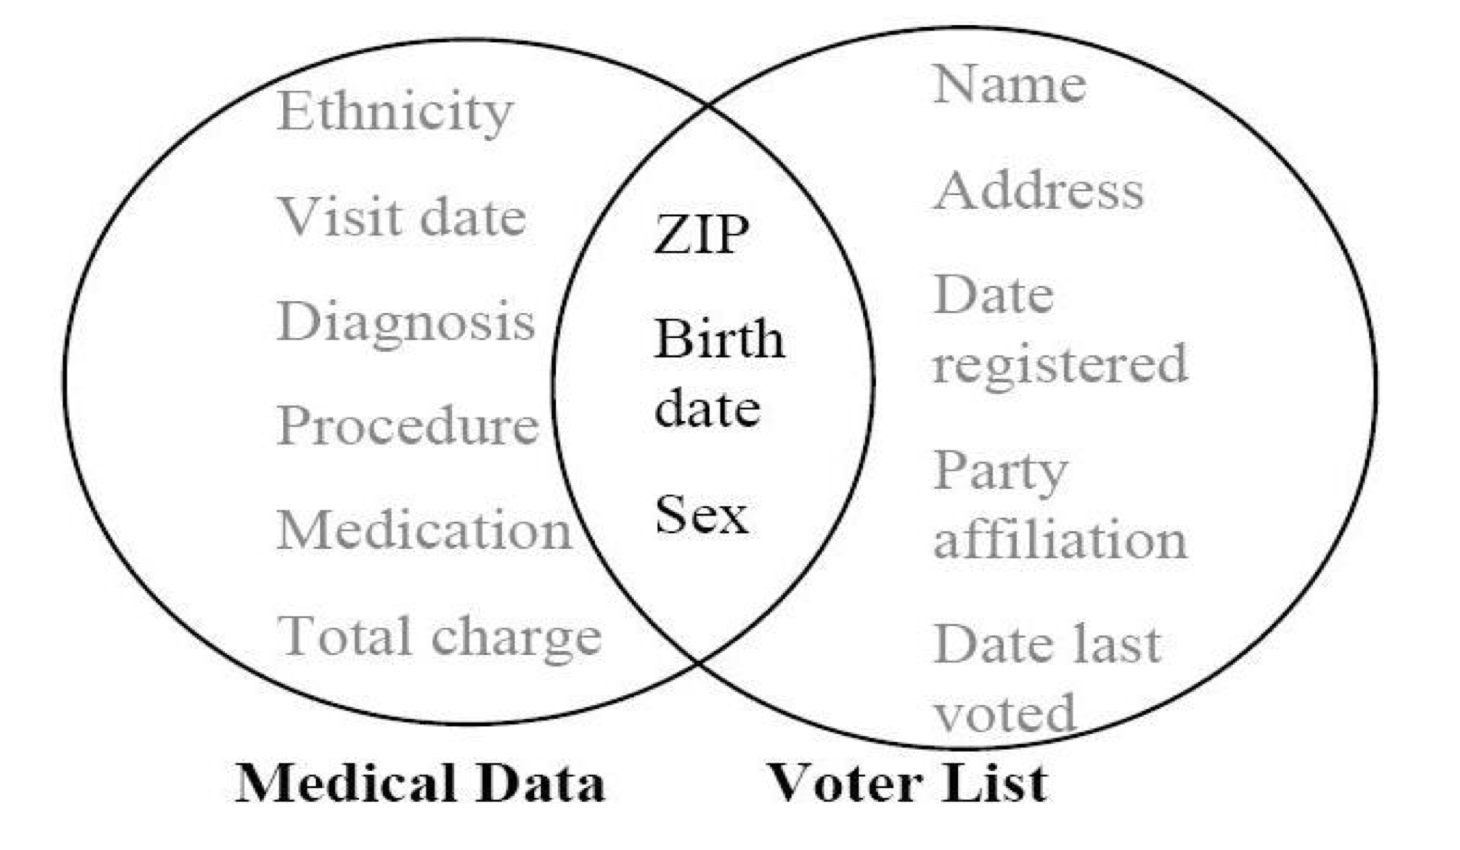
Record Linkage Example
Record Linkage: A Real-World Example
In Massachusetts (USA), the Group Insurance Commission (GIC) released an anonymized medical dataset of state employees.
Latanya Sweeney purchased the public voter registration list for Cambridge, MA for $20.
Former Massachusetts governor William Weld lived in Cambridge and was included in the voter database.
In the voter database:
  6 individuals shared Weld’s date of birth
  3 of them were male
  Only one matched Weld’s ZIP code
Result:
Mr. Weld’s medical record was uniquely identified.
His medical information was disclosed without his consent.
Notes:
Record Linkage
An anonymized dataset may still contain attributes that indirectly identify individuals. Even when explicit identifiers such as names are removed, combinations of seemingly harmless attributes can uniquely distinguish a person within a population.
Record linkage occurs when a released dataset is combined with external information, such as voter records or public registries. By matching shared attributes across datasets, an adversary can re-identify individuals without accessing confidential systems or violating access controls.
This risk depends on the adversary’s background knowledge and available auxiliary data. As more datasets become publicly accessible, the likelihood of successful linkage attacks increases significantly.
Key Takeaway:
Removing direct identifiers is not sufficient to prevent re-identification when datasets can be linked using shared attributes.

Slide 45
CATEGORIES OF IDENTIFIERS
Explicit Identifiers
Attributes that unambiguously identify an individual on their own
Examples: name, social security number, email address, IP address
Quasi-Identifiers
Attributes that do not identify alone, but can identify individuals when combined
Examples: age, gender, ZIP code, date of birth
These attributes are the main source of re-identification attacks.
Sensitive Attributes
Attributes containing confidential information about individuals
Examples: disease, salary, political affiliation
Key Takeaway
Privacy breaches typically occur not because of explicit identifiers,
but due to quasi-identifiers combined with external information.
Notes:
Explicit identifiers are attributes that uniquely and directly identify an individual on their own. When present in a dataset, they immediately reveal identity and therefore must be removed or protected before any form of data release.
Quasi-identifiers do not uniquely identify individuals in isolation, but can become identifying when combined with other attributes or external data sources. These attributes are particularly dangerous because they often appear harmless yet enable re-identification through linkage attacks.
Sensitive attributes contain confidential information about individuals, such as health, income, or political views. While they may not identify individuals directly, their disclosure becomes harmful once a record is linked to a specific person.
Key Takeaway:
Most privacy breaches arise from quasi-identifiers that enable re-identification when combined with auxiliary information, not from explicit identifiers alone.

Slide 46
K-Anonymity (Intuition and Definition)
K-anonymity is a privacy model used to protect individuals in released datasets.
A dataset satisfies k-anonymity if each individual is indistinguishable from at least (k − 1) others based on selected identifying attributes.
These identifying attributes are called quasi-identifiers (QI).
  Examples: ZIP code, age, gender, date of birth
Formal definition (simplified):
Let T be a table and QI be the set of quasi-identifiers.
Table T satisfies k-anonymity if every combination of QI values appears at least k times in the table.
Key idea:
“You can be identified only as part of a group, not as an individual.”
Notes:
K-anonymity is a privacy model designed to protect individuals in released datasets by ensuring that no record can be uniquely distinguished using identifying attributes. The core intuition is that an individual should blend into a group of similar records, so that an adversary cannot confidently single out one person. This model directly addresses record linkage attacks by limiting how precisely individuals can be identified based on available data.
The protection in k-anonymity is defined with respect to a selected set of quasi-identifiers, such as ZIP code, age, gender, or date of birth. A dataset satisfies k-anonymity if every unique combination of quasi-identifier values appears in at least k records. In practice, this means that each individual is indistinguishable from at least k − 1 others when viewed through these attributes, forming equivalence classes of size k or larger.
To achieve k-anonymity, datasets are typically transformed using techniques such as generalization (for example, replacing exact ages with age ranges) or suppression (removing certain values entirely). While k-anonymity reduces the risk of re-identification, it does not guarantee full privacy, especially when sensitive attributes lack diversity within an equivalence class. This limitation motivates stronger models that build on k-anonymity.
Key Takeaway:
K-anonymity protects privacy by ensuring individuals cannot be uniquely identified using quasi-identifiers, forcing identification only at the level of a group rather than an individual.

Slide 47
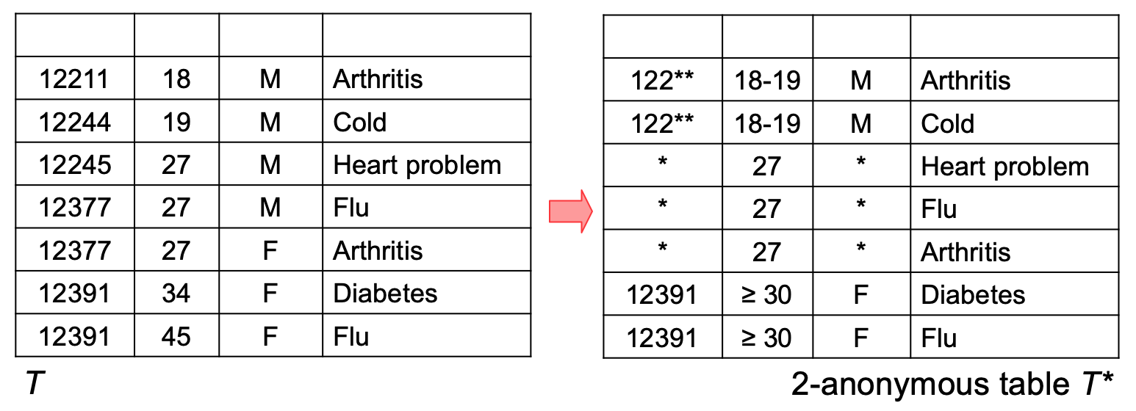
How K-Anonymity Is Achieved
To achieve k-anonymity, we modify quasi-identifiers using:
  Generalization (e.g., age → age range)
  Suppression (e.g., replacing values with *)
Sensitive attributes (e.g., disease) are not modified.
Example (k = 2):
ZIP code: 12211 → 122**
Age: 18, 19 → 18–19
Age: 34, 45 → ≥ 30
After transformation:
Each quasi-identifier group contains at least 2 records
The table becomes 2-anonymous
Notes:
Core principle
K-anonymity is achieved by modifying quasi-identifiers so that each individual record becomes indistinguishable from at least $k−1$other records.
Modification Techniques
Generalization
Specific values are replaced with broader categories to reduce identifiability.
Examples include replacing an exact age with an age range, or truncating a ZIP code.
Suppression
Certain quasi-identifier values are removed or masked (e.g., replaced with *) when generalization alone is insufficient.
Important:
Sensitive attributes (such as disease or salary) are not modified. Only quasi-identifiers are transformed.
Example (k = 2)
Original quasi-identifiers
ZIP codes are unique or near-unique
Exact ages allow precise distinction
Applied transformations
ZIP code 12211 → 122**
Ages 18, 19 → 18–19
Ages 34, 45 → ≥ 30
Resulting Property
2-anonymity achieved
After transformation, every combination of quasi-identifier values appears in at least two records.
Effect
Individual records cannot be uniquely linked using quasi-identifiers
Identification is only possible at the group level
Key Takeaway
K-anonymity is enforced by generalizing and suppressing quasi-identifiers until every individual record blends into a group of size $k$, reducing the risk of record linkage attacks.

Slide 48
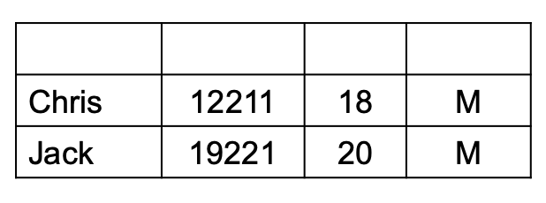
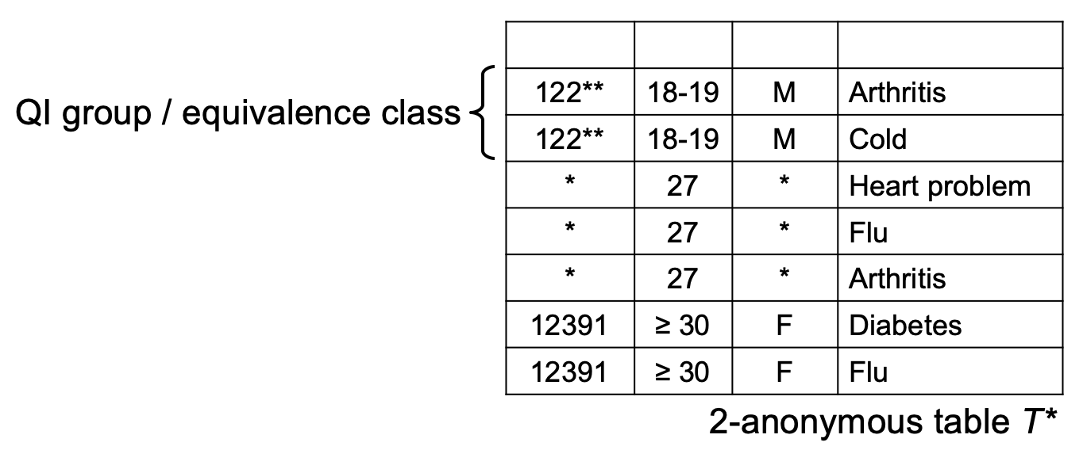
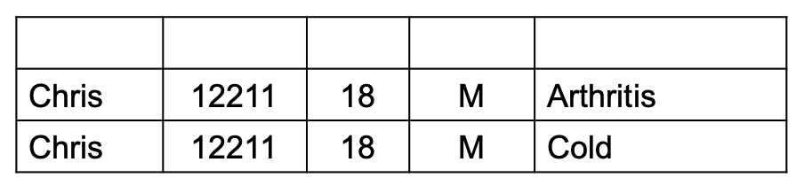
K-Anonymity Example: Record Linkage
What k-anonymity guarantees:
An attacker can identify a group of possible records but the attacker cannot determine the exact sensitive value
Example outcome:
Chris matches two records
His disease is uncertain (Arthritis or Cold)
Chris remains anonymous within his anonymity set
Publicly available Data
Chris remains anonymous within this anonymity set
Anonymized patient data
Notes:
K-Anonymity Example: Record Linkage
This slide illustrates what k-anonymity protects against in the presence of record linkage attacks. An attacker may possess publicly available information about an individual, such as age, ZIP code, and gender, and attempt to link this information to an anonymized dataset. These attributes, known as quasi-identifiers, do not uniquely identify individuals on their own but can significantly reduce anonymity when combined.
In the anonymized table shown, the quasi-identifiers have been generalized or suppressed so that each combination appears at least twice. As a result, when the attacker attempts to match Chris using public data, the match does not lead to a single record but instead to an equivalence class containing multiple possible records. Chris can therefore be linked only to a group, not to a specific row in the dataset.
Although the attacker can narrow down the possibilities, the sensitive attribute (in this case, the disease) cannot be uniquely determined. Chris’s condition remains ambiguous between multiple values. This demonstrates the core guarantee of k-anonymity: it prevents unique re-identification through quasi-identifiers, even when external data sources are available.
Takeaway:
K-anonymity protects individuals from record linkage by ensuring they are indistinguishable from at least k−1 others based on quasi-identifiers, but it does not fully prevent inference of sensitive attributes.

Slide 49
Database Reconstruction Attack (DRA)
In a Database Reconstruction Attack, an attacker:
  Observes answers to many aggregate queries
  Uses computation to infer the underlying individual data
Even random or noisy-looking queries can leak information
Example (U.S. Census):
Census data contains individual responses (race, location, etc.)
Only statistics are published (e.g., number of people of a given race in a block)
An attacker:
  Enumerates possible individual datasets
  Finds the dataset(s) that best match the published statistics
This can partially or fully reconstruct sensitive individual data.
Notes:
A Database Reconstruction Attack (DRA) shows that privacy risks can exist even when only aggregate statistics are released and no individual records are shared. In this type of attack, an adversary observes the answers to many statistical queries about a dataset, such as counts, sums, or averages. Although each individual answer appears harmless, together they can reveal far more information than intended.
The core insight behind a DRA is that aggregate answers constrain the possible underlying datasets. If an attacker observes enough query results, there may be only one—or very few—individual-level datasets that are consistent with all published statistics. By systematically enumerating or optimizing over possible datasets and comparing them against the released aggregates, the attacker can infer individual attributes, partially or even fully reconstructing the original data.
This risk has been demonstrated in real-world settings, most notably with census data, where governments publish highly granular statistics for transparency and research. Even though individual census responses are never released, attackers can combine many published statistics across overlapping populations to reconstruct sensitive information about specific individuals or households. This result highlights a fundamental limitation of traditional approaches to privacy that rely solely on aggregation or access control.
Key takeaway:
Releasing aggregate statistics alone does not guarantee privacy—without formal safeguards, sufficiently many accurate queries can mathematically enable reconstruction of individual data.

Slide 50
Database Reconstruction Attack (DRA): Worked Example
Aggregate Stats
Group | Count | Mean Age | Median Age
Female Professors | 3 | 35 | 35.6
Mathematical Constraints Implied by the Statistics
Statistic | What it Implies
Count = 3 | There are exactly 3 individuals
Mean = 35 | Ages must sum to 105
Median = 35.6 | The middle age is approximately 36
Notes:
A Database Reconstruction Attack (DRA) demonstrates that privacy can be compromised even when only aggregate statistics are released. In this example, no individual ages are disclosed. Instead, the published information consists solely of high-level summaries: the number of individuals, the mean age, and the median age. While these statistics appear innocuous, each one imposes a mathematical constraint on the possible underlying individual values.
The first slide shows how these aggregate statistics translate into concrete constraints. A count of three individuals fixes the dataset size, a mean age of 35 requires the ages to sum to 105, and a median of 35.6 restricts the ordering and approximate values of the ages. An attacker can exploit these constraints by systematically enumerating possible age combinations and checking which ones are consistent with all released statistics. Most candidate combinations are eliminated immediately because they violate at least one condition.
The next slide makes this process explicit by listing candidate age triples and showing why some are invalid and others remain plausible. Combinations such as (10, 10, 85) or (20, 35, 50) satisfy the mean but fail the median constraint, while combinations like (34, 35, 36) or (33, 36, 36) satisfy both. Even though the exact ages are not uniquely determined, the uncertainty has been dramatically reduced. This illustrates how combining multiple simple statistics can significantly narrow the space of possible individual-level data, leading to partial reconstruction.
Key takeaway:
Even basic aggregate statistics, when combined, can sharply constrain the underlying data and enable reconstruction attacks, showing that privacy loss can arise from mathematical inference alone—not from releasing individual records.

Slide 51
Contd.
Age 1 | Age 2 | Age 3 | Valid? | Reason
10 | 10 | 85 | ❌ | Median incorrect
20 | 35 | 50 | ❌ | Median incorrect
34 | 35 | 36 | ✅ | Matches mean & median
33 | 36 | 36 | ✅ | Matches mean & median
Candidate Age Combinations
“Even simple statistics can significantly reduce uncertainty about individual data.”

Slide 52
Why K-Anonymity Is Not Enough
What k-anonymity protects against
Direct re-identification using quasi-identifiers
Record linkage with external datasets
What k-anonymity does NOT protect against
Inference attacks
Database reconstruction attacks
Attacks using aggregate statistics
Key limitation
Privacy depends on how data is used, not only how it is anonymized
Conclusion
To provide formal, provable privacy guarantees — even against powerful attackers — we need Differential Privacy.
Notes:
Limits of Identity-Based Protection
K-anonymity was introduced to reduce the risk of re-identification by ensuring that each individual record is indistinguishable from at least $k−1$others with respect to quasi-identifiers. This approach is effective against direct record linkage attacks, where an adversary attempts to match anonymized records with external datasets using attributes such as age, ZIP code, or gender. By grouping records into equivalence classes, k-anonymity makes it difficult to pinpoint a single individual based solely on released microdata.
Inference Beyond Re-identification
However, protecting identity alone is not sufficient to guarantee privacy. Even when individuals cannot be uniquely identified, an adversary may still infer sensitive information about them. If all records within an anonymity group share the same or highly similar sensitive attribute values, the attacker can learn that attribute with high confidence. These inference attacks exploit statistical regularities rather than explicit identifiers, revealing that anonymity does not necessarily imply confidentiality.
Aggregate Statistics and Reconstruction Attacks
More fundamentally, k-anonymity does not protect against attacks that rely only on aggregate statistics. Database reconstruction attacks demonstrate that answering many statistical queries can impose strong mathematical constraints on the underlying data. When enough aggregates are released, an attacker can reconstruct individual-level information even without access to anonymized records. This shows that privacy risk depends not only on how data is anonymized, but also on how it is queried and released over time.
Key Takeaway
K-anonymity protects against direct re-identification, but it does not prevent inference or reconstruction attacks; meaningful privacy guarantees require controlling what can be learned from data, not just how identifiers are removed.

Slide 53
Differential Privacy — Motivation and Core Idea
K-anonymity and anonymization protect against direct re-identification
They fail against:
  Inference attacks
  Database reconstruction attacks
Even aggregate statistics can leak individual information
How can we publish useful data without revealing whether any individual is in the dataset?
Differential Privacy (DP)
A privacy model that provides a formal, provable guarantee
The output of an analysis is nearly the same whether or not any single individual’s data is included
Notes:
Why Traditional Anonymization Fails
Techniques such as k-anonymity and basic anonymization were designed to protect against direct re-identification by hiding individuals among groups. While effective against simple record linkage attacks, these methods do not account for more powerful adversaries who can perform inference attacks or exploit aggregate statistics. As shown earlier, even when individual records are not released, repeated or carefully chosen statistical queries can leak sensitive information about individuals.
The Core Privacy Challenge
The fundamental privacy problem is not only about hiding identities, but about limiting what can be learned from data. An attacker should not be able to determine whether a specific individual’s data was used, even if they have extensive background knowledge and access to many query results. This challenge becomes especially critical in settings such as censuses, health statistics, and large-scale analytics, where aggregate data must be published but individual participation must remain protected.
Differential Privacy: A Stronger Guarantee
Differential Privacy addresses this challenge by providing a formal, provable privacy guarantee. Under differential privacy, the output of an analysis is designed to be nearly the same whether or not any single individual’s data is included in the dataset. This ensures that participation in the dataset does not significantly increase privacy risk. Rather than relying on assumptions about the attacker or the data, differential privacy offers protection that holds even against worst-case adversaries.
Key Takeaway
Differential Privacy shifts the goal of privacy from hiding identities to limiting what can be learned, providing strong guarantees even against inference and reconstruction attacks.

Slide 54
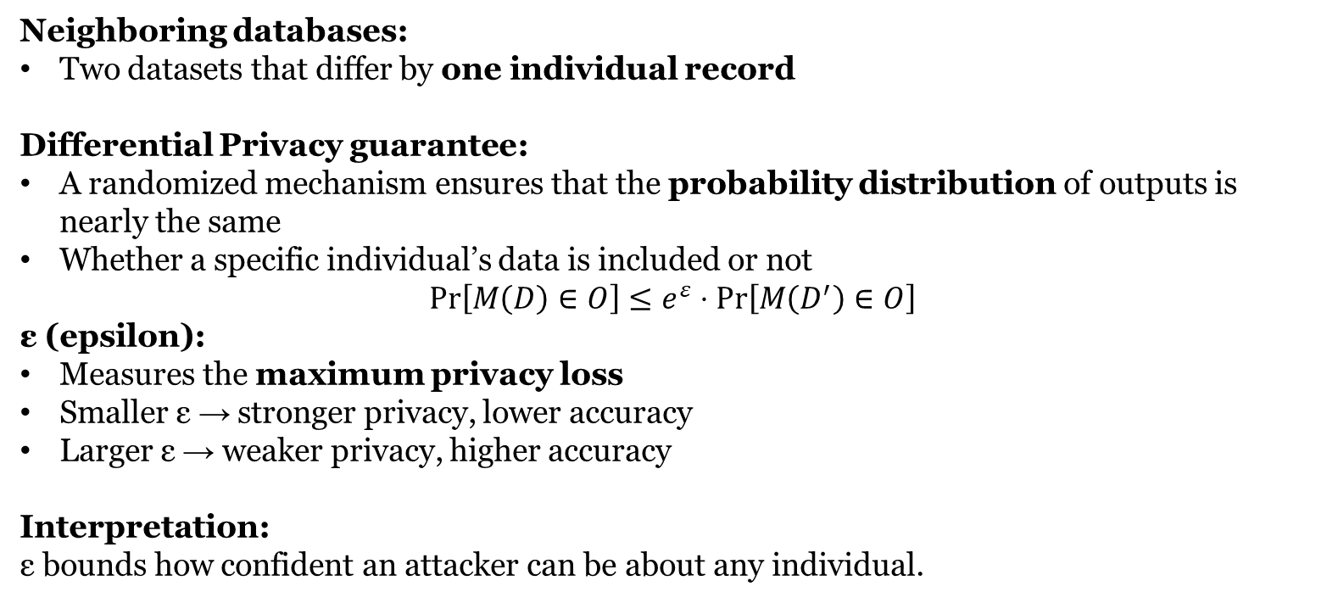
Differential Privacy — Guarantee and ε (Epsilon)
Neighboring databases:
Two datasets that differ by one individual record
Differential Privacy guarantee:
A randomized mechanism ensures that the probability distribution of outputs is nearly the same
Whether a specific individual’s data is included or not
$$Pr⁡\left[M\left(D\right)∈O\right]≤e^{ε}⋅Pr⁡\left[M\left(D^{′}\right)∈O\right]$$
ε (epsilon):
Measures the maximum privacy loss
Smaller ε → stronger privacy, lower accuracy
Larger ε → weaker privacy, higher accuracy
Interpretation:
ε bounds how confident an attacker can be about any individual.
Notes:
Neighboring Databases and the Privacy Threat
Differential Privacy formalizes privacy by comparing neighboring databases, which are datasets that differ in the data of exactly one individual. This captures the strongest realistic threat model: an attacker who knows everything about the dataset except whether a specific person is included. Privacy protection is therefore defined with respect to the impact of a single individual’s participation on the output of an analysis.
The Differential Privacy Guarantee
A mechanism satisfies differential privacy if its outputs are statistically similar on any two neighboring databases. This means that the probability of observing a particular result does not change significantly depending on whether one individual’s data is present or absent. The guarantee is probabilistic and applies to all possible outputs, ensuring that no single individual can substantially influence what is revealed by the analysis.
Understanding ε (Epsilon)
The parameter ε (epsilon) quantifies the maximum privacy loss allowed by the mechanism. A smaller ε means stronger privacy protection, because the outputs from neighboring datasets are more similar, but this typically reduces accuracy. A larger ε allows more accurate results, but weakens privacy. Thus, ε represents a fundamental trade-off between privacy and utility, and choosing ε is a policy and engineering decision rather than a purely technical one.
Key Takeaway
Epsilon controls how much influence any single individual can have on the output, defining a precise trade-off between privacy protection and data accuracy.

Slide 55
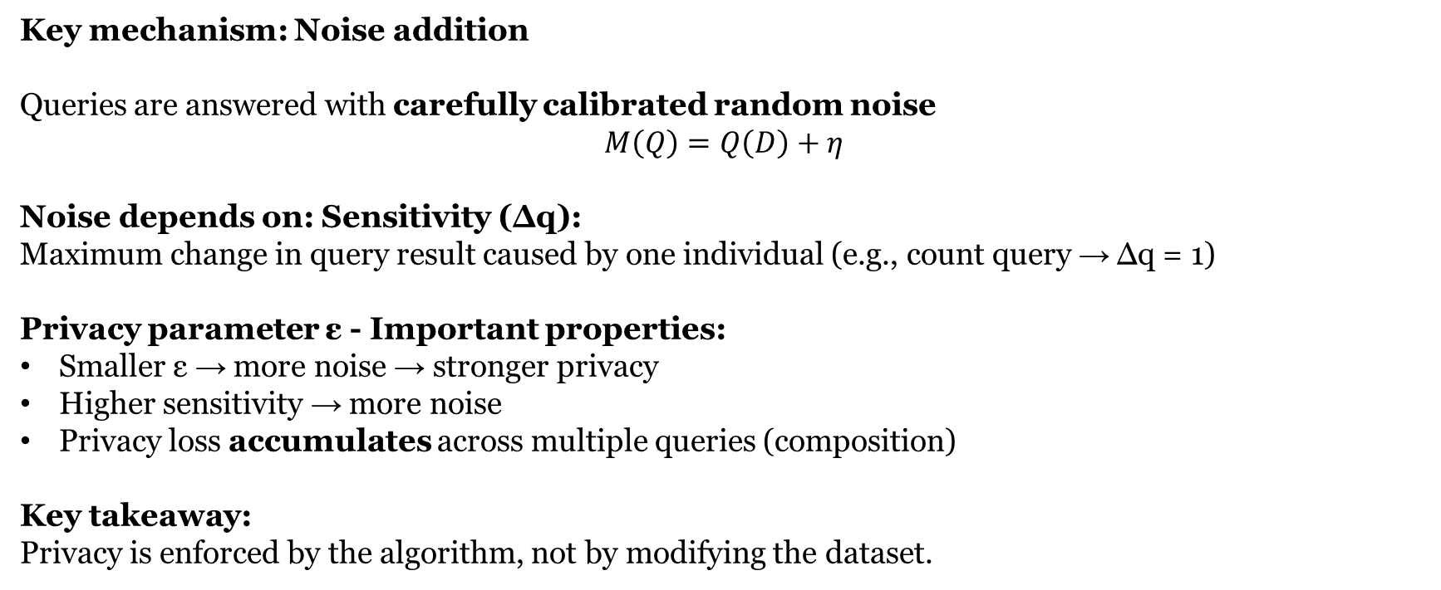
How Differential Privacy Is Achieved
Key mechanism: Noise addition
Queries are answered with carefully calibrated random noise
$$M\left(Q\right)=Q\left(D\right)+η$$
Noise depends on: Sensitivity (Δq):
Maximum change in query result caused by one individual (e.g., count query → Δq = 1)
Privacy parameter ε - Important properties:
Smaller ε → more noise → stronger privacy
Higher sensitivity → more noise
Privacy loss accumulates across multiple queries (composition)
Key takeaway:
Privacy is enforced by the algorithm, not by modifying the dataset.
Real World Use Cases: https://desfontain.es/blog/real-world-differential-privacy.html
Notes:
Noise Addition as the Core Mechanism
Differential Privacy is achieved by answering queries with carefully calibrated random noise rather than exact results. Instead of releasing the true query value computed on the dataset, the mechanism adds randomness so that the output is slightly perturbed. This randomness ensures that an attacker cannot confidently determine whether any single individual’s data influenced the result.
Sensitivity and Noise Calibration
The amount of noise added depends on the sensitivity of the query, which measures how much the query result can change when one individual’s data is modified or removed. Queries with higher sensitivity require more noise because a single individual has a larger potential impact on the output. For example, a count query typically has low sensitivity, while queries involving sums or averages may have higher sensitivity depending on how they are defined.
Role of ε and Query Composition
The privacy parameter ε controls how much noise is added and therefore how strong the privacy guarantee is. Smaller values of ε result in more noise and stronger privacy, while larger values allow more accurate results at the cost of weaker privacy. Importantly, privacy loss accumulates when multiple queries are answered, meaning that repeated analysis of the same dataset gradually consumes the available privacy budget.
Key Takeaway
Differential Privacy protects individuals by modifying the computation itself through noise addition, rather than altering or anonymizing the underlying dataset.

Slide 56
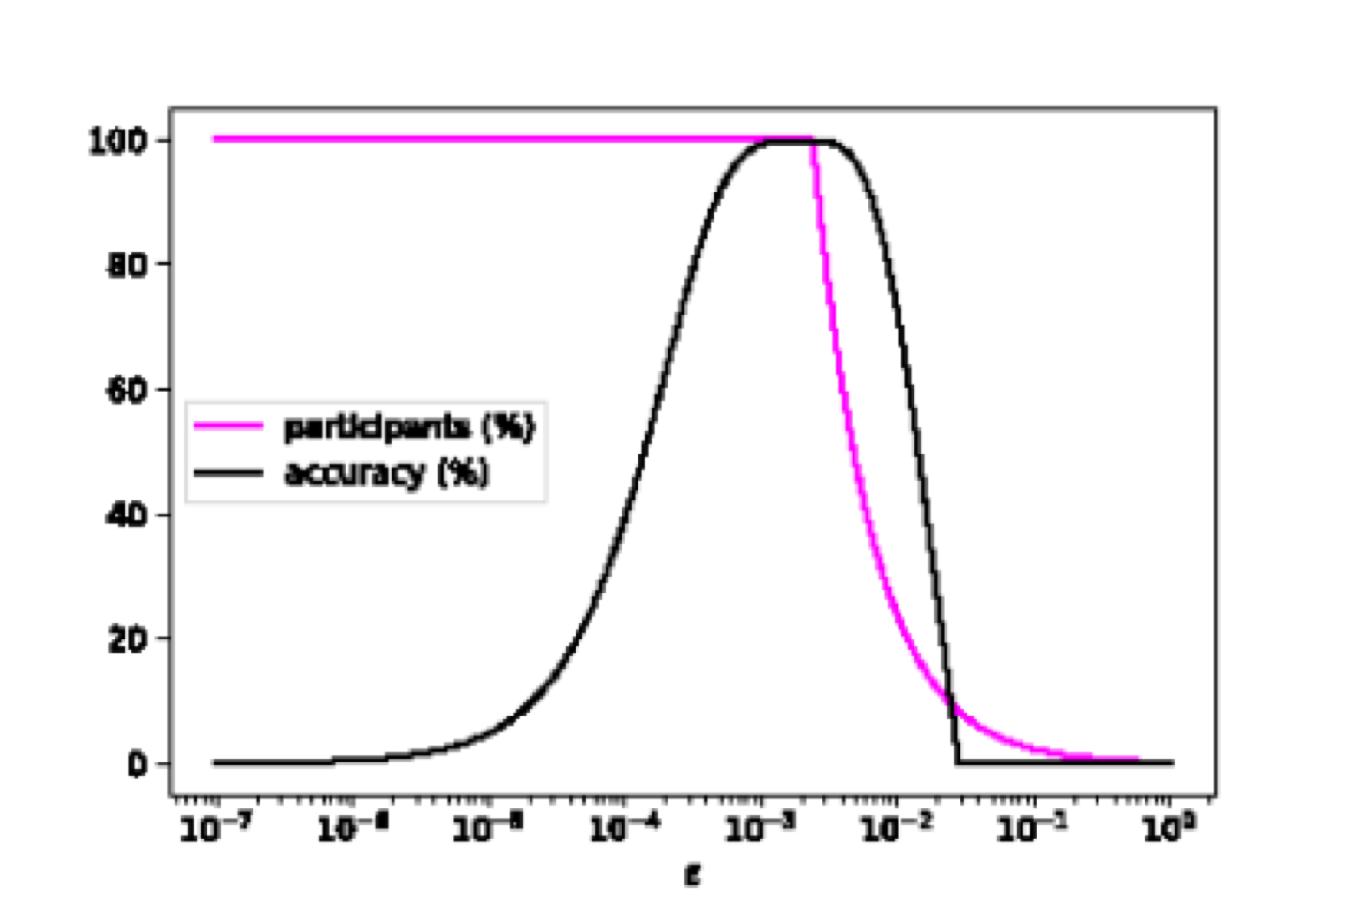
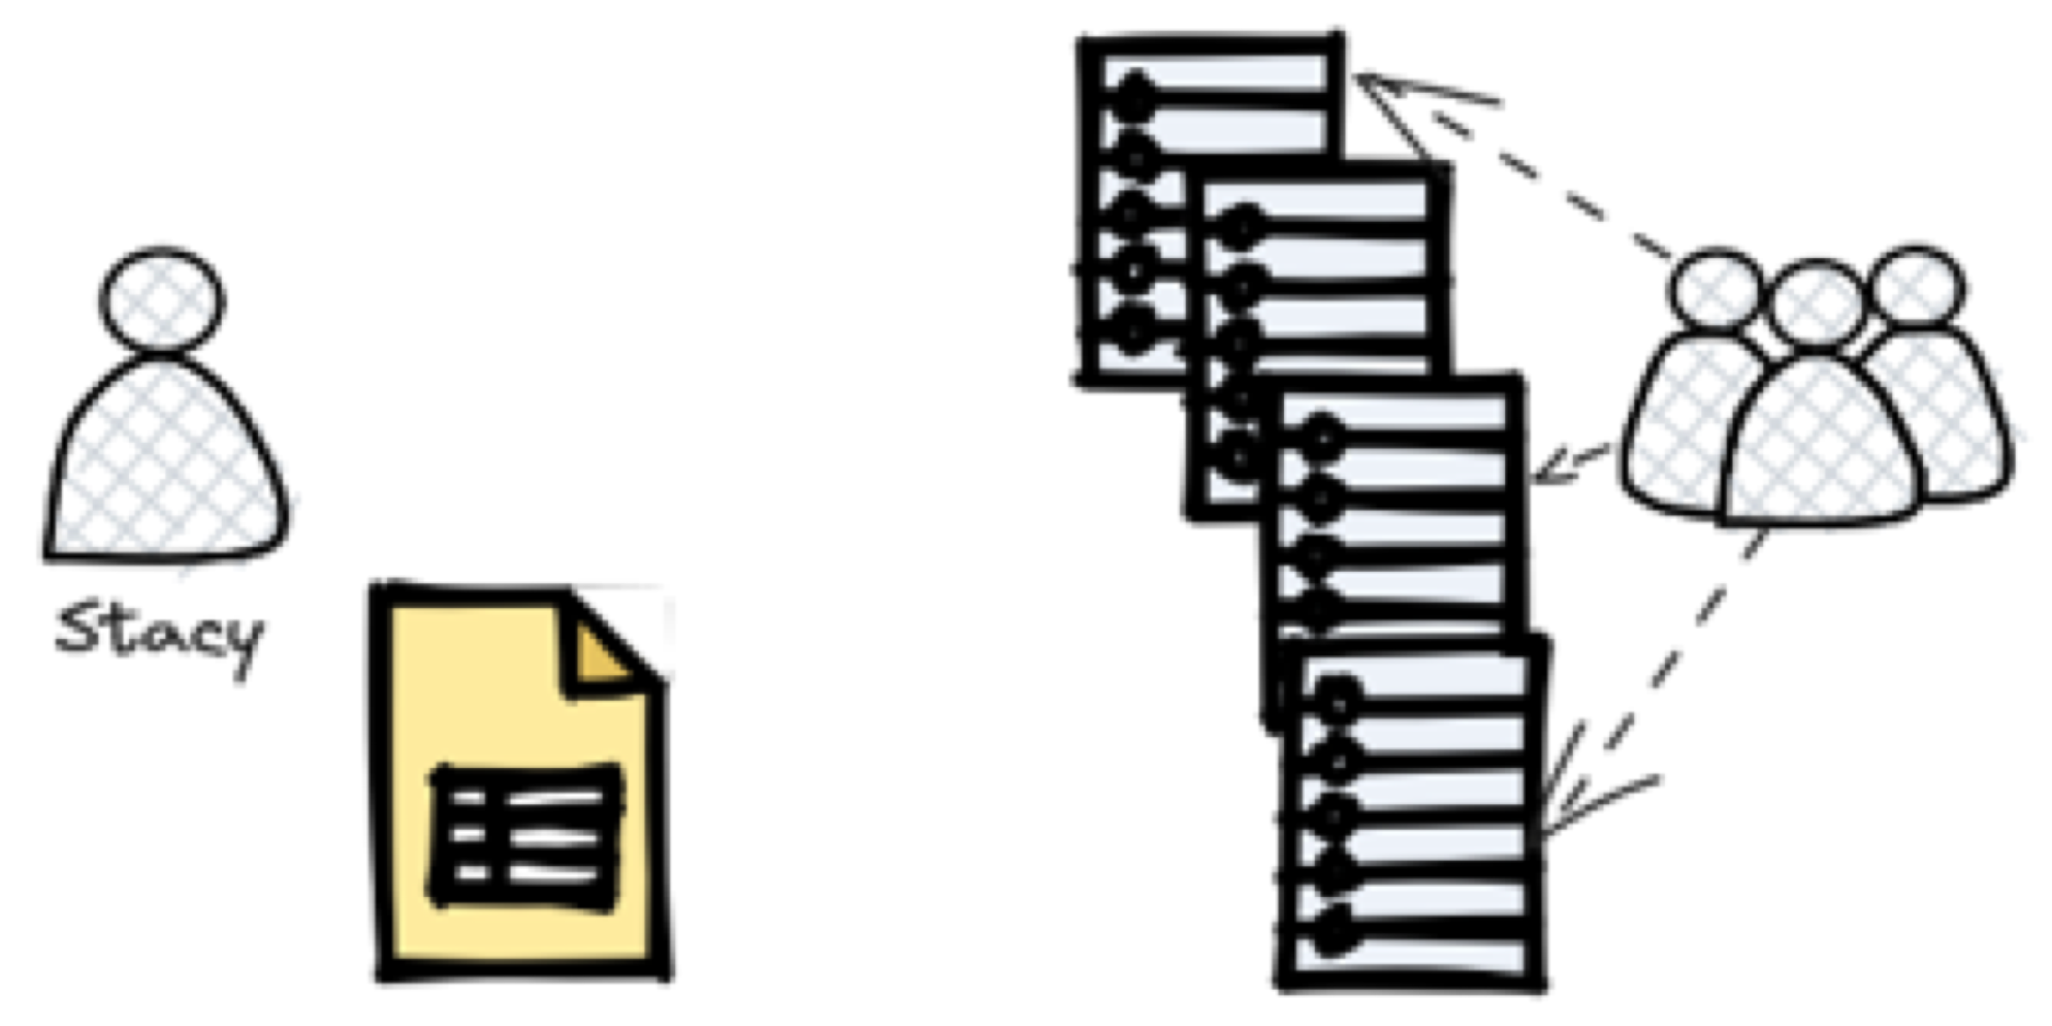
Why Privacy-Preserving Machine Learning?
Differential privacy limits what can be inferred about any single individual, while privacy-preserving machine learning reduces data exposure by training models without directly sharing raw training data.
Users are more willing to share data when privacy guarantees exist
Strong privacy guarantees increase participation and reduce data bias
More participants often compensate for the noise added for privacy
Result: better generalization and more trustworthy models
Notes:
Privacy Limits and Data Exposure
Differential Privacy limits what can be inferred about any single individual from the output of an analysis, while privacy-preserving machine learning further reduces risk by avoiding direct sharing of raw training data. Instead of collecting all data centrally, models are trained in ways that minimize exposure of sensitive information. This reduces the harm caused by data leaks, misuse, or unauthorized access.
Trust, Participation, and Bias
When strong privacy guarantees are in place, users are more willing to contribute their data. Increased participation leads to datasets that are larger and more representative, reducing selection bias that often arises when privacy-sensitive individuals opt out. As a result, privacy protection can improve not only ethical compliance but also the statistical quality of the data.
Accuracy Despite Noise
Privacy-preserving techniques often introduce noise or constraints that reduce accuracy at the individual level. However, this loss is frequently offset by having more participants and more diverse data. In practice, the combination of privacy guarantees and broader participation often leads to models that generalize better and behave more reliably in real-world settings.
Key Takeaway
Privacy-preserving machine learning enables trustworthy models by trading limited precision for greater participation, reduced bias, and stronger protection of individual data.

Slide 57
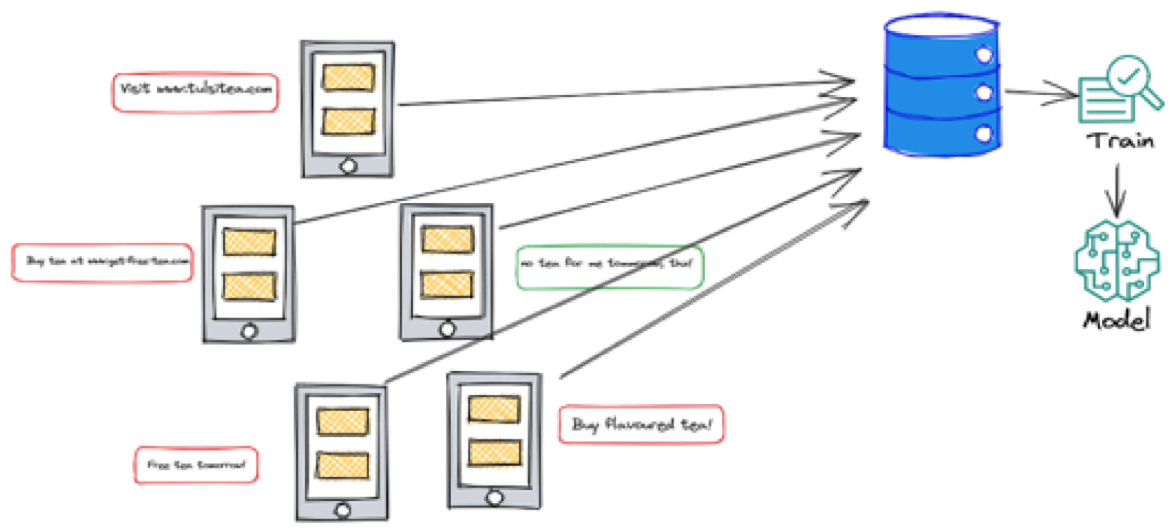
Centralised ML Model Training
Notes:
Centralised Data Collection
In centralised machine learning, data from many users or devices is collected and transferred to a single central server. This server stores all raw training data in one place, creating a complete dataset that can be directly accessed during model development. The learning process relies on having full visibility of individual data records at the central location.
Model Training at the Server
Once data is aggregated, the machine learning model is trained entirely on the central server. This simplifies system design, as training algorithms can operate without coordination across participants. However, it also means that the server must be fully trusted to store, process, and protect all sensitive data used during training.
Privacy and Security Implications
Centralised training creates significant privacy and security risks. A data breach, insider misuse, or unauthorized access can expose the entire dataset, including sensitive personal information. Even when legal or technical safeguards exist, concentrating raw data in one place increases the potential impact of failures and makes strong privacy guarantees difficult to enforce.
Key Takeaway
Centralised machine learning is simple and efficient, but it concentrates sensitive data in one location, creating substantial privacy and security risks.

Slide 58
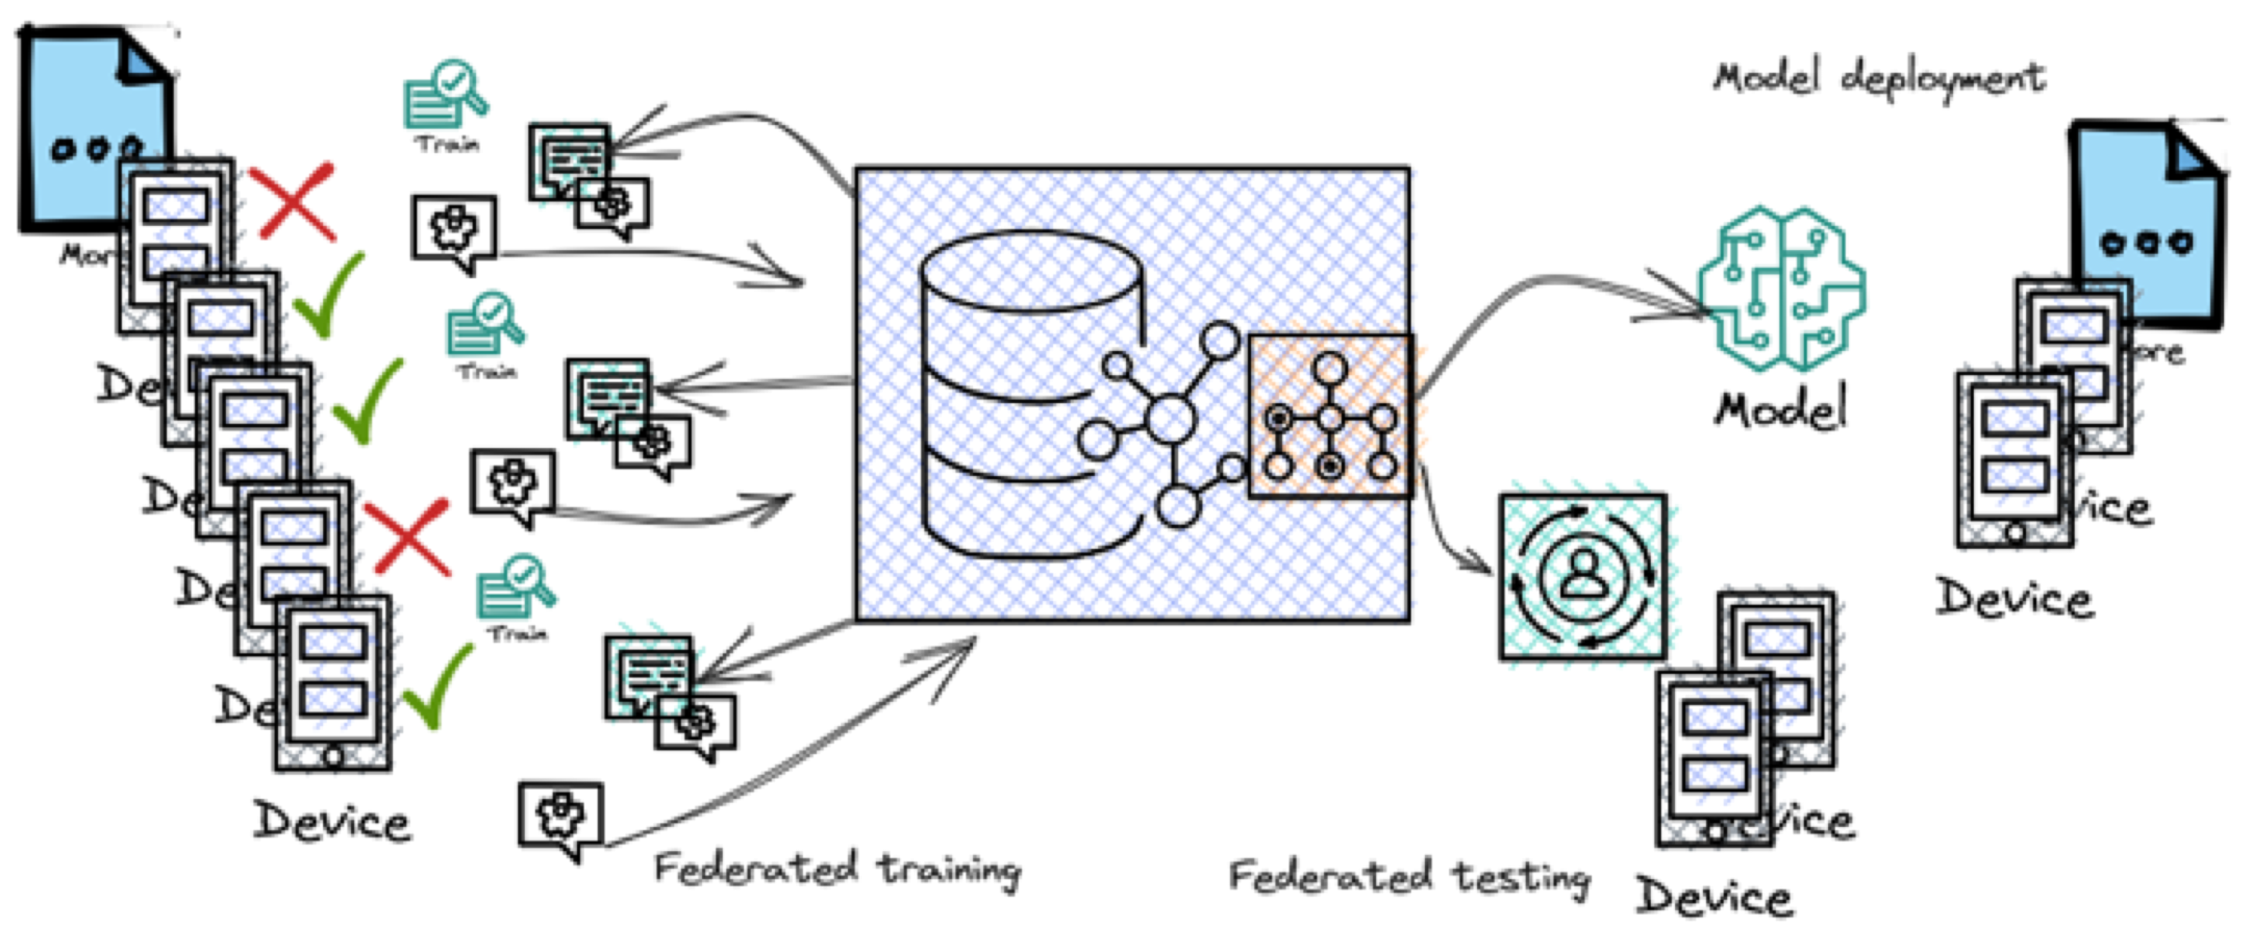
Federated Machine Learning
Federated learning is a distributed machine learning setting where multiple clients collaboratively train a model under the coordination of a central server
Raw training data remains on user devices and is never shared
The server sends a global model to a subset of selected devices
Each device trains the model locally using its own data
Only model updates (e.g., gradients or weight updates) are sent back to the server for aggregation
Notes:
Distributed Training Paradigm
Federated machine learning is a distributed learning approach in which multiple clients, such as smartphones or edge devices, collaboratively train a shared model under the coordination of a central server. Unlike centralised learning, the training data never leaves the user devices. Each participant contributes to learning while keeping their raw data local.
Local Training and Server Coordination
The process begins when the central server sends a global model to a selected subset of devices. Each device then trains this model locally using its own private data. After local training, devices send back only model updates, such as gradients or weight changes, rather than raw data. The server aggregates these updates to improve the global model.
Privacy Benefits and Practical Considerations
By design, federated learning significantly reduces direct data exposure, since sensitive training data remains on user devices. However, model updates can still leak information if not carefully protected, which is why federated learning is often combined with techniques such as secure aggregation and differential privacy. In practice, federated learning also introduces challenges related to communication cost, device heterogeneity, and unreliable participation.
Key Takeaway
Federated learning reduces data sharing by keeping raw data on user devices, but strong privacy guarantees still require additional protections beyond decentralisation alone.

Slide 59
References
[Pfitzmann & Hansen, 2010] A. Pfitzmann, M. Hansen, A Terminology for Talking about Privacy by Data Minimization: Anonymity, Unlinkability, Undetectability, Unobservability, Pseudonymity, and Identity Management, Version 0.34, Technical Report, 2010.
[Dwork et al., 2006] C. Dwork, F. McSherry, K. Nissim, A. Smith, Calibrating Noise to Sensitivity in Private Data Analysis, in Proceedings of the 3rd Theory of Cryptography Conference (TCC), 2006.
[Dwork & Roth, 2013] C. Dwork, A. Roth, The Algorithmic Foundations of Differential Privacy, Foundations and Trends in Theoretical Computer Science, Vol. 9, No. 3–4, Now Publishers, 2013.
[Warren & Brandeis, 1890] S. D. Warren, L. D. Brandeis, The Right to Privacy, Harvard Law Review, Vol. 4, No. 5, pp. 193–220, 1890.
[Agre & Rotenberg, 1998] P. E. Agre, M. Rotenberg (eds.), Technology and Privacy: The New Landscape, MIT Press, 1998.
[Dinur & Nissim, 2003] I. Dinur, K. Nissim, Revealing Information While Preserving Privacy, in Proceedings of the 22nd ACM SIGMOD-SIGACT-SIGART Symposium on Principles of Database Systems (PODS), 2003.
[McSherry & Talwar, 2007] F. McSherry, K. Talwar, Mechanism Design via Differential Privacy, in Proceedings of the 48th Annual IEEE Symposium on Foundations of Computer Science (FOCS), 2007.
[Fung et al., 2010] B. C. M. Fung, K. Wang, R. Chen, P. S. Yu, Privacy-Preserving Data Publishing: A Survey of Recent Developments, ACM Computing Surveys, Vol. 42, No. 4, Article 14, 2010.
[Shokri et al., 2017] R. Shokri, M. Stronati, C. Song, V. Shmatikov, Membership Inference Attacks against Machine Learning Models, in Proceedings of the IEEE Symposium on Security and Privacy, 2017. (arXiv preprint: arXiv:1610.05820)
[Fredrikson et al., 2015] M. Fredrikson, S. Jha, T. Ristenpart, Model Inversion Attacks that Exploit Confidence Information and Basic Countermeasures, in Proceedings of the 22nd ACM Conference on Computer and Communications Security (CCS), 2015.

