Slide 1
Metrics
Kristian Sandahl

Slide 2
Introduction
Motivation:
Management:
  Appraisal (What do we have?)
  Assurance (Predict the level by process choice)
  Control (Takin corrective action)
  Improvement (Increase quality, lower variance)
Research:
  Cause-effect models
Terms:
Metric
Measurement

Slide 3
Classification
Product metrics:
  Observable or computed properties of the product
  Examples: Lines of code, number of pages
Process metrics:
  Properties of how you are developing the product
  Examples: Cycle time for a change request, number of parallel activities
Resource metrics:
  Properties and volumes of the instruments you are using when developing the product
  Examples: Years of education, amount of memory in testing environment

Slide 4
Scales
Examples
Nominal | = , ≠ | Categories | Type of software
Ordinal | < , > | Rankings | Skill rating: high, medium, low
Interval | + , - | Differences | %less bugs project delay
Ratio | / | Absolute zero | Lines of code

Slide 5
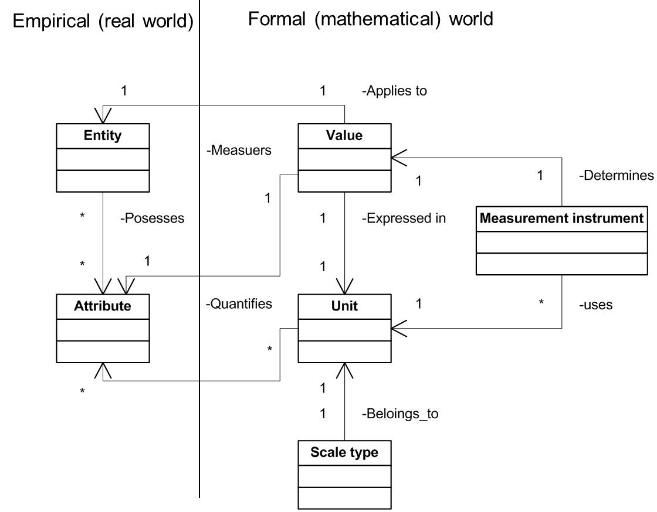
Structural model of measurement

Slide 6
Theoretical validation of metrics
Representational theory, based on the mapping between attributes of real-world entities – numerical values and units:
For an attribute to be measurable, it must allow different entities to be distinguished from one another.
A valid measure must obey the representational condition.
Different entities can have the same attribute value.
B. Kitchenham, S. L. Pfleeger and N. Fenton, "Towards a framework for software measurement validation," in IEEE Transactions on Software Engineering, vol. 21, no. 12, pp. 929-944, Dec. 1995.
doi: 10.1109/32.489070

Slide 7
Empirical (external) validation of metrics
Correlation between internal and external attributes
Cause-effect models
Statistical analysis
Handle bias

Slide 8
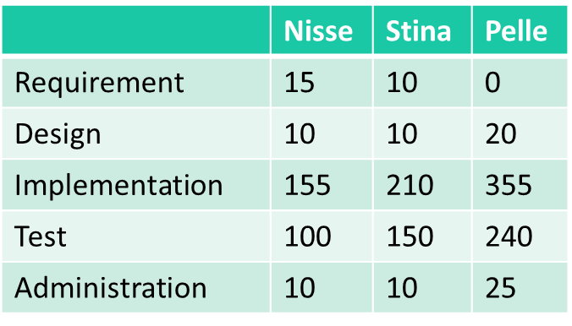
Time sheets provide a powerful source for process improvements
Sprint 1 | Nisse | Stina | Pelle
Requirement | 15 | 10 | 0
Design | 10 | 10 | 20
Implementation | 155 | 210 | 355
Test | 100 | 150 | 240
Administration | 10 | 10 | 25
 | Nisse | Stina | Pelle
Requirement | 15 | 10 | 0
Design | 10 | 10 | 20
Implementation | 155 | 210 | 355
Test | 100 | 150 | 240
Administration | 10 | 10 | 25
Well defined categories is a strength.

Slide 9
Halstead’s software science_{1/2}
The measurable and countable properties are :
n₁ = number of unique or distinct operators appearing in that implementation
n₂ = number of unique or distinct operands appearing in that implementation
N₁ = total usage of all of the operators appearing in that implementation
N₂ = total usage of all of the operands appearing in that implementation http://yunus.hacettepe.edu.tr/~sencer/complexity.html

Slide 10

Halstead’s software science_{2/2}
Equations:
Vocabulary n = n₁ + n₂
Implementation length N = N₁ + N₂
Length equation: N ' = n₁log₂n₁ + n₂log₂n₂
Program Volume V = Nlog₂n
Potential Volume V ' = ( n*₁ + n*₂ ) log₂ ( n*₁ + n*₂ )
Program Level L = V ‘/ V
L ' = n*₁n₂ / n₁N₂
Elementary mental discriminations E = V / L = V² / V '
Intelligence Content I = L ' x V = ( 2n₂ / n₁N₂ ) x (N₁ + N₂)log₂(n₁ + n₂)
Time T ' = ( n₁N₂( n₁log₂n₁ + n₂log₂n₂) log₂n) / 2n₂S

Slide 11
Chidamber & Kemerer object-oriented metrics suite
WMC – weighted methods per class
DIT – depth of inheritance tree
NOC – number of children
CBO – coupling between object classes
RFC – response for a class
LCOM1 – lack of cohesion of methods
https://www.aivosto.com/project/help/pm-oo-ck.html

Slide 12
Weighted methods per class
Count the number of methods per class
Try to keep WMC low
High WMC:
  More faults
  Less reuse
  Impact of derived classes

Slide 13
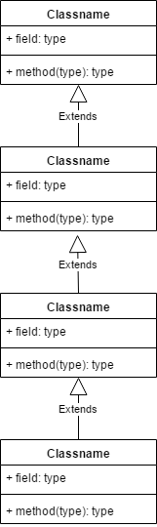
Depth of inheritance tree
DIT
0
1
2
3
High DIT:
  Indicates high reuse
  Middle classes error-prone
Recommended max 5-8

Slide 14
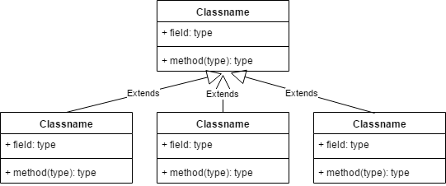
Number of children
High NOC:
  High reuse of base class
  Base class requires more testing
  Misuse of sub-classing
  Dangerous with high WMC
NOC=3

Slide 15
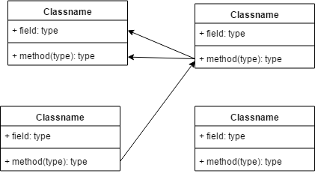
Coupling between object classes
Limit CBO
Low reuse
Low maintainability
Limit 14?
Counted as 1
CBO = 1
CBO = 2
CBO = 1

Slide 16
Response for a class
Let M = number of methods in a class
Let R = number of remote methods that can be called by methods in the class
RFC = M +R
High RFC:
Low maintainability
Low testability
RFC’ includes all recursive methods in the call tree

Slide 17
Lack of cohesion of methods
For each pair (m1, m2) of methods in a class:
If m1 and m2 use a disjoint set of instance variables:
  Increase P with 1
If m1 and m2 use at least one common variable:
  Increase Q with 1
LCOM1 = {P-Q, if P>Q; 0 otherwise}
High LCOM1 : fault prone, low testability
Criticized measure, variants exist.

Slide 18
Code metrics in Visual Studio
Lines Of Code
Cyclomatic Complexity
Maintainability Index = 171–5.2*ln(aveV)–0.23*ave(g’)– 16.2*ln(aveLOC)
Depth Of Inheritance
Class Coupling

Slide 19
Function Points - Background
First suggested by Albrecht 1979
Captures complexity and size
Language independent
Can be used before implementation
Used as input for estimation
Common versions IFPUG v 4.x
Competitor MARK II:
  simpler to count
  has finer granularity
  is a continuous measure
A “closed community”
Traditionally used for business systems
See the pdf in Course Documents on Lisam

Slide 20
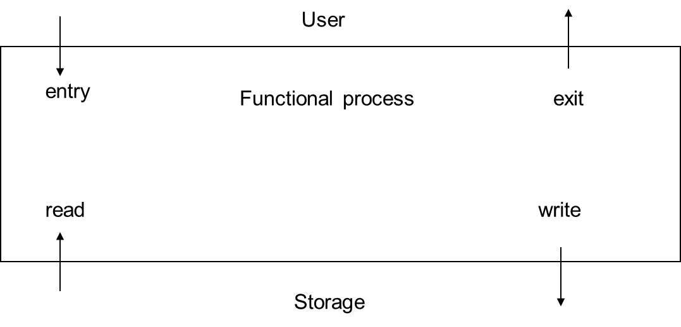
COSMIC-FFP
(COmmon Software Measurement International Consortium Full Function Point)
An ISO-approved method for calculating FP for embedded, real-time systems
Partitions the system in Functional User Requirements (FUR)

Slide 21
Example: Change customer data in a warehouse of items
User entry | Entry | 1
Retrieve customer data | Read | 1
Display error message | Exit | 1
Display customer data | Exit | 1
Enter changed data | Entry | 1
Retrieve item data | Read | 1
Store item data | Write | 1
Store modified data | Write | 1
Total Cfsu |  | 8

Slide 22
Connections to other methods
Mapping to UML – Use cases as Sequence diagrams, count messages
Cfsu = C₁ + C₂ FP, for less than 100 Cfsu
C₂ 1.1-1.2
C₁ varies
Are FP valid?

Slide 23
Change-based metrics: Code churn

Slide 24
Measure usability?

Slide 25
System Usability Scale (SUS)
I think that I would like to use this system frequently.
I found the system unnecessarily complex.
I thought the system was easy to use.
I think that I would need the support of a technical person to be able to use this system.
I found the various functions in this system were well integrated.
I thought there was too much inconsistency in this system.
I would imagine that most people would learn to use this system very quickly.
I found the system very cumbersome to use.
I felt very confident using the system.
I needed to learn a lot of things before I could get going with this system.

Slide 26
Strongly disagree
Strongly agree
1
2
3
4
5
For odd question numbers score = answer – 1
For even question numbers score = 5 – answer
SUS score = 2.5 ∑ score [0,100]
SUS score 68 is considered average

Slide 27
Simplified model with repair time
TBF₁
TBF₂
status
TTR₁
TTR₂
Up and running
Being repaired
0
t₁
t₂
t₃
time
TTF₃
TTF₁
TTF₂

Slide 28
Reliability growth model
The probability that the software executes with no failures during a specified time interval
MTTF = Mean Time To Failure
Approximation: MTTF/(1+MTTF)
Example
Easier to manage: Failure intensity,
[failures / hours of execution time]
Another approximation: λ = (1-R)/t
Example

Slide 29
Similar pattern: Availability and Maintainability
Measure Mean Time To Repair (MTTR) and Mean Time To Failure (MTTF)
Availability, A:
A = MTTF/(MTTF+MTTR)
Measure Mean Time To Repair (MTTR)
Maintainability, M:
M = 1/(1 + MTTR)

Slide 30
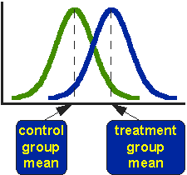
Comparing means
Under certain conditions: Student’s t-test
Significance level: nomally 5%

Slide 31
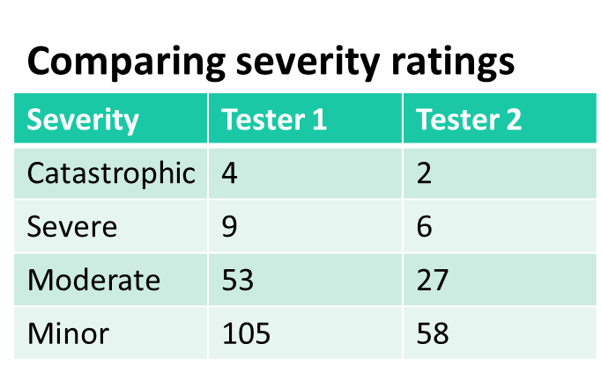
Comparing distributions
Are the testers’ methods the same?
Under certain conditions: use the Chi-square test
For 2x2 contingency tables other methods apply, for instance Cohen’s Kappa

Slide 32
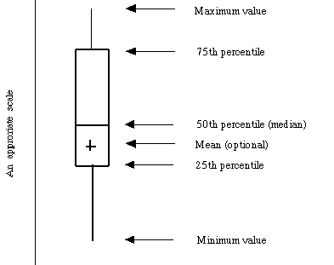
The box plot

Slide 33
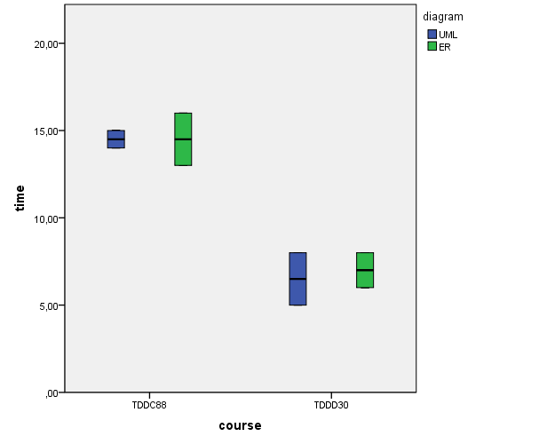
Comparing variance

Slide 34
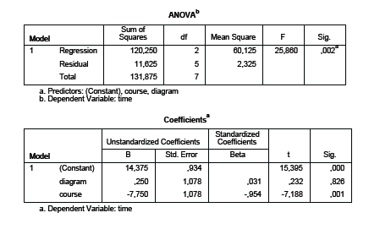
Linear regression

Slide 35
Prediction metrics
Prediction of:
Resources
Calendar time
Quality (or lack of quality)
Change impact
Process performance
Often confounded with the decision process

Slide 36
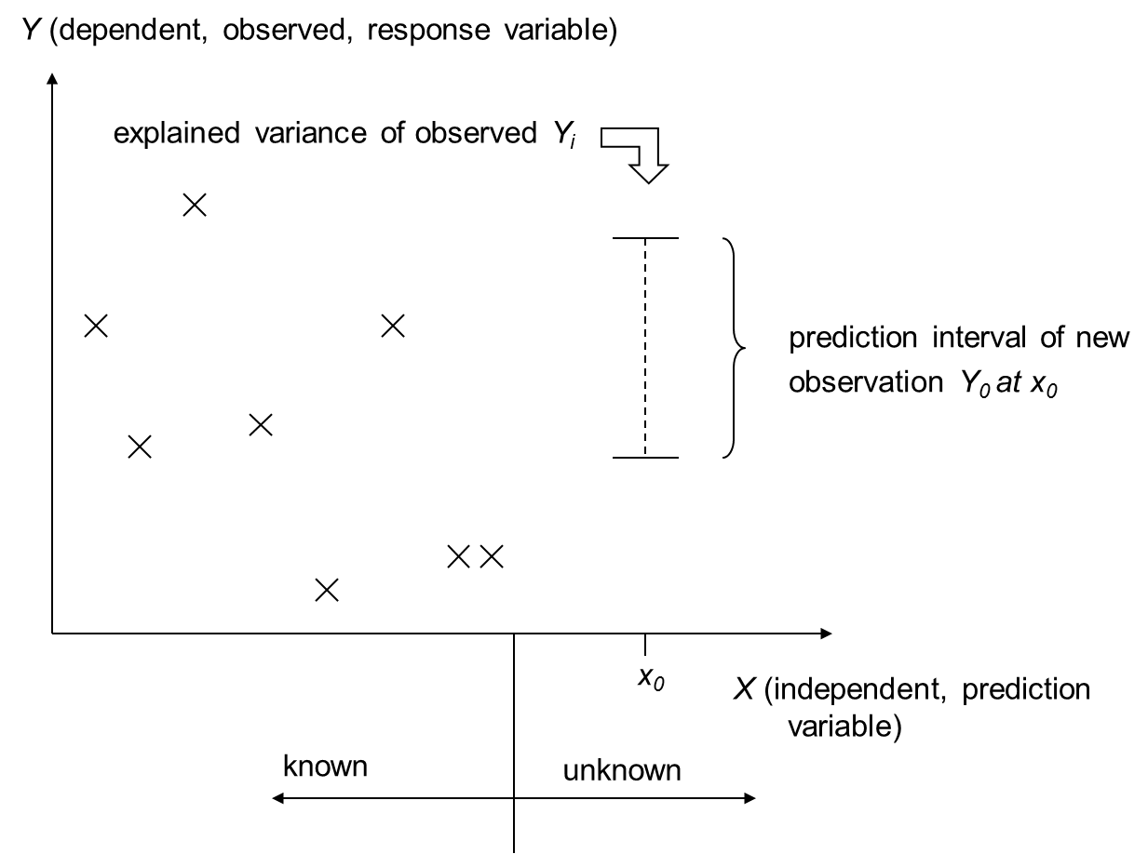
Historical data

Slide 37
Methods for building prediction models
Statistical
  Parametric
    Make assumptions about distribution of the variables
    Good tools for automation
    Linear regression, Variance analysis, ...
  Non-parametric, robust
    No assumptions about distribution
    Less powerful, low degree of automation
    Rank-sum methods, Pareto diagrams, ...
Causal models
  Link elements with semantic links or numerical equations
  Simulation models, connectionism models, genetic models, ...
Judgemental
  Organise human expertise
  Delphi method, pair-wise comparison, Lichtenberg method

Slide 38
The Lichtenbeg method process
Staff the analysis group
Describe the work to be estimated
Define general constraints and assumptions
Define the structure
Individual judgement of MIN, MAX, LIKLEY
Calculate common result (MIN+MAX+3*LIKELY)/5
Find workpagages with large variance
Sub-devide them and rework
5-20 participants
Never influence each others judgements
MIN and MAX should be extreme – 1% of the cases

Slide 39
Example of a pareto diagram
Notes:
Pär

Slide 40
Metrics and experimentation/
Kristian Sandahl

