Slide 1
Software Quality Management _{TDDE46}
Azeem Ahmad
Linköping University, Sweden

Slide 2
Objectives
Introduction to Software Quality Management
Introduction to Total Quality Management
Understanding Cost of Quality
Understanding Quality Function Deployment
Introduction to Risk Management

Slide 3
Software Quality Management (SQM)
Managing the quality of the software project, process and products
Making sure that the required level of quality is achieved in a software product
Involves defining appropriate quality standards and procedures and ensuring that these are followed
Should aim to develop a ‘quality culture’ where quality is seen as everyone’s responsibility

Slide 4
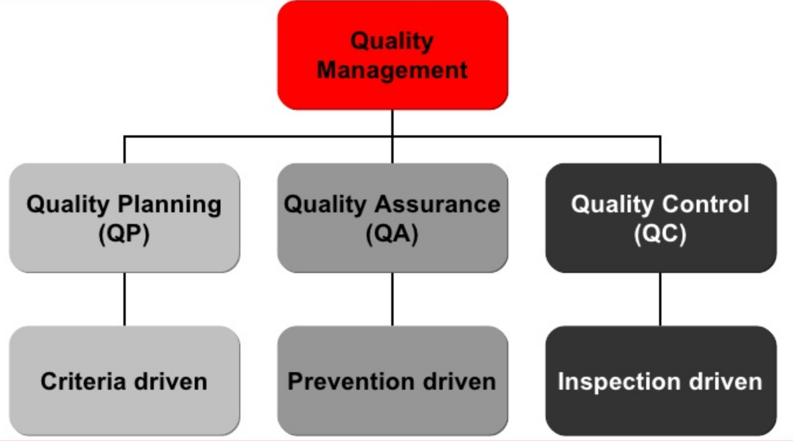
SQM Activities
Quality assurance
Establish organisational procedures and standards for quality
Quality planning
Select applicable procedures and standards for a particular project and modify these as required
Quality control
Ensure that procedures and standards are followed by the software development team

Slide 5
SQM Activities - Quality Assurance
A planned and systematic way of creating an environment to assure that the software product being developed meets the quality requirements
QA refers to the implementation of well-defined standard practices and methods. It is a pro-active quality process
This process is controlled and determined at managerial level
Examples:
process checklists, process standards, process documentation and project audit.

Slide 6
SQM Activities - Quality Planning
A quality plan sets out the desired product qualities and how these are assessed and define the most significant quality attributes
It should define the quality assessment process
It should set out which organisational standards should be applied and, if necessary, define new standards

Slide 7
SQM Activities - Quality Planning Structure
Product introduction
Product plans
Process descriptions
Quality goals
Risks and risk management
Quality plans should be short, succinct documents

Slide 8
SQM Activities - Quality Planning – IEEE 730-1989 Software Quality Assurance Plans
1. Purpose
2. Referenced documents
3. Management
3.1 Organization
3.2 Tasks
3.3 Responsibilities
4. Documentation
4.1 Purpose
4.2 Minimum documen-
tation requirements
4.3 Other
5. Standards, practices, conventions and metrics
5.1 Purpose
5.2 Content
6. Reviews and audits
6.1 Purpose
6.2 Minimum requirements
6.2.1 Software requirements
review
6.2.2 Preliminary design review
6.2.3 Critical design review
6.2.4 SVVP review
6.2.5 Functional audit
6.2.6 Physical audit
6.2.7 In-process audits
6.2.8 Managerial review
6.2.9 SCMP review
6.2.10 Post mortem review
6.3 Other
7. Testing
8. Problem Reporting and Corrective Action
9. Tools, Techniques and Methodologies
10. Code Control
11. Media Control
12. Supplier Control
13. Records Collection, Maintenance and Retention
14. Training
15. Risk Management

Slide 9
SQM Activities - Quality Control
Checking the software development process to ensure that procedures and standards are being followed
Examples:
inspection, deliverable peer reviews and the software testing process

Slide 10
How the Definition of Quality Changed Over Time
Total Quality Management (TQM)
Quality Through
Design
Quality
Statistical
Process
Control
(SPC)
Improved Design
Inspection
1920
1940
1960
1980
2000

Slide 11
Total Quality Management
Focus on identifying root causes of quality problems and correcting them at the source, as opposed to inspecting the product after it has been made
Attempts to embed quality in every aspect of the organization.
Focuses on building quality into the processas opposed to simply inspecting for poor quality after production
Specific concepts that make up the philosophy of TQM:
Customer Focus
Continuous Improvement
Employee Empowerment
Use of Quality Tools
Product Design
Process Management
Managing Supplier Quality
“Do the right things right the first time, every time.”

Slide 12
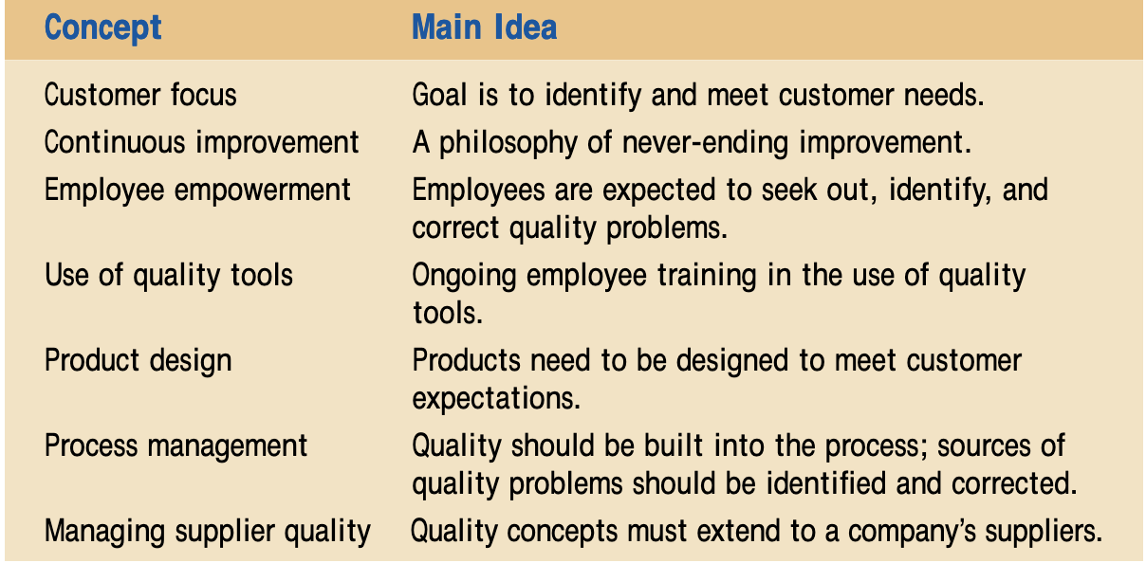
Total Quality Management
Specific concepts that make up the philosophy of TQM:
Customer Focus
Continuous Improvement
Employee Empowerment
Use of Quality Tools
Product Design
Process Management
Managing Supplier Quality

Slide 13
Total Quality Management – Customer Focus
Company’s focus on its customers
Quality is defined as meeting or exceeding customer expectations
The goal is to first identify and then meet customer needs.
It is a challenge because customer focus changes such as small cars to sports utilities to back to small cars and then electric cars.

Slide 14
Total Quality Management – Continuous Improvement
Company continually strive to be better through learning and problem solving
We can never achieve perfection, we must always evaluate our performance and take measures to improve it.
Some of the approaches:
The Plan – Do – Study – Act Cycle
Benchmarking: Implement continuous improvement is by studying business practices of companies considered “best in class.”

Slide 15
Total Quality Management – Employee Empowerment
Empower all employees to seek out quality problems and correct them
Avoid culture of making it “someone else’s problem”
Incentives for employees to identify quality problems

Slide 16
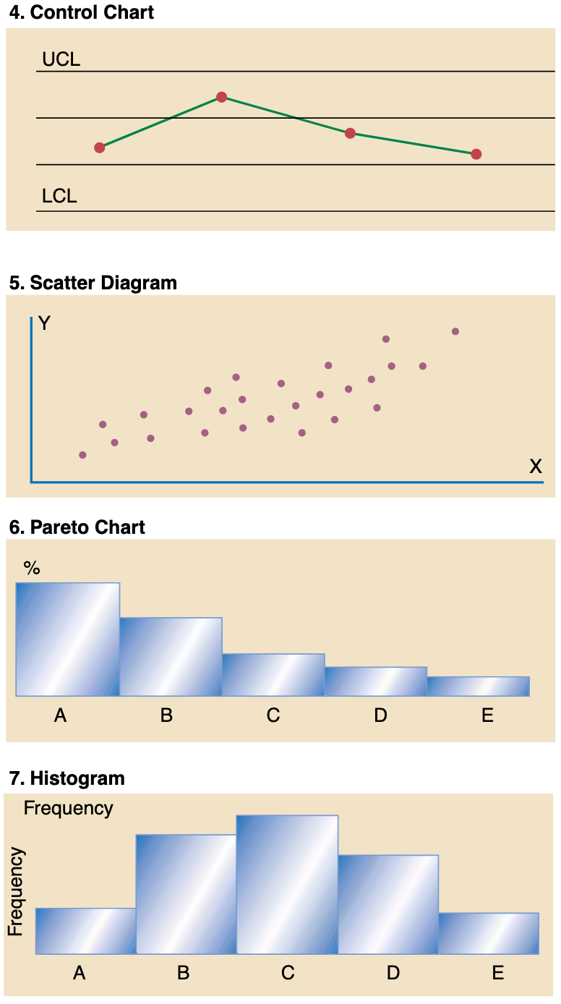
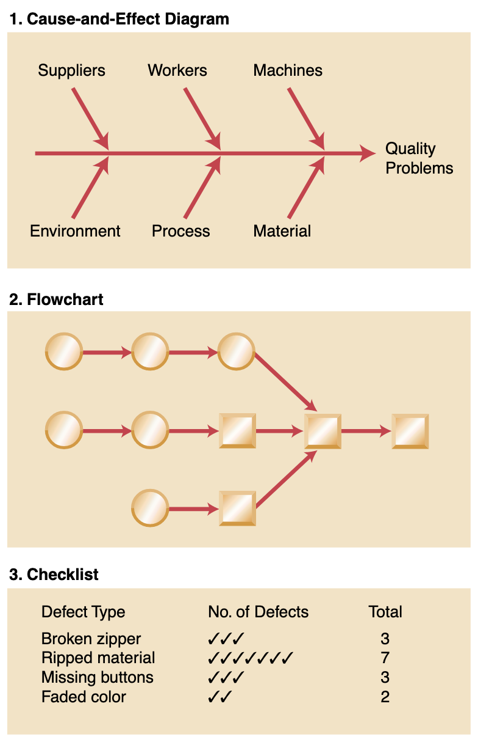
Total Quality Management – Use of Quality Tools
Employees need quality tool to asses quality.

Slide 17
Total Quality Management – Product Design
Building quality into a product and to ensure that the product design meets customer expectations
To produce a product that customers want, we need to translate customers’ everyday language into specific technical requirements
A useful tool for translating the voice of the customer into specific technical requirements is quality function deployment (QFD) (discussed later in slides)

Slide 18
Total Quality Management – Process Management
A quality product comes from a quality process
Burned Cookies: Throw away or the temperature setting may be too high; the pan may be curved, placing some cookies closer to the heating element; or the oven may not be distributing heat evenly
Old Quality Concept: if a defect is found, correct defect and release the product
New Quality Concept: If a defect is found, look for root cause.

Slide 19
Total Quality Management – Managing Supplier Quality
Extends the concept of quality to a company’s suppliers
If suppliers meet preset quality standards, materials do not have to be inspected upon arrival.
Many companies have a representative residing at their supplier’s location, thereby involving the supplier in every stagefrom product design to final production

Slide 20
Deming Total Quality Management Philosophy
14 points philophy ranging from
Institute training on the job.
Adopt and institute leadership.
Drive out fear.
Break down barriers between staff areas.
Remove barriers that rob people of pride in their work, and eliminate the annual rating or merit system.
Put everybody in the company to work to accomplish the transformation.
Others

Slide 21
The Cost of Quality
Quality is important, but it costs us time and money. It costs too much time and money to get the level of software quality we really want.
There is no doubt that quality has a cost, but lack of quality also has a cost —not only to end users who must live with faulty software, but also to the software organization that has built and must maintain it
Cost of Quality Include:
All costs incurred in the pursuit of quality
All cost incurred in performing quality-related activities

Slide 22
The Cost of Quality
 | Cost Type | Definition | Example
 | Prevention | Costs that are associated with preventing defects. | Training, early reviews, quality planning, tools, process improvement initiatives.
 | Appraisal/Asses | Costs that are associated with analyzing and testing the product to ensure it conforms to specifications. | Inspections, testing, audits, quality control.
Failures | Internal Failure | Costs that are associated with fixing defects found prior to release. | Fix the Bug, Repair, retesting, updating documentations.
 | External Failure | Costs that are associated with fixing defects found after release. | Technical support, defect reporting and tracking, field updates, loss of future sales.
Joseph M. Juran and F. M. Gryna, Quality Planning and Analysis (New York: McGraw-Hill, 1970), p. 60.

Slide 23
The Hidden Cost of Quality
Missed Payments
Testing Costs
Bugs
Canceled Licenses
Inspection Costs
Rework
Employee Turnover
Expediting Costs
Lost Customers
Hidden Rework
Excessive Overtime
Bad Will
Field Service Costs
Customer Allowances
Excessive Travel Expense
Consulting Time
Loss of Market Share

Slide 24
Its Menti Time
Which phase of SDLC such as requirements, design, coding, testing or maintenance requires larger cost in your opinion?

Slide 25
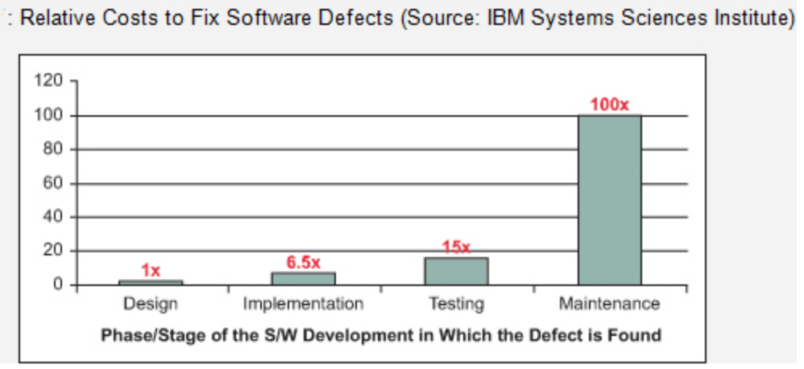
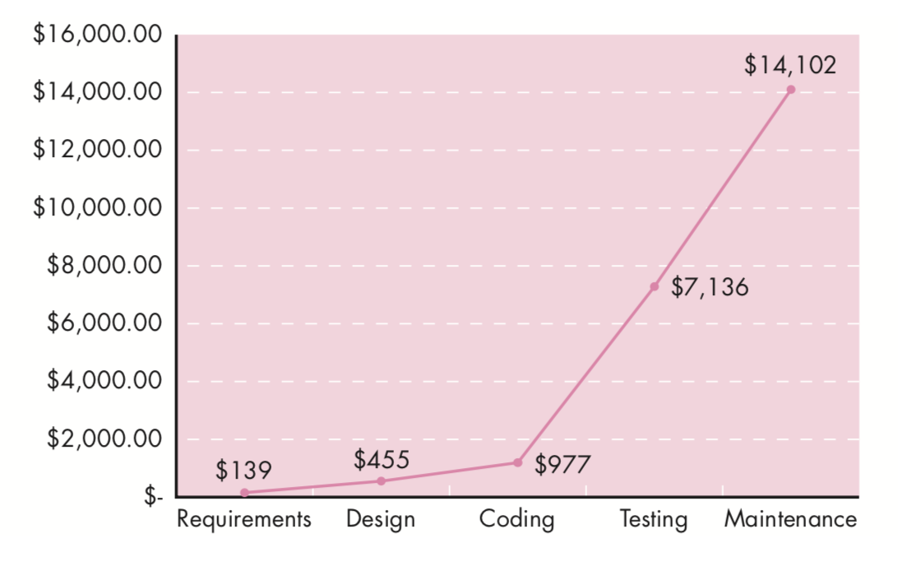
According to industry average data, the cost of finding and correcting defects during the coding phase is $977 per defect. Thus, the total cost for correcting the 200 “critical” defects during this phase (200 X $977) is approximately $195,400.
Primary source: Boehm, B., and V. Basili, “Software Defect Reduction Top 10 List,” IEEE Computer,
vol. 34, no. 1, January 2001, pp. 135–137 & Picture Copied from Software Engineering by Roger S. Pressmen

Slide 26
Risk of Poor Quality
”Throughout the month of November 2000 at a hospital in Panama, 28 patients received massive overdoses of gamma rays during treatment for a variety of cancers. In the months that followed, 5 of these patients died from radiation poisoning and 15 others developed serious complications. What caused this tragedy? A software package, developed by a U.S. company, was modified by hospital technicians to compute doses of radiation for each patient”
The three Panamanian medical physicists, who “tweeked” the software to provide additional capability, were charged with second-degree murder. The U.S. company is faced with serious litigation in two countries

Slide 27
Quality Function Deployment (QFD)
A useful tool for translating the voice of the customer into specific technical requirements is quality function deployment (QFD)
Enables us to view the relationships among the variables involved in the design of a product, such as technical versus customer requirements
Running tests to see how changes in certain technical requirements of the product affect customer requirements such as an automobile manufacturer evaluating how changes in materials affect customer safety requirements

Slide 28
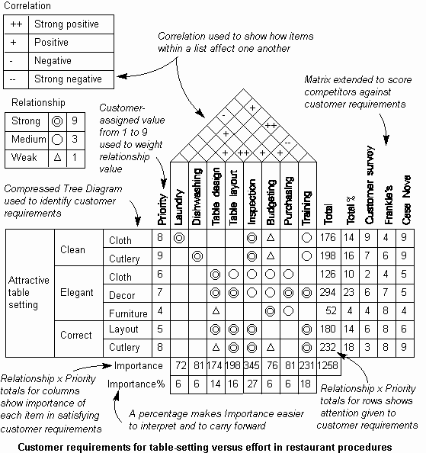
primary planning tool used in QFD is the house of quality

Slide 29
QFD
Step 1: Identifying important customer requirements, which typically come from the marketing department
Step 2: These requirements are numerically scored based on their importance, and scores are translated into specific product characteristics
Step 3: Evaluations are then made of how the product compares with its main competitors relative to the identified characteristics
Step 4: Specific goals are set to address the identified problems
The resulting matrix looks like a picture of a houseand is often called the house of quality

Slide 30
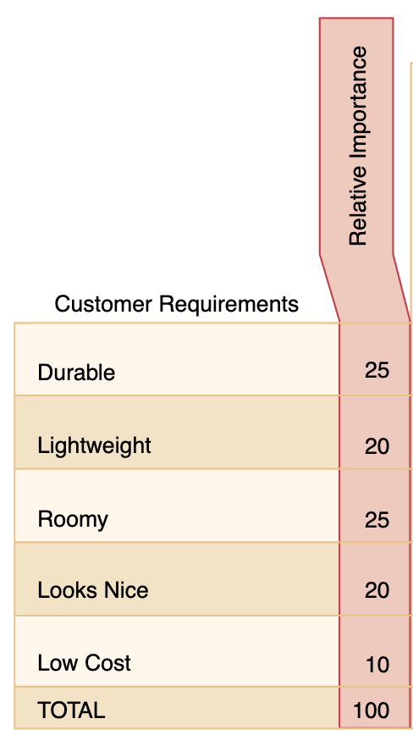
QFD - Customer Requirements
Conduct survey, phone calls, interview, focus study to find what customers wants.
The importance customers attach to each of these requirements should also determined

Slide 31
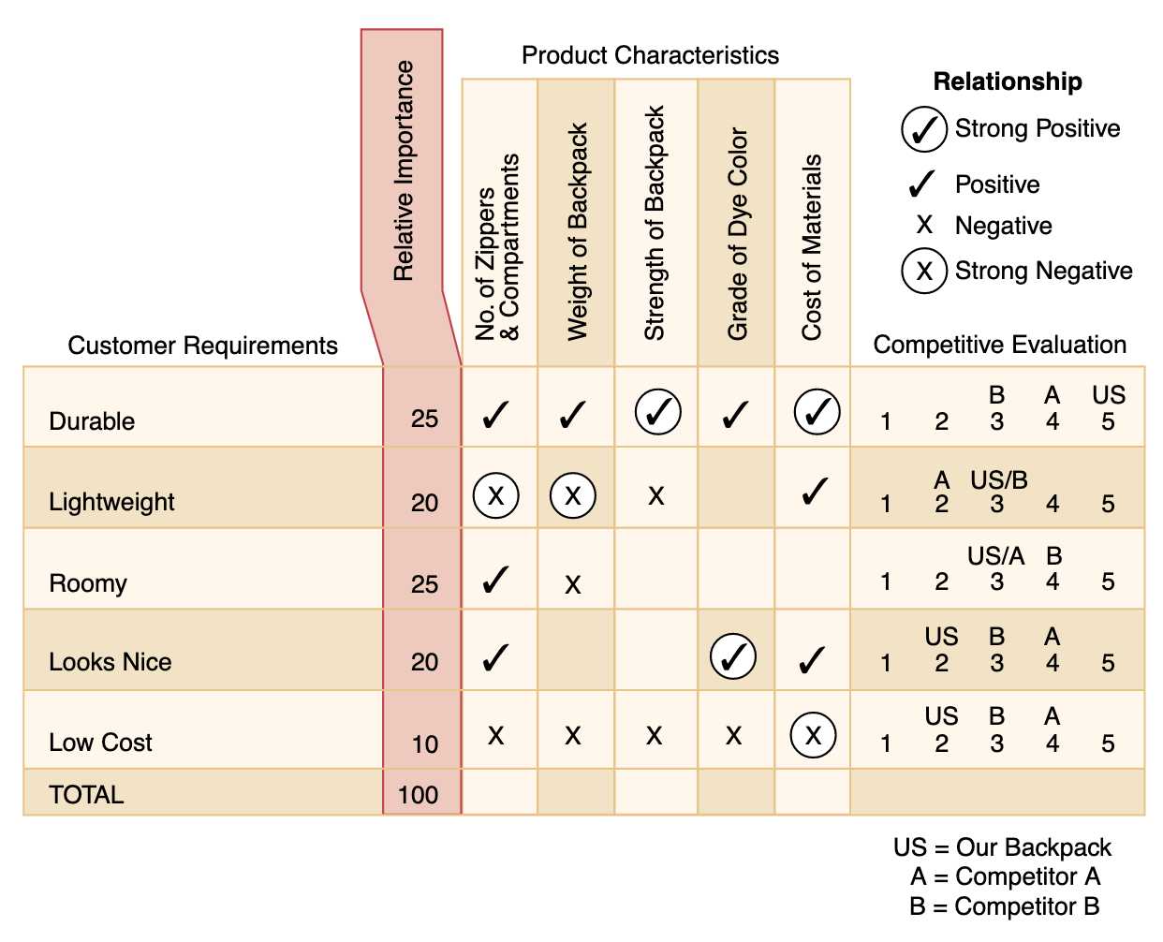
QFD - Competitive Evaluation
On the far right of our relationship matrix is an evaluation of how our product compares to those of competitors
The important thing here is to identify which customer requirements we should pursue and how we fare relative to our competitors.
For example, you can see that our product excels in durability relativeto competitors, yet it does not look as nice. This means that in designing ourproduct, we could gain a competitive advantage by focusing our design effortson a more appealing product

Slide 32
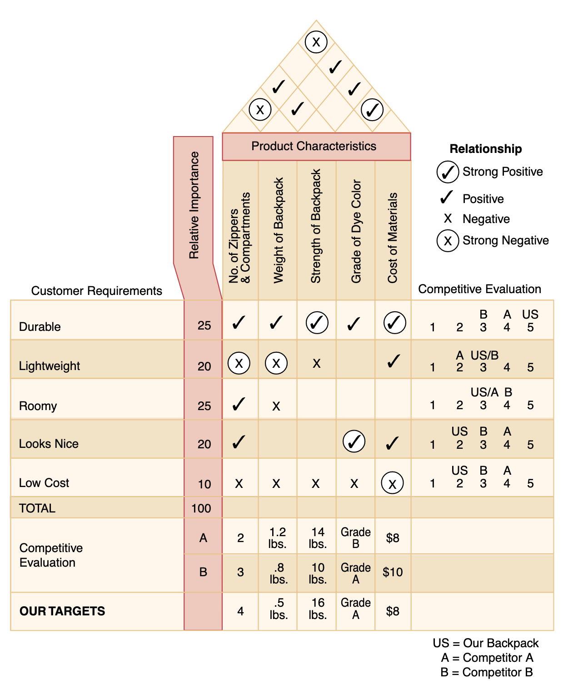
QFD - Product Characteristics
Specific product characteristics are on top of the relationship matrix
These are technical measures
In our example these include the number of zippers and compartments, the weight of the backpack, strength of the backpack, grade of the dye color, and the cost of materials

Slide 33
QFD - The Relationship Matrix
The strength of the relationship between customer requirements and product characteristics is shown in the relationship matrix
A negative relationship means that as we increase the desirability of one variable we decrease the desirability of theother.

Slide 34
QFD - The Trade-off Matrix
This is done through a trade-off matrix, which shows how each product characteristic is related to the others and thus allows us to see what tradeoffs we need to make
For example, the number of zippers is negatively related to the weight of the back-pack

Slide 35
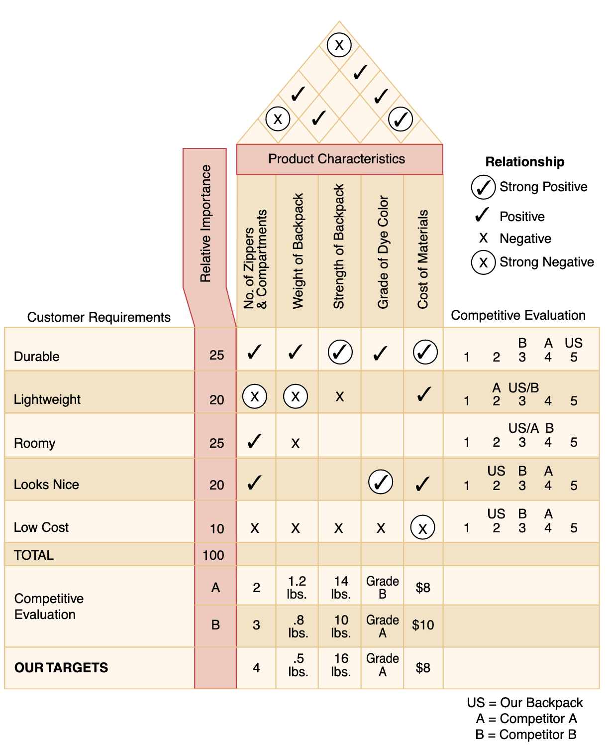
QFD - Setting Targets
The last step in constructing the house of quality is to evaluate competitors’ products relative to the specific product characteristics and to set targets for our own product
The bottom row of the house is the output of quality function deployment.
These are specific, measurable product characteristics that have been formulated from general customer requirements

Slide 36
QFD – Case Study - What Do Customers Want?
GCA was a Chicago-based advertising agency that developedcampaigns and promotions for small- and medium-sized firms. Their expertise was in the retail area, but they worked with a widerange of firms from the food service industry to the medical field. GCA competed on price and speed of product development. Advertising in the retail area was competitive and price had always been important. Also, since retail fashions change rapidly, speed in advertising development was thought to be critical. George reminded himself that price and speed had always been what customers wanted. Now he felt confused that he really didn’t know his customers. This was just another crisis that would pass,he told himself. But he needed to deal with it immediately
1. What is wrong with how Gold Coast Advertising measures its quality? Explain why Gold Coast should ask its customers about how they define quality
2. Offer suggestions to George Stein on ways of identifying quality dimensions GCA’s customers consider important.

Slide 37
Risk Management (some pointers)
Reactive: At best, a reactive strategy monitors the project for likely risks. Resources are set aside to deal with them, should they become actual problems. More commonly, the software team does nothing about risks until something goes wrong
Proactive: A proactive strategy begins long before technical work is initiated. Potential risks are identified, their probability and impact are assessed, and they are ranked by impor- tance. Then, the software team establishes a plan for managing risk

Slide 38
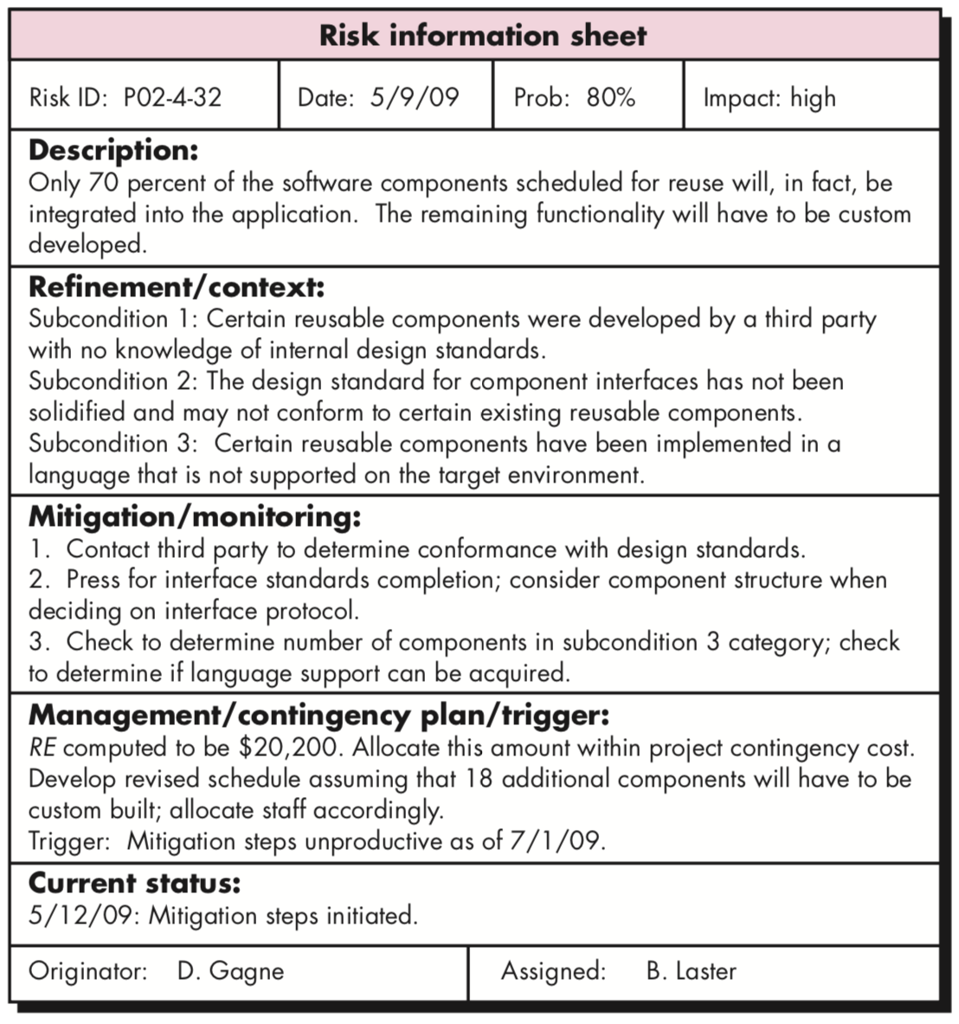
Risk Management (some pointers)
Chapter 28 in Rogger S. Pressmen
Risk identification
Risk estimation
Risk refinement
Risk mitigation, monitoring and management

Slide 39
Muddy Card Time
Thank You.

