Slide 1
Software Quality Planning_{TDDE46}
Azeem Ahmad
Linköping University, Sweden

Slide 2
Objectives
Introduction and use of the GQM -> Set-up a measurement program
ISO 730:2014
Pointers to coaching and reviews

Slide 3
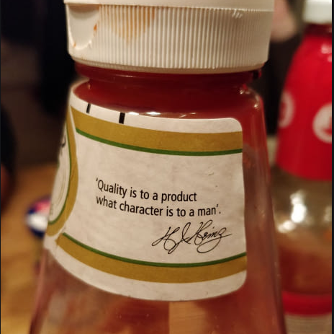
Good Quality Software
What is a good quality software?
How to achieve the good quality software?

Slide 4
Software Measurement Goals
Software Measurement Goals provides a valuable tool for understanding the effects of actions that are implemented to improve a software development process.
Increased understanding of the software development process
Increased control of the software development process
‘Projects without clear goals will not achieve their goal clearly’
Tom Gilb

Slide 5
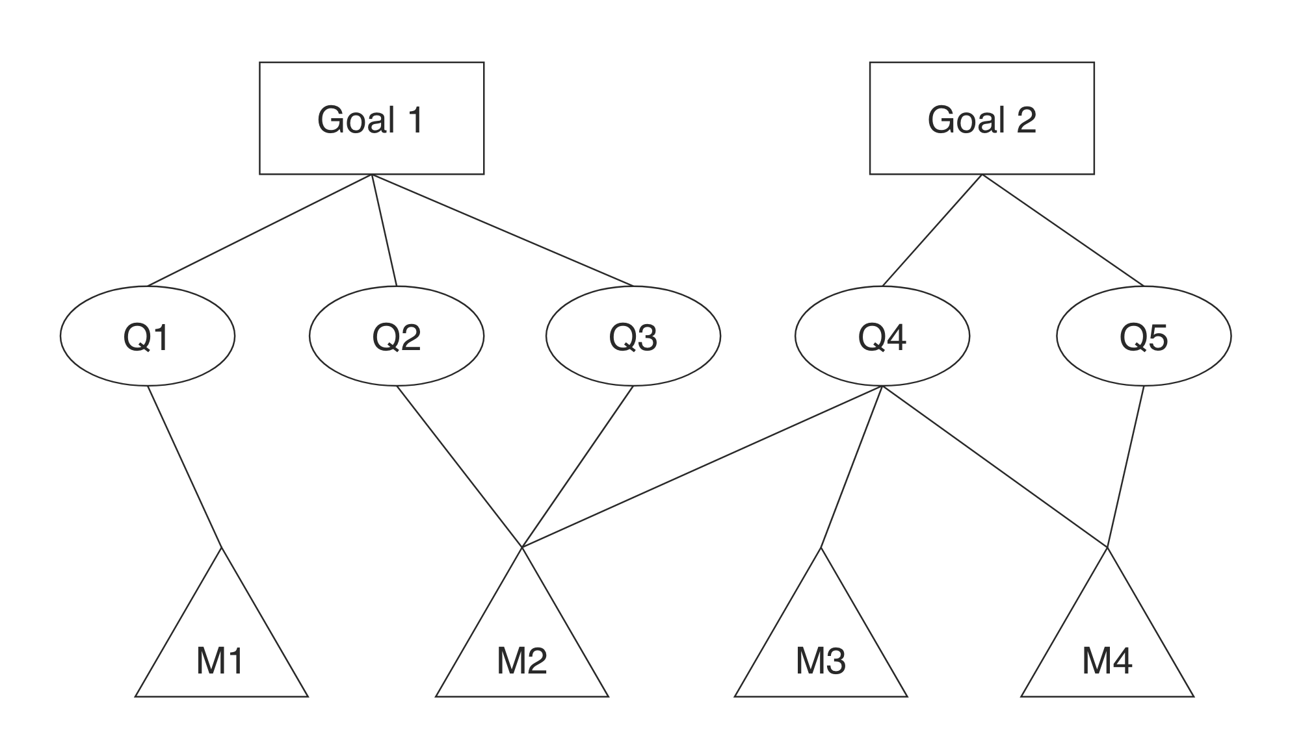
Goal Oriented Software Measurement (GQM)
Performed towards an explicitly stated purpose such as Goal Question Metrics (GQM), proposed by Basili and Weiss
Goals (Conceptual Level): what organization wants to improve
i.e. increase code readability
i.e. fault free software
Questions (Operational Level): refine each goal to more quantifiable way
How to write readable code?
What are the bottle necks?
Metric (Quantitative Level): indicate the metrics required to answer each question
Cyclomatic complexity

Slide 6
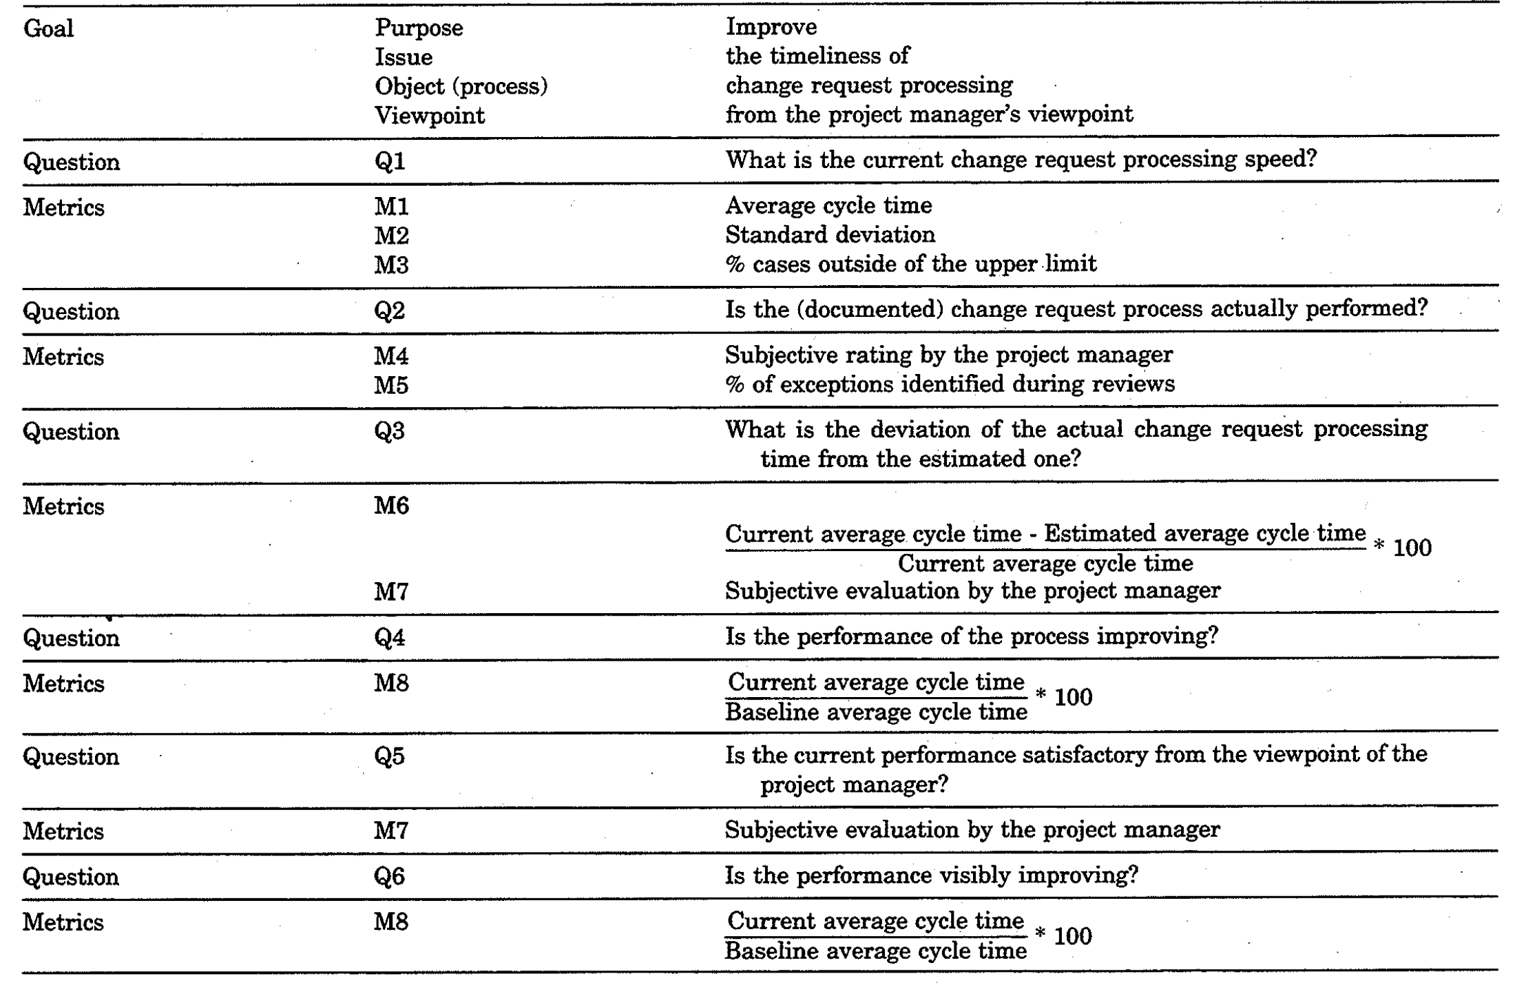
GQM
An example from the paper named “Goal Question Metric Paradigm by Basili and Rombach”

Slide 7
Let’s assume that you own a product that provides budget management to students who have limited budget for a month. Students add all their financial activities (i.e. shopping, gym, beer etc) and the system predicts whether to buy new stuff or not in coming week. All students in Sweden are using your products. You are also expecting some other companies to develop the same software. What would be your one measurement goal.
Explain:
The purpose
Issues
Object
View point.

Slide 8
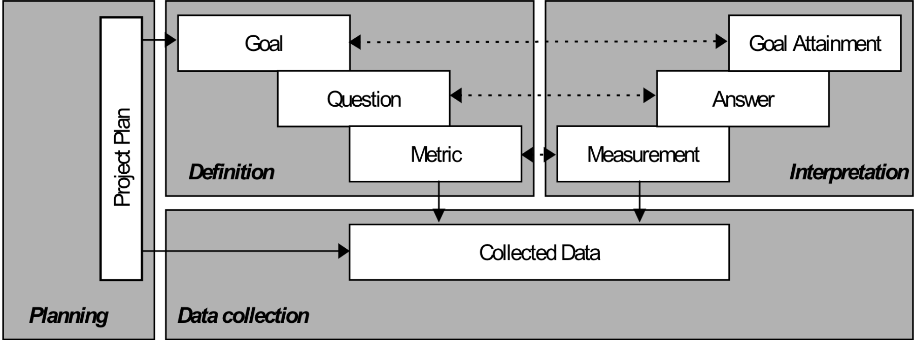
Four Phases of GQM – Setting up a Measurement Program
The Planning phase, during which a project for measurement application is selected, defined, characterised, and planned, resulting in a project plan.
The Definition phase, during which the measurement programme is defined (goal, questions, metrics, and hypotheses are defined) and documented
The Data Collection phase, during which actual data collection takes place, resulting in collected data.
The Interpretation phase, during which collected data is processed with respect to the defined metrics into measurement results, that provide answers to the defined questions, after which goal attainment can be evaluated

Slide 9
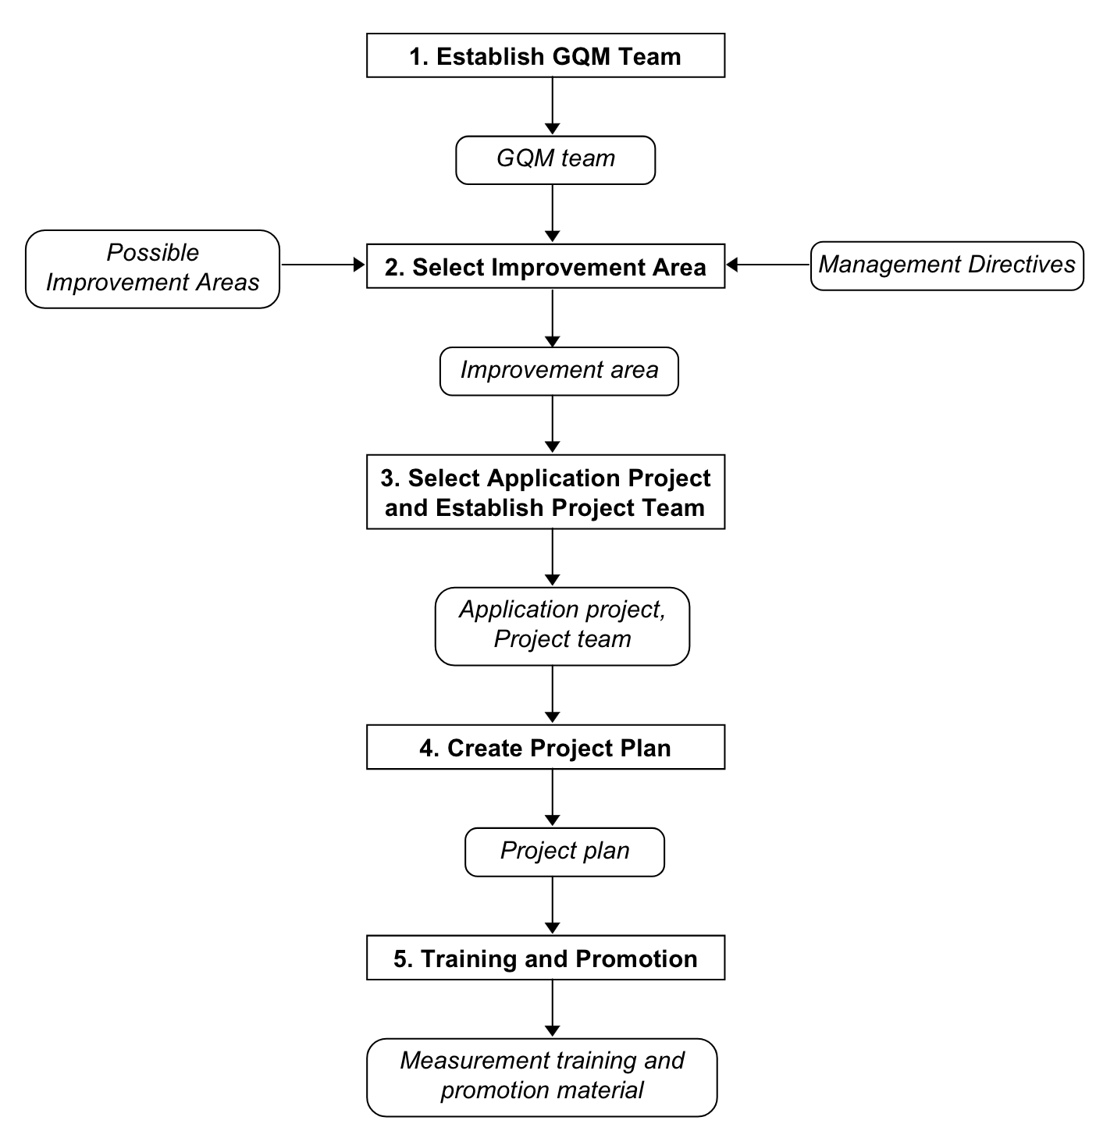
The Planning Phase
The planning phase is performed to fulfil all basic requirements to make a GQM measurement programme a success, including training, management involvement and project planning
‘If I had eight hours to chop down a tree, I would spend six sharpening my axe’
Abraham Lincoln

Slide 10
The Planning Phase – Establish GQM Team
Teams should:
Be independent.
Possess sufficient background knowledge.
Be improvement oriented.
Be enthusiastic
Main activities are:
Plan measurement programmes.
Carry out measurement definition activities and develop GQM deliverables
Feedback session after data interpretation.
Report progress

Slide 11
The Planning Phase – Select Improvement Area
Areas:
Apparent problems that the organisation struggles with.
More Details After Area Identification
problem or improvement area.
processes or products involved.
environmental, legislative, organisational, and technological influences

Slide 12
The Planning Phase – Select Application Project & Establish a Project Team
Project team is different than GQM team.
A project team consists of all the people that work on a particular software development
The success of a measurement programme heavily depends on their willingness, motivation, and enthusiasm

Slide 13
The Planning Phase – Create Project Plan
Project Plan should have:
Introduction which presents the scope of the measurement programme, and the relation of the improvement objectives to the software development project goals
Schedule
Timeline
list of deliverables
resource allocation
cost-benefit analysis
Priorities
Risk control activities
Training and promotion activities
many more!

Slide 14
The Planning Phase – Training and Promotion
During Training & Promotion Session:
Clear definition of proposed improvement goals are presented;
Benefits of the measurement programmes are explained;
Answers to Questions:
What measurement tasks should I perform?
Why should I perform those tasks?
How and when should I perform those tasks?
How much effort is required by me to perform those tasks?
Do the tasks influence my daily activities?
What do I get back from this?
What will I learn?

Slide 15
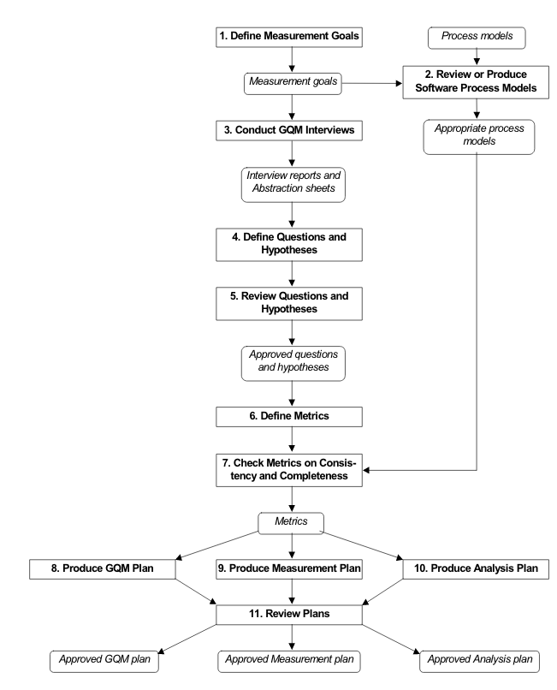
The Definition Phase
The Definition phase concerns all activities that should be performed to formally define a measurement programme. During this phase three documents are produced
GQM plan
Measurement plan
Analysis plan

Slide 16
The Definition Phase– Define Measurement Goal
1. What are the strategic goals of your organisation?
3. How can you improve your performance?
4. What are your major concerns (problems)?
5. What are your improvement goals?
Deliverable -> List of GQM measurement goal specifications

Slide 17
The Definition Phase– Conduct GQM Interviews
Team members are the experts with respect to the object under measurement, so include them
make the implicit knowledge of the project members explicit
input of the project team is of crucial importance.
Deliverable -> Set of interview reports and abstraction sheets

Slide 18
The Definition Phase– Define Questions and Hypotheses
Goals are defined on an abstract level, questions are refinements of goals to a more operational level
By answering the questions, one should be able to conclude whether goal is reached
Deliverable -> List of measurement questions and hypotheses, defined
with respect to the measurement goals

Slide 19
The Definition Phase– Review Questions and Hypotheses
It is important to make sure that these questions are correct
Possibility of misinterpretaion should be reduced
Deliverable -> List of approved measurement questions and hypotheses

Slide 20
The Definition Phase– Define Metrics
Metrics should be defined that provide all the quantitative information to answer the questions in a satisfactory way
Deliverable -> List of metrics suitable for supplying information to
answer the questions

Slide 21
The Definition Phase– Check on Metric Consistency and Completeness
If product metrics are defined these should be checked as to whether they are in fact possible and whether they can actually be measured at a specific moment in the development process
Deliverable -> Consistent and complete definitions of questions and
metrics related to the measurement goals.

Slide 22
The Definition Phase– Produce a GQM Plan
Explicit description of goals, questions, metrics and hypotheses
Basis for definition of data collection procedures
Guideline for interpretation of collected data
Deliverable -> Preliminary GQM plan.

Slide 23
The Definition Phase– Produce a Measurement Plan
It provides textual descriptions of direct measurements.
It identifies a person that collects a particular direct measurement, ie a programmer, engineer, project manager, tester etc.
It defines the particular moment in time when the person should collect the direct measurement.
It defines by which medium (tool or form) that person should collect the direct measurement
Deliverable -> Preliminary measurement plan.

Slide 24
The Definition Phase– Produce Analysis Plan
Simulates data interpretation according to the GQM plan before actual measuring starts
Simulated outcomes of the metrics, graphs and tables
indication to the project team which charts they can expect to receive
Deliverable -> Preliminary analysis plan.

Slide 25
The Definition Phase– Review Plan
Do project members agree upon the defined goals, questions and metrics?
Do project members identify any missing or unnecessary definitions?
Do project members agree with the proposed definition of feedback material?
Deliverable -> Preliminary review plan.

Slide 26
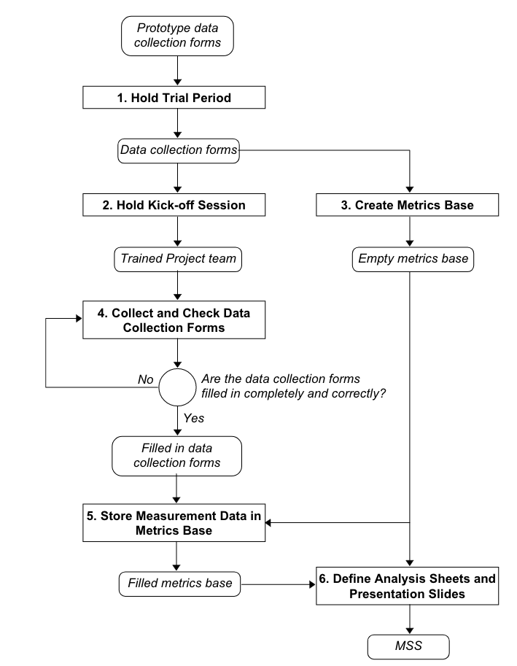
The Data Collection Phase

Slide 27
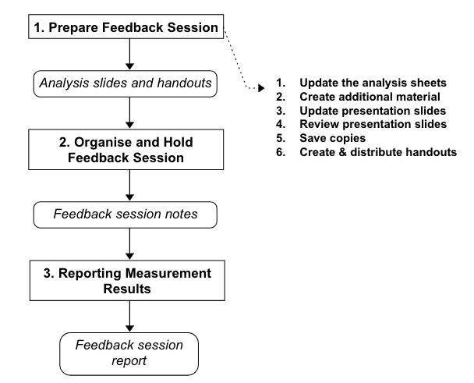
The Interpretation Phase

Slide 28
Software Quality Assurance (SQA)
Evaluating the effectiveness of the software processes (requirements, development, & maintenance)
IEEE 730:2014
IEEE 730:2014 provides a foundation for Software Quality Assurance, which in turns provides confidence that software products will conform to their established requirements and satisfy the customer.
Normative sections describe SQA processes, activities, and expectations
Informative sections contain:
Guidance for creating SQA Plans
Assessing product risks
Corrective/preventive action processes & root cause analysis

Slide 29
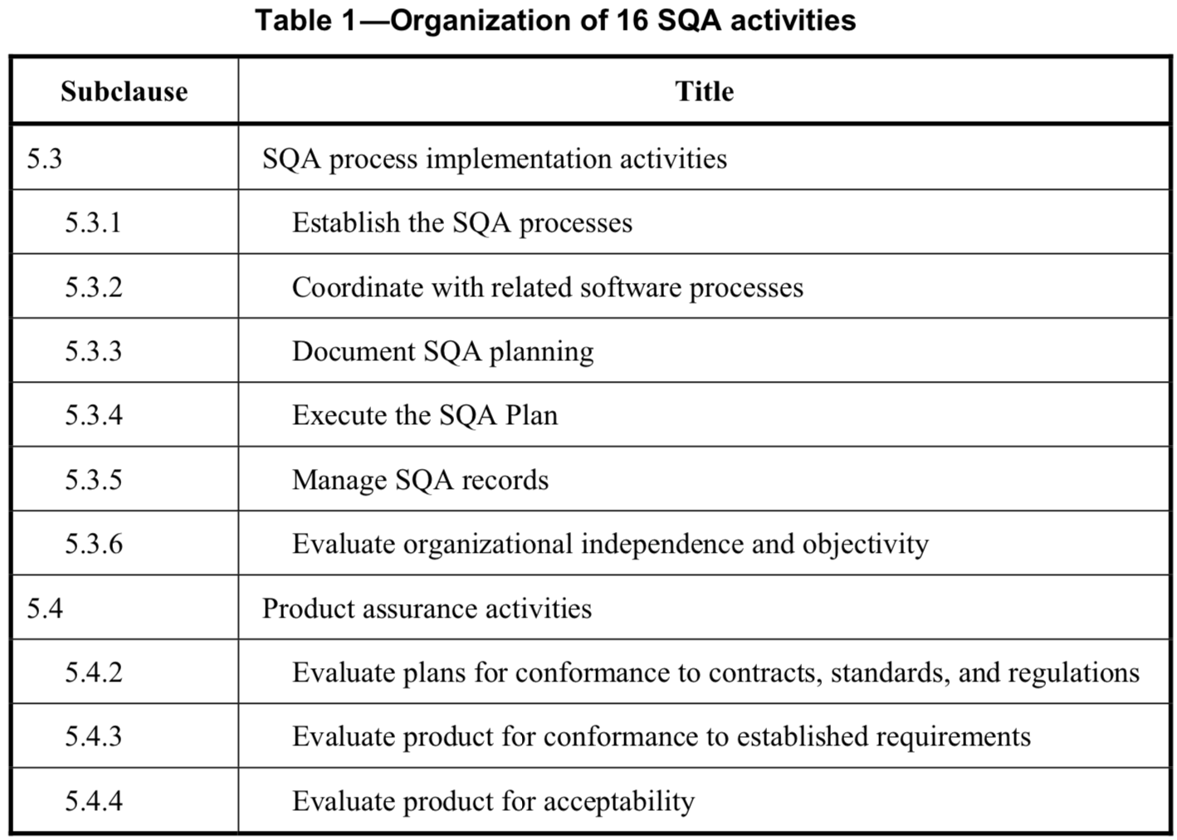
IEEE 730:2014- Section 5- Normative Section
The 16 SQA activities are organized into three groups

Slide 30
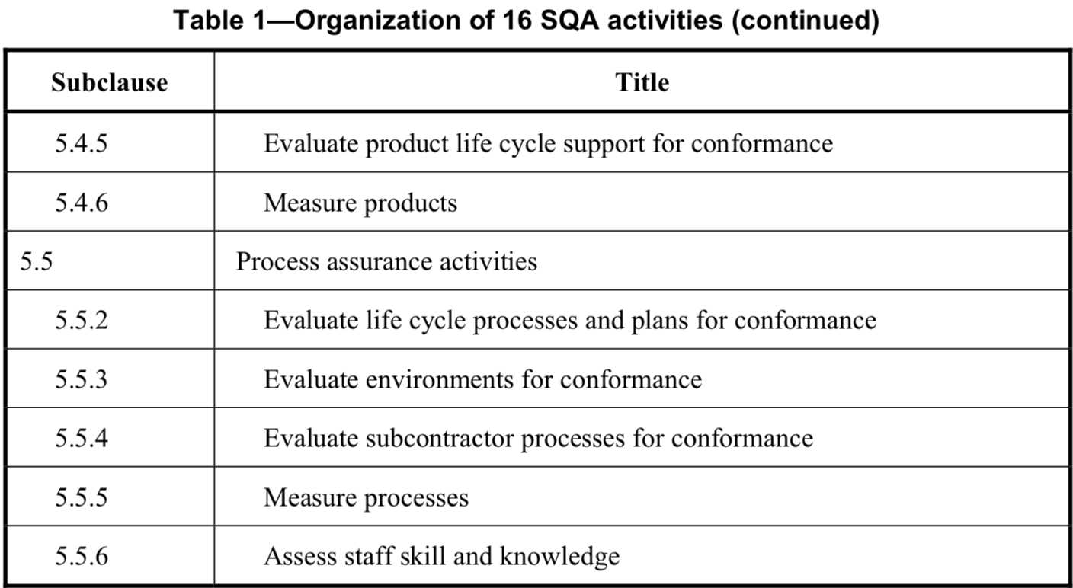
IEEE 730:2014- Section 5- Normative Section
The 16 SQA activities are organized into three groups

Slide 31
IEEE 730:2014- Section 5- Normative Section
Each activity has four sections:
Reference to IEEE12207: The text of the ISO/IEC/IEEE 12207:2008 subclause relevant to the activity
Purpose: Defines the activity’s intention
Outcome: Specific observable results of the successful achievement of activity’s purpose. An outcome may an information item (e.g., records, documents), a change in the state or an attribute of an information item, a change to a project constraint, or a change to an attribute (e.g., training, experience, capability) of a project team member.
Task: Specific actions that are intended to contribute to the achievement of one or more of the stated outcomes of the activity

Slide 32
5.5.2 Evaluate life cycle processes and plans for conformance
Reference to IEEE12207: The text of the ISO/IEC/IEEE 12207:2008 subclause relevant to the activity
Purpose:
Determine whether the project life cycle processes and plans conform to the established process requirements. Determine whether execution of software activities conform to the project’s processes and plans.
Outcome:
Documented software life cycle processes and plans are evaluated for conformance to the established process requirements.
Non-conformances are raised when software life cycle processes and plans are not adequate, efficient, or effective.
Task:
Identify applicable process requirements that may affect the selection of a software life cycle process.
Determine whether the defined software life cycle processes selected by the project team are appropriate, given the product risk.
Audit software development activities periodically to determine consistency with defined software life cycle processes.

Slide 33
An Exercise Together!

Slide 34
Coaching
“A professional, collaborative and outcomes-driven method of learning that seeks to develop an individual and raise self-awareness so that he or she might achieve specific goals and perform at a more effective level. ”
Develop and clarify their goals / desired state
Clarify their current reality
Develop ideas and options
Develop action plans which will lead to results
Current Way of Working
Where are we? Where we want to be? how can we reach there?
New Way of Working (Desired State)

Slide 35
Coaching Models
GROW (Goals, Reality, Options, Wrap up/Will)
CLEAR (Contract, Listen, Explore, Actions, Review)
SOAR: (Story, Options, Actions, Review)
ARROW: (Aims, Reality, Reflections, Options, What next)
POWER: (Purpose, Objectives, Whats happening, Empower, Review)
CREATE: (Current Reality, Explore Alternatives, Tap their Energy)
ACHIEVE (Assess current situation, Creative brainstorming,
Hone goal, Initiate option generation, Evaluate options,
Valid action, Encourage momentum
5A: (Aims, Awareness, Analysis, Action, Assessment)

Slide 36
Software Reviews
A method involving a structured encounter in which a group of technical personnel analyzes or improves the quality of the original work product as well as the quality of the method
The IEEE Standard for Software Reviews defines 5 types of review:
Management Reviews
Technical Reviews
Inspections (Formal Peer Review)
Walk-throughs
Audits
Check/read Links for more details:
https://www.ida.liu.se/~TDDC88/theory/lectures.shtml
https://www.ida.liu.se/~TDDC90/timetable/index.en.shtml

