Slide 1
Course Introdction_{TDDE46}
Kristian Sandahl, Azeem Ahmad
Linköping University, Sweden

Slide 2
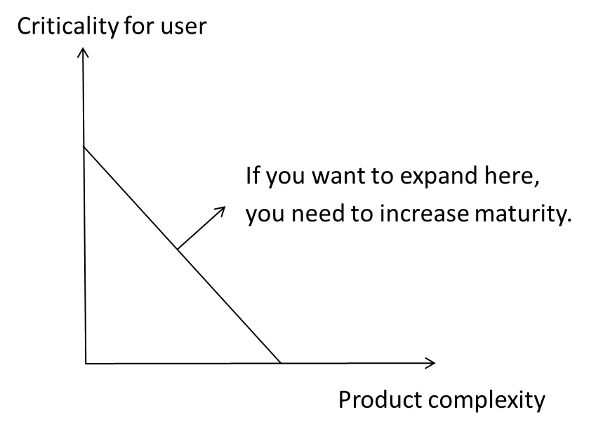
Quality work in a software company is done for different reasons
Take new challenges
Grow your assets
Avoid complaints

Slide 3
Quality is free?
Prevention cost
Appraisal cost
Cost for the right quality
Cost of quality
Cost for insufficient quality
Internal failure cost
External failure cost
Feigenbaum, Armand V. (November–December 1956), "Total Quality Control", Harvard Business Review, 34 (6)
Notes:
On the board: Figure 2 of: https://www.researchgate.net/publication/317428436_Role_of_Cost_of_Quality_in_the_Automotive_Industry

Slide 4
Drivers for quality
Experience
The way we build and reuse
Solutions
Testing
Static analysis
Review
Measurement
How we manage our company
The way we evaluate quality
The way we cooperate
Quality
The way we work
The way we describe quality
Competence
Understanding users’ true needs
Available resources
Tools
How we position the product on the market
Infrastructure
Time
Competitors
Portfolio

Slide 5
Course content
Measuring software products, processes and resources
Quality planning
Describing processes and practices with SEMAT Essence
Process evaluation and improvement
Software quality management
Information quality and tools
Coaching bachelor projects
Evaluating bachelor projects
Taught in other courses:
Software reviews
Formal verification
Software testing
Design for quality factors
Taught at IEI:
Quality management
Statistical process control

Slide 6
The position in the course programme
Software Verification
Software Security
Software Architectures
Software Security
Large-Scale Software Development
Large-Scale Software Development
Software Testing
Software Quality
Software Design and Construction
SE-theory
SE-project
TDDD30

Slide 7
Lectures give the most common theoretical aspects of software quality
Well-known concepts
Introduction to scientific literature and standards
Practical hints
Do not replace own studies
If we think that you ask and discuss too much we will let you know

Slide 8
Labs are there to give you hands on and reflection
Tools for measurement
Process modeling and improvement
Verify requirements for an API
Visualizing metrics with a dashboard
Tools for robustness and availability.

Slide 9
You will coach the bachelor thesis projects to get the process and people experience
This is a true need
You will help them to achieve:
Measurable quality requirements
A useful quality plan
You will practice:
Identify, suggest and evaluate a process improvement
Evaluate a product
http://www.culturaltravelguide.com/wp-content/uploads/2012/05/plan-a-trip-tourist-guide1.jpg

Slide 10
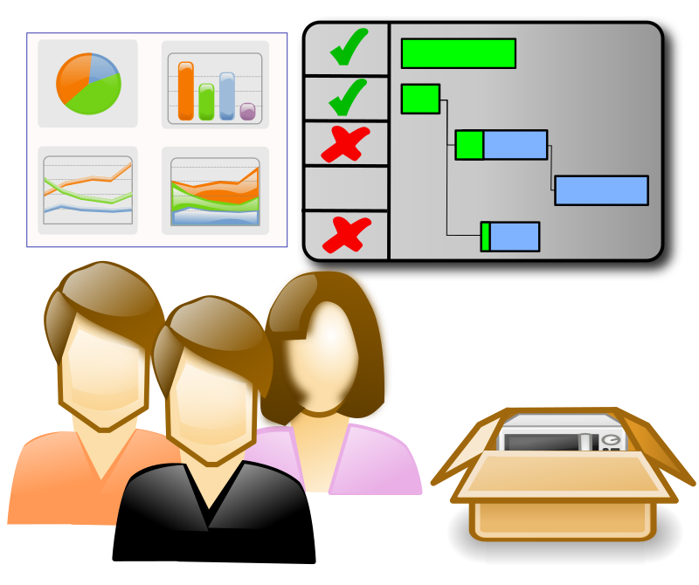
Organisation
Lab groups
…
Project and seminar groups
…
Bachelor projects
…

Slide 11
In seminars we discuss articles and account for coaching activities
Metrics and estimation
Processes and practices
Software quality management
Automatization
Prepare by reading
Write a short individual report on major take-aways

Slide 12
Finally, we write a report of the coaching project and individual contributions
Common part about the coaching project
Individual appendices:
Deepened follow up from seminars
Deepened follow up from 1-2 labs
Deepened follow up from the coaching project
Independent essay within the scope of the course

Slide 13
Grading rewards your ambition and achievements
Lab series (G/U) – accomplish the lab goals, 2 hp
Project work (U/3/4/5):
Seminars – presence and active participation, plus reflection report
Well-performed coaching
Common written report on the project
Individual appendix:
10-line abstracts with major results
2-3 good references
Understandable English
About 4 pages excluding pictures and references
= grade 3

Slide 14
Grading rewards your ambition and achievements
Individual appendix:
10-line abstracts with major results
10 good references
Good, fault-free English
4-8 pages excluding pictures and references
Same as grade 4 and:
Clear comparison between 2-3 distinct findings in the coaching projects and the literature
= grade 4
= grade 5

Slide 15
Objectives for next 45 minutes
What is software quality?
Different views on quality
What are software quality factors?
ISO 25010 standard in detail

Slide 16
What does Quality mean to you?
You are a project manager of the BlaBla communication AB in Sweden. Your company develops networking products such as routers and switches. Your company also develops software for routers and switches to make it easy to use for customers. You are competing with other 5 companies to get the contract for 1 million devices for third world countries as part of United Nation campaign. This contract is very important for your financial planning otherwise you can go bankrupt. The contract is to submit the following documentation of one line by just filling the blanks. Your answer (i.e. for the blank) must be between 1-5 words.
Your hardware and/or software has a good quality because it ____________!

Slide 17
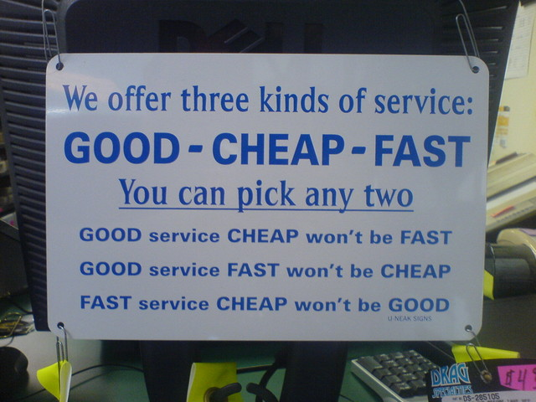

Slide 18
What is Software Quality?
Quality is a complex and multifaceted concept (David Garvin)
Quality = Fitness for Purpose (Juran)
Quality = Zero Defect (Crosby)

Slide 19
Different Views of Quality
Five different views according to David Garvin:¹
Transcendental view: that quality is something that you immediately recognize, but cannot explicitly define.
User view: sees quality in terms of an end user’s specific goals. If a product meets those goals, it exhibits quality.
A product is of good quality, if it satisfy a large number of users
Manufacturer view: defines quality in terms of the original specification of the product. If the product conforms to the specification, it exhibits quality.
Does the product satisfy the specification/requirements?
Product view: suggests that quality can be tied to inherent characteristics (e.g., module approach and feature's re-usability) of a product.
Value-based view: measures quality based on how much a customer is willing to pay for a product.
How much a customer is willing to pay for a certain level of quality
1. Garvin, D., “What Does ‘Product Quality’ Really Mean?” Sloan Management Review, Fall 1984, pp. 25–45

Slide 20
Software Quality Factors
To know that quality has improved, it would be helpful to be able to measure quality in term of factors.
Quality Factors (Availability, Reliability, Maintainability, Security …..):
Goal-oriented methodology for measuring software quality

Slide 21
Software Quality Standards & Models
Standards (i.e. international, regional, national or organizational):
Increase customer’s confidence in the products
Help to achieve effective quality management
Avoid repetitions of past mistakes
Helps staff understand the organization by understanding the standard
Developed by:
IEEE, ISO, DOD (US Department of Defence), ANSI (American National Standard Organization), EIA (Electronic Industries Association) and others
Models:
McCall -> 11 quality factors (1977)
Deutsch and Willis -> 12 quality factors (1988)
Evans and Marciniak-> 15 quality factors (1987)
Many others (Seminar 1 is about quality models)

Slide 22
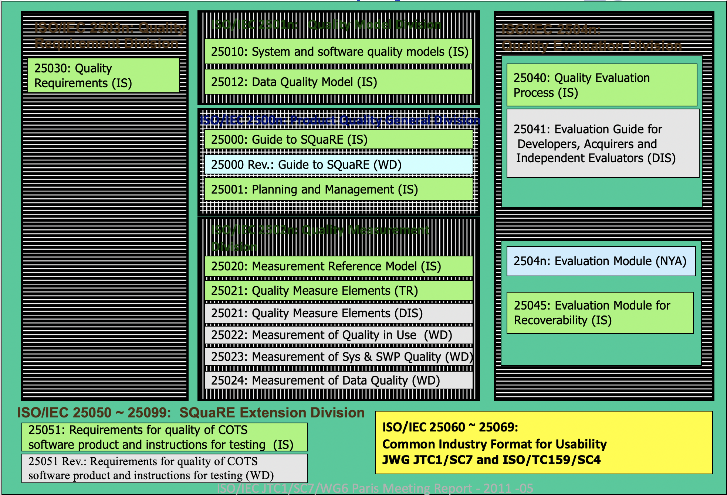
Software Quality Standards – ISO 250XX
Software Product Quality Requirements and Evaluation (SQuaRE)

Slide 23
ISO/IEC 25010 (replaced with ISO 9126)
“The quality of a system is the degree to which the system satisfies the stated and implied needs of its various stakeholders, and thus provides value. Those stakeholders' needs (functionality, performance, security, maintainability, etc.) are precisely what is represented in the quality model [……]” (www.iso2500.com)

Slide 24
ISO/IEC 25010 (replaced with ISO 9126)

Slide 25
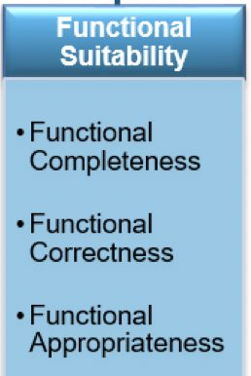
ISO/IEC 25010
Some lessons to take away; what should you do?
Check if all use cases have been written
Use traceability matrices to make sure that software matched with all business requirements completely and correctly
Everyone in Sweden should pay tax -> complete?.
Car rental prices shall show all applicable taxes (including 6% kummun tax) ->correct?.

Slide 26
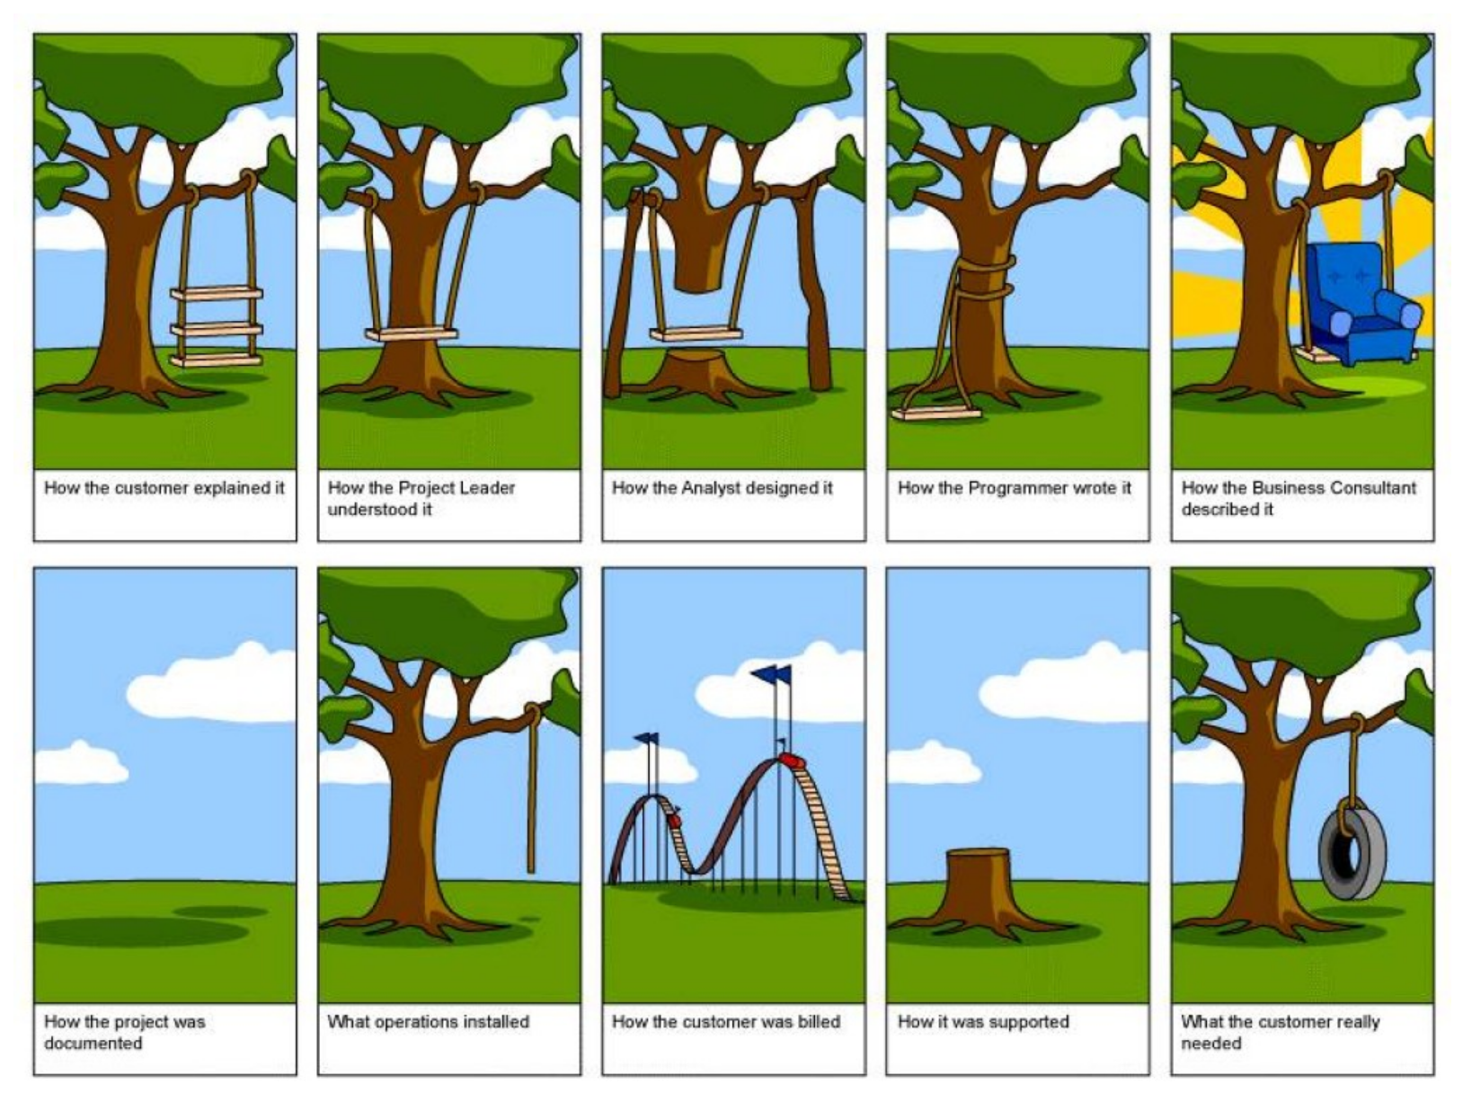

Slide 27
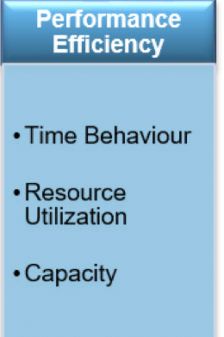
ISO/IEC 25010
Some lessons to take away; what should you do?
Select appropriate data structure when writing code
Select appropriate algorithms
Consider data cashing, memory leakage, multi-threading, locking and other issues

Slide 28
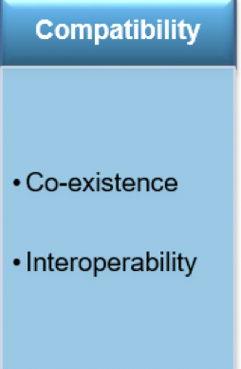
ISO/IEC 25010
Some lessons to take away; what should you do?
Write code that can communicate with different platform such as Windows, Mac, Linux, Ubuntu
Ability to use different functions (open-source, COTS, etc.) to make one complete program

Slide 29
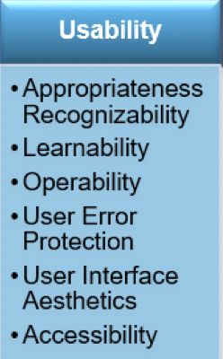
ISO/IEC 25010
•Keep it Simple
•Keep it Consistent
•Always Include a Search Bar

Slide 30
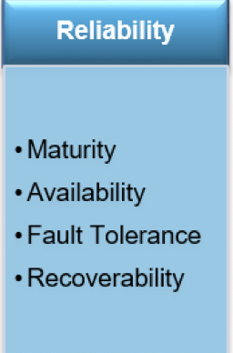
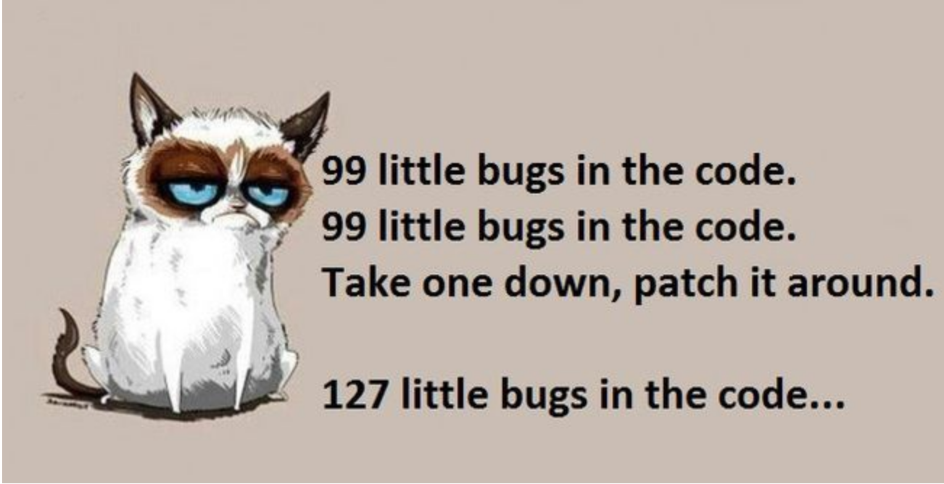
ISO/IEC 25010
Some lessons to take away; what should you do?
Pay attention to exception handling
Keep the state save, when crashing and load program back to that state – crashing gracefully

Slide 31
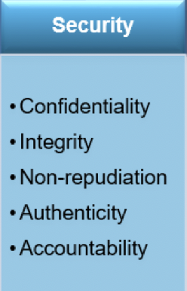
ISO/IEC 25010
Some lessons to take away; what should you do?
Pay attention to three AAAs (Authentication, Authorization & Access Control) for taking care of CIA (Confidentiality, Integrity and Availability) attributes
Pay attention to OWASP vulnerabilities’ recommendation and focus on doing input validation to take care of issues related with CIA
Make sure that there are test cases (security testing) to test the above aspects

Slide 32
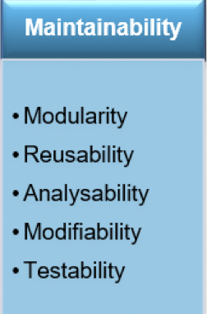
ISO/IEC 25010
Some lessons to take away; what should you do?
Apply object-oriented principles to take care of concerns such as reusability & modularity while doing both, design and coding.
Use static code analysis tools

Slide 33
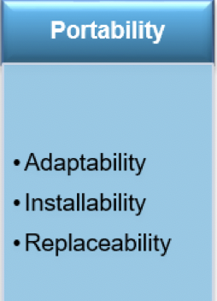
ISO/IEC 25010
Some lessons to take away; what should you do?
Either write N software version for N platform or use JVM (Java Virtual Machine)
Either the executable code is portable or the source code must be re-compiled for each platform

Slide 34
Key Points
Consider activities related to software quality as early as possible in SDLC
Software quality depends in the eyes of behold
Certainly the nature of the app dictates more concern on some of these factors than others (safety, for example)
There are no universally applicable model or standard for software quality. Each organization can choose model or standard according to their need
Standards and Models are a good start.

