Slide 1


Computer Networking: A Top Down Approach
7th edition
Jim Kurose, Keith Ross
Pearson/Addison Wesley
April 2016
Chapter 2
Application Layer
Chapter 9
Multimedia Networking
8th edition
Jim Kurose, Keith Ross
Pearson,
2020
A note on the use of these Powerpoint slides:
We’re making these slides freely available to all (faculty, students, readers). They’re in PowerPoint form so you see the animations; and can add, modify, and delete slides (including this one) and slide content to suit your needs. They obviously represent a lot of work on our part. In return for use, we only ask the following:
If you use these slides (e.g., in a class) that you mention their source (after all, we’d like people to use our book!)
If you post any slides on a www site, that you note that they are adapted from (or perhaps identical to) our slides,and note our copyright of this material.
Thanks and enjoy! JFK/KWR
All material copyright 1996-2016
J.F Kurose and K.W. Ross, All Rights Reserved

Slide 2




Video Streaming and CDNs: context
stream video traffic: major consumer of Internet bandwidth
  Netflix, YouTube, Amazon Prime: 80% of residential ISP traffic (2020)
challenge: scale - how to reach ~1B users?
challenge: heterogeneity
  different users have different capabilities (e.g., wired versus mobile; bandwidth rich versus bandwidth poor)
solution: distributed, application-level infrastructure

Slide 3

Multimedia: video
spatial coding example: instead of sending N values of same color (all purple), send only two values: color value (purple) and number of repeated values (N)
video: sequence of images displayed at constant rate
  e.g., 24 images/sec
digital image: array of pixels
  each pixel represented by bits
coding: use redundancy within and between images to decrease # bits used to encode image
  spatial (within image)
  temporal (from one image to next)
……………………..
……………….…….
frame i
temporal coding example: instead of sending complete frame at i+1, send only differences from frame i
frame i+1

Slide 4
Multimedia: video
spatial coding example: instead of sending N values of same color (all purple), send only two values: color value (purple) and number of repeated values (N)
CBR: (constant bit rate): video encoding rate fixed
VBR: (variable bit rate): video encoding rate changes as amount of spatial, temporal coding changes
examples:
  MPEG 1 (CD-ROM) 1.5 Mbps
  MPEG2 (DVD) 3-6 Mbps
  MPEG4 (often used in Internet, 64Kbps – 12 Mbps)
……………………..
……………….…….
frame i
temporal coding example: instead of sending complete frame at i+1, send only differences from frame i
frame i+1

Slide 5
Multimedia networking: 3 example types
streaming, stored audio, video
  streaming: can begin playout before downloading entire file
  stored (at server): can transmit faster than audio/video will be rendered (implies storing/buffering at client)
  e.g., YouTube, Netflix, Hulu
conversational voice/video over IP
  interactive nature of human-to-human conversation limits delay tolerance
  e.g., Skype
streaming live audio, video
  e.g., live sporting event (football, hockey, etc.)

Slide 6
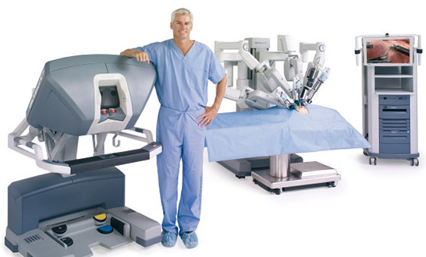


And the future has more …

Slide 7

Streaming stored video
Cumulative data
2. video
sent
video
recorded (e.g., 30 frames/sec)
3. video received, played out at client
(30 frames/sec)
network delay
(fixed in this example)
time
streaming: at this time, client playing out early part of video, while server still sending later part of video

Slide 8
Streaming stored video
simple scenario:
Continuous playout constraint:
once client playout begins, playback must match original timing
… but network delays are variable (jitter), so will need client-side buffer to match playout requirements
Internet
video server
(stored video)
client
Main challenges:
server-to-client bandwidth will vary over time, with changing network congestion levels (in house, access network, network core, video server)
packet loss, delay due to congestion will delay playout, or result in poor video quality
Other challenges
client interactivity: pause, fast-forward, rewind, jump through video
video packets may be lost, retransmitted

Slide 9
Streaming stored video: revisited
constant bit
rate video
transmission
client video
reception
constant bit
rate video
playout at client
Cumulative data
variable
network
delay
buffered
video
client playout
delay
time
client-side buffering and playout delay: compensate for network-added delay, delay jitter

Slide 10

Client-side buffering, playout
buffer fill level, Q(t)
variable fill
rate, x(t)
playout rate,
e.g., CBR r
video server
client application
buffer, size B
client

Slide 11
Client-side buffering, playout
buffer fill level, Q(t)
variable fill
rate, x(t)
playout rate,
e.g., CBR r
video server
client application
buffer, size B
client
1. Initial fill of buffer until playout begins at t_{p}
2. playout begins at t_{p,}
3. buffer fill level varies over time as fill rate x(t) varies and playout rate r is constant

Slide 12

Streaming multimedia: Basic HTTP
multimedia file retrieved via HTTP GET
send at maximum possible rate under TCP
fill rate fluctuates due to TCP congestion control, retransmissions (in-order delivery)
larger playout delay: smooth TCP delivery rate
HTTP/TCP passes more easily through firewalls
variable rate, x(t)
video
file
TCP send buffer
TCP receive buffer
application playout buffer
server
client

Slide 13
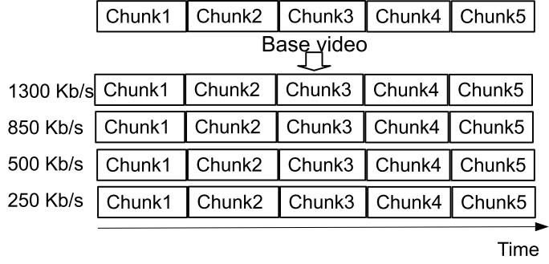
HTTP-based Adaptive Streaming (HAS) or DASH …
HTTP-based adaptive streaming
  Video is split into chunks
  Each chunk in multiple bitrates (qualities)
  Clients adapt quality encoding based on buffer/network conditions

Slide 14
HTTP-based Adaptive Streaming (HAS) or DASH
HTTP-based adaptive streaming
  Video is split into chunks
  Each chunk in multiple bitrates (qualities)
  Clients adapt quality encoding based on buffer/network conditions

Slide 15
HTTP-based Adaptive Streaming (HAS) or DASH
Chunk4
Chunk5
Chunk2
Chunk3
Chunk1
HTTP-based adaptive streaming
  Video is split into chunks
  Each chunk in multiple bitrates (qualities)
  Clients adapt quality encoding based on buffer/network conditions

Slide 16
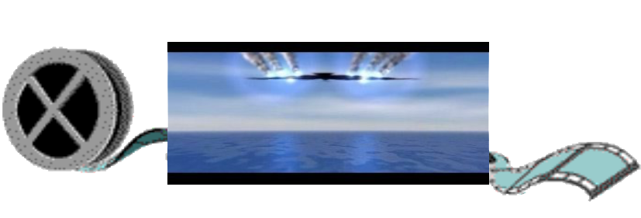
Streaming multimedia: DASH (or HAS)
Dynamic, Adaptive Streaming over HTTP
server:
  divides video file into multiple chunks
  each chunk encoded at multiple different rates
  different rate encodings stored in different files
  files replicated in various CDN nodes
  manifest file: provides URLs for different chunks
...
...
?
...
client
client:
  periodically estimates server-to-client bandwidth
  consulting manifest, requests one chunk at a time
    chooses maximum coding rate sustainable given current bandwidth
    can choose different coding rates at different points in time (depending on available bandwidth at time), and from different servers

Slide 17

Streaming multimedia: DASH (or HAS)
“intelligence” at client: client determines
  when to request chunk (so that buffer starvation, or overflow does not occur)
  what encoding rate to request (higher quality when more bandwidth available)
...
...
?
...
client
  where to request chunk (can request from URL server that is “close” to client or has high available bandwidth)
Streaming video = encoding + DASH + playout buffering

Slide 18
Content Distribution Networks (CDNs)
Challenge: how to stream content (selected from millions of videos) to hundreds of thousands of simultaneous users?
option 1: single, large “mega-server”
  single point of failure
  point of network congestion
  long (and possibly congested) path to distant clients
….quite simply: this solution doesn’t scale

Slide 19


Content Distribution Networks (CDNs)
challenge: how to stream content (selected from millions of videos) to hundreds of thousands of simultaneous users?
option 2: store/serve multiple copies of videos at multiple geographically distributed sites (CDN)
  enter deep: push CDN servers deep into many access networks
    close to users
    Akamai: 240,000 servers deployed
    in > 120 countries (2015)
  bring home: smaller number (10’s) of larger clusters in POPs near access nets
    used by Limelight

Slide 20

Content Distribution Networks (CDNs)
CDN: stores copies of content (e.g. MADMEN) at CDN nodes
subscriber requests content, service provider returns manifest
  using manifest, client retrieves content at highest supportable rate
  may choose different rate or copy if network path congested
…
…
…
…
manifest file
where’s Madmen?
…
…
Notes:
20
Akamai: 100,000+ servers in 1000+ clusters in 1000+ networks in 70+ countries serving trillions of requests a day.
How many people use Netflix?

Slide 21
Content Distribution Networks (CDNs)
OTT: “over the top”
…
…
Internet host-host communication as a service
…
…
OTT challenges: coping with a congested Internet from the “edge”
  what content to place in which CDN node?
  from which CDN node to retrieve content? At which rate?
…
…
Notes:
21
peak load: 7million viewers, 2 Tbytes via

Slide 22
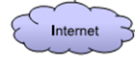


Example: HAS and proxy
Clients’ want
High playback quality
Small stall times
Few buffer interruptions
Few quality switches

Slide 23
Example: HAS and proxy
Slides from: V. Krishnamoorthi et al.
"Helping Hand or Hidden Hurdle:
Proxy-assisted HTTP-based Adaptive
Streaming Performance",
Proc. IEEE MASCOTS, 2013
Clients’ want
HAS is increasingly responsible for larger traffic volumes
… proxies to reduce traffic??
High playback quality
Small stall times
Few buffer interruptions
Few quality switches

Slide 24
Example: HAS and proxy
Slides from: V. Krishnamoorthi et al.
"Helping Hand or Hidden Hurdle:
Proxy-assisted HTTP-based Adaptive
Streaming Performance",
Proc. IEEE MASCOTS, 2013
Clients’ want
Network providers’ want
High playback quality
Small stall times
Few buffer interruptions
Few quality switches
High QoE of customers/clients

Slide 25
Example: HAS and proxy
Slides from: V. Krishnamoorthi et al.
"Helping Hand or Hidden Hurdle:
Proxy-assisted HTTP-based Adaptive
Streaming Performance",
Proc. IEEE MASCOTS, 2013
Clients’ want
Network providers’ want
High playback quality
Small stall times
Few buffer interruptions
Few quality switches
High QoE of customers/clients
Low bandwidth usage
High hit rate

Slide 26
Example: HAS and proxy
Slides from: V. Krishnamoorthi et al.
"Helping Hand or Hidden Hurdle:
Proxy-assisted HTTP-based Adaptive
Streaming Performance",
Proc. IEEE MASCOTS, 2013
Clients’ want
Network providers’ want
High playback quality
Small stall times
Few buffer interruptions
Few quality switches
High QoE of customers/clients
Low bandwidth usage
High hit rate

Slide 27
Example: HAS and proxy
Proxy example …

Slide 28
Example: HAS and proxy

Slide 29
Example: HAS and proxy

Slide 30
Example: HAS and proxy

Slide 31
Example: HAS and proxy

Slide 32
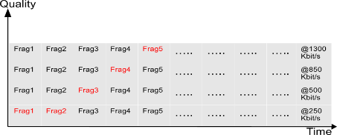
Example: HAS and proxy
1,4
2,4
3,4
4,4
5,4
6,4
7,4
1,4
2,4
3,4
4,4
5,4
6,4
7,4
1,3
2,3
3,3
4,3
5,3
6,3
7,3
1,3
2,3
3,3
4,3
5,3
6,3
7,3
1,2
2,2
3,2
4,2
5,2
6,2
7,2
1,2
2,2
3,2
4,2
5,2
6,2
7,2
1,1
2,1
3,1
4,1
5,1
6,1
7,1
1,1
2,1
3,1
4,1
5,1
6,1
7,1
Client
Proxy

Slide 33
Example: HAS and proxy
1,4
2,4
3,4
4,4
5,4
6,4
7,4
1,3
2,3
3,3
4,3
5,3
6,3
7,3
1,2
2,2
3,2
4,2
5,2
6,2
7,2
1,4
2,4
3,4
4,4
5,4
6,4
7,4
1,1
2,1
3,1
4,1
5,1
6,1
7,1
1,3
2,3
3,3
4,3
5,3
6,3
7,3
Proxy before
1,2
2,2
3,2
4,2
5,2
6,2
7,2
1,1
2,1
3,1
4,1
5,1
6,1
7,1
Client 1
1,4
2,4
3,4
4,4
5,4
6,4
7,4
1,3
2,3
3,3
4,3
5,3
6,3
7,3
1,2
2,2
3,2
4,2
5,2
6,2
7,2
1,1
2,1
3,1
4,1
5,1
6,1
7,1
Proxy after

Slide 34
Example: HAS and proxy
1,4
2,4
3,4
4,4
5,4
6,4
7,4
1,3
2,3
3,3
4,3
5,3
6,3
7,3
1,2
2,2
3,2
4,2
5,2
6,2
7,2
1,4
2,4
3,4
4,4
5,4
6,4
7,4
1,1
2,1
3,1
4,1
5,1
6,1
7,1
1,3
2,3
3,3
4,3
5,3
6,3
7,3
Proxy before
1,2
2,2
3,2
4,2
5,2
6,2
7,2
1,1
2,1
3,1
4,1
5,1
6,1
7,1
Client 1
1,4
2,4
3,4
4,4
5,4
6,4
7,4
1,3
2,3
3,3
4,3
5,3
6,3
7,3
1,2
2,2
3,2
4,2
5,2
6,2
7,2
1,1
2,1
3,1
4,1
5,1
6,1
7,1
Proxy after

Slide 35
Example: HAS and proxy
1,4
2,4
3,4
4,4
5,4
6,4
7,4
1,3
2,3
3,3
4,3
5,3
6,3
7,3
1,2
2,2
3,2
4,2
5,2
6,2
7,2
1,4
2,4
3,4
4,4
5,4
6,4
7,4
1,1
2,1
3,1
4,1
5,1
6,1
7,1
1,3
2,3
3,3
4,3
5,3
6,3
7,3
Proxy before
1,2
2,2
3,2
4,2
5,2
6,2
7,2
1,1
2,1
3,1
4,1
5,1
6,1
7,1
Client 2
1,4
2,4
3,4
4,4
5,4
6,4
7,4
1,3
2,3
3,3
4,3
5,3
6,3
7,3
1,2
2,2
3,2
4,2
5,2
6,2
7,2
1,1
2,1
3,1
4,1
5,1
6,1
7,1
Proxy after

Slide 36
Example: HAS and proxy
1,4
2,4
3,4
4,4
5,4
6,4
7,4
1,3
2,3
3,3
4,3
5,3
6,3
7,3
1,2
2,2
3,2
4,2
5,2
6,2
7,2
1,4
2,4
3,4
4,4
5,4
6,4
7,4
1,1
2,1
3,1
4,1
5,1
6,1
7,1
1,3
2,3
3,3
4,3
5,3
6,3
7,3
Proxy before
1,2
2,2
3,2
4,2
5,2
6,2
7,2
1,1
2,1
3,1
4,1
5,1
6,1
7,1
Client 2
1,4
2,4
3,4
4,4
5,4
6,4
7,4
1,3
2,3
3,3
4,3
5,3
6,3
7,3
1,2
2,2
3,2
4,2
5,2
6,2
7,2
1,1
2,1
3,1
4,1
5,1
6,1
7,1
Proxy after

Slide 37
Example: HAS and proxy
1,4
2,4
3,4
4,4
5,4
6,4
7,4
1,3
2,3
3,3
4,3
5,3
6,3
7,3
1,2
2,2
3,2
4,2
5,2
6,2
7,2
1,4
2,4
3,4
4,4
5,4
6,4
7,4
1,1
2,1
3,1
4,1
5,1
6,1
7,1
1,3
2,3
3,3
4,3
5,3
6,3
7,3
Proxy before
1,2
2,2
3,2
4,2
5,2
6,2
7,2
1,1
2,1
3,1
4,1
5,1
6,1
7,1
Client 3
1,4
2,4
3,4
4,4
5,4
6,4
7,4
1,3
2,3
3,3
4,3
5,3
6,3
7,3
1,2
2,2
3,2
4,2
5,2
6,2
7,2
1,1
2,1
3,1
4,1
5,1
6,1
7,1
Proxy after

Slide 38
Example: HAS and proxy
1,4
2,4
3,4
4,4
5,4
6,4
7,4
1,3
2,3
3,3
4,3
5,3
6,3
7,3
1,2
2,2
3,2
4,2
5,2
6,2
7,2
1,4
2,4
3,4
4,4
5,4
6,4
7,4
1,1
2,1
3,1
4,1
5,1
6,1
7,1
1,3
2,3
3,3
4,3
5,3
6,3
7,3
Proxy before
1,2
2,2
3,2
4,2
5,2
6,2
7,2
1,1
2,1
3,1
4,1
5,1
6,1
7,1
Client 3
1,4
2,4
3,4
4,4
5,4
6,4
7,4
1,3
2,3
3,3
4,3
5,3
6,3
7,3
1,2
2,2
3,2
4,2
5,2
6,2
7,2
1,1
2,1
3,1
4,1
5,1
6,1
7,1
Proxy after

Slide 39
Multimedia networking: outline
9.1 multimedia networking applications
9.2 streaming stored video
9.3 voice-over-IP
9.4 protocols for real-time conversational applications
9.5 network support for multimedia

Slide 40
Multimedia: audio
analog audio signal sampled at constant rate
  telephone: 8,000 samples/sec
  CD music: 44,100 samples/sec
each sample quantized, i.e., rounded
  e.g., 2⁸=256 possible quantized values
  each quantized value represented by bits, e.g., 8 bits for 256 values
quantization error
quantized value of
analog value
analog
signal
audio signal amplitude
time
sampling rate
(N sample/sec)

Slide 41
Multimedia: audio
example: 8,000 samples/sec, 256 quantized values: 64,000 bps
receiver converts bits back to analog signal:
  some quality reduction
example rates
CD: 1.411 Mbps
MP3: 96, 128, 160 kbps
Internet telephony: 5.3 kbps and up
quantization error
quantized value of
analog value
analog
signal
audio signal amplitude
time
sampling rate
(N sample/sec)

Slide 42

Multimedia: video
spatial coding example: instead of sending N values of same color (all purple), send only two values: color value (purple) and number of repeated values (N)
video: sequence of images displayed at constant rate
  e.g., 24 images/sec
digital image: array of pixels
  each pixel represented by bits
coding: use redundancy within and between images to decrease # bits used to encode image
  spatial (within image)
  temporal (from one image to next)
……………………...…
……………………...…
frame i
temporal coding example: instead of sending complete frame at i+1, send only differences from frame i
frame i+1

Slide 43
Multimedia: video
spatial coding example: instead of sending N values of same color (all purple), send only two values: color value (purple) and number of repeated values (N)
CBR: (constant bit rate): video encoding rate fixed
VBR: (variable bit rate): video encoding rate changes as amount of spatial, temporal coding changes
examples:
  MPEG 1 (CD-ROM) 1.5 Mbps
  MPEG2 (DVD) 3-6 Mbps
  MPEG4 (often used in Internet, < 1 Mbps)
……………………...…
……………………...…
frame i
temporal coding example: instead of sending complete frame at i+1, send only differences from frame i
frame i+1

Slide 44
Multimedia networking: 3 application types
streaming, stored audio, video
  streaming: can begin playout before downloading entire file
  stored (at server): can transmit faster than audio/video will be rendered (implies storing/buffering at client)
  e.g., YouTube, Netflix, Hulu
conversational voice/video over IP
  interactive nature of human-to-human conversation limits delay tolerance
  e.g., Skype
streaming live audio, video
  e.g., live sporting event (futbol)

Slide 45
Multimedia networking: outline
9.1 multimedia networking applications
9.2 streaming stored video
9.3 voice-over-IP
9.4 protocols for real-time conversational applications
9.5 network support for multimedia

Slide 46
Streaming stored video:
Cumulative data
2. video
sent
video
recorded (e.g., 30 frames/sec)
3. video received,
played out at client
(30 frames/sec)
network delay
(fixed in this example)
time
streaming: at this time, client
playing out early part of video,
while server still sending later
part of video

Slide 47
Streaming stored video: challenges
continuous playout constraint: once client playout begins, playback must match original timing
  … but network delays are variable (jitter), so will need client-side buffer to match playout requirements
other challenges:
  client interactivity: pause, fast-forward, rewind, jump through video
  video packets may be lost, retransmitted

Slide 48
Streaming stored video: revisited
constant bit
rate video
transmission
client video
reception
constant bit
rate video
playout at client
Cumulative data
variable
network
delay
buffered
video
client playout
delay
time
client-side buffering and playout delay: compensate for network-added delay, delay jitter

Slide 49
Client-side buffering, playout
buffer fill level, Q(t)
variable fill
rate, x(t)
playout rate,
e.g., CBR r
video server
client application
buffer, size B
client

Slide 50
Client-side buffering, playout
buffer fill level, Q(t)
variable fill
rate, x(t)
playout rate,
e.g., CBR r
video server
client application
buffer, size B
client
1. Initial fill of buffer until playout begins at t_{p}
2. playout begins at t_{p,}
3. buffer fill level varies over time as fill rate x(t) varies and playout rate r is constant

Slide 51
Client-side buffering, playout
buffer fill level, Q(t)
variable fill
rate, x(t)
playout rate,
e.g., CBR r
video server
client application
buffer, size B
playout buffering: average fill rate (x), playout rate (r):
x < r: buffer eventually empties (causing freezing of video playout until buffer again fills)
x > r: buffer will not empty, provided initial playout delay is large enough to absorb variability in x(t)
  initial playout delay tradeoff: buffer starvation less likely with larger delay, but larger delay until user begins watching

Slide 52
Streaming multimedia: UDP
server sends at rate appropriate for client
  often: send rate = encoding rate = constant rate
  transmission rate can be oblivious to congestion levels
short playout delay (2-5 seconds) to remove network jitter
error recovery: application-level, time permitting
RTP [RFC 2326]: multimedia payload types
UDP may not go through firewalls

Slide 53
Streaming multimedia: HTTP
multimedia file retrieved via HTTP GET
send at maximum possible rate under TCP
fill rate fluctuates due to TCP congestion control, retransmissions (in-order delivery)
larger playout delay: smooth TCP delivery rate
HTTP/TCP passes more easily through firewalls
variable rate, x(t)
video
file
TCP send buffer
TCP receive buffer
application playout buffer
server
client

Slide 54
Multimedia networking: outline
9.1 multimedia networking applications
9.2 streaming stored video
9.3 voice-over-IP
9.4 protocols for real-time conversational applications
9.5 network support for multimedia

Slide 55
Voice-over-IP (VoIP)
VoIP end-end-delay requirement: needed to maintain “conversational” aspect
  higher delays noticeable, impair interactivity
  < 150 msec: good
  > 400 msec bad
  includes application-level (packetization, playout), network delays
session initialization: how does callee advertise IP address, port number, encoding algorithms?
value-added services: call forwarding, screening, recording
emergency services: 911

Slide 56
VoIP characteristics
speaker’s audio: alternating talk spurts, silent periods.
  64 kbps during talk spurt
  pkts generated only during talk spurts
  20 msec chunks at 8 Kbytes/sec: 160 bytes of data
application-layer header added to each chunk
chunk+header encapsulated into UDP or TCP segment
application sends segment into socket every 20 msec during talkspurt

Slide 57
VoIP: packet loss, delay
network loss: IP datagram lost due to network congestion (router buffer overflow)
delay loss: IP datagram arrives too late for playout at receiver
  delays: processing, queueing in network; end-system (sender, receiver) delays
  typical maximum tolerable delay: 400 ms
loss tolerance: depending on voice encoding, loss concealment, packet loss rates between 1% and 10% can be tolerated

Slide 58
Delay jitter
constant bit
rate
transmission
client
reception
constant bit
rate playout
at client
Cumulative data
variable
network
delay
(jitter)
buffered
data
client playout
delay
time
end-to-end delays of two consecutive packets: difference can be more or less than 20 msec (transmission time difference)

Slide 59
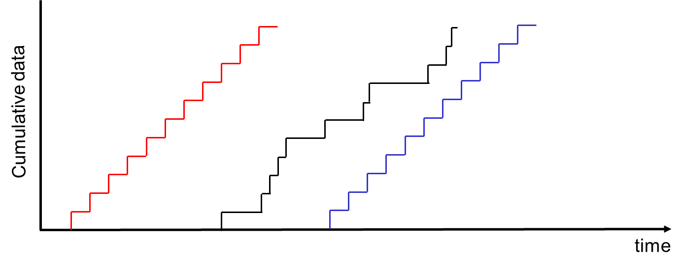
VoIP: fixed playout delay
receiver attempts to playout each chunk exactly q msecs after chunk was generated.
  chunk has time stamp t: play out chunk at t+q
  chunk arrives after t+q: data arrives too late for playout: data “lost”
tradeoff in choosing q:
  large q: less packet loss
  small q: better interactive experience
q

Slide 60
VoIP: fixed playout delay
sender generates packets every 20 msec during talk spurt.
first packet received at time r
first playout schedule: begins at p
second playout schedule: begins at p’

Slide 61
Adaptive playout delay (1)
goal: low playout delay, low late loss rate
approach: adaptive playout delay adjustment:
  estimate network delay, adjust playout delay at beginning of each talk spurt
  silent periods compressed and elongated
  chunks still played out every 20 msec during talk spurt
E.g., adaptively estimate packet delay: Exponentially weighted moving average (EWMA) [recall TCP RTT estimate]:
d_{i} = (1−α)d_{i-1} + α (r_{i} – t_{i})
delay estimate after ith packet
small constant, e.g. 0.1
time received -
time sent (timestamp)
measured delay of ith packet

Slide 62
Adaptive playout delay (2)
also useful to estimate average deviation of delay, v_{i} :
v_{i} = (1−β)v_{i-1} + β |r_{i} – t_{i} – d_{i}|
estimates d_{i}, v_{i} calculated for every received packet, but used only at start of talk spurt
for first packet in talk spurt, playout time is:
remaining packets in talkspurt are played out periodically
playout-time_{i} = t_{i} + d_{i} + Kv_{i}

Slide 63
Adaptive playout delay (3)
Q: How does receiver determine whether packet is first in a talkspurt?
if no loss, receiver looks at successive timestamps
  difference of successive stamps > 20 msec -->talk spurt begins.
with loss possible, receiver must look at both time stamps and sequence numbers
  difference of successive stamps > 20 msec and sequence numbers without gaps --> talk spurt begins.

Slide 64
VoiP: recovery from packet loss (1)
Challenge: recover from packet loss given small tolerable delay between original transmission and playout
each ACK/NAK takes ~ one RTT
alternative: Forward Error Correction (FEC)
  send enough bits to allow recovery without retransmission (recall two-dimensional parity in Ch. 5)
simple FEC
for every group of n chunks, create redundant chunk by exclusive OR-ing n original chunks
send n+1 chunks, increasing bandwidth by factor 1/n
can reconstruct original n chunks if at most one lost chunk from n+1 chunks, with playout delay

Slide 65
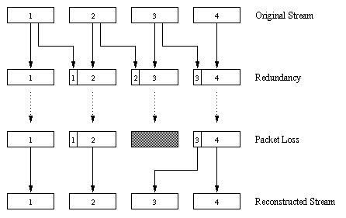
VoiP: recovery from packet loss (2)
another FEC scheme:
“piggyback lower
quality stream”
send lower resolution
audio stream as
redundant information
e.g., nominal
stream PCM at 64 kbps
and redundant stream
GSM at 13 kbps
non-consecutive loss: receiver can conceal loss
generalization: can also append (n-1)st and (n-2)nd low-bit rate
chunk

Slide 66
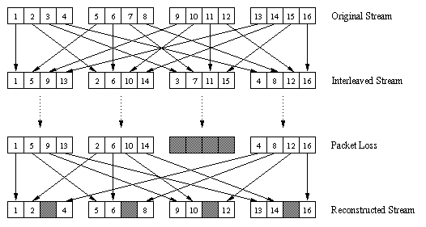
VoiP: recovery from packet loss (3)
interleaving to conceal loss:
audio chunks divided into smaller units; e.g., four 5 msec units per 20 msec audio chunk
packet contains small units from different chunks
if packet lost, still have most of every original chunk
no redundancy overhead, but increases playout delay

Slide 67





Voice-over-IP: Skype
proprietary application-layer protocol (inferred via reverse engineering)
  encrypted msgs
P2P components:
Skype clients (SC)
Skype
login server
supernode (SN)
  clients: Skype peers connect directly to each other for VoIP call
supernode
overlay
network
  super nodes (SN): Skype peers with special functions
  overlay network: among SNs to locate SCs
  login server

Slide 68

P2P voice-over-IP: Skype
Skype client operation:
1. joins Skype network by contacting SN (IP address cached) using TCP
Skype
login server
2. logs-in (username, password) to centralized Skype login server
3. obtains IP address for callee from SN, SN overlay
  or client buddy list
4. initiate call directly to callee

Slide 69


Skype: peers as relays
problem: both Alice, Bob are behind “NATs”
  NAT prevents outside peer from initiating connection to insider peer
  inside peer can initiate connection to outside
relay solution: Alice, Bob maintain open connection
to their SNs
  Alice signals her SN to connect to Bob
  Alice’s SN connects to Bob’s SN
  Bob’s SN connects to Bob over open connection Bob initially initiated to his SN

Slide 70
Multimedia networking: outline
9.1 multimedia networking applications
9.2 streaming stored video
9.3 voice-over-IP
9.4 protocols for real-time conversational applications: RTP, SIP
9.5 network support for multimedia

Slide 71
Real-Time Protocol (RTP)
RTP specifies packet structure for packets carrying audio, video data
RFC 3550
RTP packet provides
  payload type identification
  packet sequence numbering
  time stamping
RTP runs in end systems
RTP packets encapsulated in UDP segments
interoperability: if two VoIP applications run RTP, they may be able to work together

Slide 72
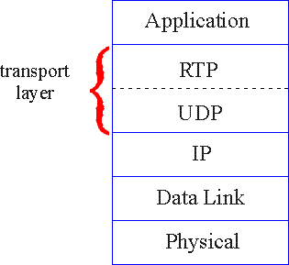
RTP runs on top of UDP
RTP libraries provide transport-layer interface
that extends UDP:
  port numbers, IP addresses
  payload type identification
  packet sequence numbering
  time-stamping

Slide 73
RTP example
example: sending 64 kbps PCM-encoded voice over RTP
application collects encoded data in chunks, e.g., every 20 msec = 160 bytes in a chunk
audio chunk + RTP header form RTP packet, which is encapsulated in UDP segment
RTP header indicates type of audio encoding in each packet
  sender can change encoding during conference
RTP header also contains sequence numbers, timestamps

Slide 74
RTP and QoS
RTP does not provide any mechanism to ensure timely data delivery or other QoS guarantees
RTP encapsulation only seen at end systems (not by intermediate routers)
  routers provide best-effort service, making no special effort to ensure that RTP packets arrive at destination in timely matter

Slide 75
RTP header
payload type
sequence number type
time stamp
Synchronization
Source ID
Miscellaneous fields
payload type (7 bits): indicates type of encoding currently being
used. If sender changes encoding during call, sender
informs receiver via payload type field
sequence # (16 bits): increment by one for each RTP packet sent
  detect packet loss, restore packet sequence
timestamp field (32 bits long): sampling instant of first byte in this RTP data packet (e.g., for audio, timestamp clock increments by one for each sampling period)
SSRC field (32 bits long): identifies source of RTP stream. Each stream in RTP session has distinct SSRC

Slide 76
RTP header
payload type
sequence number type
time stamp
Synchronization
Source ID
Miscellaneous fields
payload type (7 bits): indicates type of encoding currently being
used. If sender changes encoding during call, sender
informs receiver via payload type field
  Payload type 0: PCM mu-law, 64 kbps
  Payload type 3: GSM, 13 kbps
  Payload type 7: LPC, 2.4 kbps
  Payload type 26: Motion JPEG
  Payload type 31: H.261
  Payload type 33: MPEG2 video
sequence # (16 bits): increment by one for each RTP packet sent
  detect packet loss, restore packet sequence

Slide 77
RTP header
payload type
sequence number type
time stamp
Synchronization
Source ID
Miscellaneous fields
timestamp field (32 bits long): sampling instant of first byte in this RTP data packet
  for audio, timestamp clock increments by one for each sampling period (e.g., each 125 usecs for 8 KHz sampling clock)
  if application generates chunks of 160 encoded samples, timestamp increases by 160 for each RTP packet when source is active. Timestamp clock continues to increase at constant rate when source is inactive.
SSRC field (32 bits long): identifies source of RTP stream. Each stream in RTP session has distinct SSRC

Slide 78
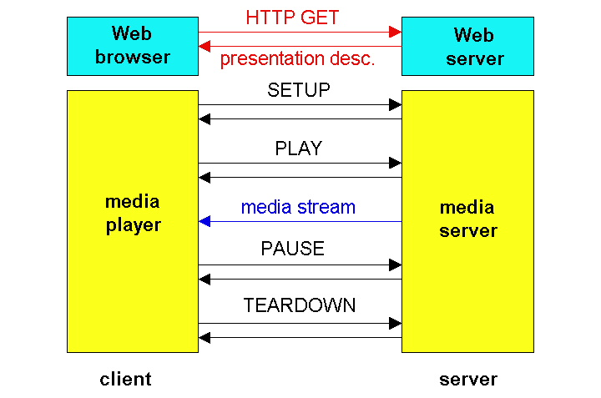
RTSP Operation
Control messages
“out-of-band”
  port 554
Media stream “in-band”.

Slide 79
RTSP/RTP programming assignment
build a server that encapsulates stored video frames into RTP packets
  grab video frame, add RTP headers, create UDP segments, send segments to UDP socket
  include seq numbers and time stamps
  client RTP provided for you
also write client side of RTSP
  issue play/pause commands
  server RTSP provided for you

Slide 80
Real-Time Control Protocol (RTCP)
works in conjunction with RTP
each participant in RTP session periodically sends RTCP control packets to all other participants
each RTCP packet contains sender and/or receiver reports
  report statistics useful to application: # packets sent, # packets lost, interarrival jitter
feedback used to control performance
  sender may modify its transmissions based on feedback

Slide 81


RTCP: multiple multicast senders
E.g., RTCP attempts to limit its traffic to 5% of session bandwidth
sender
RTP
RTCP
receiver report packets:
fraction of packets lost, last sequence number, average interarrival jitter
sender report packets:
SSRC of RTP stream, current time, number of packets sent, number of bytes sent
RTCP
RTCP
receivers
each RTP session: typically a single multicast address; all RTP /RTCP packets belonging to session use multicast address
RTP, RTCP packets distinguished from each other via distinct port numbers
to limit traffic, each participant reduces RTCP traffic as number of conference participants increases

Slide 82
Fairness of UDP Streams (1/2)
Media Client
Media Server
R1
R2
1.5 Mbps
10 Mbps
FTP Server
FTP Client
R1-R2 is the bottleneck link
Streaming uses UDP at the transport layer; requested media encoded at 1 Mbps
What fraction of the bottleneck is available to FTP?
Credit: MSc thesis work by Sean Boyden (2006)

Slide 83
Fairness of RealVideo Streams (2/2)

Slide 84
RTCP: packet types
receiver report packets:
fraction of packets lost, last sequence number, average interarrival jitter
sender report packets:
SSRC of RTP stream, current time, number of packets sent, number of bytes sent
source description packets:
e-mail address of sender, sender's name, SSRC of associated RTP stream
provide mapping between the SSRC and the user/host name

Slide 85
RTCP: stream synchronization
RTCP can synchronize different media streams within a RTP session
e.g., videoconferencing app: each sender generates one RTP stream for video, one for audio.
timestamps in RTP packets tied to the video, audio sampling clocks
  not tied to wall-clock time
each RTCP sender-report packet contains (for most recently generated packet in associated RTP stream):
  timestamp of RTP packet
  wall-clock time for when packet was created
receivers uses association to synchronize playout of audio, video

Slide 86
RTCP: bandwidth scaling
RTCP attempts to limit its traffic to 5% of session bandwidth
example : one sender, sending video at 2 Mbps
RTCP attempts to limit RTCP traffic to 100 Kbps
RTCP gives 75% of rate to receivers; remaining 25% to sender
75 kbps is equally shared among receivers:
  with R receivers, each receiver gets to send RTCP traffic at 75/R kbps.
sender gets to send RTCP traffic at 25 kbps.
participant determines RTCP packet transmission period by calculating avg RTCP packet size (across entire session) and dividing by allocated rate

Slide 87
SIP: Session Initiation Protocol [RFC 3261]
long-term vision:
all telephone calls, video conference calls take place over Internet
people identified by names or e-mail addresses, rather than by phone numbers
can reach callee (if callee so desires), no matter where callee roams, no matter what IP device callee is currently using

Slide 88
SIP services
SIP provides mechanisms for call setup:
  for caller to let callee know she wants to establish a call
  so caller, callee can agree on media type, encoding
  to end call
determine current IP address of callee:
  maps mnemonic identifier to current IP address
call management:
  add new media streams during call
  change encoding during call
  invite others
  transfer, hold calls

Slide 89

Example: setting up call to known IP address
Alice’s SIP invite message indicates her port number, IP address, encoding she prefers to receive (PCM μlaw)
Bob’s 200 OK message indicates his port number, IP address, preferred encoding (GSM)
SIP messages can be sent over TCP or UDP; here sent over RTP/UDP
default SIP port number is 5060

Slide 90
Setting up a call (more)
codec negotiation:
  suppose Bob doesn’t have PCM μlaw encoder
  Bob will instead reply with 606 Not Acceptable Reply, listing his encoders. Alice can then send new INVITE message, advertising different encoder
rejecting a call
  Bob can reject with replies “busy,” “gone,” “payment required,” “forbidden”
media can be sent over RTP or some other protocol

Slide 91
Example of SIP message
INVITE sip:bob@domain.com SIP/2.0
Via: SIP/2.0/UDP 167.180.112.24
From: sip:alice@hereway.com
To: sip:bob@domain.com
Call-ID: a2e3a@pigeon.hereway.com
Content-Type: application/sdp
Content-Length: 885
c=IN IP4 167.180.112.24
m=audio 38060 RTP/AVP 0
Notes:
HTTP message syntax
sdp = session description protocol
Call-ID is unique for every call
Here we don’t know Bob’s IP address
  intermediate SIP
  servers needed
Alice sends, receives SIP messages using SIP default port 506
Alice specifies in header that SIP client sends, receives SIP messages over UDP

Slide 92
Name translation, user location
caller wants to call callee, but only has callee’s name or e-mail address.
need to get IP address of callee’s current host:
  user moves around
  DHCP protocol
  user has different IP devices (PC, smartphone, car device)
result can be based on:
  time of day (work, home)
  caller (don’t want boss to call you at home)
  status of callee (calls sent to voicemail when callee is already talking to someone)

Slide 93
SIP registrar
one function of SIP server: registrar
when Bob starts SIP client, client sends SIP REGISTER message to Bob’s registrar server
register message:
REGISTER sip:domain.com SIP/2.0
Via: SIP/2.0/UDP 193.64.210.89
From: sip:bob@domain.com
To: sip:bob@domain.com
Expires: 3600

Slide 94
SIP proxy
another function of SIP server: proxy
Alice sends invite message to her proxy server
  contains address sip:bob@domain.com
  proxy responsible for routing SIP messages to callee, possibly through multiple proxies
Bob sends response back through same set of SIP proxies
proxy returns Bob’s SIP response message to Alice
  contains Bob’s IP address
SIP proxy analogous to local DNS server plus TCP setup

Slide 95

SIP example: jim@umass.edu calls keith@poly.edu
Poly SIP
registrar
2. UMass proxy forwards request
to Poly registrar server
2
3
3. Poly server returns redirect response,
indicating that it should try keith@eurecom.fr
UMass SIP proxy
4. Umass proxy forwards request
to Eurecom registrar server
Eurecom SIP
registrar
4
7
1. Jim sends INVITE
message to UMass SIP proxy.
6-8. SIP response returned to Jim
5. eurecom registrar forwards INVITE to 197.87.54.21, which is running keith’s SIP client
8
5
6
1
9
128.119.40.186
9. Data flows between clients
197.87.54.21

Slide 96
Comparison with H.323
H.323: another signaling protocol for real-time, interactive multimedia
H.323: complete, vertically integrated suite of protocols for multimedia conferencing: signaling, registration, admission control, transport, codecs
SIP: single component. Works with RTP, but does not mandate it. Can be combined with other protocols, services
H.323 comes from the ITU (telephony)
SIP comes from IETF: borrows much of its concepts from HTTP
  SIP has Web flavor; H.323 has telephony flavor
SIP uses KISS principle: Keep It Simple Stupid

Slide 97
Multimedia networking: outline
9.1 multimedia networking applications
9.2 streaming stored video
9.3 voice-over-IP
9.4 protocols for real-time conversational applications
9.5 network support for multimedia

Slide 98
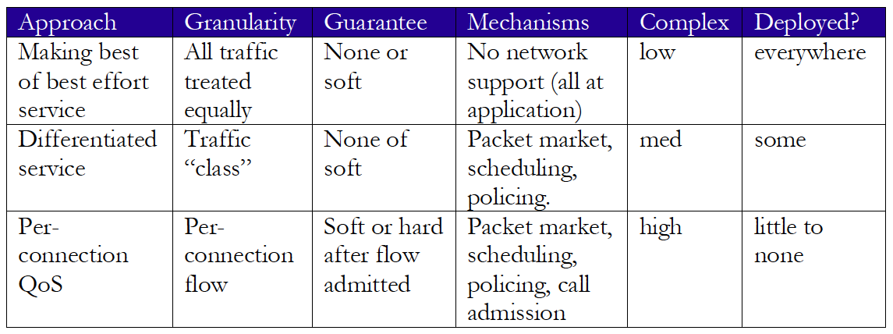
Network support for multimedia

Slide 99
Dimensioning best effort networks
approach: deploy enough link capacity so that congestion doesn’t occur, multimedia traffic flows without delay or loss
  low complexity of network mechanisms (use current “best effort” network)
  high bandwidth costs
challenges:
  network dimensioning: how much bandwidth is “enough?”
  estimating network traffic demand: needed to determine how much bandwidth is “enough” (for that much traffic)

Slide 100

Providing multiple classes of service
thus far: making the best of best effort service
  one-size fits all service model
alternative: multiple classes of service
  partition traffic into classes
  network treats different classes of traffic differently (analogy: VIP service versus regular service)
granularity: differential service among multiple classes, not among individual connections
history: ToS bits
0111

Slide 101


Multiple classes of service: scenario
H1
H3
R1
R2
H4
H2
R1 output
interface
queue
1.5 Mbps link

Slide 102
Scenario 1: mixed HTTP and VoIP
example: 1Mbps VoIP, HTTP share 1.5 Mbps link.
  HTTP bursts can congest router, cause audio loss
  want to give priority to audio over HTTP
R1
R2
Principle 1
packet marking needed for router to distinguish between different classes; and new router policy to treat packets accordingly

Slide 103

Principles for QOS guarantees (more)
what if applications misbehave (VoIP sends higher than declared rate)
  policing: force source adherence to bandwidth allocations
marking, policing at network edge
1 Mbps
phone
R1
R2
1.5 Mbps link
packet marking and policing
Principle 2
provide protection (isolation) for one class from others

Slide 104
Principles for QOS guarantees (more)
allocating fixed (non-sharable) bandwidth to flow: inefficient use of bandwidth if flows doesn’t use its allocation
1 Mbps
phone
1 Mbps logical link
R1
R2
1.5 Mbps link
0.5 Mbps logical link
Principle 3
while providing isolation, it is desirable to use
resources as efficiently as possible

Slide 105
Scheduling and policing mechanisms
packet scheduling: choose next queued packet to send on outgoing link
previously covered in Chapter 4:
  FCFS: first come first served
  simply multi-class priority
  round robin
  weighted fair queueing (WFQ)
packet
arrivals
packet
departures
queue
(waiting area)
link
(server)

Slide 106
Policing mechanisms
goal: limit traffic to not exceed declared parameters
Three common-used criteria:
(long term) average rate: how many pkts can be sent per unit time (in the long run)
  crucial question: what is the interval length: 100 packets per sec or 6000 packets per min have same average!
peak rate: e.g., 6000 pkts per min (ppm) avg.; 1500 ppm peak rate
(max.) burst size: max number of pkts sent consecutively (with no intervening idle)

Slide 107
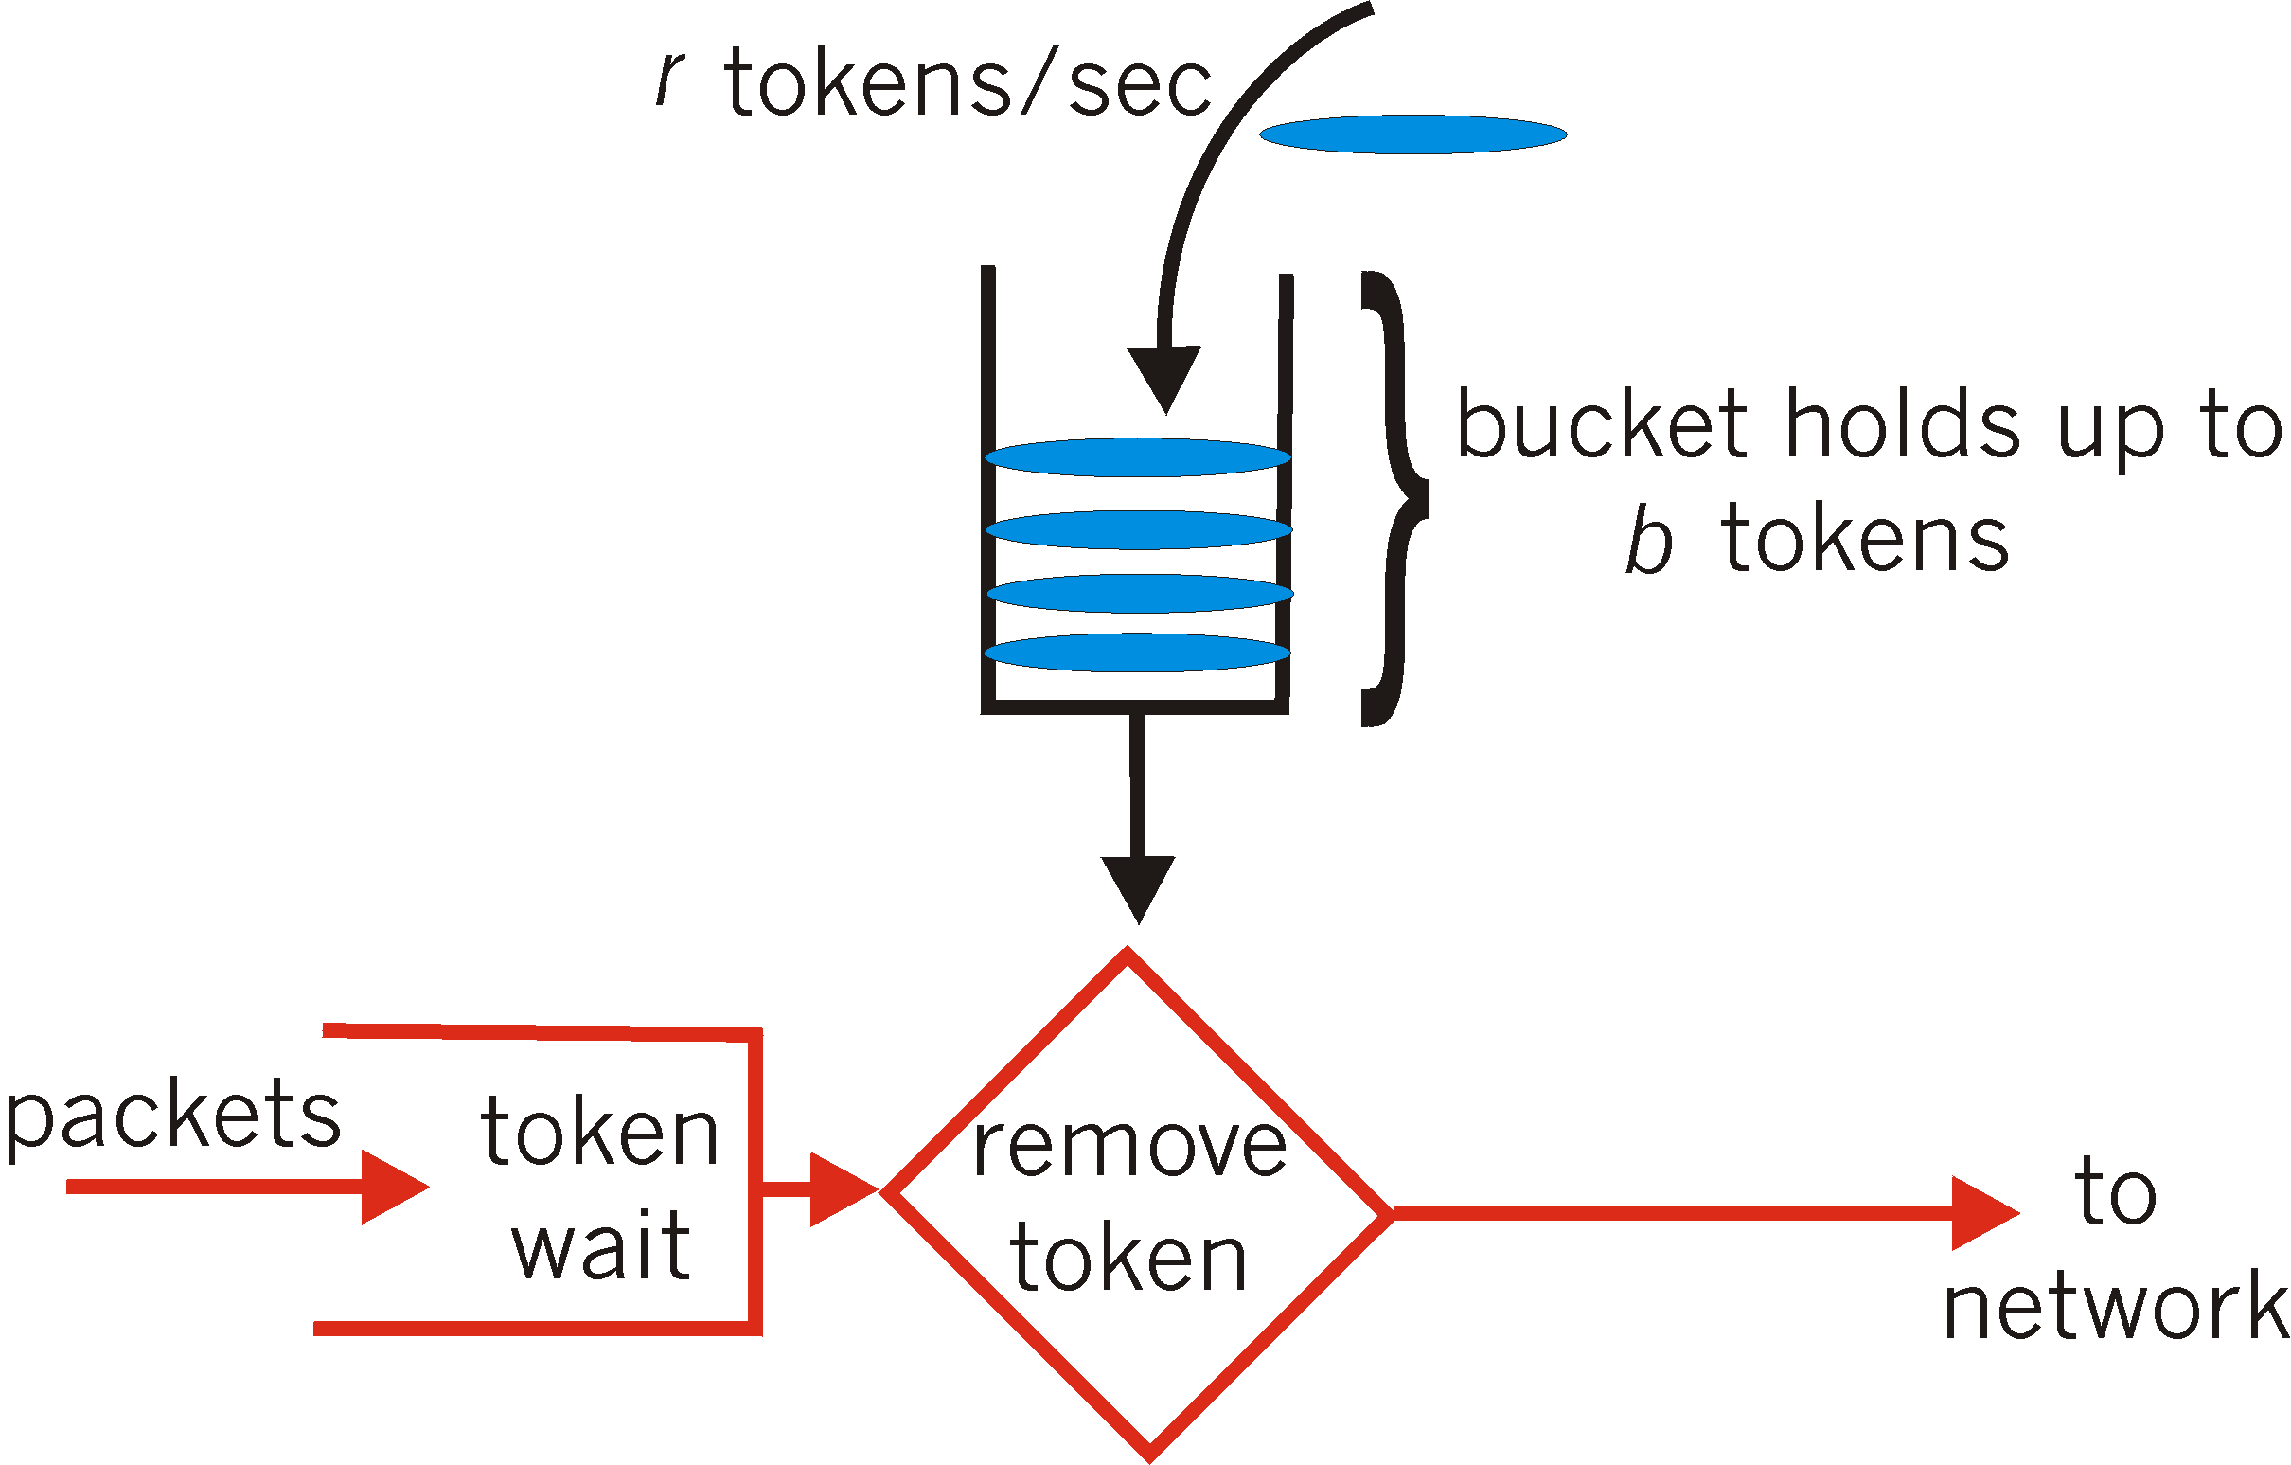
Policing mechanisms: implementation
token bucket: limit input to specified burst size and average rate
bucket can hold b tokens
tokens generated at rate r token/sec unless bucket full
over interval of length t: number of packets admitted less than or equal to (r t + b)

Slide 108
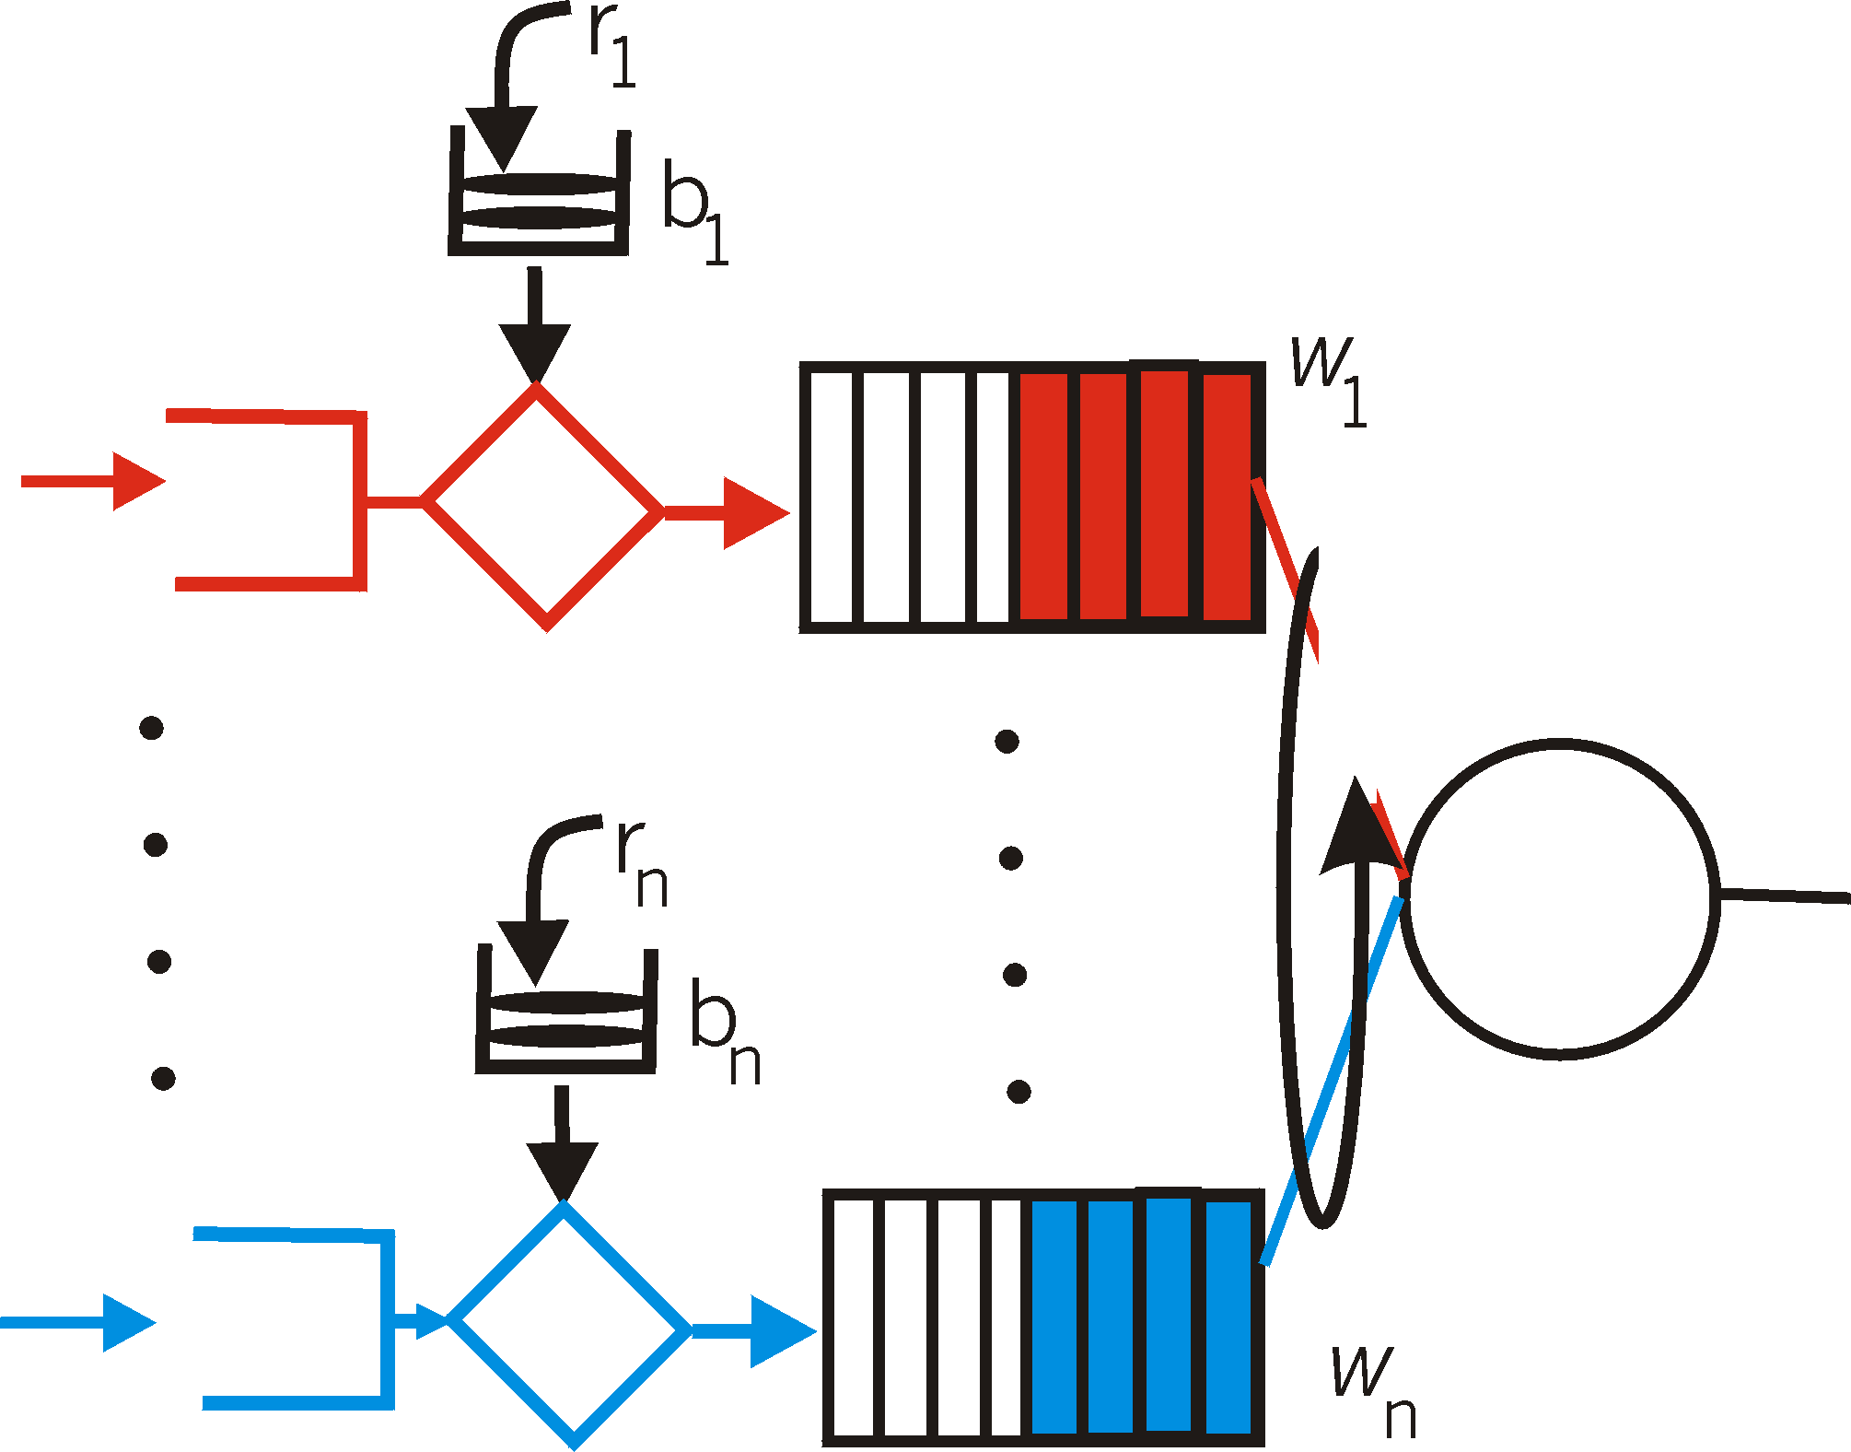
Policing and QoS guarantees
token bucket, WFQ combine to provide guaranteed upper bound on delay, i.e., QoS guarantee!
arriving
traffic
token rate, r
bucket size, b
per-flow
rate, R
WFQ
D = b/R
arriving
traffic
max

Slide 109
Differentiated services
want “qualitative” service classes
  “behaves like a wire”
  relative service distinction: Platinum, Gold, Silver
scalability: simple functions in network core, relatively complex functions at edge routers (or hosts)
  signaling, maintaining per-flow router state difficult with large number of flows
don’t define define service classes, provide functional components to build service classes

Slide 110

Diffserv architecture
marking
r
b
scheduling
edge router:
per-flow traffic management
marks packets as in-profile and out-profile
.
.
.
core router:
per class traffic management
buffering and scheduling based on marking at edge
preference given to in-profile packets over out-of-profile packets

Slide 111
Edge-router packet marking
profile: pre-negotiated rate r, bucket size b
packet marking at edge based on per-flow profile
rate r
b
user packets
possible use of marking:
class-based marking: packets of different classes marked differently
intra-class marking: conforming portion of flow marked differently than non-conforming one

Slide 112
Diffserv packet marking: details
packet is marked in the Type of Service (TOS) in IPv4, and Traffic Class in IPv6
6 bits used for Differentiated Service Code Point (DSCP)
  determine PHB that the packet will receive
  2 bits currently unused
DSCP
unused

Slide 113
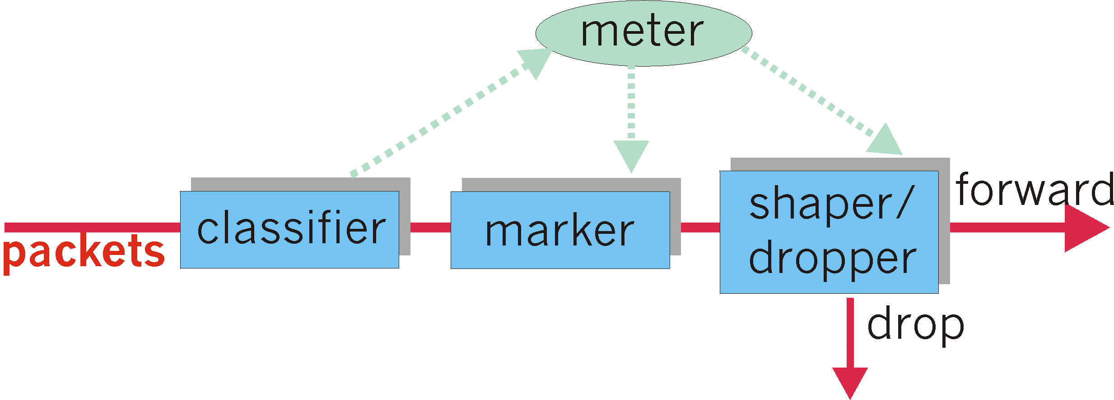
Classification, conditioning
may be desirable to limit traffic injection rate of some class:
user declares traffic profile (e.g., rate, burst size)
traffic metered, shaped if non-conforming

Slide 114
Forwarding Per-hop Behavior (PHB)
PHB result in a different observable (measurable) forwarding performance behavior
PHB does not specify what mechanisms to use to ensure required PHB performance behavior
examples:
  class A gets x% of outgoing link bandwidth over time intervals of a specified length
  class A packets leave first before packets from class B

Slide 115
Forwarding PHB
PHBs proposed:
expedited forwarding: packet departure rate of a class equals or exceeds specified rate
  logical link with a minimum guaranteed rate
assured forwarding: 4 classes of traffic
  each guaranteed minimum amount of bandwidth
  each with three drop preference partitions

Slide 116
Per-connection QOS guarantees
basic fact of life: can not support traffic demands beyond link capacity
1 Mbps
phone
R1
R2
1 Mbps
phone
1.5 Mbps link
Principle 4
call admission: flow declares its needs, network may
block call (e.g., busy signal) if it cannot meet needs

Slide 117

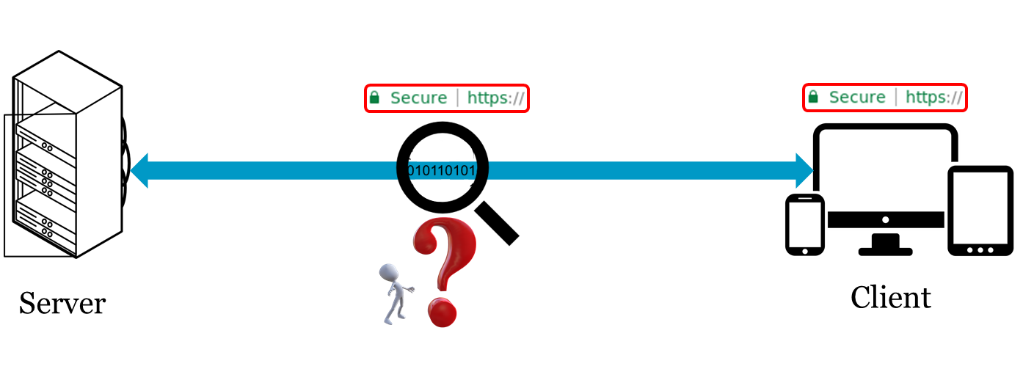
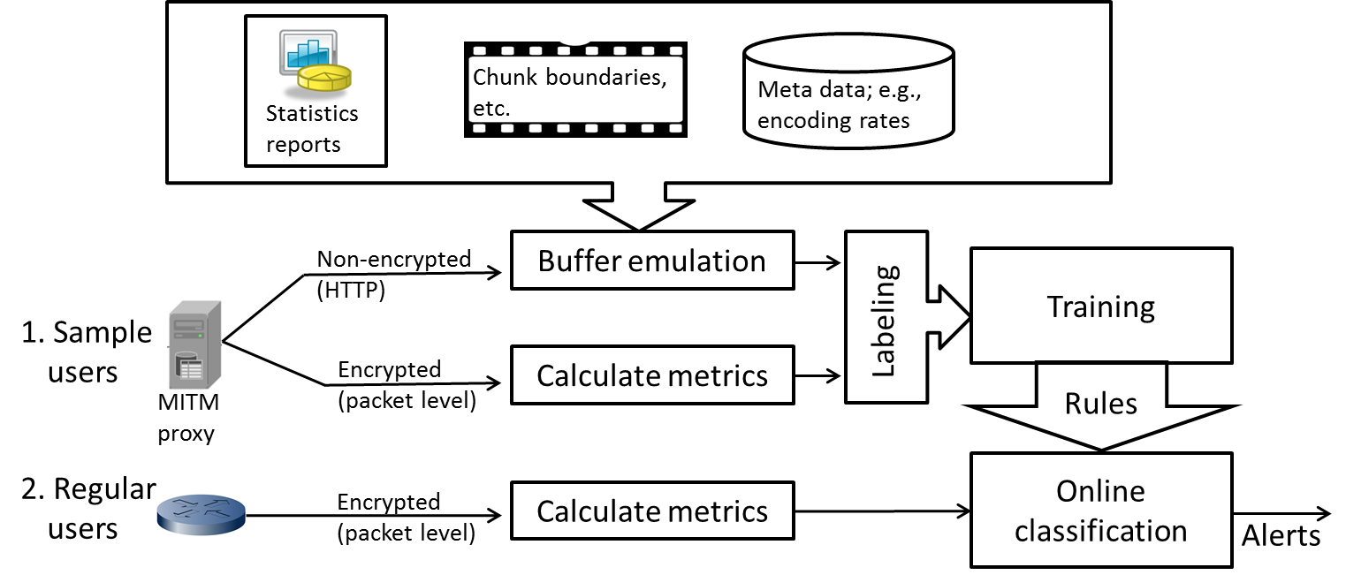
… BUFFEST (per connection discussion)...
ACM MMSys 2017
(Krishnamoorthi et al.)

Slide 118

QoS guarantee scenario
resource reservation
  call setup, signaling (RSVP)
  traffic, QoS declaration
  per-element admission control
request/
reply
  QoS-sensitive scheduling (e.g., WFQ)

Slide 119
Multimedia networking: outline
9.1 multimedia networking applications
9.2 streaming stored video
9.3 voice-over-IP
9.4 protocols for real-time conversational applications
9.5 network support for multimedia

