Slide 1
XML and RDF
Slides based on slides by Lena Strömbäck and Fang Wei-Kleiner

Slide 2
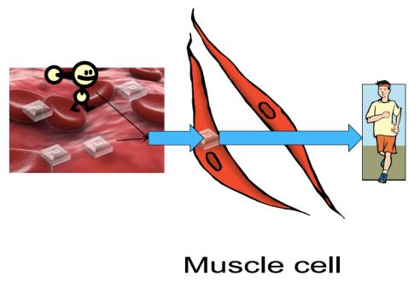
XML motivation example
Describe the transformation process of sugar in the blood
to the energy in muscle cells.

Slide 3
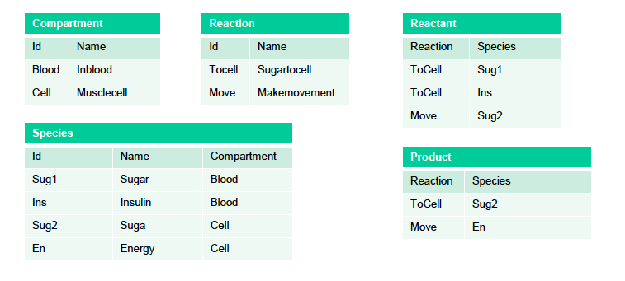
Relational modeling
r

Slide 4
Modeling problem
Far from semi-structured proposal
Not suitable for describing tree structure
Too general or many tables
Static – all attributes typed
All data entries atomic – in principle

Slide 5
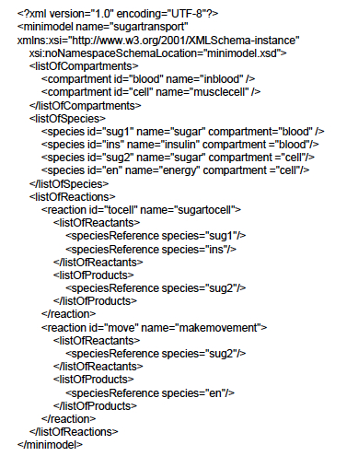
XML representation
Ordered tree
Similar to semi-structured proposal
Extensible
New kinds of data can be integrated
Flexible
Easy to mix different kinds of data

Slide 6
Tag: reaction
Start tag: <reaction>
End tag: </reaction>
Element: <reaction>…</reaction>
Elements can be nested
Attribute: <reaction id= “tocell”
Namespaces allow external schemas and qualified names
Xmlns:xsi=“…

Slide 7
Defining the XML model: DTD
A Document Type Definition (DTD) defines the legal building blocks of an XML document.
It defines the document structure with a list of legal elements and attributes.
In the DTD all XML documents are one of:
Elements
Attributes
Entities
PCDATA – parsed character data
CDATA – character data

Slide 8
DTD example
<!DOCTYPE bibliography [
<!ELEMENT bibliography (book+)>
<!ELEMENT book (title, author*, publisher?, year?, section*)>
<!ATTLIST book ISBN CDATA #REQUIRED>
<!ATTLIST book price CDATA #IMPLIED>
<!ELEMENT title (#PCDATA)>
<!ELEMENT author (#PCDATA)>
<!ELEMENT publisher (#PCDATA)>
<!ELEMENT year (#PCDATA)>
<!ELEMENT i (#PCDATA)>
<!ELEMENT content (#PCDATA|i)*>
<!ELEMENT section (title, content?, section*)>
]>
+: 1+ *: 0+, ?: 0 or 1
#IMPLIED : optional

Slide 9
XML Schema
The XML Schema defines the legal building blocks of an XML document.
An XML Schema:
defines elements
defines attributes
defines which elements are child elements
defines the order of child elements
defines the number of child elements
defines data types for elements and attributes
defines default and fixed values for elements and attributes

Slide 10
DTD vs XML Schema
Data
<note> <to>Tove</to> <from>Jani</from> <heading>Reminder</heading> <body>Don't forget me this weekend!</body> </note>
DTD
<!ELEMENT note (to, from, heading, body)> <!ELEMENT to (#PCDATA)> <!ELEMENT from (#PCDATA)> <!ELEMENT heading (#PCDATA)> <!ELEMENT body (#PCDATA)>

Slide 11
DTD vs XML Schema
XML Schema
<?xml version="1.0"?> <xs:schema xmlns:xs="http://www.w3.org/2001/XMLSchema" targetNamespace="http://www.w3schools.com" xmlns="http://www.w3schools.com" elementFormDefault="qualified"> <xs:element name="note"> <xs:complexType> <xs:sequence> <xs:element name="to" type="xs:string"/> <xs:element name="from" type="xs:string"/> <xs:element name="heading" type="xs:string"/> <xs:element name="body" type="xs:string"/> </xs:sequence> </xs:complexType> </xs:element> </xs:schema>

Slide 12
XML Schema vs. DTD
XML Schemas are extensible to future additions
extend element definitions
XML Schemas are richer and more powerful than DTDs
XML Schemas are written in XML
XML Schemas support data types
XML Schemas support namespaces

Slide 13
Why use DTD or XML Schema?
Benefits of not using them
Unstructured data is easy to represent
Overhead of validation is avoided
Benefits of using them
Serve as schema for the XML data
Guards against errors
Helps with processing
Facilitate information exchange
People can agree to use a common DTD or XML Schema to exchange data (e.g., XHTML)

Slide 14
RDF: Resource Description Framework
Framework for describing resources on the web
Designed to be read and understood by computers
Not designed for being displayed to people
Written in XML
RDF is a W3C Recommendation

Slide 15
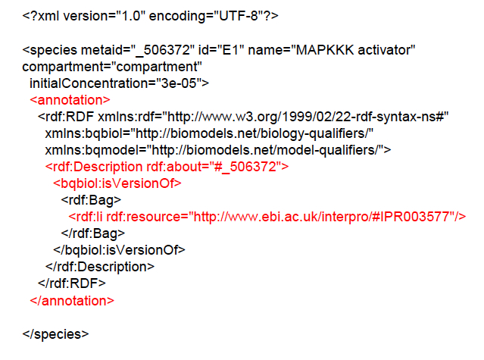
RDF example

Slide 16
RDF data model: triples
A Resource is anything that can have a URI, such as our molecule "_506372 ”
A Property is a Resource that has a name, such as “isVersionof"
A Property value is the value of a Property, such as "IPR003577 "
(note that a property value can be another resource)
Suitable for semi-structured data.

Slide 17
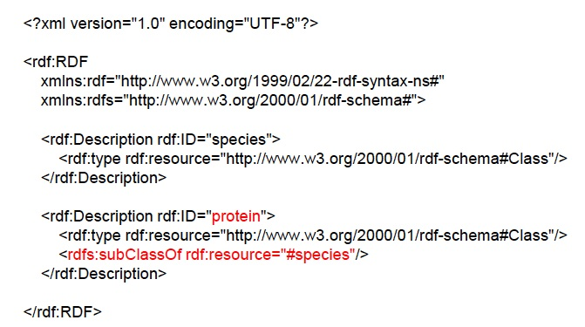
RDF Schema
Define relations between objects

Slide 18
Query languages for XML
XPath
Path expressions with conditions
Building block of other standards (e.g. XQuery)
XQuery
XPath + full-fledged SQL-like query language

Slide 19
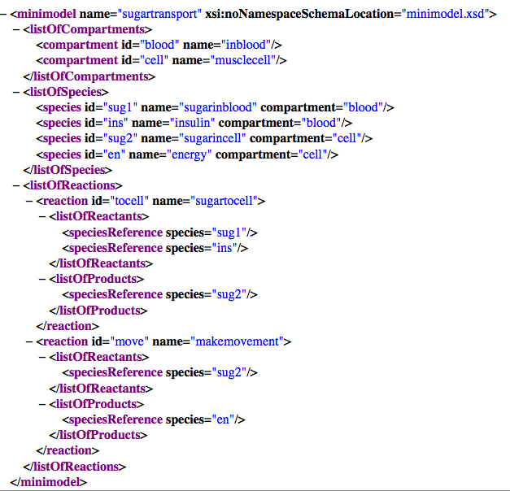

Slide 20
XPath
XPath specifies path expressions that match XML data by navigating down (and occasionally up and across) the tree
Example
Query: /minimodel/listOfReactions/reaction
Like a UNIX path
Result: all reaction elements reachable from root via the path

Slide 21
Basic Xpath constructs
/ separator between steps in a path
name matches any child element with this tag name
* matches any child element
@name matches the attribute with this name
@* matches any attribute
// matches any descendent element or the current element itself
. matches the current element
.. matches the parent element

Slide 22
Simple XPath examples
All reactions
/minimodel/listOfReactions/reaction
All reaction names
/minimodel/listOfReactions/reaction/@name
All reaction elements, anywhere in the document
//reaction
All species id, anywhere in the document
//species/@id
Species of the minimodel
/minimodel/*/species

Slide 23
Predicates in path expressions
[condition] matches the “current” element if condition evaluates to true on the current element
Species in blood compartment
/minimodel//species[@compartment=“blood”]
Reactions with listOfProducts as child element
//reaction[listOfProducts]
Name of species in blood compartment
/minimodel//species[@compartment="blood"]/@name

Slide 24
Predicates
Predicates can have and ’s and or ’s
Species with id as ‘en’ and compartment as ‘cell’
//species[@id="en" and @compartment="cell"]
Species with id as ‘en’ or compartment as ‘cell’
//species[@id=‘en’ or @compartment=‘cell’]

Slide 25
Predicates involving nodesets
/minimodel/listOfSpecies [species/@compartment="cell"]
There may be multiple species element, so species/@compartment in general returns a node-set (in XPath terminology)
The predicate evaluates to true as long as it evaluates true for at least one node in the node-set, i.e., at least one species has a compartment with value “cell”
Tricky query
/minimodel/listOfSpecies [species/@compartment=‘cell’ and
species/@compartment !=‘cell’]

Slide 26
XPath functions
contains(x, y) true if string x contains string y
count(node-set) counts the number nodes in node-set
position() returns the context position (roughly, the position of the current node in the node-set containing it)
last() returns the “context size” (roughly, the size of the node-set containing the current node)
name() returns the tag name of the current element

Slide 27
More examples
All elements whose tag names contain “species”
//*[contains(name(), “species”)]
Name of the first species
/minimodel/listOfSpecies/species[position()=1]/@name
A shorthand: /minimodel/listOfSpecies/species[1]/@name
Name of the last species
/minimodel/listOfSpecies/species[position()=last()]/@name
Lists with fewer than 10 species
/minimodel/listOfSpecies [count(species)<10]
All elements whose parent’s tag name is not “reaction”
//*[name()!=‘reaction’]/*

Slide 28
General XPath location steps
Technically, each XPath query consists of a series of location steps separated by /
Each location step consists of
An axis: one of self, attribute, parent, child, ancestor, ancestor-or-self, descendant, descendant-or-self, following, following-sibling, preceding, preceding-sibling, and namespace
A node-test: either a name test (e.g., reaction, *) or a type test (e.g., text(), node(), comment()), separated from the axis by ::
Zero of more predicates (or conditions) enclosed in square brackets

Slide 29
Example
Verbose (axis, node test, predicate):
/child::minimodel/descendant-or-self::node()/child::species[attribute::id=“sug1”]
Abbreviated:
/minimodel//species[@id=‘sug1’]
child is the default axis
// stands for /descendant-or-self::node()/

Slide 30
Example
Which of the following queries correctly find the third speciesReferences in the entire input document?
//speciesReference [position()=3]
Finds all third speciesReferences (for each of its parent element)
/descendant-or-self::node()[name()=“speciesReference” and position()=3]
Returns the third element in the document if it is a speciesReferences
/descendant-or-self::node()[name()=“speciesReference”][position()=3]
After the first condition is passed, the evaluation context changes
Context size: # of nodes that passed the first condition
Context position: position of the context node within the list of nodes

Slide 31
XQuery
XPath + full-fledged SQL-like query language
XQuery expressions can be
XPath expressions
FLWOR expressions
Quantified expressions
Aggregation, sorting, and more…
An XQuery expression in general can return a new result XML document
Compare with an XPath expression, which always returns a sequence of nodes from the input document or atomic values (boolean, number, string, etc.)

Slide 32
FLWOR expression
<result>{
for $s in doc(“minimodel.xml”)/minimodel//species
let $n := $s/@name
where $s/@compartment = ‘cell’
return
<cellspecies>
{ $s/@id }
{ $n }
</cellspecies>
}</result>
for: loop
let: assignment
where: filter condition
order by
return: result construction

Slide 33
FLWOR expression
data function accepts a sequence of items and returns their typed values

Slide 35
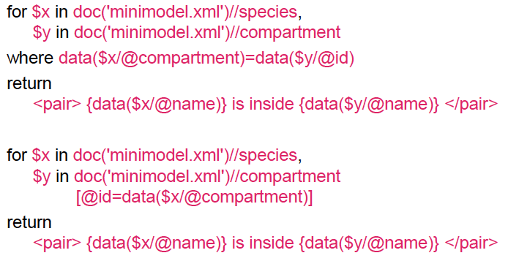
Join in XQuery

Slide 36
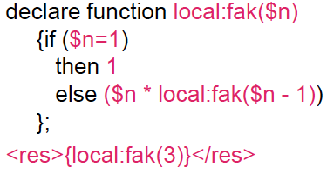
XQuery functions
Note: factorial（recursion）

