Slide 1
RDF & Linked Data
TDDD43 – Advanced Data Models and Databases
Sebastián Ferrada
sebastian.ferrada@liu.se
Based on previous slides by Olaf Hartig

Slide 2
RDF

Slide 3
RDF – Resource Description Framework
Triples!
Subject | Predicate | Object
Chile | hasCapital | Santiago
Santiago | partOf | Chile
Santiago | population | 6,811,595

Slide 4
RDF – Resource Description Framework
Which of these are Resources?
Chile and Santiago
Subject | Predicate | Object
Chile | hasCapital | Santiago
Santiago | partOf | Chile
Santiago | population | 6,811,595

Slide 5
Resources
Resources can be nearly anything: People, places, objects, abstract concepts
RDF helps us to describe these resources through attributes and relationships

Slide 6
Triples
Subject | Predicate | Object
Chile | hasCapital | Santiago
Santiago | partOf | Chile
Santiago | population | 6,811,595
Subjects are always Resources
Predicates are always Properties
Objects are Resources or Literals

Slide 7
Graphs
A set of RDF triples is called an RDF graph, because we interpret each triple as a directed edge between two nodes
(Chile, hasCapital, Santiago)
(Santiago, population, 6811595)
Chile
hasCapital
Santiago
population
6811595

Slide 8
URI – Uniform Resource Identifier
RDF aims to describe resources on the Web
To reference a resource, we use URIs which are globally unique
URIs not only identify Web documents:
me: http://sferrada.com/rdf/foaf.ttl#me
RDF document about me: http://sferrada.com/rdf/foaf.ttl
HTML document about me: http://sferrada.com/index.html

Slide 9
URIs
Subject | Predicate | Object
Chile | hasCapital | Santiago
Santiago | partOf | Chile
Santiago | population | 6,811,595

Slide 10
URIs
Subject | Predicate | Object
http://example.org/Chile | http://example.org/hasCapital | http://example.org/Santiago
http://example.org/Santiago | http://example.org/partOf | http://example.org/Chile
http://example.org/Santiago | http://example.org/population | 6,811,595

Slide 11
URIs – Prefix Names
Subject | Predicate | Object
ex:Chile | ex:hasCapital | ex:Santiago
ex:Santiago | ex:partOf | ex:Chile
ex:Santiago | ex:population | 6,811,595
ex: is used instead of http://example.org/

Slide 12
Literals
Represented with strings + optional datatypes
Usually, we use XML Schema datatypes
No datatype implies xsd:string
Can include language tags
ex:Santiago
ex:population
“6811595”^^xsd:integer
ex:name
ex:name
“Santiago de Chile”@es
“Santiago of Chile”@en

Slide 13
Syntax
There are many ways to write RDF data. They are called syntaxes.
Examples:
Turtle
NTriples
RDF/XML
RDFa
JSON-LD

Slide 14
Turtle – A human readable syntax
In its most basic form, each element of the triple is separated with a whitespace, and the triples are separated with periods (.)
http://example.org/Chile http://example.org/capital http://example.org/Santiago .
http://example.org/Santiago http://example.org/population “6811595”^^xsd:integer .
http://example.org/Santiago http://example.org/name “Santiago de Chile”@es .
http://example.org/Santiago http://example.org/name “Santiago of Chile”@en .

Slide 15
Turtle – Prefix Names
Using the tag @prefix allows the definition of namespaces to abbreviate the notation
@prefix ex:<http://example.org/> .
ex:Chile ex:capital ex:Santiago .
ex:Santiago ex:population “6811595”^^xsd:integer .
ex:Santiago ex:name “Santiago de Chile”@es .
ex:Santiago ex:name “Santiago of Chile”@en .

Slide 16
Turtle – Syntactic Sugar
Turtle allows us to “reuse” subjects and predicates using semicolons (;) and commas (,)
@prefix ex:<http://example.org/> .
ex:Chile ex:capital ex:Santiago .
ex:Santiago ex:population “6811595”^^xsd:integer ;
ex:name “Santiago de Chile”@es ,
“Santiago of Chile”@en .

Slide 17
Turtle – Implicit Datatypes
For numeric literals, turtle allows to omit the datatype tags
@prefix ex:<http://example.org/> .
ex:Chile ex:capital ex:Santiago .
ex:Santiago ex:population 6811595 ;
ex:name “Santiago de Chile”@es ,
“Santiago of Chile”@en .

Slide 18
Turtle – rdf:type
We can use “a” as a shorthand for the class relationship
@prefix ex:<http://example.org/> .
ex:Chile a ex:Country
ex:Chile ex:capital ex:Santiago .
ex:Santiago a ex:City ;
ex:population 6811595 ;
ex:name “Santiago de Chile”@es ,
“Santiago of Chile”@en .

Slide 19
NTriples
Like turtle, but one triple per line, no syntax sugars, nor URI namespaces
<http://example.org/Chile> <http://example.org/capital> <http://example.org/Santiago> .
<http://example.org/Santiago> <http://example.org/population> “6811595”^^<http://www.w3.org/2001/XMLSchema#integer>.
<http://example.org/Santiago> <http://example.org/name> “Santiago de Chile”@es .
<http://example.org/Santiago> <http://example.org/name> “Santiago of Chile”@en .

Slide 20
RDF/XML
RDF triples in XML
<rdf:RDF xmlns:rdf="http://www.w3.org/1999/02/22-rdf-syntax-ns#"
xmlns:ex="http://example.org/">
<rdf:Description rdf:about="http://example.org/Santiago">
<ex:population rdf:datatype="http://www.w3.org/2001/XMLSchema#integer">
6811565
</ex:population>
...
</rdf:Description>
</rdf:RDF>

Slide 21
RDFa
RDF inside HTML documents
<div xmlns="http://www.w3.org/1999/xhtml"
prefix="ex: http://example.org/
xsd: http://www.w3.org/2001/XMLSchema#" >
<div about="http://example.org/Santiago">
<div property="ex:population" datatype="xsd:integer”>6811565</div>
...
</div>
</div>

Slide 22
JSON-LD
JSON notation + context file
{
“@context”: “http://example.org/context.jsonld”,
“@id”: “http://example.org/Santiago”,
“population”: 6811595,
“name”: “Santiago de Chile”,
“partOf”: {
“@id”: “http://example.org/Chile”
}
}
{
“@context”: {
“population”: “http://example.org/population”,
“name”: “http://example.org/name”,
“partOf”: “http://example.org/partOf”
}
}

Slide 23
SPARQL

Slide 24
SPARQL
Recursive acronym for the SPARQL Protocol And RDF Query Language
Consists in a protocol, an update language and a query language
We will focus only on the query part today

Slide 25
SPARQL – Triple Pattern
A triple pattern is a triple (s, p, o) that can have variables, URIs, Literals and Blank nodes
The idea is to match the data with the pattern, and bind the matching elements from the data to the variables
?c
rdf:type
ex:Country

Slide 26
SPARQL – Triple Pattern
@prefix ex:<http://example.org/> .
ex:Chile a ex:Country
ex:Chile ex:capital ex:Santiago .
ex:Santiago a ex:City ;
ex:population 6811595 ;
ex:name “Santiago de Chile”@es ,
“Santiago of Chile”@en .

Slide 27
SPARQL – Triple Pattern
ex:Chile
rdf:type
ex:Country
?c
rdf:type
ex:Country
ex:capital
Query
ex:Santiago
rdf:type
ex:City
ex:population
6811595
ex:name
ex:name
“Santiago de Chile”@es
?c
ex:Chile
“Santiago of Chile”@en
Data

Slide 28
SPARQL – Triple Pattern
ex:Chile
rdf:type
ex:Country
ex:Santiago
?n
ex:name
ex:capital
Query
ex:Santiago
rdf:type
ex:City
ex:population
6811595
ex:name
ex:name
“Santiago de Chile”@es
?n
“Santiago de Chile”@es
“Santiago of Chile”@en
“Santiago of Chile”@en
Data

Slide 29
SPARQL – Triple Pattern
ex:Chile
rdf:type
ex:Country
ex:Santiago
?v
?p
ex:capital
Query
ex:Santiago
rdf:type
ex:City
ex:population
6811595
?p | ?v
rdf:type | ex:City
ex:population | 6811595
ex:name | “Santiago de Chile”@es
ex:name | “Santiago of Chile”@en
ex:name
ex:name
“Santiago de Chile”@es
“Santiago of Chile”@en
Data

Slide 30
SPARQL – Basic Graph Pattern
Basic Graph Patterns are sets of Triple patterns
?cn
rdf:type
ex:Country
ex:capital
?ct

Slide 31
SPARQL – Basic Graph Pattern
Basic Graph Patterns are sets of Triple patterns
?cn
rdf:type
ex:Country
?ct
rdf:type
ex:City

Slide 32
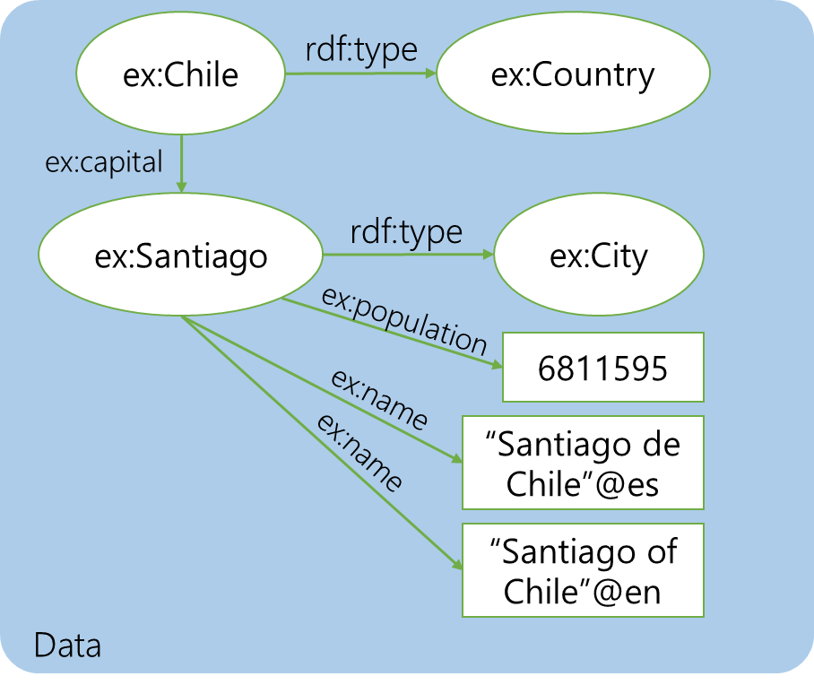
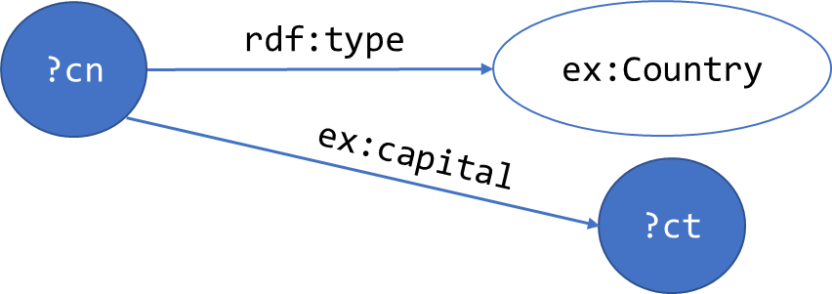
SPARQL – Basic Graph Patterns
Query
?cn | ?ct
ex:Chile | ex:Santiago

Slide 33
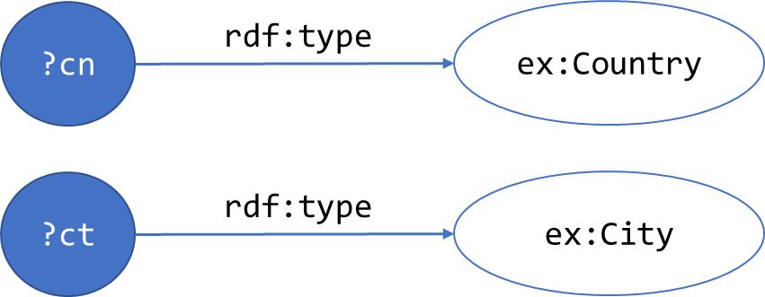
SPARQL – Basic Graph Patterns
Query
?cn | ?ct
ex:Chile | ex:Santiago

Slide 34
SPARQL – Basic Graph Patterns
What happens with the results if we add this triple to the data?
ex:Sweden
rdf:type
ex:Country

Slide 35
SPARQL – Basic Graph Patterns
Query
?cn | ?ct
ex:Chile | ex:Santiago
ex:Sweden | ex:Santiago

Slide 36
SPARQL – Syntax
Ok, but how do we write queries?
Becomes:
PREFIX ex:<http://example.org>
SELECT ?cn ?ct WHERE {
?cn a ex:Country .
?cn ex:capital ?ct .
}

Slide 37
SPARQL - Syntax
PREFIX ex:<http://example.org>
SELECT ?cn ?ct
WHERE {
?cn a ex:Country .
?cn ex:capital ?ct .
}
Prologue: namespace definitions for abbreviated URIs
Result form specification: Select for projection (like in R.A.)
Query Pattern: WHERE clause specifies the graph pattern to be matched

Slide 38
SPARQL – Syntax
Query patterns allow for turtle syntax:
PREFIX ex:<http://example.org>
SELECT ?cn ?ct WHERE {
?cn a ex:Country ;
ex:capital ?ct .
}

Slide 39
SPARQL – FROM
It is possible to have different graphs in the same dataset
To choose just one of them, you can use the FROM clause
PREFIX ex:<http://example.org>
FROM <http://example.org/countries>
SELECT ?cn ?ct WHERE {
?cn a ex:Country ;
ex:capital ?ct .
}

Slide 40
SPARQL – Optional
Obtain all countries in the dataset:
PREFIX ex:<http://example.org>
SELECT ?c WHERE {
?c a ex:Country .
}
?c
ex:Chile
ex:Sweden

Slide 41
SPARQL – Optional
Obtain all countries and their capitals
PREFIX ex:<http://example.org>
SELECT ?c WHERE {
?cn a ex:Country ;
ex:capital ?ct .
}
What happened with Sweden?
?cn | ?ct
ex:Chile | ex:Santiago

Slide 42
SPARQL – Optional
Obtain all countries and their capitals
PREFIX ex:<http://example.org>
SELECT ?c WHERE {
?cn a ex:Country ;
OPTIONAL {
?cn ex:capital ?ct .
}
}
Might produce unbound variables
?cn | ?ct
ex:Chile | ex:Santiago
ex:Sweden

Slide 43
SPARQL – Filter
To impose conditions over the results of the query, you can use the FILTER function inside the WHERE clause
For instance, to obtain cities with populations larger than 2 million people
Also useful to filter labels in a given language, and to apply string functions like STARTSWITH or CONTAINS

Slide 44
SPARQL – Filter Constraints
Unary operators:
Operator | Type of A | Result Type
!A | xsd:boolean | xsd:boolean
+A | Numeric | Numeric
-A | Numeric | Numeric
BOUND(A) | variable | xsd:boolean
isURI(A) | RDF Term | xsd:boolean
isBLANK(A) | RDF Term | xsd:boolean
isLITERAL(A) | RDF Term | xsd:boolean
STR(A) | Literal or URI | Simple Literal
LANG(A) | Literal | Simple Literal
DATATYPE(A) | Literal | Simple Literal

Slide 45
SPARQL – Filter Constraints
Binary and other operators:
Description | Operators | Domain
Logical Connectives | && and || | xsd:boolean
Comparison | =, !=, >, <, >= and <= | Numeric, dates, strings, etc.
Arithmetic | +, -, *, and / | Numeric
Regular Expressions | REGEX(string, pattern) | String
String Functions | CONTAINS(A,B), STARTSWITH(A, B), ENDSWITH(A, B), etc. | String

Slide 46
SPARQL - Filter
Cities with more than 2 million people:
SELECT ?city WHERE {
?city ex:population ?pop .
FILTER (?pop > 2000000)
}
?city
ex:Santiago

Slide 47
SPARQL – Filter
The names in English of the cities:
SELECT ?name WHERE {
?city ex:name ?name .
FILTER( LANG(?name)=‘en’ )
}
?name
“Santiago of Chile”@en

Slide 48
SPARQL – Solution Modifiers
Operations that modify the result set as a whole, like sorting and pagination
Keywords: ORDER BY, DISTINCT, LIMIT and OFFSET
PREFIX ex:<http://example.org>
SELECT ?c WHERE {
?c a ex:Country ;
ex:name ?name ;
}
ORDER BY ?name

Slide 49
SPARQL 1.1
New features:
Aggregation:
Aggregated functions: COUNT, SUM, AVG, MIN, MAX
Grouping: GROUP BY
Conditions over aggregated values: HAVING
SELECT (COUNT(?country) AS ?c) WHERE {
?country ex:continent ?continent .
}
GROUP BY ?continent
HAVING COUNT(?country) > 10

Slide 50
SPARQL 1.1
Nested queries
Negation operators:
[NOT] EXISTS
MINUS
Assignment:
BIND, VALUES
Basic Federation:
SERVICE

Slide 51
SPARQL 1.1
Property paths (à la XPath)
ex:X
ex:A
ex:p
ex:p
ex:B
ex:q
ex:C
ex:p
ex:D
ex:q
ex:E
ex:q
ex:F

Slide 52
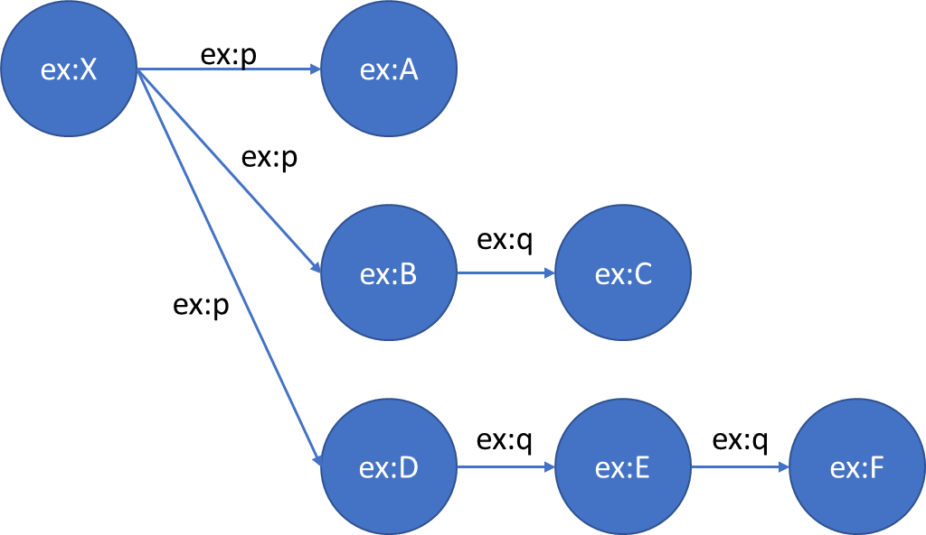
SPARQL 1.1
Obtain the nodes that are connected by ex:p and 0 or more occurrences of ex:q
SELECT ?n WHERE {
ex:X ex:p/ex:q* ?n
}
Path concatenation
0 or more times

Slide 53
SPARQL 1.1
Obtain the nodes that are connected by ex:p and 0 or more occurrences of ex:q
SELECT ?n WHERE {
ex:X ex:p/ex:q* ?n
}
?n
ex:A
ex:B
ex:C
ex:D
ex:E
ex:F

Slide 54
SPARQL 1.1
Obtain the nodes that are connected by ex:p and 1 or more occurrences of ex:q
SELECT ?n WHERE {
ex:X ex:p/ex:q+ ?n
}
Path concatenation
1 or more times

Slide 55
SPARQL 1.1
Obtain the nodes that are connected by ex:p and 0 or more occurrences of ex:q
SELECT ?n WHERE {
ex:X ex:p/ex:q+ ?n
}
?n
ex:C
ex:E
ex:F

Slide 56
Linked Data

Slide 57
Linked Data
The goal is to publish structured data on the WWW in a standardized, machine-readable manner

Slide 58
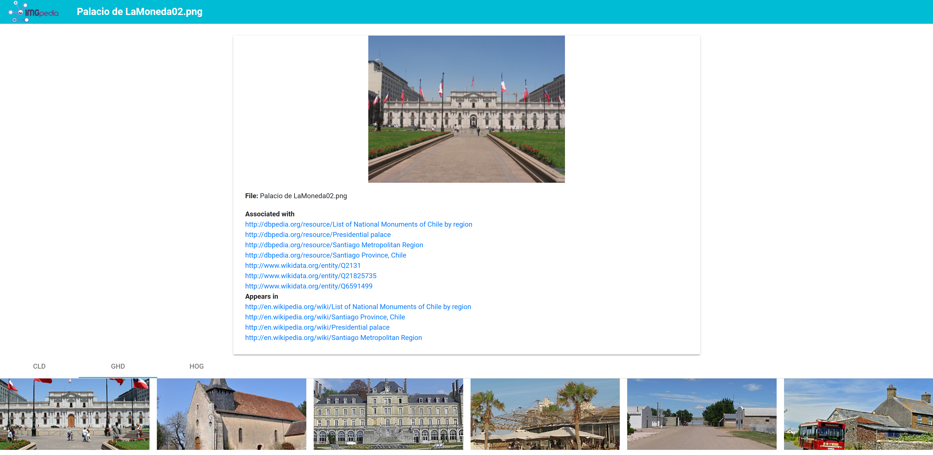
Linked Data

Slide 59
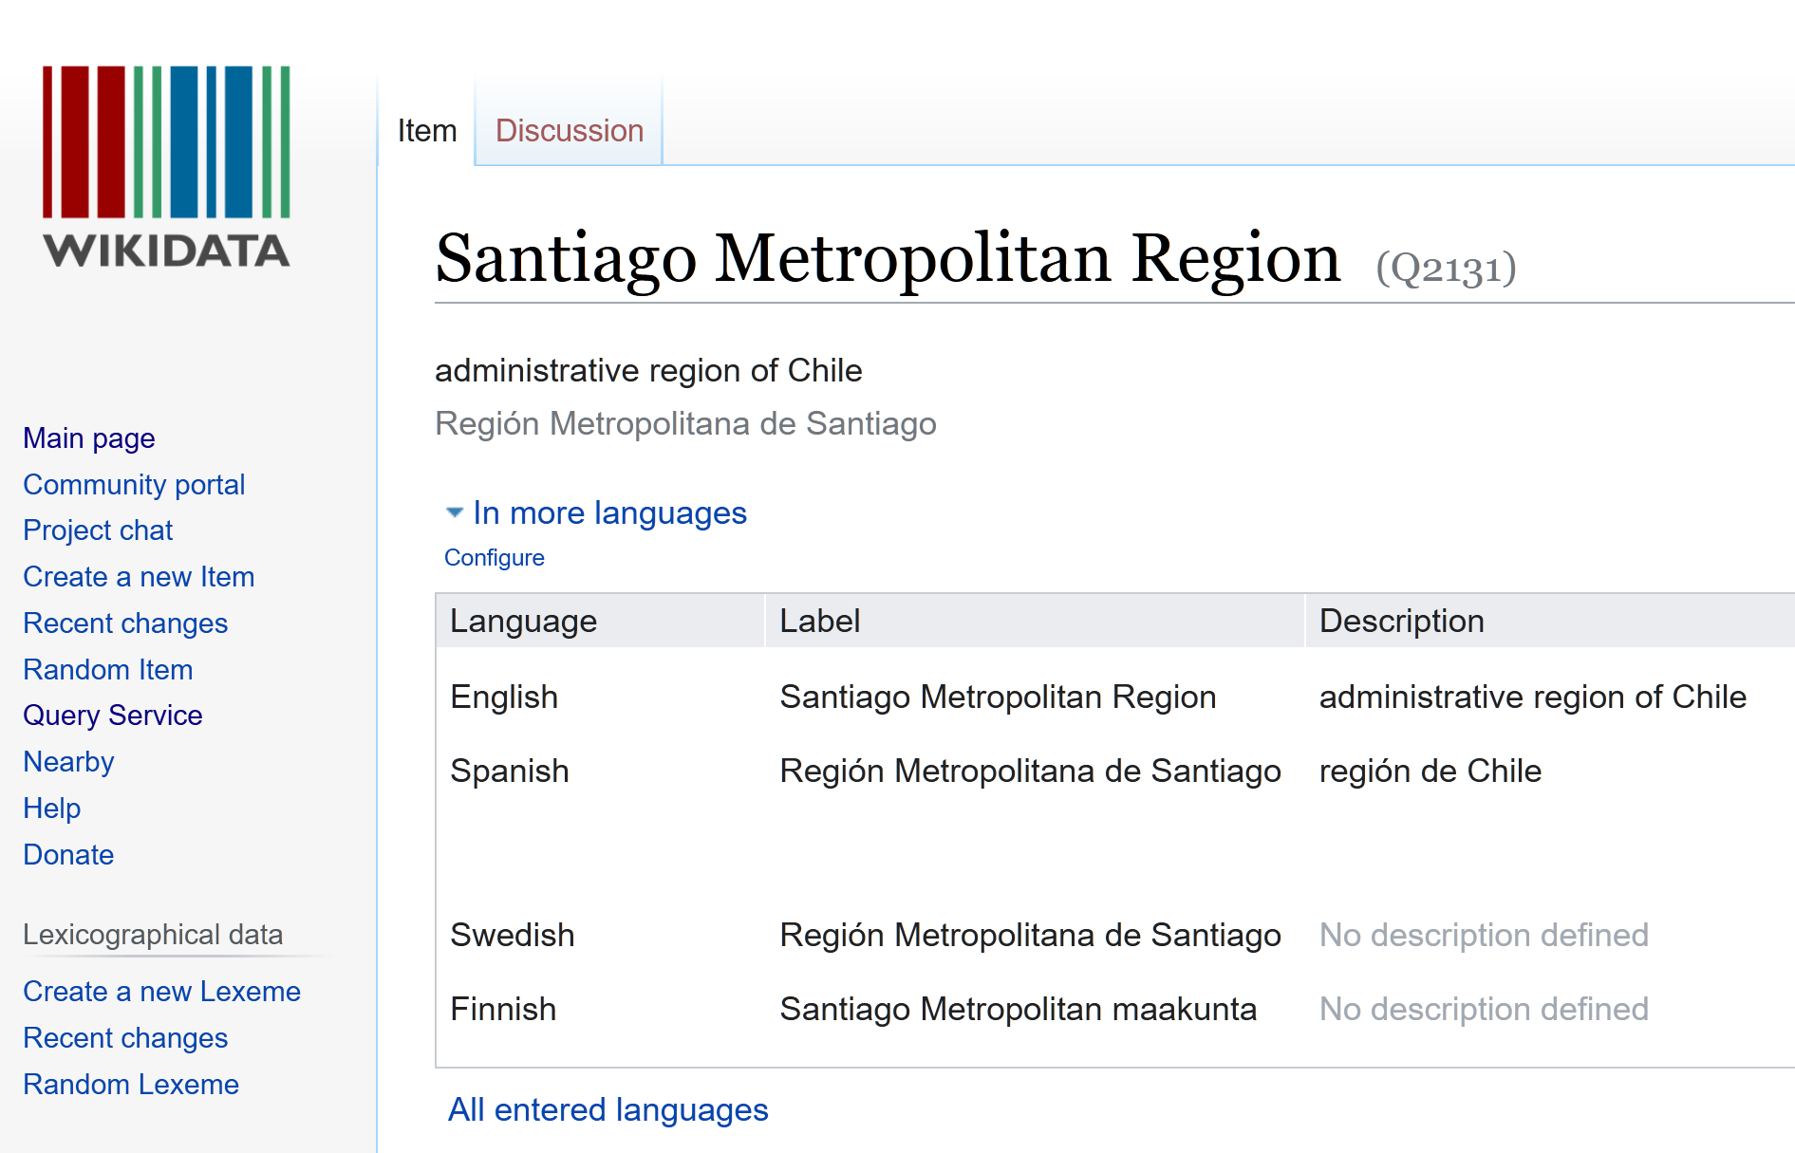
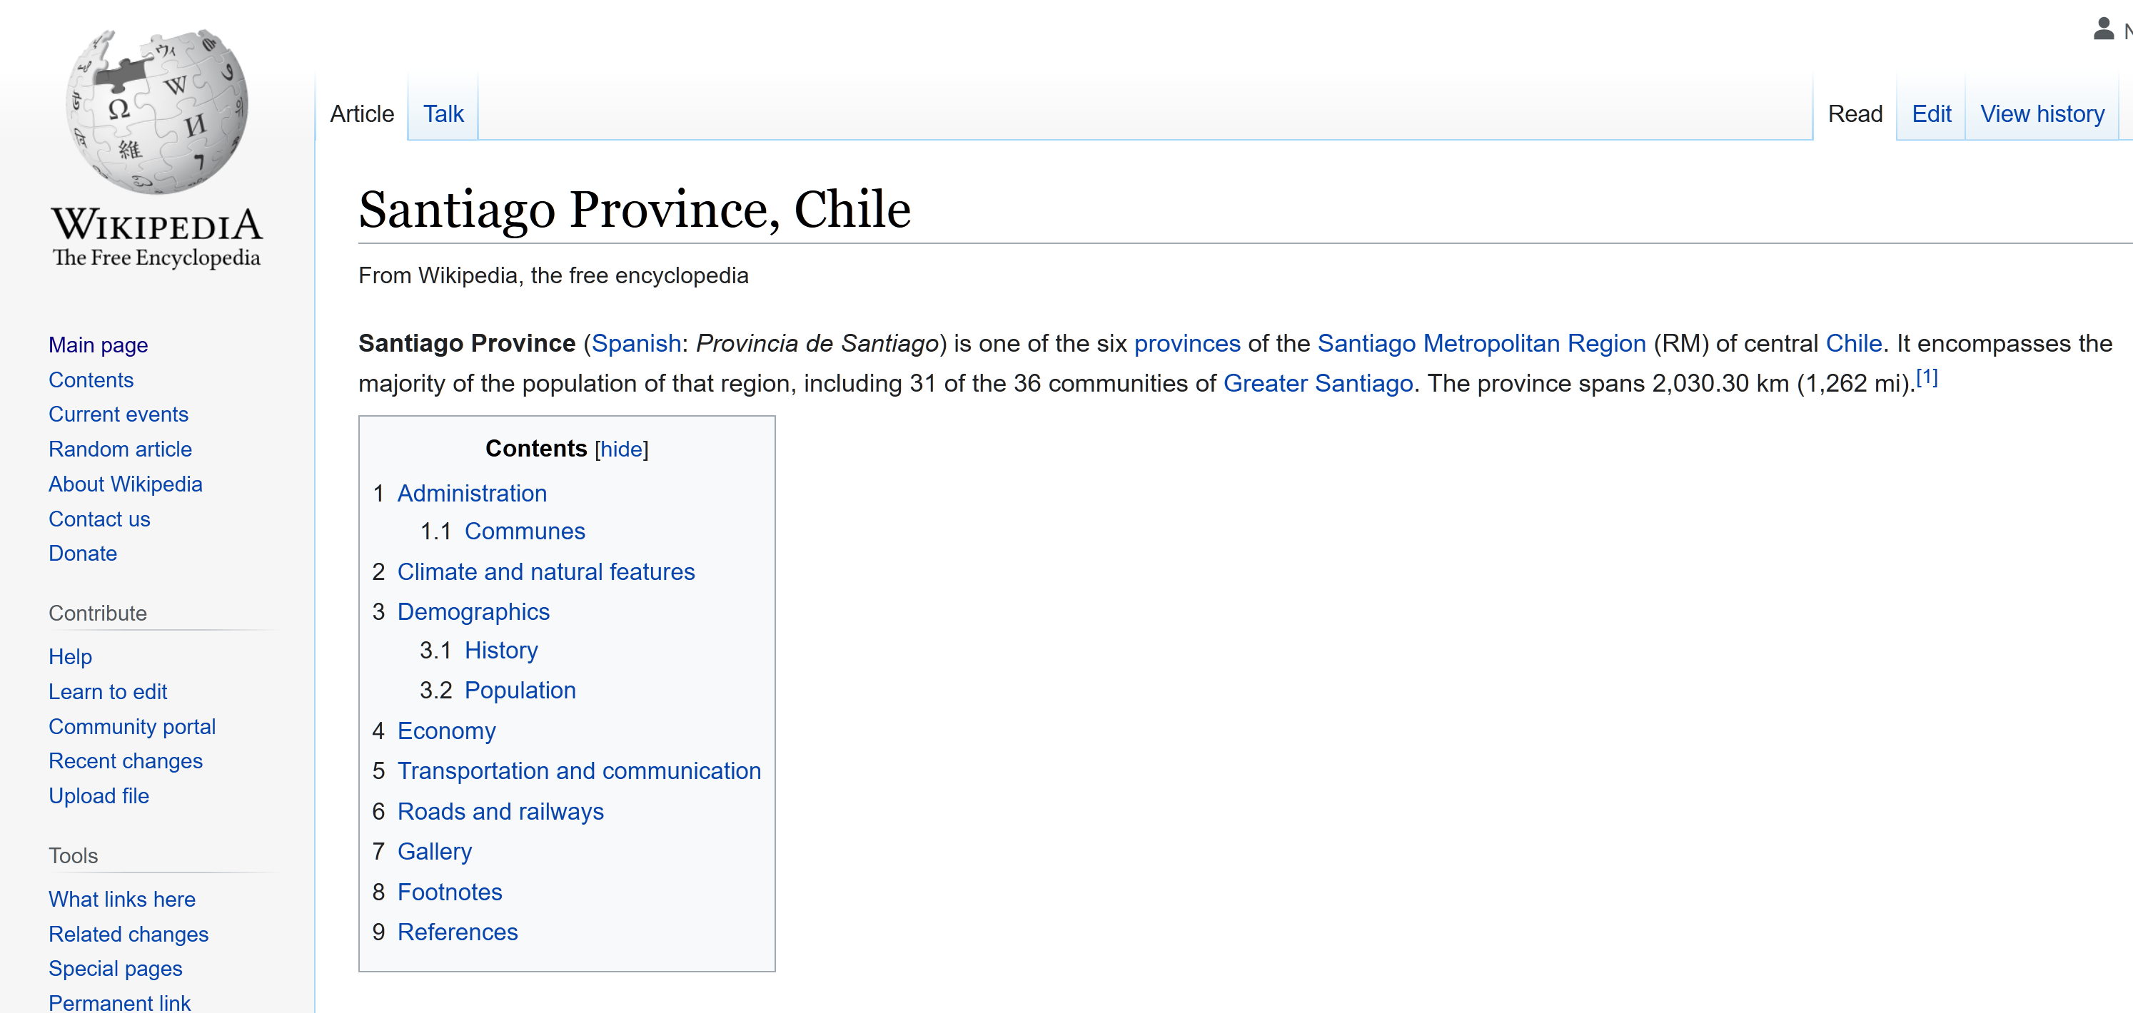
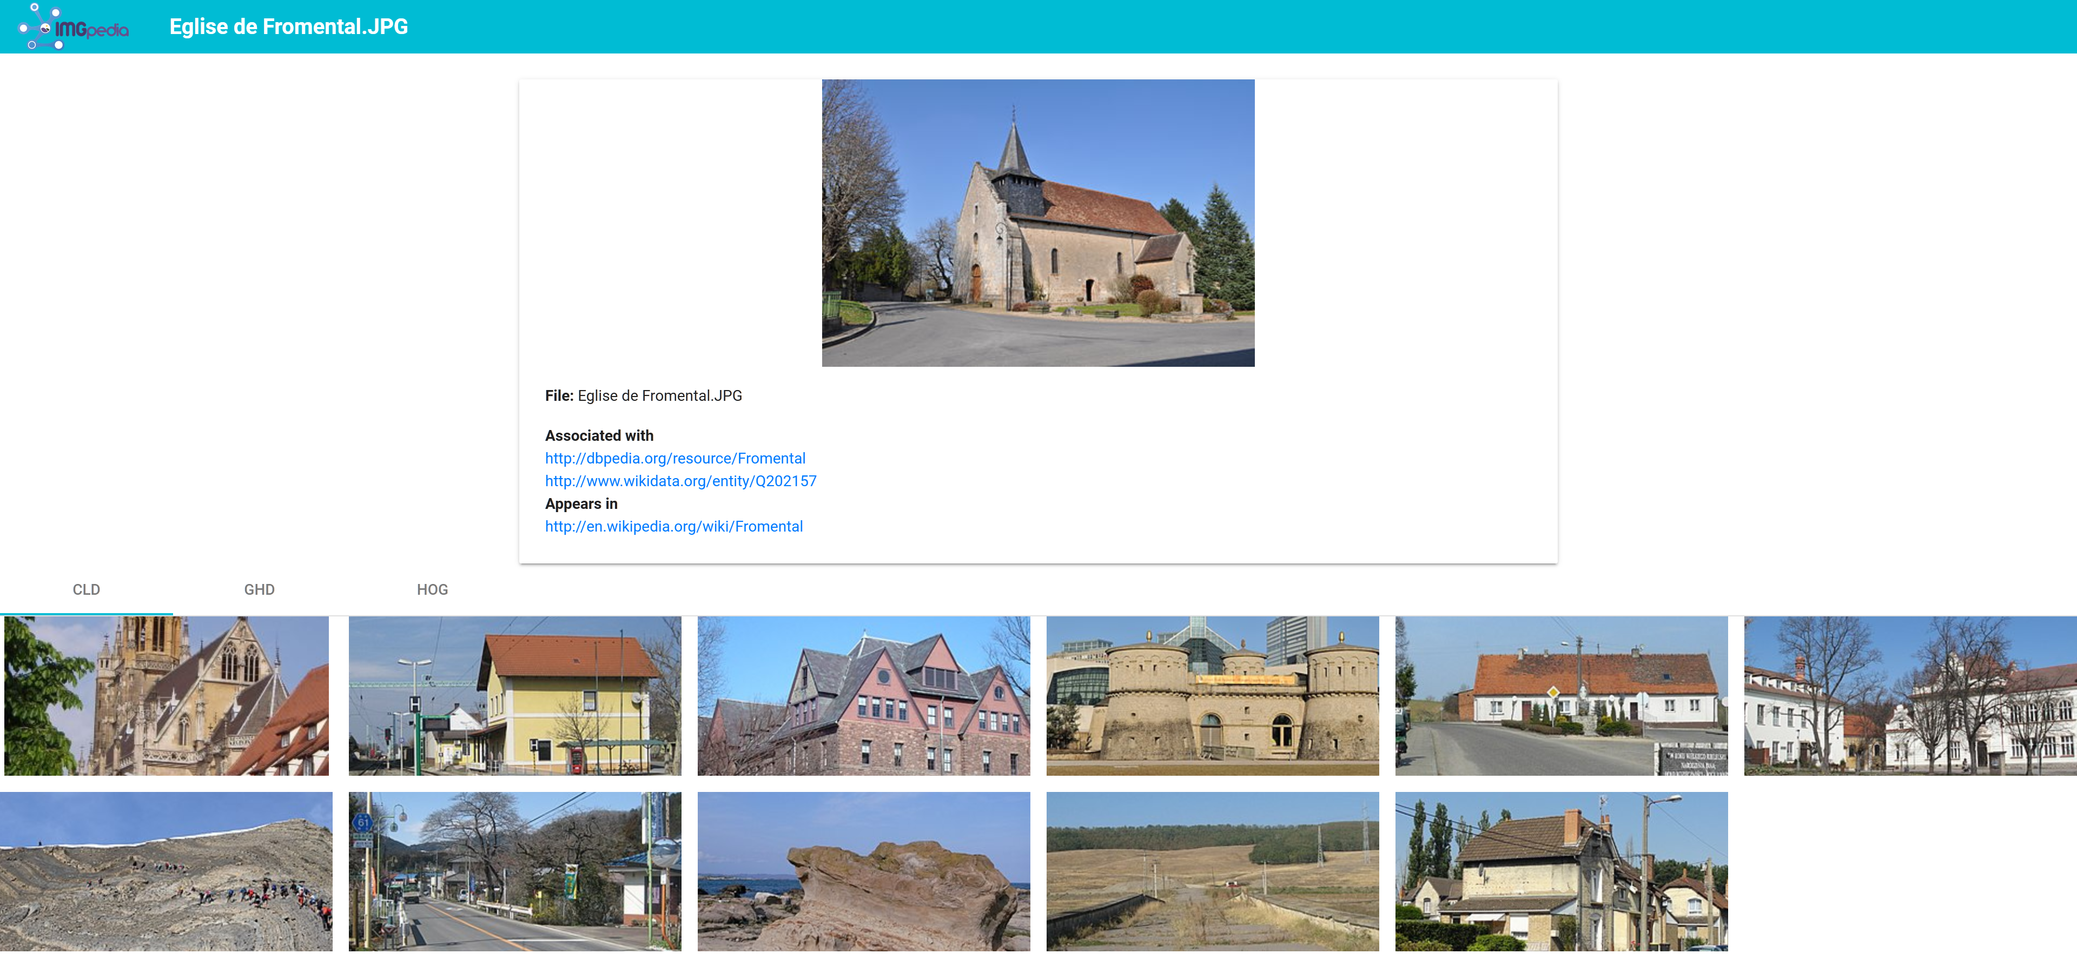
Linked Data

Slide 60
Linked Data – Adoption
Started as a grassroots community effort in 2007
Published existing open license datasets as Linked Data
Prominent publishers joined the effort
BBC, Springer, Nature, UK Government, etc
Encyclopaedic knowledge:
DBPedia, Wikidata

Slide 61
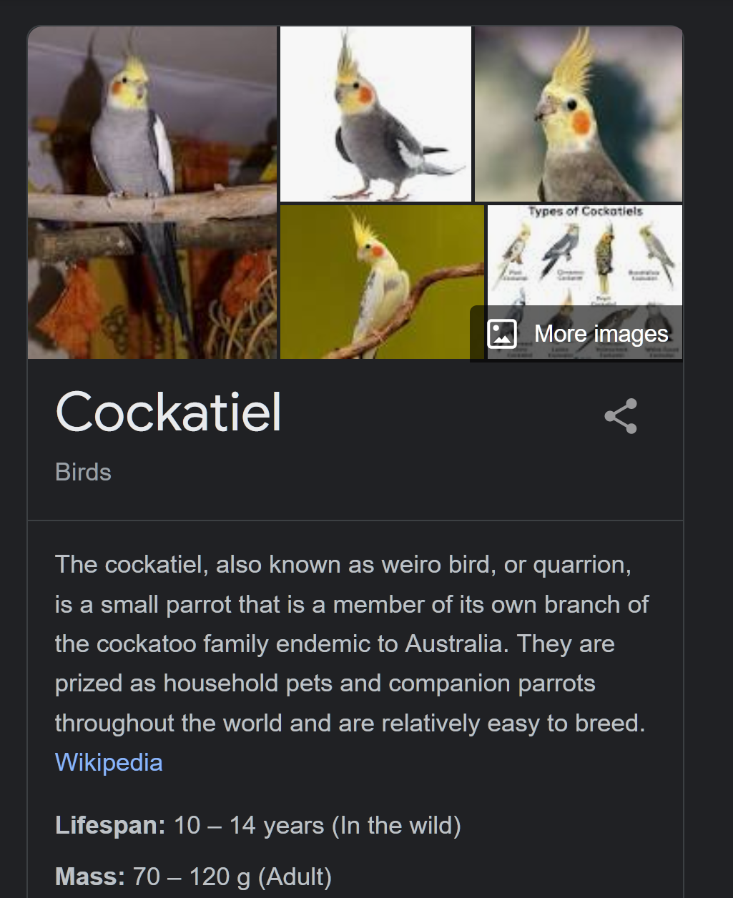
Linked Data – Applications
Google Rich Snippet Formats:
Reads RDFa data on search results to display infoboxes
Usually obtains data from Wikipedia/ Wikidata

Slide 62
Linked Data - Applications
Alexa is testing their own knowledge graphs to provide fast and trustworthy question answering services

Slide 63
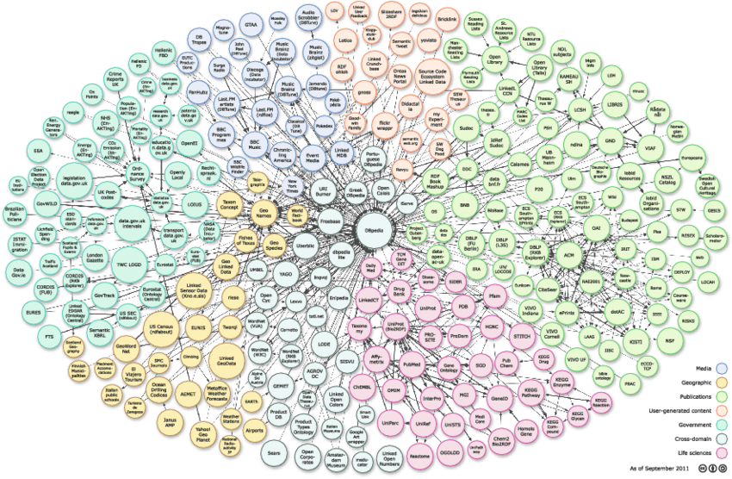
The Web of Linked Data
Is a globally distributed network of Data
... which we may understand as a huge distributed database
Lots of research questions regarding querying of this data
This is an active area of research
Get in contact if you are interested!

