Slide 1
Graph Databases
TDDD43 – Advanced Data Models and Databases
Sebastián Ferrada
sebastian.ferrada@liu.se
Slides based on previous ones by Olaf Hartig

Slide 2
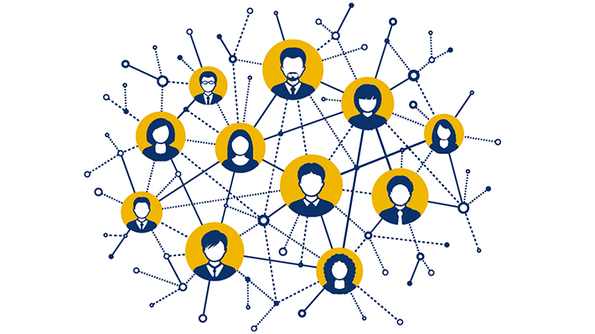
Graphs are Everywhere
Transportation networks
Bibliographic networks
Computer networks
Social networks
Topic maps
Knowledge bases
Protein interactions
Biological food chains
etc...

Slide 3
Graph Data Systems
Triple Stores:
Pattern matching queries
Prevalent model: RDF
Graph Databases
Typically navigational queries
Path finding or matching
Prevalent model: Property Graphs
Graph Processing Systems
Complex graph analysis tasks: page-rank and centrality measures, minimum spanning trees, etc.
Prevalent model: Generic Graphs

Slide 4
Graph Data Models

Slide 5
RDF Data Model
Data comes as a set of triples $(s, p, o)$:
$s$ is the subject, an IRI
$p$ is the predicate, an IRI
$o$ is the object, an IRI or Literal
Triples $(s, p, o)$ are understood as labelled directed edges
s
p
o
ex:Chile
rdf:type
ex:Country

Slide 6
(Labelled) Property Graphs

Slide 7
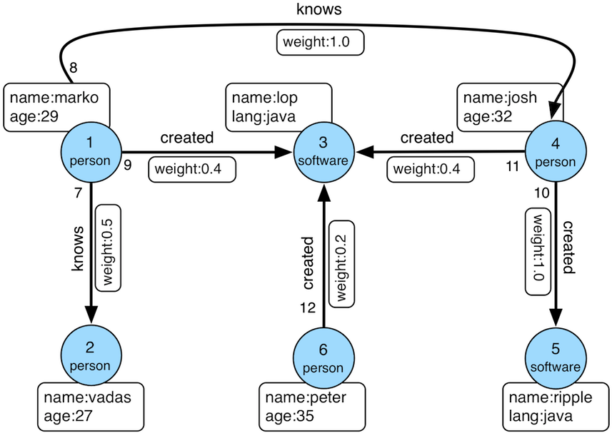
(Labelled) Property Graphs
Directed multigraph:
multiple edges between the same pair of nodes are allowed
Any node and edge may have a label and identifier
Any node and edge may have a set of key-value pairs (called properties)

Slide 8
Property Graphs (PGs) vs. RDF
Similarities:
Both model labelled, directed multigraphs
Both allow properties/attributes on vertices
Differences
RDF doesn’t allow edge properties
Edge labels cannot be also vertices in PGs, but they can in RDF
PGs don’t allow multiple values for a property, unless an array is used
Node and edge identifiers are local to the property graph, IRIs are universally unique (important for data integration)

Slide 9
Generic Graphs
Data model
Directed multigraphs
Arbitrary user-defined data structure can be used as value of a vertex or an edge (e.g., a Java object)
Example (Flink Gelly API):
Advantage: give users maximum flexibility
Drawback: systems cannot provide built-in operators related to vertex data or edge data
// create new vertexes with a Long ID and a String value
Vertex<Long, String> v1 = new Vertex<Long, String>(1L, "foo");
Vertex<Long, String> v2 = new Vertex<Long, String>(2L, "bar");
Edge<Long, Double> e = new Edge<Long, Double>(1L, 2L, 0.5);

Slide 10
Graph Databases

Slide 11
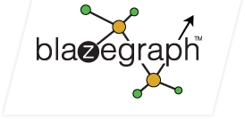
Graph Database Vendors
Systems that focus on graph databases
Neo4j
Sparksee
Titan
InfiniteGraph
Multi-model NoSQL stores with support for graphs:
OrientDB
ArangoDB
Triple stores with TinkerPop support
Blazegraph
Stardog
IBM System G

Slide 12
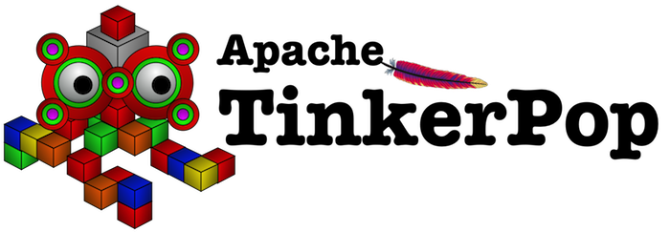
Apache TinkerPop
Graph computing framework
Vendor-agnostic
Includes a graph structure API
Formerly known as Blueprints API
For creating and modifying Property Graphs
Example:
Graph graph = …
Vertex marko = graph.addVertex(T.label, "person", T.id, 1, "name", "marko", "age", 29);
Vertex vadas = graph.addVertex(T.label, "person", T.id, 2, "name", "vadas", "age", 27);
marko.addEdge("knows", vadas, T.id, 7, "weight", 0.5f);

Slide 13
Apache TinkerPop
Includes a process API
Graph-parallel engine
Graph traversal, based on a language called gremlin

Slide 14
Apache TinkerPop

Slide 15
Gremlin
Part of the TinkerPop framework
Powerful domain-specific language (DSL) with embeddings in various programming languages
Expressions specify a concatenation of traversal steps

Slide 16
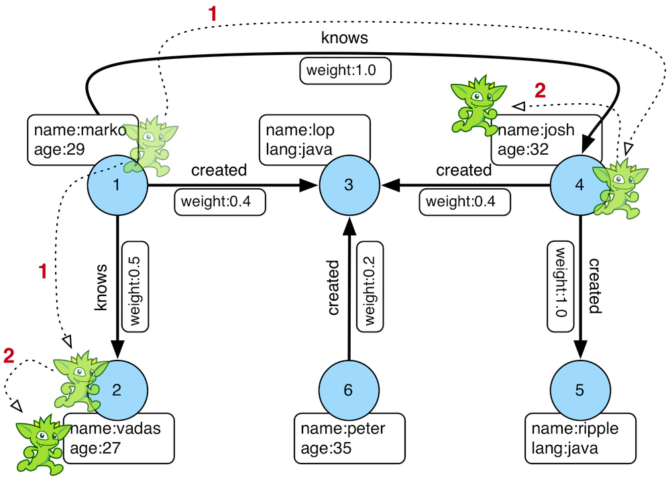
Gremlin
g.V().has(‘name’, ‘marko’).out(‘knows’).values(‘name’)
Results:
-vadas
-josh

Slide 17
Gremlin
g.V().has(‘name’, ‘marko’).out(‘knows’).values(‘name’).path()
Results:
-V[1], V[2], vadas
-V[1], V[4], josh

Slide 18
Gremlin
g.V().has(‘name’, ‘marko’).repeat(out()).times(2).values(‘name’)
Results:
-ripple
-lop

Slide 19
Cypher
Declarative graph database query language
Proprietary (used by Neo4j)
The OpenCypher project aims to deliver an open specification

Slide 20
Cypher – Example
Recall our initial Gremlin example:
g.V().has('name','marko').out('knows').values('name’)
In Cypher we could express this query as follows:
MATCH ( {name:'marko'} )-[:knows]->( x ) RETURN x.name

Slide 21
Cypher – Clauses
CREATE - creates nodes and edges
DELETE - removes nodes, edges, properties
SET - sets values of properties
MATCH - specifies a pattern to match in the data graph
WHERE - filters pattern matching results
RETURN - which nodes / edges / properties in the matched data should be returned
UNION - merges results from two or more queries
WITH - chains subsequent query parts (like piping in Unix commands)

Slide 22
Cypher – Node Patterns
Node patterns may have different forms:
( ) - matches any node
(:person) - matches nodes whose label is person
( {name:'marko’}) - matches nodes that have a property name='marko’
(:person {name:'marko’}) - matches nodes that have both the label person and a property name='marko'

Slide 23
Cypher – Variables
Every node pattern can be assigned a variable
The variable can be used to refer to the matching node in another query clause or to express joins
For instance, (x), (x:person)

Slide 24
Cypher – Relationship Patterns
Relationship patterns must be placed between two node patterns, and they may have different forms.
Relationship patterns use a direction:
--> for relationships “to the right”
<-- for relationships “to the left”
-- for undirected relationships

Slide 25
Cypher – Relationship Patterns
From here we assume → directions, but remember it can be any
-[]-> - matches any edges in the given direction
-[:knows]-> - matches edges whose label is knows
-[ {weight:0.5} ]-> - matches edges that have a property weight=0.5
-[:knows {weight:0.5}]-> - matches edges that have both the label knows and a property weight=0.5
-[:knows*..4]-> - matches paths of knows edges of up to length 4

Slide 26
Cypher – Relationship Patterns
Every relationship pattern can be assigned a variable
For instance, <-[x:knows]-, -[x]->

Slide 27
Cypher – Complex Patterns
Node patterns and relationship patterns are just basic building blocks that can be combined into more complex patterns
Examples:
MATCH (a)-[:knows]->()-[:knows]->(a) RETURN a
MATCH p = shortestPath( (:person {name:'marko'])-[*]->(:person {name:'josh']) ) RETURN p

Slide 28
Cypher – Filtering
Pattern matching results can be filtered out by using the WHERE clause (similar to SQL)
Examples:
MATCH (a:person)-[x:knows]->(b:person) WHERE x.weight > 0.5 AND x.weight < 0.9 RETURN a , b
MATCH ()-[x:knows]->() WHERE exists(x.weight) RETURN x
MATCH (a)-[:knows]->(b)-[x:knows]->(c) WHERE NOT (a)-[:knows]->(c) RETURN *

Slide 29
Graph Processing Systems

Slide 30
Complex Graph Analysis Tasks
Tasks that require an iterative processing of the entire graph or large portions of it:
Centrality analysis (e.g., PageRank)
Clustering, connected components
Graph colouring
Diameter finding
All-pairs shortest path
Graph pattern mining (e.g., frequent subgraphs, community detection)
Machine learning (e.g., belief propagation, Gaussian non-negative matrix factorization)

Slide 31
PageRank
$$PR_{k+1}\left(v\right)=\sum_{v_{IN}}{PR_{k}(v_{IN})/|Out\left(v_{IN}\right)|}$$
v1
v3
v2
v4
$$PR_{k}$$ | K=0 | K=1 | K=2 | K=3 | K=4 | K=5 | K=6
$$PR_{k}(V_{1})$$ | 0.25
$$PR_{k}(V_{2})$$ | 0.25
$$PR_{k}(V_{3})$$ | 0.25
$$PR_{k}(V_{4})$$ | 0.25

Slide 32
PageRank
$$PR_{k+1}\left(v\right)=\sum_{v_{IN}}{PR_{k}(v_{IN})/|Out\left(v_{IN}\right)|}$$
$$PR_{2}\left(v_{1}\right)=\frac{PR_{1}\left(v_{3}\right)}{1}+\frac{PR_{1}\left(v_{4}\right)}{2}=0.25+\frac{0.25}{2}=0.375$$
v1
v3
v2
v4
$$PR_{k}$$ | K=0 | K=1 | K=2 | K=3 | K=4 | K=5 | K=6
$$PR_{k}(V_{1})$$ | 0.25 | 0.375
$$PR_{k}(V_{2})$$ | 0.25
$$PR_{k}(V_{3})$$ | 0.25
$$PR_{k}(V_{4})$$ | 0.25

Slide 33
PageRank
$$PR_{k+1}\left(v\right)=\sum_{v_{IN}}{PR_{k}(v_{IN})/|Out\left(v_{IN}\right)|}$$
v1
v3
v2
v4
$$PR_{k}$$ | K=0 | K=1 | K=2 | K=3 | K=4 | K=5 | K=6
$$PR_{k}(V_{1})$$ | 0.25 | 0.37 | 0.43 | 0.35 | 0.39 | 0.38 | 0.38
$$PR_{k}(V_{2})$$ | 0.25 | 0.08 | 0.12 | 0.14 | 0.11 | 0.13 | 0.13
$$PR_{k}(V_{3})$$ | 0.25 | 0.33 | 0.27 | 0.29 | 0.29 | 0.28 | 0.28
$$PR_{k}(V_{4})$$ | 0.25 | 0.20 | 0.16 | 0.20 | 0.19 | 0.19 | 0.19
Convergence

Slide 34
PageRank
Many of these algorithms iterative propagate data along the graph structure by transforming intermediate vertex and edge values

Slide 35
Can MapReduce be used for this?

Slide 36
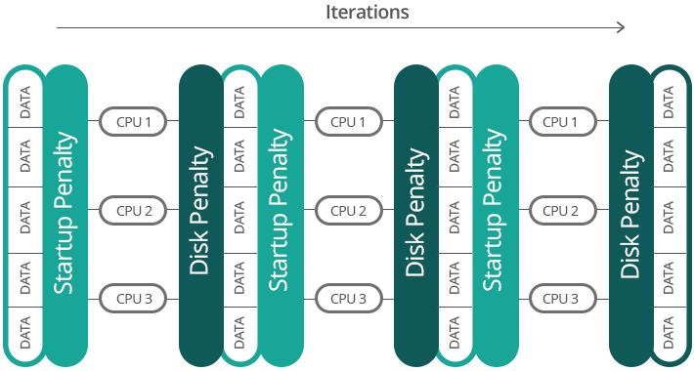
Can MapReduce be used for this?
M/R does not directly support iterative algorithms
Materializing intermediate results at each M/R iteration harms performance
Extra M/R job on each iteration for checking whether a fixed point has been reached
Additional issue for graph algorithms
Invariant graph-topology data reloaded and reprocessed at each iteration
Wastes I/O, CPU, and network bandwidth

Slide 37
Graph Processing Systems
Pregel Family
Pregel
Giraph
Giraph++
Mizan
GPS
Pregelix
Pregel+
GraphLab Family
GraphLab
PowerGraph
GraphChi (centralized)
Other Systems
Trinity
TurboGraph (centralized)
Signal/Collect

Slide 38
Vertex-centric Abstraction
Many such algorithms iteratively propagate data along the graph structure by transforming intermediate vertex and edge values
These transformations are defined in terms of functions on the values of adjacent vertexes and edges
Hence, such algorithms can be expressed by specifying a function that can be applied to any vertex separately
“Think like a vertex”

Slide 39
Vertex-centric Abstraction
Vertex compute function consists of three steps:
Read all incoming messages from neighbors
Update the value of the vertex
Send messages to neighbors
Additionally, the function may “vote to halt” if a local convergence criterion is met
Overall execution can be parallelized!
Terminates when all vertexes have halted and no messages in transit

Slide 40
Vertex-centric PageRank
Read all incoming messages from neighbors
Update the value of the vertex
Send messages to neighbors
$$PR_{k+1}\left(v\right)=\sum_{v_{IN}}{PR_{k}(v_{IN})/|Out\left(v_{IN}\right)|}$$
v1
v3
0.083
v2
v4
0.125
$$PR_{k}$$ | K=0 | K=1 | K=2 | K=3 | K=4 | K=5 | K=6
$$PR_{k}(V_{1})$$ | 0.25
$$PR_{k}(V_{2})$$ | 0.25
$$PR_{k}(V_{3})$$ | 0.25
$$PR_{k}(V_{4})$$ | 0.25

Slide 41
Vertex-centric PageRank
Read all incoming messages from neighbors
Update the value of the vertex
Send messages to neighbors
$$PR_{k+1}\left(v\right)=\sum_{v_{IN}}{PR_{k}(v_{IN})/|Out\left(v_{IN}\right)|}$$
v1
v3
v2
v4
$$PR_{k}$$ | K=0 | K=1 | K=2 | K=3 | K=4 | K=5 | K=6
$$PR_{k}(V_{1})$$ | 0.25
$$PR_{k}(V_{2})$$ | 0.25
$$PR_{k}(V_{3})$$ | 0.25
$$PR_{k}(V_{4})$$ | 0.25 | 0.20

Slide 42
Vertex-centric PageRank
Read all incoming messages from neighbors
Update the value of the vertex
Send messages to neighbors
$$PR_{k+1}\left(v\right)=\sum_{v_{IN}}{PR_{k}(v_{IN})/|Out\left(v_{IN}\right)|}$$
v1
v3
0.1
0.1
v2
v4
$$PR_{k}$$ | K=0 | K=1 | K=2 | K=3 | K=4 | K=5 | K=6
$$PR_{k}(V_{1})$$ | 0.25 | 0.37
$$PR_{k}(V_{2})$$ | 0.25 | 0.08
$$PR_{k}(V_{3})$$ | 0.25 | 0.33
$$PR_{k}(V_{4})$$ | 0.25 | 0.20

Slide 43
Vertex-centric PageRank
Additionally, the function may “vote to halt” if a local convergence criterion is met
$$PR_{k+1}\left(v\right)=\sum_{v_{IN}}{PR_{k}(v_{IN})/|Out\left(v_{IN}\right)|}$$
v1
v3
v2
v4
$$PR_{k}$$ | K=0 | K=1 | K=2 | K=3 | K=4 | K=5 | K=6
$$PR_{k}(V_{1})$$ | 0.25 | 0.37 | 0.43 | 0.35 | 0.39 | 0.38
$$PR_{k}(V_{2})$$ | 0.25 | 0.08 | 0.12 | 0.14 | 0.11 | 0.13
$$PR_{k}(V_{3})$$ | 0.25 | 0.33 | 0.27 | 0.29 | 0.29 | 0.28
$$PR_{k}(V_{4})$$ | 0.25 | 0.20 | 0.16 | 0.20 | 0.19 | 0.19
Local Convergence

Slide 44
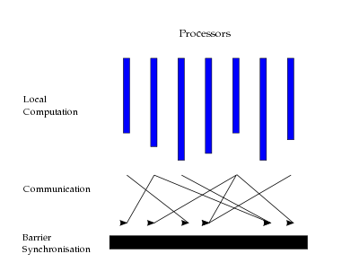
Google Pregel
First system that implemented vertex-centric computation for shared-nothing clusters
Communication through message passing
Based on the bulk synchronous parallel (BSP) programming model
Supersteps with synchronization barriers
Apache Giraph was a first open-source implementation of Pregel
| ← Superstep → |
| ← Superstep → |
| ← Superstep → |

Slide 45
MapReduce vs. Pregel
MapReduce
Pregel
Requires passing of entire graph topology from one iteration to the next
Intermediate result after each iteration is stored on disk and then read again from disk
Programmer needs to write a driver program to support iterations, and another M/R job to check for fixed point
Graph topology is not passed across iterations, vertexes only send their state to their neighbors
Main memory based
Usage of supersteps and master-client architecture makes programming easy

Slide 46
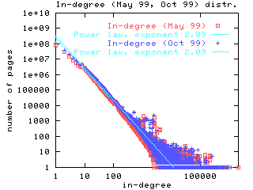
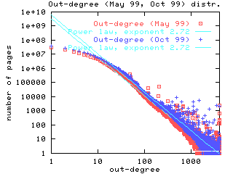
Google Pregel – Limitations
In the BSP (bulk synchronous parallel) model, performance is limited by slowest worker machine
Many real-world graphs have power-law degree distribution, which may lead to few highly-loaded workers

Slide 47
Google Pregel – Limitations
Possible optimizations to balance the workload:
Decompose the vertex program
Sophisticated graph partitioning
Graph-centric abstraction
Another possibility: asynchronous execution (instead of BSP)

Slide 48
Combiner
Takes two messages and combines them into one associative, commutative function
Can be used to aggregate messages before sending them to the worker node that has the target vertex
Example:
In the vertex-centric PageRank, messages are values $m_{IN}=\left(\frac{PR_{k}\left(v_{IN}\right)}{\left|Out\left(v_{IN}\right)\right|}\right)$ of each incoming neighbor $v_{IN}$.
In the vertex function these values are summed up: $\left(\frac{PR_{k}\left(v_{IN1}\right)}{\left|Out\left(v_{IN1}\right)\right|}+\frac{PR\left(v_{IN2}\right)}{\left|Out\left(v_{IN2}\right)\right|}+…\right)$
Parts of this sum may be computed by worker nodes that have some of the incoming neighbor vertexes

Slide 49
Signal/Collect Model
Signaling (edge function):
Every edge uses the value of its source vertex to compute a message (“signal”) for the target vertex
Executed on the worker that has the source vertex
Collecting (vertex function):
Every vertex computes its new value based on the messages received from its incoming edges
Executed on the worker that has the target vertex

Slide 50
Gather, Apply, Scatter (GAS) Model
Gather:
Accumulate incoming messages, i.e., same purpose as a combiner
Apply:
Update the vertex value based on the accumulated information
Operates only on the vertex
Scatter:
Computes outgoing messages
Can be executed in parallel for each adjacent edge

Slide 51
Google Pregel – Limitations
Possible optimizations to balance the workload:
Decompose the vertex program
Sophisticated graph partitioning
Graph-centric abstraction
Another possibility: asynchronous execution (instead of BSP)

Slide 52
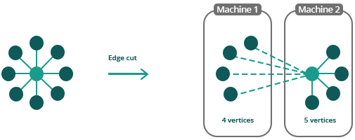
Partitioning
Goal: distribute the vertexes to achieve a balanced workload while minimizing inter-partition edges to avoid costly network traffic
For instance, hash-based (random) partitioning has extremely poor locality
Unfortunately, the problem is NP-complete
k-way graph partitioning problem
Various heuristics and approximation algorithms

Slide 53
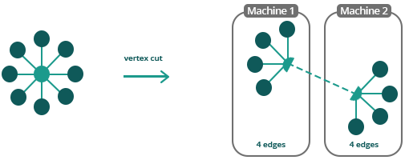
Vertex-cut
PowerGraph introduced a partitioning scheme that “cuts” vertexes such that the edges of high-degree vertexes are handled by multiple workers
improved work balance
Power-law graphs have good vertex cuts
Communication is linear in the number of machines each vertex spans
Vertex-cut minimizes this number
Hence, reduced network traffic

Slide 54
Google Pregel – Limitations
Possible optimizations to balance the workload:
Decompose the vertex program
Sophisticated graph partitioning
Graph-centric abstraction
Another possibility: asynchronous execution (instead of BSP)

Slide 55
Graph Databases
TDDD43 – Advanced Data Models and Databases
Sebastián Ferrada
sebastian.ferrada@liu.se
Slides based on previous ones by Olaf Hartig

