Slide 2
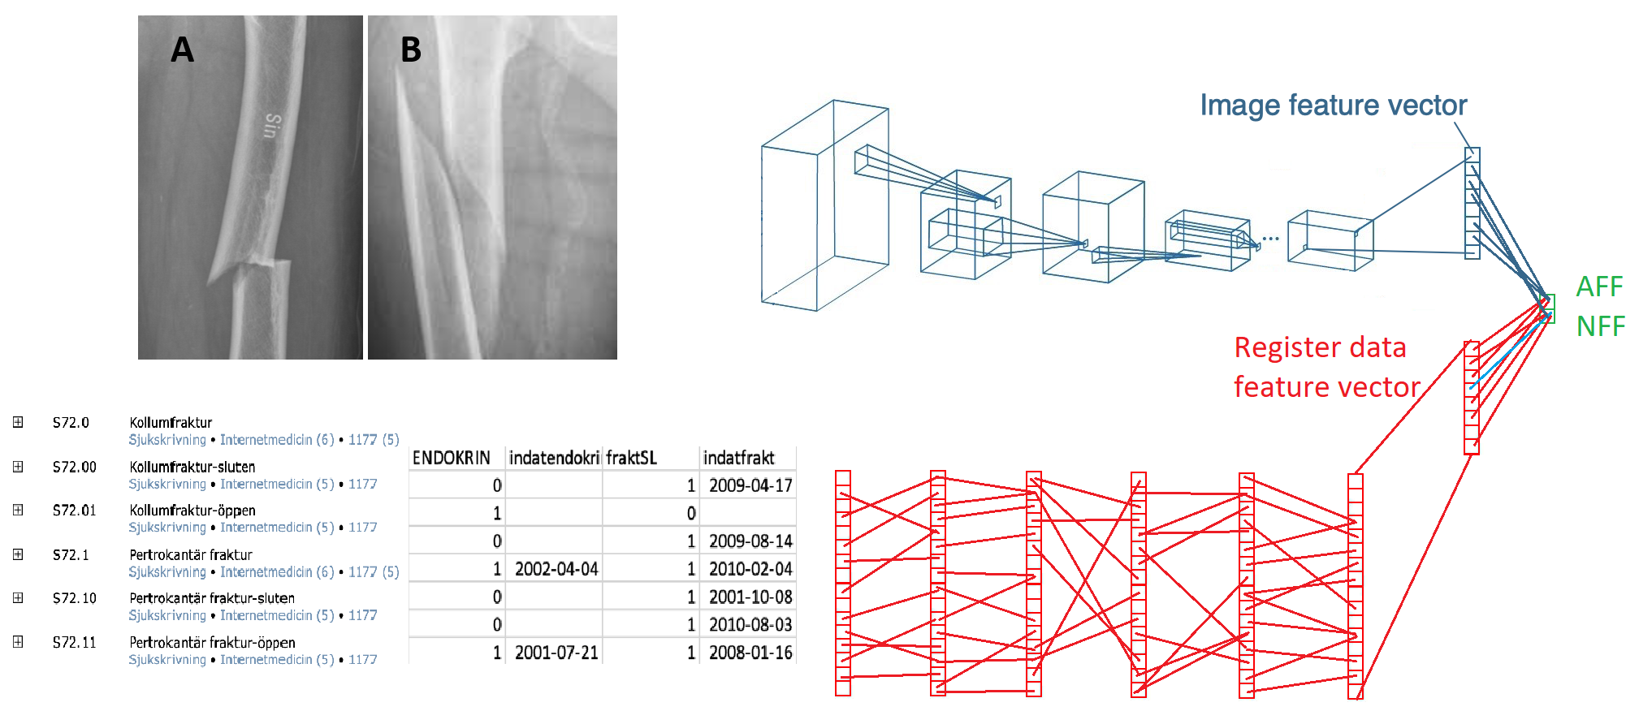
Master thesis idea
What is the classification performance using only image data? 90%?
What is the classification performance using only register data? 90%?
What is the classification performance using image and register data? 96%?
What is the best data fusion approach?

Slide 3
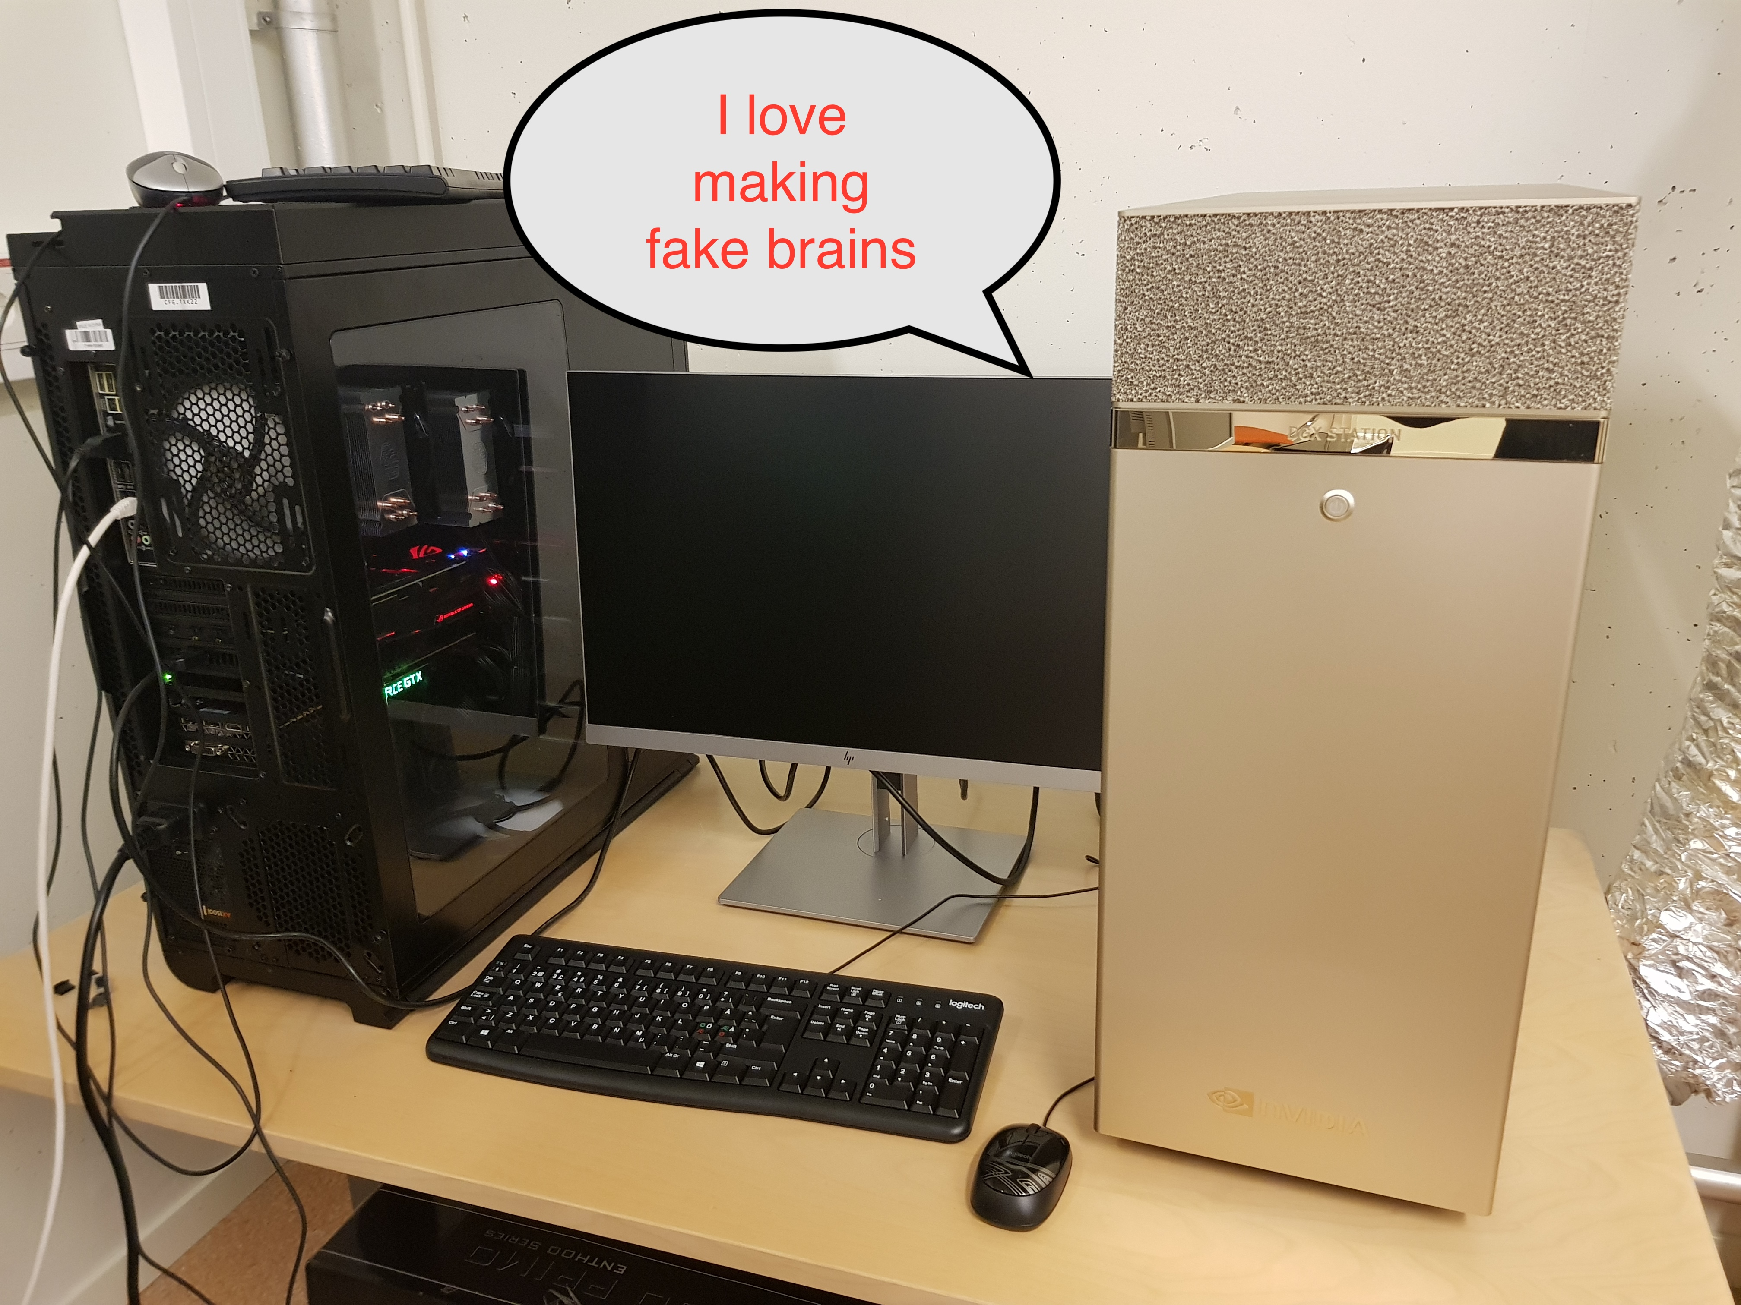
Hardware for deep learning
In total > 30 graphics cards including Tesla V100, RTX 3090, Quadro RTX 8000

