Slide 1
Temperature-Gradient Based Burn-In for 3D Stacked ICs
Nima Aghaee, Zebo Peng, and Petru Eles
Embedded Systems Laboratory (ESLAB)
Linkoping University
12th Swedish System-on-Chip Conference – May 2013

Slide 2
Outline
Introduction
    Early life failures
    Temperature gradient effects
    Thermal maps
Proposed methods
    Steady state solution
    Transient based heuristic
      only in paper
Experimental results

Slide 3
Outline
Introduction
    Early life failures
    Temperature gradient effects
    Thermal maps
Proposed methods
    Steady state solution
    Transient based heuristic
Experimental results

Slide 4
Early Life
Bathtub curve
Also known as
  Infant mortality
Failure rate
  Large
  Decreasing
Failure mechanism
  Birth defects
Warranty
  Manufacturers warranty
Burn-in process tries to cover this area
Survival curve

Slide 5
Burn-In
Burn-in is an effort to speed up the life
  Elevated temperature and voltage
Wear mechanisms include
  Metal stress voiding and electromigration
  Metal sliver bridging shorts
  Gate-oxide wearout and breakdown
Some wear mechanisms strongly dependent on temperature gradients

Slide 6
Outline
Introduction
    Early life failures
    Temperature gradient effects
    Thermal maps
Proposed methods
    Steady state solution
    Transient based heuristic
Experimental results

Slide 7
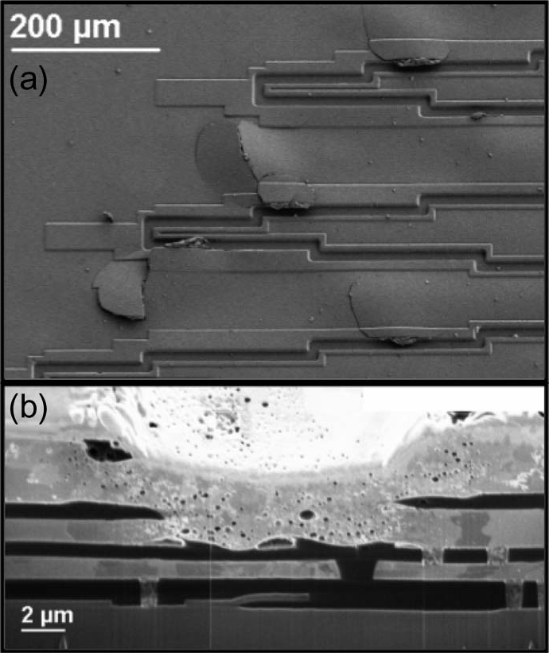
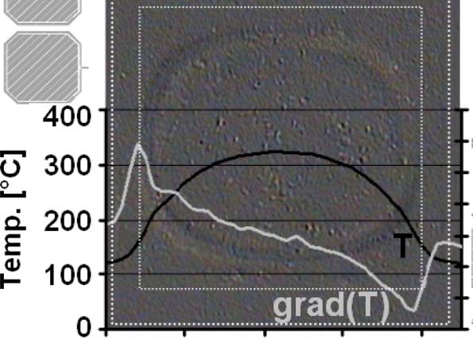
Metal Layer Elevation
Temperature-Gradient Induced Wear
Source: T. Smorodin, J. Wilde, P. Alpern, and M. Stecher, “A temperature-gradient-induced failure mechanism in metallization under fast thermal cycling,” IEEE Transactions on Device and Materials Reliability, 2008, vol. 8, no. 3, pp. 590–599.

Slide 8
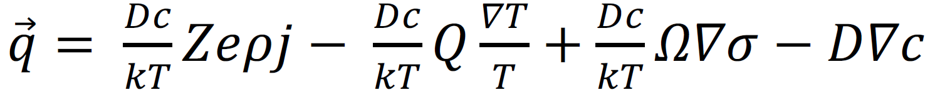
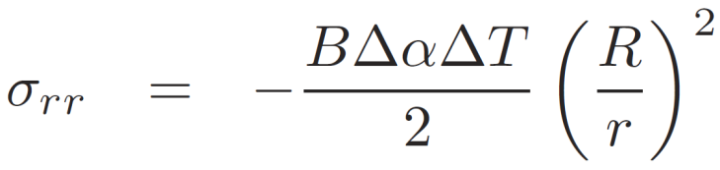
Electromigration (Atomic Flux)
Temperature-Gradient Induced Wear
J. Pak, M. Pathak, S. K. Lim, and D. Z. Pan, “Modeling of electromigration in through-silicon-via based 3D IC,” Electronic Components and Technology Conference (ECTC), 2011, pp. 1420–1427.
Migration depends on temperature gradients
temperature
stress
K. Chakrabarty, S. Deutsch, H. Thapliyal, and F. Ye, “TSV defects and TSV-induced circuit failures: The third dimension in test and design-for-test,” International Reliability Physics Symposium (IRPS), 2012, pp. 5F.1.1–5F.1.12.

Slide 9
Temperature-Gradient Dependence
Some wear mechanisms depend on temperature gradients
Creating temperature gradients during burn-in speeds up the early life more effectively than uniform heating
  Potential defects are speeded up faster

Slide 10
Outline
Introduction
    Early life failures
    Temperature gradient effects
    Thermal maps
Proposed methods
    Steady state solution
    Transient based heuristic
Experimental results

Slide 11
3D Stacked IC and Burn-In
Thermal gradients for 3D-SIC 3 times larger than normal 2D ICs
  Very important to pay attention to temperature gradients for 3D ICs
Multiple thermal maps to improve effectiveness of burn-in

Slide 12
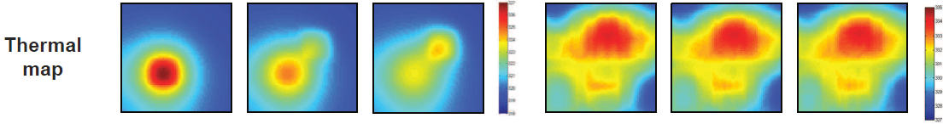
Thermal Map
For different benchmarks for a microprocessor
For different functional modes of an IC
Synthetic maps to target certain defects
  Knowledge from yield learning process
  Based on experience and empirical approaches
  Based on analysis and computer simulation
Specifies high and low temperature limits for each core or each thermal node

Slide 13
Burn-In Moments
Wafer-Level Burn-In (WLBI)
  Similar to bare-die test in 2D
Die-Level Burn-In (DLBI)
  Similar to final test in 2D
  Usually done after packaging
Possibilities for 3D
  Pre-bond
  Mid-bond
  Post-bond
  Final (after packaging)

Slide 14
Alternatives for Creating a Thermal Map (1)
1. Using real inputs/input ports
Especially for different benchmarks for a microprocessor or functional modes of an IC
Might be slow
Might be impossible to create large gradients
Might not be possible before final bond in 3D
  Some inputs are from TSVs
  Intermediate data usually has high volume and high speed
  TSVs could not be properly accessed using test equipment
  There will be a test access mechanism that has access to cores

Slide 15
Alternatives for Creating a Thermal Map (2)
2. Synthetic thermal maps in order to target certain defects
Might not be achievable using real inputs
Might be achievable using test access mechanism
  Direct access to cores

Slide 16
Description of the Problem
Multiple thermal maps are to be applied
A maps is created by selectively applying heating sequences (dummy tests)
Heating sequences are applied via Test Access Mechanism (TAM)
Inputs
  Thermal maps
  TAM width
  Other IC specifications
Output
  Schedules indicating proper times for heating sequence application

Slide 17
Outline
Introduction
    Early life failures
    Temperature gradient effects
    Thermal maps
Proposed methods
    Steady state solution
    Transient based heuristic
Experimental results

Slide 18
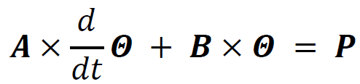
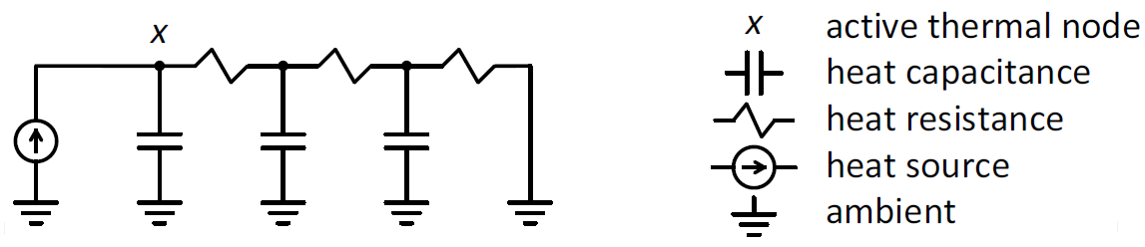
Thermal Model
Notes:
A and B characteristic matrices
Theta is temperatures
P is powers

Slide 19


Steady-State Solution for Burn-In
Thermal model
Target temperatures
Steady-state

Slide 20
Necessary Reachability Condition
Stray power
  Static power (Leakage)
  Clock network power
Heating sequence power
  Large (largest) power
  Achieved in test mode

Slide 21
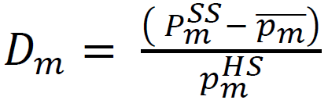
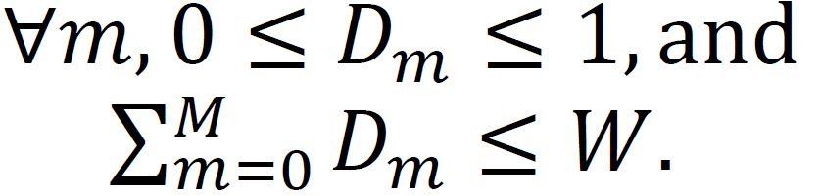
Pulse Width Modulation - PWM
Creating arbitrary power values
  Duty cycle
  Period
Test access mechanism limited bandwidth (W)
Schedulability condition:

Slide 22
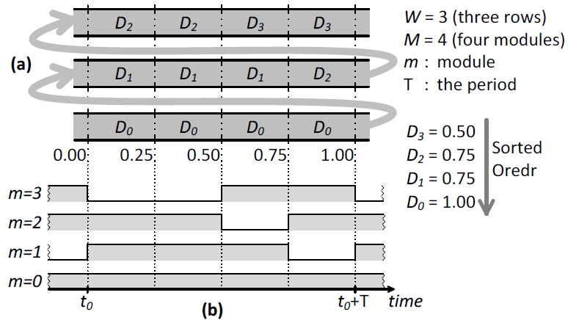
Scheduling

Slide 23
Ripples
On-off changes in power create ripples in temperature

Slide 24
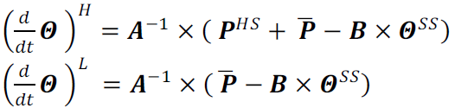
Ripples and the Period (1)
Ripples should not drive the temperature higher than or lower than limits specified in the map
Thermal model:
Power on:
Power off:

Slide 25
Ripples

Slide 26


Ripples and the Period (2)
Estimation of the derivative in a short time interval:
Period that temperature touches the max in an power-on period:
Smallest period (High/Low period for a core, for all cores) is the period to go with

Slide 27
Ripples

Slide 28
Steady-State Solution - Summary
The schedule is repeated periodically
Transition to a new thermal map is slow
  Initial temperatures to fade away
  New temperatures to build up
Schedule generation is fast
To be faster, the transient response should be taken into account

Slide 29
Outline
Introduction
    Early life failures
    Temperature gradient effects
    Thermal maps
Proposed methods
    Steady state solution
    Transient based heuristic
Experimental results

Slide 30
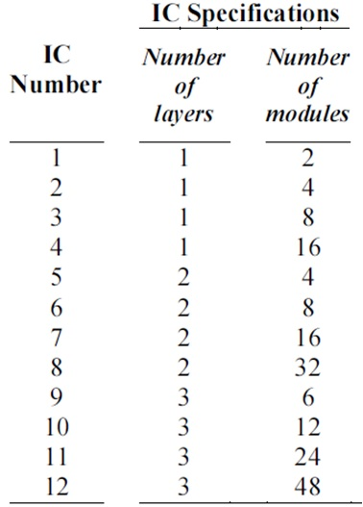
Experimental Setup
12 ICs
1, 2, and 3 layers
2 to 48 modules
Min/max in thermal maps
  35/45
  45/55
  55/65
  65/75
  75/85
  85/95

Slide 31
Experimental Results
CPU time
  Steady-state solution : 2 sec
  Transient-based heuristic : 12 min
Test time percentage change
  Transient-based heuristic compared with steady-state solution -78%

Slide 32
Conclusion (1)
Early life failures dependency on temperature gradients
Proper temperature gradients and thermal maps should be in place during burn-in
  Cannot be achieved using ordinary ovens
  Using test access mechanism is unavoidable

Slide 33
Conclusion (2)
 | Steady-state solution | Transient-based heuristic
Simple | Yes | No
Fast to generate the schedules | Yes | No
Fast to achieve a new thermal map | No | Yes
Supports high resolution thermal maps | No | Yes
Supports different TAM widths for different modules | No | Yes

Slide 34
Questions
?

