Slide 1
Heuristics for Adaptive Temperature-Aware SoC Test Scheduling Considering Process Variation
Nima Aghaee, Zebo Peng, and Petru Eles
Embedded Systems Laboratory (ESLAB), Linkoping University
The 11th Swedish System-on-Chip Conference (SSoCC’11)

Slide 2
Content
Introduction
Effects of process variation
Schedule tree
Optimization heuristics
Experimental results
Conclusion

Slide 3
High Test Temperature
High test power density
High test temperature
Overheating
Yield loss (Overkill): good dies fail the test
Damage to the devices under test

Slide 4
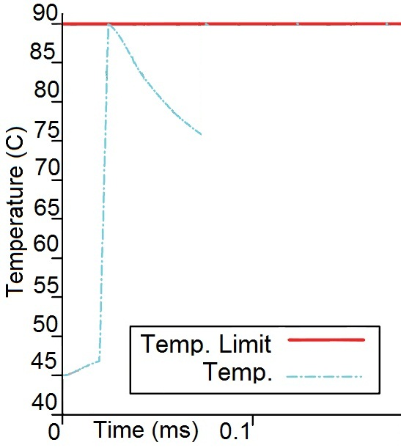
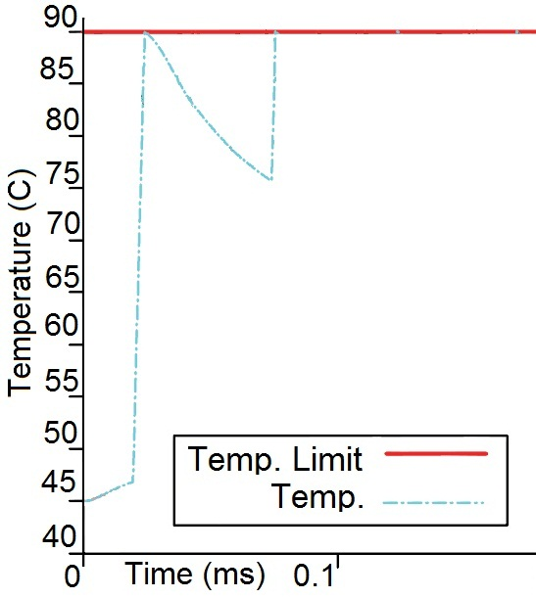
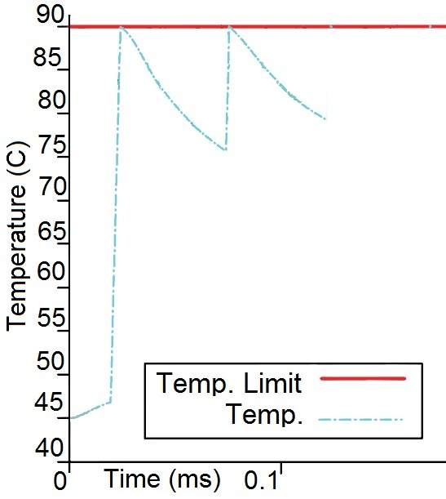
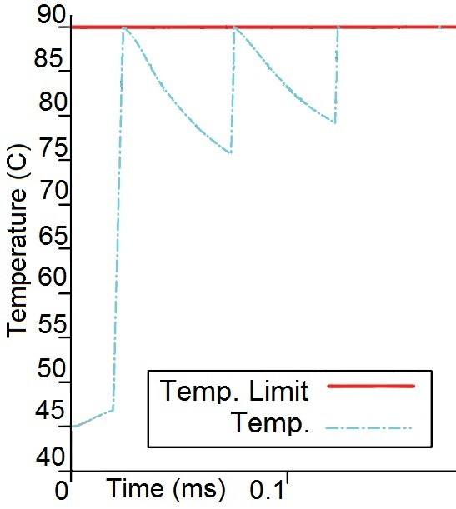
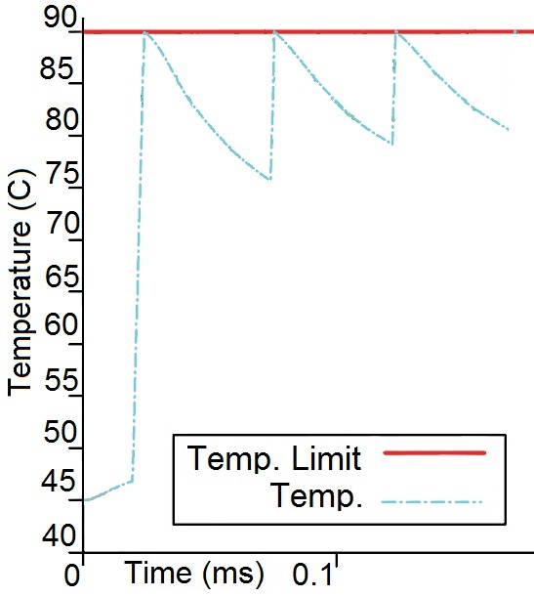
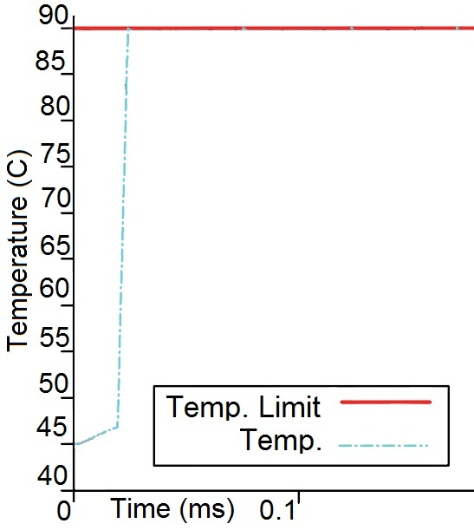
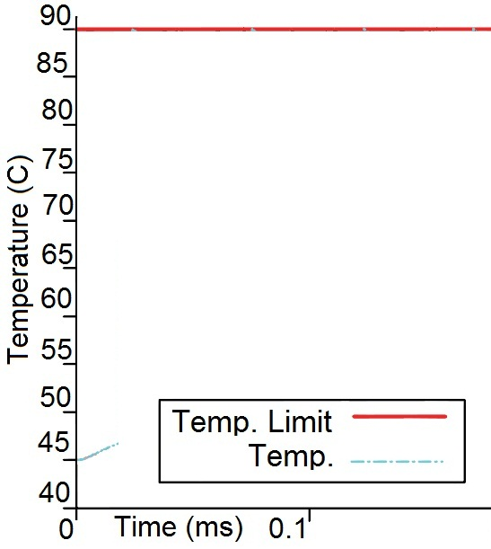
Temperature-Aware Scheduling
Introduce cooling cycles to avoid overheating
Partition the test to reduce Test Application Time

Slide 5
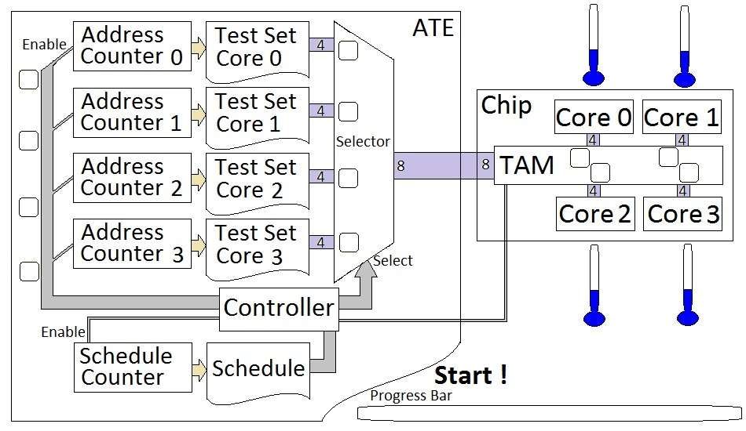
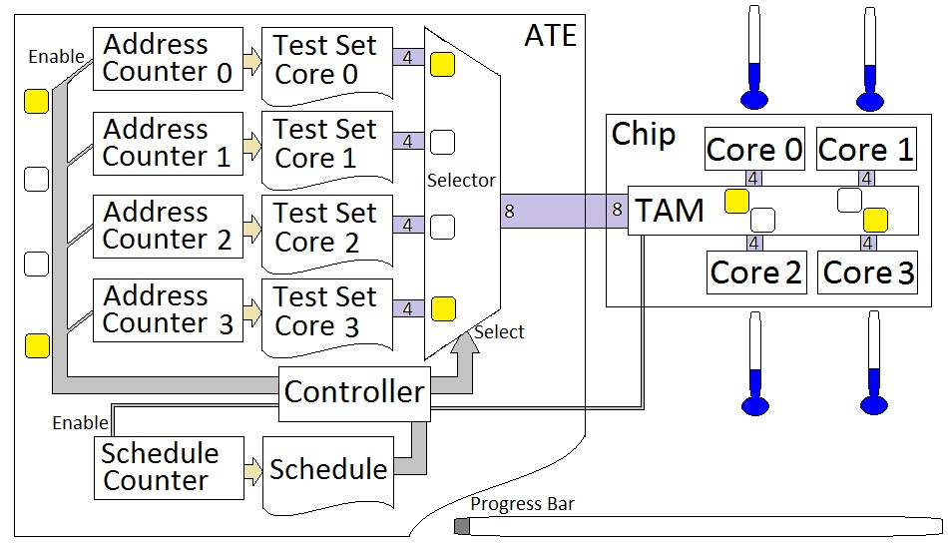
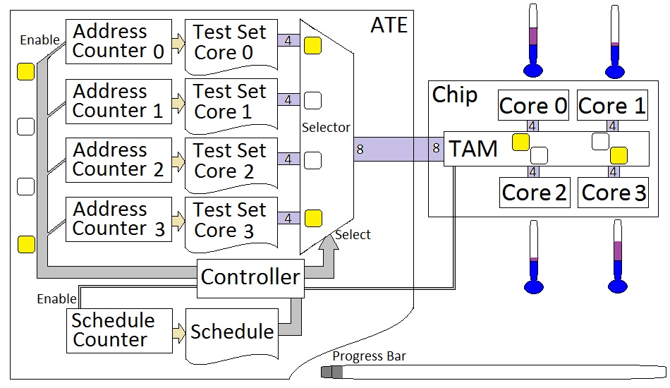
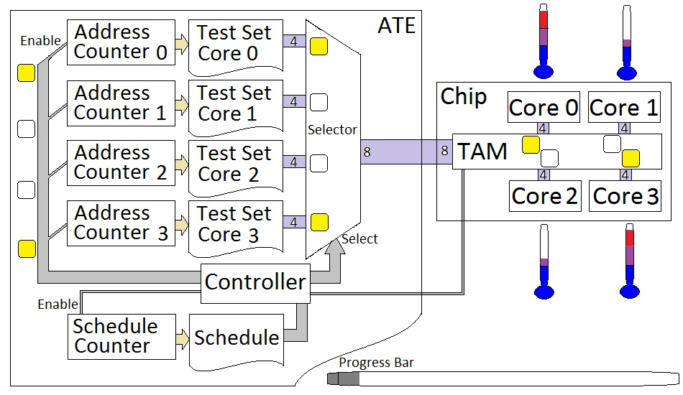
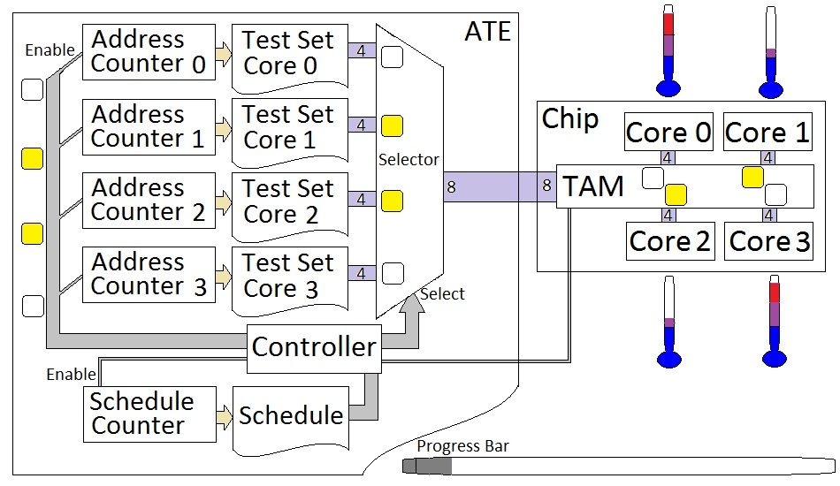
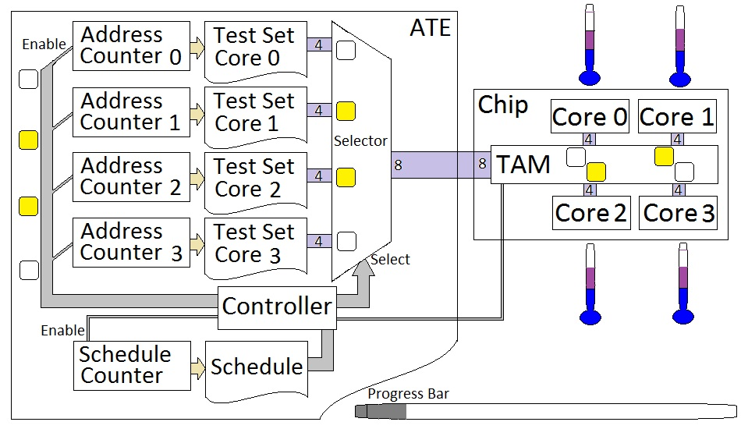
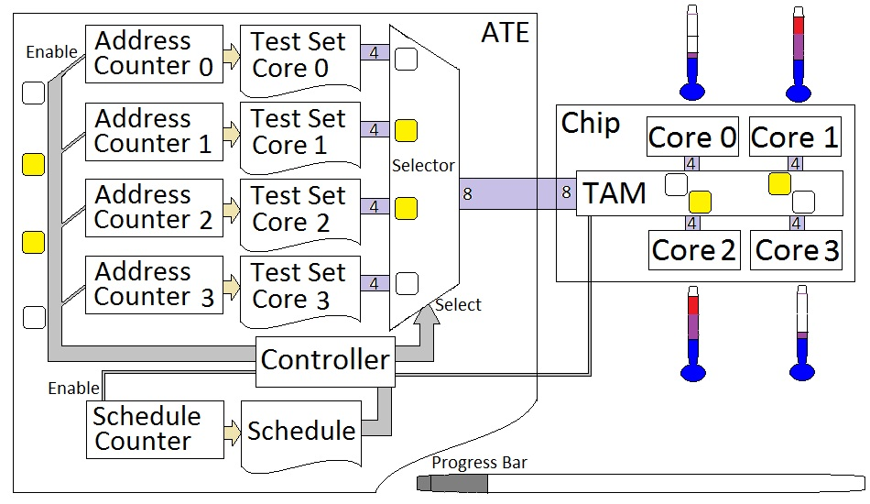
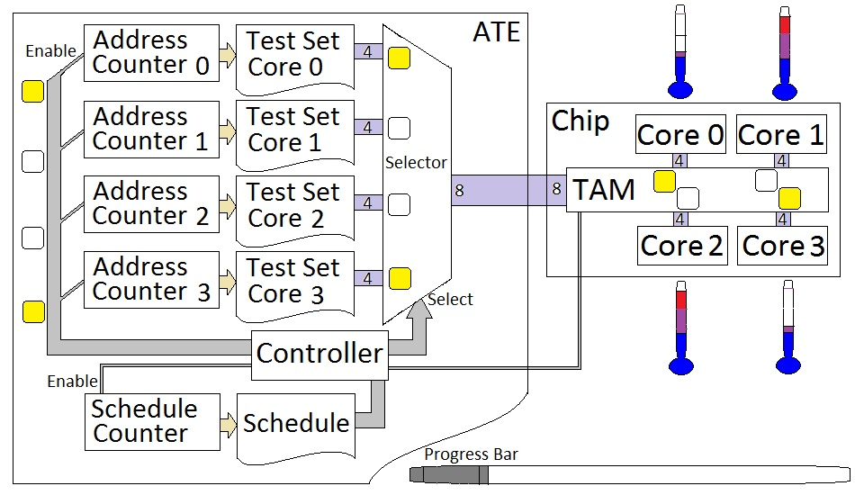
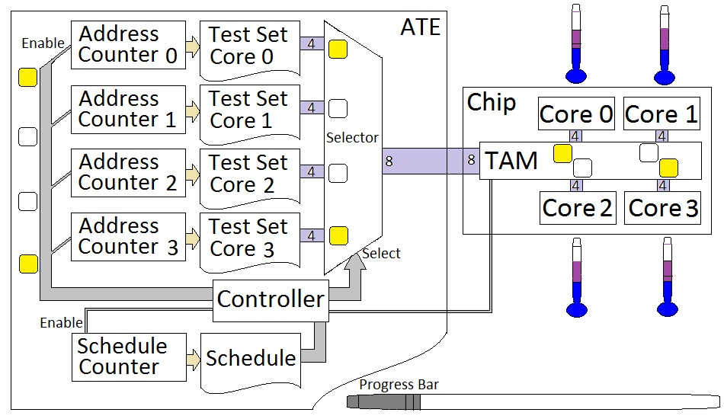
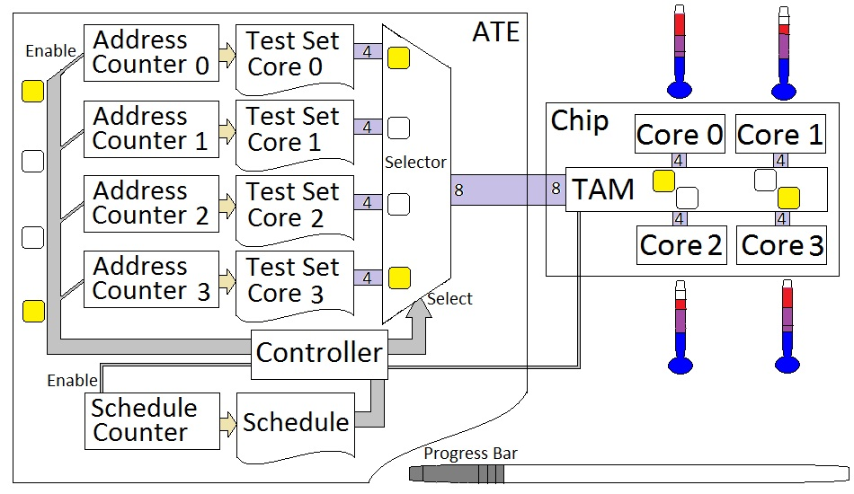
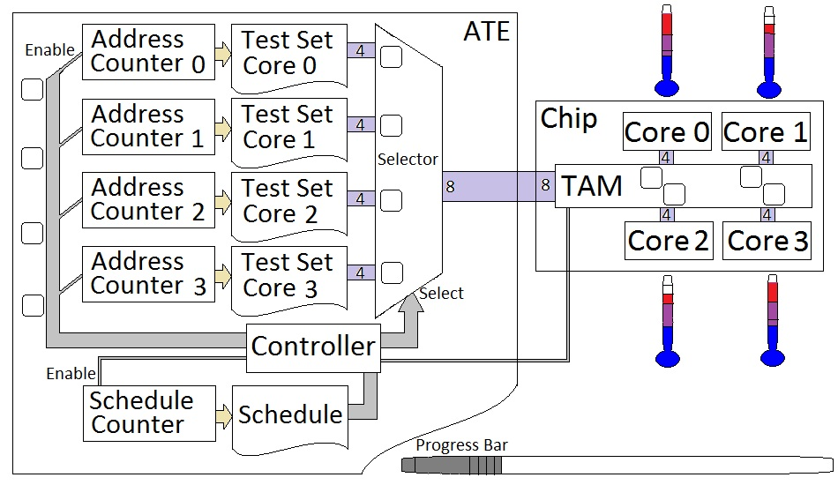
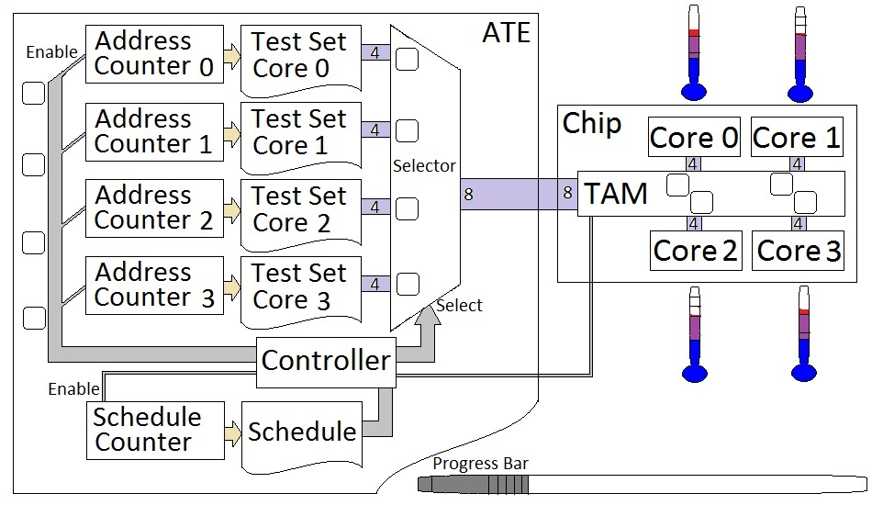
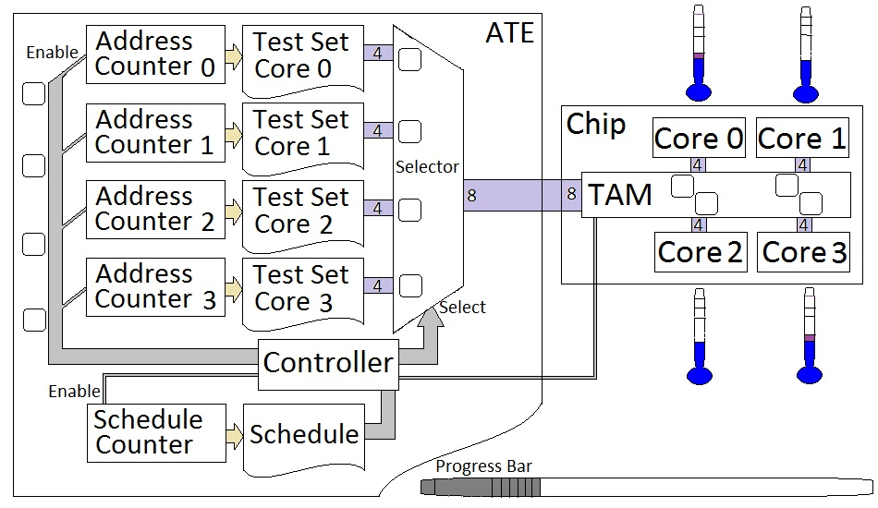
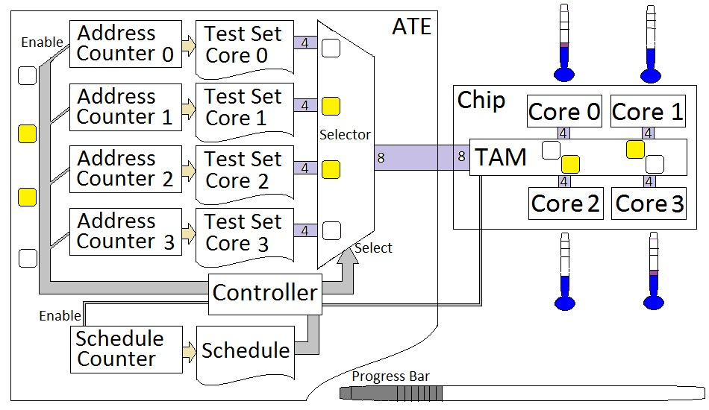
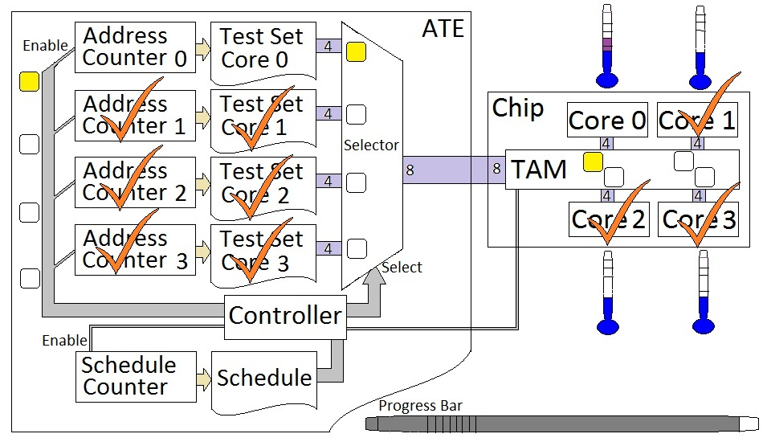
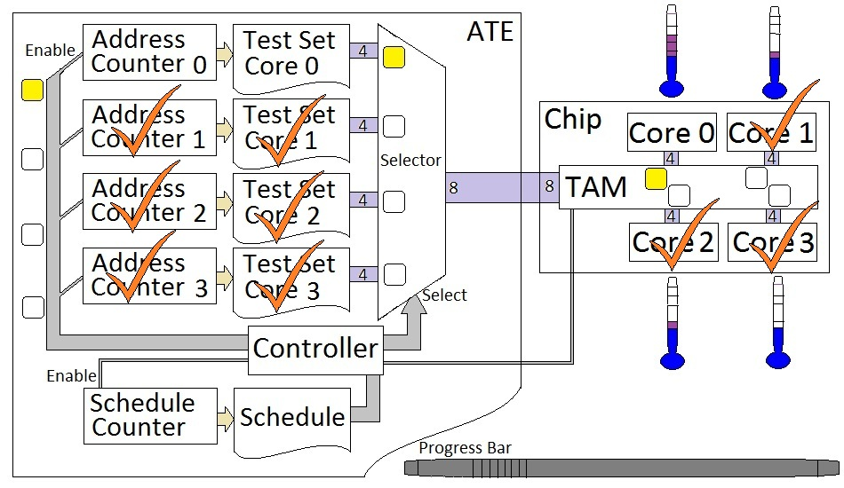
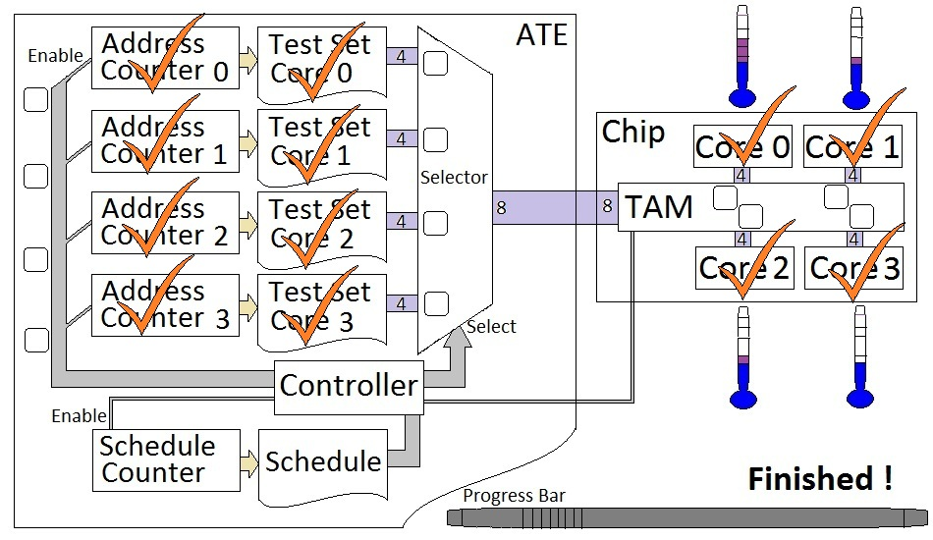
SoC Test Scheduling (in our framework)
Notes:
Introduce cooling cycles to avoid overheating using an offline thermal simulation

Slide 6
Process Variation - Causes
Variation in geometries and material properties
Variation in electrical parameters
Example: electrical resistances and capacitances
Result: variation in power profile
Variation in thermal parameters
Example: heat capacity and thermal conductivity
Result: variation in thermal behavior

Slide 7
Process Variation - Consequences
Identical switching activity
Different power profiles
Different temperature profiles

Slide 8
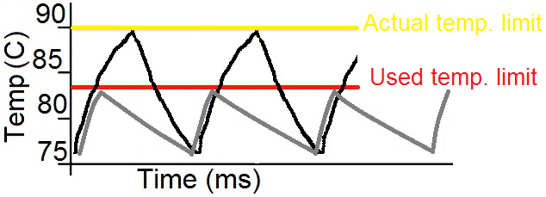
Schedule for Worst-case
Long Test Application Time
Scheduling for worst-case chip

Slide 9
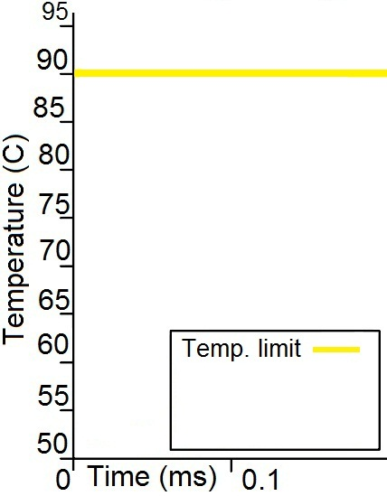
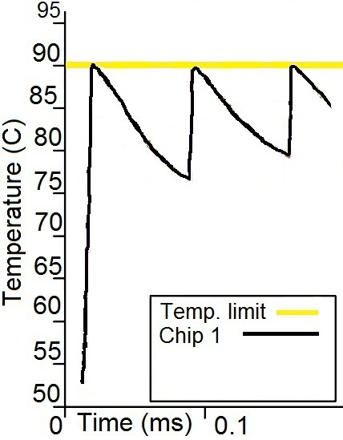
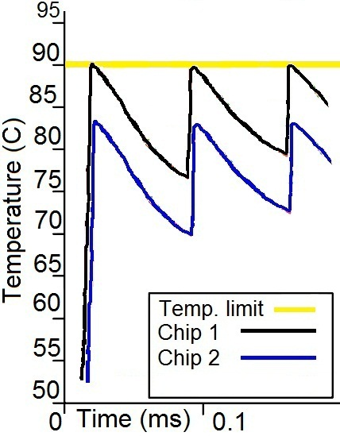
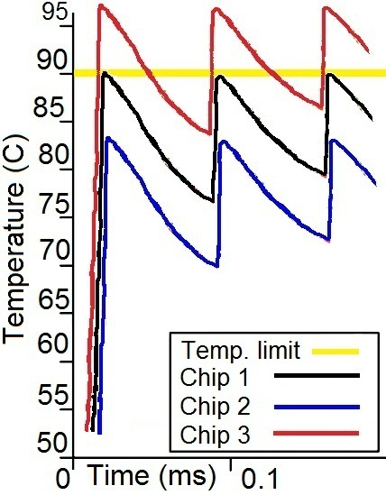
Schedule for Typical
Scheduling for typical chip
Warmer chips will Overheat
Minimize the test cost. Trade-offs are
Overheated chips
Test Application Time

Slide 10
Temperature Error
Temperature Error (TE) = Actual_Temperature – Expected_Temperature
Each core is characterized by its TE
TE distribution
Gives the probability that a chip has a certain temperature error
more

Slide 11
Linear Schedule
(a) No TE
(b) Time-invariant TE (not taken care of)
(c) Time-invariant TE (Statically taken care of)
(d) Time-variant TE (not taken care of)
Time variant TE
Dynamic schedule
Notes:
(b) X overheats, if no action is taken
(c) Excessively long Test Application Time is Safe action is taken to guarantee safety for worst-case

Slide 12
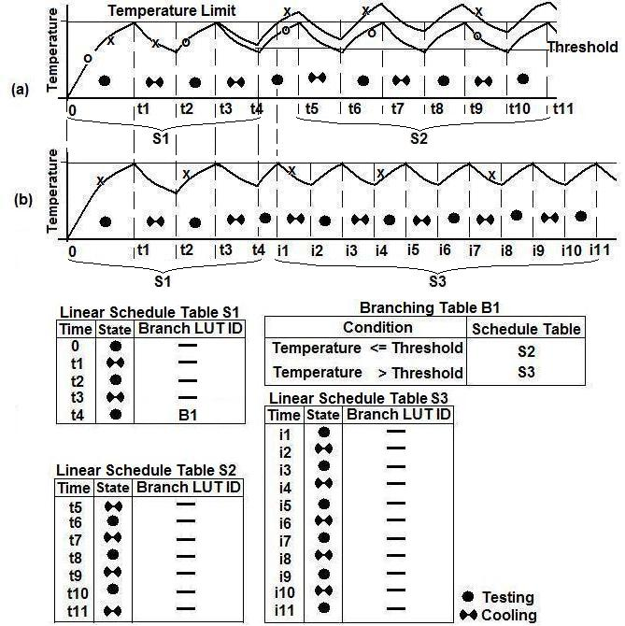
Branching Table
(a) Time variant TE (not taken care of X)
(b) Dynamically taken care of X
Linear schedules and a Branching table
Placement of the linear schedule tables and Branching tables
A tree structure

Slide 13
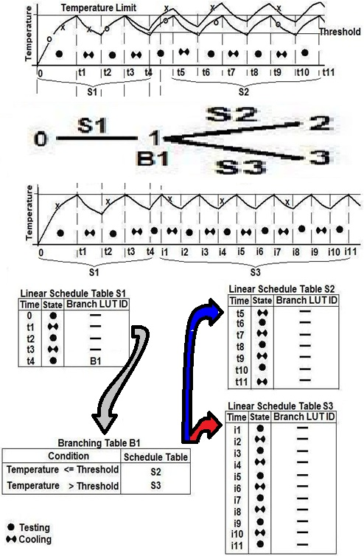
Schedule Tree
Online Phase
When to read
Which cores
How to react
Offline Phase
Find the optimum tree
Minimize TAT
Minimize Overheating
Keep required ATE memory within limits

Slide 14
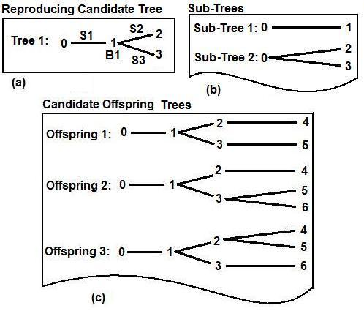
Optimization Heuristics
Tree construction
Optimize sub-tree topologies for each active leaf (more):
Genetic Algorithm
Particle Swarm Optimization
Add sub-tree combinations to leaves
Drop trees exceeding ATE memory
Select new reproducing trees
Exit, when no active leaf

Slide 15
Experimental Results 1

Slide 16
Experimental Results 2
Particle Swarm Optimization (PSO) finds the typical solution in shorter time (~45%) compared to Genetic Algorithm (GA)
PSO finds the best ever-found solution

Slide 17
Conclusion
An adaptive temperature–aware SoC test scheduling method is required for large process variation condition
On-chip sensors have to be used during test
PSO outperforms GA in sub-tree clustering problem
PSO is faster to develop
At least, the code size is 370 lines compared to 730 lines for GA

Slide 18
Questions ?

Slide 19
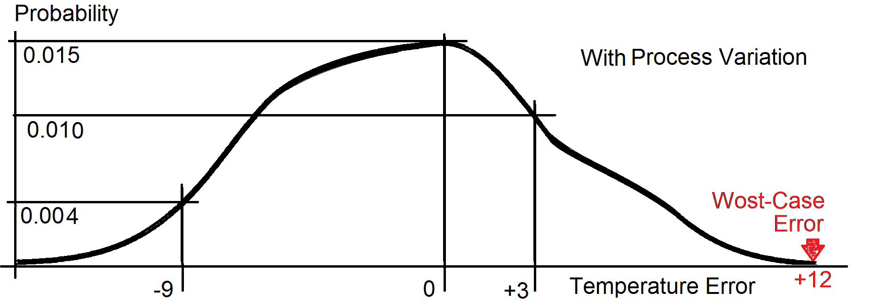
Temperature Error – Example
Probability of TE = 0 is 0.015
Probability of TE = +3 is 0.010
Probability of TE = -9 is 0.004
Notes:
The curve is discrete, just for the sake of the presentation is illustrated as continuous.

Slide 20
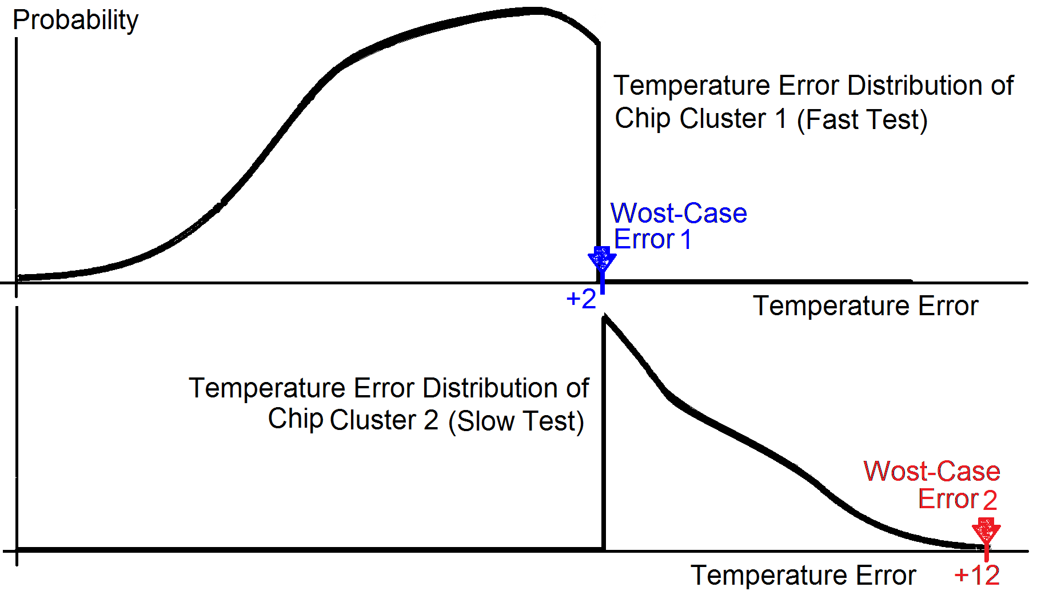
Chip Clustering
Chip cluster
Chips with cores within certain TE ranges
Test of each cluster is scheduled base on a Representative Error
Example: Worst-Case error
Chip cluster 1
Cool
Fast test
Chip cluster 2
Warm
Slow test
back
Notes:
The curve is discrete, just for the sake of the presentation is illustrated as continuous.

Slide 21
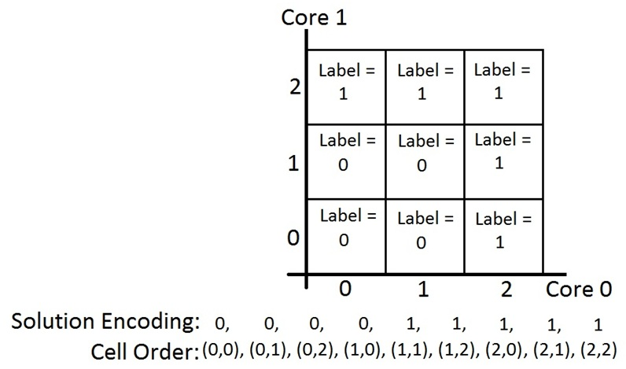
Sub-tree Optimization - Coding
Branching node
Number of Branches = Number of Chip Clusters
Example, one node:
2 chip clusters
2 cores
3 error cells per core
Cell is labeled with cluster ID
9 cells to be labeled with 0 and1
Nodes are placed serially in the solution
Heuristics:
Genetic Algorithm
Particle Swarm Optimization

Slide 22
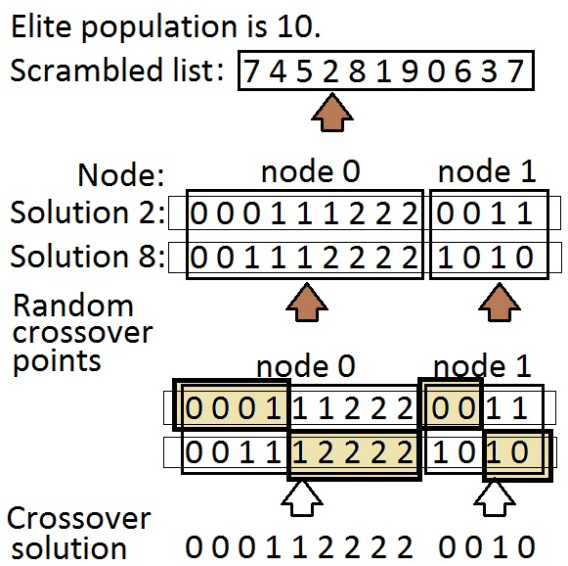
Genetic Algorithm – cross over
Generate scrambled list of elites
Traverse scrambled list
For each node
Generate a random cross over point
Mix the chromosome with its next neighbor
Assure all clusters are present

Slide 23
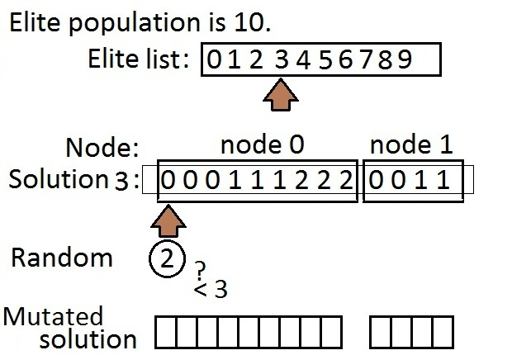
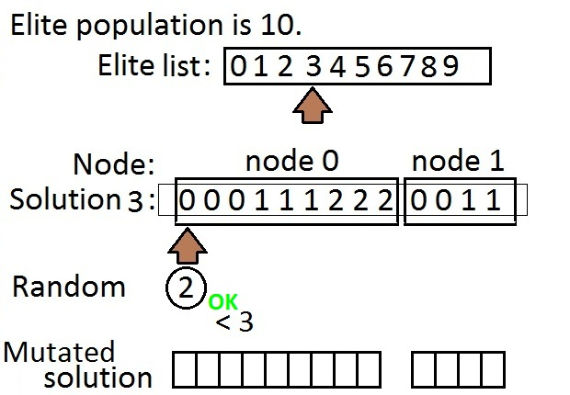
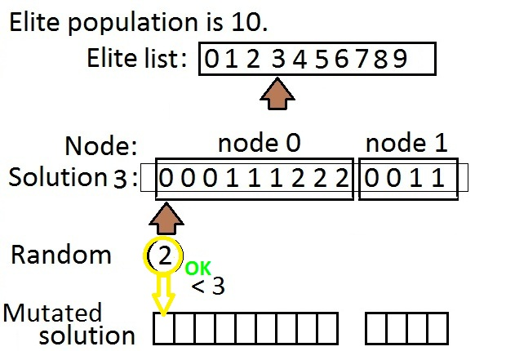
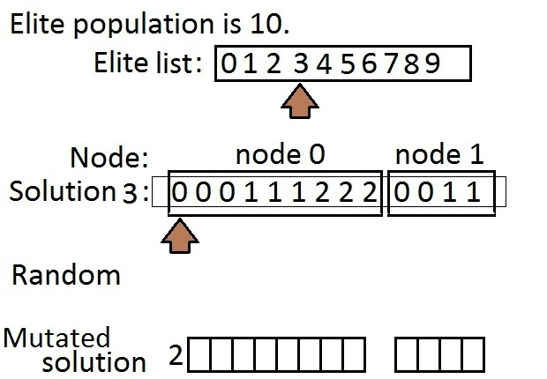
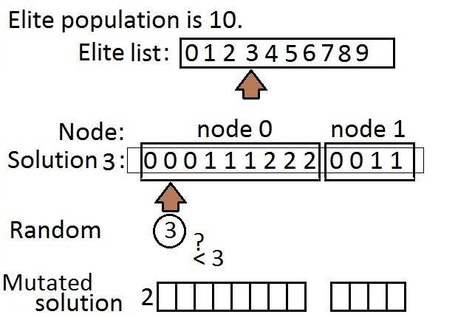
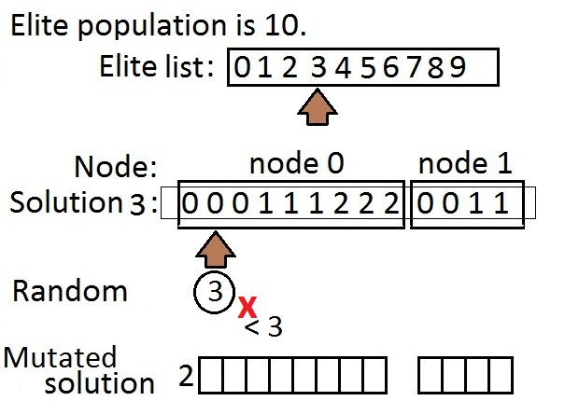
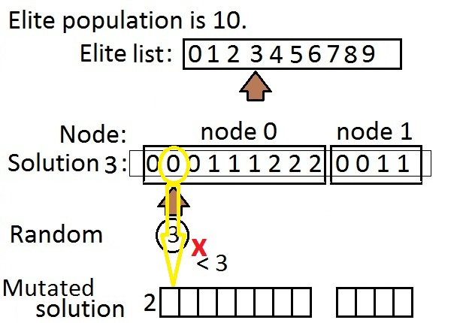
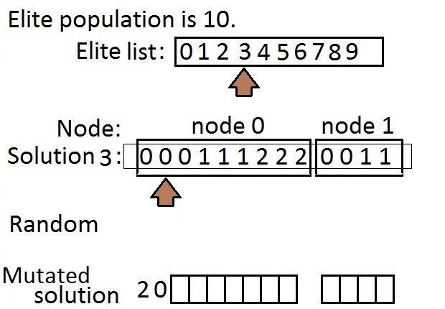
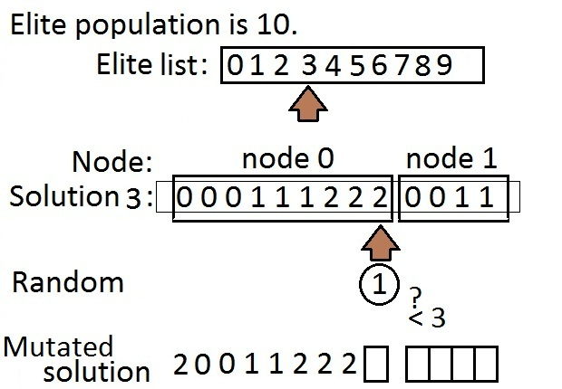
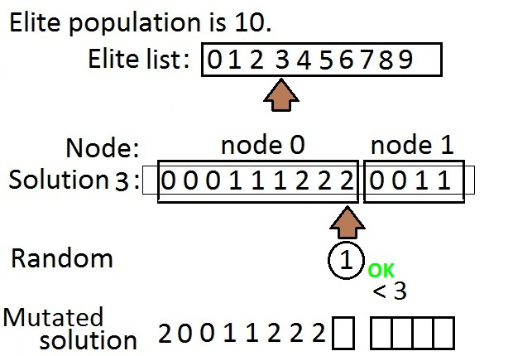
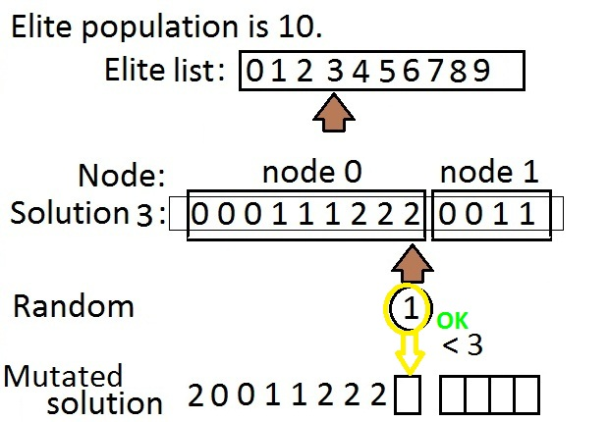
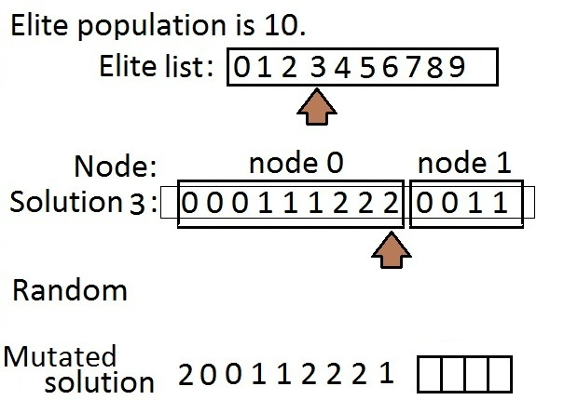
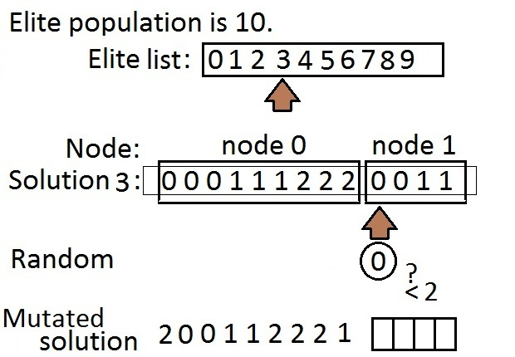
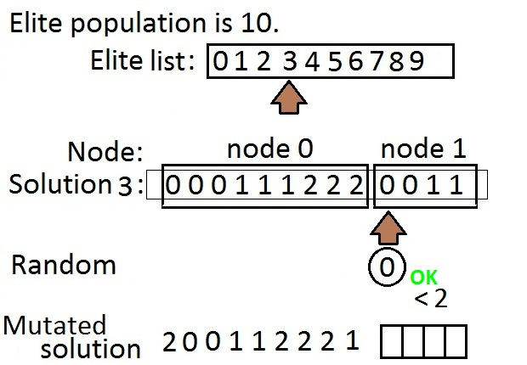
Genetic Algorithm - mutation
Traverse elite list
For each generate random integer (numberOfClusters-1)/MutationProbability
If smaller than numberOfClusters, copy the random integer, otherwise from the parent

Slide 24
Particle Swarm Optimization
Mimics the social behavior
School of fish searching for food,
Flock of birds in a cornfield
Swarm of particles (population)
Particles explore search space by semi random moves
Each particle remembers the previous best location it has visited
The global best location is also kept
The previous best and global best, give the search a direction

Slide 25
PSO – 1-D example
A canonic form:
skip

Slide 26
PSO – Sub-tree Optimization
Differences with canonical form:
Location is integer
Velocity is real
If a chip cluster is absent
Reset the particle to its previous best
If out of range particle
Saturate to nearest border point
Set the corresponding velocity component to 0

Slide 27
Termination for GA and PSO
If the improve in the cost is smaller than MinimumAcceptableImprovement increment iterationsWithoutImprove, otherwise, clear iterationsWithoutImprove
If iterationsWithoutImprove is larger than MaximumNumberOfNonImprovingIterations exit with global best as final solution.
back

