Slide 1
Process-Variation and Temperature Aware SoC Test Scheduling Using Particle Swarm Optimization
Nima Aghaee, Zebo Peng, and Petru Eles
Embedded Systems Laboratory (ESLAB)
Linkoping University
6th IEEE International Design and Test Workshop (IDT'11)

Slide 2
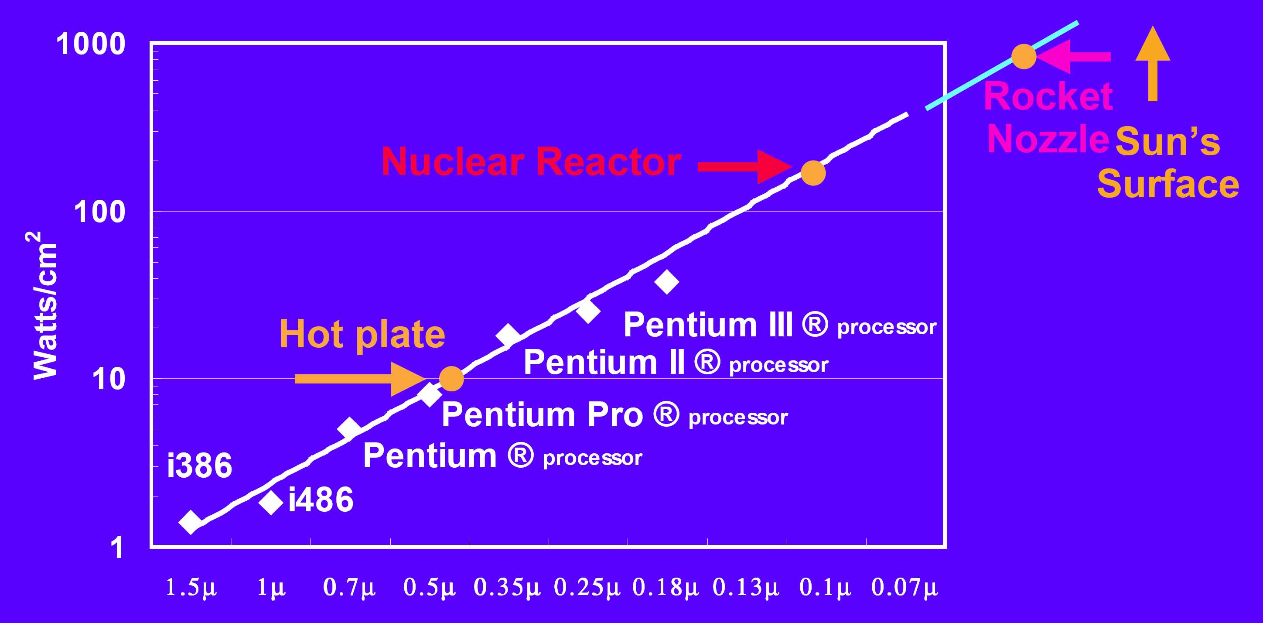
Increasing Power Density
Power density increases exponentially with technology scaling!
Source:
F. Pollack, Int. Symp. Microarchitecture, 1999

Slide 3
High Test Power
Power consumption during SoC test is much higher than that in normal mode [Zorian, 93 & Wang, 98]
Test patterns with high toggle rate
Parallel testing
High speed scan-based testing

Slide 4
High Test Temperature
High test power density
High test temperature
Overheating
Yield loss (Overkill): good chips fail the test
Damage to the devices under test

Slide 5
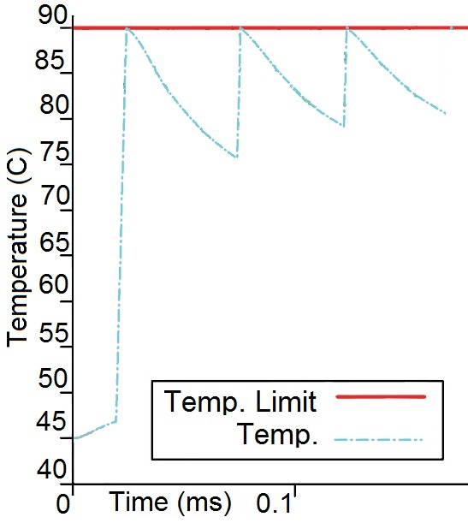
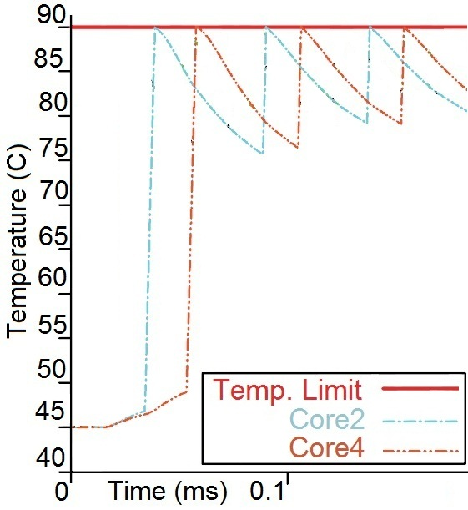
Temperature-Aware Test Scheduling
Introduce cooling cycles to avoid overheating
Partitioning and interleaving
Reduced Test Application Time

Slide 6
Related Works
Z. He, Z. Peng, P. Eles, P. Rosinger and B. M. Al-Hashimi. “Thermal-aware SoC test scheduling with test set partitioning and interleaving.” J. Electronic Testing, 2008.
Thermal-safe schedule
Partitioning and interleaving
D.R. Bild et Al. “Temperature-aware test scheduling for multiprocessor systems-on-chip.” ICCAD 2008.
Test power analysis
Phased steady state thermal model

Slide 7
Related Works
N. Aghaee, Z. He, Z. Peng, and P. Eles. “Temperature-aware SoC test scheduling considering inter-chip process variation.” ATS 2010.
Thermal consequences of the process variation
Inter-chip time-invariant deviations
C. Yao, K. K. Saluja, P. Ramanathan. “Thermal-aware test scheduling using on-chip temperature sensors.” VLSI Design 2011.
Simulation inaccuracies
Tests run to the end

Slide 8
Outline
Introduction
Effects of process variation
Test scheduling technique
Particle Swarm Optimization
Experimental results
Conclusion

Slide 9
Process Variation - Causes
Variation in geometries and material properties
Variation in electrical parameters
Example: electrical resistances and capacitances
Result: variation in power profile
Variation in thermal parameters
Example: heat capacity and thermal conductivity
Result: variation in thermal behavior

Slide 10
Process Variation - Consequences
Identical switching activity
Different power profiles
Different temperature profiles

Slide 11
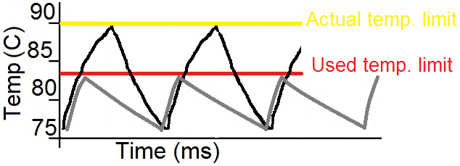
Schedule for Worst-Case
Scheduling for worst-case chip
Long Test Application Time

Slide 12
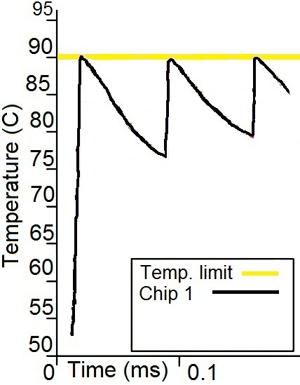
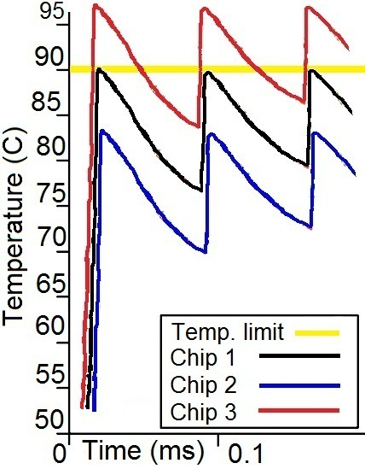
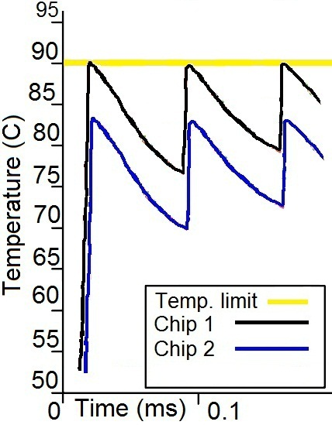
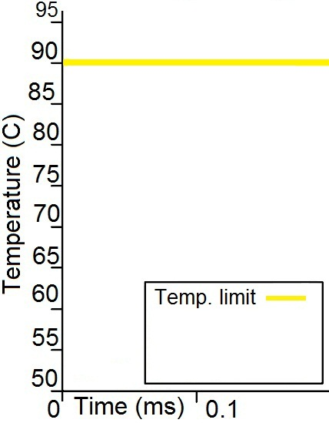
Schedule for Typical Case
Scheduling for typical chip
Warmer chips will Overheat
Minimize the test cost. Trade-offs are
Overheated chips
Test Application Time

Slide 13
Temperature Error Model
Temperature Error (TE) is Actual Temperature – Expected Temperature
TE distribution gives the temperature error probabilities
For cores
For time instances

Slide 14
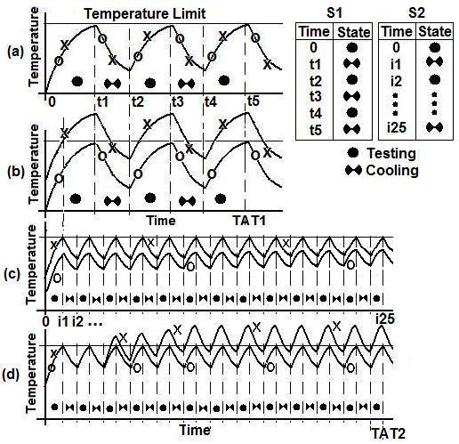
Linear Schedule: Four Scenarios
a. No TE
b. Time-invariant TE
(not taken care of)
c. Time-invariant TE
(Statically taken care of)
d. Time-variant TE
(not taken care of)
Traditional methods
Not dynamic
Not process variation aware
Adaptive method used here
Dynamic schedule (based on sensor readouts)
Consider 2 chips called O and X
One linear schedule table is perfect
When to test
When to cool
Time variant TE
Dynamic schedule

Slide 15
The Proposed Method
A number of schedules generated in offline phase (Design)
Find the near optimal schedule
Minimize expected TAT
Minimize expected Overheating
Respect ATE memory limit
The computationally expensive part is done using Particle Swarm Optimization
In online phase (Testing), the proper schedules are selected based on temperature sensor readouts
No computation in Online phase, we know from the schedule:
When to read the sensors
For which cores
How to react

Slide 16
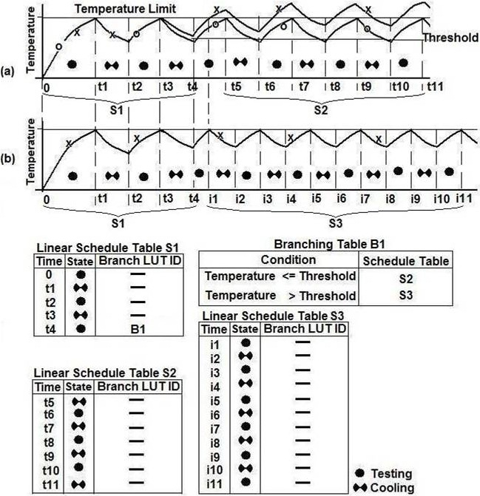
Branching Table
Time variant TE:
a. Not taken care of X
Only linear schedule
(static/offline schedule)
b. Dynamically taken care of X
Linear schedules + Branching
Placement of the linear schedule tables and branching tables
A tree structure

Slide 17
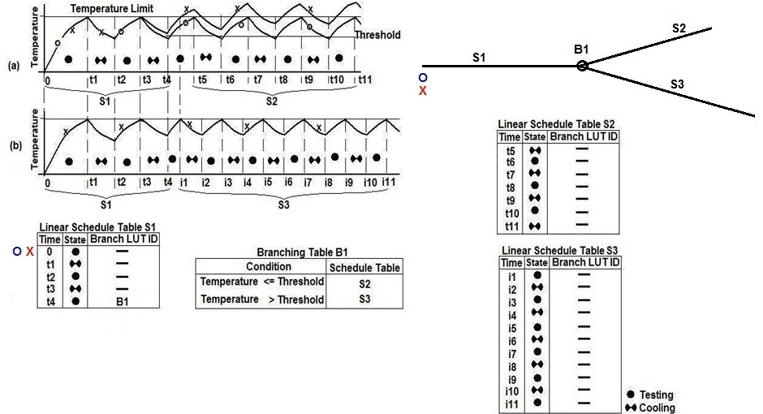
Schedule Tree - Example

Slide 18
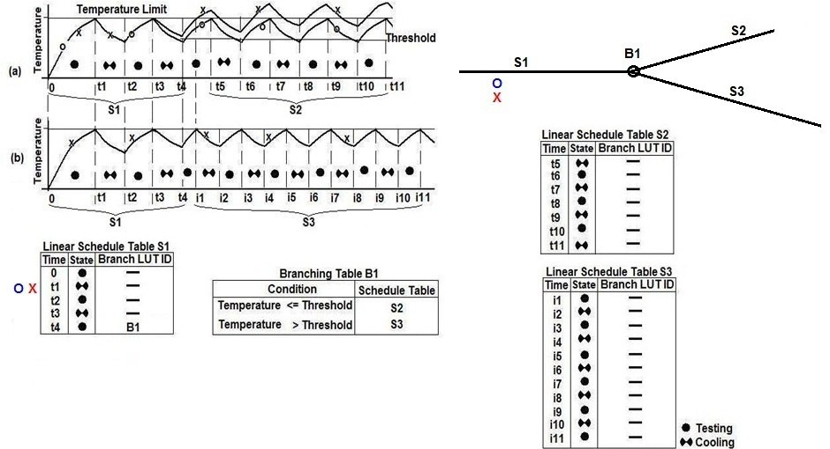
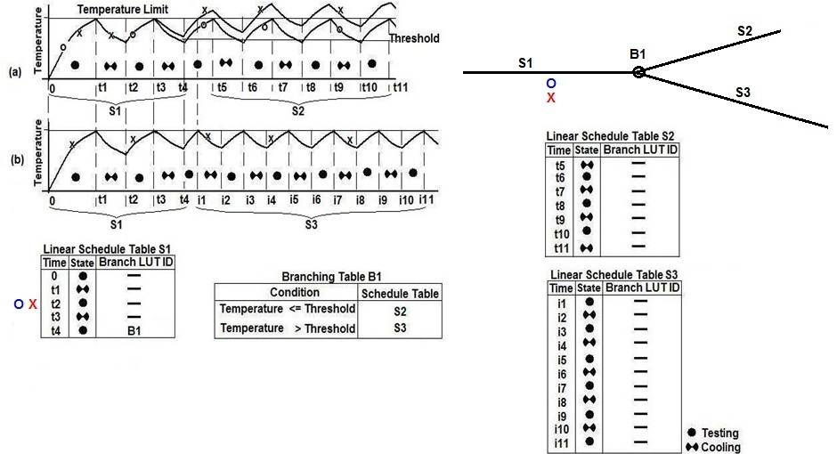
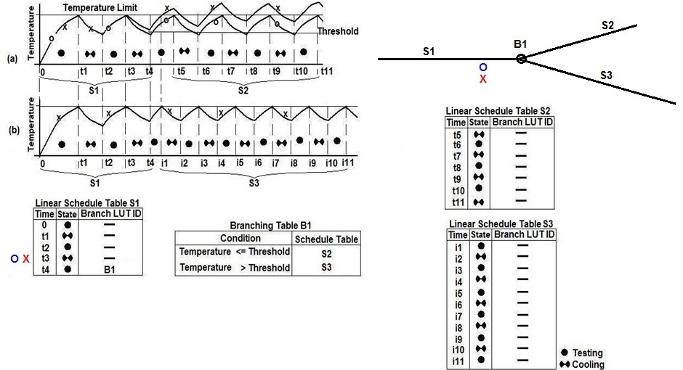
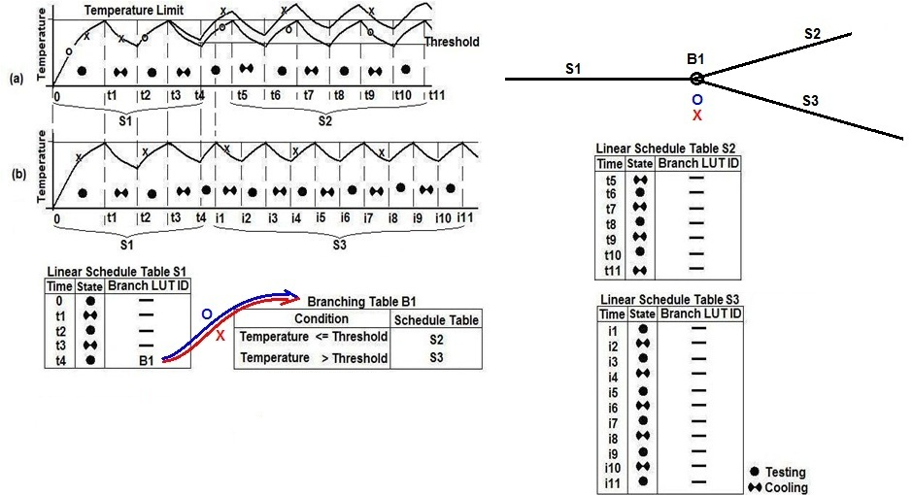
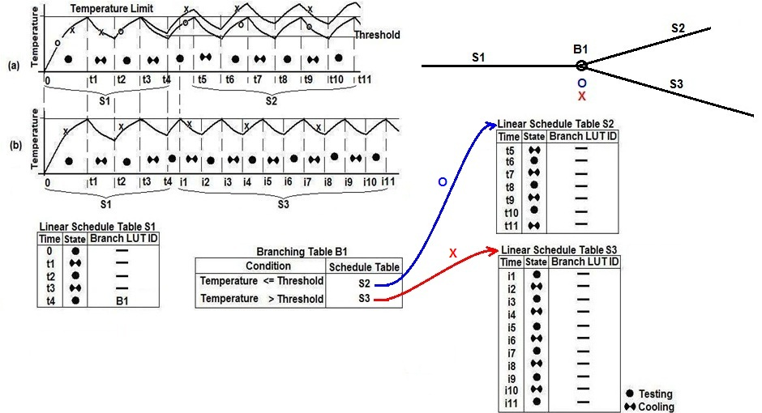
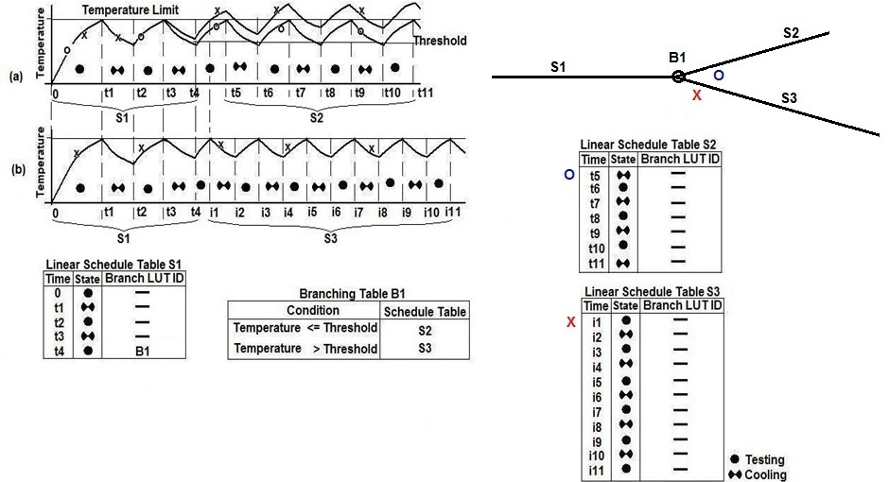
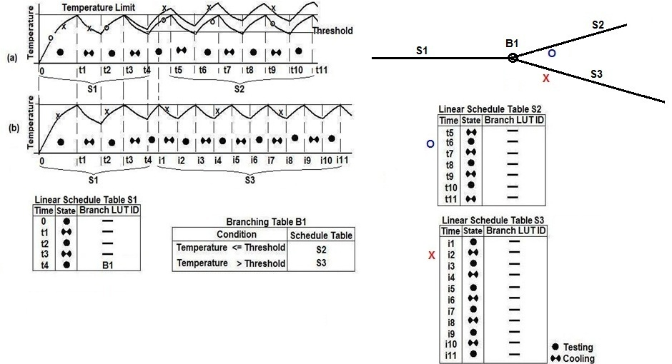
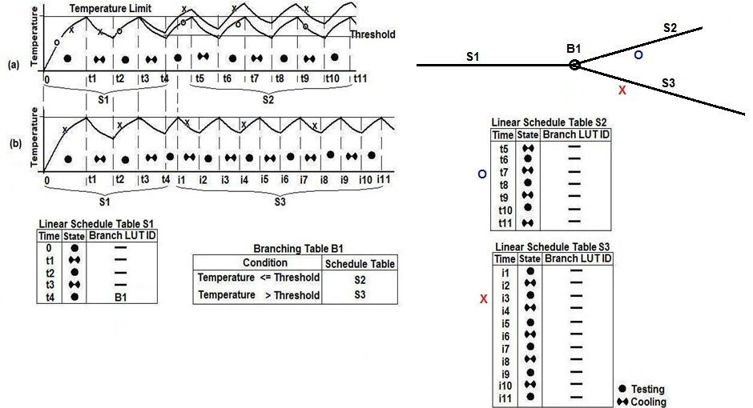
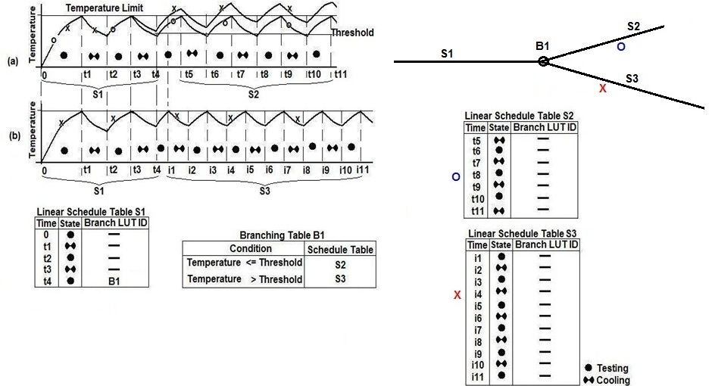
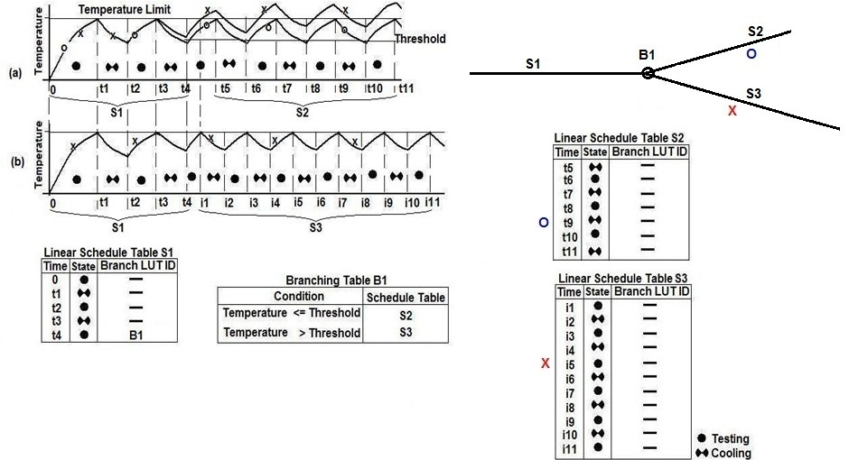
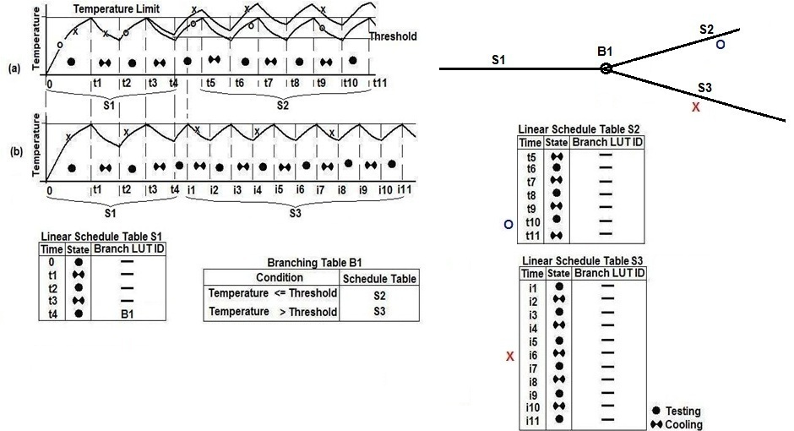
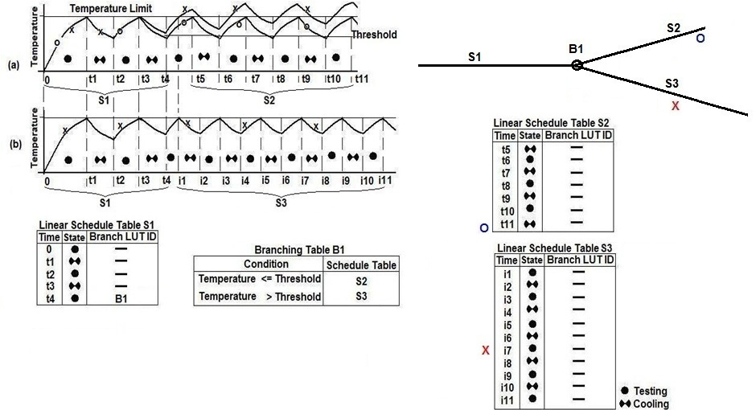
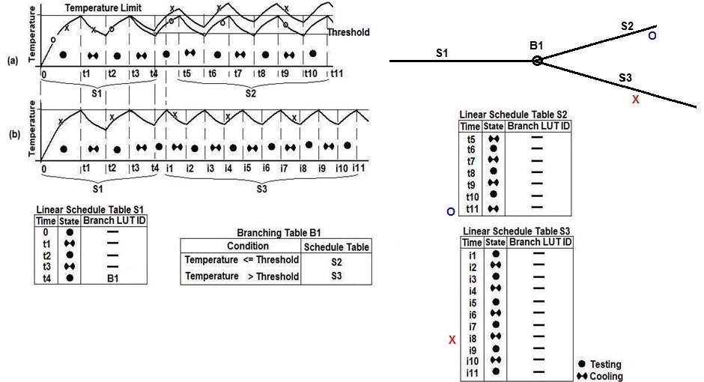
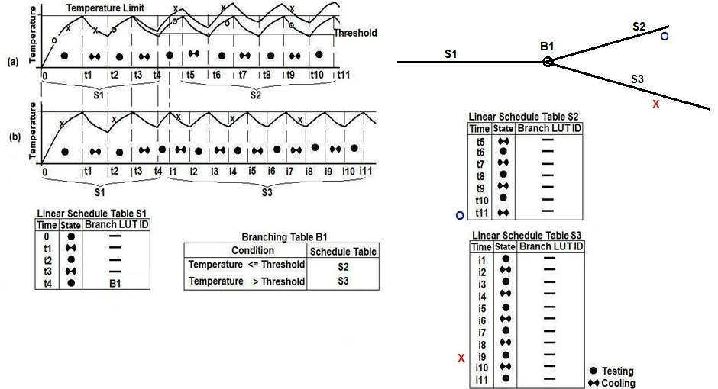
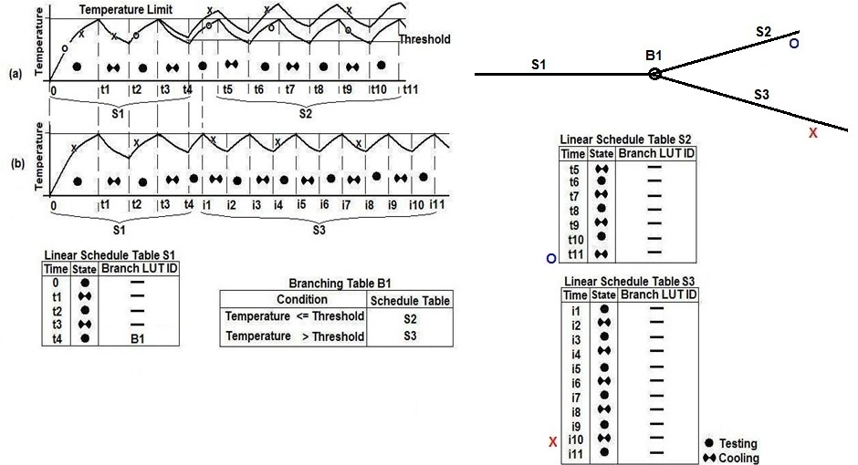
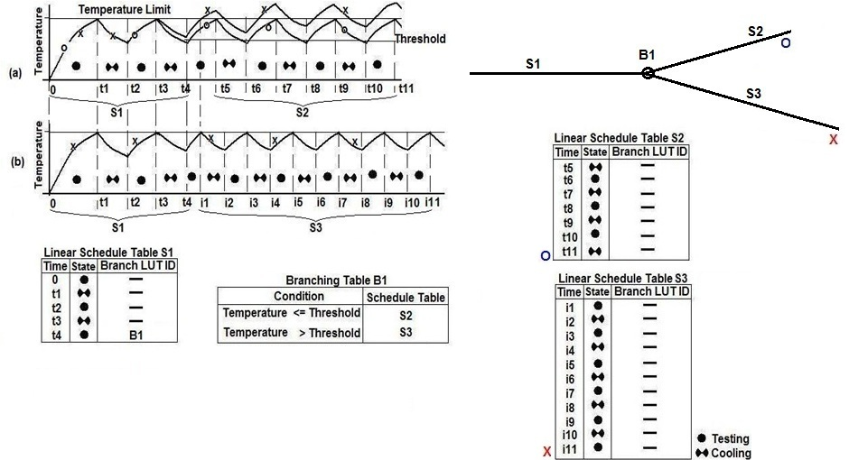
Schedule Tree – Online Phase
Depending on the temperature, ATE branches to S2 or S3 in order to test chip O or X
Test of O is over, but X needs more time since it works warmer and needs more cooling
Both O and X initially follow S1
At t4 ATE reads the temperature sensor and refers to B1

Slide 19
Schedule Tree – Offline Phase
Finding the optimal tree
Tree topology
Number and order of linear and branching table
Content of the tables
Time instances and actions in linear tables
Conditions and actions in branching tables
Constructive approach for tree
Sub-trees are building blocks

Slide 20
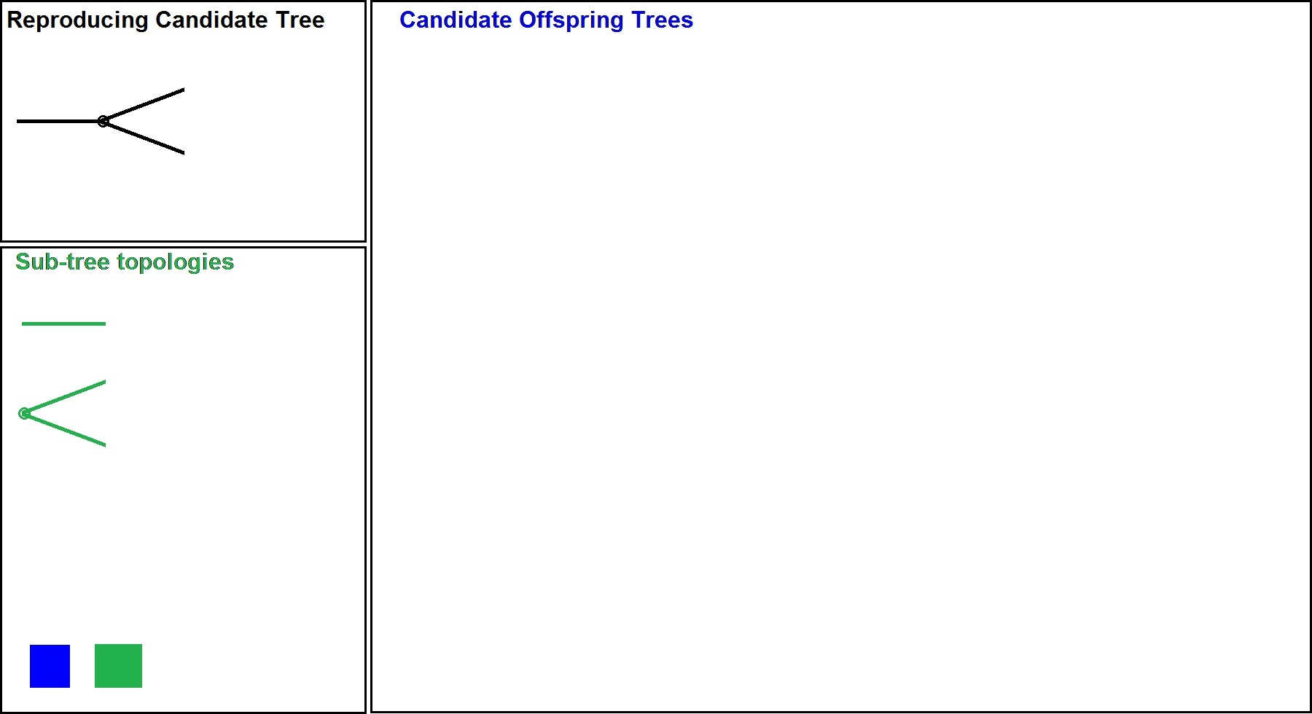
Tree Construction
Schedule tree is constructed by adding the sub-trees to a reproducing candidate tree
Sub-tree Topologies

Slide 21
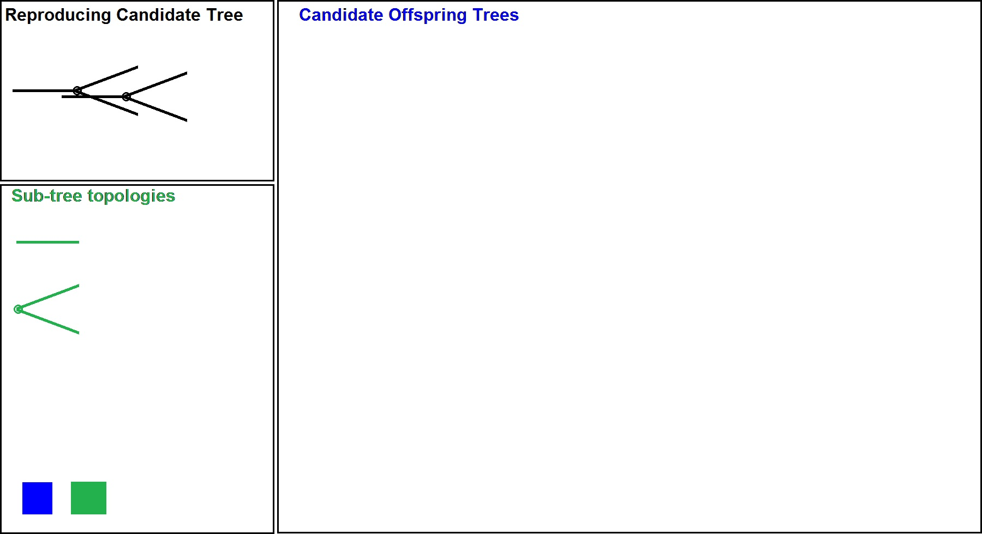
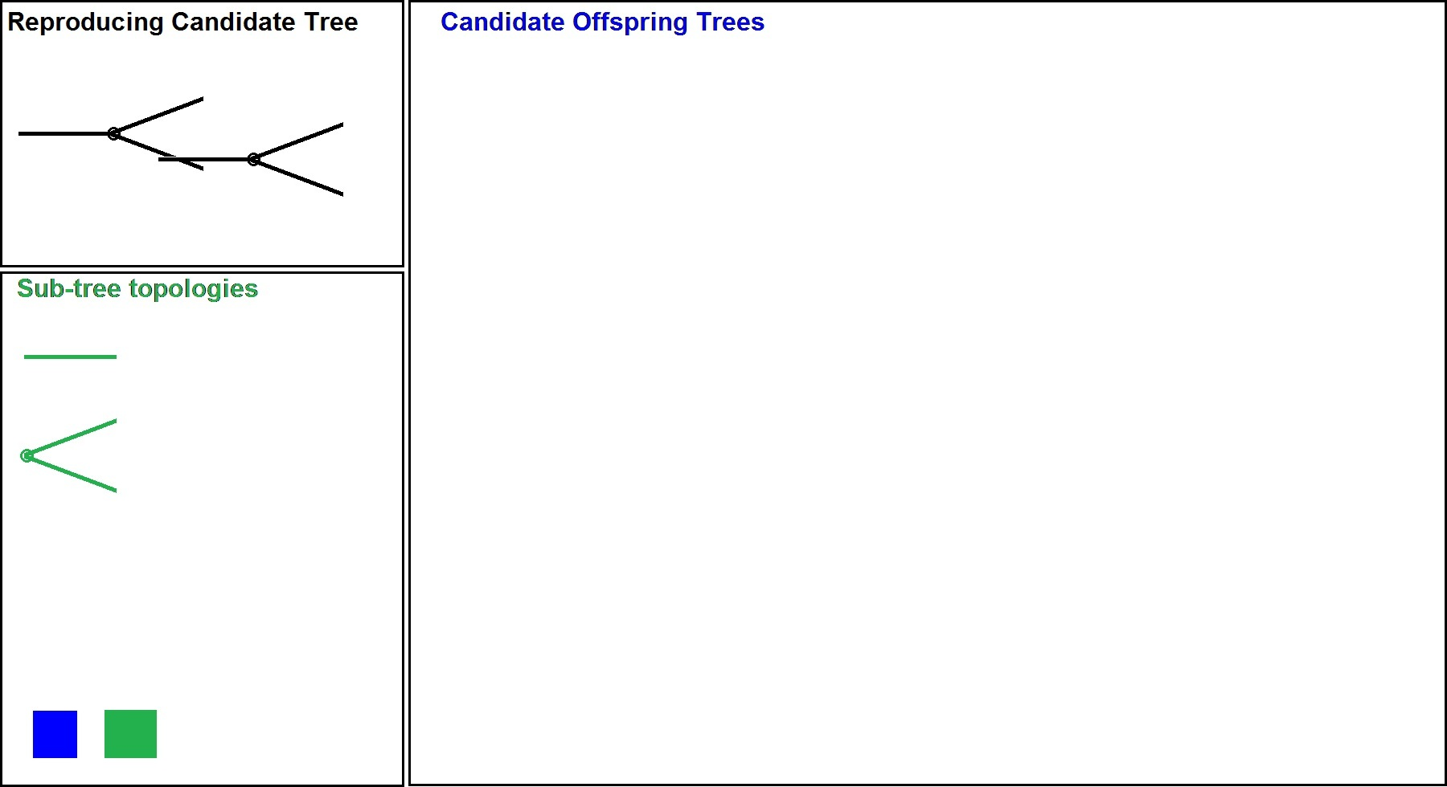
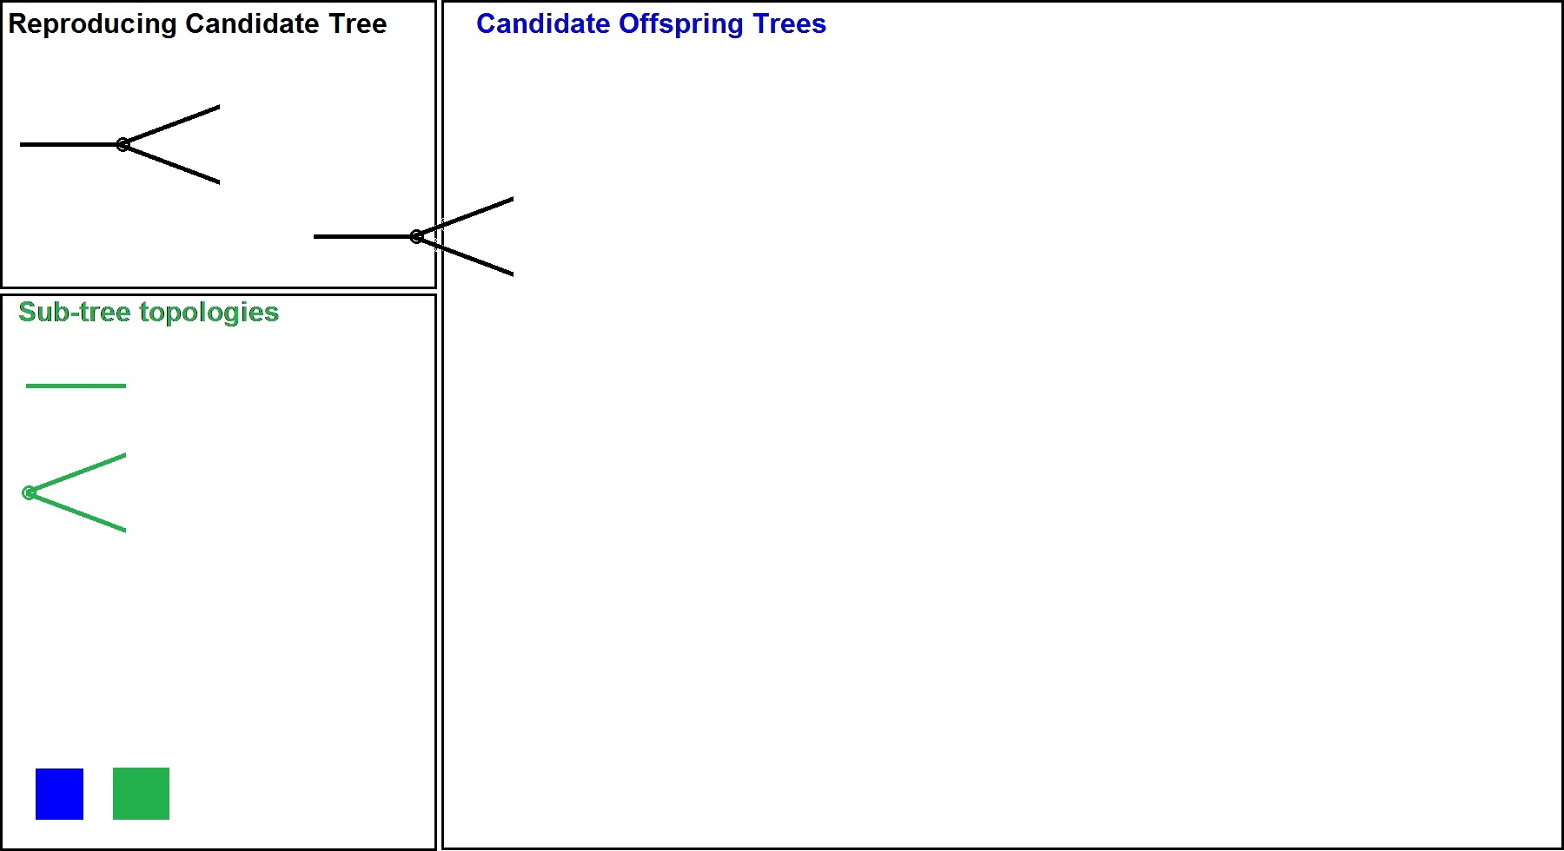
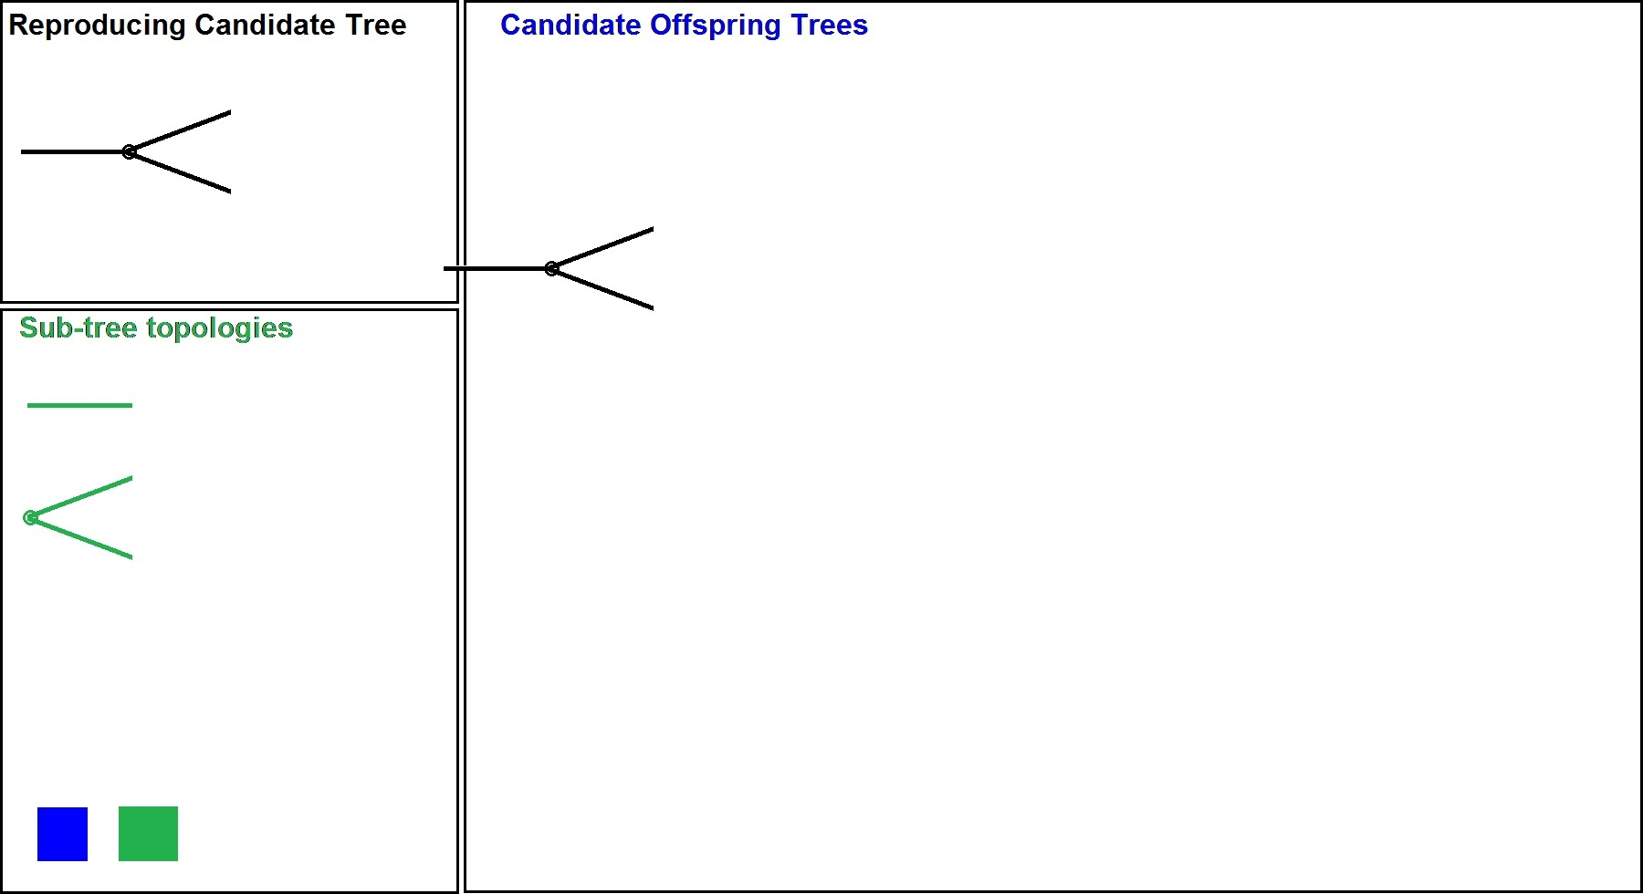
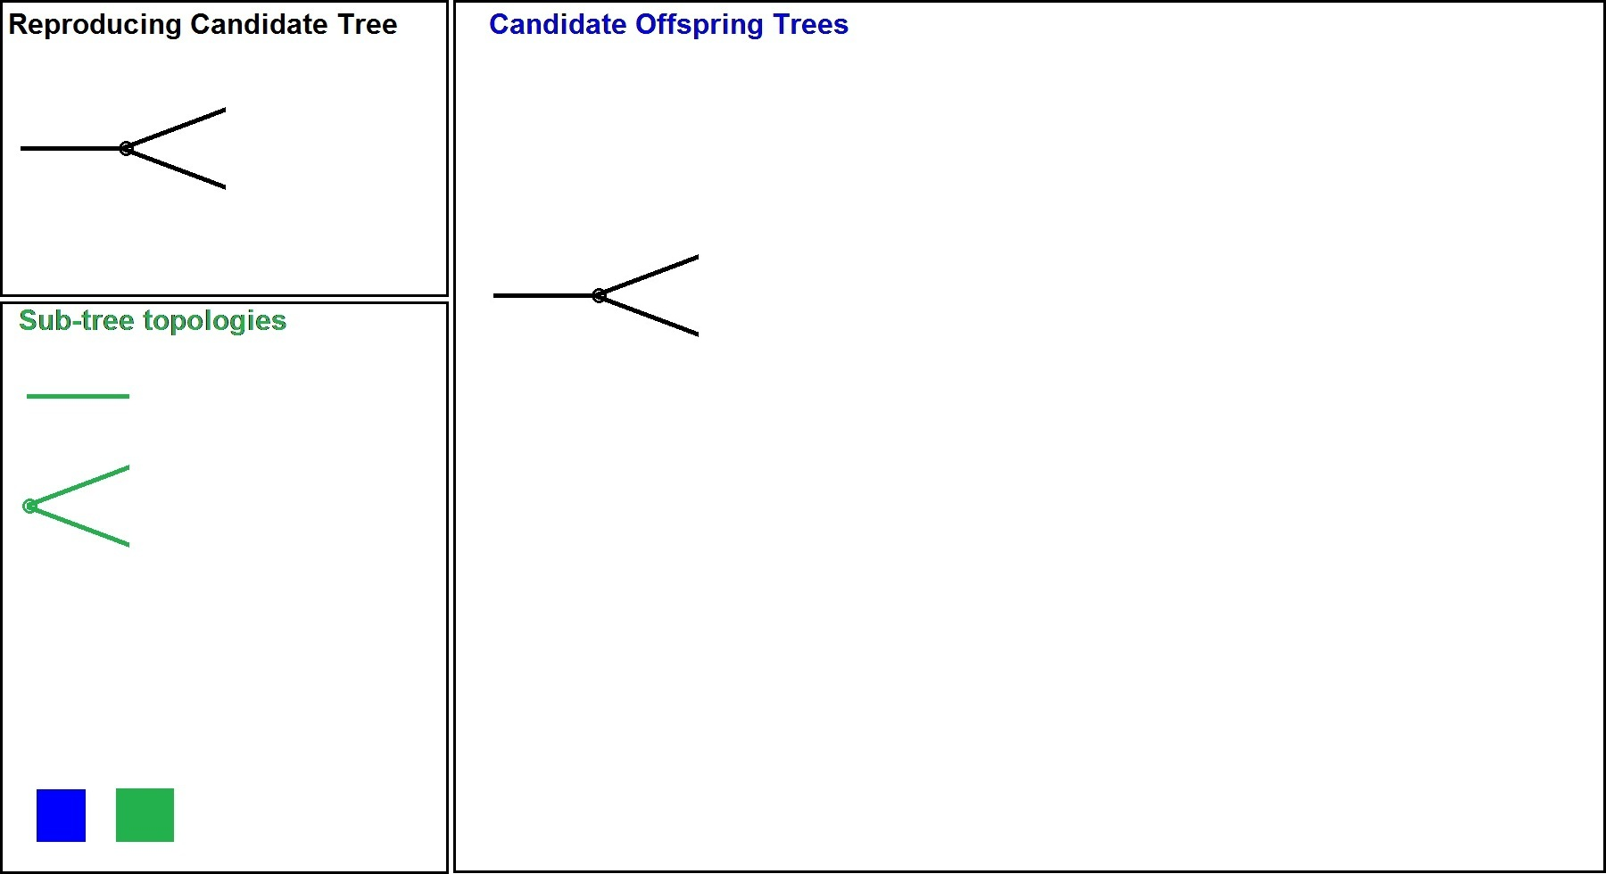
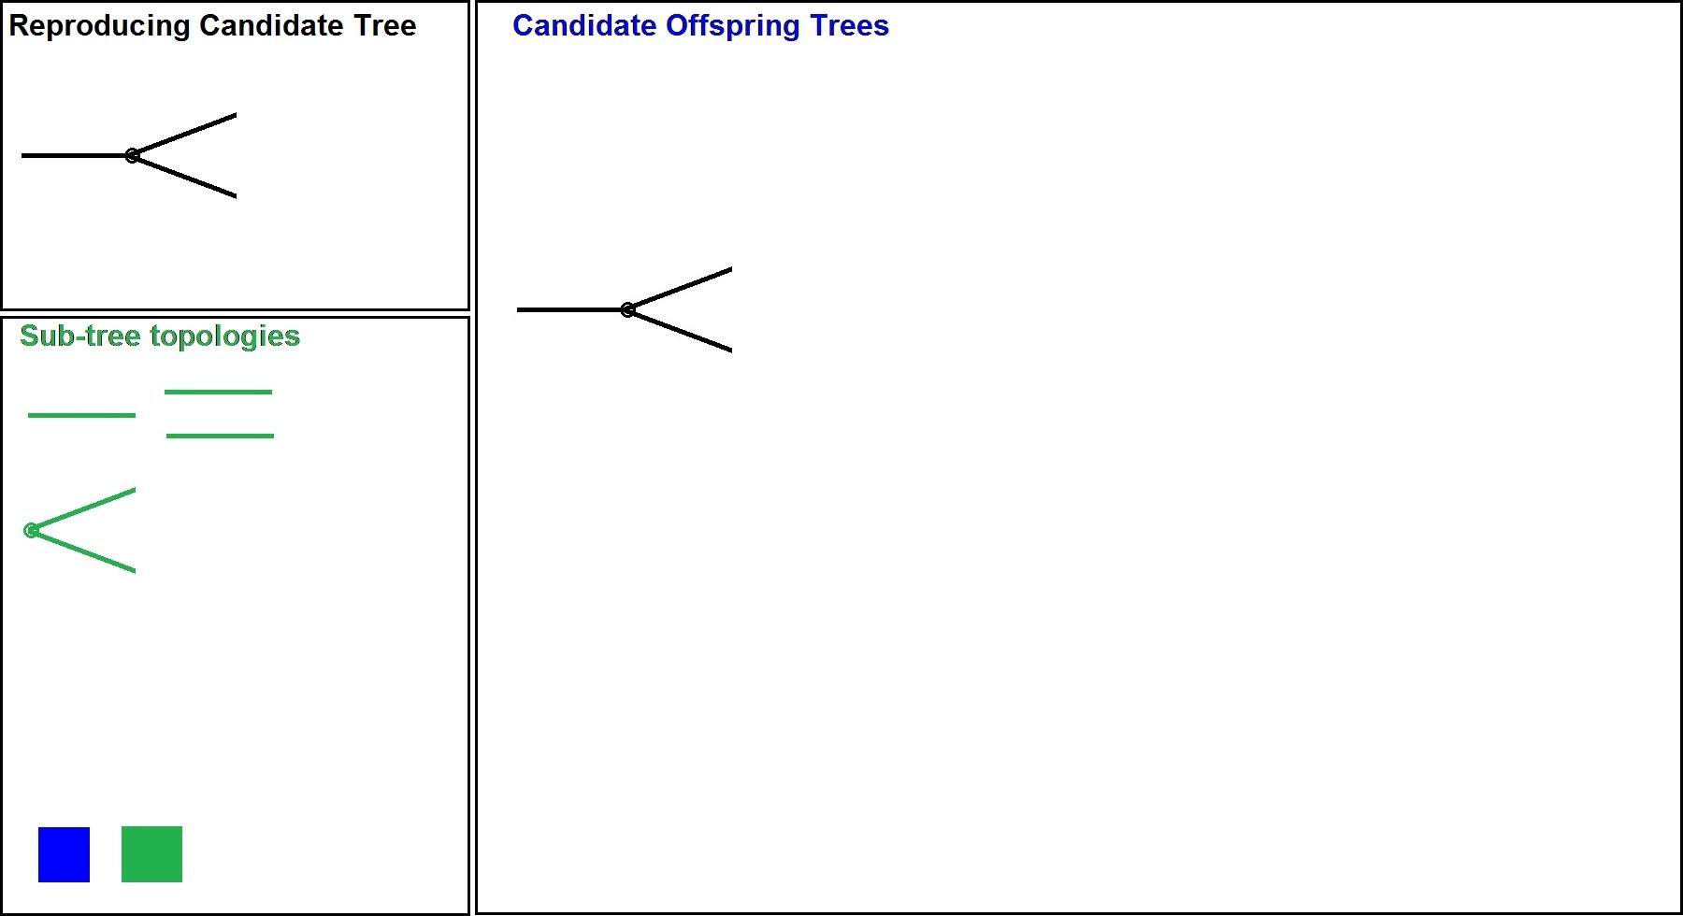
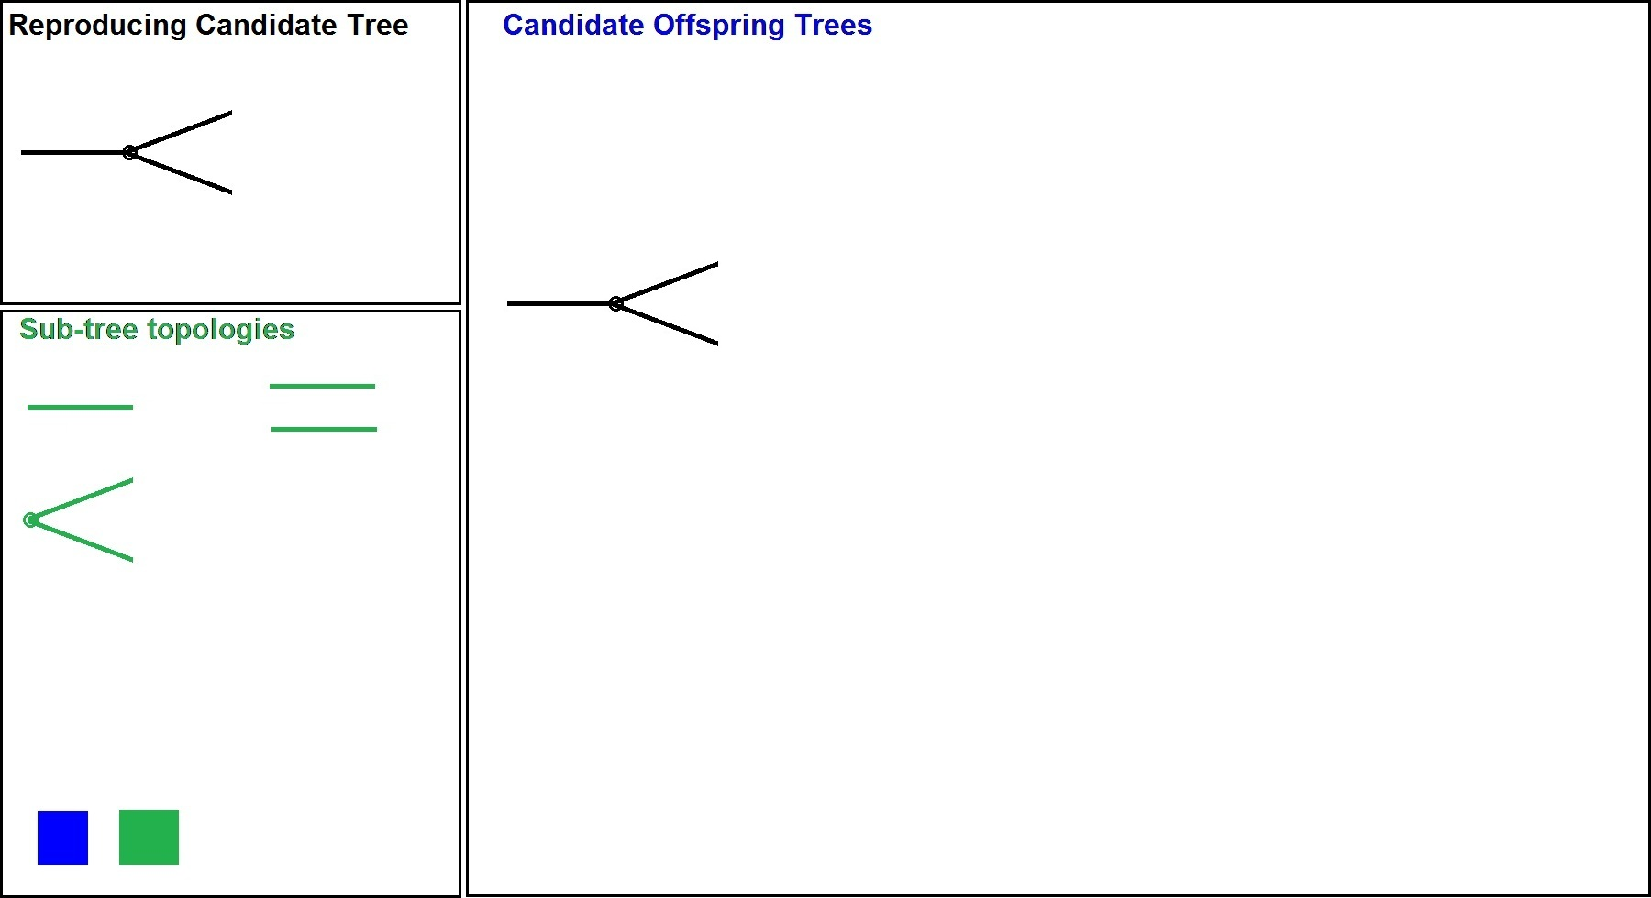
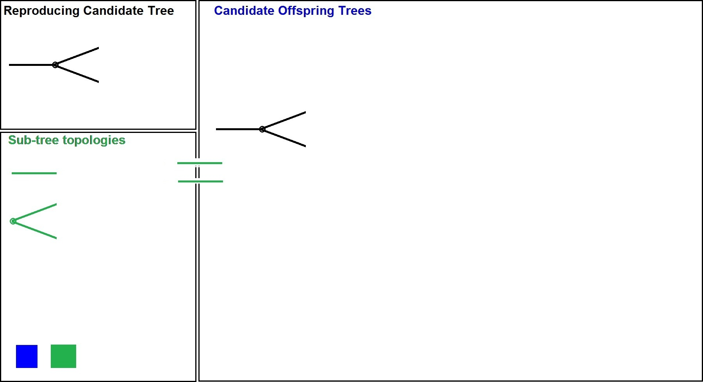
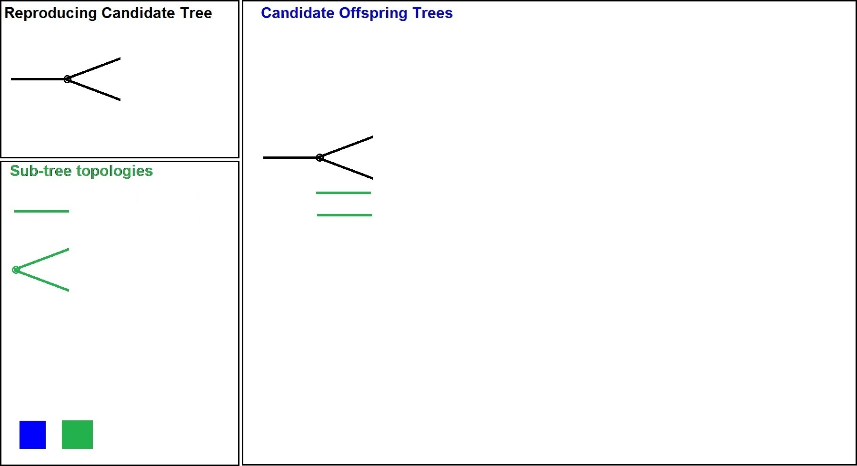
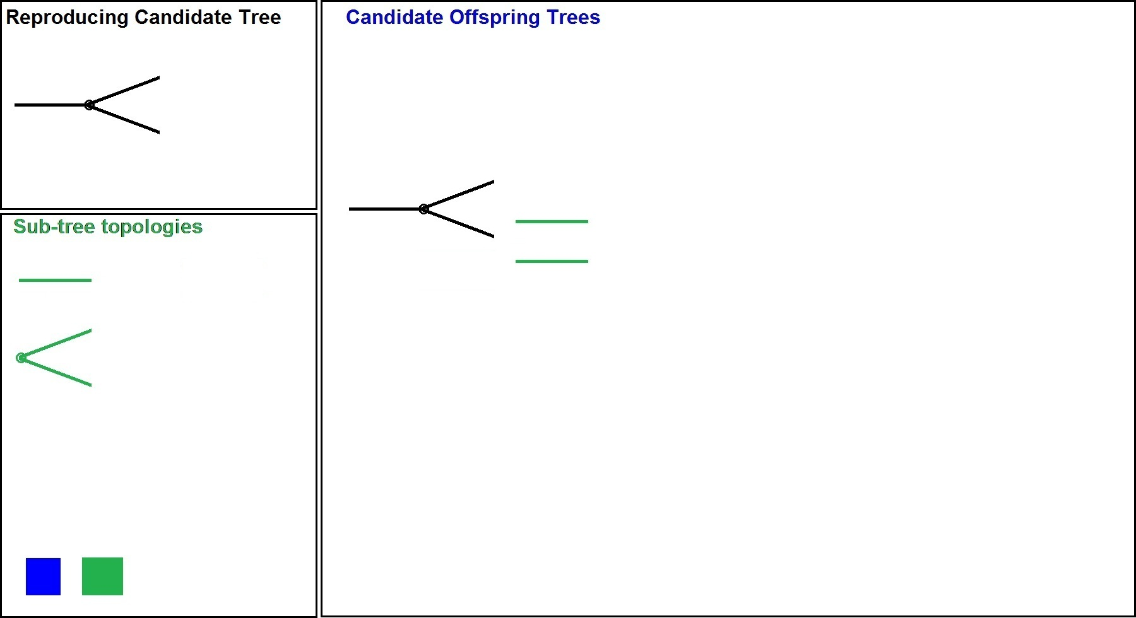
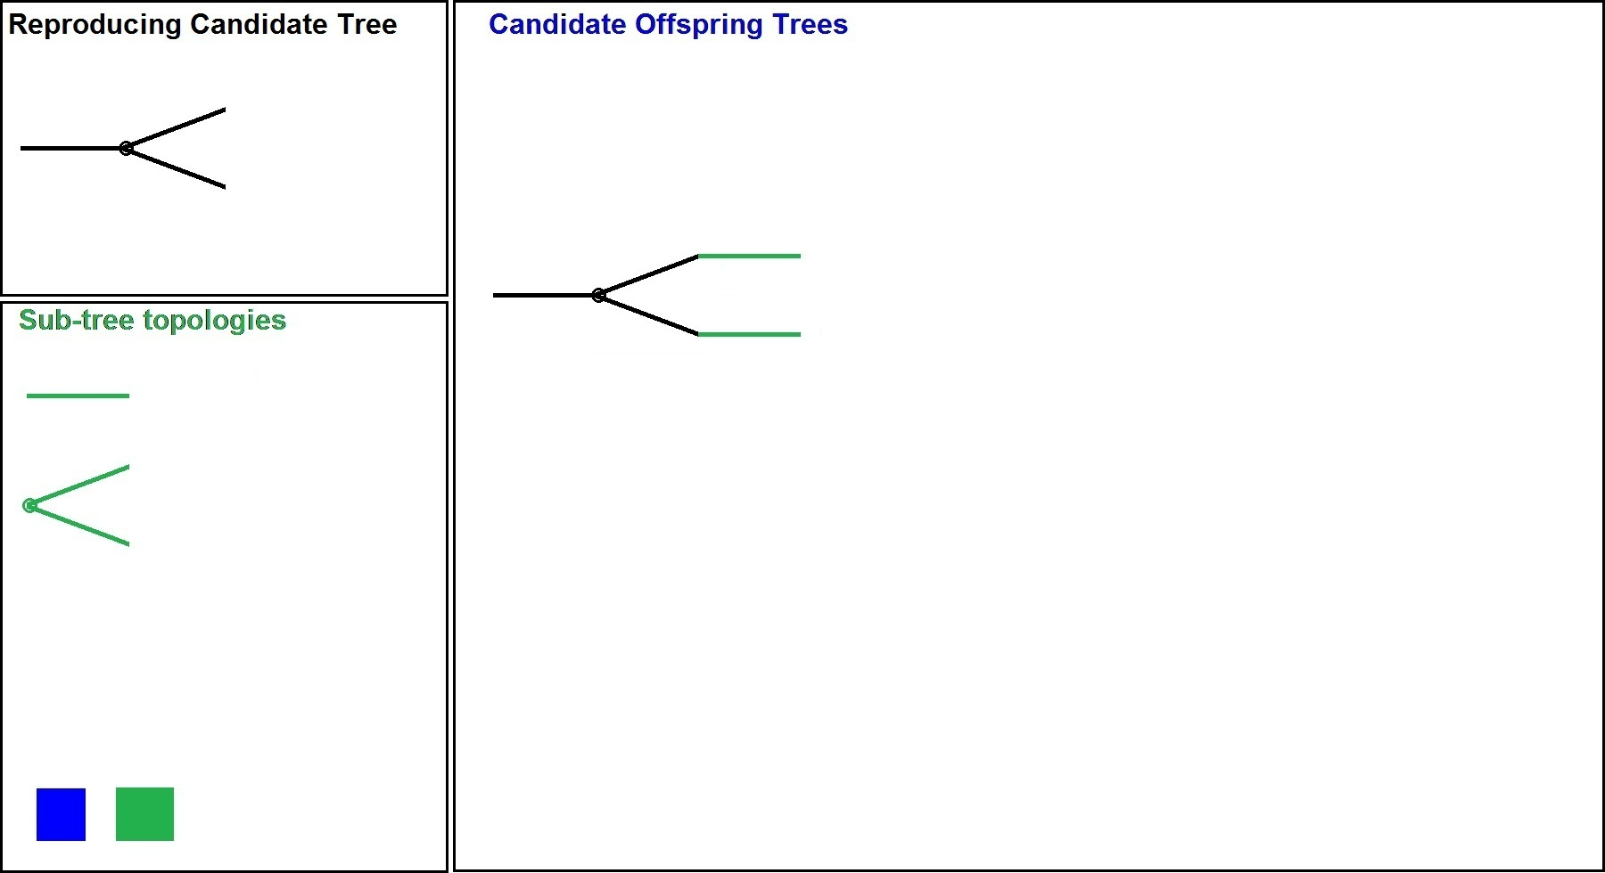
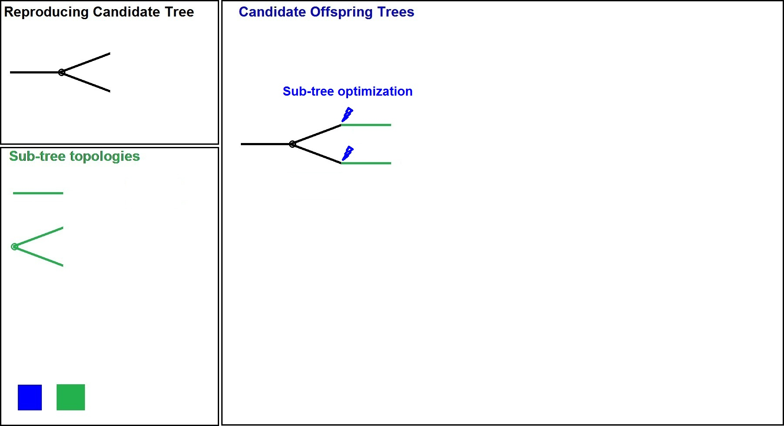
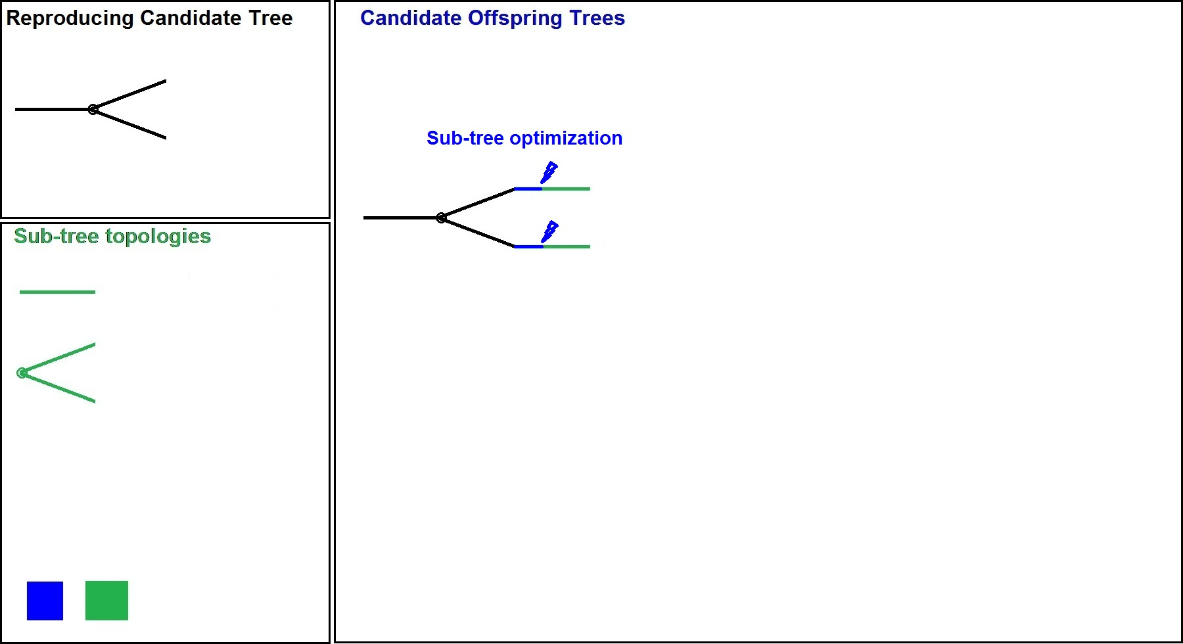
Tree Construction
Sub-tree Topologies
Sub-tree optimization includes thermal simulation of the chip
It is the most computationally intensive part of the algorithm

Slide 22
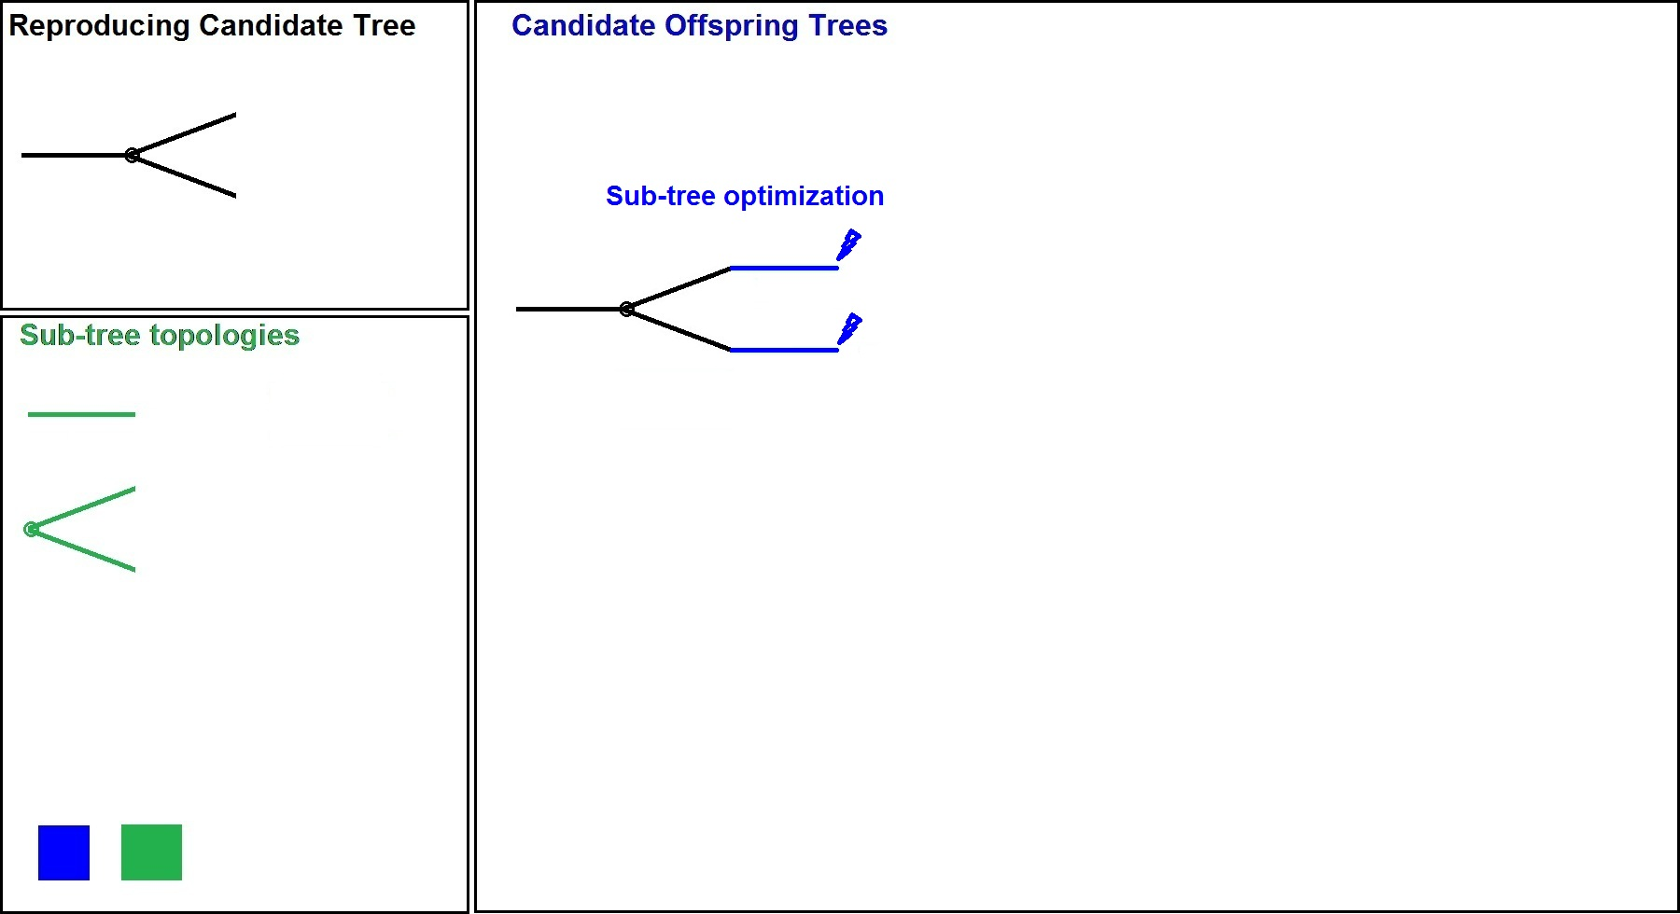
Tree Construction
Sub-tree Topologies
Other candidate offspring trees are constructed in a similar way.
Candidates exceeding memory limit are dropped.

Slide 23
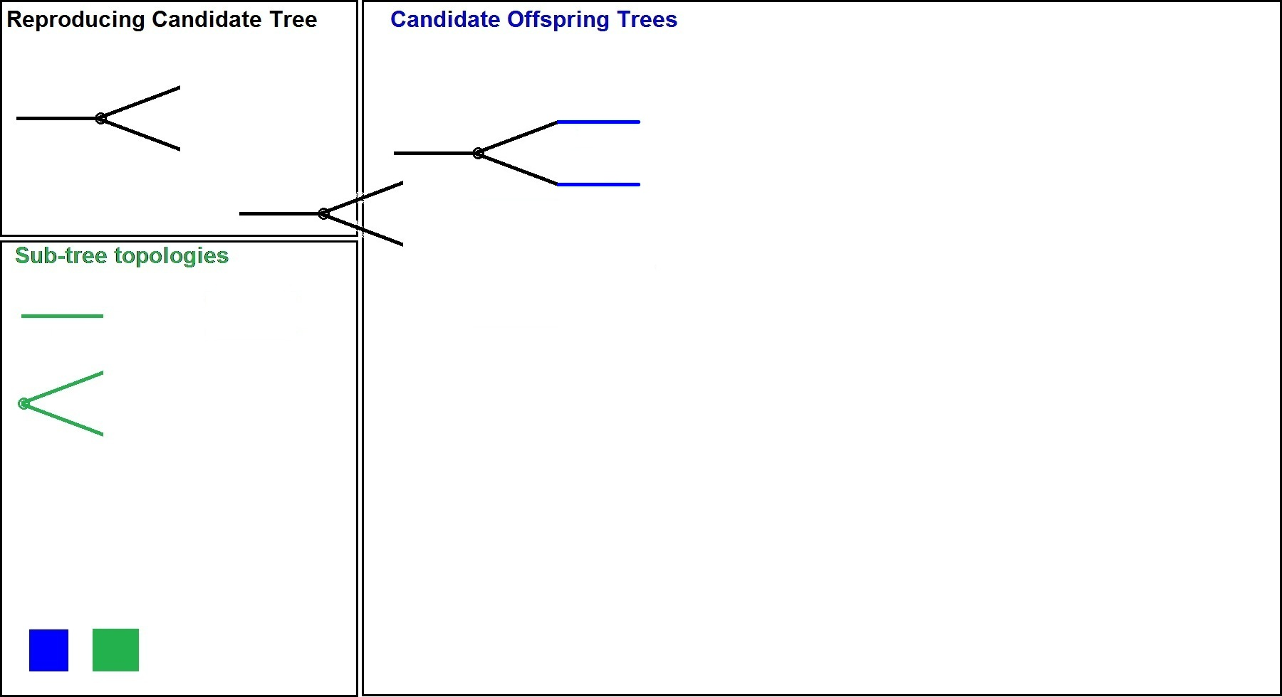
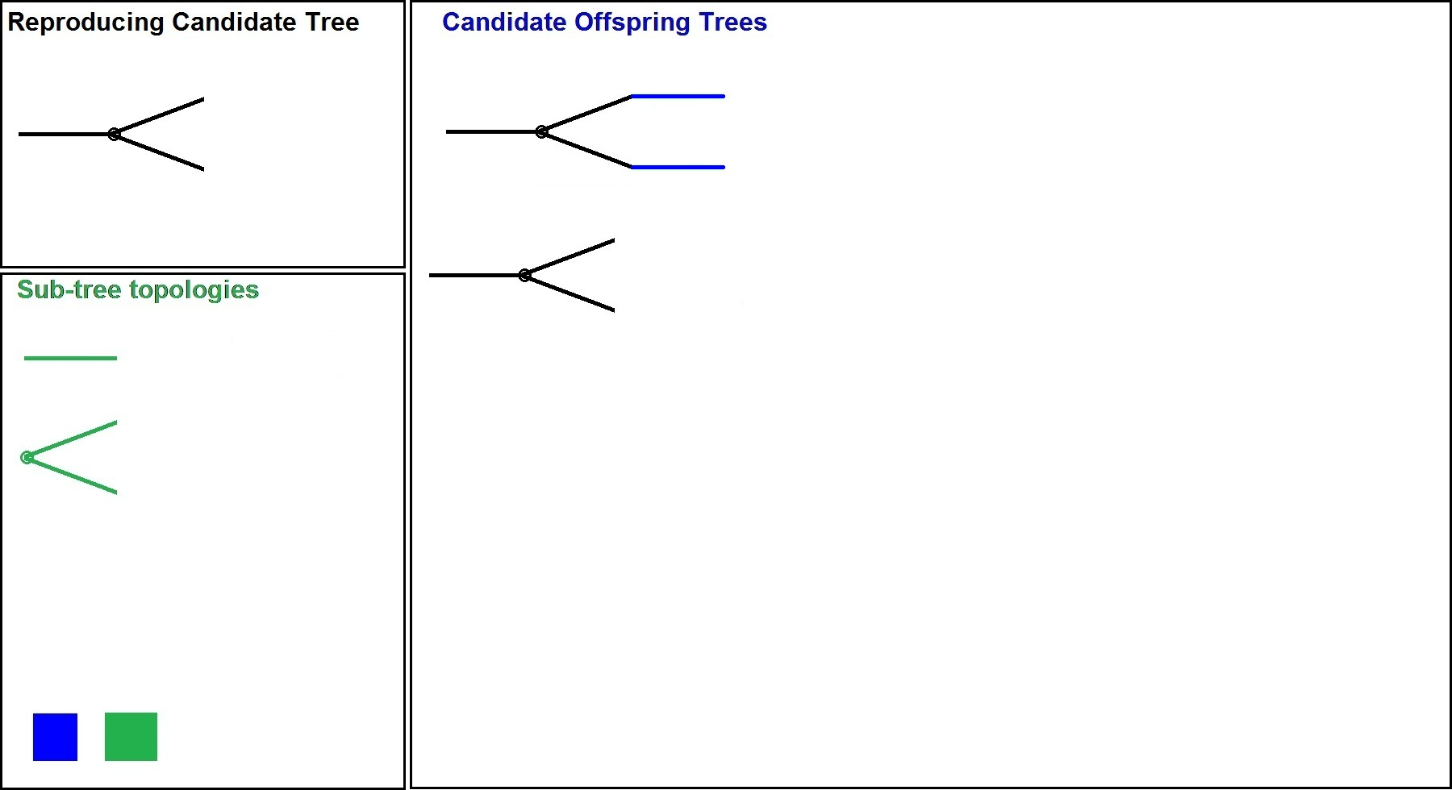
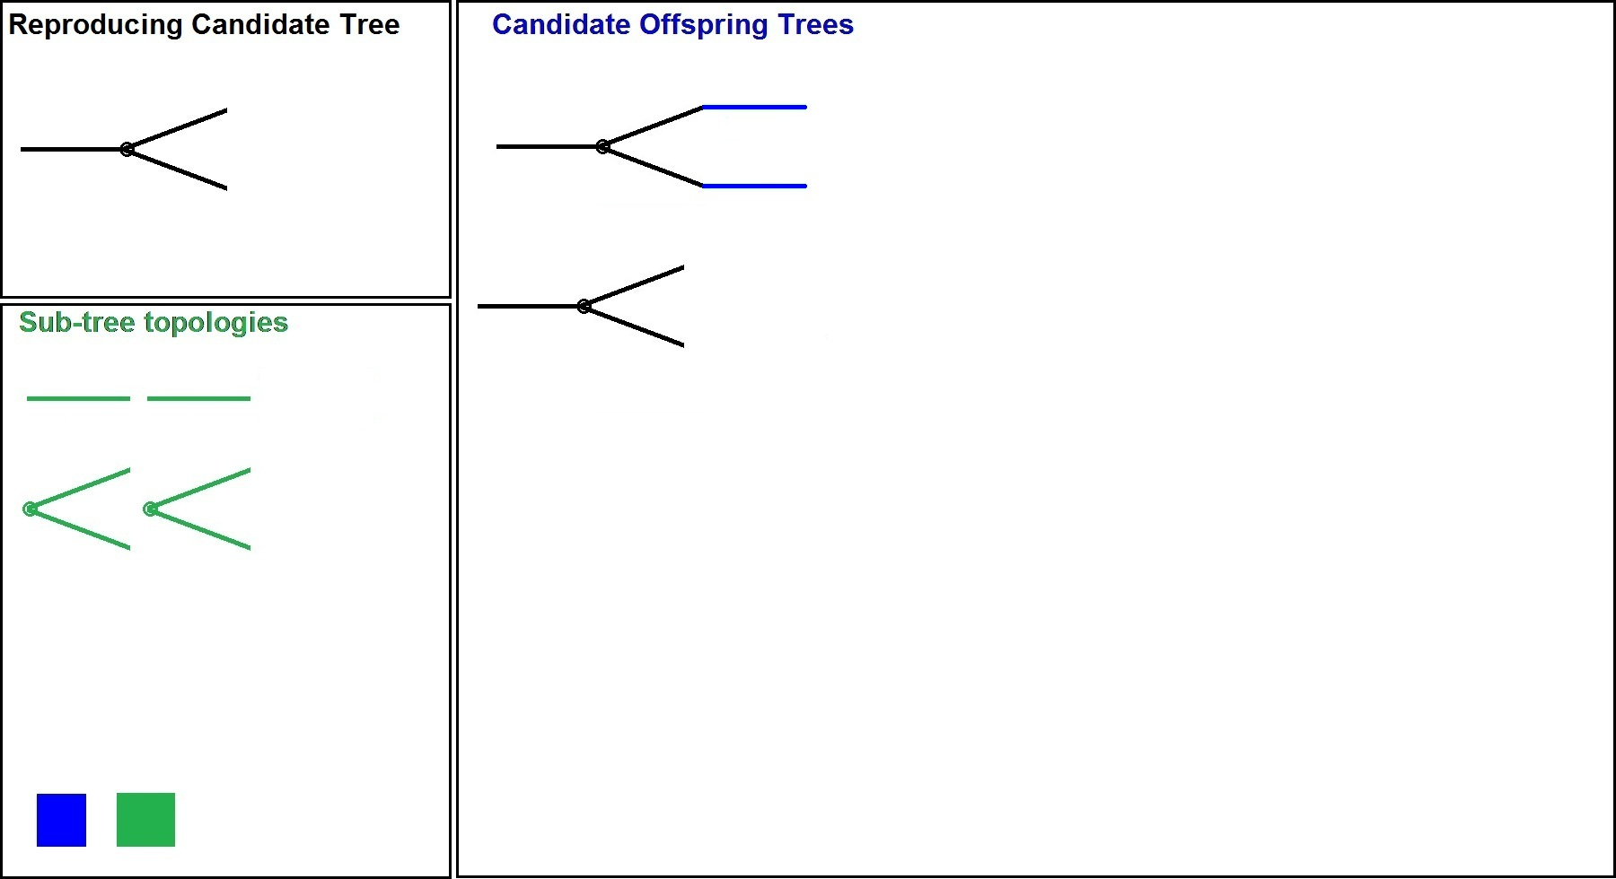
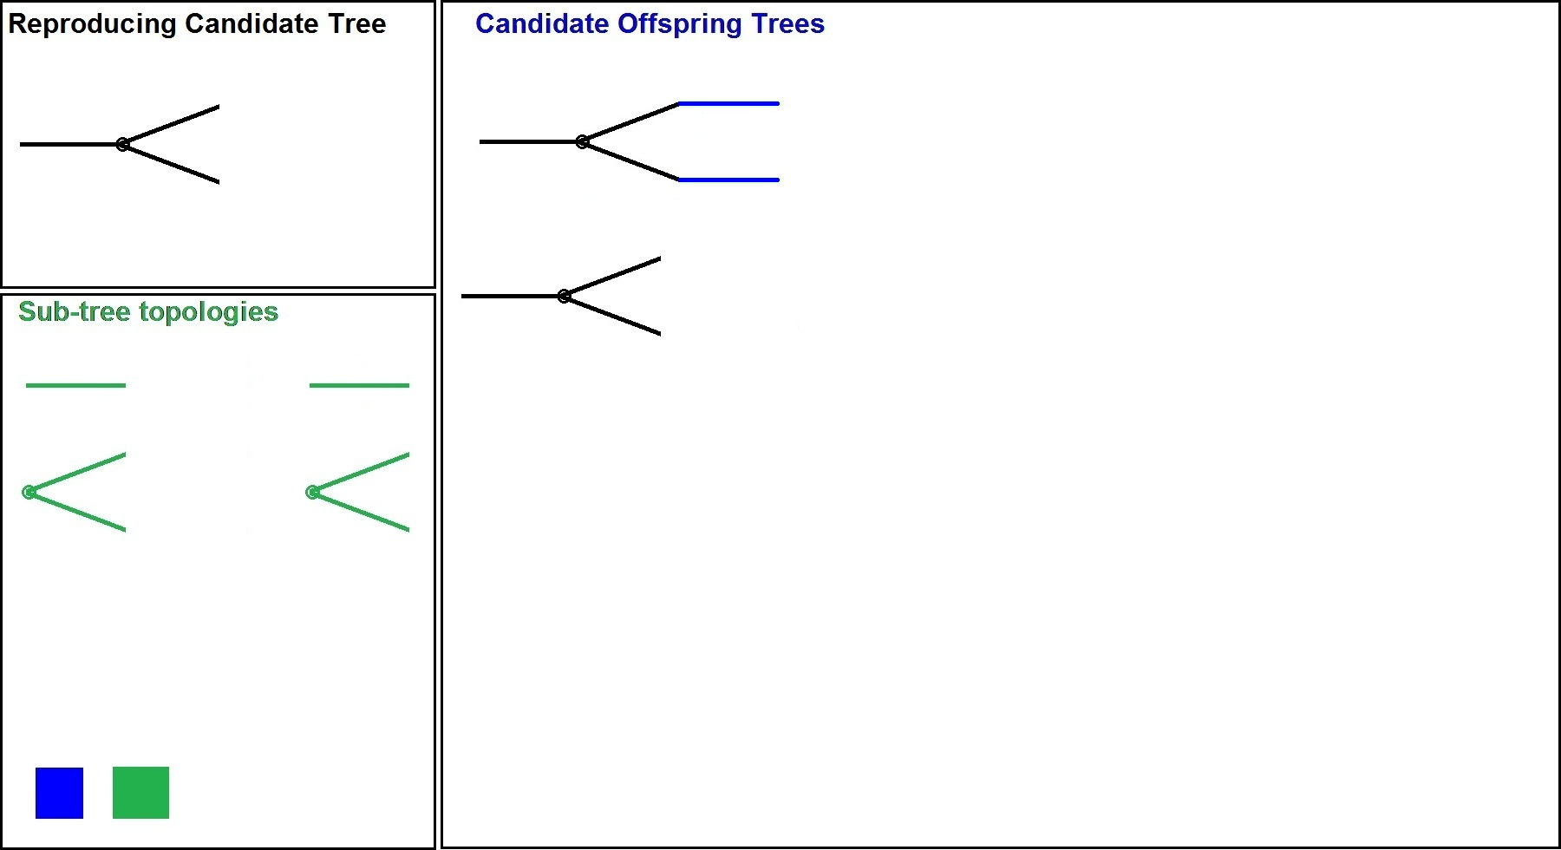
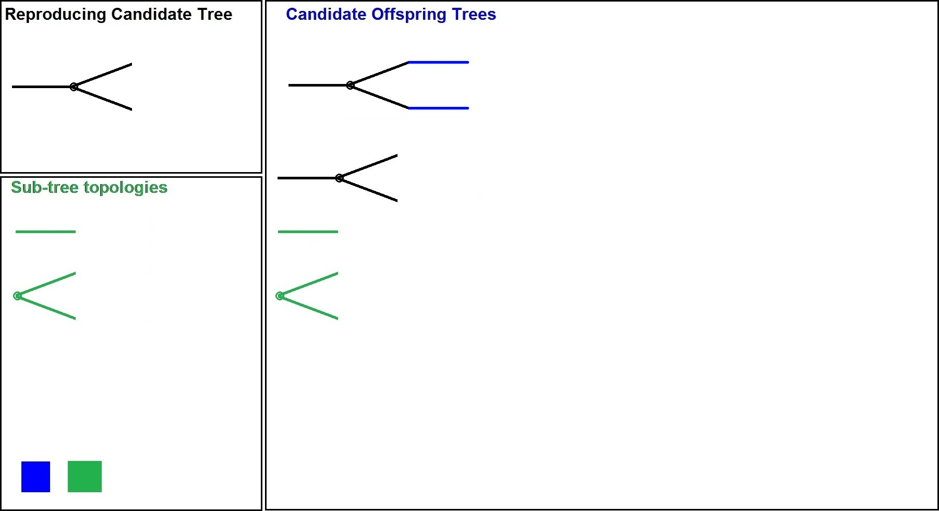
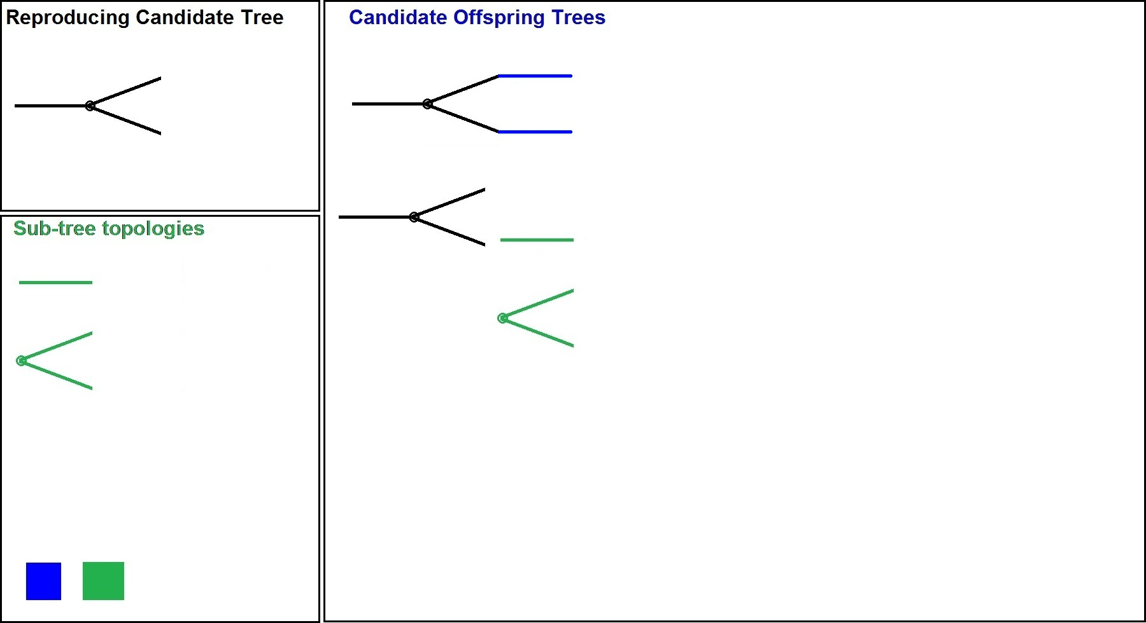
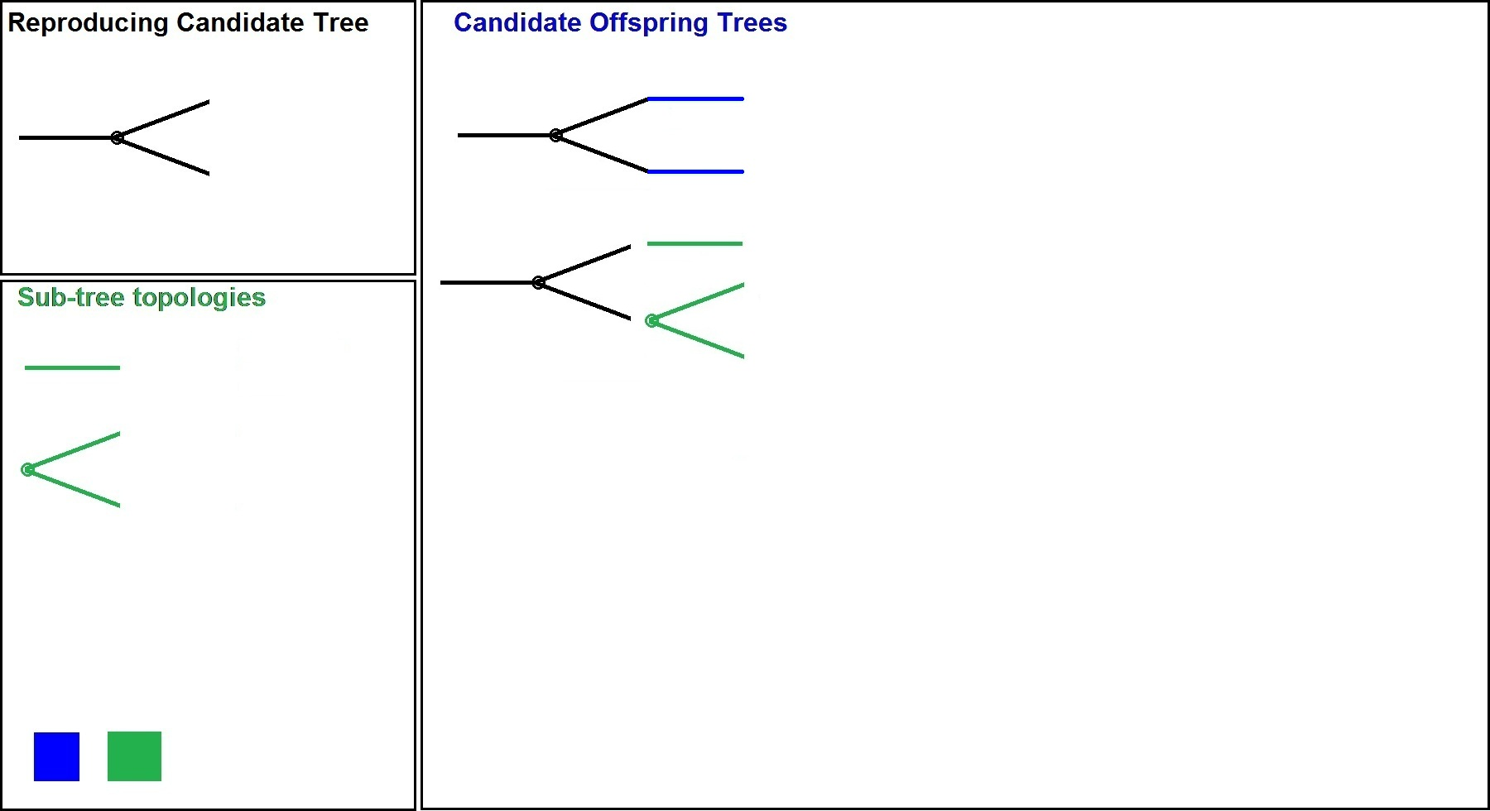
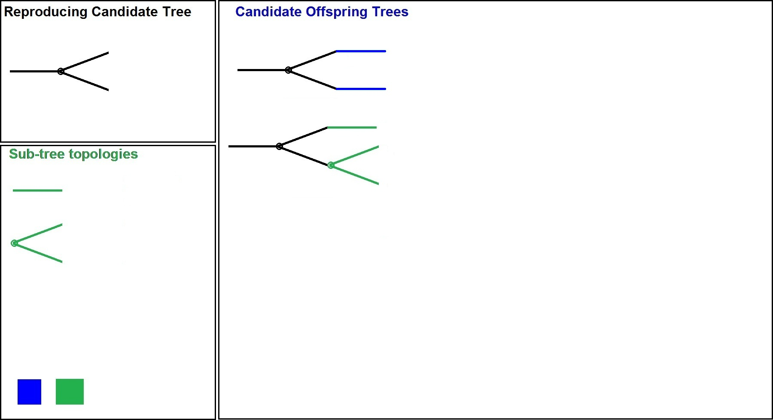
Tree Construction
Sub-tree Topologies
Search for the best candidate

Slide 24
Tree Construction
Sub-tree Topologies
This procedure is repeated until all the tests are scheduled
This is the next reproducing candidate tree

Slide 25
Sub-tree Optimization - Nodes
Nodes are placed serially in the solution vector
Number of Branches = Number of Chip Clusters

Slide 26
Sub-tree Optimization - Coding
Example
1 node
2 chip clusters
2 cores
3 error clusters per core
Cells are labeled with cluster IDs
9 cells to be labeled with 0 and1
Particle Swarm Optimization is then used in order to find a Sub-tree with minimal cost

Slide 27
Particle Swarm Optimization
Mimics the social behavior
School of fish searching for food,
Flock of birds in a cornfield
The population is a swarm of particles
Particles explore search space by semi random moves
Each particle remembers the previous best location it has visited
The global best location is also recorded
The previous best and the global best guide the search (therefore semi-random search)

Slide 28
PSO – 1-D Example
A canonic form:

Slide 29
PSO – Sub-tree Optimization
Differences with canonical form:
Location is integer
Velocity is real
If a chip cluster is absent
Reset the particle to its previous best
If out of range particle
Saturate to nearest border point
Set the corresponding velocity component to 0

Slide 30
Overview of the Adaptive Method
Temperature Error distribution data
Analytical methods
Experimental methods
Near optimal adaptive schedule tree
Constructed using Particle Swarm Optimization
Test
Load the test sets into the ATE
Load the schedule tree into the ATE
Test as described earlier

Slide 31
Experimental Results - Metrics
Problem size is the product of
Number of the error clusters and
ATE’s memory limit
Cost of test is combination of
Cost of the overheated chips and
Cost of the test facility operation
Utilized memory consists of
Memory occupied by linear tables and
Memory occupied by branching tables
CPU time is overall time to obtain the schedule tree

Slide 32
Experimental Results
Method | Experimental scenario 1 |  | Experimental scenario 2
 | Cost of test | Utilized memory | Cost of test | Utilized memory
Offline | 5.96 (100%) | 460 (100%) | 5.97 (100%) | 460 (100%)
Hybrid | 5.58 (94%) | 920 (200%) | 5.82 (97%) | 980 (213%)
Adaptive | 5.30 (89%) | 1540 (335%) | 5.50 (92%) | 1800 (391%)
Adaptive method reduces the cost about two times the hybrid method.

Slide 33
Experimental Results
Problem Size | Genetic Algorithm |  |  | Particle Swarm Optimization
 | Cost of test | Utilized memory | CPU time | Cost of test | Utilized memory | CPU time
1800 | 5.96 | 460 | 2 : 33 | 5.96 | 460 | 2 : 21
3000 (a) | 5.58 | 920 | 3 : 58 | 5.58 | 920 | 3 : 26
3000 (b) | 5.97 | 460 | 5 : 21 | 5.97 | 460 | 2 : 57
5000 | 5.82 | 980 | 5 : 55 | 5.82 | 980 | 5 : 03
6000 | 5.30 | 1540 | 4 : 15 | 5.30 | 1540 | 4 : 48
10000 | 5.50 | 1800 | 10 : 51 | 5.41 | 1880 | 11 : 20
Utilized memory is only for schedule, excluding the test data

Slide 34
Conclusions
SoC test should be thermal aware
Process variation should be considered
Adaptive methods are required
On-chip temperature sensors are utilized
No online computation
Minimized ATE effort
Shortened test application time
Particle Swarm Optimization is the most promising heuristic for schedule tree construction

Slide 35
Questions
?

