Slide 1
Temperature-Aware SoC Test Scheduling Considering Inter-Chip Process Variation
Nima Aghaee, Zhiyuan He, Zebo Peng, and Petru Eles
Embedded Systems Laboratory (ESLAB), Linkoping University, Sweden
{g-nimgh, zhihe, zebpe, petel}@ida.liu.se
IEEE 19th Asian Test Symposium (ATS2010)

Slide 2
Content
Temperature-Aware Scheduling
Inter-Chip Process Variation
Temperature Error
Hybrid Method
Experimental Results

Slide 3
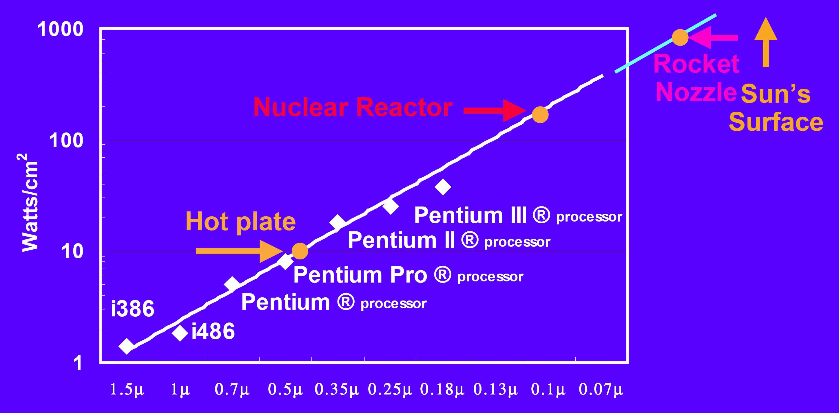
Increasing Power Density
Source: F. Pollack, Int. Symp. Microarchitecture, 1999
Power density increases exponentially with technology scaling!

Slide 4
High Test Power
Power consumption during SoC test is much higher than that in normal [Zorian, 93 & Wang, 98]
Test patterns with higher toggle rate
Parallel testing
High speed scan-based testing

Slide 5
High Test Temperature
High test power density leads to high test temperature
Overheating leads to:
Yield loss (good dies fail the test)
Damage to the devices under test

Slide 6
Temperature-Aware Scheduling
Temperature-aware SoC test scheduling techniques are required to prevent overheating
[Z. He et al., J. Electron Test, 2008]
[C. Yao et al., ATS 2009]

Slide 7
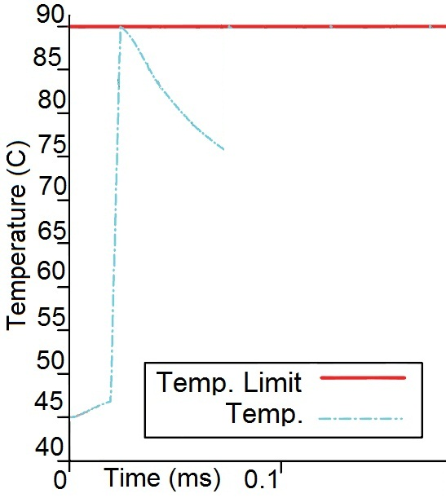
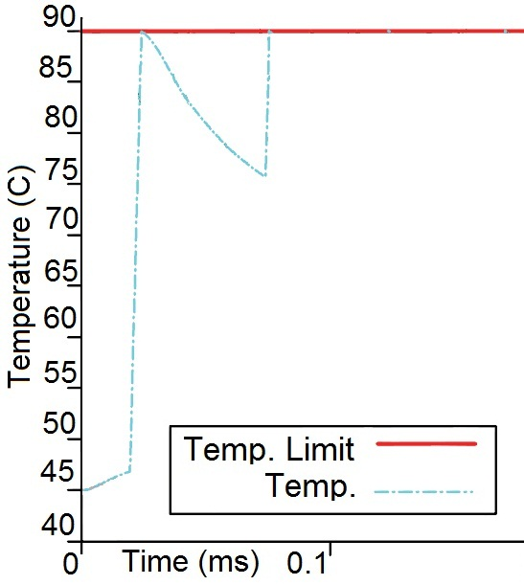
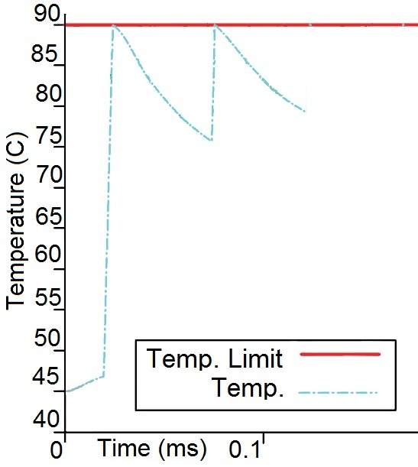
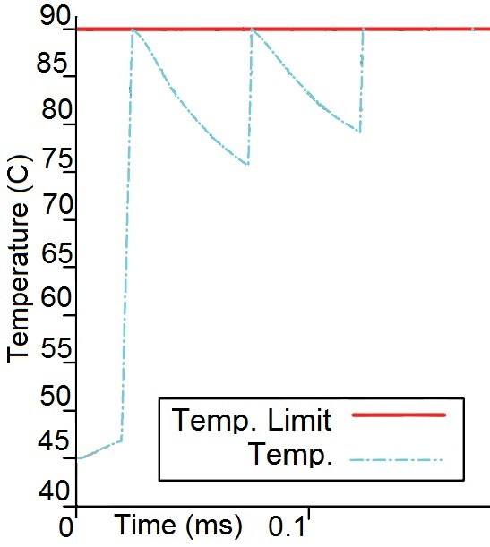
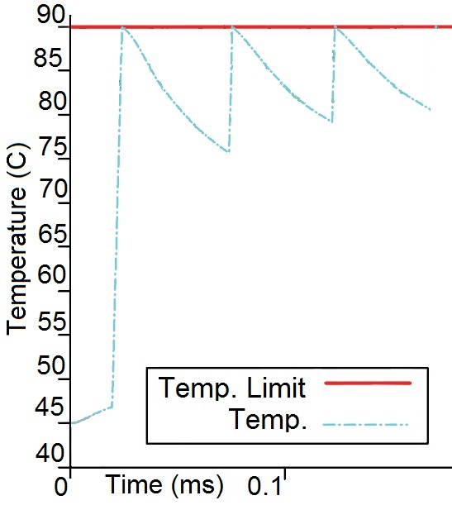
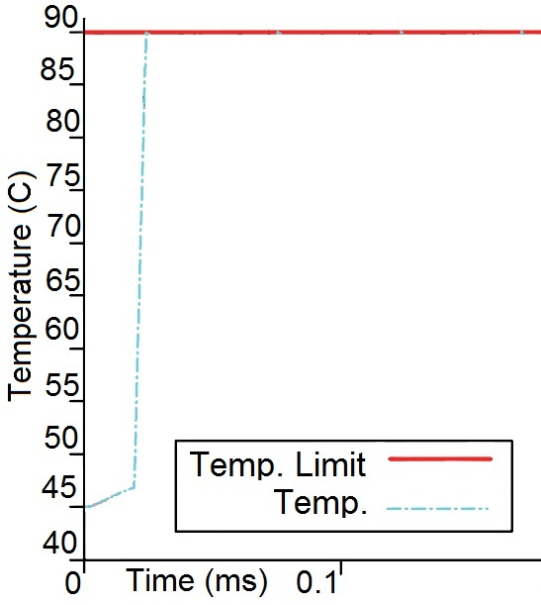
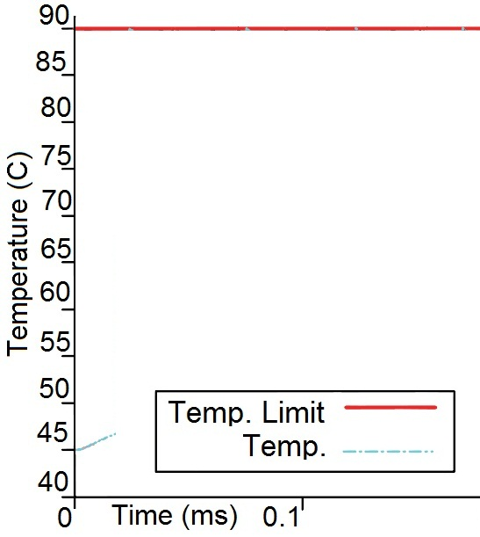
Temperature-Aware Scheduling
Introduce cooling cycles to avoid overheating

Slide 8
Process Variation
Variation in geometries and material properties
Variation in electrical parameters
Example: electrical resistances and capacitances
Result: variation in power profile
Variation in thermal parameters
Example: heat capacity and thermal conductivity
Result: variation in thermal behavior

Slide 9
Process Variation
Identical switching activity
Different power profiles
Different temperature profiles

Slide 10
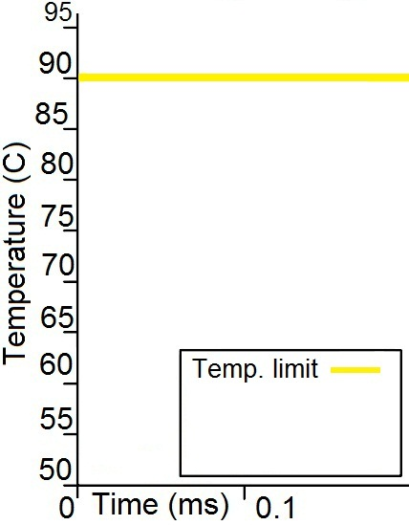
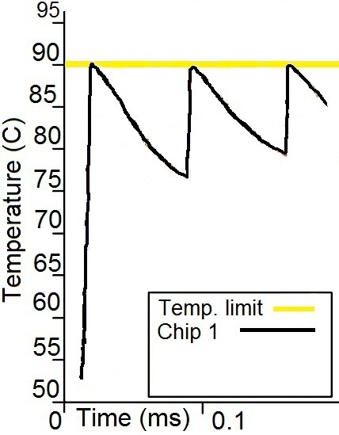
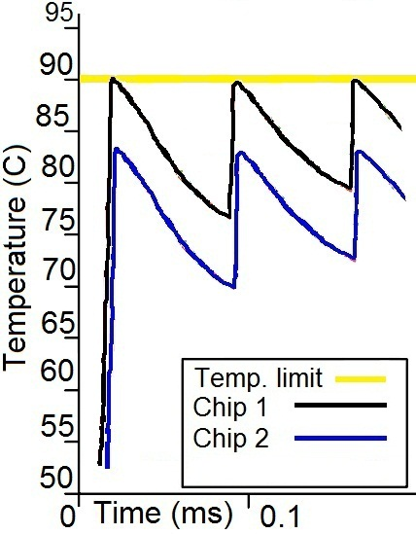
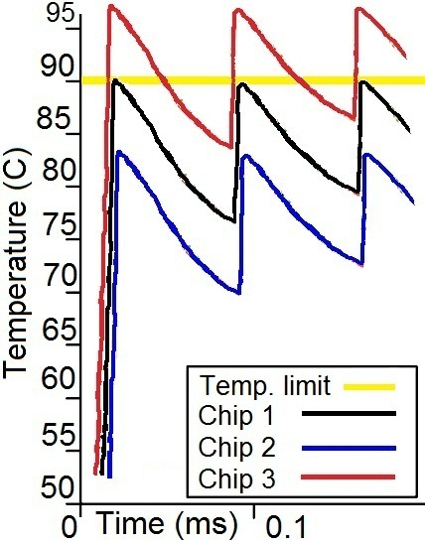
Inter-Chip Process Variation
If no action
Warmer chips will Overheat

Slide 11
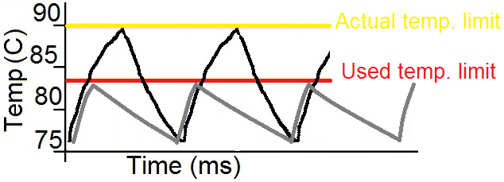
Inter-Chip Process Variation
Safe action is to use worst case temperature limit
Long test application time

Slide 12
Temperature Error
Temperature Error (TE) =
Actual_Temperature – Expected_Temperature
Each chip is characterized by its TE
TE distribution
Is discrete
Gives the probability that a chip has a certain temperature error

Slide 13
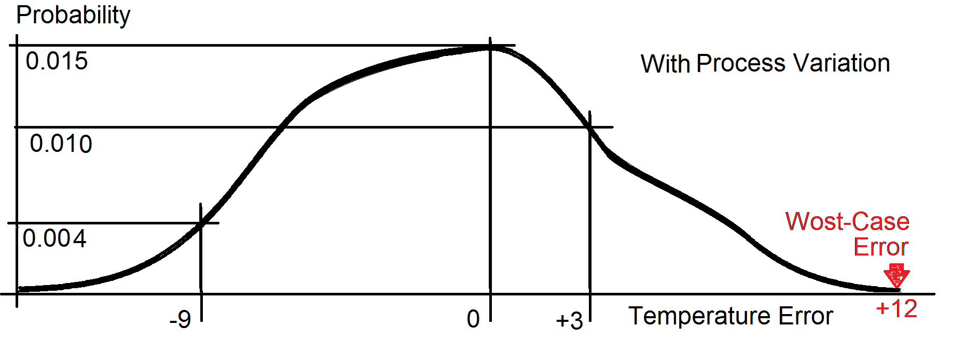
Temperature Error – Example
Probability of TE = 0 is 0.015
Probability of TE = +3 is 0.010
Probability of TE = -9 is 0.004
Notes:
The curve is discrete, just for the sake of the presentation is illustrated as continuous.

Slide 14
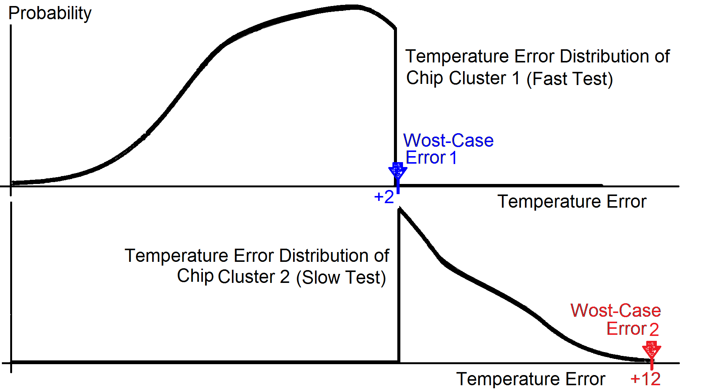
Hybrid Method - Basic Concept
Chip cluster
Chips within a certain TE range
Chip cluster 1
Cool
Fast test
Chip cluster 2
Warm
Slow test
Notes:
The curve is discrete, just for the sake of the presentation is illustrated as continuous.

Slide 15
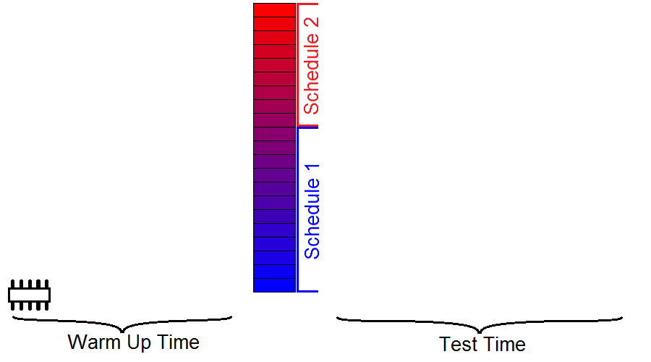
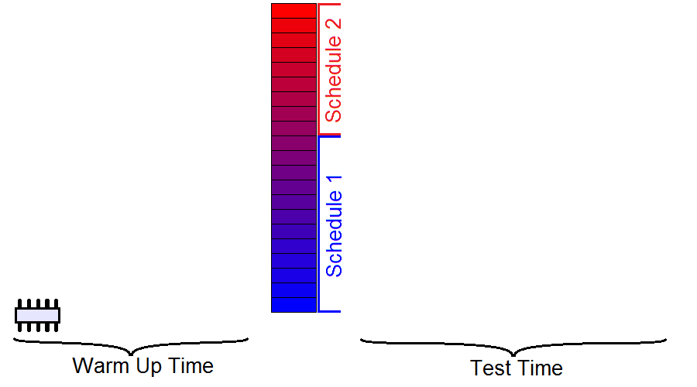
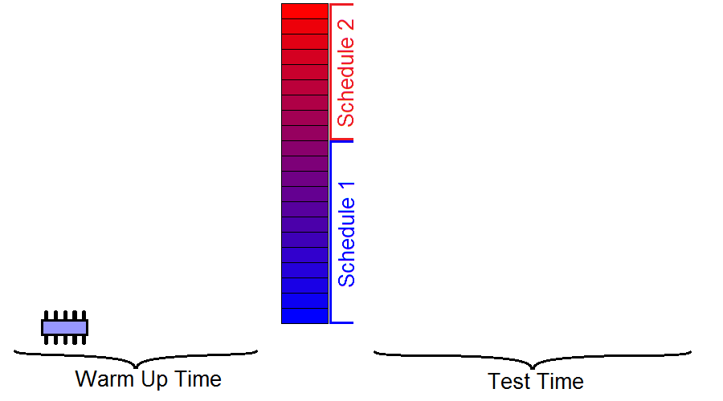
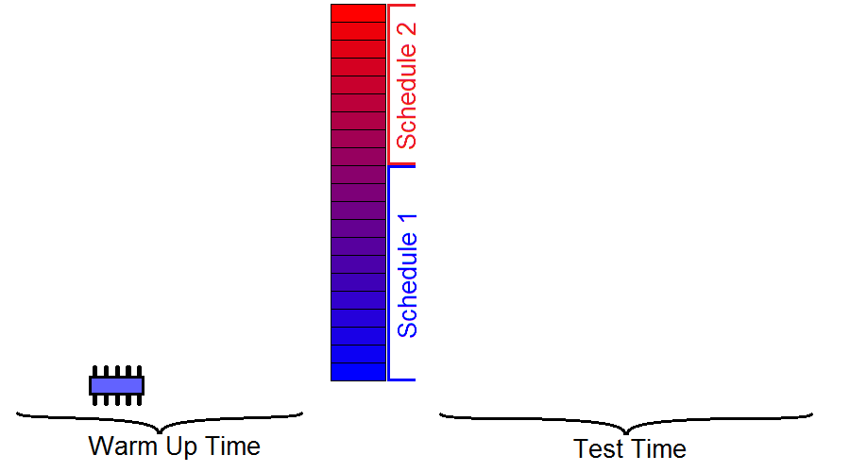
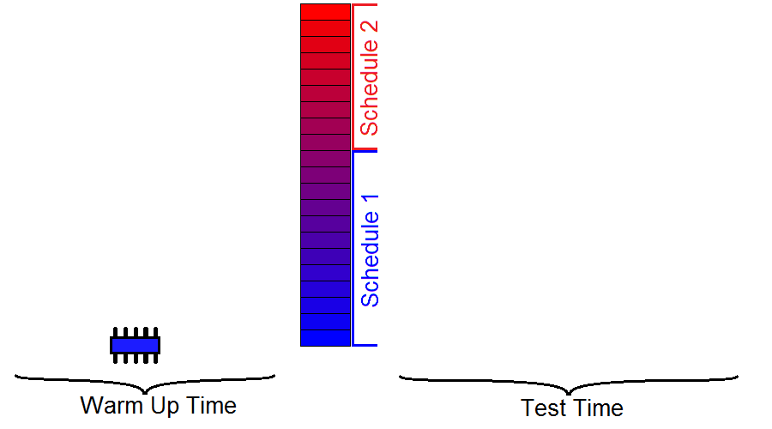
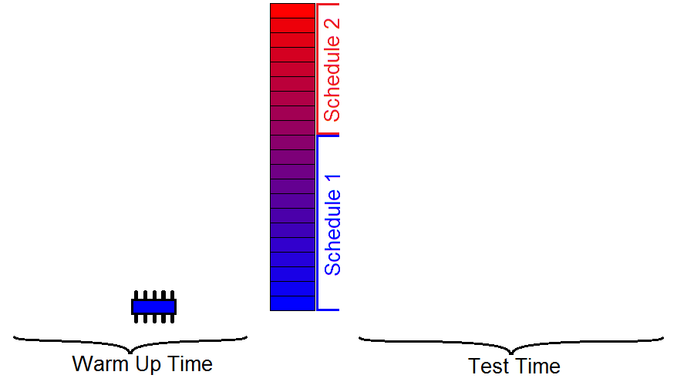
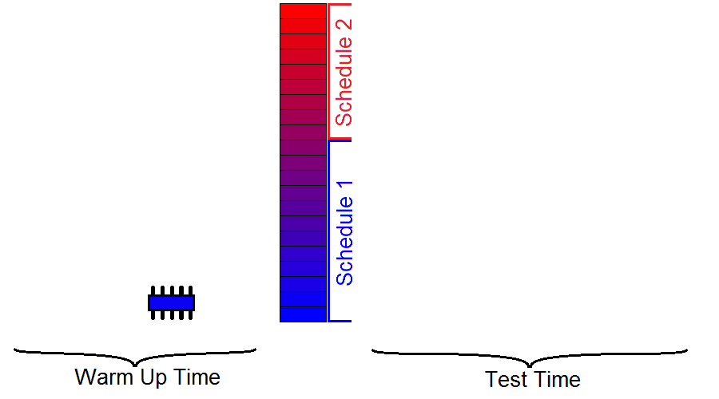
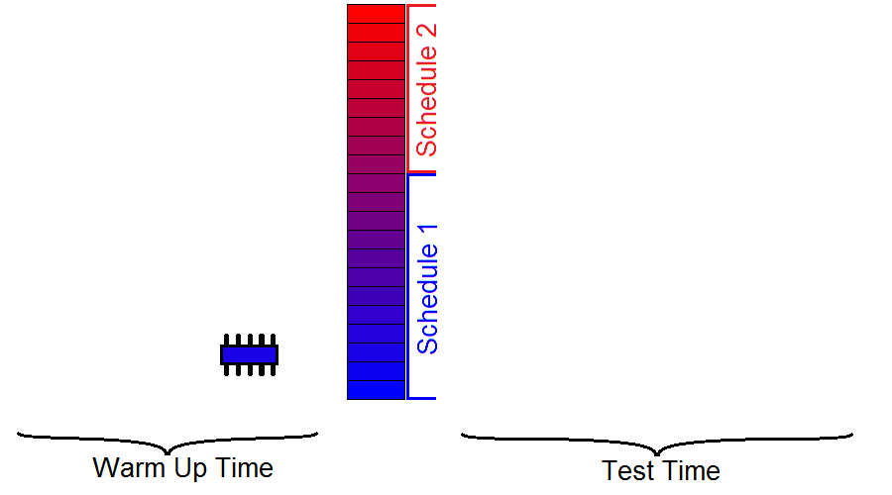
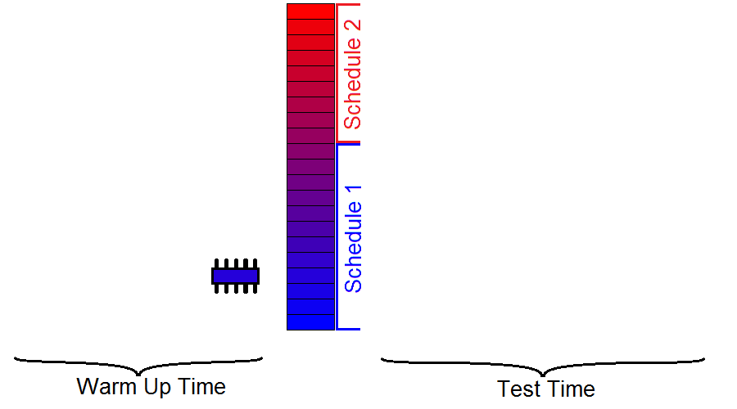
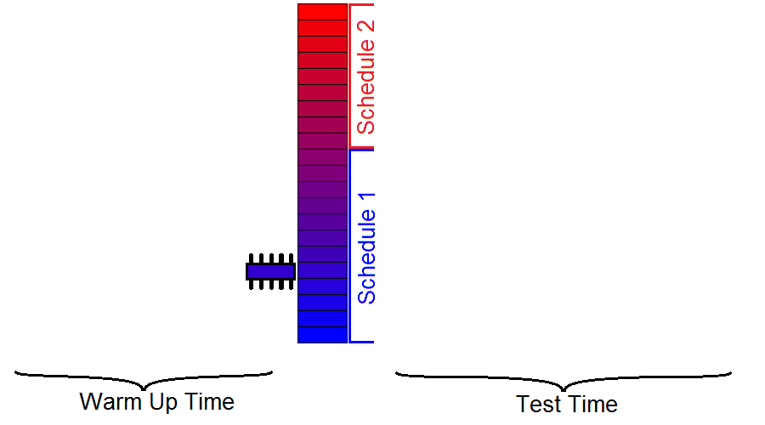
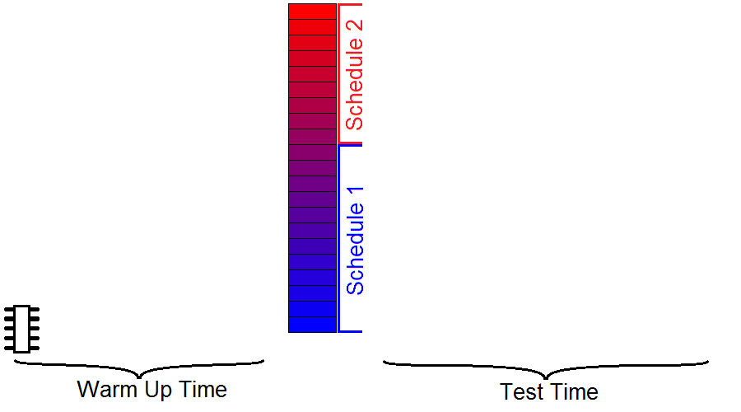
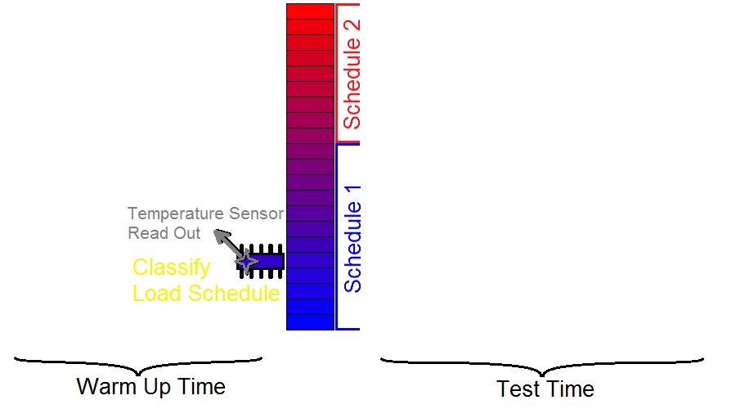
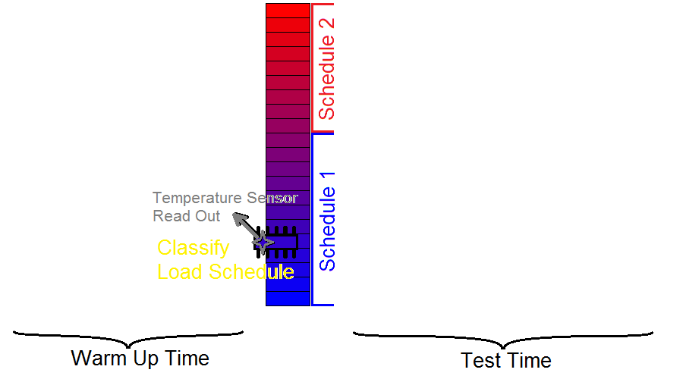
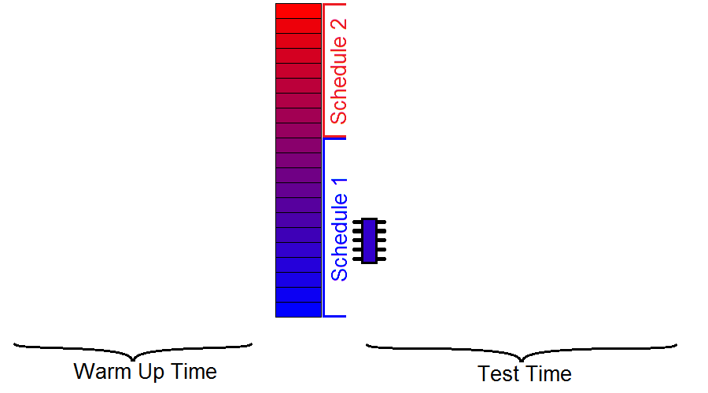
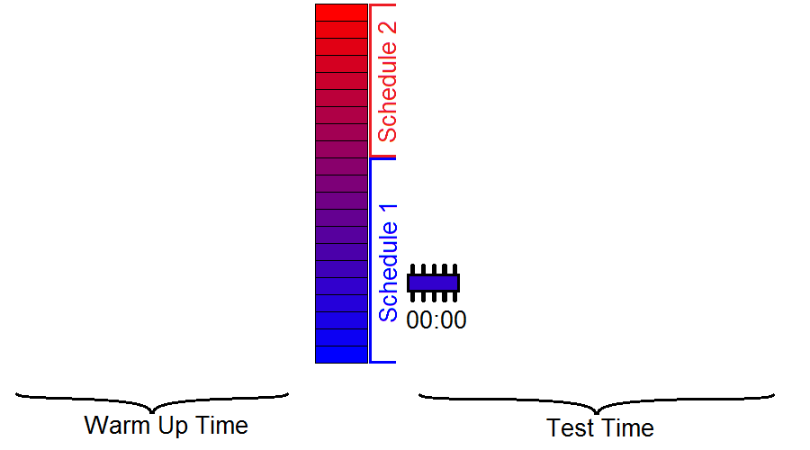
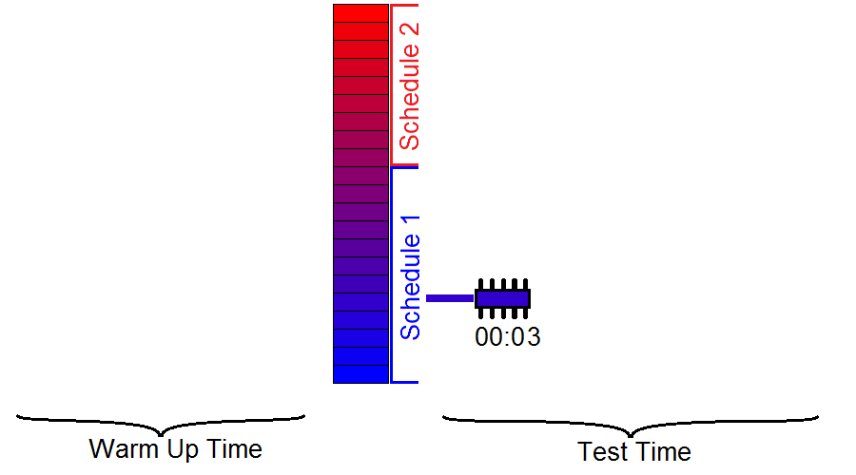
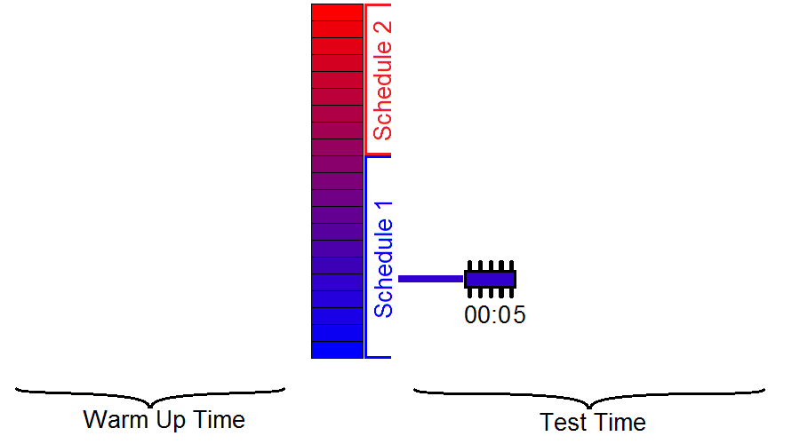
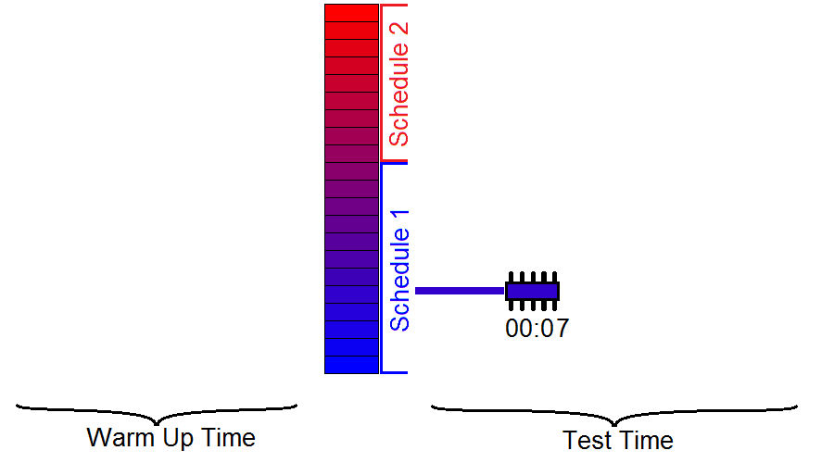
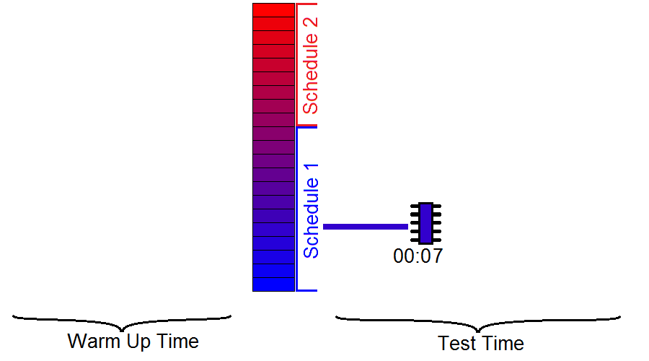
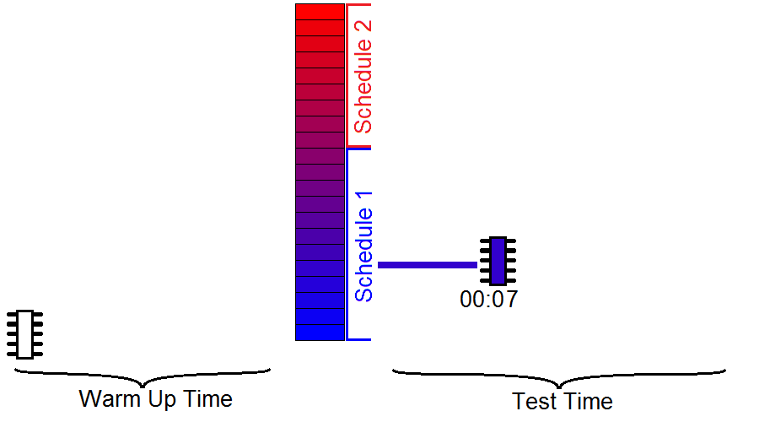
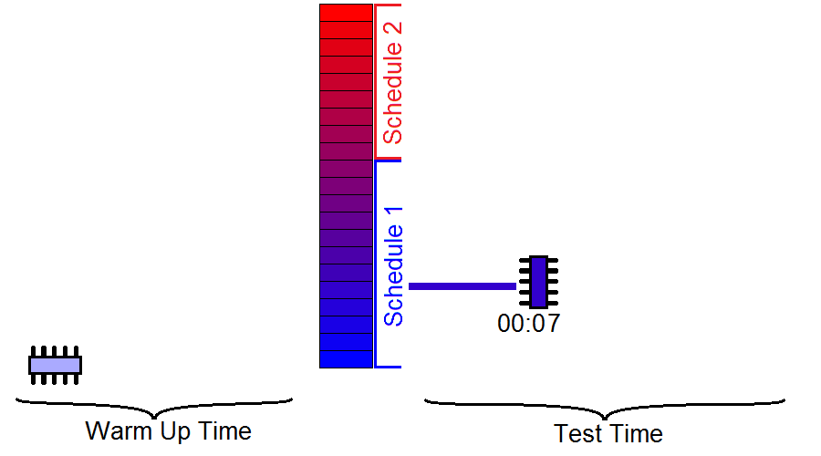
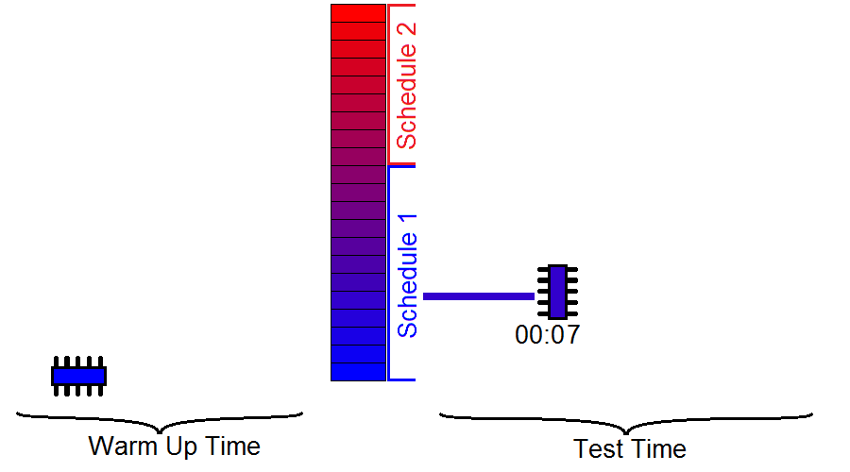
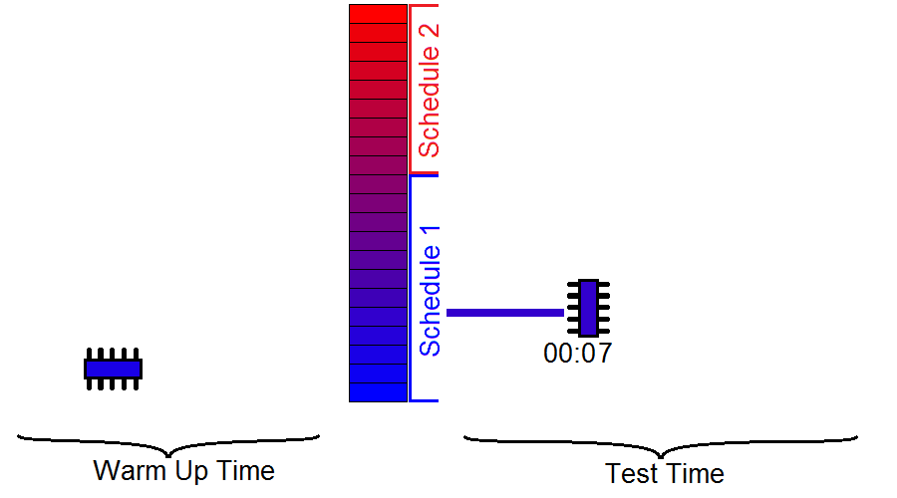
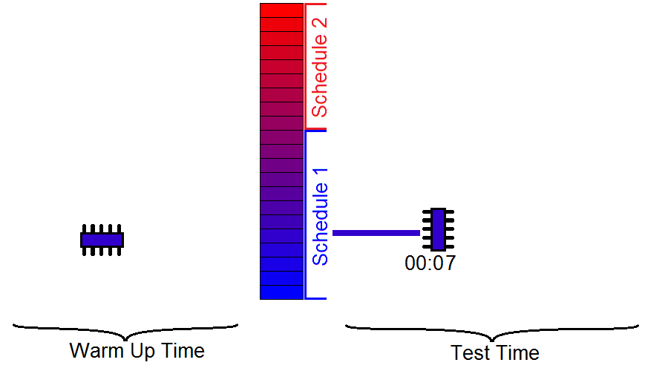
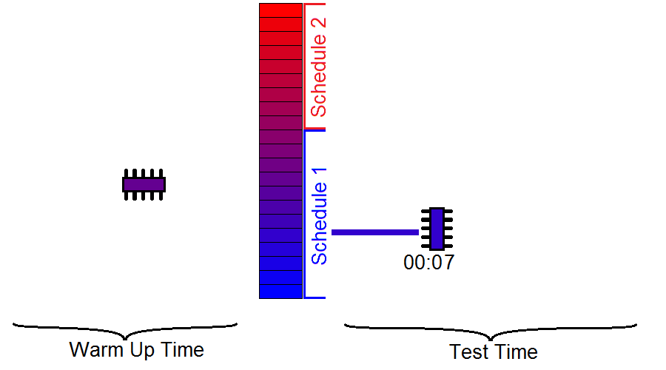
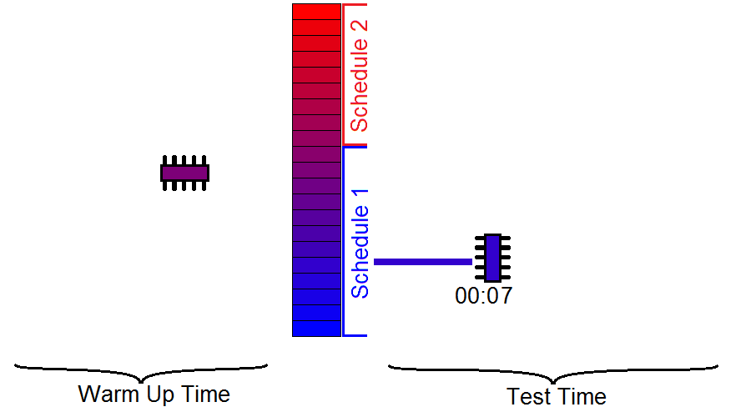
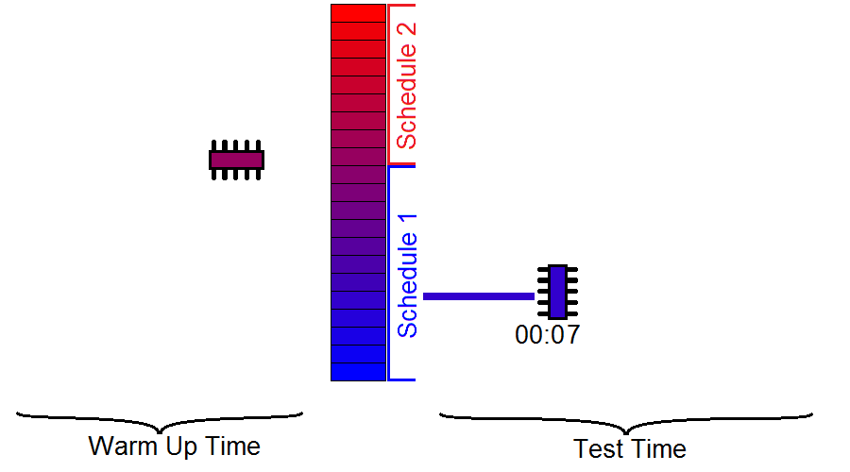
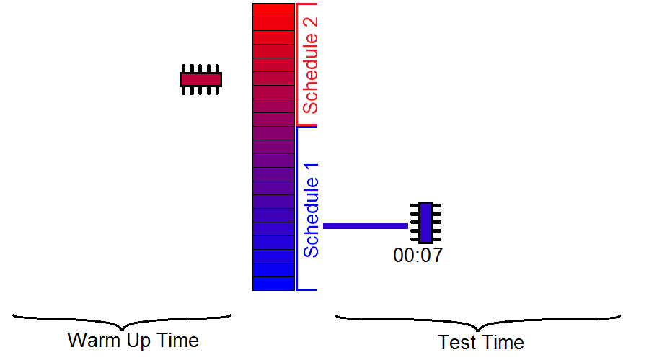
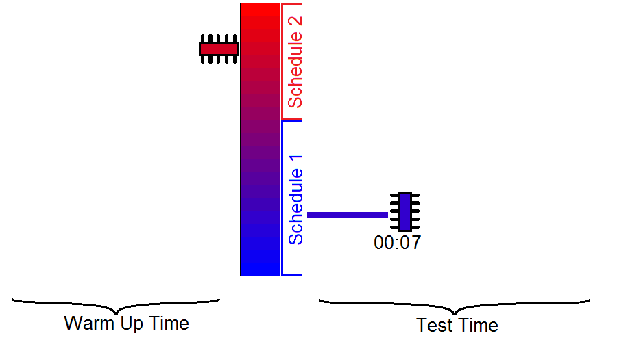
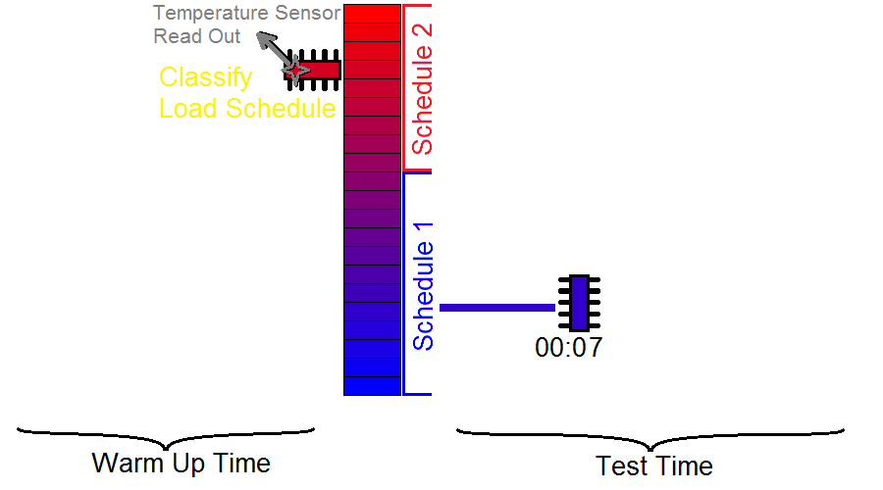
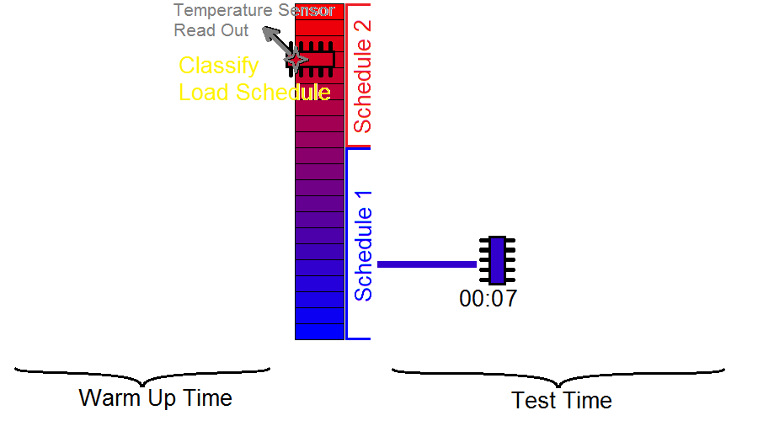
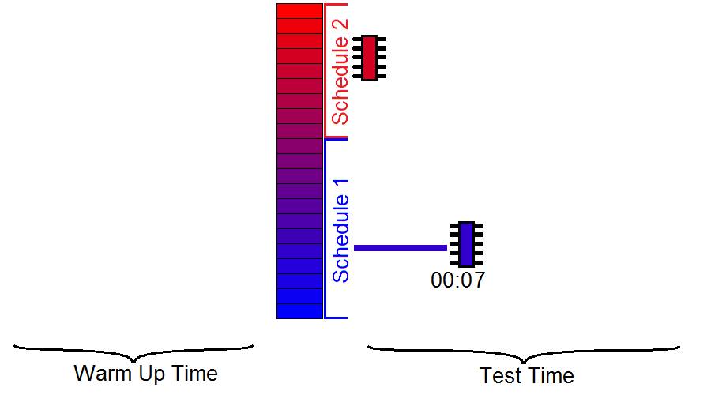
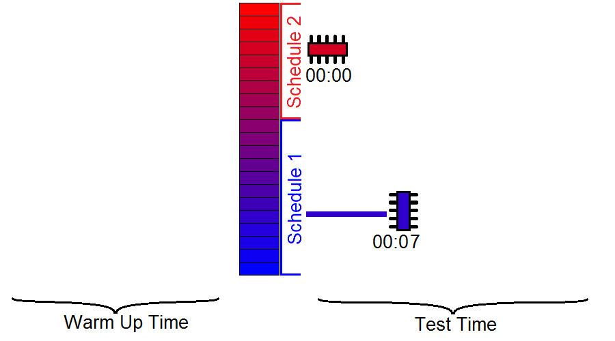
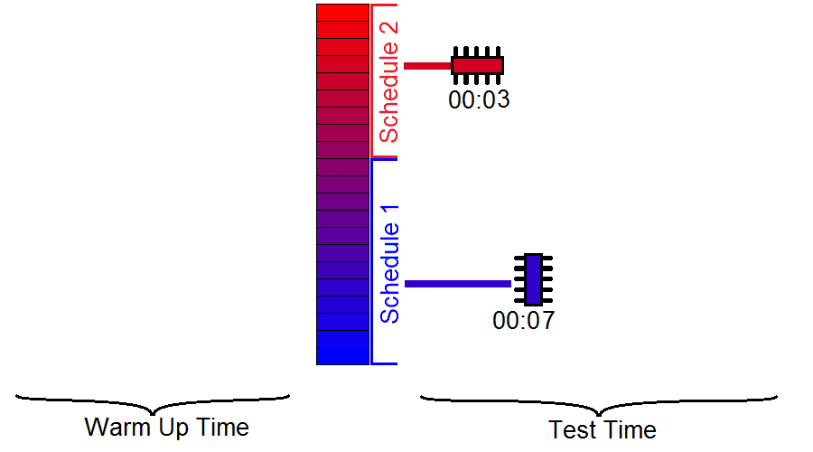
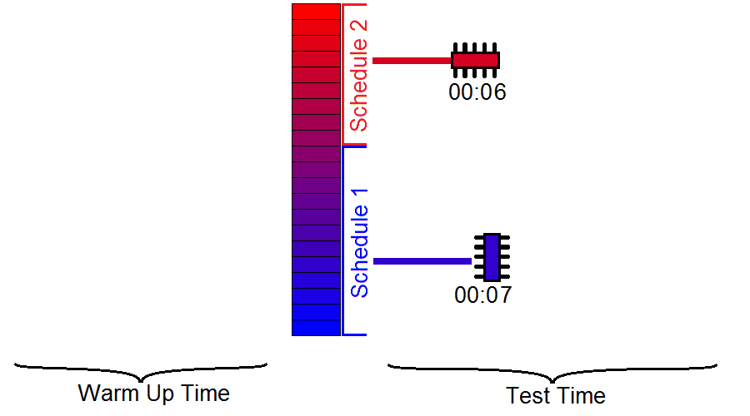
Hybrid Method - Test Process
Two group of chips, and two schedules
Notes:
Obtain the temperature error of chip under test
Read the actual temperature
Temperature sensor
Classify the chip under test into one of the clusters
Comparison against cluster borders
Load the corresponding test schedule
Run the test
The Warm Up Time is very short (the time scale on the image is illustrative) it is a special test sequence
The “Testing with Dedicated Schedule” is the optimized (“Warm Up Time” is negligible)

Slide 16
Hybrid Method – Scheduling Process
Find the optimum cluster border
Tradeoff
Faster test for cluster
More chips covered in faster clusters
Exact search
Find the schedules for clusters
Heuristic
Notes:
Number of clusters
small: bad schedule
Large: high ATE memory
ATE memory => number of clusters
The curve is discrete, just for the sake of the presentation is illustrated as continuous.

Slide 17
Experimental Results
Test Throughput (TT)
Number of chips tested safely per time unit
Notes:
TT here is normalized to ATE machine parameters. In order to have the chip/hour, the ATE machines specifications should be given.

Slide 18
Notes:
Message: Low numb of clusters gives a large portion of possible improvement in a short time
Example: here 4 is good

Slide 19
Conclusion
SoC test scheduling should be thermal aware
Process variation should be considered
Best way to handle thermal issues when affected by process variation is an adaptive approach
Temperature sensing

Slide 20
Questions ?

