Slide 1



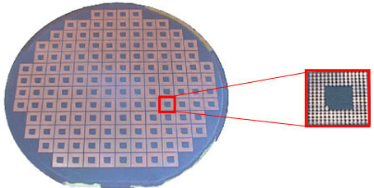
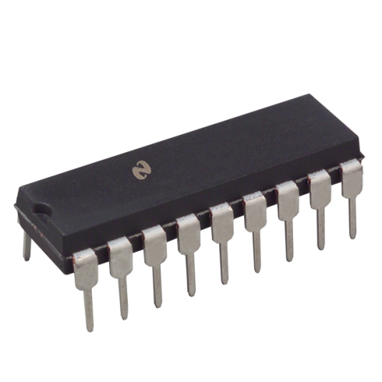
Test Scheduling and Test Access Optimization for Core-Based 3D Stacked ICs with Through-Silicon Vias
Breeta SenGupta Urban Ingelsson Erik Larsson
{breeta.sengupta, urban.ingelsson, erik.larsson}@liu.se
Linköping University, Sweden
Purpose
  Schedule core tests for 3D stacked ICs (SICs) with Through-Silicon Vias (TSVs)
  Reduction of overall test time (wafer sort + package test)
  Consider hardware cost of test data registers (TDRs)
3 Package Test
1 Manufacturing Test
Testing of non stacked chips
Two stages
    Wafer sort
    Package test
Same schedule in both stages
Wafer Sort
Package Test
Above: Test access mechanism for a stack during package test
When Core3, Core4 and Core5 are in the same session
TDRs required: 2
Test time required:
Testing of 3D Stacked chips
Two stages
    Wafer sort (individual chips)
    Package test (all chips combined)
Creating the schedule for package test by applying wafer sort test schedules serially may lead to sub optimal test time
Test scheduling is therefore different from non stacked chip testing
When Core3 is in a different session with Core4 and Core5
TDRs required: 2
Test time required:
Number of TDRs required remains same
Required test time decreases
To obtain the lowest overall cost (test time and hardware), cores of different chips should be tested concurrently
2 Wafer Sort
4 Objective
  Co-optimization of overall test time (wafer sort + package test) along with the TDR (hardware) cost
5 Experimental Results
  The L and P values for each core is provided in the table below, for the 3D TSV-SIC design considered
Above: Test access mechanism for a single chip during wafer sort
  Cores in the chips are accessed by JTAG
    On each chip, only one TDR can be accessed at a time
    Cores on the same TDR are in the same session
Core1 and Core2 share the same TDR, therefore must be tested in the same session (Session1)
Core3 has an independent TDR, therefore Core3 must have a separate session (Session2)
Therefore, additional sessions ⇒ Additional TDR hardware cost
 | Chip1 |  |  | Chip2
 | Core 1 | Core 2 | Core 3 | Core 4 | Core 5
Length of scan chain (L ) | 50 | 30 | 10 | 40 | 20
Number of patterns (P ) | 10 | 20 | 30 | 40 | 50
  The test time variations with the number of sessions is shown
Cases | Wafer Sort |  |  |  | Package Test |  | Total Time | Number of TDRs
 | Chip 1 |  | Chip 2
 | Core Test in Session | Time | Core Test in Session | Time | Core Test in Session | Time
1 | (1) + (2) + (3) | 1400 | (4) + (5) | 2600 | (1) + (2) + (3) + (4) + (5) | 4000 | 8000 | 5
2 | (1, 2) + (3) | 2000 | (4, 5) | 3600 | (1, 2) + (3) + (4, 5) | 5600 | 11200 | 3
3 | (1, 2) + (3) | 2000 | (4, 5) | 3600 | (1, 2) + (3, 4, 5) | 4700 | 10300 | 3
4 | (1, 2, 3) | 3000 | (4, 5) | 3600 | (1, 2, 3) + (4, 5) | 6600 | 13200 | 2
5 | (1, 2, 3) | 3000 | (4, 5) | 3600 | (1, 2, 3, 4, 5) | 7500 | 14100 | 2
  Trade off between test time and number of TDRs among various alternatives
  It is seen that Case 3 has lower test time as well as number of sessions when compared to Case 6
  Compared to Case 4, Case 3 has lower test time but more TDRs
  The lowest total time is achieved at the highest TDR cost
  The lowest number of TDRs is achieved at a high cost in terms of test time
When Core1 and Core2 are in the same session
TDRs required: 1
Test time required:
When Core1 and Core2 are in different sessions
TDRs required: 2
Test time required:
Conclusions
  Testing of stacked 3D chips is different from non-stacked chip testing, since, in the case of 3D TSV-SICs, the package test requires all chips in the stack to be tested together
  Increase in number of sessions ⇒ Increase in number of TDRs ⇒ Increased Cost
  Core tests of different chips performed simultaneously during package test may lead to reduction in the total test time
  This also leads to lower TDR cost
Number of TDRs required increases
Required test time decreases
To obtain the lowest overall cost (test time and hardware), there is a trade-off between test time and the number of TDRs

