Slide 1
Scheduling for Fault-Tolerant Communication on the Static Segment of FlexRay
Bogdan Tanasa, Unmesh D. Bordoloi,
Petru Eles, Zebo Peng
Department of Computer and Information Science,
Linkoping University, Sweden
December 3, 2010

Slide 2
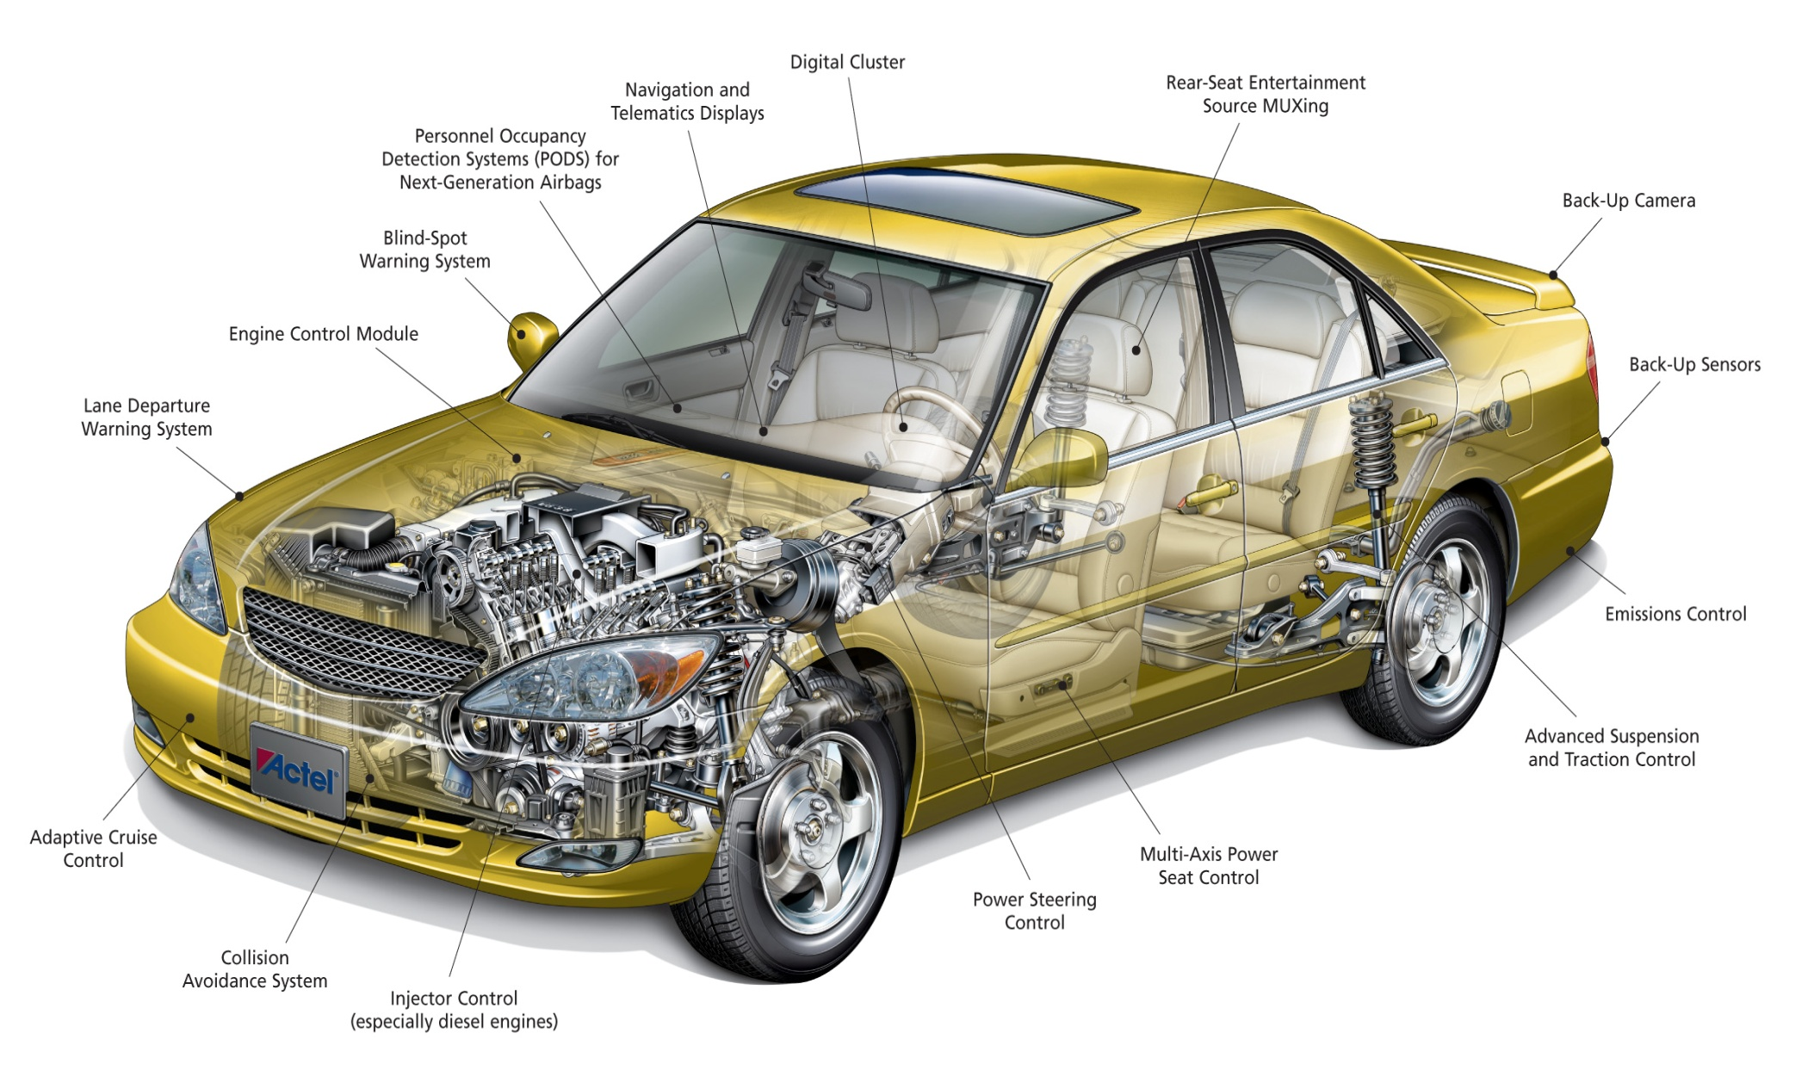
Introduction
Today’s cars are a complex distributed embedded system with multiple electronic components
Automotive electronics are also affected by faults
[Corno et. al. 2004, Zanoni et. al. 1993]

Slide 3
On the other hand …
Automotive applications are safety-critical
Guaranteeing reliability is mandatory
No room for errors whatever may be the cause
Hard real-time constraints

Slide 4
Our contribution
We focus on in-vehicle communication
Reliable message scheduling over FlexRay based automotive networks
Via temporal fault-tolerance
Retransmissions
At a minimum bandwidth utilization cost

Slide 5
Why FlexRay ?
Supported by a large consortium
Car manufacturers
Automotive suppliers
Expected to become the de facto standard in automotive communication
Hybrid protocol
FlexRay combines features of time-triggered and event-triggered protocols
We focus on the Static Segment

Slide 6
Rest of the talk …
System Model
Reliability Analysis
Motivational Example
CLP-based Formulation
Heuristic Solution
Experimental Results
Conclusions

Slide 7
System Model
1. Messages | 2. FlexRay Protocol | 3. Fault Model
Offset | Length of the FlexRay cycle | Time unit
Period | Length of the Static Segment | Reliability goal
Deadline | Number of available slots | Bit Error Rate
Length |  | Probability of failure
Length of the Static Segment
Length of the Dynamic Segment
Static Slots
1 | 2 | 3 | 4 |  | 1 | 2 | 3 | 4 |  | 1 | 2 | 3 | 4 |  | 1 | 2 | 3 | 4 |  | 1 | 2 | 3 | 4 |  | 1 | 2 | 3 | 4
Length of the FlexRay Cycle

Slide 8
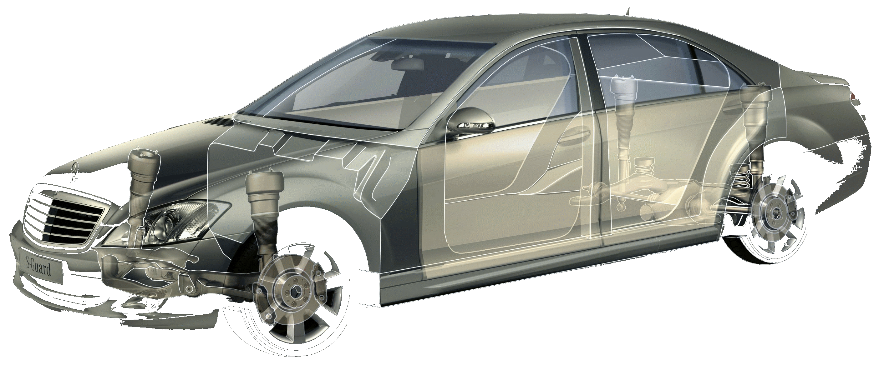
System Model
3. Fault Model
Time unit
Reliability goal
Bit Error Rate
Probability of failure
The case of transient faults
Temperature variation
Electromagnetic interferences
Radiations
BER
ECU₁
ECU₂
ECU_{M}
FlexRay Bus

Slide 9
Reliability Analysis
The particular case of one message
Probability to have the initial transmission faulty:
Probability to have k consecutive retransmissions faulty:
1
2
Probability to have at least one successful transmission in the case of k consecutive retransmissions for one instance:
Probability to have at least one successful transmission in the case of k consecutive retransmissions for all instances over a time unit:
3
4

Slide 10
Reliability Analysis
The general case of more then one message
Preliminaries :
Different messages can be retransmitted for different number of times
Faults in messages are independent events
The probability to have at least one successful transmission for all instances of all messages:

Slide 11
Reliability Analysis
Problem: What are the minimum number of retransmissions which have to be performed for each message in part such that the reliability goal is achieved?

Slide 12
Motivational Example
0
2
4
6
2
3
time (ms)
2
2¹
1
1¹
1²
2
2¹
2
2¹
1
1¹
1²
Cycle 1
Cycle 2
Cycle 3
2 utilized slots
(1-p₁)² x (1-p₂)³ = 0.034 < 0.09
4 utilized slots
(1 – p³₁)² x (1 – p₂)³ = 0.131 > 0.09
3 utilized slots
(1 – p₁)² x (1 – p²₂)³ = 0.094 > 0.09
M1: T = 3, D = 2.5, p = 0.6
M2: T = 2, D = 0.4, p = 0.4
FC = 2, ST = 2, NS = 5
= 6, = 0.09

Slide 13
Motivational Example
0
2
4
6
2
3
time (ms)
0.4
0.4
0.4
2
2¹
1
2
2¹
2
2¹
1
Cycle 1
Cycle 2
Cycle 3
3 utilized slots
(1 – p₁)² x (1 – p²₂)³ = 0.094 > 0.09
M1: T = 3, D = 2.5, p = 0.6
M2: T = 2, D = 0.4, p = 0.4
FC = 2, ST = 2, NS = 5
= 6, = 0.09

Slide 14
CLP-based Formulation
Optimization objective
Minimize the total number of used slots
Message params
FlexRay params
Reliability goal
Input
Fault tolerant schedule
Output
Solver
(CLP based)
Reliability constraints
Scheduling constraints

Slide 15
CLP-based Formulation
A schedule represents an assignment of messages to slots
Scheduling constraints
All instances of a given message have to accommodate k retransmissions until the deadline
Sharing slots between messages is not allowed
Ensuring the temporal order of retransmissions

Slide 16
Heuristic Solution
Stage I
Get the required number of retransmissions
Get the required number of retransmissions
Feedback Loop
Stage II
Stage III
Get the schedule
Identify critical messages
Failure
Final output

Slide 17
Heuristic Solution Stage I
Lower bound
The minimum number of retransmissions is defined as the smallest k for which:
Particular case:

Slide 18
Heuristic Solution Stage I
Definition: A group is a set of messages which can satisfy the reliability goal using the lower bounds
Greedily build groups of messages which satisfy the reliability goal
Combine the groups to reach the global goal

Slide 19
Heuristic Solution Stage I
Example:
Message | Period | Deadline | Length | Lower bound | Reliability
M1 | 5 | 3 | 32 | 1 | X
M2 | 15 | 10 | 64 | 2
M3 | 20 | 15 | 24 | 1
M4 | 8 | 6 | 128 | 2
M5 | 16 | 10 | 64 | 2
M6 | 32 | 16 | 64 | 1
Group 1 | Group 2 | Group 3
M1 M3 M6 | M2 M5 | M4
Reliability

Slide 20
Heuristic Solution Stage II
Stage I
Get the required number of retransmissions
Feedback Loop
Stage II
Stage III
Get the schedule
Get the schedule
Identify critical messages
Identify critical messages
Failure
Final output

Slide 21
Heuristic Solution Stage III
Once the values of k are computed the scheduler is invoked (Stage II)
Identify messages which might have created bottlenecks
Based on the scheduling constraints
Formulated as a CLP problem
Heuristic search based on the limited discrepancy search algorithm

Slide 22
Heuristic Solution Stage III
Values given by Stage I
Search space for Stage III
3
4
4
5
3
Minimize:
k*
k*
1
2
1
1
2
2
3
1
Lower bounds

Slide 23
Heuristic Solution Stage III
Example
Stage I
Stage III
Recall Stage I for M1, M3, M4
Stage II
Message | Period (ms) | Deadline (ms) | Length (bits)
M1 | 5 | 4.5 | 96
M2 | 3.5 | 3.0 | 128
M3 | 2.5 | 2.0 | 64
M4 | 10 | 10 | 32
Lower bounds | k
1 | 2
2 | 2
1 | 2
1 | 1
Reliable
Message | Period (ms) | Deadline (ms) | Length (bits)
M1 | 5 | 4.5 | 96
M2 | 3.5 | 3.0 | 128
M3 | 2.5 | 2.0 | 64
M4 | 10 | 10 | 32
Lower bounds | k
1 | 2
2 | 3
1 | 2
1 | 1
Reliable
Lower bound | k
1 | 2
2 | 2
1 | 2
1 | 3
Reliable
Schedulable?
X
X
Schedulable ?
Who is responsible for the fact that M2 and M4 are NOT schedulable?
M2 is responsible !

Slide 24
Experimental Results
3 methods are compared:
Optimal-CLP
The CLP-based formulation
H-CLP
Heuristic approach for computing the required number of retransmissions
Optimal implementation of message scheduling (Stage II)
H-H
Heuristic approach for computing the required number of retransmissions
Heuristic approach for obtaining the schedule

Slide 25
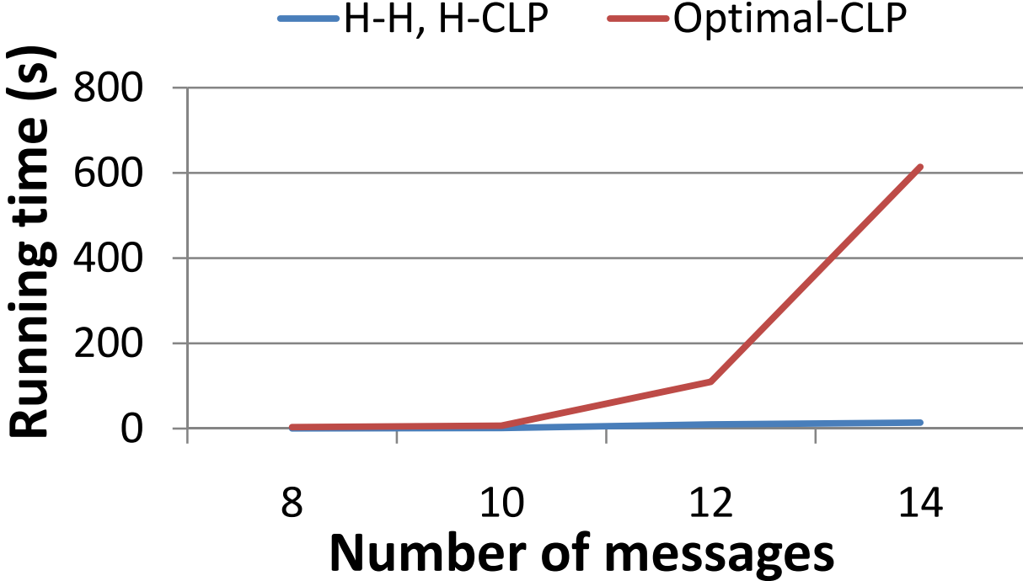
Experimental Results
Small test cases
The CLP formulation runs in reasonable amount of time and the optimal solution is provided
93%

Slide 26
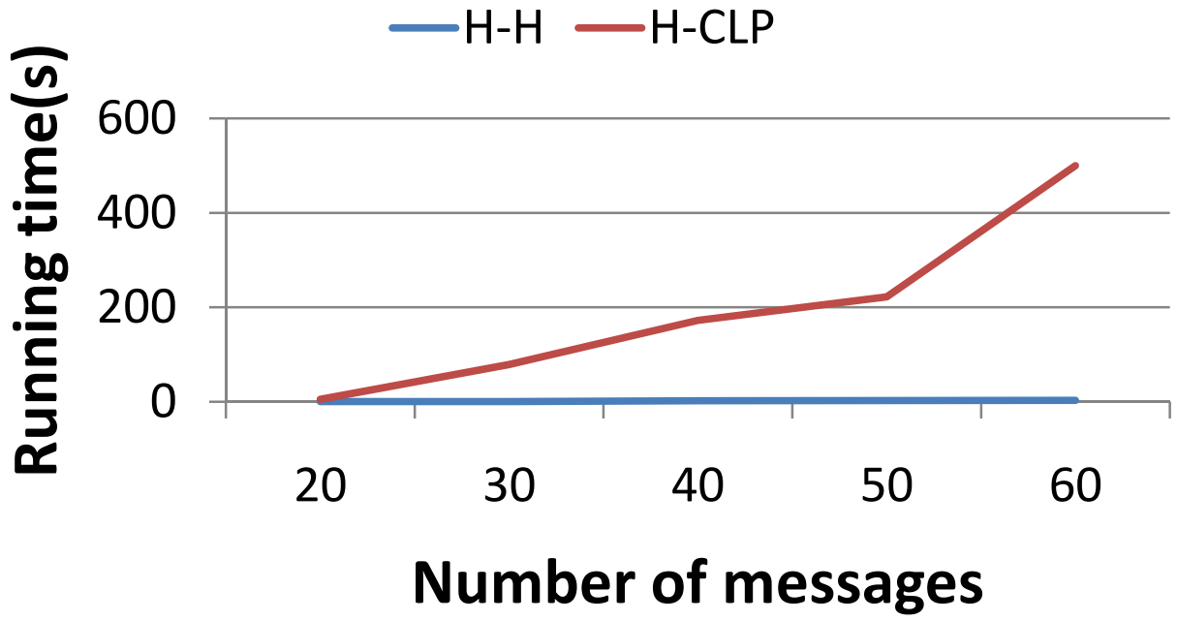
Experimental Results
Large test cases
The CLP formulation is NOT able to run and the optimal solution is NOT provided
95%

Slide 27
Conclusions
A method for synthesizing reliable schedules on the FlexRay bus has been presented:
Number of needed retransmissions is determined
For each message and retransmission a slot is assigned
Easy to generalize the proposed method to classes of messages with different reliability constraints

Slide 28
Thank you!

Slide 29
Heuristic Solution Stage I
Compute the lower bounds
Update the reliability goal
1
4
The worst case time complexity:
O(N² log N)
Sort the messages in
the decreasing order
of the PS_{i} values
2
Recursively call the algorithm for the
remaining messages
5
Identify the biggest group for which:
3

Slide 30
Heuristic Solution
The addressed problem is NP-complete
Efficient heuristic is needed
A 3 stage approach
Identify the required number of retransmissions
Reliability analysis
Test the scheduling constraints
Feedback loop
Identify critical messages

Slide 31
Heuristic Solution Stage III
Messages for which are declared to be critical
The lower bound will be used for them
Recall Stage I for the remaining messages
Stops when:
the schedule is build, or
the method cannot identify any other critical messages
Critical messages cannot form a group

