Slide 1
Reliability-Aware Frame Packing for the Static Segment of FlexRay
Bogdan Tanasa, Unmesh Bordoloi,
Petru Eles, Zebo Peng
Linkoping University, Sweden

Slide 2
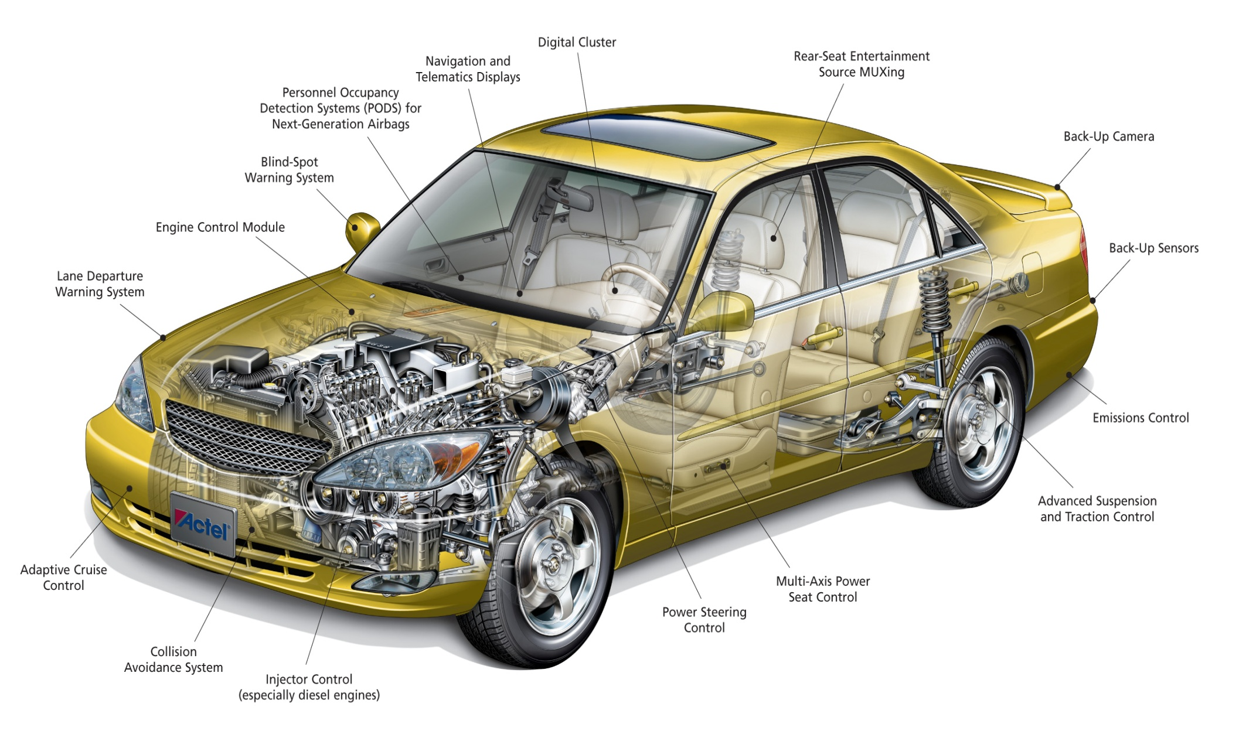
Introduction
Today’s cars are a complex distributed embedded system with multiple electronic components
Automotive electronics are also affected by faults

Slide 3
Introduction
Some automotive applications are
safety-critical
Guaranteeing reliability is mandatory
In-vehicle communication
Fault Tolerance techniques for reliable communication
Hard real-time constraints
End to end deadlines must be satisfied

Slide 4
Our contribution
Signal packing
Elementary pieces of information
Signals will be packed into frames
Reliable frame scheduling over FlexRay based automotive networks
Via temporal fault-tolerance
Retransmissions
At a minimum bandwidth utilization cost

Slide 5
Why FlexRay ?
Supported by a large consortium
Car manufacturers
Automotive suppliers
Hybrid protocol
FlexRay combines features of time-triggered and event-triggered protocols
We focus on the Static Segment

Slide 6
Rest of the talk …
System Model
Signal Packing
Reliability Analysis
CLP-based Formulation
Heuristic Solution
Experimental Results

Slide 7
System Model
Distributed Automotive Architecture
set of ECUs E_{1,} E₂, … E_{N}
set of Signals per ECU S = {s₁, s₂, …, s_{L}}
Offset
Period
Deadline
Length

Slide 8
System Model
FlexRay Communication Cycle
FlexRay Protocol Parameters
Length of the Communication Cycle
Length of the Static Segment
Number of slots within the Static Segment
FlexRay Static Segment
Static Slot
1 | 2 | 3 | 4 | 5 | 6 | …

Slide 9
System Model
FlexRay Frame Format:
Packing more signals into frames help reducing the overhead
Header | Signals | Footer
Overhead

Slide 10
System Model
Fault Model - The case of transient faults
Time unit - τ
Used to define the reliability goal
Ex: one hour of functionality
Reliability Goal - ρ
Imposed by the designer: Ex. ρ = 0.99999
Maximum number of tolerated faults over a time unit
Bit Error Rate - BER
Represents the “quality” of the environment
Used to compute the probabilities of failures

Slide 11
Signal Packing
Definition:
Having a set of signals S = {s₁, s₂, …, s_{N}} build a set of frames F = {f₁, f₂, …, f_{M}} such that:
- each signal belongs to only one frame
- signals will not violate their deadlines
- frames do not exceed the slot capacity
- the bandwidth used by the set F is minimum

Slide 12
Signal Packing
Signal | Offset | Period | Deadline | Length
S₁ | 0 | 5 | 5 | 16
S₂ | 0 | 2 | 2 | 32
S₃ | 0 | 3 | 3 | 64
…
S_{N} | 0 | 10 | 10 | 54
F | 0 | 2 | ? | 112
The signal with the minimum period imposes the period of the resulting frame
The deadline of the resulting frame must be computed such that the deadlines of the initial signals will not be violated

Slide 13
Signal Packing
Example
Signal | Offset | Period | Deadline | Length
S₁ | 0 | 3.00 | 2.00 | 16
S₂ | 0 | 2.00 | 1.50 | 24
F | 0 | 2.00 | ? | 40
2.00 – 1.00 = 1.00
 | 0 |  | 1.5 | 2 |  | 3 | 3.5 | 4 |  | 5 | 5.5 | 6
S2
S1
F
Remaining time
Slack
Waiting time
S1S2
S2
S1S2

Slide 14
Signal Packing
General Case:
gcd – Greatest Common Divisor

Slide 15
How packing signals affects the schedulability?
Period | Deadline
6 | 6
7 | 7
12 | 12
Frame:
Period: T = 6
Deadline: D = 2
Frame:
Period: T = 6
Deadline: D = 6
Deadline violation!
0 |  | 2 |  |  | 5 | 6 |  | 8 |  | 10 |  | 12 |  | 14
FC = 5 ms |  |  | ST = 2 ms |  |  | NS = 2 slots
1 | 2 | DYN | 1 | 2 | DYN | 1 | 2 | DYN

Slide 16
How packing signals affects the schedulability?
Period | Deadline
6 | 6
7 | 7
12 | 12
Frame:
Period: T = 6
Deadline: D = 6
Schedulable using the second slot!
0 |  |  |  |  | 5 | 6 |  |  |  | 10 |  | 12
15 |  |  | 18
FC = 5 ms |  |  | ST = 2 ms |  |  | NS = 2 slots
1 | 2 | DYN | 1 | 2 | DYN | 1 | 2 | DYN
1 | 2 | DYN

Slide 17
Reliability Analysis
For a given packing of signals into frames the required number of retransmissions has to be computed
Based on:
period of frames
probabilities of failure of each frame in part
time unit
reliability goal

Slide 18
Reliability Analysis
The particular case of one frame
Probability to have the initial transmission faulty:
Probability to have k consecutive retransmissions faulty:
1
2
Probability to have at least one successful transmission in the case of k consecutive retransmissions for one instance:
Probability to have at least one successful transmission in the case of k consecutive retransmissions for all instances over a time unit:
3
4

Slide 19
Reliability Analysis
The general case of more then one frame
Assumptions :
Different messages can be retransmitted for different number of times
Faults in messages are independent events
The probability to have at least one successful transmission for all instances of all messages:

Slide 20
Reliability Analysis
Solve:
p_{i} = probability of failure of frame F_{i}
Based on Bit Error Rate - BER and length - W_{i}
T_{i} = period of frame F_{i}
k_{i} = the required number of retransmissions of frame F_{i}
Directly impacts the bandwidth
τ = time unit
ρ = reliability goal
The reliability goal must be satisfied with a minimum cost in terms of bandwidth utilization:

Slide 21
Why it is important to consider fault tolerance requirments while packing?
Signals | Offset | Period | Deadline | Length
S1 | 1 | 8 | 8 | 20
S2 | 1 | 8 | 8 | 15
S3 | 2 | 4 | 4 | 20
S4 | 1 | 12 | 12 | 25
S5 | 2 | 12 | 12 | 20
S6 | 1 | 16 | 16 | 14
Method 1:
Pack signals first and after that apply fault tolerance technique
(S1 ... S6) | 1 | 4 | 4 | 114
Output:
Only one frame which requires 10 slots

Slide 22
Why it is important to consider fault tolerance requirments while packing?
Signals | Offset | Period | Deadline | Length
S1 | 1 | 8 | 8 | 20
S2 | 1 | 8 | 8 | 15
S3 | 2 | 4 | 4 | 20
S4 | 1 | 12 | 12 | 25
S5 | 2 | 12 | 12 | 20
S6 | 1 | 16 | 16 | 14
Method 2:
Consider fault tolerance requirments while packing
(S1 S2 S3) | 2 | 4 | 4 | 55
(S4 S5 S6) | 1 | 12 | 12 | 59
Output:
Two frames which requires 9 slots in total

Slide 23
Problem Formulation
Each ECU generates a set of signals
For all sets of signals find a set of frames such that:
The reliability goal is satisfied
Slots can be assigned to frames such that the deadlines are satisfied
Signals don’t miss their deadlines
Bandwidth utilization is minimum

Slide 24
CLP-based Formulation
Optimization objective
Minimize the total number of used slots
Signal params
Packing rules
FlexRay params
Reliability goal
Input
A set of packed frames that are fault tolerant and schedulable
Output
Solver
(CLP based)
Reliability constraints
Scheduling constraints

Slide 25
CLP-based Formulation
A schedule represents an assignment of final frames to slots
Scheduling constraints
All instances of a given frame have to accommodate k retransmissions before the deadline

Slide 26
Heuristic Solution
ECU₁
...
ECU_{i}
...
ECU_{N}
Initial: Each signal is a frame
Compute the required number of retransmissions
Reliability Analysis
Solve:
Relax the integrality constraint
Impose ∇F = 0 (first order optimality condition)
Obtain in general non-integer values of k_{i}

Slide 27
Heuristic Solution
ECU₁
...
ECU_{i}
...
ECU_{N}
Initial: Each signal is a frame
Compute the required number of retransmissions
Reliability Analysis
For each ECU
Input: Set of frames
Goal: Find the best pair of frames based on the packing metric
Output: A new set of frames

Slide 28
Heuristic Solution
Step 2: Packing Metric
Input: F = {f₁, f₂, …, f_{L}} – set of frames
Find: f_{u} ● f_{v}, u ≠ v – the best pair of frames which minimize the bandwidth
T_{uv} = min{T_{i}}
D_{uv} = min{D_{i} – T_{uv} + gcd(T_{uv}, T_{i})}
W_{uv} = W_{i}+W_{j}
K_{uv} ≥ max{K_{i}, K_{j}}
Try to fill the frames which have large periods
Packing of signals into frame
The required number of retransmissions
Try to keep large deadlines while increasing the value of K by very little
Approximate K_{uv}

Slide 29
Heuristic Solution
Step 3: Build a fault tolerant static schedule
Called with the ceiling values of k_{i}
Find an assignment of slots to the final frames
Step 4: Remove signals from frames to increase the deadlines
Detect the signal which provides two frames with the highest possible deadlines
Recall step 1 and step 3

Slide 30
Experimental Results
Two set of experiments
Small test cases
Compare the heuristic with results provided by the optimal CLP implementation
Large test cases
Compare the heuristic against the traditional method when fault tolerant requirements are applied after packing the signal into frames

Slide 31
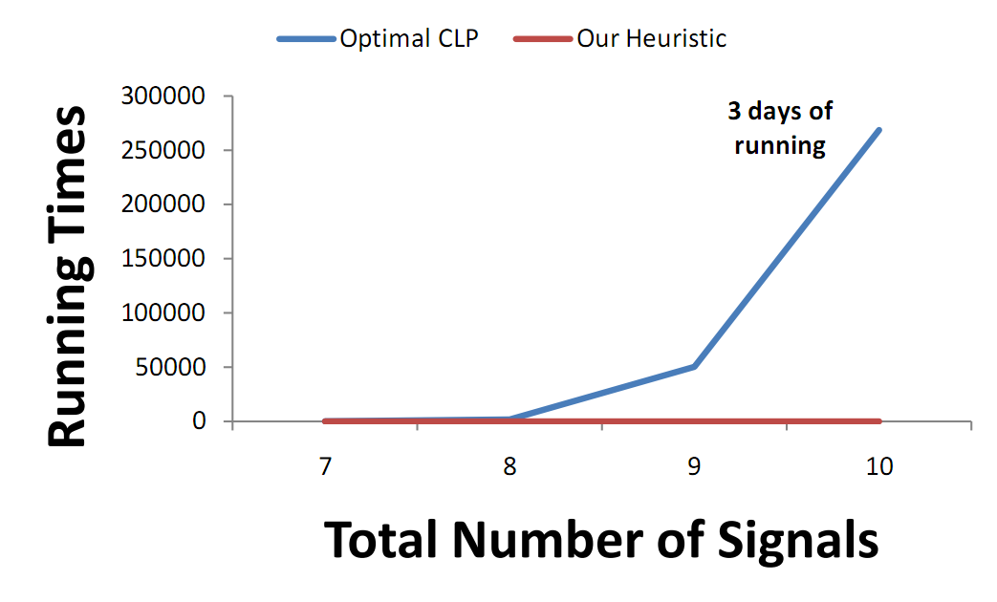
Experimental Results
Small test cases
Our heuristic was in average only 15 % far from the optimal solution

Slide 32
Experimental Results
Large test cases
Our method vs. traditional method
First pack the signal into frames
Second apply fault-tolerance techniques
In average the improvement is around 30% in terms of bandwidth utilization

Slide 33
Experimental Results

Slide 34
Conclusions
A method for packing signals into frames with fault tolerance requirements was presented
The required number of retransmissions is computed
An fault tolerant schedule for the Static Segment is constructed
Message:
The fault tolerance requirments need to be considered while packing to achive
good bandwidth utilization

Slide 35
Thank you!

Slide 36
Heuristic Solution
ECU₁
...
ECU_{i}
...
ECU_{N}
Initial: Each signal is a frame
Compute the required number of retransmissions
Reliability Analysis
1
2
Pack frames for ECU_{i}
Input: F = {f₁, f₂, …, f_{L}} – set of frames
Find: f_{u} ● f_{v}, u ≠ v – the best pair of frames based on packing metric
Explore L x (L – 1) / 2 pairs
Output: F’ = F – {f_{u}, f_{v}} U {f_{uv}}
Evaluate the bandwidth consumption
Go to Step 1
3
Build a fault tolerant schedule for the resulted frames
Extract signals from frames to increase the deadlines
Relax deadlines if needed
4

