Slide 1
ADIT Meeting
2021-10-29

Slide 2
New employees
Announcement of postdoc position

Slide 3
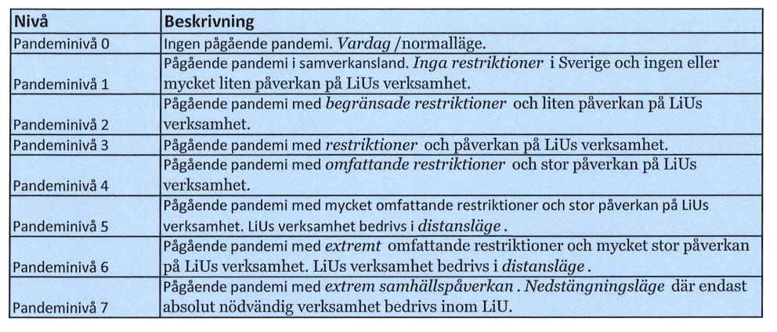
LiU - Covid-19
New policy based on pandemic levels
https://insidan.liu.se/HR-Personal/coronavirus/coronavirus/1.784719/Beslut-aktivering-pandeminiva-varen-2021.pdf

Slide 4
IDA - Covid-19
Work on campus
Teaching as earlier prepared (can be online)
Exams BSc/MSc level on campus or digital (until 2022-01-31)
ADIT meetings digital
PhD courses digital
Travel according to recommendations of government
Note: if you travel, stay away from ADIT corridor for 2 weeks after return
Directives regarding work from home on the way

Slide 5
Info from IDA - strategy work
Progress in research clusters
AI: interviews, discussions on web page
Ulf Nilsson coordinator
SaCS: interviews, discussions on web page
HCS
Data Science – STIMA received questionnaire

Slide 6
Info from TFK FU
Changes in licentiate defense
Pre-check process: examiner and opponent need to certify the quality is high enough to be able to present the lic. thesis
Examiner has to be from LiU
Opponent cannot be from LiU

Slide 7
Info from IDA FU
Deadline for proposing courses for 2022: November 15

Slide 8
Info from IDA FU
New director of studies for PhD studies from 2022:
Zebo Peng

Slide 9
Info from TFK GU
Evaluation of Master Computer Science program in 2022. (Patrick will work 6% at TFK in 2022.)

Slide 10
Info from IDA GU
New head director of studies:
Marco Kuhlmann

Slide 11
Info from IDA GU
New way to deal with tekfak MSc/BSc theses that are not given in course format
ADIT: 12 MSc + 4 BSc
Based on registration (instead of finishing)
Full coverage
Per thesis, not per student
MSc/BSc: distribute 1%/0,5% to examiner and supervisor each

Slide 12
Info from IDA GU
Questionnaire regarding the use of WexUpp.
Answer latest november 12.
https://forms.office.com/Pages/ResponsePage.aspx?id=7Bg_kSZ_X0yoFnhP6aWO3ZFP7iEiI5xGg5ES7WxkIWVUMEdRTjY0RVdIVzJYMkVQNDNLRTBETUFDSi4u

Slide 13
Info from LiU
Recording studios:
https://liuonline.sharepoint.com/sites/intranet-it/SitePages/Inspelningsrum.aspx
https://status.liu.se/

Slide 14
Salary revision
PhD students:
Start: 30 850 kr
After 30%: 31 850 kr
After 60%/licexamen: 34 450 kr
Plan to pay new salaries in december (and retroactively for october/november)

Slide 15
Notes
Teaching budget
Work environment questionnaire → next time

Slide 16
Info from group members

