Slide 1
ADIT Meeting
2021-09-03

Slide 2
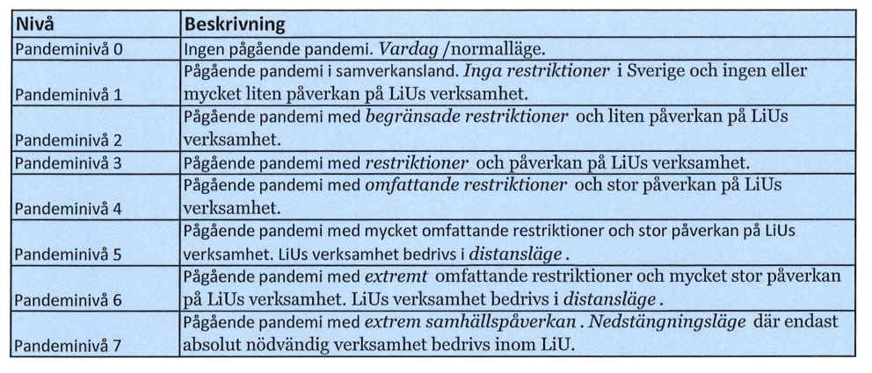
LiU - Covid-19
New policy based on pandemic levels
https://insidan.liu.se/HR-Personal/coronavirus/coronavirus/1.784719/Beslut-aktivering-pandeminiva-varen-2021.pdf

Slide 3
LiU - Covid-19
https://insidan.liu.se/HR-Personal/coronavirus?l=en&sc=true
Teaching and exams mainly distance mode (GU and FU)
Meetings distance mode (also supervision)
Work on campus: only if neccesary (discuss with me)
No travel for conferences
Questions:
Contact me; For work environment issues, contact HR

Slide 4
LiU - Covid-19
Level 2 from 2021-08-01
Work from home as much as possible until 2021-09-30; no decision on what happens after 2021-09-30
Courses:
Recommendation to do as VT
Not possible to get extra rooms
Distance of 1.5 m between students in rooms
Distance mode for teaching and exams allowed until 2022-01-31 (applying initiated by examiner instead of IDA)

Slide 5
IDA - Covid-19
Until 2021-09-30
Work from home
All meetings digital
Undergraduate courses as planned earlier
PhD courses digital; supervision digital
No travel for work
Note: if you traveled during holidays, stay away from ADIT corridor for 2 weeks after return

Slide 6
Info from LiU - Värdegrundsarbete
Values
Workshops at all units and divisions
(offered)
Discussion groups at IDA level
(Patrick responsible for ’Life Science’; latest 30/4)

Slide 7
Info from IDA - strategy work
Progress in research clusters
AI: interviews, discussions on web page
Ulf Nilsson coordinator
SaCS: interviews, discussions on web page
HCS
Data Science – STIMA received questionnaire

Slide 8
ADIT mailing list
adit.ida@liu.se

Slide 9
New employees
Industrial PhD student David Hasselquist
Changes: Mina, Ying, Mohammad, Suleman become PhD students

Slide 10
Leaving
Ioannis
Matus

Slide 11
Info from group members

