Slide 1
ADIT Meeting
2021-06-22

Slide 2
New employees
Industrial PhD student David Hasselquist (1/9)
Open announcements PhD students
CUGS (Andrei and Patrick) – closes 24/6
IDA (Andrei)
Closed announcements PhD students
IDA (Patrick) – decision: Ying Li

Slide 3
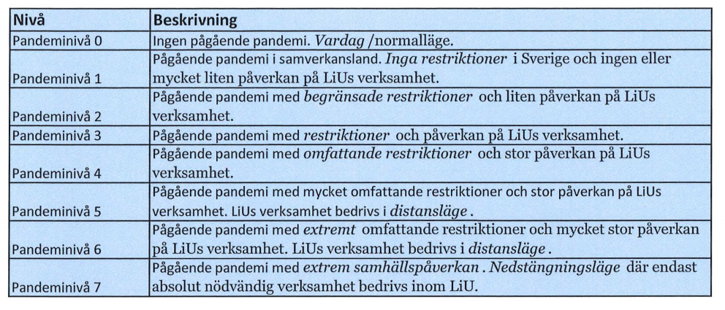
LiU - Covid-19
New policy based on pandemic levels
https://insidan.liu.se/HR-Personal/coronavirus/coronavirus/1.784719/Beslut-aktivering-pandeminiva-varen-2021.pdf

Slide 4
LiU - Covid-19
Current level: 4 until 2021-07-31

Slide 5
LiU - Covid-19
https://insidan.liu.se/HR-Personal/coronavirus?l=en&sc=true
Teaching and exams mainly distance mode (GU and FU)
Meetings distance mode (also supervision)
Work on campus: only if neccesary (discuss with me)
Report to government
No travel
Students less opportunities to be on campus
Questions:
Contact me; For work environment issues, contact HR

Slide 6
LiU - Covid-19
Level 2 from 2021-08-01
Work from home as much as possible until 2021-09-15
Planned (not decided): level 1 from 2021-09-16
Courses:
Recommendation to do as planned even after 2021-08-01
Not possible to get extra rooms
Until 2021-09-15: distance of 1.5 m between students in rooms
Distance mode for teaching and exams allowed until 2022-01-31 (applying initiated by examiner instead of IDA)

Slide 7
IDA - Covid-19
Until 2021-09-15
Work from home
All meetings digital
Undergraduate courses as planned earlier
PhD courses digital; supervision digital
No travel for work
Note: if you travel during holidays, stay away from ADIT corridor for 2 weeks after return

Slide 8
Info from LiU - Värdegrundsarbete
Values
Workshops at all units and divisions
Latest September 30, 2021
Discussion groups at IDA level
(Patrick responsible for ’Life Science’; latest 30/4)

Slide 9
Info from IDA - strategy work
Progress in research clusters
AI: interviews, discussions on web page
Ulf Nilsson coordinator
SaCS: interviews, discussions on web page
HCS
Data Science – STIMA received questionnaire

Slide 10
Info from LiU – new funding model
New model for distribution of funding from faculties to departments (from Jan 2023; in practice new rules need to be ready spring 2022)
GU
Funding for course mainly based on registrations
All computations in current year
Faculty can fund special commitments (max 15%)

Slide 11
Info from LiU – new funding model
New model for distribution of funding from faculties to departments (from Jan 2023; in practice new rules need to be ready spring 2022)
FO
To people 20-30%
To research environments 55-80%
Special commitments 0-15%
Prefekt can redistribute in the department

Slide 12
Info from LiU - vaccination
Employees can now also book time at Feelgood
Tannefors (Linköping) or Bråddgatan (Norrköping)
Same conditions as Region Östergötland
https://liuonline.sharepoint.com/sites/intranet-nyheter/SitePages/en/Vaccinera-dig-hos-Feelgood.aspx?CT=1623400935972&OR=OWA-NT&CID=7b715611-61d2-2cb9-a19f-e0c396557e0c

Slide 13
Info from group members

