Slide 1
ADIT Meeting
2021-04-16

Slide 2
New administrator
Agne Virsilaite Maras (research)
As before (undergraduate education):
MSc/BSc theses: Annelie Almqvist (back from leave)
Courses: see your course home page
  schema@ida.liu.se
  inrapportering@ida.liu.se
  adm-gu@ida.liu.se

Slide 3
New employees
Tekniker (postdoc)
Sebastian Ferrada – visum approved

Slide 4
Leaving
Senyang

Slide 5
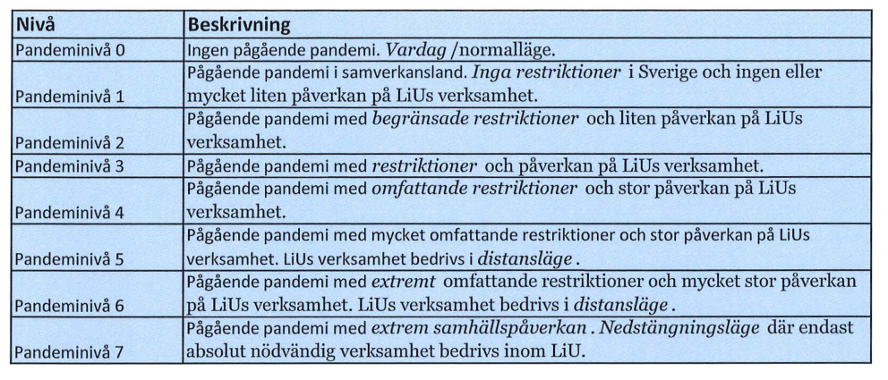
LiU - Covid-19
New policy based on pandemic levels
https://insidan.liu.se/HR-Personal/coronavirus/coronavirus/1.784719/Beslut-aktivering-pandeminiva-varen-2021.pdf

Slide 6
LiU - Covid-19
Current level: 4 until 2021-06-30
Priorities for students on campus: 1) last year, 2) necessary for progression, 3) not possible distance 4) other
Priorities according to the deans: (only take up ADIT-relevant)
  Absolutely necessary: last year exam, (parts of thesis)
  Necessary: examinations on low level of bloom taxonomy where problem with legality
  Examples of non-necessary: lectures, seminars, exercise/tutorial sessions, supervision

Slide 7
LiU - Covid-19
https://insidan.liu.se/HR-Personal/coronavirus?l=en&sc=true
Teaching and exams mainly distance mode (GU and FU)
All IDA March exams in distance mode
Meetings distance mode (also supervision)
Work on campus: only if neccesary (discuss with me)
Report to government
No travel
Students less opportunities to be on campus
Questions:
Contact me; For work environment issues, contact HR

Slide 8
LiU - Covid-19
New directive:
LiU needs to report all cases from the beginning of the pandemic of people that were infected at work

Slide 9
Info from LiU - Dialogues
Personal development dialogue (samarbetssamtal)
Salary discussion (lönesättande samtal)
probably: payment in May
https://www.ida.liu.se/local/ida/staff/lonerev/

Slide 10
Info from LiU - Värdegrundsarbete
Values
Workshops at all units and divisions
Latest September 30, 2021
Discussion groups at IDA level
(Patrick responsible for ’Life Science’; latest 30/4)

Slide 11
Info from IDA - strategy work
Progress in research clusters
AI: interviews, discussions on web page
Ulf Nilsson coordinator
SaCS: interviews, discussions on web page
HCS
Data Science – STIMA received questionnaire

Slide 12
Two-step verification
https://insidan.liu.se/it/it-nyheter/1.788492?l=en&sc=true
From outside LiU
Last date for activation: May 6

Slide 13
Digital signatures
https://edusign.sunet.se
Internal documents (but not all)
Not for sensitive documents
For documents in pdf A/1a (need acrobat professional)
Double two-step verification
Not clear if different signatures are needed

Slide 14
Info from HR
No more paper documents for
Föräldrarledighet (Parental leave)
Tjänstledighet (paid and unpaid leave)
→ Primula

Slide 15
Info from group members

Slide 16
For Seniors

