Slide 1
ADIT Meeting
2021-01-26

Slide 2
New employees
Tekniker (postdoc) – from April
Sebastian Ferrada

Slide 3
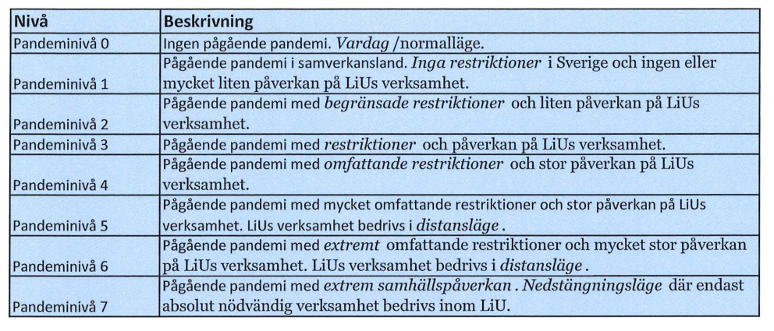
LiU - Covid-19
New policy based on pandemic levels
https://insidan.liu.se/HR-Personal/coronavirus/coronavirus/1.784719/Beslut-aktivering-pandeminiva-varen-2021.pdf

Slide 4
LiU - Covid-19
Current level: 4 until 2021-03-28
For teaching/examination: plan according to level 4 for 2021VT
Priorities for students on campus: 1) last year, 2) necessary for progression, 3) not possible distance 4) other
Priorities according to the deans: (only take up ADIT-relevant)
  Absolutely necessary: last year exam, (parts of thesis)
  Necessary: examinations on low level of bloom taxonomy where problem with legality
  Examples of non-necessary: lectures, seminars, exercise/tutorial sessions, supervision

Slide 5
LiU - Covid-19
https://insidan.liu.se/HR-Personal/coronavirus?l=en&sc=true
Teaching and exams mainly distance mode (GU and FU)
All IDA January exams in distance mode
Meetings distance mode (also supervision)
Work on campus: only if neccesary (discuss with me)
Report to government
No travel
Students less opportunities to be on campus
Questions:
Contact me; For work environment issues, contact HR

Slide 6
Info from LiU - Dialogues
Personal development dialogue (samarbetssamtal)
Salary discussion (lönesättande samtal) delayed

Slide 7
Info from LiU – telephone operator
New telephone operator (Telenor) from 2021-02-03
For people who have LiU sim-cards → change of sim-cards
Lene Rosell contact person at IDA

Slide 8
Info from LiU - Värdegrundsarbete
Values
Workshops at all units and divisions
Latest June 30, 2021

Slide 9
Info from IDA - strategy work
Progress in research clusters
AI: interviews, discussions on web page
SaCS: interviews, discussions on web page
HCS
Data Science

Slide 10
Info from FANS – Electronic ISP
eISP → hand in in January

Slide 11
Info from director of studies
Changes in courses 2022? → latest 2021-02-05
www.lith.liu.se/lith-remisser/viktiga-datum-2021?l=sv

Slide 12
Questionnaire home work environment
7 (+1) answered
Printer/scanner → not from LiU
Chair →can take from your office, but LiU does not deliver anymore / does not pay for delivery
Table → check with Daniel what is in storage (NOT from office), but LiU does not deliver anymore / does not pay for delivery
Installment of software → as before

Slide 13
Questionnaire home work environment
Digital signing → work ongoing
Fika/julbord home → not possible (LiU checked)
Shared IDA credit card → not possible (name based)
Organize ADIT events (virtual fika etc.) → welcome to do so

Slide 14
Info from group members

