Slide 1
ADIT Meeting
2020-12-17

Slide 2
New employees
postdoc: Ioannis Avgouleas
Announcement out:
Tekniker (postdoc)

Slide 3
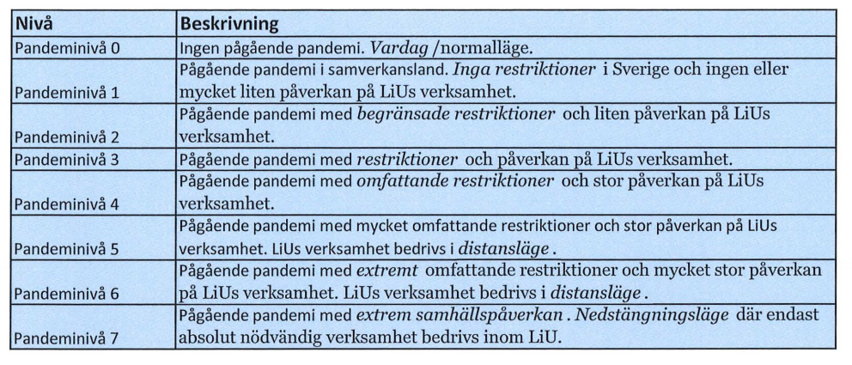
LiU - Covid-19
New policy based on pandemic levels
https://insidan.liu.se/HR-Personal/coronavirus/coronavirus/1.784719/Beslut-aktivering-pandeminiva-varen-2021.pdf

Slide 4
LiU - Covid-19
Current level: 4 until 2021-03-28
For teaching/examination: plan according to level 4 for 2021VT
Priorities for students on campus: 1) last year, 2) necessary for progression, 3) not possible distance 4) other
Priorities according to the deans: (only take up ADIT-relevant)
Absolutely necessary: last year exam, (parts of thesis)
Necessary: examinations on low level of bloom taxonomy where problem with legality
Examples of non-necessary: lectures, seminars, exercise/tutorial sessions, supervision

Slide 5
LiU - Covid-19
https://insidan.liu.se/HR-Personal/coronavirus?l=en&sc=true
Teaching and exams mainly distance mode (GU and FU)
All IDA January exams in distance mode
Meetings distance mode (also supervision)
Work on campus: only if neccesary (discuss with me)
No travel
Questions:
Contact me
For work environment issues, contact HR

Slide 6
Info from LiU - Dialogues
Personal development dialogue (samarbetssamtal)
Salary discussion (lönesättande samtal) delayed

Slide 7
Info from LiU – telephone operator
New telephone operator (Telenor) from 2021-02-03
For people who have LiU sim-cards → change of sim-cards

Slide 8
Info from LiU - Värdegrundsarbete
Values
Workshops at all units and divisions
Latest June 30, 2021

Slide 9
Info from LiU - IT
Since 2020-12-14 for all employees:
Links in mail become ’flinks’
Attachments in mails are scanned for virus by Microsoft
https://insidan.liu.se/it/it-nyheter/1.784832?l=en&sc=true

Slide 10
Info from IDA - strategy work
Progress in research clusters
AI: interviews, discussions on web page
SaCS: interviews, discussions on web page
HCS
Data Science

Slide 11
Info from FANS – Electronic ISP
Uppföljningsblankett (follow up) →hand in latest 16/12
eISP → hand in in January

Slide 12
Info from director of studies
Changes in courses 2022? → latest 2021-02-05
www.lith.liu.se/lith-remisser/viktiga-datum-2021?l=sv

Slide 13
Info from director of studies
From Didacticum:
https://insidan.liu.se/didacticum/didacticum-nyhetsarkiv/1.784502?l=sv
Drop-in regarding
Distance exams: Dec 1-18, 14:00-14:30
Pedagogical development: mondays 13:15-14:00
Lisam-support: tuesdays 10:30-11:30

Slide 14
Info from director of studies
Schedule 2021VT: All rooms will be taken away from the schedule except SU, LA. Send mail to schema@lith.liu.se when they are not needed.
(currently done for VT1, will be done for VT2 later unless lower pandemic level)

Slide 15
Info from director of studies
External thesis works can from 2021 only start at the beginning of the periods.
These are the dates for starting external thesis projects 2021:
VT1: Start date 2021-01-18. Application in WExUpp at the latest 2020-12-18.
VT2: Start date 2021-03-29. Application in WExUpp at the latest 2021-02-28.
HT1: Start date 2021-08-30. Application in WExUpp at the latest 2021-07-30.
HT2: Start date 2021-11-01. Application in WExUpp at the latest 2021-10-01.
Internal thesis works can still start whenever.

Slide 16
Info from group members

