Slide 1
Visualization for Ontology Evolution
Patrick Lambrix¹, Zlatan Dragisic¹, Valentina Ivanova¹, Craig Anslow²
¹Linköping University, Linköping, Sweden
²Middlesex University, London, UK

Slide 2
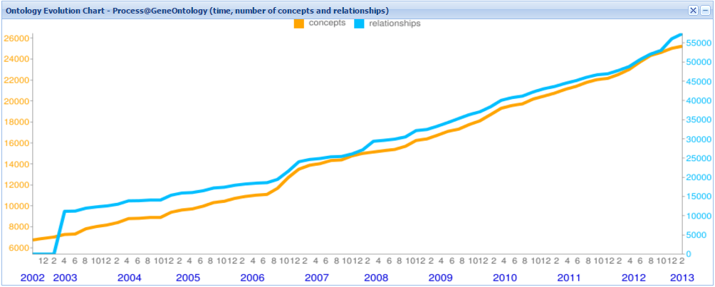
Motivation
Ontologies are not static
Anomalies
Scientific advance
Cases:
Ontology evolves while being used in a semantically-enabled application
Data integration
Querying
Ontology evolution to obtain knowledge about an evolving ontology
Quality assessment
Trends
Few tools exist
Notes:
EXAMPLE on gene ontology
Dealing with anomalies
Extending the scope
Dealing with diverging terminology
Mirroring scientific advance
Adding relations

Slide 3
This work…
We have:
identified desired functionalities for an ontology evolution system
conducted a study to see how current systems implement the functionalities – focus on visualization

Slide 4
Ontology evolution
Steps of ontology evolution*
Detecting the need for evolution
Suggesting changes
Validating the changes
Assessing impact of the changes
Managing changes
*Zablith et. al, Ontology Evolution: A Process Centric Survey, Knowledge Engineering Review, 2015
Notes:
picture

Slide 5
Functionalities
Step | Functionality | CODEX | REX | OnEX | PromptDiff | OntoView | NeON | KAON | Ontology Lookup
Detecting the need for changes | Show an ontology version |  |  |  | X |  | X | X | X
 | Show different ontology versions in evolution graph
 | Show change/diff between ontology versions | X | X | X | X | X |  |  | X
 | Show summary of changes | X | X | X |  |  |  |  | X
 | Show specialized view of changes
 | Show change history of a concept/relations |  | X | X
 | Show provenance information |  | X | X | X |  | X
 | Show information about/context of concept/relation
 | Search and query ontology |  |  |  | X |  |  | X | X
 | Query old versions using terminology of new version
 | Discover trends | X | X | X
 | Discover volatile and stable regions |  | X
Notes:
ONTOVIEW
1-3, 4, 5, 9– version level
6 - 8- Concept level
10/11 – query
12/13 – getting knowledge about the evolving ontology
Each group what exists
General statement what is lacking

Slide 6
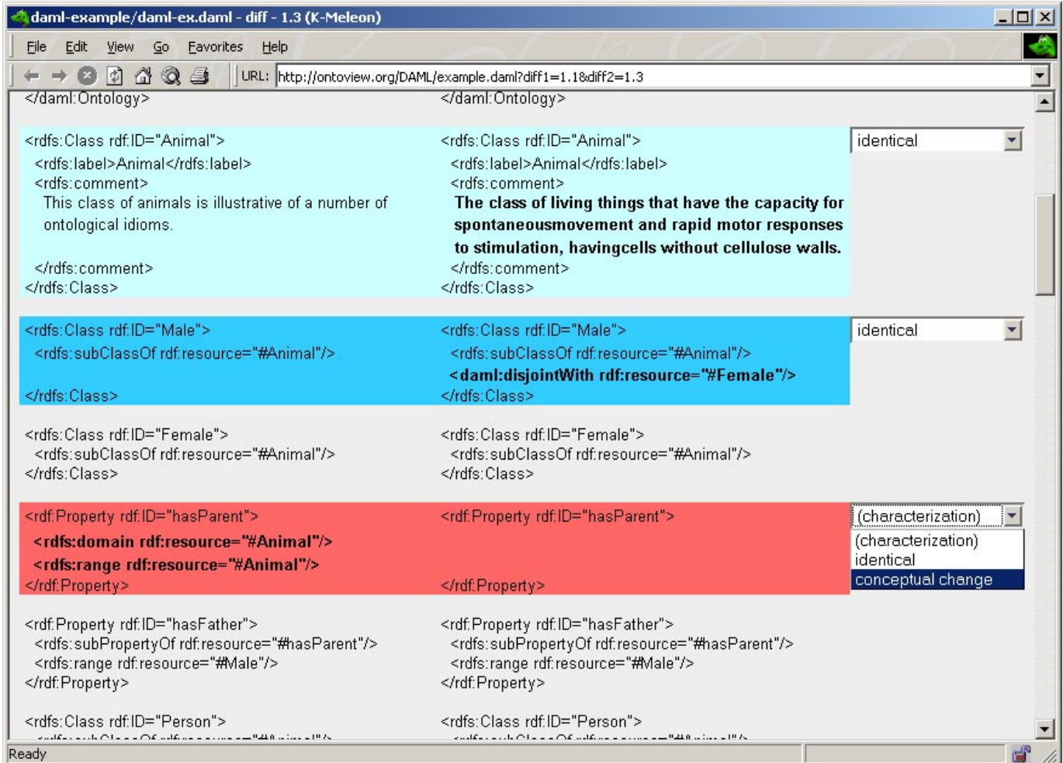
Show change/diff between ontology versions
OnEX
OntoView

Slide 7
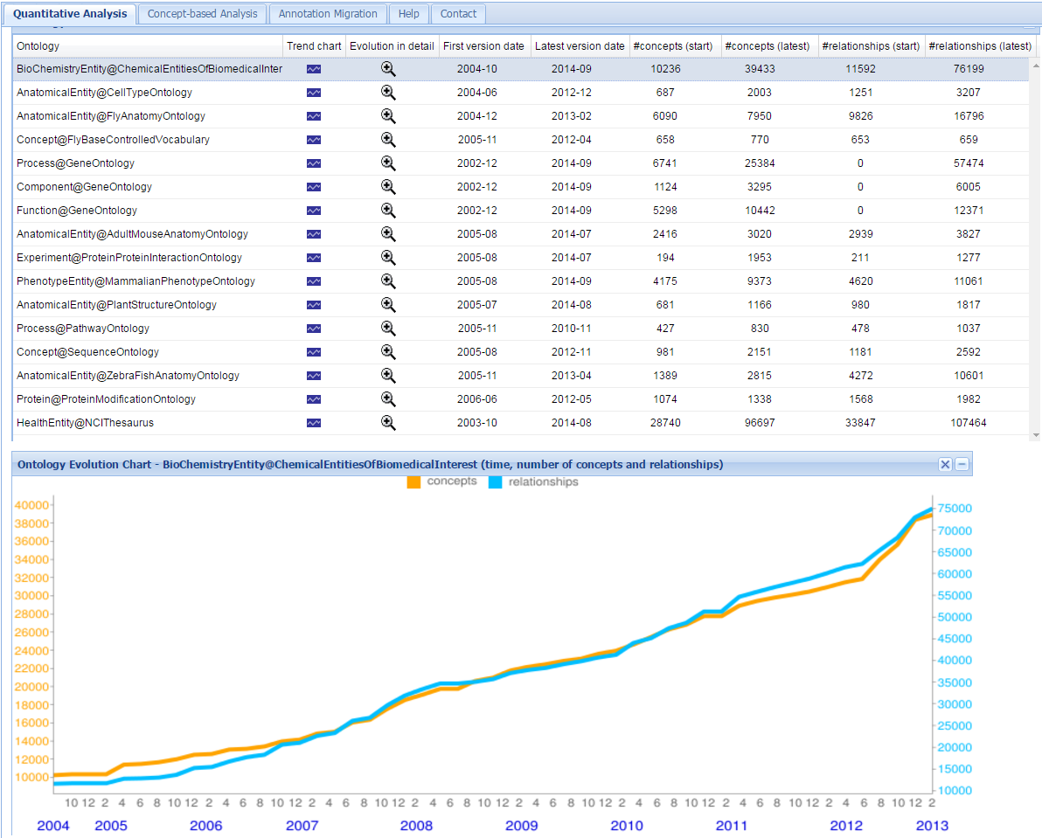
Show summary of changes
OnEX
Codex

Slide 8
Functionalities
Step | Functionality | CODEX | REX | OnEX | PromptDiff | OntoView | NeON | KAON | Ontology Lookup
Detecting the need for changes | Show an ontology version |  |  |  | X |  | X | X | X
 | Show different ontology versions in evolution graph
 | Show change/diff between ontology versions | X | X | X | X | X |  |  | X
 | Show summary of changes | X | X | X |  |  |  |  | X
 | Show specialized view of changes
 | Show change history of a concept/relations |  | X | X
 | Show provenance information |  | X | X | X |  | X
 | Show information about/context of concept/relation
 | Search and query ontology |  |  |  | X |  |  | X | X
 | Query old versions using terminology of new version
 | Discover trends | X | X | X
 | Discover volatile and stable regions |  | X
Notes:
ONTOVIEW
1-3, 4, 5, 9– version level
6 - 8- Concept level
10/11 – query
12/13 – getting knowledge about the evolving ontology
Each group what exists
General statement what is lacking

Slide 9
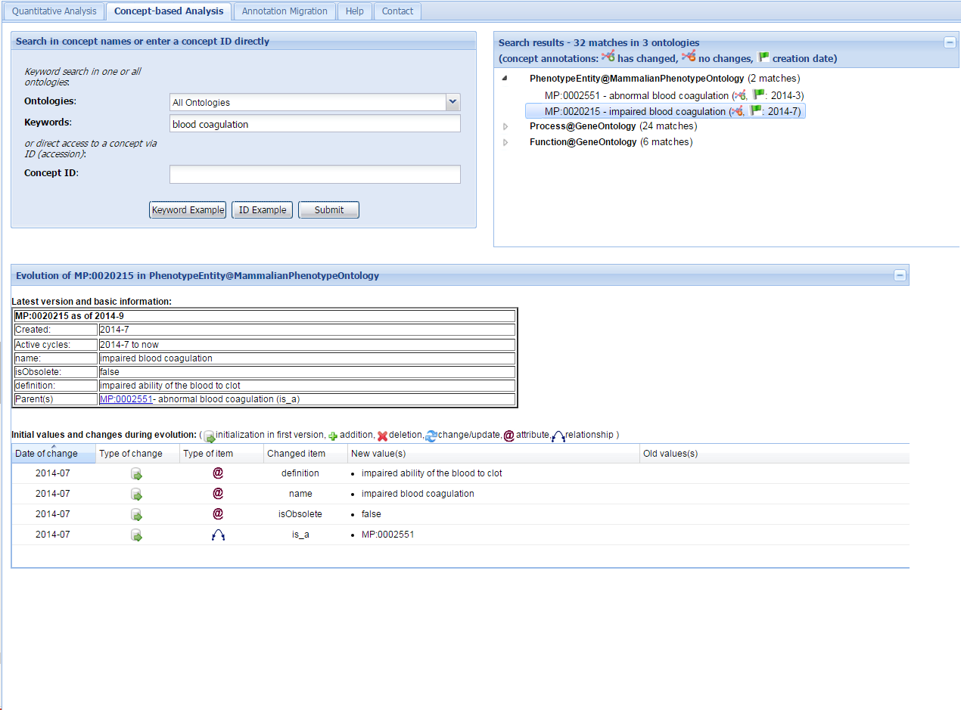
Show change history of a concept/relation
OnEX

Slide 10
Functionalities
Step | Functionality | CODEX | REX | OnEX | PromptDiff | OntoView | NeON | KAON | Ontology Lookup
Detecting the need for changes | Show an ontology version |  |  |  | X |  | X | X | X
 | Show different ontology versions in evolution graph
 | Show change/diff between ontology versions | X | X | X | X | X |  |  | X
 | Show summary of changes | X | X | X |  |  |  |  | X
 | Show specialized view of changes
 | Show change history of a concept/relations |  | X | X
 | Show provenance information |  | X | X | X |  | X
 | Show information about/context of concept/relation
 | Search and query ontology |  |  |  | X |  |  | X | X
 | Query old versions using terminology of new version
 | Discover trends | X | X | X
 | Discover volatile and stable regions |  | X
Notes:
ONTOVIEW
1-3, 4, 5, 9– version level
6 - 8- Concept level
10/11 – query
12/13 – getting knowledge about the evolving ontology
Each group what exists
General statement what is lacking

Slide 11
Functionalities
Step | Functionality | CODEX | REX | OnEX | PromptDiff | OntoView | NeON | KAON | Ontology Lookup
Detecting the need for changes | Show an ontology version |  |  |  | X |  | X | X | X
 | Show different ontology versions in evolution graph
 | Show change/diff between ontology versions | X | X | X | X | X |  |  | X
 | Show summary of changes | X | X | X |  |  |  |  | X
 | Show specialized view of changes
 | Show change history of a concept/relations |  | X | X
 | Show provenance information |  | X | X | X |  | X
 | Show information about/context of concept/relation
 | Search and query ontology |  |  |  | X |  |  | X | X
 | Query old versions using terminology of new version
 | Discover trends | X | X | X
 | Discover volatile and stable regions |  | X
Notes:
ONTOVIEW
1-3, 4, 5, 9– version level
6 - 8- Concept level
10/11 – query
12/13 – getting knowledge about the evolving ontology
Each group what exists
General statement what is lacking

Slide 12
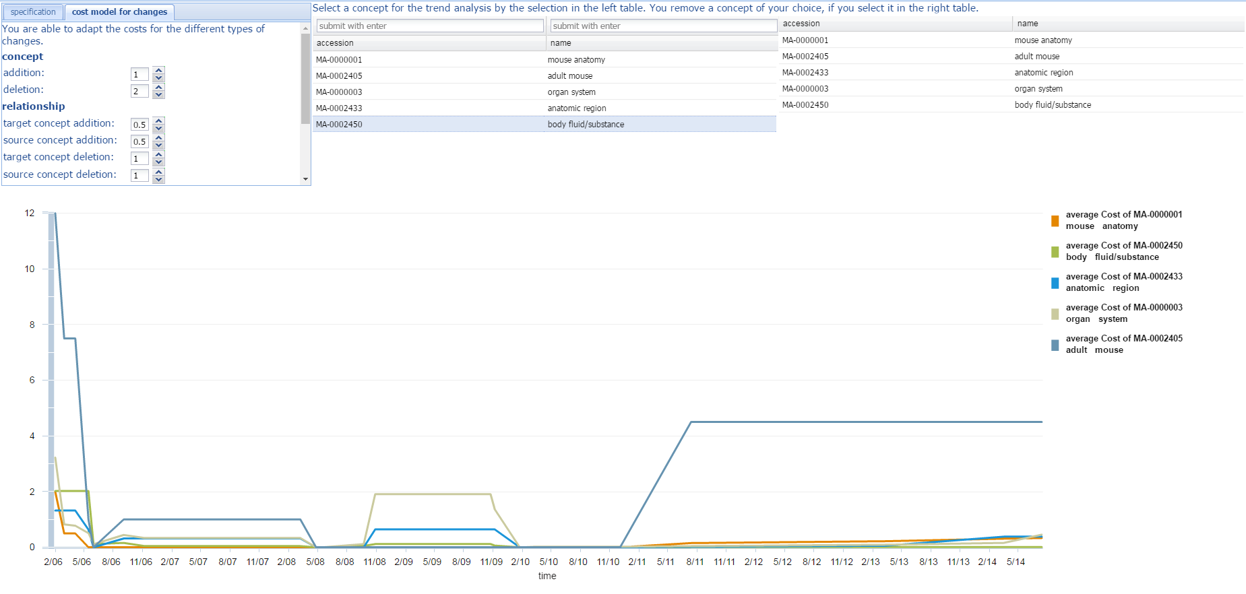
Discover trends Discover volatile/stable regions
REX

Slide 13
Functionalities
Step | Functionality | CODEX | REX | OnEX | PromptDiff | OntoView | NeON | KAON | Ontology Lookup
Detecting the need for changes | Show an ontology version |  |  |  | X |  | X | X | X
 | Show different ontology versions in evolution graph
 | Show change/diff between ontology versions | X | X | X | X | X |  |  | X
 | Show summary of changes | X | X | X |  |  |  |  | X
 | Show specialized view of changes
 | Show change history of a concept/relations |  | X | X
 | Show provenance information |  | X | X | X |  | X
 | Show information about/context of concept/relation
 | Compare different versions |  | X | X | X | X
 | Search and query ontology |  |  |  | X |  |  | X | X
 | Query old versions using terminology of new version
 | Discover trends | X | X | X
 | Discover volatile and stable regions |  | X
Suggesting changes | Identify and suggest changes
Notes:
ONTOVIEW
1-3, 4, 5, 9– version level
6 - 8- Concept level
10/11 – query
12/13 – getting knowledge about the evolving ontology
Each group what exists
General statement what is lacking

Slide 14
Functionalities
Step |  | CODEX | REX | OnEX | PromptDiff | OntoView | NeON | KAON | Ontology Lookup
Suggesting changes | Identify and suggest changes
Validating the changes | Identify conflicts
 | Show conflicts
 | Resolve conflicts
 | Accept and reject suggested changes
Assessing the impact of changes | Evaluate influence on dependent artifacts
 | Show influence on dependent artifacts
 | Update of dependent artifacts
Managing changes | Execute changes |  |  |  | X |  |  | X
 | Identify and show implication of change in ontology | X |  |  |  | X | X
 | Add/edit change annotations |  |  |  | X
 | Roll-back mechanism |  |  |  |  |  |  | X
 | Save current state |  |  |  | X |  |  | X

Slide 15
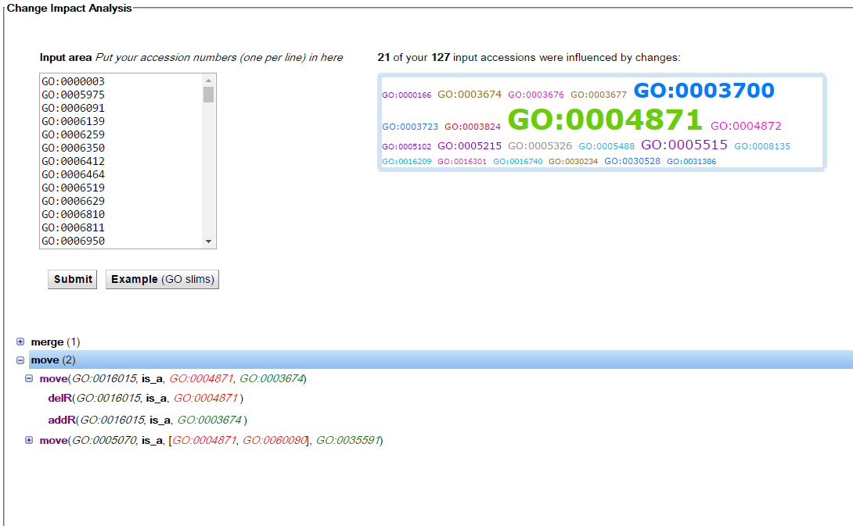
Identify and show implications of change

Slide 16
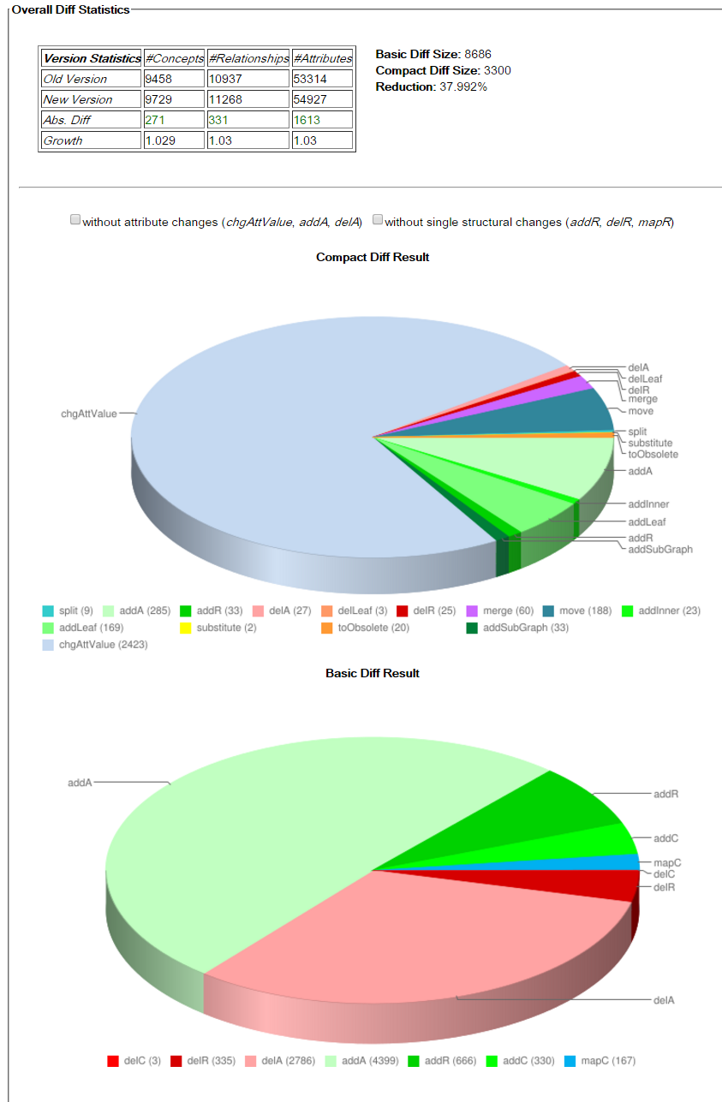

Slide 18
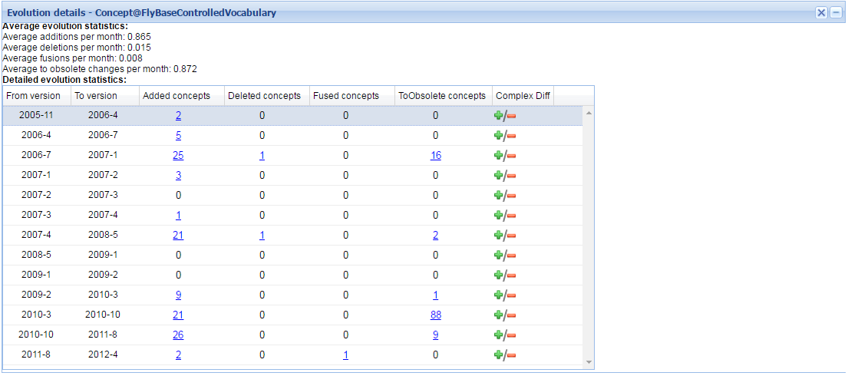

Slide 20
Information for ontology evolution functionalities
Ontology and ontology versions representation | Concepts, relations, instances, axioms
Ontology version statistics | Number of concepts/relations (structural)/instances Concept types (leaf/inner, obsolete/non-obsolete) Proportion of leaves Nodes’ average height and average depth In- and out-degrees of nodes Number of paths, path lengths
Change representation | Logs of elementary/complex changes
Change statistics | Number of concepts/relations added/deleted Number of axiomatic changes Changes w.r.t. time interval Add-delete ration, growth rates
Provenance | Change author Cost of change Change description
Connections | Ontology version level connections Conceptual relations between concepts/relations in different versions

Slide 21
Conclusions
Visualization can help understand how ontologies evolve
Not much research on ontology evolution visualization
Functional requirements
Existing tools
Usually do not cover the whole ontology evolution process
No support for Suggesting and validating changes and Assessing the impact of changes

Slide 22
Future work
Schema versioning and evolution
Software evolution visualization
User studies

