Slide 1
Experiences from the Anatomy track in the Ontology Alignment Evaluation Initiative
Zlatan Dragisic, Valentina Ivanova, Huanyu Li, and Patrick Lambrix

Slide 2
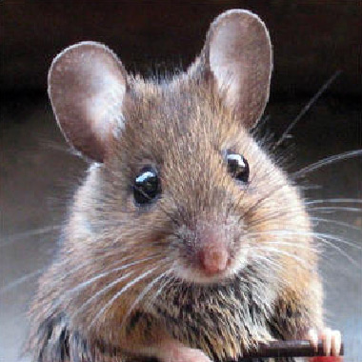
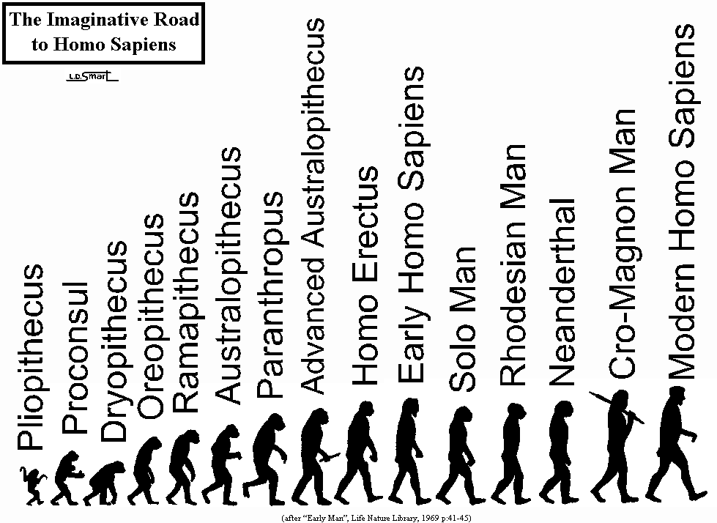
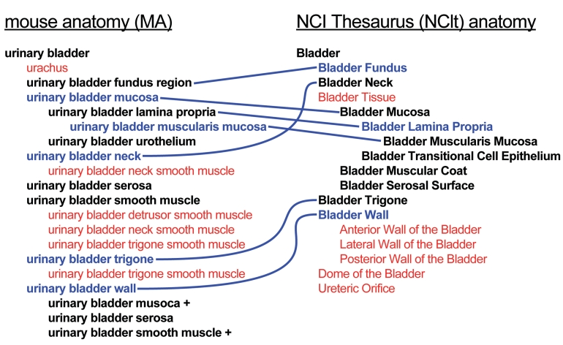
Ontology Alignment
Overlapping ontologies;
Data integration and sharing;
Agent communication;
Bottom-up development
of new ontologies;
Notes:
Currently there are many ontologies in one domain and often we want to use more than one of them.
Bottom-up creation of ontologies – combining existing ontologies
That’s why we need to know the relations between the concepts in the different ontologies.
Mappings are used to define the relations between the concepts in the ontologies.
The set of mappings between the ontologies is called an alignment.
The mappings connect the concepts in the different ontologies. Equivalence, Subsumption.
Problems with mappings
Different context (databases, ontologies) and different logics
Same concept, different names
Same name, different concepts
Different approaches to conceptualization (e.g., subclasses versus property values)‏
Different levels of granularity
Different, but overlapping, areas
SAMBO - P Lambrix and H Tan. SAMBO - a system for aligning and merging biomedical ontologies. Journal of Web Semantics, 4(3):196–206, 2006.
Wins Ontology Alignment Evaluation Initiative 2008, Anatomy track – annual competition between ontology alignment systems

Slide 3
Introduction
Ontology Alignment Evaluation Initiative
  started in 2004 as a part of the Ontology Matching Workshop
Goals:
  assessing strengths and weaknesses of alignment/matching systems
  comparing performance of techniques
  increase communication among algorithm developers
  improve evaluation techniques
  most of all, helping improving the work on ontology alignment/matching

Slide 4
Introduction cont’d
New tracks/problems
Improvements on existing tracks
New evaluation methods (SEALS 2010)
Since 2010 systems are evaluated on all tracks
Both blind/non-blind tests
Some tracks:
  Anatomy
  Benchmark
  Conference
  Multifarm
  LargeBio
  Instance matching

Slide 5
Anatomy track
One of the longest running tracks – since 2005
Ontologies in the biomedical domain
Foundational Model of Anatomy and OpenGalen Anatomy Model – 2005-2006
Since 2007 - A part of NCI Thesaurus – human anatomy and Adult Mouse Anatomy ontology

Slide 6
Outline
The data set and tasks
Participating systems
Results for different tasks
Summary and future directions

Slide 7
The data set - ontologies
First version in 2007:
  AMA - 2744 concepts and 3 object properties
    ca 4500 is-a relations
    ca 3500 annotations
  A fragment of NCI-A – 3304 concepts and 2 object properties
    ca 5500 is-a relations
    Ca 15000 annotations
Minor changes to ontologies in 2010

Slide 8
The data set – reference alignment
Alignment as a part of a project to enable linking these ontologies
  Manually curated by domain experts
Initially 1544 equivalence relations
Refined in 2008 and 2010 to current 1516 equivalence relations
More work is needed to guarantee its correctness

Slide 9
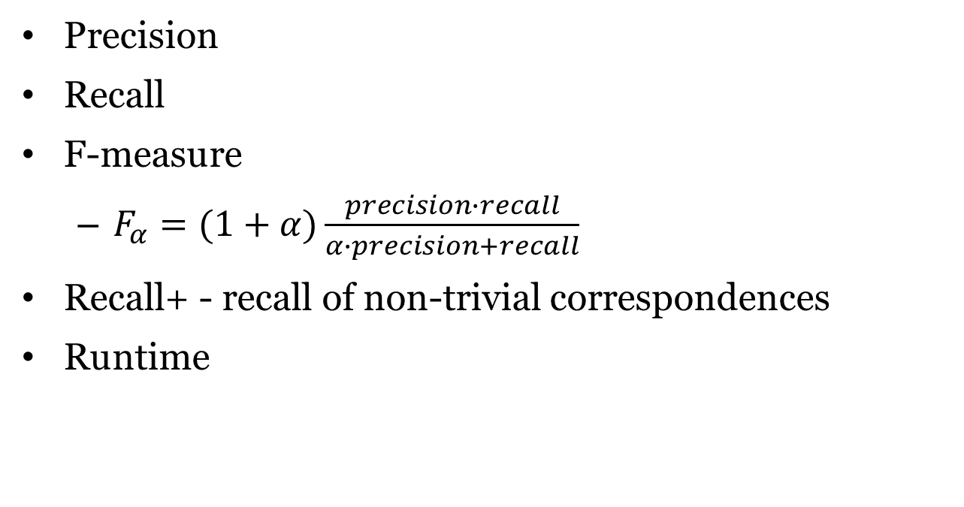
Performance measures
Precision
Recall
F-measure
  $F_{α}=(1+α)\frac{precision∙recall}{α∙precision+recall}$
Recall+ - recall of non-trivial correspondences
Runtime

Slide 10
Tasks
Task 1: optimize F-measure
Task 2 : optimize F-measure with a focus on precision
Task 3: optimize F-measure with a focus on recall
Task 4: optimize F-measure given a partial reference alignment (50 non-trivial correspondences)
Interactive track: using an oracle (which may make mistakes)

Slide 11
Evaluation
2007-2010:
  tests were done blind
  authors submitted their alignment
2010-2016:
  reference alignment available since 2011
  evaluation done through the SEALS framework
    organizers run the tools

Slide 12
Outline
The data set and tasks
Participating systems
Results for different tasks
Summary and future directions

Slide 13
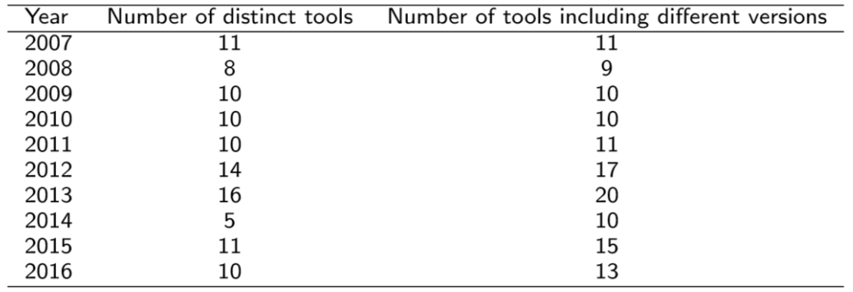
Participating systems
Since 2011 – all tools are evaluated in all tracks
Some tools participate with different versions
A number of tools participate often, e.g.:
  Lily, LogMap – 6
  Aroma – 5
  AgreementMaker, AML, ASMOV, MaasMatch, TaxoMap, XMap - 4

Slide 14
Overview framework of Ontology Alignment
Notes:
This is a overview framework of ontology alignment.

Slide 15
Basic processes of participating systems
Preprocessing
  Data preparation
  Reduction of search space
Matching
Combination
Filtering
Debugging
User Interaction
Notes:
We analyzed the participating systems in terms of these basic components, preprocessing, matching, combination, filtering, debugging and user interaction. We focuses on what components the participating systems have and what detailed techniques they use. For today’s presentation, our focuses are expecially matching, combination and filter. Before we come back to them, I will talke about sth about others,
for preprocessing, it exists in some systems, and most systems use it to achieve data preparation, such as generate an ontology profile to use in following matching step. Collect or manage strings from concepts or description from ontology Some other systems achieve the reduction of search space in this step which means they will match on a smaller size data compared with whole data size.
For debugging,
For user interaction, it refers to user interface or some interactions from users like user give suggestions for the matching result.

Slide 16
Matching strategies of participating systems
String-based
  Edit-Distance, Jaccard, Soft Jaccard, Soft TF-IDF …
Structure-based
  Similarity propagation, Similarity flooding …
Constraint-based
  Domain restriction
Instance-based
  Rarely used in Anatomy track
Notes:
So For matching strategies, common techniques are string-based, structure-based, constraint- based and instance-based. The string based technology is a foundamental way we use to get similarity of the objects such as edit distance and other methods. From another research, it shows that edit distance is a good choice for interest in high precision result while jaccard, soft jaccard and soft TF-IDF is more suitable for high recall and F-measure result.
For structure based strategies, usually, they are based on the hierarchies in the ontology and the matching result we obtained from string-based algorithms, and then use similarity propagation or similarity flooding method to get the similarities of parents or children.
For Constraint based strategy, it usually use domain restriction information coming from data property or object property.

Slide 17
Combination
Weighted Sum-based or Maximum-based selection
  Weighted Sum-based: weighted sum of similarities of different matchers
  Maximum-based: maximum of similarity of different matchers
Advanced approaches
  Neural network, Genetic algorithm, Clustering algorithm, Overlap of different matchers
Notes:
Combination is used to get a result from different kinds matchers. Generally, there are two methods, first one is weighted sum and the other is maximum based.
Weighted sum based means, we define weights for different matchers and we compute the final result by combine all the matchers’ result multiple with their weights.
For maximum-based, we just take the maximum among the matchers into account.
In recent years, there are some advanced approaches implemented in some systems, such as clustering algorithm on results of different matcher.

Slide 18
Filtering
Single Threshold
  Only define a lower boundary
Double Threshold
  To define the lower and the upper boundaries to filter matching result
Advanced approaches
  Maximum Entropy Approach
  Stable Marriage Algorithm
Notes:
So after we use combination technology to get the result based on different technologies, we need to define in what extent the result is meaningful for ontology alignment. Either too high or too low value result restrict the
Generally, we have two ways to filter data, they are single threshold and double threshold.
We define only one boundary in single threshold method as the lowest boundary. That means we only care those results which are bigger than the boundary.
For double threshold, we not only care about lower boundary but also upper boundary, that means some results with too high matching result we don’t take into account.
Some advanced approaches also appears in recent years.

Slide 19
Use of auxiliary information by participating systems
Biomedical resources
  UMLS (Unified Medical Language System) used by 9 systems
  Uberon used by 5 systems
  BioPortal used by 1 system
  MeSH (Medical Subject Headings) used by 1 system
  FMA (Foundational Model of Anatomy) used by 2 systems
Non-biomedical resources
  WordNet (25 systems), WikiPedia, Google, Apache Lucene …
Notes:
UMLS: is a famous and widely used database for biomedical information systems
Uberon:Uberon is an integrated cross-species ontology covering anatomical structures in animals
Bioportal: the world’s most comprehensive repository of biomedical ontologies
Medical Subject Headings!
The Foundational Model of Anatomy ontology is one of the information resources integrated in the distributed framework of the Anatomy Information System
WordNet® is a large lexical database of English. Nouns, verbs, adjectives and adverbs are grouped into sets of cognitive synonyms (synsets), each expressing a distinct concept.

Slide 20
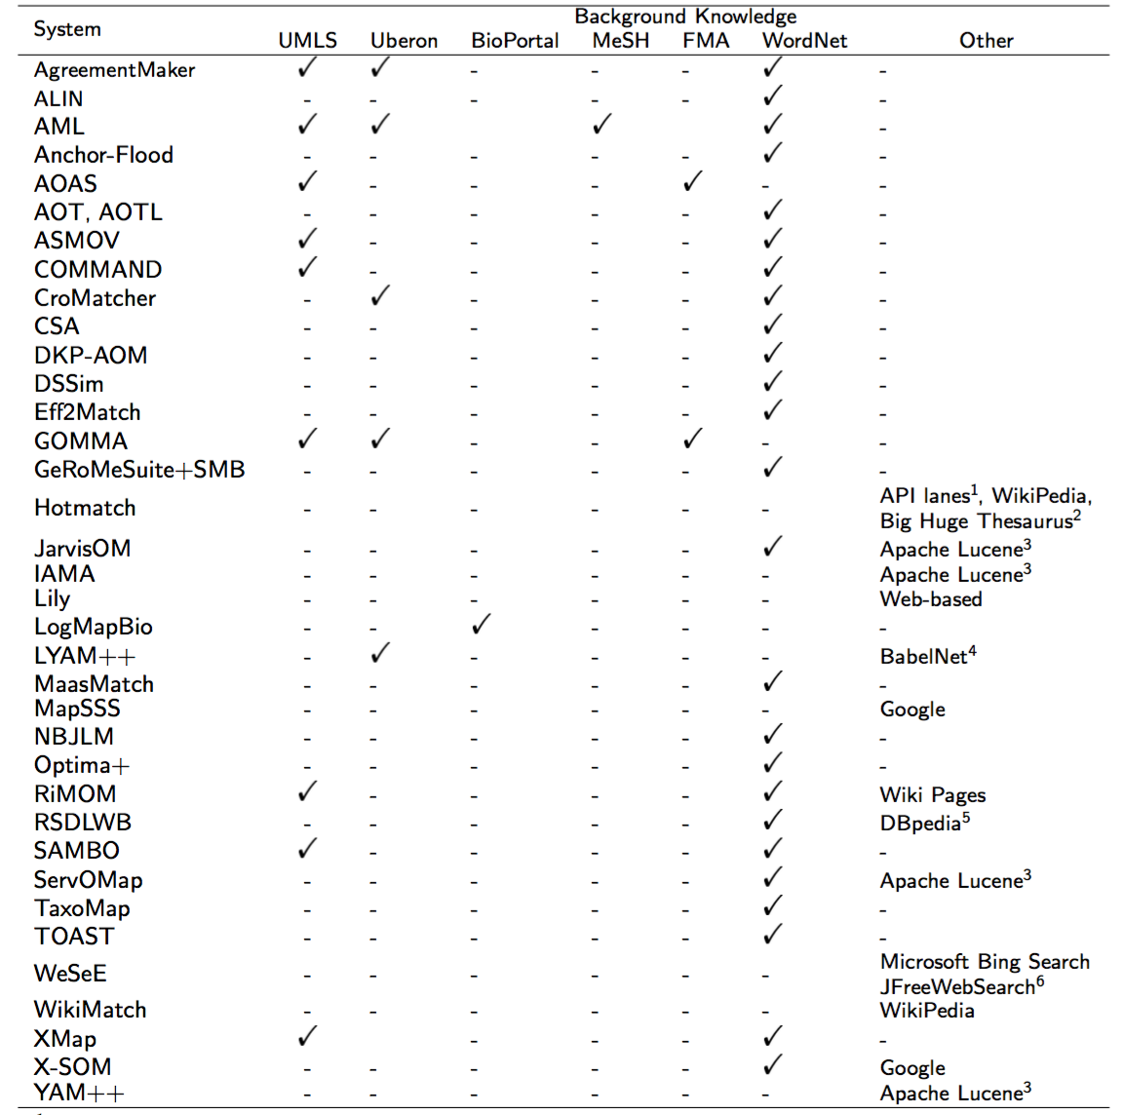

Slide 21
Findings
Processes
  Preprocessing
    Many systems implement this step and most of them have this step for data preparation
  Matching
  Combination
    Weighted sum is most common approach
  Filtering
    Most common approach is single threshold
Matching strategies
  All systems use string-based strategies
  Most systems implement structure-based strategies
  Some systems implement constraint-based strategies
  Instance-based approaches are not often used in the Anatomy track

Slide 22
Findings
Use of auxiliary information
  WordNet is most often used
  In terms of biomedical background knowledge, UMLS is the most used resource

Slide 23
Outline
The data set and tasks
Participating systems
Results for different tasks
Summary and future directions

Slide 24
Evaluation of the OAEI – task 1 results
We collected reported results (precision/recall/F-measure) for the tools in 2007-2009
Alignment files were collected for the period 2010-2016 and revaluated on the most recent version of the ontologies/reference alignment
Analysis of most common mistakes and least commonly found correspondences

Slide 25
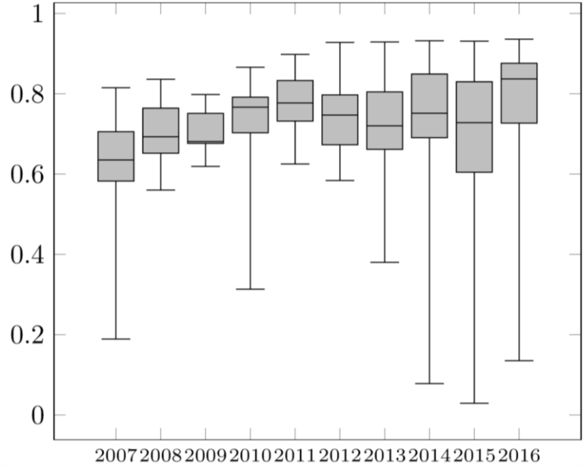
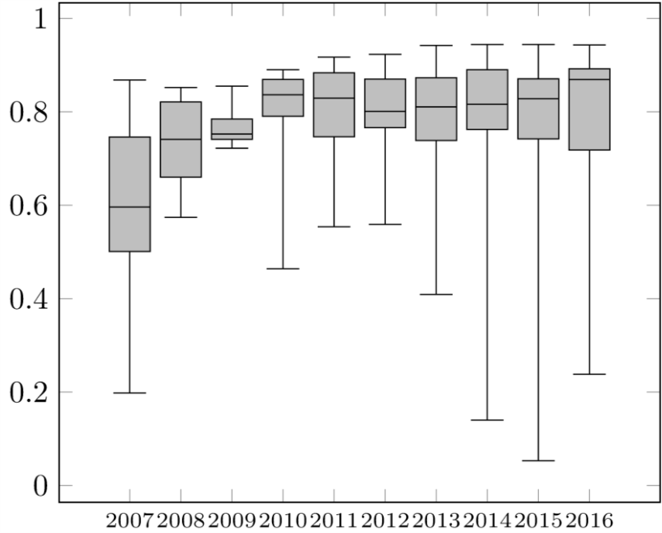
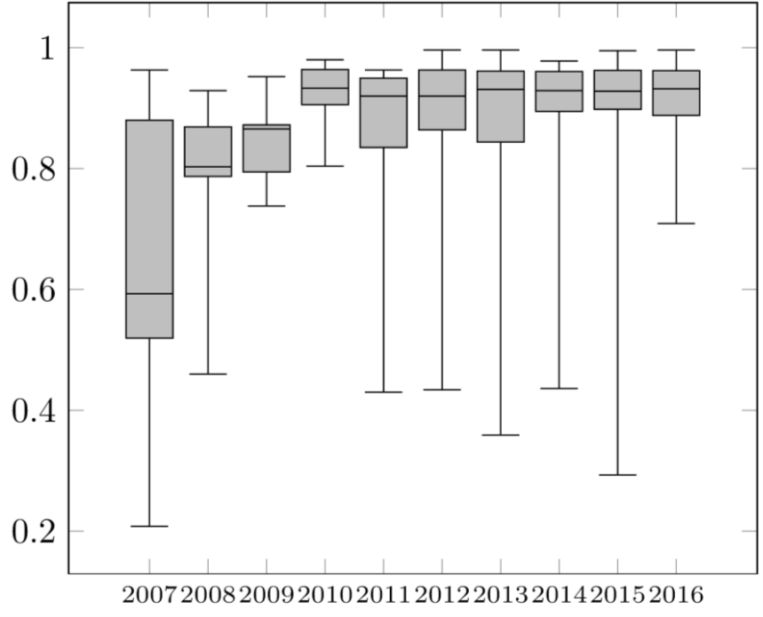
Task 1 – recall/F-measure/precision
Recall
F-measure
Precision
2007 – 2011 - Steady increase in F-measure (due to improvements in precision)
2011 – all systems evaluated in all tracks
Since 2011 – stable precision, slight drop in recall
Since 2013 – AML best performing system

Slide 26
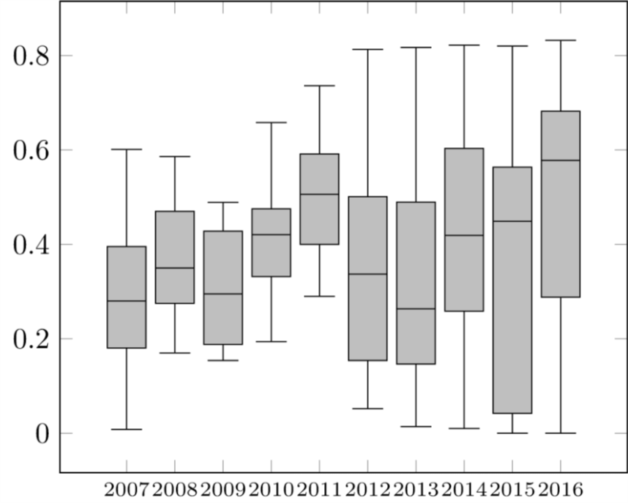
Task 1 – recall+
Recall+ evaluates the ability of the tool to find non-trivial correspondences
Little improvement over the years (best results do improve)
Tools that use auxiliary sources achieve better results
Best tools still do not find ca 20% of non-trivial correspondences

Slide 27
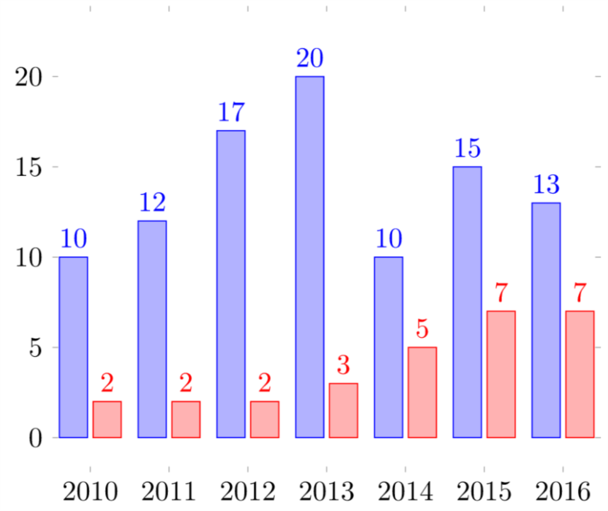
Task 1 - Coherence of the produced alignment
Evaluated since 2010
Evaluates if the merged ontologies and the alignment produce a coherent ontology (no unsatisfiable classes)
Positive trend in recent years

Slide 28
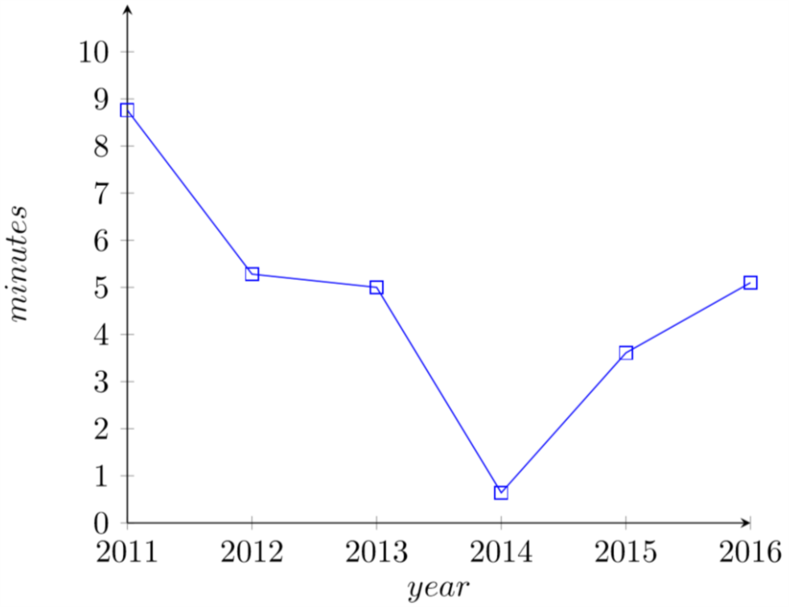
Task 1 – runtimes
Evaluated since 2007 except in 2010
Initially reported by the authors
From 2007-2009 median decreased from 4.5 h (2007) to 11 min (2009)
From 2011 and on no obvious trend
No correlation between runtimes and the quality of the alignment
Median runtimes

Slide 29
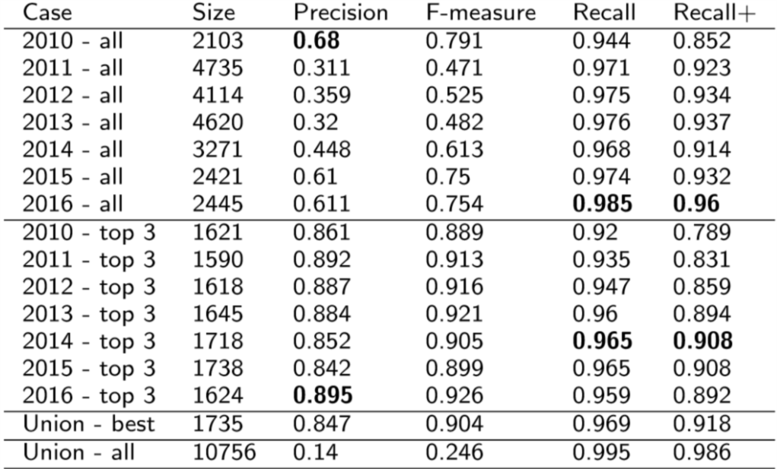
Aggregated results – 2010-2016
When using more systems recall/recall+ is better than the best system for that year
Top3 in 2010 and top3 in 2011 have better F-measure than the best systems for those year
Union-all shows that there are still correspondences which were not found by any system

Slide 30
Analysis of the found correspondences
Analysis of least commonly found correct correspondences:
  Cannot be identified using simple string matching
  Some mistakes in the reference alignment/ontologies
Analysis of most common mistakes w.r.t. the reference alignment:
  Usually similar labels
  Concepts which are related via other relations, such as part of or subsumption relation
  Some mistakes in the reference alignment/ontologies

Slide 31
Tasks 2 and 3
Run 4 times (2007-2010)
Most systems could be optimized with a focus on recall/precision
In all cases increase in precision/recall meant decrease in the other measure
Most common approach using different thresholds
  Some systems use additional heuristics

Slide 32
Task 4
Partial reference alignment – ca 50 non-trivial correspondences and all trivial ones
During 3 years (2008-2010) 8 systems participated
All systems achieved improvement in precision
Some systems (SAMBO) showed increase in recall
The task inspired other work

Slide 33
Interactive track
Since 2015
User interaction simulated using an oracle in the SEALS client
Different error rates: 0.0, 0.1, 0.2 and 0.3
6 participating systems implementing different strategies
Evaluated on precision/F-measure/recall as well as number of interactions
F-measure improved (in most case even in presence of errors)
Notes:
Needs to be finished

Slide 34
Outline
The data set and tasks
Participating systems
Results for different tasks
Summary and future directions

Slide 35
Summary of findings
Average 10 to 15 systems participate
Systems participating often improve results
Many systems implement a preprocessing step
  Data preparation
  Reducing search space
Many systems implement multiple matching strategies (all use string-matching)
More and more systems check for the coherence of the proposed alignment
Substantial improvements in F-measure (lately mostly due to improvements in recall)
Interaction benefits the quality of the alignment
Notes:
Needs to be finished

Slide 36
Possible changes and directions
Update of the ontologies and the reference alignment
Repair of the reference alignment
Considering other types of relationships (part-of and subsumption relations)
Improving the documentation provided by the tools

