Slide 1
User validation in ontology alignment
Zlatan Dragisic¹, Valentina Ivanova¹, Patrick Lambrix¹, Daniel Faria²,
Ernesto Jiménez-Ruiz³ and Catia Pesquita⁴
¹ Linköping University
² Gulbenkian Science Institute, Portugal
³ University of Oxford, UK
⁴ Universidade de Lisboa, Portugal

Slide 2
Motivation
Many automatic ontology alignment systems
Limits to the performance of automated systems
Users involvement in the alignment process enables
  the detection and removal of erroneous mappings
  the addition of alternative and potentially new mappings
  the adjustment of system settings
Notes:
Even when the user makes error there is benefit from the interaction
(selection of the most suitable alignment algorithms, and the incorporation of user knowledge)
The growth of the ontology alignment area led to the development of

Slide 3
Motivation cont’d
User involvement in ontology alignment is directly related to a number of the challenges facing the community [SE13]
Quality and effectiveness of user intervention
  OAEI – Interactive matching track (2013)
Users can/will make mistakes
  2015 – Interactive matching extended to cover erroneous input
[SE13] Ontology Matching: State of the Art and Future Challenges, Shvaiko P, and Euzenat J, IEEE Transactions on Knowledge and Data Engineering
Notes:
explanation of matching results to users
fostering user involvement in the matching process
social and collaborative matching
Adopting more advanced alignment techniques has brought diminishing returns [40,21]. This is likely due to the complexity and intricacy of the ontology alignment process, with each task having its particularities, dictated by both the domain and the design of the ontologies. Thus, automatic generation of mappings should be viewed only as a first step towards a final alignment, with validation by one or more users being essential to ensure alignment quality
, experiments have shown that user validation is still beneficial up to an error rate of 20% [26], although the exact error threshold will depend on the alignment system and how it makes use of the user input.

Slide 4
Contributions
Identification of issues related to user validation in ontology alignment
  User profile
  Interface
  System services
Qualitative evaluation evaluating how state-of-the-art systems deal with the issues
Experiments evaluating how systems deal with erroneous input from the user
Notes:
While there has been work on user involvement, here the focus is on one aspect user validation
First extensive qualitative evaluation
A broad study of user validation in ontology alignment
First experiments in the field
Now we look at the user profile

Slide 5
Issues regarding user alignment validation
User profile
System services
User interface

Slide 6
Identified issues regarding user profile
Domain expertise of the user
Technical expertise of the user
Expertise with the alignment system
Users can be expected to make mistakes
Notes:
Domain expertise - concerns his knowledge about the domain of the aligned ontologies, and therefore his ability to assess the correctness of a mapping conceptually (e.g., whether two ontology classes mapped as equivalent actually represent the same concept in the domain).
Technical expertise - pertains to his knowledge about ontologies themselves, and his experience in knowledge engineering and modeling, and therefore his ability to assess the correctness of a mapping formally (i.e., whether a mapping is logically sound given the constraints of the two ontologies).
Knowledge engineer, domain expert pictures

Slide 7
Identified issues regarding system services
Issue |  |  | Agreement Maker | AlViz | AML | CogZ Prompt | COMA | LogMap | SAMBO | RepOSE
System services | Stage of involvement | before, after, during, iterative | a+i | a | a | d | b,a+i | a | b,a+i | a+i
 | Suggestions selection | Threshold/ advanced filtering | ✓ | ✓- | ✓ | - | ✓- | ✓ | ✓- | ✓-
 | Feedback Propagation | Recomputation | ✓ | - | - | ✓ | ✓ | - | ✓ | ✓
 |  | Conflict detection/blocking/revalidation | ✓ | - | ✓- | ✓- - | - | ✓- - | ✓- - | ✓-
( 2, B )
( 3, F )
( 6, D )
( 4, C )
( 5, C )
( 5, E )
……
sim
suggest
th
discard
Notes:
ADD SOME EXAMPLES
Say how current systems are doing
First, is when the user is involved
Similarity value above/below threshold
filtering with respect to some principles (e.g., consistency, locality, and conservativity) [25] or quality checks [3]
selecting only “problematic” mappings where different alignment algorithms disagree [8]
and using a similarity propagation graph to select the most informative questions to ask the user [44]
Propagating mapping confidence from validated mappings to those in their neighborhood,
be that neighborhood defined from the structure of the ontologies [31,37,44] or
from the pattern of similarity scores from the various alignment algorithms

Slide 8
Identified issues regarding system services
Issue |  |  | Agreement Maker | AlViz | AML | CogZ Prompt | COMA | LogMap | SAMBO | RepOSE
System services | Stage of involvement | before, after, during, iterative | a+i | a | a | d | b,a+i | a | b,a+i | a+i
 | Suggestions selection | Threshold/ advanced filtering | ✓ | ✓- | ✓ | - | ✓- | ✓ | ✓- | ✓-
 | Feedback Propagation | Recomputation | ✓ | - | - | ✓ | ✓ | - | ✓ | ✓
 |  | Conflict detection/blocking/revalidation | ✓ | - | ✓- | ✓- - | - | ✓- - | ✓- - | ✓-
(2,C)
0.5
0.5
(5,F)
(6,F)
Notes:
ADD SOME EXAMPLES
Say how current systems are doing
First, is when the user is involved
Similarity value above/below threshold
filtering with respect to some principles (e.g., consistency, locality, and conservativity) [25] or quality checks [3]
selecting only “problematic” mappings where different alignment algorithms disagree [8]
and using a similarity propagation graph to select the most informative questions to ask the user [44]
Propagating mapping confidence from validated mappings to those in their neighborhood,
be that neighborhood defined from the structure of the ontologies [31,37,44] or
from the pattern of similarity scores from the various alignment algorithms

Slide 10
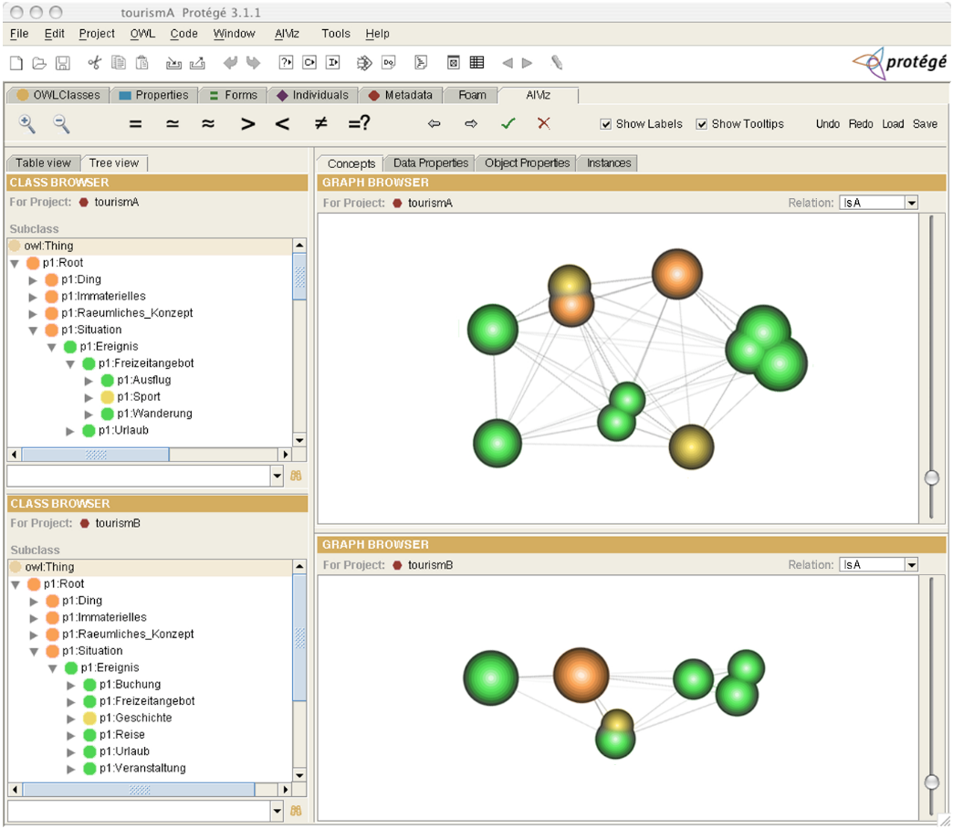
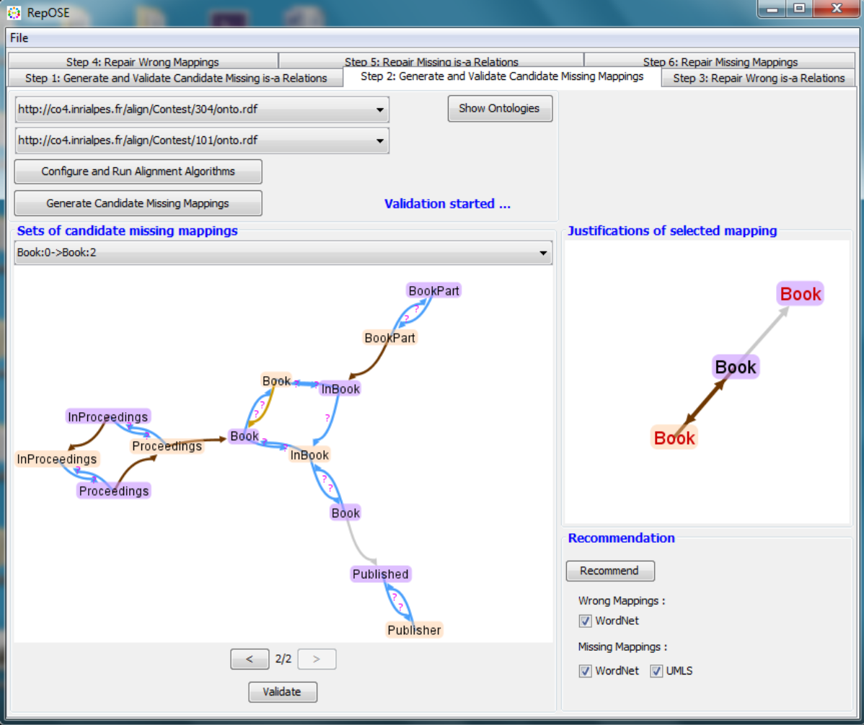
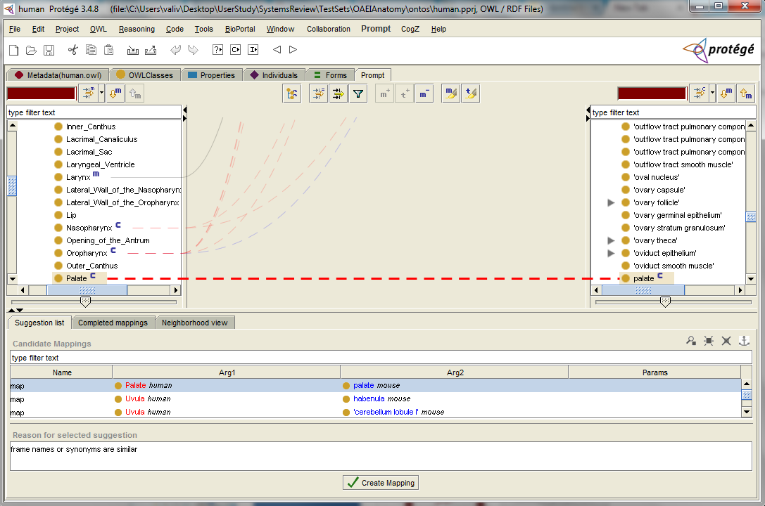
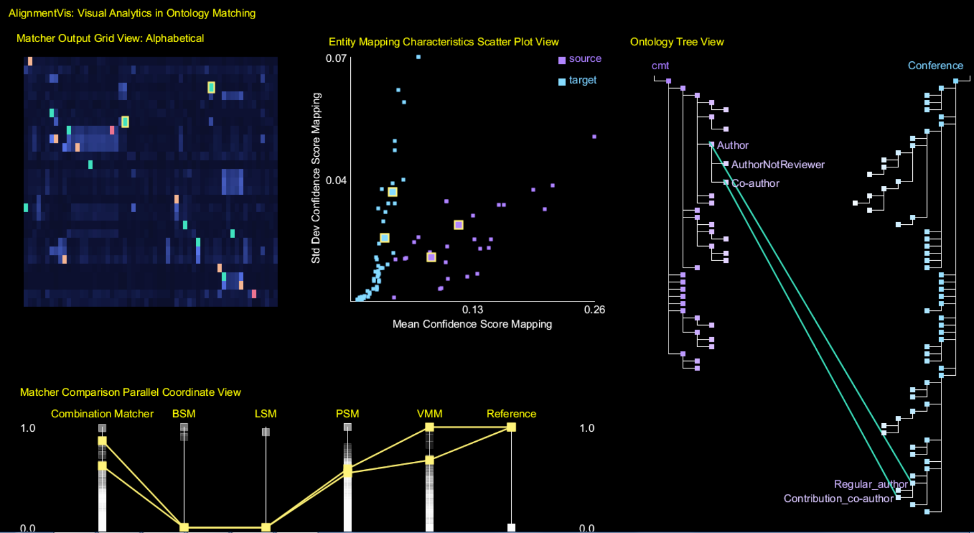
Identified issues regarding user interface
Issue |  |  | Agreement Maker | AlViz | AML | CogZ Prompt | COMA | LogMap | SAMBO | RepOSE
Alignment presentation | Visual information seeking tasks |  | ✓ | ✓ | ✓- | ✓ | ✓- - | - | ✓- - | ✓- -
 | Visual analytics |  | ✓ | ✓- | - | - | - | - | - | -
 | Alternative views |  | ✓ | ✓ | ✓ | ✓ | - | - | ✓ | -
 | Grouping |  | ✓ | ✓ | ✓ | ✓ | - | - | ✓ | -
 | Validated/candidate mappings |  | ✓- | ✓- | ✓ | ✓ | ✓- - | - | ✓- | ✓-
 | Metadata & context |  | ✓ | - | ✓ | ✓ | - | ✓ | ✓- - | ✓-
 | Ranking/ recommendations |  | - | ✓ - - | ✓ - - | ✓- - | - | ✓- | - | ✓
 | Mapping explanation | Provenance & justification | ✓ - - | ✓ - - | ✓- | ✓- | ✓- - | ✓- - | - | ✓- -
 |  | Impact/ consequences | ✓- | - | - | ✓- - | - | ✓- | - | ✓- -
Overview
Zoom
Filter
Details-on-demand
Relate
History
Extract
Notes:
Visual Information Seeking Mantras – overview and
defines seven low-level tasks to be supported by information visualization interfaces in order to enable enhanced data exploration and retrieval
overview usually supported and filter, history and relate rarely supported
Visual analytics – uses data mining uses interactive vis techniques provides helps you getting insights from the data. Providing enhanced information while addressing the working memory limits - data mining and interactive visualization techniques
an overview of the mappings obtained between all the entities in the source ontology and in the target ontology, as presented in the Matcher Output Grid View; (2) the behavior of the entities of the source and target ontologies with respect to various statistics, as provided by the Entity Mapping Characteristics Scatter Plot View; (3) the mappings between entities in the source and target ontologies, which uses the interactive Ontology Tree View; (4) the results for all the matchers alongside the reference alignment (when available) for comparative analysis, as enabled by the Parallel Coordinate View
Alternative views – graphs for information perception, while trees for searching (condensing information will overwhelm the user)
TEXTUAL AND VISUAL JUSTIFICATION OF MAPPINGS

Slide 11
Identified issues regarding user interface
Issue |  |  | Agreement Maker | AlViz | AML | CogZ Prompt | COMA | LogMap | SAMBO | RepOSE
Alignment presentation | Visual information seeking tasks |  | ✓ | ✓ | ✓- | ✓ | ✓- - | - | ✓- - | ✓- -
 | Visual analytics |  | ✓ | ✓- | - | - | - | - | - | -
 | Alternative views |  | ✓ | ✓ | ✓ | ✓ | - | - | ✓ | -
 | Grouping |  | ✓ | ✓ | ✓ | ✓ | - | - | ✓ | -
 | Validated/candidate mappings |  | ✓- | ✓- | ✓ | ✓ | ✓- - | - | ✓- | ✓-
 | Metadata & context |  | ✓ | - | ✓ | ✓ | - | ✓ | ✓- - | ✓-
 | Ranking/ recommendations |  | - | ✓ - - | ✓ - - | ✓- - | - | ✓- | - | ✓
 | Mapping explanation | Provenance & justification | ✓ - - | ✓ - - | ✓- | ✓- | ✓- - | ✓- - | - | ✓- -
 |  | Impact/ consequences | ✓- | - | - | ✓- - | - | ✓- | - | ✓- -
Overview
Zoom
Filter
Details-on-demand
Relate
History
Extract
Notes:
Provide sufficient information to support decision making while not overwhelming the user
Visual Information Seeking Mantras - defines seven low-level tasks to be supported by information visualization interfaces in order to enable enhanced data exploration and retrieval
overview usually supported and filter, history and relate rarely supported

Slide 12
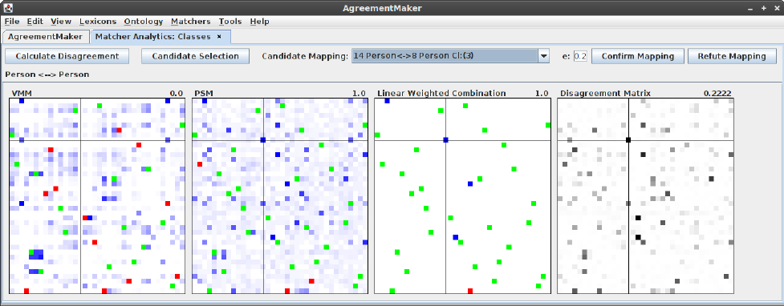
Identified issues regarding user interface
Issue |  |  | Agreement Maker | AlViz | AML | CogZ Prompt | COMA | LogMap | SAMBO | RepOSE
Alignment presentation | Visual information seeking tasks |  | ✓ | ✓ | ✓- | ✓ | ✓- - | - | ✓- - | ✓- -
 | Visual analytics |  | ✓ | ✓- | - | - | - | - | - | -
 | Alternative views |  | ✓ | ✓ | ✓ | ✓ | - | - | ✓ | -
 | Grouping |  | ✓ | ✓ | ✓ | ✓ | - | - | ✓ | -
 | Validated/candidate mappings |  | ✓- | ✓- | ✓ | ✓ | ✓- - | - | ✓- | ✓-
 | Metadata & context |  | ✓ | - | ✓ | ✓ | - | ✓ | ✓- - | ✓-
 | Ranking/ recommendations |  | - | ✓ - - | ✓ - - | ✓- - | - | ✓- | - | ✓
 | Mapping explanation | Provenance & justification | ✓ - - | ✓ - - | ✓- | ✓- | ✓- - | ✓- - | - | ✓- -
 |  | Impact/ consequences | ✓- | - | - | ✓- - | - | ✓- | - | ✓- -
Notes:
Visual analytics – uses data mining uses interactive vis techniques provides helps you getting insights from the data. Providing enhanced information while addressing the working memory limits - data mining and interactive visualization techniques

Slide 13
Identified issues regarding user interface
Issue |  |  | Agreement Maker | AlViz | AML | CogZ Prompt | COMA | LogMap | SAMBO | RepOSE
Alignment presentation | Visual information seeking tasks |  | ✓ | ✓ | ✓- | ✓ | ✓- - | - | ✓- - | ✓- -
 | Visual analytics |  | ✓ | ✓- | - | - | - | - | - | -
 | Alternative views |  | ✓ | ✓ | ✓ | ✓ | - | - | ✓ | -
 | Grouping |  | ✓ | ✓ | ✓ | ✓ | - | - | ✓ | -
 | Validated/candidate mappings |  | ✓- | ✓- | ✓ | ✓ | ✓- - | - | ✓- | ✓-
 | Metadata & context |  | ✓ | - | ✓ | ✓ | - | ✓ | ✓- - | ✓-
 | Ranking/ recommendations |  | - | ✓ - - | ✓ - - | ✓- - | - | ✓- | - | ✓
 | Mapping explanation | Provenance & justification | ✓ - - | ✓ - - | ✓- | ✓- | ✓- - | ✓- - | - | ✓- -
 |  | Impact/ consequences | ✓- | - | - | ✓- - | - | ✓- | - | ✓- -
Notes:
Alternative views – graphs for information perception, while trees for searching (condensing information will overwhelm the user)

Slide 14
Identified issues regarding user interface
Issue |  |  | Agreement Maker | AlViz | AML | CogZ Prompt | COMA | LogMap | SAMBO | RepOSE
Alignment presentation | Visual information seeking tasks |  | ✓ | ✓ | ✓- | ✓ | ✓- - | - | ✓- - | ✓- -
 | Visual analytics |  | ✓ | ✓- | - | - | - | - | - | -
 | Alternative views |  | ✓ | ✓ | ✓ | ✓ | - | - | ✓ | -
 | Grouping |  | ✓ | ✓ | ✓ | ✓ | - | - | ✓ | -
 | Validated/candidate mappings |  | ✓- | ✓- | ✓ | ✓ | ✓- - | - | ✓- | ✓-
 | Metadata & context |  | ✓ | - | ✓ | ✓ | - | ✓ | ✓- - | ✓-
 | Ranking/ recommendations |  | - | ✓ - - | ✓ - - | ✓- - | - | ✓- | - | ✓
 | Mapping explanation | Provenance & justification | ✓ - - | ✓ - - | ✓- | ✓- | ✓- - | ✓- - | - | ✓- -
 |  | Impact/ consequences | ✓- | - | - | ✓- - | - | ✓- | - | ✓- -
Frame names or synonyms are similar
Notes:
SHOW TASKS FOR vism
Visual Information Seeking Mantras – overview and
defines seven low-level tasks to be supported by information visualization interfaces in order to enable enhanced data exploration and retrieval
overview usually supported and filter, history and relate rarely supported
Visual analytics – uses data mining uses interactive vis techniques provides helps you getting insights from the data. Providing enhanced information while addressing the working memory limits - data mining and interactive visualization techniques
an overview of the mappings obtained between all the entities in the source ontology and in the target ontology, as presented in the Matcher Output Grid View; (2) the behavior of the entities of the source and target ontologies with respect to various statistics, as provided by the Entity Mapping Characteristics Scatter Plot View; (3) the mappings between entities in the source and target ontologies, which uses the interactive Ontology Tree View; (4) the results for all the matchers alongside the reference alignment (when available) for comparative analysis, as enabled by the Parallel Coordinate View
Alternative views – graphs for information perception, while trees for searching (condensing information will overwhelm the user)
TEXTUAL AND VISUAL JUSTIFICATION OF MAPPINGS

Slide 15
Identified issues regarding user interface
Issue |  | Agreement Maker | AlViz | AML | CogZ Prompt | COMA | LogMap | SAMBO | RepOSE
Alignment Interaction | Accept/reject | ✓ | ✓- | ✓ | ✓ | ✓- | ✓ | ✓ | ✓
 | Create/refine | ✓ | ✓ | ✓ | ✓ | ✓ | - | ✓ | ✓-
 | Search | - | ✓ | ✓ | ✓ | ✓ | - | ✓ | ✓-
 | User annotation | - | - | - | ✓ | - | - | ✓ | -
 | Session | ✓- | ✓- | ✓- | ✓- | ✓ | ✓ | ✓ | ✓-
 | Temporary mappings | - | ✓ | ✓- | ✓ | - | - | - | -

Slide 16
System services
Stages of involvement
  Before
  During
  After
  Iterative
Suggestions selection
  Threshold
  Advance filtering
Feedback propagation
Notes:
filtering with respect to some principles (e.g., consistency, locality, and conservativity) [25] or quality checks [3]
selecting only “problematic” mappings where different alignment algorithms disagree [8]
and using a similarity propagation graph to select the most informative questions to ask the user [44]
Propagating mapping confidence from validated mappings to those in their neighborhood,
be that neighborhood defined from the structure of the ontologies [31,37,44] or
from the pattern of similarity scores from the various alignment algorithms
Feedback propagataion,
Recomputation
Conflict detection/blocking/revalidation

Slide 17
User interface
Alignment presentation
  Visual Information Seeking Mantra – (overview, zoom, filter, details-on-demand, relate, history and extract )
  Visual analytics
  Alternative views
  Grouping
  Validated/candidate mappings
  Ranking/recommendation
  Explanation of mapping suggestions
    Metadata & context
    Provenance & justification
    Impact of decisions
Notes:
Ontologies are large and many mappings
Information overload, memory load
Visual Information Seeking Mantras – overview and directs
defines seven low-level tasks to be supported by information visualization interfaces in order to enable enhanced data exploration and retrieval
Visual analytics – helps you getting insights from the data. Providing enhanced information while addressing the working memory limits - data mining and interactive visualization techniques
Alternative views – graphs for information perception, while trees for searcuing (condensing information will overwhelm the user)

Slide 18
User interface
Alignment interaction
  Accept/reject
  Create/refine
  Search
  Annotations
  Sessions
  Temporary mappings

Slide 19
Qualitative evaluation
State of the art systems which incorporate user validation and have a mature user interface:
  AgreementMaker
  AlViz
  AML
  CogZ/Prompt
  COMA
  LogMap
  RepOSE
  SAMBO
Notes:
Screenshots

Slide 20
Qualitative study - summary
Majority of systems ask for validation after the alignment process
Most systems use simple thresholds for candidate selection
Feedback propagation mostly limited to conflict detection
  Some systems employ propagation strategies
Visualization - mostly trees/graphs, mappings as links between nodes, or as lists/table
Most systems support grouping of mappings
Limited support for explanation and ranking/recommendation of mappings
Alignment interaction
  Rejected mappings are rarely shown
  No distinction between candidate and validated mappings
  Overview and filter supported (to a certain extent), history and relate rarely supported
  Sessions supported directly or indirectly
Notes:
Example row from the study

Slide 21
Experiments
Purpose
  Simulate users with different expertise levels
  Show how systems service are affected by and cope with errors
Interaction simulated via reference alignment
Varying degrees of errors: 0%, 10%, 20%, 30%
Anatomy (mid-size ontologies) and Conference track (small ontologies)
Measures:
  Precision and recall
  Number of interactions
Systems:
  AML
  JarvisOM
  LogMap
  ServOMBI
Notes:
Check how the interaction/error is computed
AML – post-alignment interaction
JarvisOM – interaction during the alignment
LogMap – post-alignment interaction
ServOMBI – post-alignment interaction

Slide 22
Experiments - results
All tools improve with the all-knowing expert – highest Jarvis
When increasing the error, performance deteriorates – most affected Jarvis
Notes:
ADD TEXTUAL POINTS

Slide 23
Experiments - results
More improvement w.r.t. recall: AML
More improvement w.r.t. precision: LogMap, ServOMBI
Notes:
ADD TEXTUAL POINTS

Slide 24
Experiments - results
Errors impact precision: AML, JarvisOM
Errors impact recall: ServOMBI
Notes:
ADD TEXTUAL POINTS

Slide 25
Experiments - results
Redundant requests
Extrapolation from user feedback
Balance in TP/TN

Slide 26
Experiments - results

Slide 27
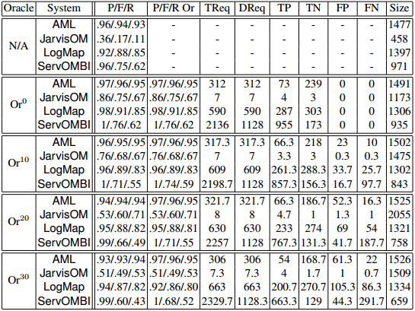
Experiments - results
All tools improve with the all-knowing expert
Notes:
Highlighted differences

Slide 28
Experiments - results
AML:
Improves more in terms of recall
At 20% drops below the non-interactive version
Linearly affected by errors
Does not extrapolate from the user feedback

Slide 29
Experiments - results
JarvisOM:
Highest improvement with user interaction
Least requests to the oracle
Affected severely by the user errors
Results better than the non-interactive version even with 30% error

Slide 30
Experiments - results
LogMap:
Improves more in terms of precision
Balanced positive/negative requests
Error affects both precision and recall
Increase in the number of requests

Slide 31
Experiments - results
ServOMBI:
Least improvment with interaction
Improves more in terms of precision
Most oracle requests (redundant as well)
Strongly affected by the errors (recall)
Increase in the number of requests

Slide 32
Conclusions
A step towards guidelines and best practices for good user interface design
User profiles need to be supported (errors)
Systems need to prioritize which mappings to present to the user
  Extrapolate knowledge by feedback propagation (double-edged sword)
The presented mappings need to be explained
  Consequences
  Justification

Slide 33
Future work
Usability studies with real users
Choice between conflicting mappings
Non-binary classification

