Slide 1
TDTS21 Advanced Networking
Lecture 2: Hosts, the Internet architecture, and the E2E arguments …
Based on slides from D. Choffnes, P. Gill, and J. Rexford
Revised Spring 2015 by N. Carlsson

Slide 2
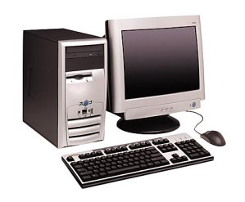
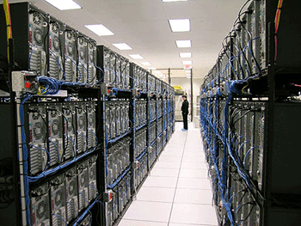
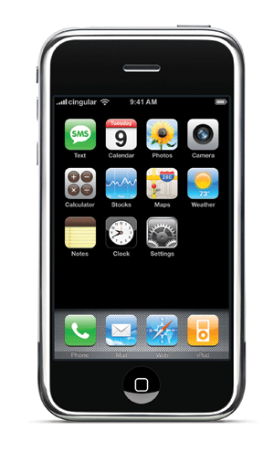

End hosts …
The Host

Slide 3

Host-Network Division of Labor
Network
  Best-effort packet delivery
  Between two (or more) end-point addresses
Hosts
  Everything else
host
host
network

Slide 4
The Role of the End Host
Network discovery and bootstrapping
  How does the host join the network?
  How does the host get an address?
Interface to networked applications
  What interface to higher-level applications?
  How does the host realize that abstraction?
Distributed resource sharing
  What roles does the host play in network resource allocation decisions?

Slide 5
Three Kinds of Identifiers
 | Host Name | IP Address | MAC Address
Example | www.cs.princeton.edu | 128.112.7.156 | 00-15-C5-49-04-A9
Size | Hierarchical, human readable, variable length | Hierarchical, machine readable, 32 bits (in IPv4) | Flat, machine readable, 48 bits
Read by | Humans, hosts | IP routers | Switches in LAN
Allocation, top-level | Domain, assigned by registrar (e.g., for .edu) | Variable-length prefixes, assigned by ICANN, RIR, or ISP | Fixed-sized blocks, assigned by IEEE to vendors (e.g., Dell)
Allocation, low-level | Host name, local administrator | Interface, by DHCP or an administrator | Interface, by vendor
Notes:
whois –h whois.arin.net 128.112.155.165
http://standards.ieee.org/regauth/oui/oui.txt
Why both MAC and IP:
Need identifier to use in bootstrap process
IP address is topology-dependent, so cannot keep when host moves
- LAN was meant to handle many different network protocols (not just IP)

Slide 6
Learning a Host’s Address
me
you
adapter
adapter
Who am I?
  Hard-wired: MAC address
  Static configuration: IP interface configuration
  Dynamically learned: IP address configured by DHCP
Who are you?
  Hard-wired: IP address in a URL, or in the code
  Dynamically looked up: ARP or DNS

Slide 7
Mapping Between Identifiers
Dynamic Host Configuration Protocol (DHCP)
  Given a MAC address, assign a unique IP address
  … and tell host other stuff about the Local Area Network
  To automate the boot-strapping process
Address Resolution Protocol (ARP)
  Given an IP address, provide the MAC address
  To enable communication within the Local Area Network
Domain Name System (DNS)
  Given a host name, provide the IP address
  Given an IP address, provide the host name

Slide 8
Dynamic Host Configuration Protocol
DHCP discover
(broadcast)
arriving
client
DHCP offer
DHCP server
Host learns
IP address,
Subnet mask, Gateway address, DNS server(s), and a lease time.
DHCP request
(broadcast)
DHCP ACK

Slide 9
Address Resolution Protocol (ARP)
Every host maintains an ARP table
  (IP address, MAC address) pair
Consult the table when sending a packet
  Map destination IP address to destination MAC address
  Encapsulate and transmit the data packet
But, what if the IP address is not in the table?
  Sender broadcasts: “Who has IP address 1.2.3.156?”
  Receiver responds: “MAC address 58-23-D7-FA-20-B0”
  Sender caches the result in its ARP table

Slide 10
Domain Name System
Host at cis.poly.edu wants IP address for gaia.cs.umass.edu
root DNS server
2
3
TLD DNS server
4
local DNS server
dns.poly.edu
5
7
6
1
8
authoritative DNS server
dns.cs.umass.edu
Recursive query: #1
Iterative queries: #2, 4, 6
requesting host
cis.poly.edu
gaia.cs.umass.edu

Slide 11
Questions
Should addresses correspond to the interface (point of attachment) or to the host?
Why do we have all three identifiers? Do we need all three?
What should be done to prevent spoofing of addresses?

Slide 12
Interface to Applications

Slide 13
Socket Abstraction
Best-effort packet delivery is a clumsy abstraction
  Applications typically want higher-level abstractions
  Messages, uncorrupted data, reliable in-order delivery
Applications communicate using “sockets”
  Stream socket: reliable stream of bytes (like a file)
  Message socket: unreliable message delivery
User process
User process
socket
socket
Operating
System
Operating
System

Slide 14
Two Basic Transport Features
Demultiplexing: port numbers
Error detection: checksums
Server host 128.2.194.242
Service request for
128.2.194.242:80
(i.e., the Web server)
Client host
Web server
(port 80)
Client
OS
Echo server
(port 7)
IP
payload
detect corruption

Slide 15
Two Main Transport Layers
User Datagram Protocol (UDP)
  Just provides demultiplexing and error detection
  Header fields: port numbers, checksum, and length
  Low overhead, good for query/response and multimedia
Transmission Control Protocol (TCP)
  Adds support for a “stream of bytes” abstraction
  Retransmitting lost or corrupted data
  Putting out-of-order data back in order
  Preventing overflow of the receiver buffer
  Adapting the sending rate to alleviate congestion
  Higher overhead, good for most stateful applications

Slide 17
Life in the 1970s…
Multiple unconnected networks
  ARPAnet, data-over-cable, packet satellite (Aloha), packet radio, …
Heterogeneous designs
  Addressing, max packet size, handling of lost/corrupted data, fault detection, routing, …
ARPAnet
satellite net

Slide 18
Handling Heterogeneity
Where to handle heterogeneity?
  Application process? End hosts? Packet switches?
Compatible process and host conventions
  Obviate the need to support all combinations
Retain the unique features of each network
  Avoid changing the local network components
Introduce the notion of a gateway

Slide 19
Internetwork Layer and Gateways
Internetwork Layer
Gateway
Internetwork appears as a single, uniform entity
Despite the heterogeneity of the local networks
Network of networks
“Embed internetwork packets in local packet format or extract them”
Route (at internetwork level) to next gateway
gateway
ARPAnet
satellite net

Slide 20
The design philosophy of the DARPA Internet Protocols
Clark ‘88

Slide 21
Goals of the Internet Architecture (Clark ‘88)
Connect existing networks
Robust in face of failures (not nuclear war…)
Support multiple types of services
Accommodate a variety of networks
Allow distributed management
Easy host attachment
Cost effective
Allow resource accountability
Notes:
Different types of services: e.g., even those that don’t want TCP (network debugging)
Cost effective: efficiently use the expensive communication resource. -> 40 B header “long”
Accountability becomes more important as non-military folks start to use the network

Slide 22
Robust
As long as the network is not partitioned, two endpoints should be able to communicate
Failures (excepting network partition) should not interfere with endpoint semantics (why?)
Maintain state only at end-points
  Fate-sharing, eliminates network state restoration
    If information associated with an entity is lost, then the entity itself must have been lost
  stateless network architecture (no per-flow state)
Routing state is held by network (why?)
No failure information is given to ends (why?)

Slide 23
Types of Services
Use of the term “communication services” already implied that they wanted application-neutral network
Realized TCP wasn’t needed (or wanted) by some applications
Separated TCP from IP, and introduced UDP
  What’s missing from UDP?
Notes:
Network debugging application → used when network is performing poorly will take what it can get. XNET

Slide 24
Variety of Networks
Incredibly successful!
  Minimal requirements on networks
  No need for reliability, in-order, fixed size packets, etc.
IP over everything
  Then: ARPANET, X.25, DARPA satellite network..
  Now: ATM, SONET, WDM…

Slide 25
Real Goals
Something that works…..
Connect existing networks
Survivability (not nuclear war…)
Support multiple types of services
Accommodate a variety of networks
Allow distributed management
Easy host attachment
Cost effective
Allow resource accountability

Slide 26
Internet Motto
We reject kings, presidents, and voting.
We believe in rough consensus and running code.”
David Clark

Slide 27
Questions
What priority order would a commercial design have?
What would a commercially invented Internet look like?
What goals are missing from this list?
Which goals led to the success of the Internet?
Something that works…..
Connect existing networks
Survivability (not nuclear war…)
Support multiple types of services
Accommodate a variety of networks
Allow distributed management
Easy host attachment
Cost effective
Allow resource accountability
Notes:
Missing: resource sharing, other considerations of malicious users (traceback, etc.), address concerns of administrative domains visible

Slide 28
Outline
Layering
  The OSI Model
Communicating
  The End-to-End Argument

Slide 29
The ISO OSI Model
OSI: Open Systems Interconnect Model
Host 1
Switch
Host 2
Application
Application
Presentation
Layers communicate peer-to-peer
Presentation
All devices implement the first three layers
Layers communicate peer-to-peer
Session
Session
Transport
Transport
Network
Network
Network
Data Link
Data Link
Data Link
Physical
Physical
Physical

Slide 30
Encapsulation
How does data move through the layers?
Data
Application
Presentation
Session
Transport
Network
Data Link
Physical
Data

Slide 31



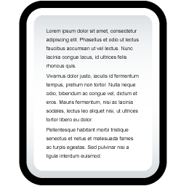




Real Life Analogy
Doesn’t know how the Postal network works
Label contains routing info
Un-packing
Doesn’t know contents of letter
Postal Service

Slide 32
Network Stack in Practice
Host 1
Switch
Host 2
Application
Application
Presentation
Presentation
Video Client
Video Server
Session
Session
FTP Client
FTP Server
UDP
UDP
Transport
Transport
TCP
TCP
Network
Network
Network
IP
IP
IP
Data Link
Data Link
Data Link
Ethernet
Ethernet
802.11n
Ethernet
802.11n
802.11n
Physical
Physical
Physical

Slide 33
Encapsulation, Revisited
HTTP Header
Web Page
Web Server
TCP Header
HTTP Header
Web Page
TCP
TCP Segment
IP Header
TCP Header
HTTP Header
Web Page
IP
IP Datagram
Ethernet Header
IP Header
TCP Header
HTTP Header
Web Page
Ethernet Trailer
Ethernet
Ethernet Frame

Slide 34
The Hourglass
HTTP, FTP, RTP, IMAP, Jabber, …
One Internet layer means all networks interoperate
All applications function on all networks
Room for development above and below IP
But, changing IP is insanely hard
TCP, UDP, ICMP
Think about the difficulty of deploying IPv6…
IPv4
Ethernet, 802.11x, DOCSIS, …
Fiber, Coax, Twisted Pair, Radio, …

Slide 35
Orthogonal Planes
Control plane: How Internet paths are established
Application
Presentation
Well cover this later…
Session
Transport
IP
BGP
RIP
OSPF
Control Plane
Data Link
Physical

Slide 36
Orthogonal Planes
Data plane: How data is forwarded over Internet paths
Host 1
Switch(es)
Host 2
Application
Application
Transport
Transport
Network
Network
Network
Data Link
Data Link
Data Link

Slide 37
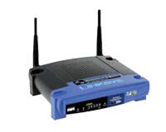


Reality Check
The layered abstraction is very nice
Does it hold in reality?
No.
Firewalls
Analyze application layer headers
Transparent Proxies
Simulate application endpoints within the network
NATs
Break end-to-end network reachability

Slide 38
Outline
Layering
  The OSI Model
Communicating
  The End-to-End Argument

Slide 39
From Layers to Eating Cake
IP gives us best-effort datagram forwarding
  So simple anyone can do it
  Large part of why the Internet has succeeded
  …but it sure isn’t giving us much
Layers give us a way to compose functionality
  Example: HTTP over TCP for Web browsers with reliable connections
…but they do not tell us where (in the network) to implement the functionality

Slide 40


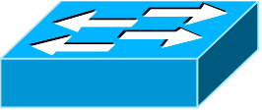
Where to Place Functionality
How do we distribute functionality across devices?
  Example: who is responsible for security?
?
?
?
?
?
Switch
Switch
Router
“The End-to-End Arguments in System Design”
  Saltzer, Reed, and Clark
  The Sacred Text of the Internet
  Endlessly debated by researchers and engineers

Slide 41
“End-to-End Arguments in System Design”
(ACM Trans. on Computer Systems, November 1984)
J. Saltzer, D. Reed, and D. Clark

Slide 42
Basic Observation
Some applications have end-to-end requirements
  Security, reliability, etc.
Implementing this stuff inside the network is hard
  Every step along the way must be fail-proof
  Different applications have different needs
End hosts…
  Can’t depend on the network
  Can satisfy these requirements without network level support

Slide 43
End-to-End Argument
Operations should occur only at the end points
… unless needed for performance optimization
2
4
3
1
5
Many things can go wrong: disk errors, software errors, hardware errors, communication errors, …

Slide 44
Tradeoffs
Put functionality at each hop
  All applications pay the price
  End systems still need to check for errors
Place functionality only at the ends
  Slower error detection
  End-to-end retransmission wastes bandwidth
Compromise solution?
  Reliable end-to-end transport protocol (TCP)
  Plus file checksums to detect file-system errors

Slide 45


Example: Reliable File Transfer
Integrity Check
Integrity Check
Integrity Check
App has to do a check anyway!
Solution 1: Make the network reliable
Solution 2: App level, end-to-end check, retry on failure

Slide 46
Example: Reliable File Transfer
Please Retry
In-network implementation…
  Doesn’t reduce host complexity
  Does increase network complexity
  Increased overhead for apps that don’t need functionality
But, in-network performance may be better
Full functionality can be built at App level
Solution 1: Make the network reliable
Solution 2: App level, end-to-end check, retry on failure

Slide 47
Conservative Interpretation
“Don’t implement a function at the lower levels of the system unless it can be completely implemented at this level” (Peterson and Davie)
Basically, unless you can completely remove the burden from end hosts, don’t bother

Slide 48
Radical Interpretation
Don’t implement anything in the network that can be implemented correctly by the hosts
Make network layer absolutely minimal
Ignore performance issues

Slide 49
Moderate Interpretation
Think twice before implementing functionality in the network
If hosts can implement functionality correctly, implement it a lower layer only as a performance enhancement
But do so only if it does not impose burden on applications that do not require that functionality…
…and if it doesn’t cost too much $ to implement

Slide 50
Reality Check, Again
Layering and E2E principals regularly violated
Firewalls
Transparent Proxies
NATs
Conflicting interests
  Architectural purity
  Commercial necessity

Slide 51
Takeaways
Layering for network functions
  Helps manage diversity in computer networks
  Not optimal for everything, but simple and flexible
Narrow waist ensures interoperability, enables innovation
E2E argument (attempts) to keep IP layer simple
Think carefully when adding functionality into the network

Slide 53
More slides …

Slide 54
Questions
Is a socket between two IP addresses the right abstraction?
  Mobile hosts?
  Replicated services?
What does the network know about the traffic?
  Inferring the application from the port numbers?
Is end-to-end error detection and correction the right model?
  High loss environments?
  Expense of retransmitting over the entire path?

Slide 56
Organizing Network Functionality
Networks are built from many components
  Networking technologies
    Ethernet, Wifi, Bluetooth, Fiber Optic, Cable Modem, DSL
  Network styles
    Circuit switch, packet switch
    Wired, Wireless, Optical, Satellite
  Applications
    Email, Web (HTTP), FTP, BitTorrent, VoIP
How do we make all this stuff work together?!

Slide 57




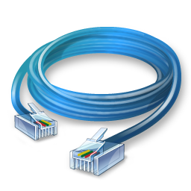
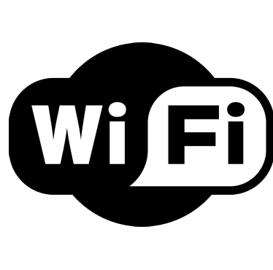


Problem Scenario
Web
Email
Bittorrent
VoIP
This is a nightmare scenario
Huge amounts of work to add new apps or media
Limits growth and adoption
Ethernet
802.11
Bluetooth
Cellular

Slide 58
More Problems
Bittorrent
Bittorrent
Application endpoints may not be on the same media
Ethernet
802.11

Slide 59
Solution: Use Indirection
Web
Email
Bittorrent
VoIP
API
O(1) work to add new apps, media
Few limits on new technology
Magical Network Abstraction Layer
API
API
API
Ethernet
802.11
Bluetooth
Cellular

Slide 60
Layered Network Stack
Applications
Modularity
  Does not specify an implementation
  Instead, tells us how to organize functionality
Encapsulation
  Interfaces define cross-layer interaction
  Layers only rely on those below them
Flexibility
  Reuse of code across the network
  Module implementations may change
Unfortunately, there are tradeoffs
  Interfaces hide information
  As we will see, may hurt performance…
Layer N
…
Layer 2
Layer 1
Physical
Media

Slide 61
Key Questions
How do we divide functionality into layers?
  Routing
  Congestion control
  Error checking
How do we distribute functionality across devices?
  Example: who is responsible for security?
  Security
  Fairness
  And many more…
Switch
Switch
Router

Slide 62
Layer Features
Service
  What does this layer do?
Interface
  How do you access this layer?
Protocol
  How is this layer implemented?
Application
Presentation
Session
Transport
Network
Data Link
Physical

Slide 63
Physical Layer
Service
  Move information between two systems connected by a physical link
Interface
  Specifies how to send one bit
Protocol
  Encoding scheme for one bit
  Voltage levels
  Timing of signals
Examples: coaxial cable, fiber optics, radio frequency transmitters
Application
Presentation
Session
Transport
Network
Data Link
Physical

Slide 64
Data Link Layer
Service
  Data framing: boundaries between packets
  Media access control (MAC)
  Per-hop reliability and flow-control
Interface
  Send one packet between two hosts connected to the same media
Protocol
  Physical addressing (e.g. MAC address)
Examples: Ethernet, Wifi, DOCSIS
Application
Presentation
Session
Transport
Network
Data Link
Physical

Slide 65
Network Layer
Service
  Deliver packets across the network
  Handle fragmentation/reassembly
  Packet scheduling
  Buffer management
Interface
  Send one packet to a specific destination
Protocol
  Define globally unique addresses
  Maintain routing tables
Example: Internet Protocol (IP), IPv6
Application
Presentation
Session
Transport
Network
Data Link
Physical

Slide 66
Transport Layer
Service
  Multiplexing/demultiplexing
  Congestion control
  Reliable, in-order delivery
Interface
  Send message to a destination
Protocol
  Port numbers
  Reliability/error correction
  Flow-control information
Examples: UDP, TCP
Application
Presentation
Session
Transport
Network
Data Link
Physical

Slide 67
Session Layer
Service
  Access management
  Synchronization
Interface
  It depends…
Protocol
  Token management
  Insert checkpoints
Examples: none
Application
Presentation
Session
Transport
Network
Data Link
Physical

Slide 68
Presentation Layer
Service
  Convert data between different representations
  E.g. big endian to little endian
  E.g. Ascii to Unicode
Interface
  It depends…
Protocol
  Define data formats
  Apply transformation rules
Examples: none
Application
Presentation
Session
Transport
Network
Data Link
Physical

Slide 69
Application Layer
Service
  Whatever you want :)
Interface
  Whatever you want :D
Protocol
  Whatever you want ;)
Examples: turn on your smartphone and look at the list of apps
Application
Presentation
Session
Transport
Network
Data Link
Physical

