Slide 1
Protocol layers and Wireshark
Rahul Hiran
TDTS11:Computer Networks and Internet Protocols
Textbook: “Computer Networking: A Top Down Approach”, by Jim Kurose and Keith Ross.
Note: The slides are adapted and modified based on slides from the book’s companion Web site, as well as modified slides by Niklas Carlsson
Notes:
Hello … Good morning every body…!
My name is Rahul Hiran ( depending if the session chair introduces me).
Else..Thanks session chair for the introduction.
I am going to talk about our project: “Keeping the network clean: dynamic alliances for collaborative evaluations”.

Slide 2
What will I talk about?
Short description from lecture 1 about computer networks
Internet protocol stack
How to see what different stack layer does
Using network analysis tool called wireshark

Slide 3

What’s the Internet: Slide from lecture 1
PC
millions of connected computing devices: hosts = end systems
  running network apps
Mobile network
server
Global ISP
wireless
laptop
cellular
handheld
Home network
communication links
  fiber, copper, radio, satellite
Regional ISP
access
points
Institutional network
wired
links
routers: forward packets (chunks of data)
router
Introduction 1-3

Slide 4
What’s a protocol?
(slide from lecture 1)
human protocols:
“what’s the time?”
“I have a question”
introductions
… specific msgs sent
… specific actions taken when msgs received, or other events
network protocols:
machines rather than humans
all communication activity in Internet governed by protocols
protocols define format, order of msgs sent and received among network entities, and actions taken on msg transmission, receipt
Introduction 1-4

Slide 5
More about protocols
There are many protocols that are involved in working of computer network
There is a internet protocol stack. A protocol normally belongs to one of the layers in the stack.
Let us look at the airline functionality

Slide 6
Layering of airline functionality
ticket (purchase)
baggage (check)
gates (load)
runway (takeoff)
airplane routing
ticket (complain)
baggage (claim
gates (unload)
runway (land)
airplane routing
ticket
baggage
gate
takeoff/landing
airplane routing
airplane routing
airplane routing
departure
airport
intermediate air-traffic
control centers
arrival
airport
Layers: each layer implements a service
  via its own internal-layer actions
  relying on services provided by layer below
Introduction 1-6

Slide 7
Internet protocol stack
application: supporting network applications
  FTP, SMTP, HTTP
transport: process-process data transfer
  TCP, UDP
network: routing of datagrams from source to destination
  IP, routing protocols
link: data transfer between neighboring network elements
  Ethernet, 802.111 (WiFi), PPP
physical: bits “on the wire”
application
transport
network
link
physical
Introduction 1-7

Slide 8
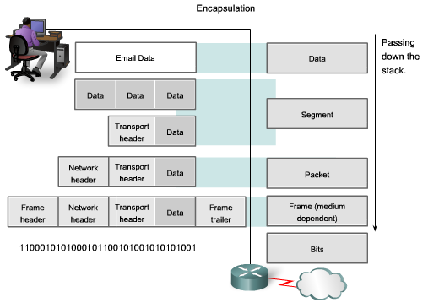
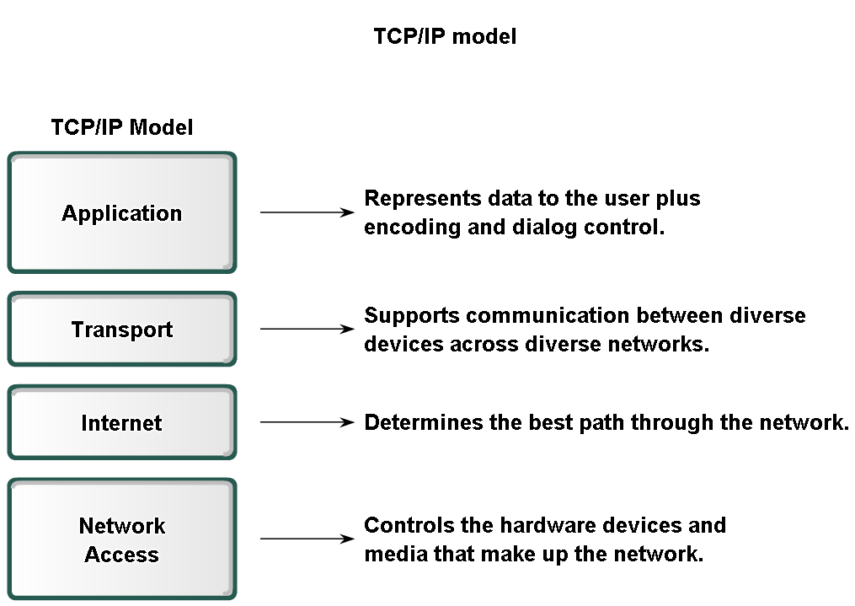
Encapsulation

Slide 9
wireshark
How can we analyze the network data?
Using tools such as wireshark
Wireshark: a network packet analyzer. A network packet analyzer will try to capture network packets and tries to display that packet data as detailed as possible.
Let us start wireshark….!

Slide 10
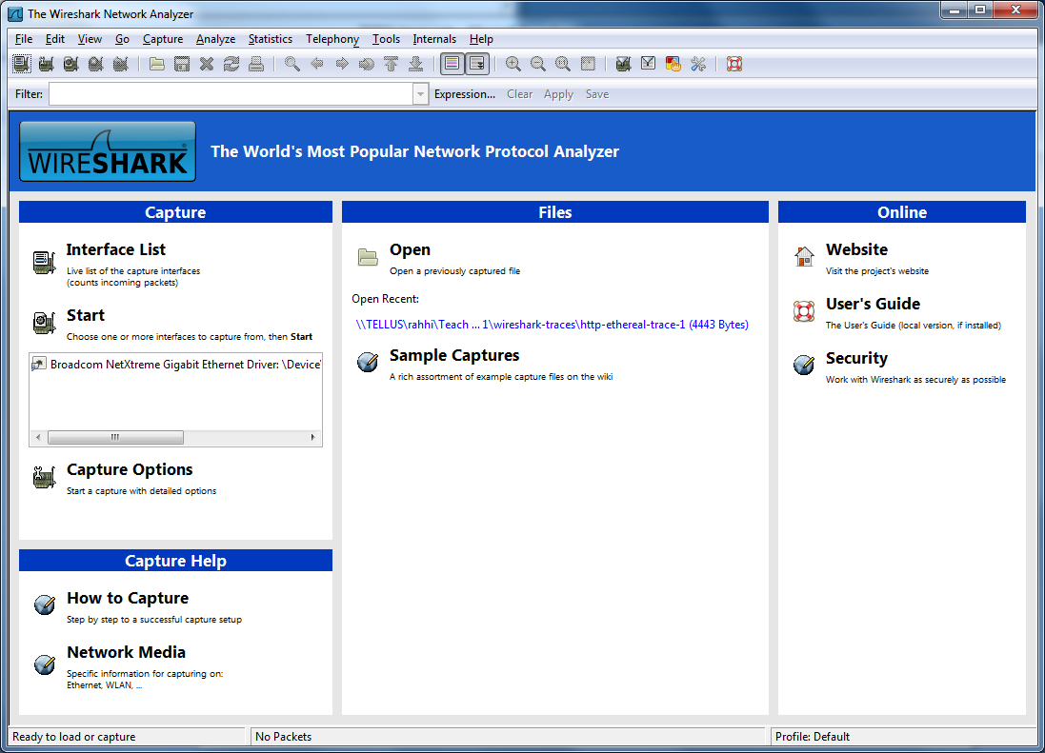
Start screen of wireshark

Slide 11
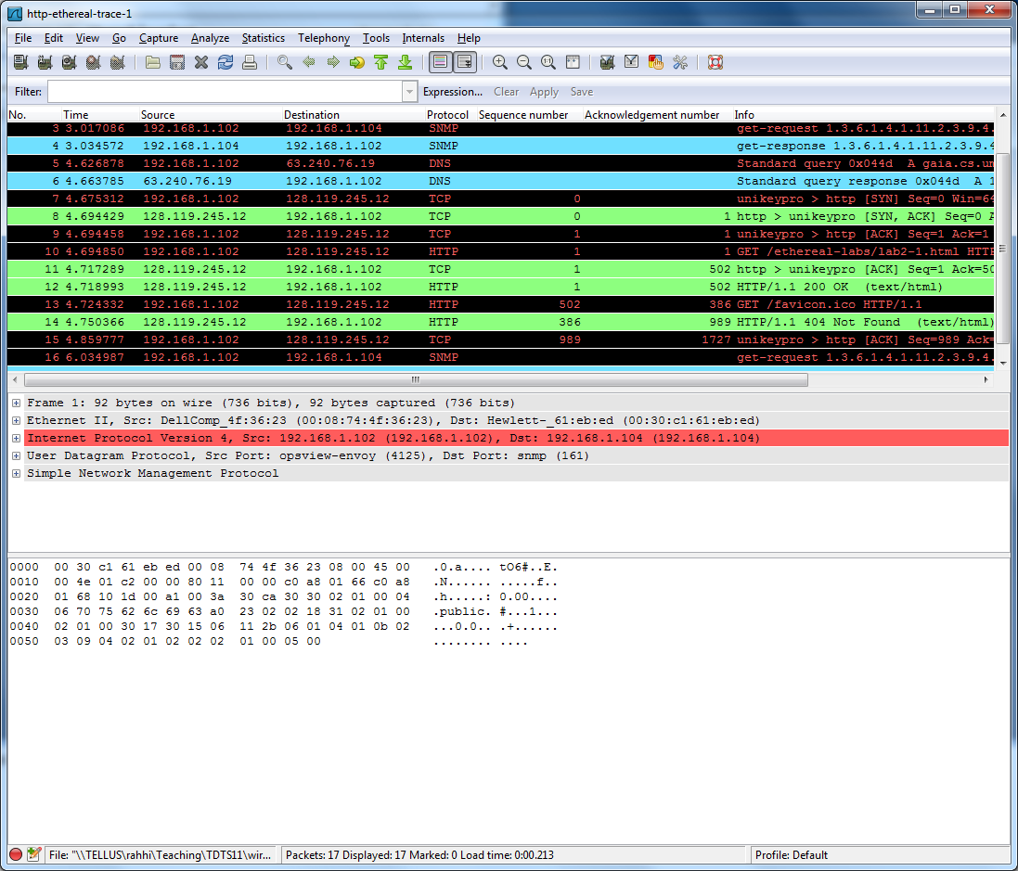
Make your own capture or open existing trace files

Slide 12
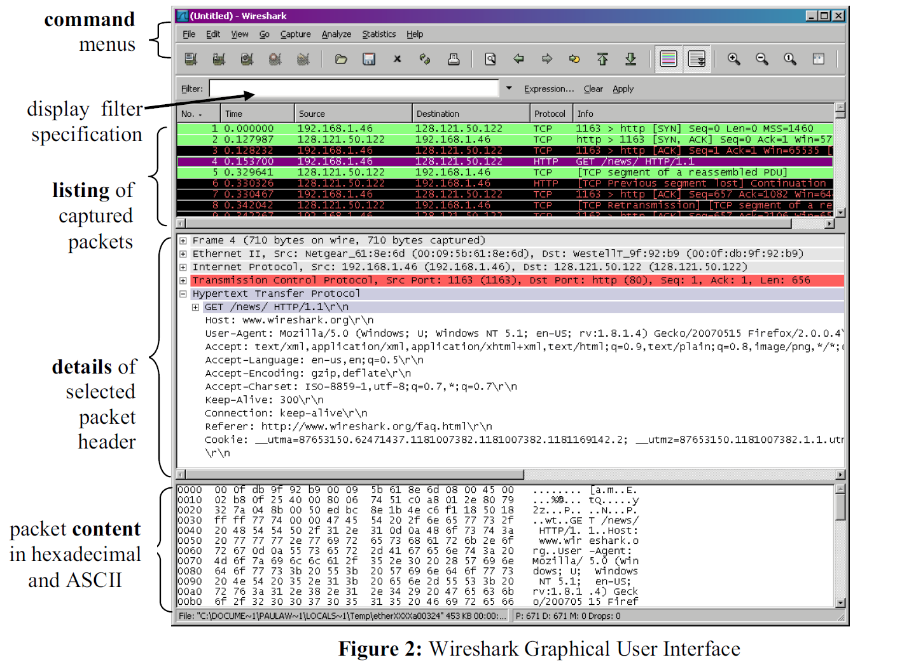
Graphical User Interface

Slide 13
Reduce clutter
Disable the checksum error messages from Views->Coloring rules…menu item
Enter data in the filter to show only http packets
Let us look at the example

Slide 14
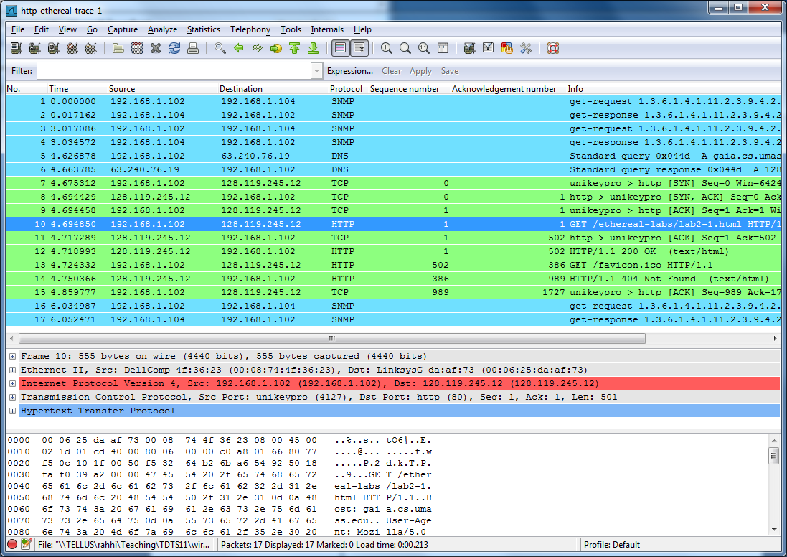
After unnecessary data is removed

Slide 15
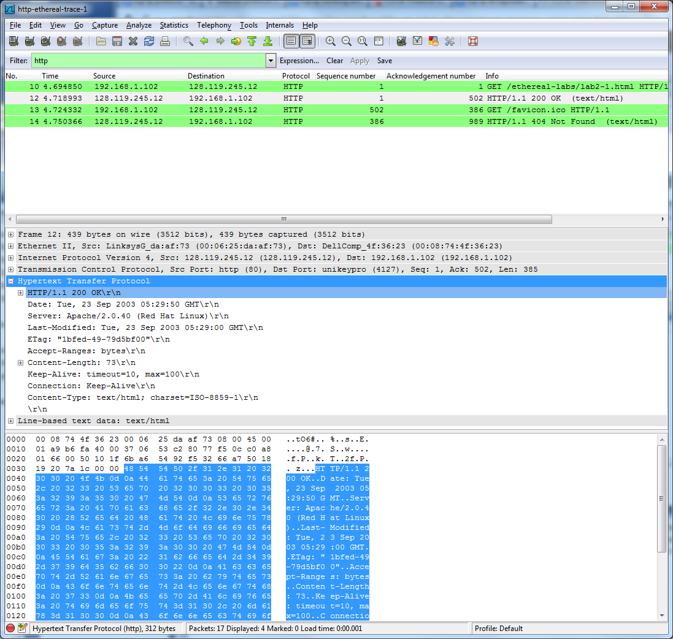
Let us look at the application level data
Notes:
Here I have selected one packet from packet listing window and details window we can see various information related to this packet.
We want to see only the data related to http protocol , therefor I have selected “Hypertext Transfer Protocol” child in packet details window.
We can clearly see various fields associated with http protocol. Similarly, when you have some other application instead of http, you will see fields associated with that protocol. In this slide we can see fields such keep-alice, last modified etc associated with the http protocol.

Slide 16
Internet protocol stack
application: supporting network applications
  FTP, SMTP, HTTP
transport: process-process data transfer
  TCP, UDP
  TCP is responsible for the establishment of a TCP connection, the sequencing and acknowledgment of packets sent, and the recovery of packets lost during transmission
network: routing of datagrams from source to destination
  IP, routing protocols
link: data transfer between neighboring network elements
  Ethernet, 802.111 (WiFi), PPP
physical: bits “on the wire”
application
transport
network
Link
physical
Introduction 1-16

Slide 17
Encapsulation

Slide 18
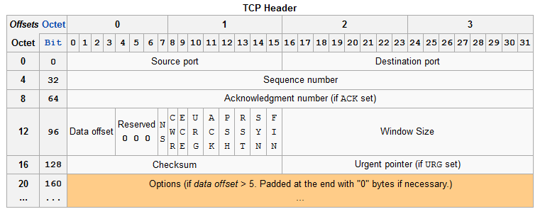
TCP header
Notes:
We will now see the what data is added at the transport layer. Here we see the header format for TCP protocol. We can see that the TCP header should have source port, destination port, sequence number, ack number, checksum related data and other data. We will now see the actual TCP header in our example packet that we just looked at.

Slide 19
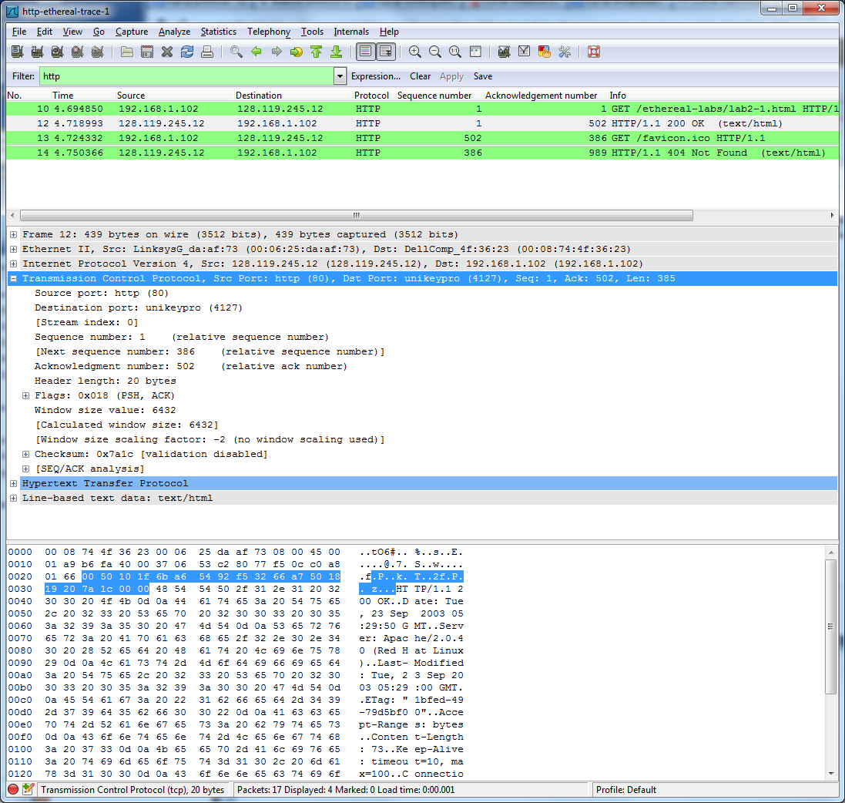
TCP header data in our packet

Slide 20
How to look at time/sequence plot
Select tcp-ethereal-trace-1
Filter by entering tcp
Select TCP segment
Go to statistics-> TCP streamgraph -> Time-sequence graph (stevens)

Slide 21
Internet protocol stack
application: supporting network applications
  FTP, SMTP, HTTP
transport: process-process data transfer
  TCP, UDP
network: routing of datagrams from source to destination
  IP, routing protocols
  The Internet layer is responsible for addressing, packaging, and routing functions.
link: data transfer between neighboring network elements
  Ethernet, 802.111 (WiFi), PPP
physical: bits “on the wire”
application
transport
network
Link
physical
Introduction 1-21

Slide 22
Encapsulation

Slide 23
Internet layer
Let us first open ip-ethereal-trace-1
And look at the first ICMP message
We also look at the IP protocol header format

Slide 24
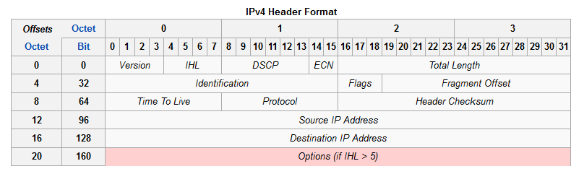
IP header

Slide 25
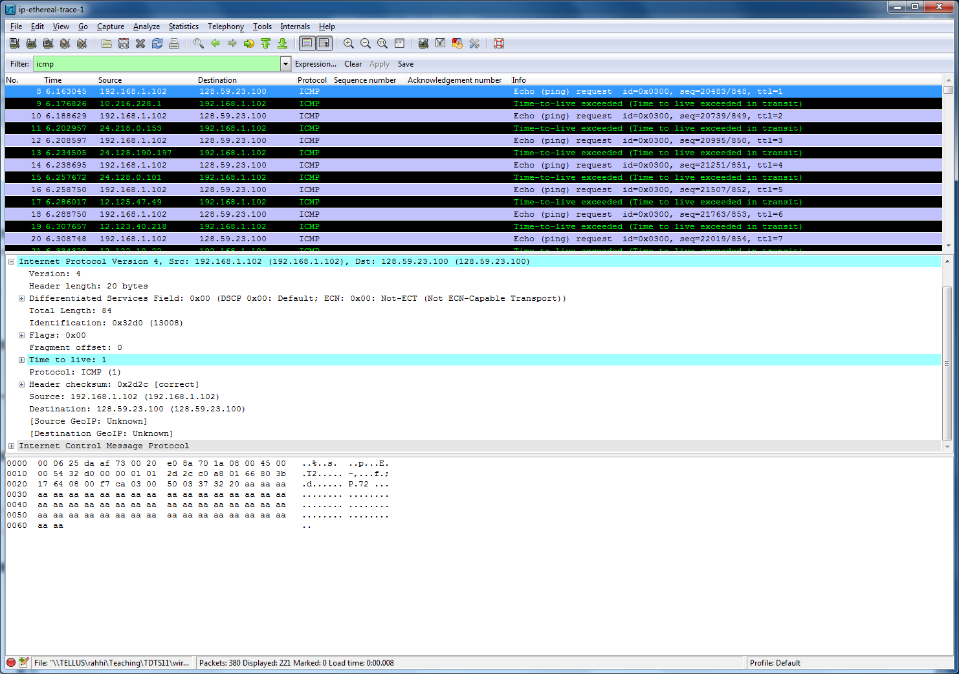
IP header in collected traces
Notes:
There are several things to notice in this screenshot. First let us see the IP header format
1. Here we can see the first ICMP message with time to leave value of 1.
In response you get Time to live exceeded message.
Note the source of the ICMP time to live exceeded message. These source values give us the path that the traceroute will take from source to the destination

Slide 26
Internet protocol stack
application: supporting network applications
  FTP, SMTP, HTTP
transport: process-process data transfer
  TCP, UDP
network: routing of datagrams from source to destination
  IP, routing protocols.
link: data transfer between neighboring network elements
  Ethernet, 802.111 (WiFi), PPP
physical: bits “on the wire”
application
transport
network
Link
physical
Introduction 1-26

Slide 27
What’s the Internet: Slide from lecture 1
Network layers job is end-to-end movement of data from source to destination
Link layers job is node-to-node movement of network-layer datagrams over a single link in the path
Ethernet is quite popular protocol
Let us look at the header
Mobile network
Global ISP
Home network
Regional ISP
Institutional network
Introduction 1-27

Slide 28
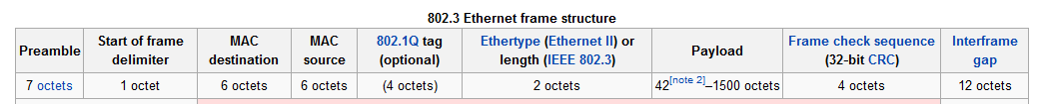
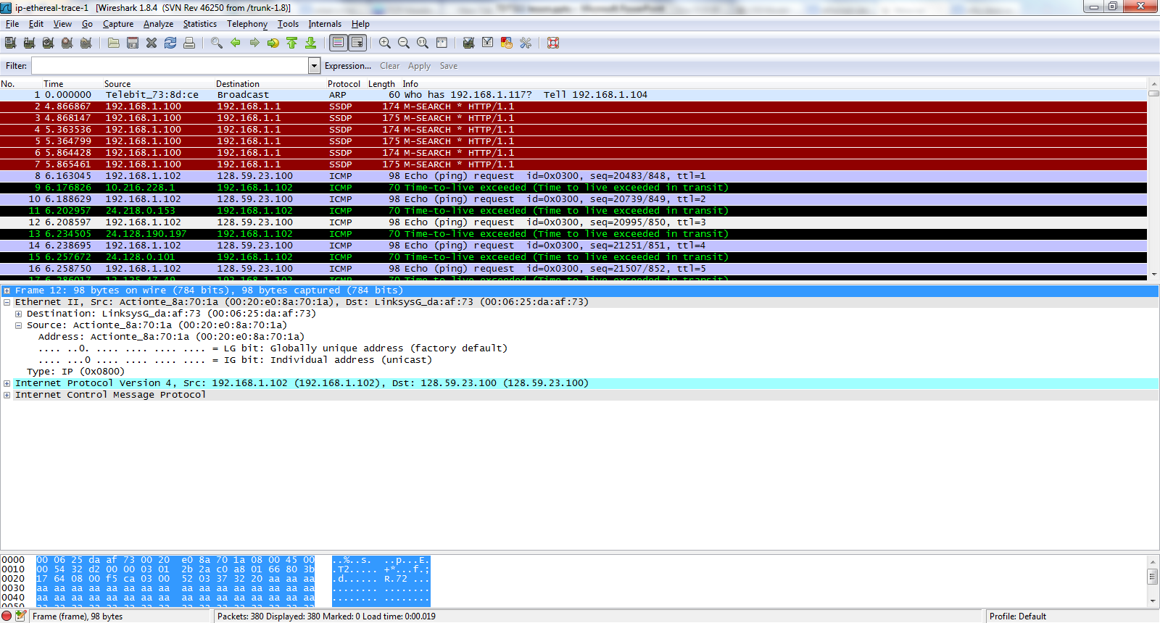
Ethernet header and trailer

Slide 29
Conclusion
application: supporting network applications
  FTP, SMTP, HTTP
transport: process-process data transfer
  TCP, UDP
network: routing of datagrams from source to destination
  IP, routing protocols
link: data transfer between neighboring network elements
  Ethernet, 802.111 (WiFi), PPP
physical: bits “on the wire”
application
transport
network
link
physical
Introduction 1-29

Slide 30
Conclusion

Slide 31

Questions…?
Notes:
Questions………!

Slide 32

www.liu.se

