Slide 1
Introduction to assignment 2 and socket programming
TDTS06: Computer Networks
September 2023

Slide 2
Lecture outline
TDTS06 Introduction to lab 2 & socket programming
General lab assignment information
Assignment 2
HTTP & Proxy
Socket programming
Questions

Slide 3
General lab assignment information
TDTS06 Introduction to lab 2 & socket programming
Assignment 1 should be finished as soon as possible
Assignment 2 takes time, and have a soft deadline due the 24th of Sep. 2022
Third assignment is more in the style of the first and shouldn’t take too much time
The last assignment (4) needs a little more time so don’t put it off
Semi-hard deadline and last time to demonstrate easily is October 14 or the last date your lab group has scheduled
Check with the TA if you plan to use languages other than those prescribed

Slide 4
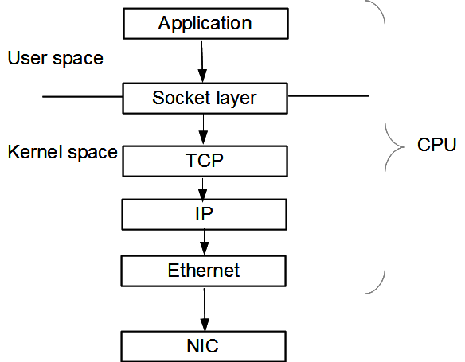
Assignment 2 – what will we do?
TDTS06 Introduction to lab 2 & socket programming
Learn about WWW and HTTP
Learn TCP/IP socket programming to
understand HTTP and WWW better
Build a simple proxy

Slide 5
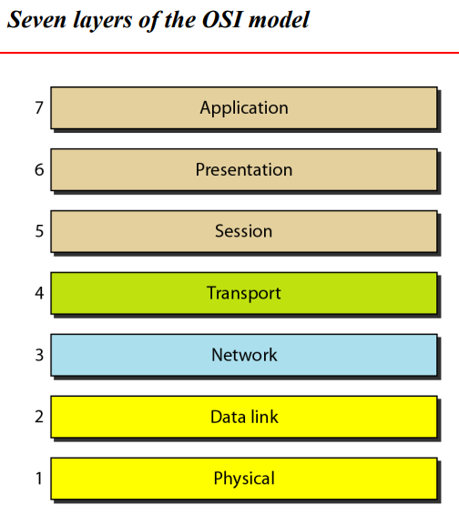

Slide 6
What is WWW?
TDTS06 Introduction to lab 2 & socket programming
It is a world-wide system of interconnected servers which distribute a special type of document.
Documents are marked-up to indicate formatting (Hypertexts)
This idea has been extended to embed multimedia and other content within the marked-up page.
Notes:
The World Wide Web (WWW), commonly known as the Web, is an information system where documents and other web resources are identified by Uniform Resource Locators (URLs, such as https://example.com/), which may be interlinked by hypertext, and are accessible over the Internet.^{[1][2]} The resources of the Web are transferred via the Hypertext Transfer Protocol (HTTP), may be accessed by users by a software application called a web browser, and are published by a software application called a web server. The World Wide Web is not synonymous with the Internet, which pre-dated the Web in some form by over two decades and upon which technologies the Web is built.

Slide 7
What is HTTP?
TDTS06 Introduction to lab 2 & socket programming
HTTP is WWW's application layer protocol
HyperText Transfer Protocol (HTTP) to transfer HyperText Markup Language (HTML) pages and embedded objects
Works on a client-server paradigm
Needs reliable transport mechanism (TCP)

Slide 8


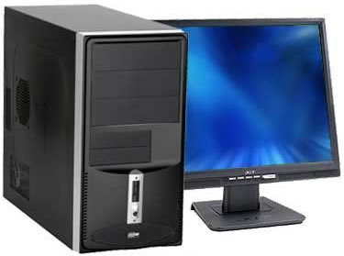
HTTP
TDTS06 Introduction to lab 2 & socket programming
Server
Router
Client

Slide 9
HTTP
TDTS06 Introduction to lab 2 & socket programming
Note: HTTP server always runs on port 80
Server
Router
Client

Slide 10
HTTP
TDTS06 Introduction to lab 2 & socket programming
Note: HTTP server always runs on port 80
Note: Client can use any unrestricted port
Generally >1024
Server
Router
Client

Slide 11
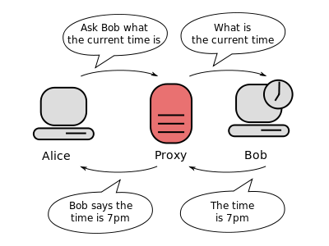
Proxy
TDTS06 Introduction to lab 2 & socket programming
Acts as intermediary between client and server.
Notes:
A Web proxy is a piece of software that functions as an intermediary between a Web client (browser) and a Web server.
The Web proxy intercepts Web requests from clients and reformulates the requests for transmission to a Web server. When a response is received from the Web server, the proxy sends the response back to the client. From the server's point of view, the proxy is the client, since that is where the request comes from. Similarly, from the client's point of view, the proxy is the server, since that is where the response comes from. A Web proxy thus provides a single point of control to regulate Internet access between clients and servers.
A lot of schools use Web proxies to limit the types of Web sites that students are allowed to access. Net Nanny and Barracuda are examples of commercially available Web proxies.

Slide 12
Benefits of a proxy
TDTS06 Introduction to lab 2 & socket programming
Hide your internal network information (such as host names and IP addresses)
You can set the proxy to require user authentication
The proxy provides advanced logging capabilities
Proxy helps you control which services users can access
Proxy-caches can be used to save bandwidth
Get access to blocked resources
Risks of using a Proxy
Free proxy server risks
Browsing history log
No encryption
A video to understand the concept
https://www.youtube.com/watch?v=5cPIukqXe5w
Some Proxy Service Providers
https://brightdata.com/proxy-types
https://smartproxy.com/
https://froxy.com/en

Slide 13
Types of Proxy Servers
Transparent
Anonymous
Elite
Further Reading (if interested) – Data center and residential proxies
Let’s check out practically:
https://www.croxyproxy.com

Slide 14
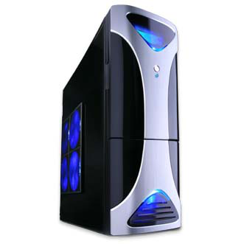
HTTP with proxy
Note: HTTP server always runs on port 80
Proxy listens on a port (>1024) and talks to server on
another (>1024)
Server
Note: Client can use any unrestricted port
Generally >1024
Router
Proxy
Client

Slide 15
What is a port?
A port is an application-specific or process-specific software construct serving as a communications endpoint
The purpose of ports is to uniquely identify different applications or processes running on a single computer and thereby enable them to share a single physical connection to a packet-switched network like the Internet

Slide 16
Ports continued
Port only identifies processes/applications
With regard to the Internet, ports are always used together with IP
Notation 192.168.1.1:80
IP address
Transport protocol port
UDP/TCP

Slide 17
Socket programming
These are software constructs used to create ports and perform operations on them
We will talk about these types of sockets:
  Datagram socket
  Stream socket
  SSL sockets

Slide 18
Datagram sockets
Datagram sockets use UDP
They are connectionless
Do not guarantee in order delivery
No form of loss recovery
No congestion control
No flow control

Slide 19
Stream sockets
Stream sockets use TCP protocol
Connection oriented sockets
In order and guaranteed delivery
Error identification and recovery
Congestion control
Flow control
SSL sockets are similar to stream sockets, but include functions to handle encryption

Slide 20
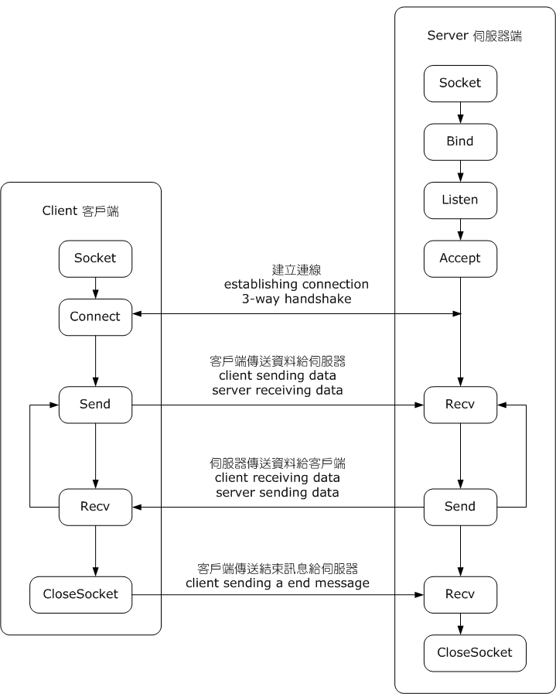
Important socket calls
socket
bind
listen
accept
connect
send
recv

Slide 21
Socket programming calls
socket()
  Takes as input
    Address family (=AF_INET)
    Socket type (=SOCK_STREAM)
  Returns
    A socket object

Slide 22
Socket programming calls
bind()
  Takes as input
    address/port tuple (for AF_INET)
What does this do?
  Associate the socket with an address/port tuple

Slide 23
Socket programming calls
listen()
  Takes as input
    Backlog (max queue of incoming connection)
This must run at the server side to listen to incoming connection

Slide 24
Socket programming calls
connect()
  Takes as input
    Address/port tuple
What does this do?
  Attempts to setup a connection with the other end

Slide 25
Socket programming calls
accept()
  Νο input
  Returns
    conn - a new socket object
    address - address/port tuple
Reads through the backlog and picks one from the list to connect to it.
Runs at the server side

Slide 26
Socket programming calls
send()
  Takes as input
    Message
  Returns
    Number of bytes sent
Send is always best effort. If it cannot send the whole message, the returned value is smaller.

Slide 27
Socket programming calls
recv()
  Takes as input
    Max buffer length
  Returns
    bytes object representing the data received

Slide 28
Socket programming calls
close()
  No input
Marks the socket as closed

Slide 29
Socket programming resource
Helpful guide linked from the assignment text:
Beej’s Guide to Network Programming
Based on C, but can be used as a foundation for
other languages

Slide 30
Assignment 2: Simple Web (HTTP) proxy
Build a properly functioning Web proxy for simple Web pages, and then use your proxy to change some of the content before it is delivered to the browse
Change all occurrences of "Smiley" on a Web page into "Trolly", and all occurrences of "Stockholm" into "Linköping". And if you find any JPG images of Smiley (linked or embedded), then you should replace them with your favorite troll image file (JPG, GIF, or PNG) from the Internet.
For the sake of simplicity, we will restrict ourselves only to HTTP (not HTTPS), and consider only basic text and HTML pages with a few images.

Slide 31
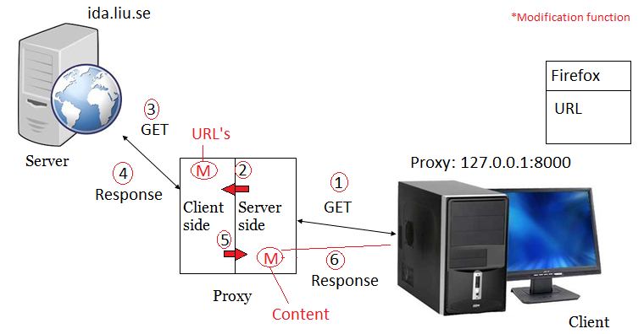
General overlay

Slide 32
Assignment 2: description
Socket programming is the key
Build a proxy to which a user can connect to
The proxy connects to the web server on user's behalf (recollect how proxy works)
Proxy receives the response from the web server
Proxy forwards the HTTP response (from the web server) to the user with all occurrences of "Smiley" replaced by "Trolly", and all occurrences of "Stockholm" replaced by "Linköping"

Slide 33
Assignment 2: requirements
The proxy should support both HTTP/1.0 and HTTP/1.1.
Handles simple HTTP GET interactions between client and server
Consider how your proxy handles commonly occurring HTTP response codes, such as 200 (OK), 304 (Not Modified), and 404 (Not Found)
Imposes no limit on the size of the transferred HTTP data
Use only the basic libraries available for socket programming

Slide 34
Assignment 2 requirements
Is compatible with all major browsers (e.g. Internet Explorer, Mozilla Firefox, Google Chrome, etc.) without the requirement to tweak any advanced feature
Allows the user to select the proxy port (i.e. the port number should not be hard coded)
Is smart in selection of what HTTP content should be searched for the forbidden keywords. For example, you probably agree that it is not wise to search inside compressed or other non-text-based HTTP content such as graphic files, etc.
You do not have to relay HTTPS requests through the proxy

Slide 35
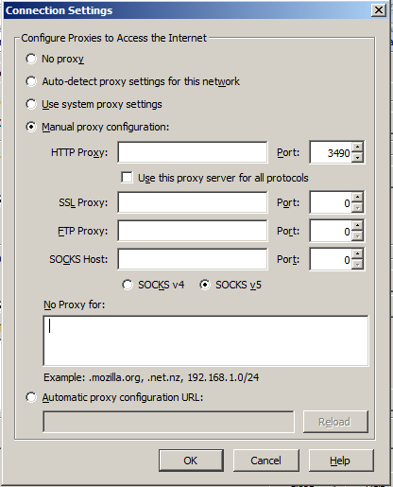
Browser configuration
Proxy listens on a particular port
127.0.0.1
Proxy's port number
Make sure it is blank

Slide 36
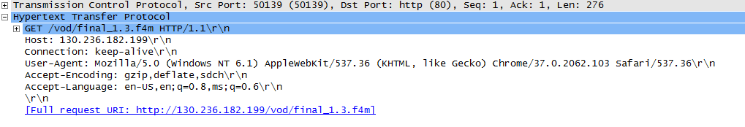
HTTP basics
Recollect lab 1. It contains things what you need in lab 2.
HTTP request
  Get
    Syn, SynAck, Ack

Slide 37
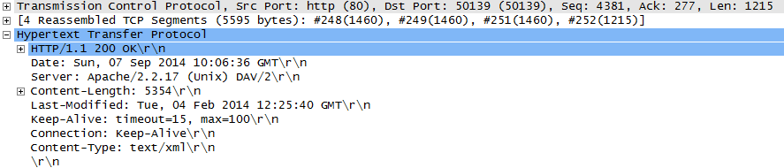
HTTP basics
HTTP response
  OK

Slide 38
HTTP basics
HTTP 1.0 vs HTTP 1.1
  Many differences read http://www8.org/w8-papers/5c-protocols/key/key.html
  For this assignment
    Connection: close
      Handshake-Get-response-OK-Teardown
    Connection: keep-alive
      Handshake-Get-response-OK-wait-Get-response
What should you use for the proxy?
Notes:
http://www.differencebetween.net/technology/protocols-formats/difference-between-http-1-0-and-1-1/

Slide 39
How to handle connections
With connection: keep-alive, the connection is kept open. You are responsible to figure out when the response is completed.
With connection: close, the server closes the connection after the response is sent.
How can you enforce connection: close on HTTP 1.1?

Slide 41
Various Steps involved:
Proxy (Server Side)
Allocate IP address and Port No. (Tuple)
Binding the socket
Listen for incoming connections
Add proxy settings in the web browser
Receive Request(s) from the user (browser)
Decode and parse through received GET
Modify URL (depends)
Encode (Opt) and send the request to Proxy (Client Side)
Receive response from Proxy (Client Side) and decode information (if not done earlier)
Modify text (not image file name) (if large, store all of them in a temporary buffer)
Encode and send to browser
Close the connection
Proxy (Client Side)
Create another socket for proxy-actual server communication
Prepare GET, encode, and send to actual server
Receive response from Actual Server, decode (optional), and send to Proxy (Server Side)
Close the connection.

Slide 42
Some Common errors.
Content length modification (Linkoping and Stockholm)
Be careful while modifying information (issues with images)
To use proxy for one port multiple times, use reuseaddress command
While loop can be a good choice to collect large data
Do not encode and decode the images
Issue with the firefox, then try with other browser like chrome
Clear the cache to see the updated outcomes

Slide 43
General overlay
Server side: listens on a port, accepts, receives, forwards to client side
Server
Client side
Server side
Proxy
Client

Slide 44
General overlay
Client side: connects to the server, send request, receive response,
Forwards to server side
Server
Client side
Server side
Proxy
Client

Slide 45
Content filtering
Need to be able to filter both based on URL and content
In which of the two halves of the proxy will you implement filtering based on URL?
In which of the two halves of the proxy will you implement content filtering?
How to actually do content filtering?

Slide 46
Content filtering
Response from the server comes in segments
Remember TCP segmentation?
Reconstruct the message in a temporary buffer
No dynamic sizing of buffer, chose a value and stick with it
Do not type-cast non-text data!
Then run filtering only on the text message

Slide 47
Text vs other binary data
What is the requirement for filtering with regard to binary data?
  Only that you have to be smart in handling any data type
What will happen if you attempt to reconstruct an image or video and try to filter it?
Solutions?

Slide 48
Text vs binary data
Content-type header
Differentiate content type
  Run/don't run filtering

Slide 49
How to block specific content
You are supposed to return a specific response based on URL filtering or content filtering
HTTP redirect
  If filtering confirms presence of inappropriate words
  > HTTP/1.1 301 Moved Permanently
  Else send response

Slide 50
Debugging advice
Stick to simple web pages initially
Debug incrementally
Check and double check request string for formatting and completeness
Source of many errors like 'server closed connection unexpectedly'
If developing on own computers, use Wireshark to debug. Can save a lot of time!

Slide 51
Debugging advice
HTTP vs HTTPS
  Requirements do not ask for a proxy which works with HTTPS
  Avoid testing on any site to which you are signed in
  Restrict yourselves to simple sites and basic test cases

Slide 52
Debugging advice
Header manipulation
  First thing to check at a proxy is the URL that it sends out to the server
  It might require different manipulations based on the site. Be sure that you test for all sites mentioned in the test scenario
  If you change some fields in the header, the packet length has to be changed or brought back to the original length

Slide 53
Basic Example Socket Programming Server Side
import socket
s = socket.socket(socket.AF_INET, socket.SOCK_STREAM)
s.bind(('127.0.0.1', 12349))
s.listen(5)
while True:
# now our endpoint knows about the OTHER endpoint.
clientsocket, address = s.accept()
print(f"Connection from {address} has been established.")
clientsocket.send(bytes("Hello", "utf-8"))

Slide 54
Basic Example Socket Programming Client Side
import socket
s = socket.socket(socket.AF_INET, socket.SOCK_STREAM)
s.connect(('127.0.0.1', 12349))
msg = s.recv(1024)
print(msg.decode("utf-8"))

Slide 55
Questions?
e-mail your TA (subject “TDTS06 …”)

