Slide 1

Course and Exam Review
A note on the use of these PowerPoint slides:
We’re making these slides freely available to all (faculty, students, readers). They’re in PowerPoint form so you see the animations; and can add, modify, and delete slides (including this one) and slide content to suit your needs. They obviously represent a lot of work on our part. In return for use, we only ask the following:
If you use these slides (e.g., in a class) that you mention their source (after all, we’d like people to use our book!)
If you post any slides on a www site, that you note that they are adapted from (or perhaps identical to) our slides, and note our copyright of this material.
For a revision history, see the slide note for this page.
Thanks and enjoy! JFK/KWR
All material copyright 1996-2020
J.F Kurose and K.W. Ross, All Rights Reserved
Computer Networking: A Top-Down Approach
8th edition
Jim Kurose, Keith Ross
Pearson, 2020
Notes:
Version History
8.0 (May 2020)
All slides reformatted for 16:9 aspect ratio
All slides updated to 8th edition material
Use of Calibri font, rather that Gill Sans MT
Add LOTS more animation throughout
lighter header font
Updated datacenter slides, day-in-the-life

Slide 2
Synthesis: a day in the life of a web request
our journey down the protocol stack is now complete!
  application, transport, network, link
putting-it-all-together: synthesis!
  goal: identify, review, understand protocols (at all layers) involved in seemingly simple scenario: requesting www page
  scenario: student attaches laptop to campus network, requests/receives www.google.com

Slide 3
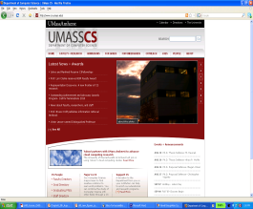



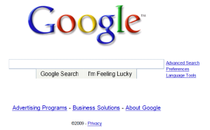
A day in the life: scenario
scenario:
DNS server
arriving mobile client attaches to network …
browser
Comcast network
68.80.0.0/13
requests web page: www.google.com
school network
68.80.2.0/24
web page
Sounds
simple!
web server
Google’s network
64.233.160.0/19
64.233.169.105

Slide 4
A day in the life: connecting to the Internet
DHCP
DHCP
UDP
IP
Eth
Phy
connecting laptop needs to get its own IP address, addr of first-hop router, addr of DNS server: use DHCP
DHCP
DHCP
DHCP
arriving mobile:
DHCP client
DHCP
DHCP request encapsulated in UDP, encapsulated in IP, encapsulated in 802.3 Ethernet
DHCP
DHCP
UDP
IP
Eth
Phy
DHCP
DHCP
DHCP
DHCP
Ethernet frame broadcast (dest: FFFFFFFFFFFF) on LAN, received at router running DHCP server
router has
DHCP server
Ethernet demuxed to IP demuxed, UDP demuxed to DHCP

Slide 5

A day in the life: connecting to the Internet
DHCP
UDP
IP
Eth
Phy
DHCP server formulates DHCP ACK containing client’s IP address, IP address of first-hop router for client, name & IP address of DNS server
DHCP
DHCP
DHCP
arriving mobile:
DHCP client
DHCP
encapsulation at DHCP server, frame forwarded (switch learning) through LAN, demultiplexing at client
DHCP
DHCP
UDP
IP
Eth
Phy
DHCP
DHCP
DHCP
DHCP
router has
DHCP server
DHCP client receives DHCP ACK reply
Client now has IP address, knows name & addr of DNS
server, IP address of its first-hop router

Slide 6
A day in the life… ARP (before DNS, before HTTP)
DNS
DNS
UDP
IP
Eth
Phy
before sending HTTP request, need IP address of www.google.com: DNS
DNS
DNS
ARP
ARP query
arriving mobile:
ARP client
DNS query created, encapsulated in UDP, encapsulated in IP, encapsulated in Eth. To send frame to router, need MAC address of router interface: ARP
ARP
ARP query broadcast, received by router, which replies with ARP reply giving MAC address of router interface
ARP reply
Eth
Phy
router has
ARP server
client now knows MAC address of first hop router, so can now send frame containing DNS query

Slide 7
A day in the life… using DNS
DNS
DNS
DNS
DNS
DNS
DNS
UDP
IP
Eth
Phy
demuxed to DNS
DNS replies to client with IP address of www.google.com
DNS
DNS
UDP
IP
Eth
Phy
DNS
DNS
DNS
DNS
DNS
DNS
server
DNS
DNS
Comcast network
68.80.0.0/13
IP datagram containing DNS query forwarded via LAN switch from client to 1st hop router
IP datagram forwarded from campus network into Comcast network, routed (tables created by RIP, OSPF, IS-IS and/or BGP routing protocols) to DNS server

Slide 8
DNS Infrastructure
root DNS server
2
Host at cis.poly.edu wants IP address for gaia.cs.umass.edu
Infrastructure:
  Client resolver
  Local DNS server
  Authoritative DNS Server
  Root DNS Server
  Top-Level Domain DNS Server
3
TLD DNS server
4
5
local DNS server
dns.poly.edu
7
6
1
8
authoritative DNS server
dns.cs.umass.edu
requesting host
cis.poly.edu
gaia.cs.umass.edu

Slide 9
Routing and Forwarding
3c
3a
2c
3b
2a
AS3
2b
1c
AS2
1a
1b
1d
AS1
Forwarding table is configured by both intra- and inter-AS routing algorithm
  Intra-AS sets entries for internal dests
  Inter-AS & Intra-As sets entries for external dests
Intra-AS
Routing
algorithm
Inter-AS
Routing
algorithm
Forwarding
table

Slide 10
A day in the life…TCP connection carrying HTTP
DNS
DNS
DNS
HTTP
HTTP
TCP
IP
Eth
Phy
to send HTTP request, client first opens TCP socket to web server
SYNACK
SYN
SYNACK
SYN
SYNACK
SYN
SYN
Comcast network
68.80.0.0/13
TCP SYN segment (step 1 in TCP 3-way handshake) inter-domain routed to web server
TCP
IP
Eth
Phy
web server responds with TCP SYNACK (step 2 in TCP 3-way handshake)
SYNACK
SYN
SYNACK
SYN
SYNACK
SYNACK
SYN
TCP connection established!
Google web server
64.233.169.105

Slide 11
A day in the life… HTTP request/reply
DNS
DNS
DNS
HTTP
HTTP
TCP
IP
Eth
Phy
HTTP request sent into TCP socket
HTTP
HTTP
HTTP
web page finally (!!!) displayed
HTTP
HTTP
HTTP
HTTP
HTTP
IP datagram containing HTTP request routed to www.google.com
Comcast network
68.80.0.0/13
web server responds with HTTP reply (containing web page)
HTTP
HTTP
TCP
IP
Eth
Phy
HTTP
HTTP
HTTP
HTTP
IP datagram containing HTTP reply routed back to client
Google web server
64.233.169.105

Slide 12
Network View: HTTP and TCP
TCP is a connection-oriented protocol
SYN
SYN/ACK
GET URL
ACK
Web Client
YOUR DATA HERE
Web Server
FIN
FIN/ACK
ACK

Slide 13

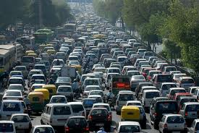
How do we avoid sending too much for the receiver and network to handle?

Slide 14
TCP Tahoe: Summary
Basic ideas
  Gently probe network for spare capacity
  Drastically reduce rate on congestion
  Windowing: self-clocking
  Other functions: round trip time estimation, error recovery
for every ACK {
if (W < ssthresh) then W++ (SS)
else W += 1/W (CA)
}
for every loss {
ssthresh = W/2
W = 1
}

Slide 15
Congestion Avoidance Example
cwnd = 1
cwnd = 2
cwnd >= ssthresh
cwnd = 4
ssthresh = 8
cwnd (in segments)
Slow Start
cwnd = 8
cwnd = 9
Round Trip Times

Slide 16
TCP Reno: Summary
Fast Recovery along with Fast Retransmit used to avoid slow start
On 3 duplicate ACKs
  Fast retransmit and fast recovery
On timeout
  Retransmit last segment and slow start

Slide 17
Fast Retransmit and Fast Recovery
ssthresh
Timeout
Congestion Avoidance
Fast Retransmit/Recovery
Timeout
cwnd
Slow Start
Time
At steady state, cwnd oscillates around the optimal window size
TCP always forces packet drops

Slide 18
Example Web Page
Harry Potter Movies
As you all know,
the new HP book
will be out in June
and then there will
be a new movie
shortly after that…
“Harry Potter and
the Bathtub Ring”
hpface.jpg
page.html
castle.gif

Slide 19
Client
Server
TCP SYN
G
page.html
The “classic” approach
in HTTP/1.0 is to use one
HTTP request per TCP
connection, serially.
TCP FIN
TCP SYN
G
hpface.jpg
TCP FIN
TCP SYN
G
castle.gif
TCP FIN

Slide 20
Client
Server
Concurrent (parallel) TCP
connections can be used
to make things faster.
TCP SYN
G
C
S
C
S
page.html
S
S
TCP FIN
G
G
hpface.jpg
castle.gif
F
F

Slide 21
Client
Server
TCP SYN
G
page.html
The “persistent HTTP”
approach can re-use the
same TCP connection for
Multiple HTTP transfers,
one after another, serially.
Amortizes TCP overhead,
but maintains TCP state
longer at server.
G
hpface.jpg
G
castle.gif
Timeout
TCP FIN

Slide 22
Client
Server
TCP SYN
G
page.html
GG
The “pipelining” feature
in HTTP/1.1 allows
requests to be issued
asynchronously on a
persistent connection.
Requests must be
processed in proper order.
Can do clever packaging.
hpface.jpg
castle.gif
Timeout
TCP FIN

Slide 23

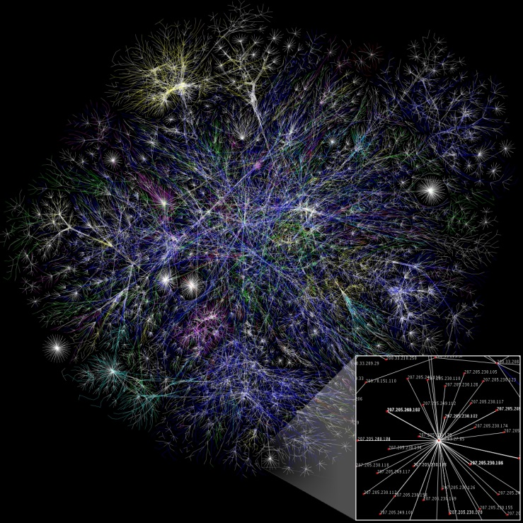
How do we find a path?

Slide 24
Routing on a Graph
Goal: determine a “good” path through the network from source to destination
What is a good path?
  Usually means the shortest path
  Load balanced
  Lowest $$$ cost
Network modeled as a graph
  Routers → nodes
  Link → edges
    Edge cost: delay, congestion level, etc.
5
3
B
C
5
2
A
2
1
F
3
1
D
E
2
1

Slide 25
Intra-domain Routing Protocols
Distance vector
  Routing Information Protocol (RIP), based on Bellman-Ford
  Routers periodically exchange reachability info with neighbors
Link state
  Open Shortest Path First (OSPF), based on Dijkstra
  Each network periodically floods neighbor information to all routers
  Routers locally compute routes

Slide 26
Hierarchical addressing: route aggregation
ISP has an address block; it can further divide this block into sub blocks and assign them to subscriber organizations.
Organization 0
200.23.16.0/23
Organization 1
200.23.18.0/23
“Send me anything
with addresses
beginning
200.23.16.0/20”
Organization 2
200.23.20.0/23
.
Fly-By-Night-ISP
.
.
.
.
Internet
Organization 7
.
200.23.30.0/23
ISPs-R-Us
“Send me anything
with addresses
beginning
199.31.0.0/16”

Slide 27
Example CIDR Routing Table
Address | Netmask | Third Byte | Byte Range
207.46.0.0 | 19 | 000xxxxx | 0 – 31
207.46.32.0 | 19 | 001xxxxx | 32 – 63
207.46.64.0 | 19 | 010xxxxx | 64 – 95
207.46.128.0 | 18 | 10xxxxxx | 128 – 191
207.46.192.0 | 18 | 11xxxxxx | 192 – 255
Hole in the Routing Table: No coverage for 96 – 127
207.46.96.0/19

Slide 28



Network of networks: BGP and ASes
AS-1
AS-3
Interior Routers
AS-2
BGP Routers

Slide 29
BGP Relationships
Provider
Peer 2 has no incentive to route 1→ 3
Peers do not pay each other
$
Customer
Provider
Customer
Peer 1
Peer 2
Peer 3
Customer pays provider
Customer

Slide 30
Importing Routes
From Provider
ISP Routes
From Peer
From Peer
From Customer

Slide 31
Exporting Routes
$$$ generating routes
Customer and ISP routes only
To Provider
To Peer
To Peer
To Customer
Customers get all routes

Slide 32
Also cover many other topics ...
For example …
  Wireless (Ch 7)
  Multimedia networking (Ch 8)
  Network security (Ch 9)

Slide 33
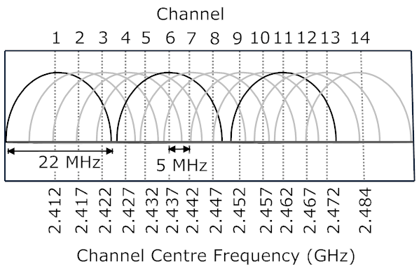
Wireless Cells
802.11b has 11 channels
Channels 1, 6, and 11 are non-overlapping
Admin chooses frequency for AP

Slide 34
Wireless Cells
Channel 1
802.11b has 11 channels
Channels 1, 6, and 11 are non-overlapping
Each AP coverage area is called a “cell”
Wireless nodes can roam between cells
Channel 11
Channel 1
AP
AP
AP
AP
AP
Channel 1
AP
Channel 6
Channel 6
Admin chooses frequency for AP
Interference possible: channel can be same as that chosen by neighboring AP!

Slide 35
HTTP-based Adaptive Streaming (HAS)
HTTP-based streaming
  Video is split into chunks
  Easy firewall traversal and caching
  Easy support for interactive VoD
HTTP-based adaptive streaming
  Multiple encodings of each fragment (defined in manifest file)
  Clients adapt quality encoding based on buffer/network conditions

Slide 36
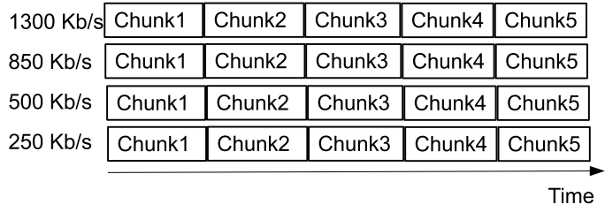
HTTP-based Adaptive Streaming (HAS)
HTTP-based streaming
  Video is split into chunks
  Easy firewall traversal and caching
  Easy support for interactive VoD
HTTP-based adaptive streaming
  Multiple encodings of each chunk (defined in manifest file)
  Clients adapt quality encoding based on buffer/network conditions

Slide 37
HTTP-based Adaptive Streaming (HAS)
HTTP-based streaming
  Video is split into chunks
  Easy firewall traversal and caching
  Easy support for interactive VoD
HTTP-based adaptive streaming
  Multiple encodings of each chunk (defined in manifest file)
  Clients adapt quality encoding based on buffer/network conditions

Slide 38
HTTP-based Adaptive Streaming (HAS)
Chunk1
HTTP-based streaming
  Video is split into chunks
  Easy firewall traversal and caching
  Easy support for interactive VoD
HTTP-based adaptive streaming
  Multiple encodings of each chunk (defined in manifest file)
  Clients adapt quality encoding based on buffer/network conditions

Slide 39
HTTP-based Adaptive Streaming (HAS)
Chunk2
Chunk1
HTTP-based streaming
  Video is split into chunks
  Easy firewall traversal and caching
  Easy support for interactive VoD
HTTP-based adaptive streaming
  Multiple encodings of each chunk (defined in manifest file)
  Clients adapt quality encoding based on buffer/network conditions

Slide 40
HTTP-based Adaptive Streaming (HAS)
Chunk2
Chunk3
Chunk1
HTTP-based streaming
  Video is split into chunks
  Easy firewall traversal and caching
  Easy support for interactive VoD
HTTP-based adaptive streaming
  Multiple encodings of each chunk (defined in manifest file)
  Clients adapt quality encoding based on buffer/network conditions

Slide 41
HTTP-based Adaptive Streaming (HAS)
Chunk4
Chunk2
Chunk3
Chunk1
HTTP-based streaming
  Video is split into chunks
  Easy firewall traversal and caching
  Easy support for interactive VoD
HTTP-based adaptive streaming
  Multiple encodings of each chunk (defined in manifest file)
  Clients adapt quality encoding based on buffer/network conditions

Slide 42
HTTP-based Adaptive Streaming (HAS)
Chunk5
Chunk4
Chunk2
Chunk3
Chunk1
HTTP-based streaming
  Video is split into chunks
  Easy firewall traversal and caching
  Easy support for interactive VoD
HTTP-based adaptive streaming
  Multiple encodings of each chunk (defined in manifest file)
  Clients adapt quality encoding based on buffer/network conditions

Slide 43



Friends and enemies: Alice, Bob, Trudy
well-known in network security world
Bob, Alice (lovers!) want to communicate “securely”
Trudy (intruder) may intercept, delete, add messages
Alice
Bob
channel
data, control messages
secure
sender
secure
receiver
data
data
Trudy

Slide 44
HTTPS (and TLS/SSL Cipher Suite)
cipher suite
  public-key algorithm
  symmetric encryption algorithm
  MAC algorithm
TLS/SSL supports several cipher suites
negotiation: client, server agree on cipher suite
  client offers choice
  server picks one
CA
Browser
Server

Slide 45
Exam (pre-COVID)
Read all instructions carefully
Please explain how you derived your answers. Your final answers should be clearly stated.
Write answers legibly; no marks will be given for answers that cannot be read easily.
Where a discourse or discussion is called for, be concise and precise.
No assistance: closed book, closed notes, and no electronics ...
https://www.ida.liu.se/~TDTS06/exam/examples2014.html

Slide 46
Exam (Remote Home)
https://www.ida.liu.se/~TDTS04/exam/exam_questions_tdts11_04_may2020.pdf
Edu. code Course name Date Time City Location / Enrolment period
TDTS04/TEN1 Datornät och distribuerade system 2021-03-22 8 - 12 Linköping 2021-02-20 - 2021-03-12
Distanstentamen / Distance exam
TDTS04/TEN1 Datornät och distribuerade system 2021-06-09 8 - 12 Linköping 2021-05-10 - 2021-05-30
TDTS04/TEN1 Datornät och distribuerade system 2021-08-27 8 - 12 Linköping 2021-07-28 - 2021-08-17

