Slide 1
Databasteknik
Databaser och bioinformatik
Data structures and Indexing (II)
Fang Wei-Kleiner

Slide 2
Storage hierarchy
CPU
Important because it effects query efficiency.
Cache memory
Main memory
Primary storage
(fast, small, expensive, volatile,
accessible by CPU)
Disk
Tape
Secondary storage
(slow, big, cheap, permanent,
inaccessible by CPU)
Databases

Slide 3
Disk Storage Devices
Preferred secondary storage device for high storage capacity and low cost.
Data stored as magnetized areas on magnetic disk surfaces.
A disk pack contains several magnetic disks connected to a rotating spindle.
Disks are divided into concentric circular tracks on each disk surface.
  Track capacities vary typically from 4 to 50 Kbytes or more

Slide 4
Disk Storage Devices (cont.)
A track is divided into smaller blocks or sectors
The division of a track into sectors is hard-coded on the disk surface and cannot be changed.
  The block size B is fixed for each system.
    Typical block sizes range from B=512 bytes to B=4096 bytes.
  Whole blocks are transferred between disk and main memory for processing.

Slide 5
Disk Storage Devices (cont.)
A read-write head moves to the track that contains the block to be transferred.
  Disk rotation moves the block under the read-write head for reading or writing.
A physical disk block (hardware) address consists of:
  a cylinder number (imaginary collection of tracks of same radius from all recorded surfaces)
  the track number or surface number (within the cylinder)
  and block number (within track).
Reading or writing a disk block is time consuming
  seek time → 5 – 10 msec
  rotational delay (depends on revolution per minute) → 3 - 5 msec

Slide 6
Disk
Read/write to disk is a bottleneck, i.e.
  Disk access sec.
  Main memory access sec.
  CPU instruction sec

Slide 7
Files and records
Data stored in files.
File is a sequence of records.
Record is a set of field values.
For instance, file = relation, record = entity, and field = attribute.
Records are allocated to file blocks.

Slide 8
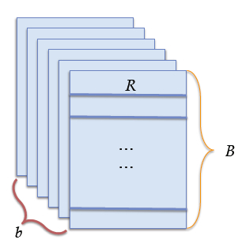
Files and records
Let us assume
  B is the size in bytes of the block.
  R is the size in bytes of the record.
  r is the number of records in the file.
Blocking factor (number of records in each block):
Blocks needed for the file:
What is the space wasted per block ?

Slide 9
Files and records
Wasted space per block = B – bfr * R.
Solution: Spanned records.
block i record 1 record 2 wasted
Unspanned
block i+1 record 3 record 5 wasted
block i record 1 record 2 record 3 p
Spanned
block i+1 record 3 record 4 record 5

Slide 10
From file blocks to disk blocks
Contiguous allocation: cheap sequential access but expensive record addition. Why ?
Linked allocation: expensive sequential access but cheap record addition. Why ?
Linked clusters allocation.
Indexed allocation.

Slide 11
File organization
Heap files.
Sorted files.
Hash files.
File organization != access method, though related in terms of efficiency.

Slide 12
Heap files
Records are added to the end of the file. Hence,
  Cheap record addition.
  Expensive record retrieval, removal and update, since they imply linear search:
    Average case: block accesses.
    Worst case: b block accesses (if it doesn't exist or several exist).
  Moreover, record removal implies waste of space. So, periodic reorganization.

Slide 13
Sorted files
Records ordered according to some field. So,
  Cheap ordered record retrieval (on the ordering field, otherwise expensive):
    All the records: access blocks sequentially.
    Next record: probably in the same block.
    Random record: binary search, then worst case implies block accesses.
  Expensive record addition, but less expensive record deletion (deletion markers + periodic reorganization).
Is record updating cheap or expensive ?

Slide 14
Primary index
Let us assume that the ordering field is a key.
Primary index = ordered file whose records contain two fields:
  One of the ordering key values.
  A pointer to a disk block.
There is one record for each data block, and the record contains the ordering key value of the first record in the data block plus a pointer to the block.
binary search !

Slide 15
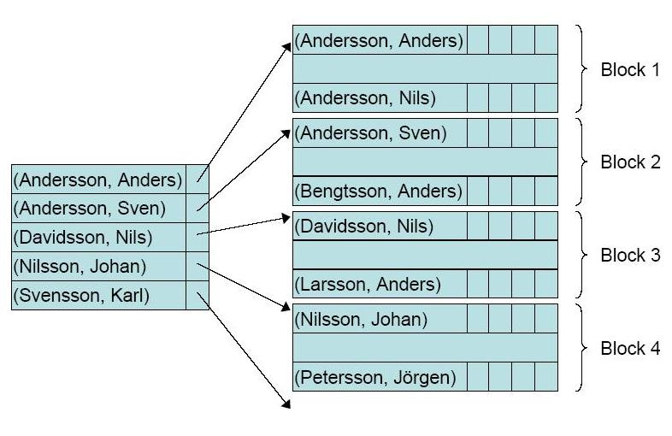
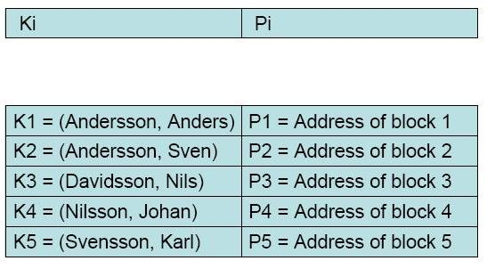
Primary index
Why is it faster to access a random record via a binary search in index than in the file ?
What is the cost of maintaining an index? If the order of the data records changes…

Slide 16
Clustering index
Now, the ordering field is a non-key.
Clustering index = ordered file whose records contain two fields:
  One of the ordering field values.
  A pointer to a disk block.
There is one record for each distinct value of the ordering field, and the record contains the ordering field value plus a pointer to the first data block where that value appears.
binary search !

Slide 17
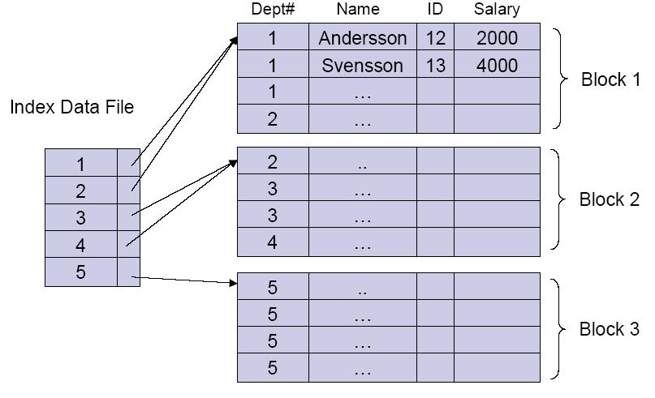
Clustering index
Efficiency gain ? Maintenance cost ?

Slide 18
Secondary indexes
The index is now on a non-ordering field.
Let us assume that that is a key.
Secondary index = ordered file whose records contain two fields:
  One of the non-ordering field values.
  A pointer to a disk record or block.
There is one record per data record.
binary search !

Slide 19
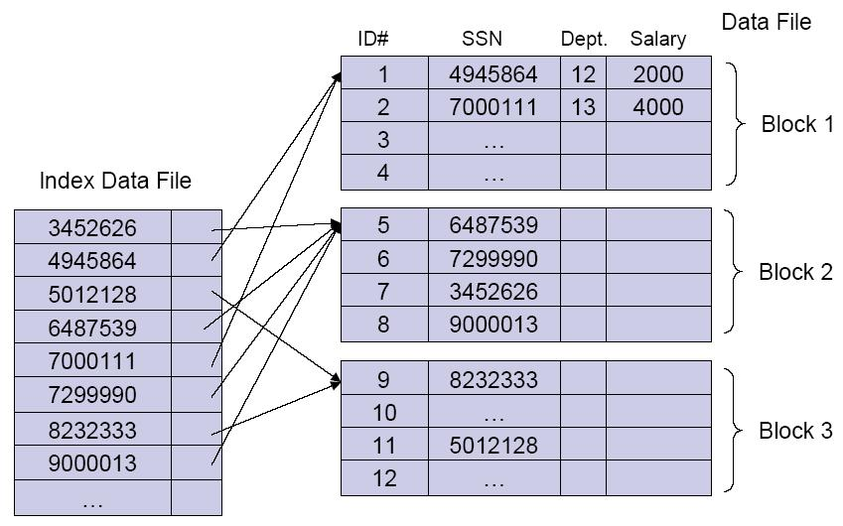
Secondary indexes
Efficiency gain ? Maintenance cost ?

Slide 20
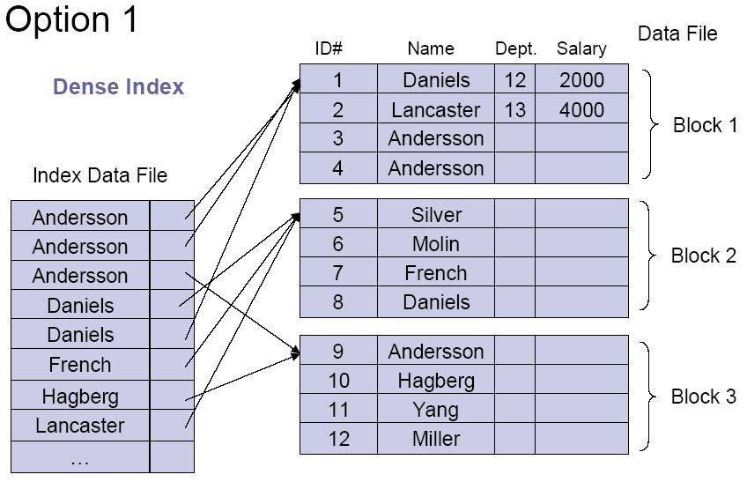
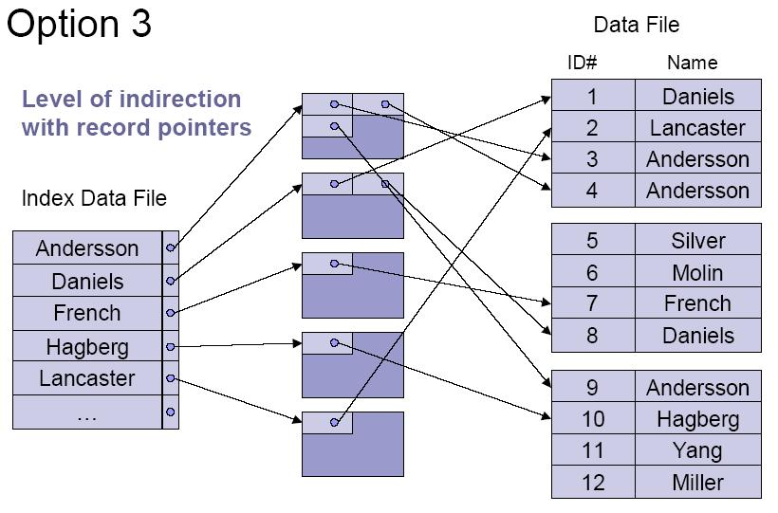
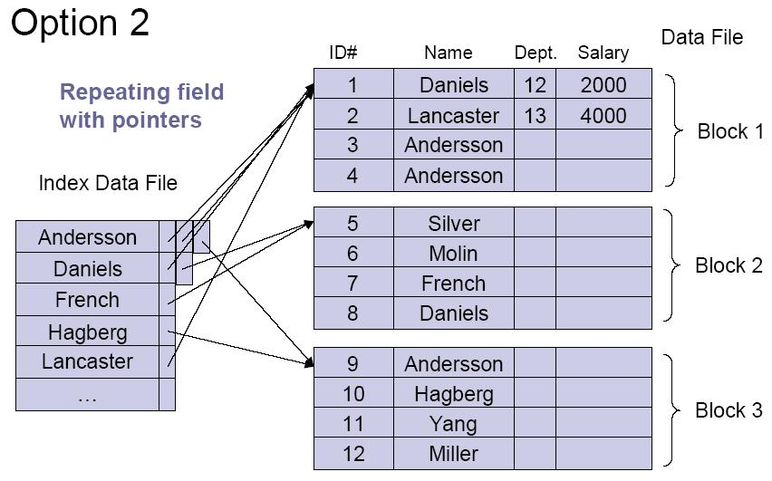
Secondary indexes
Now, the index is on a non-ordering and non-key field.

Slide 21
Multilevel indexes
Index on index (first level, second level, etc.).
Works for primary, clustering and secondary indexes as long as the first level index has a distinct index value for every entry.
How many levels ? Until the last level fits in a single disk block.
How many disk block accesses to retrieve a random record?

Slide 22
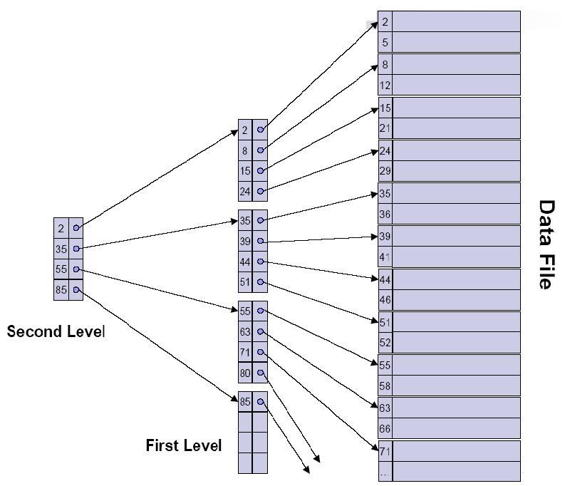
Multilevel indexes
Efficiency gain ? Maintenance cost ?

Slide 23
Exercise
Assume an ordered file whose ordering field is a key. The file has 1000000 records of size 1000 bytes each. The disk block is of size 4096 bytes (unspanned allocation). The index record is of size 32 bytes.
How many disk block accesses are needed to retrieve a random record when searching for the key field
  Using no index ?
  Using a primary index ?
  Using a multilevel index ?

Slide 24
Dynamic multilevel indexes
Record insertion, deletion and update may be expensive operations. Recall that all the index levels are ordered files.
Solutions:
  Overflow area + periodic reorganization.
  Empty records + dynamic multilevel indexes, based on B-trees and B+-trees.
→ Search tree
→ B-tree
→ B+-tree

Slide 25
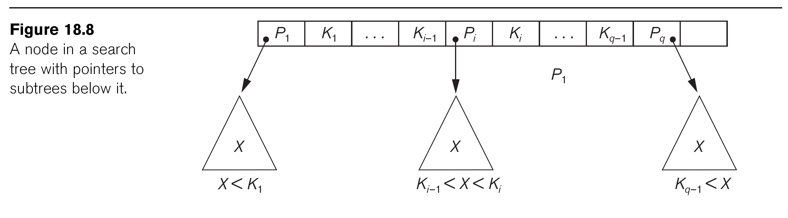
Search Tree
A search tree of order p is a tree s.t.
  Each node contains at most p-1 search values, and
  at most p pointers <P₁ ,K₁ , … P_{i} , K_{i} … K_{q-1}, P_{q}> where q ≤ p
  P_{i}: pointer to a child node
  K_{i}: a search value (key)
→ within each node: K₁ < K₂ < K_{i} < … < K_{q-1}

Slide 26
Searching a value X over the search tree
  Follow the appropriate pointer P_{i} at each level of the tree
    → only one node access at each tree level
    → time cost for retrieval equals to the depth h of the tree
    Expected that h << tree size (set of the key values)
  Is that always guaranteed?

Slide 27
Dynamic Multilevel Indexes Using B-Trees and B+-Trees
B stands for Balanced → all the leaf nodes are at the same level (both B-Tree and B+-Tree are balanced)
  Depth of the tree is minimized
These data structures are variations of search trees that allow efficient insertion and deletion of search values.
In B-Tree and B+-Tree data structures, each node corresponds to a disk block
  Recall the multilevel index
  Ensure big fan-out (number of pointers in each node)
Each node is kept between half-full and completely full
  Why?

Slide 28
Dynamic Multilevel Indexes Using B-Trees and B+-Trees (cont.)
Insertion
  An insertion into a node that is not full is quite efficient
    If a node is full the insertion causes a split into two nodes
  Splitting may propagate to other tree levels
Deletion
  A deletion is quite efficient if a node does not become less than half full
  If a deletion causes a node to become less than half full, it must be merged with neighboring nodes

Slide 29
Difference between B-tree and B+-tree
In a B-tree, pointers to data records exist at all levels of the tree
In a B+-tree, all pointers to data records exists only at the leaf-level nodes
A B+-tree can have less levels (or higher capacity of search values) than the corresponding B-tree

Slide 30
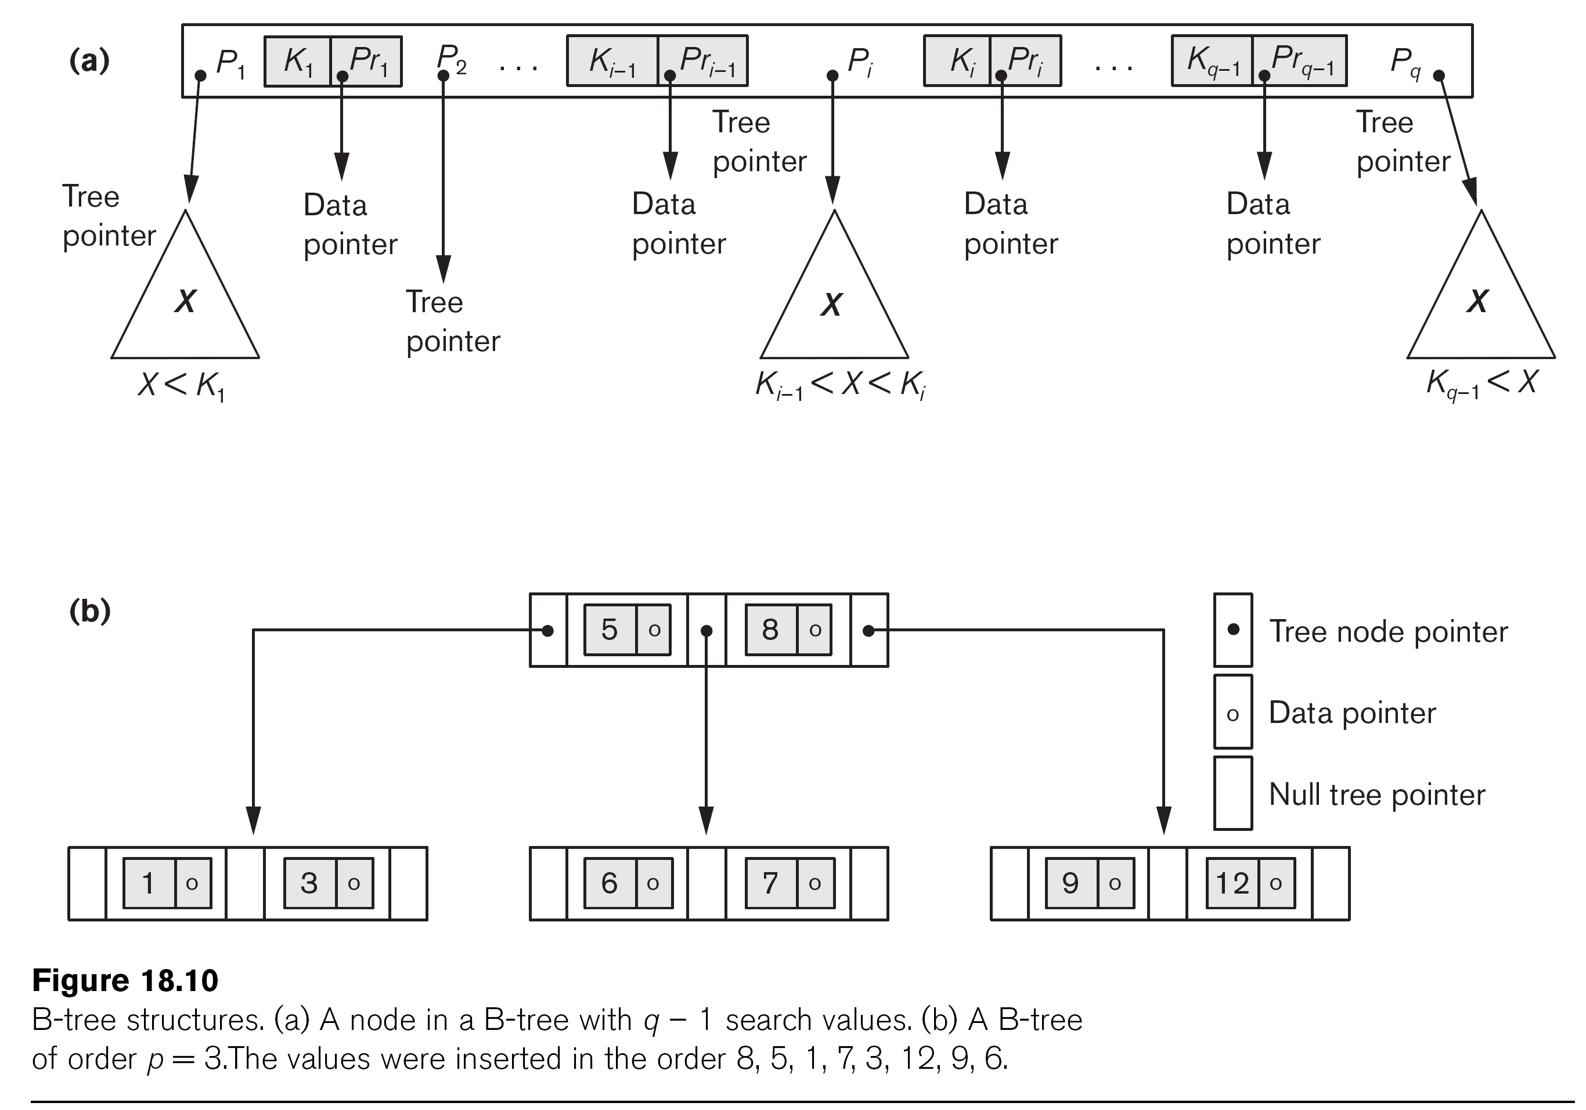
B-tree Structures

Slide 31
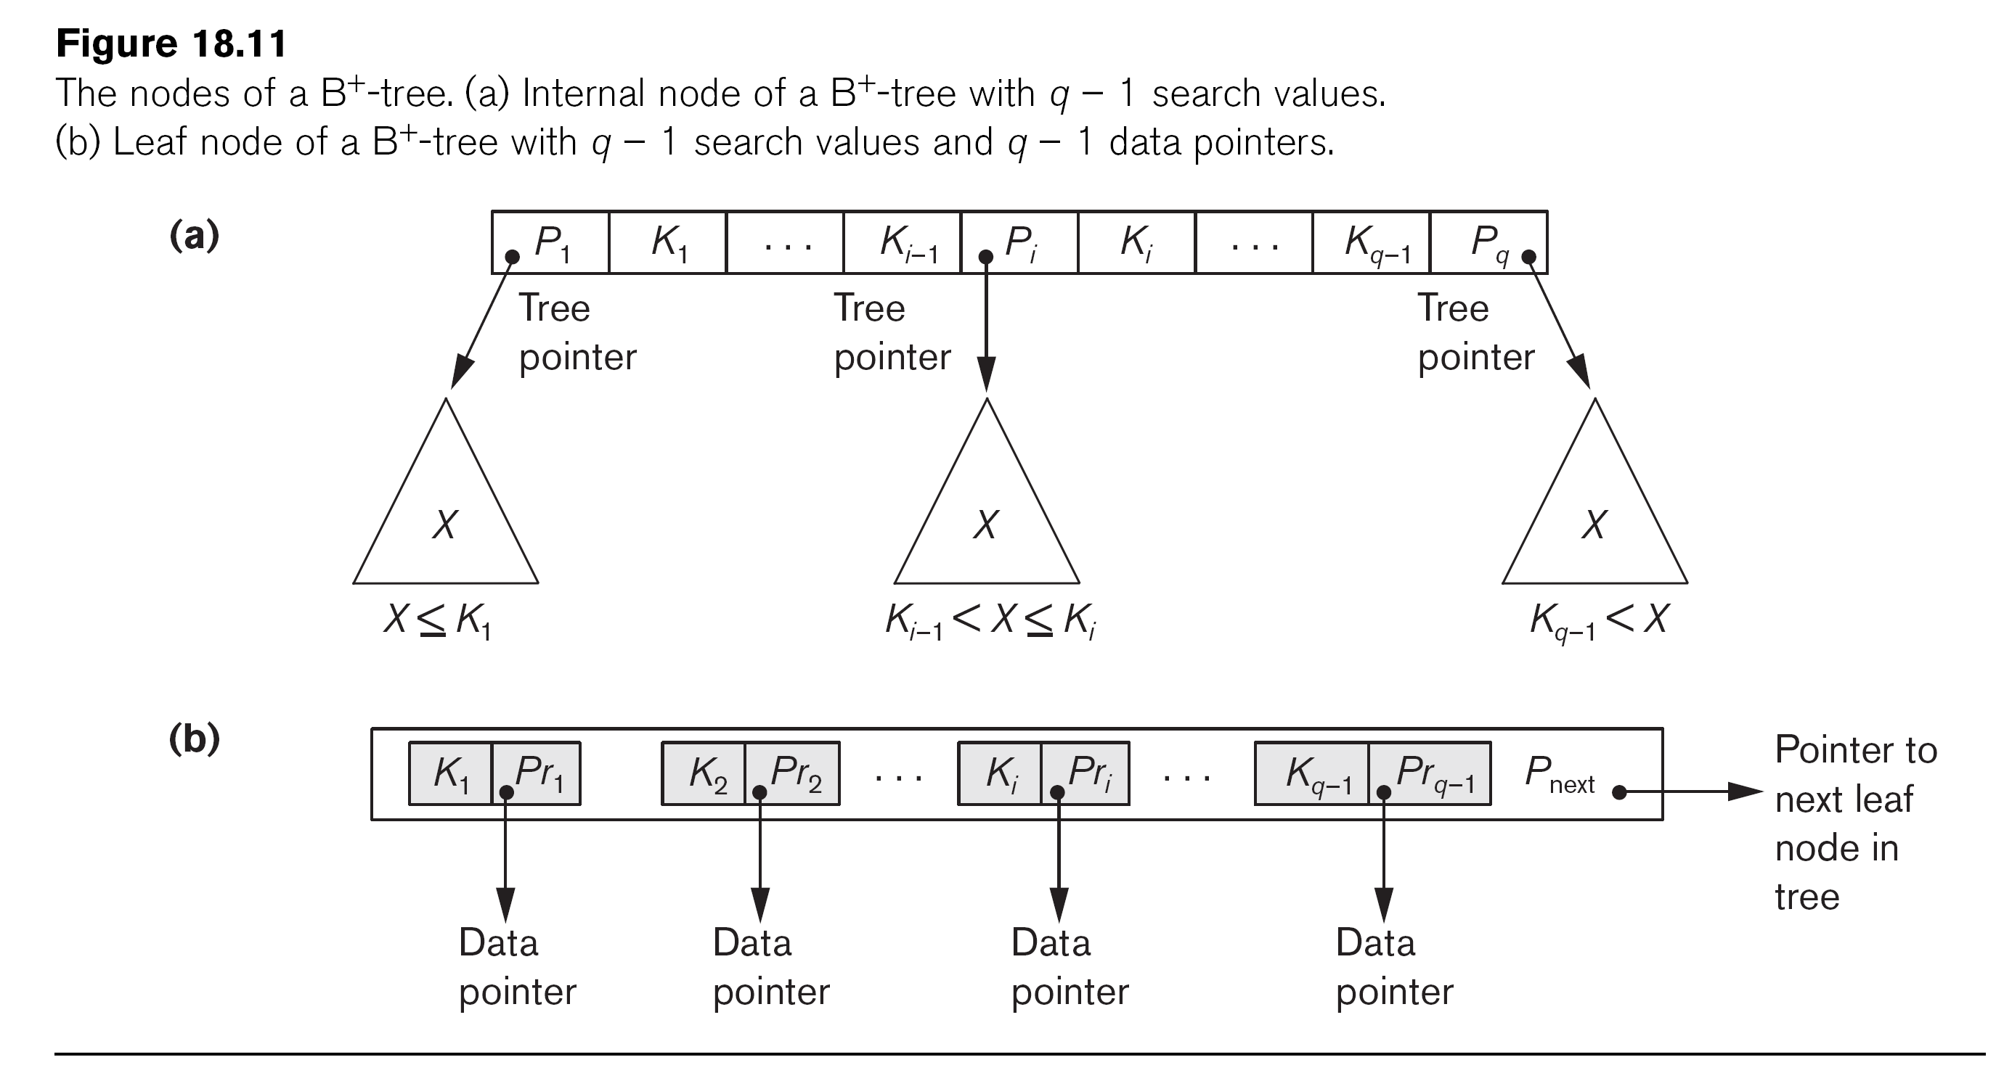
The Nodes of a B+-tree
P_{next} (pointer at leaf node): ordered access to the data records on the indexing fields

Slide 32
B+-trees: Retrieval
Very fast retrieval of a random record
  p is the order of the internal nodes of the B+-tree.
  N is the number of leaves in the B+-tree.
How would the retrieval proceed ?
Insertion and deletion can be expensive.

Slide 33
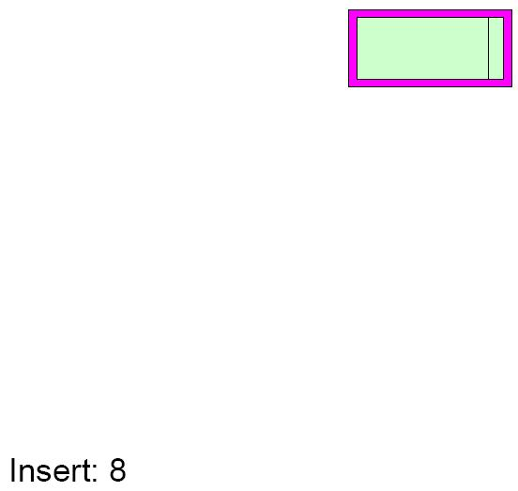
B+-trees: Insertion

Slide 34
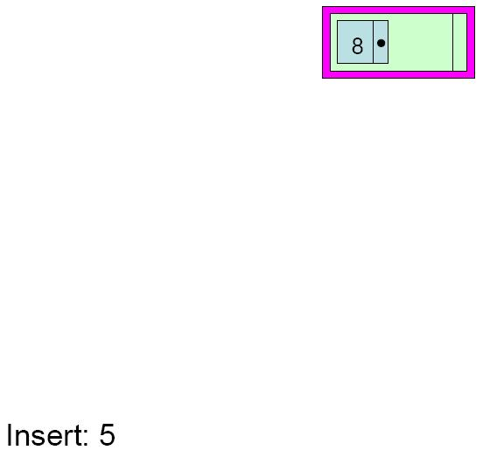
B+-trees: Insertion

Slide 35
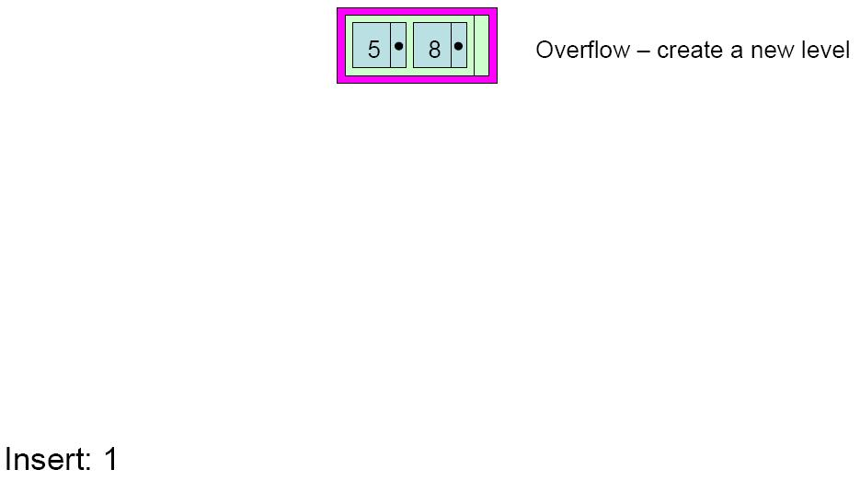
B+-trees: Insertion

Slide 36
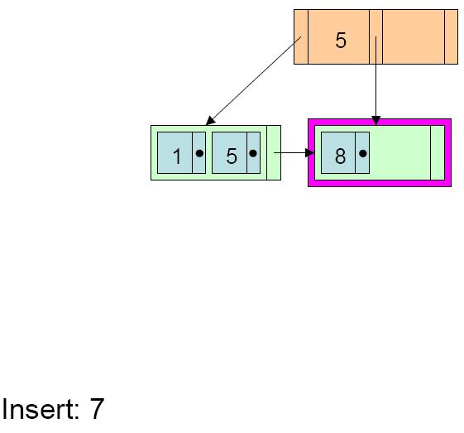
B+-trees: Insertion

Slide 37
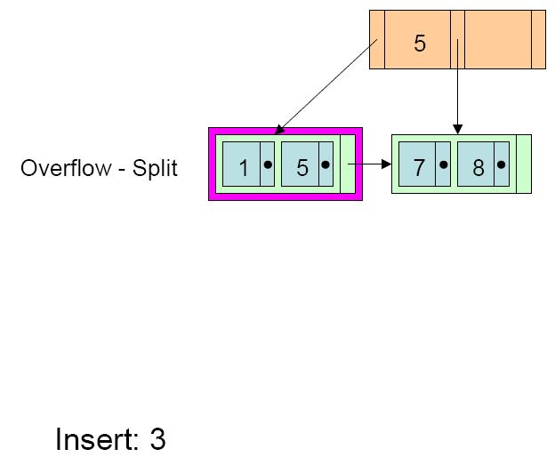
B+-trees: Insertion

Slide 38
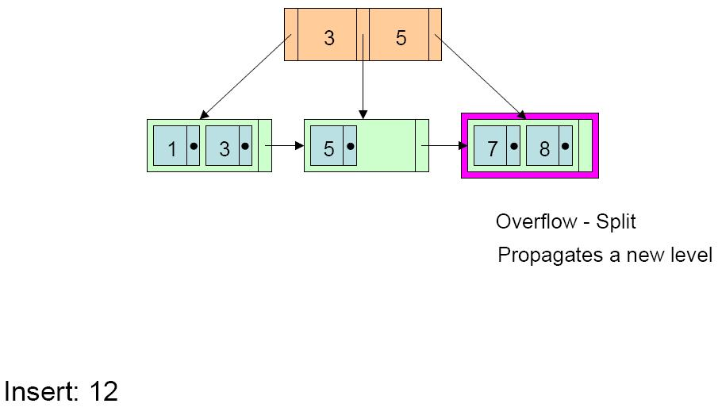
B+-trees: Insertion

Slide 39
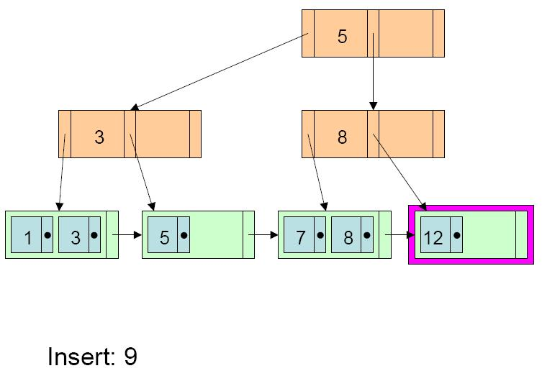
B+-trees: Insertion

Slide 40
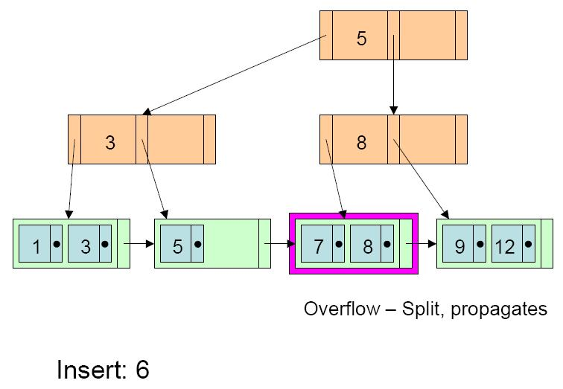
B+-trees: Insertion

Slide 41
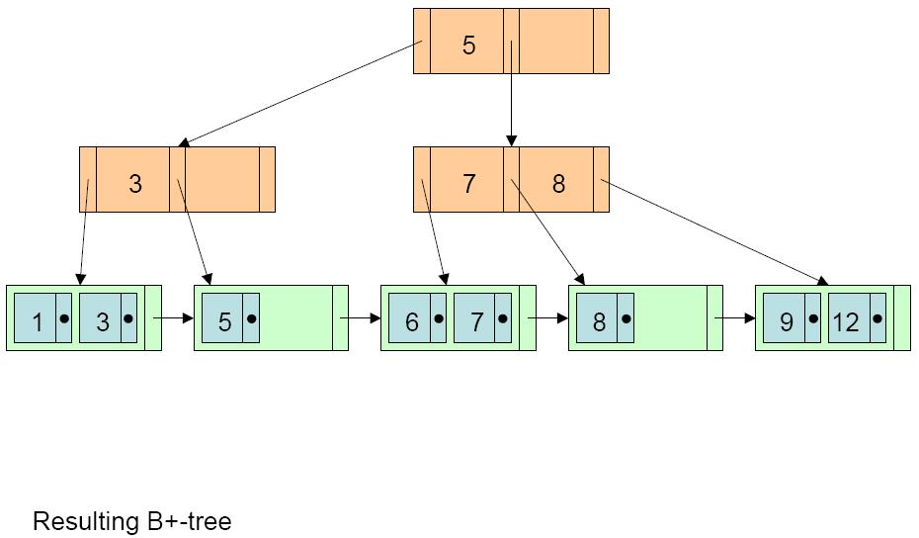
B+-trees: Insertion

Slide 42
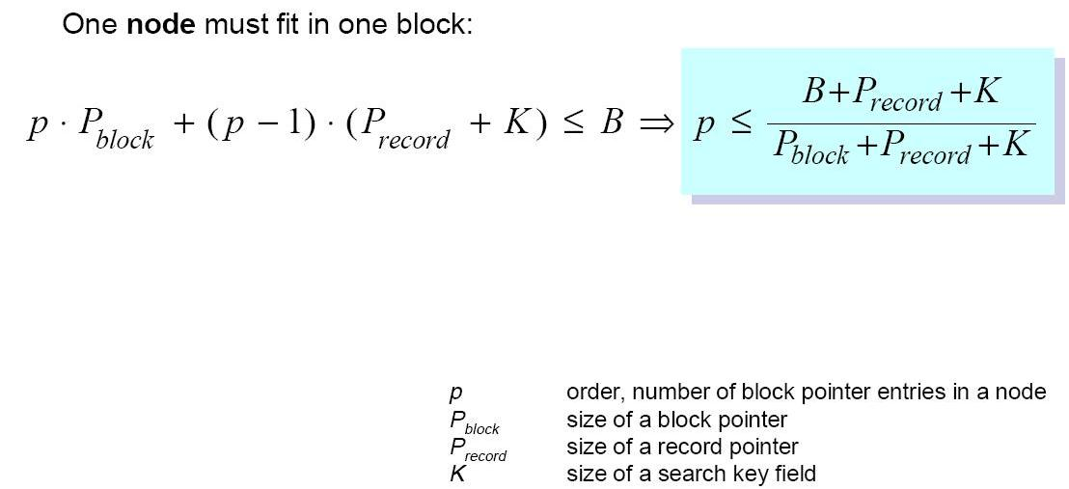
B-trees: Order

Slide 43
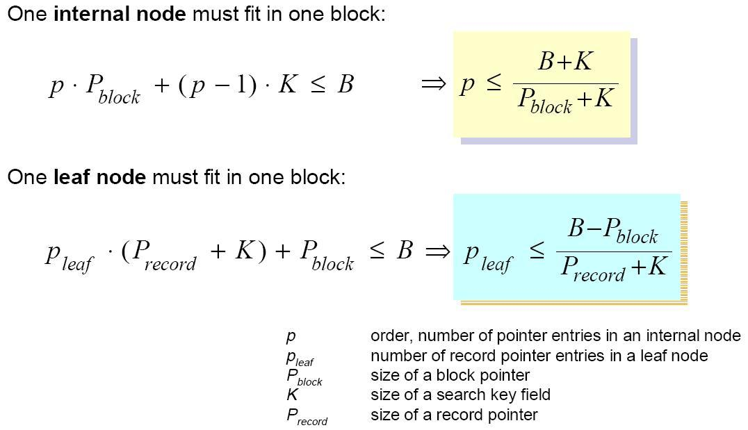
B+-trees: Order

Slide 44
Exercise
B=4096 bytes, P=16 bytes, K=64 bytes, node fill percentage=70 %.
For both B-trees and B+-trees:
  Compute the order p.
  Compute the number of nodes, pointers and key values in the root, level 1, level 2 and leaves.
  If the results are different for B-trees and B+-trees, explain why this is so.

